Slide 1

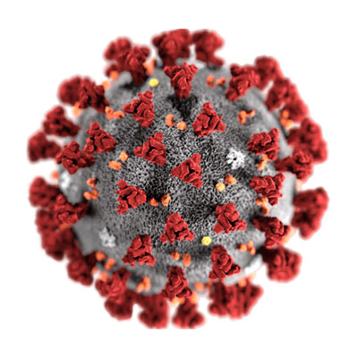
Call for Code 2020-Sterilizer->Solar terminator for coronavirus

Slide 2
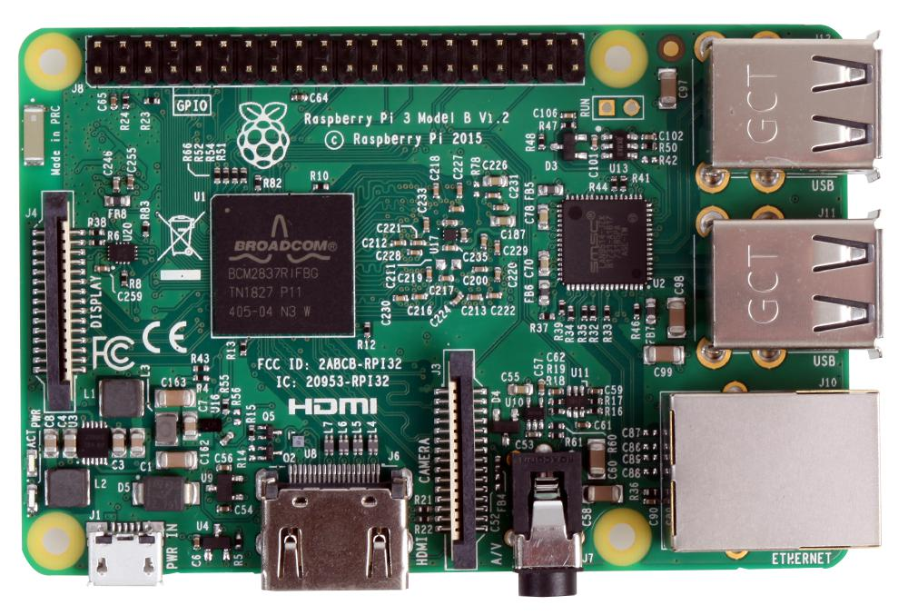
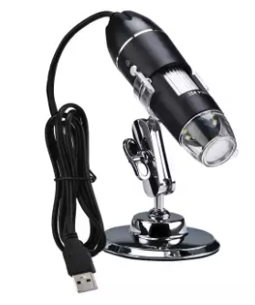

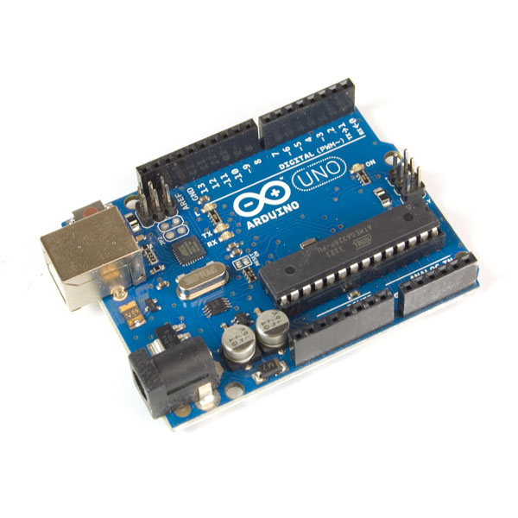
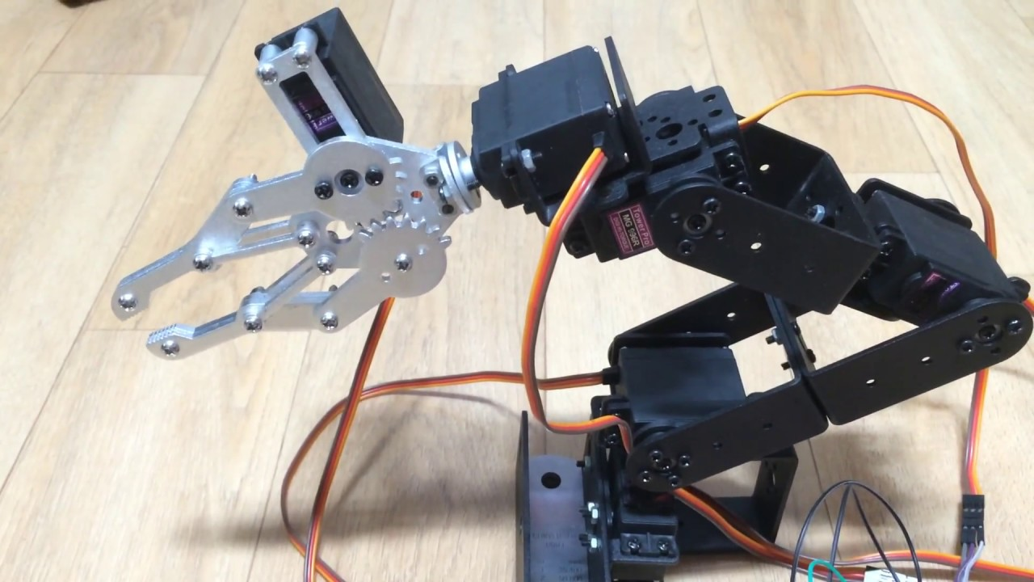
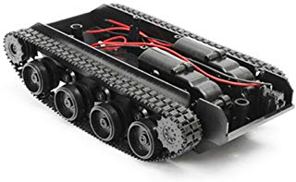
Propose setup
Raspberry Pi
USB Microscope Camera
Image classifier
+
Put on top
Of pickup
arm
6 DOF robot arm
Arduino
tank
+
+
Robot arm movement
Extract from unity

Slide 3
Watson(Red Node)
Solution
Sensor
Arduino
Tank motor
Sensor dashboard
DC motor
Actuators PWM
Lead Actuators
Raspberry Pi
Image Classifier
USB Microscope camera

Slide 4
Robot arm
Micro controller
Unity+Watson machine learning
USB Microscope Camera
Trajectory
Planner
Image classifier

Slide 5
Why use solar instead of chemical?
1) Chemical=cost Solar=free
2) Chemical=affect enviroment Solar=natural germ killer
3) Chemical=limited application Solar=Daily(9am to 4pm)
4) Chemical=need transportation Solar=can access any where
5) Chemical=wet processing Solar=dry processing
Solar Limitation
1) can only use at daytime, have to use infra red laser at night, not recommend UV laser risk affect eye
2) rain and clouded day reduce intensity need to compensate by expose area longer
3) Currently use outside of building, need portable reflector on another mobile robot or drone
Plan
First check cell with usb microscope+image classification+sonar
Second deploy reflector+solar cell to measure power
Third scan affected area
Fourth move to new area
Setup
Equipment-raspberry pi 3, arduino mega, ubuntu, ros,node red, watson
usb microscope+image classification-> node red+waston+raspberry pi
Tank motor->node red + turtlesim + rosbridge+arduino
Arm with angle feedback->roslaunch 6DOF rviz+arduino
Node red can be use on handphone.
Rescue robot modify to solar sterillzer.
Part list=recycle design to help 3rd world country to build their own robot
acuator=Lead screw+wing nut+dc motor
counter balance= spring taken out from shampoo dispense bottle
plumber strip= structure parts
3mm/5mm nut and bolts
https://youtu.be/GtBhjGxNwog

