Slide 1
TIC and Technologies Report
DAHMANI NAWFEL MOHAMED AMINE
December 29, 2023

Slide 2

Contents
Introduction
Google services
Microsoft Tools
3.1. Microsoft 365
3.2. Azure
4. Git and GitHub
4.1. Git
4.2. GitHub
5. Conclusion

Slide 3
1 Introduction
Information and Communication Technologies (TIC) have revolutionized the way we live and work. This report explores key technologies in the TIC domain, with a focus on Google services, Microsoft tools, Git, and GitHub.

Slide 4
2 Google Services
Google offers a diverse range of services that have become integral to our digital experience. Table 1 provides an overview of some key Google services.

Slide 5
Table 1: Key Google Services
Service | Description
Gmail | Email service with powerful search capabilities. It provides features like labels, filters, and integrations with other Google services.
Google Drive | Cloud storage and collaboration platform. It allows users to store files, share them with others, and collaborate in real-time on documents, spreadsheets, and presentations.
Google Docs | Online document editing and collaboration. Multiple users can work on the same document simultaneously, and changes are saved in real-time.
Google Sheets | Online spreadsheet application. Similar to Google Docs, it supports real-time collaboration and offers powerful spreadsheet functionalities.
Google Slides | Online presentation creation and sharing. Users can collaborate on presentations, add comments, and deliver presentations online.

Slide 6
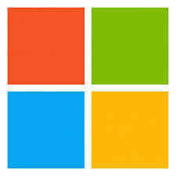
3 Microsoft Tools
Microsoft provides a suite of tools and services catering to various needs. Figure 1 displays the Microsoft logo.
Figure 1: Microsoft Logo

Slide 7
3.1 Microsoft 365
Microsoft 365 integrates productivity applications with cloud services. Table ?? outlines some components of Microsoft 365.
Component | Description
Word | Word processing application. It offers advanced formatting options, collaboration features, and compatibility with various document formats.
Excel | Spreadsheet software. Excel provides powerful data analysis tools, charting, and the ability to create complex formulas and macros.
PowerPoint | Presentation creation tool. Users can create dynamic presentations with multimedia content, transitions, and animations.
Teams | Collaboration platform for chat, video, and file sharing. Microsoft Teams facilitates communication and collaboration within teams, supporting virtual meetings and shared workspaces.

Slide 8
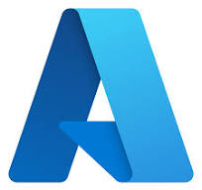
3.2 Azure
Microsoft Azure is a comprehensive cloud computing platform offering various services. Figure 2 illustrates the Azure services landscape.
Figure 2: Microsoft Azure Services

Slide 9
Microsoft Azure provides a wide range of services, including:
• Virtual Machines (VMs): Allows users to deploy and manage virtual machines in the cloud. • Azure Blob Storage: Scalable object storage for documents, images, and other unstructured data. • Azure SQL Database: A fully managed relational database service. • Azure AI Services: Provides machine learning and AI capabilities for developers.

Slide 10
4 Git and GitHub
Git and GitHub are fundamental to modern software development practices.

Slide 11
4.1 Git
Git is a distributed version control system. It allows for efficient tracking of code changes. Table ?? showcases some common Git commands.
Git allows for branching, merging, and collaboration among multiple developers. It is widely used in open-source and private software projects.
Command | Description
git init | Initialize a new Git repository.
git add | Add changes to the staging area.
git commit | Record changes in the repository.
git push | Push changes to a remote repository.

Slide 12
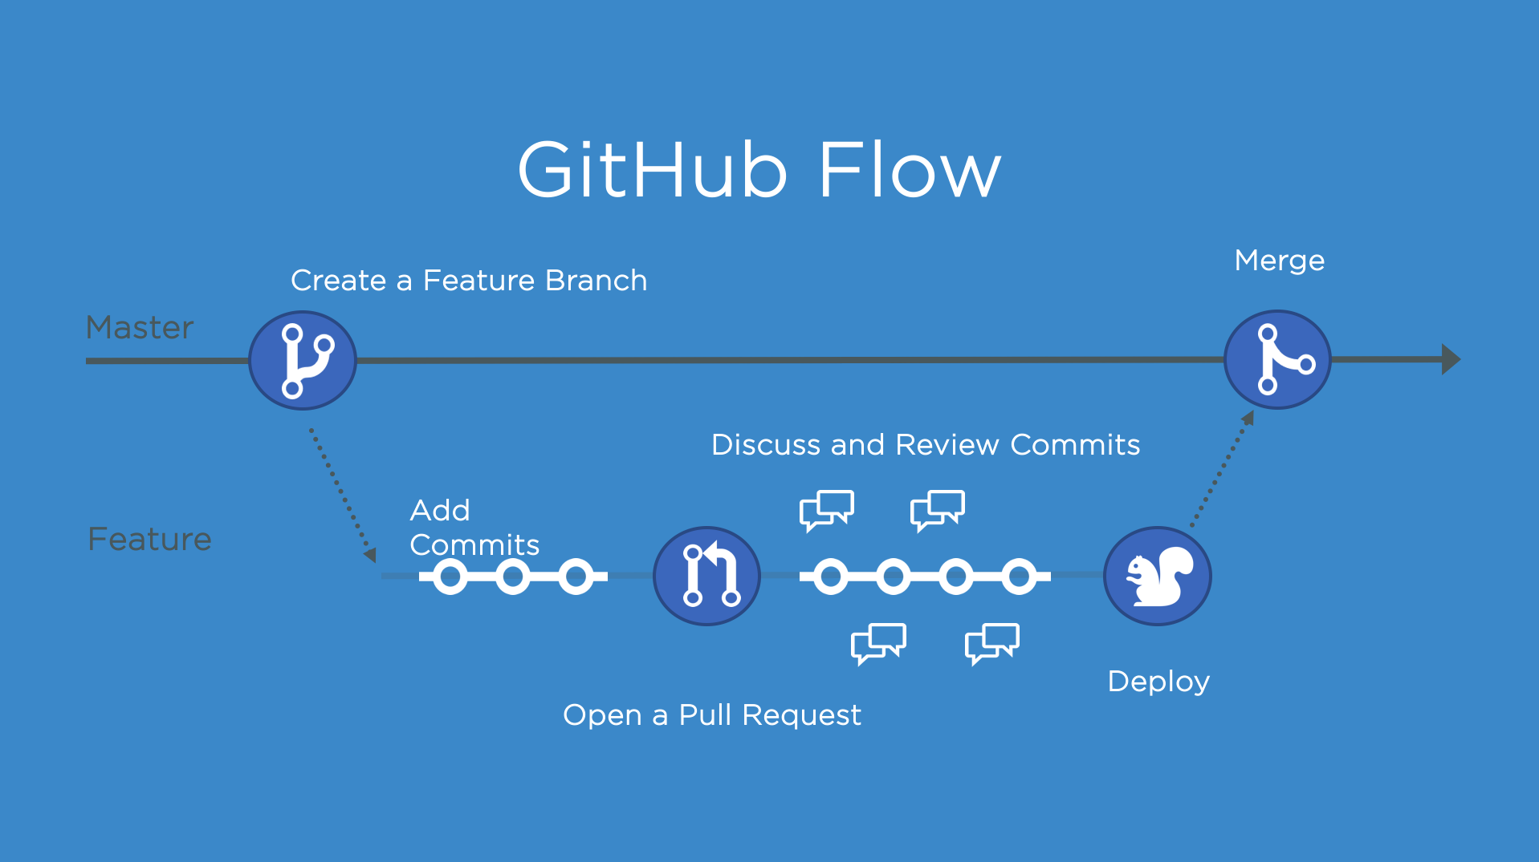
4.2 GitHub
GitHub enhances collaboration with features like pull requests and issue tracking. Figure 3 illustrates a typical GitHub workflow.
Figure 3: GitHub Workflow

Slide 13
GitHub provides a platform for hosting Git repositories, and it includes features such as:
• Pull Requests: Allows developers to propose changes, discuss, and review code before merging. • Issues: Enables tracking and discussion of bugs, enhancements, and other tasks. • Actions: Automates workflows such as building, testing, and deploying code.

Slide 14
5 Conclusion
In conclusion, TIC and associated technologies, including Google services, Microsoft tools, Git, and GitHub, play a pivotal role in shaping the digital landscape. Embracing these tools can enhance productivity, collaboration, and software development processes.

