Slide 1
TEAM-D EXAM HALL MANAGEMENT SYSTEM
GUIded by, Team members
Mrs.v.ezhilarasi m.e (ph.d) KALANITHI.M (820319205014)
ASSISTANT PROFESSOR Gokulakrishnan.v (820319205011)
DEPARTMENT OF INFORMATION TECHNOLOGY Mohamed jasim.j (820319205021)

Slide 2
OBJECTIVES
The Objective of our project is to manage the details of exam time tables and seating arrangements for student and faculties.

Slide 3
LITERATURE REVIEW
TITLE | AUTHOR | YEAR | DESCRIPTION
1.Exam management automation system (IRJET) | Yepuri,V.K.,Pamu,.C.G | 2019 | This web application is designed to manage and handle the operations in an educational institute during the time of examinations. The automation of hall seating arrangement system was developed for educational Institute to simplify the allocation of halls for students and staffs.
S.NO
TITLE

Slide 4
LITERATURE REVIEW
TITLE | AUTHOR | YEAR | DESCRIPTION
2. Anirban algorithm for efficient seating plan for centralized exam system | Prosanta kumar chaki,Shikha | 2018 | Maintaining a decent exam environment with the proper seating arrangement is one of the difficult jobs for authority. This research offers solution for exam seating arrangement problems that can be achieved through the sequential execution of three proposed algorithms.

Slide 5
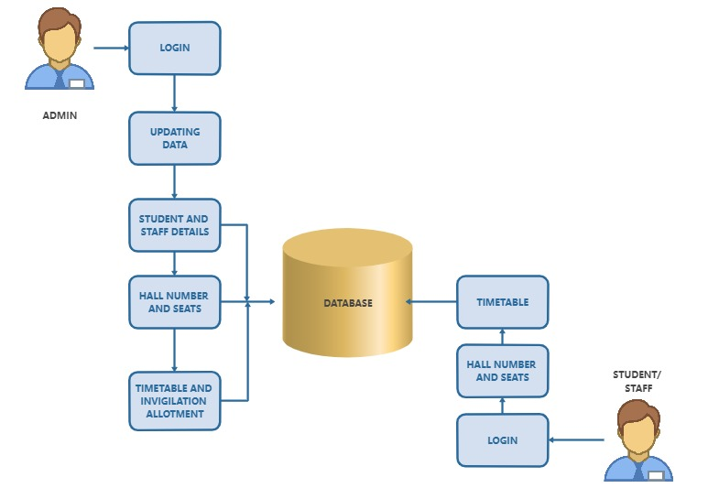
ARCHITECTURE DIAGRAM

Slide 6
MODULES
ADMIN MODULE
STAFF MODULE
STUDENT MODULE

Slide 7
MODULE DESCRIPTION
ADMIN MODULE:
In this module,admin will manage the data of time table and seating arrangements .
Admin can access the details of students and faculty.

Slide 8
MODULE DESCRIPTION
STAFF MODULE:
In this module, staff can login using the details.
They can view the time table and allotted hall for the examination.

Slide 9
MODULE DESCRIPTION
STUDENT MODULE:
In this module,students can login using the details.
they can view the time table and allotted hall for the examination.

Slide 10
WORK IN PROGRESS
Front end designing
Identified the modules and description.
Analyzed the survey work of project.

Slide 11
PLAN OF FUTURE WORK
Design the coding modules
Testing and debugging the modules.

Slide 12
CONCLUSION
Automation of the entire system provides efficiency.
updating of the information becomes easier.
It effectively overcomes the delay in communications.
It gives appropriate access to the authorized users .

Slide 13
REFERENCES
Yepuri.v.k,pamu,c.g.,kodali.n&pradyuma.l.v(2019).”Examination Management automation system” International research Journal of engineering and technology,05(04).
Prosanta kumar chaki,shikha ”Anirban algorithm for efficient seating plan for centralized exam system” International conference on computational technique in information and communication technologies (ICCTICT),2018

Slide 14
IMPLEMENTATION

Slide 15
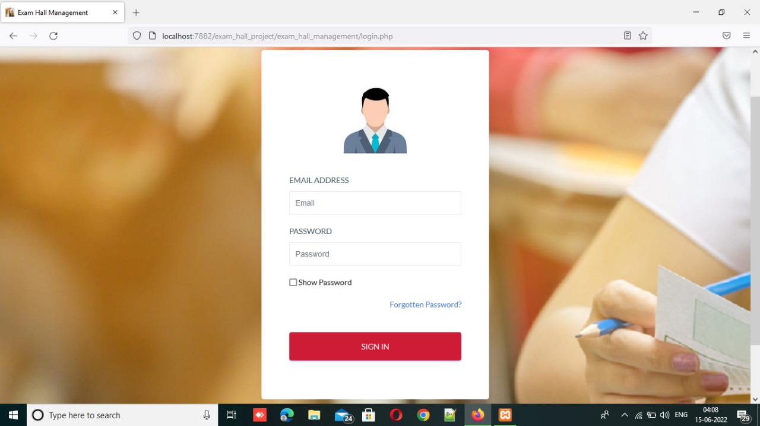
ADMIN LOGIN

Slide 16
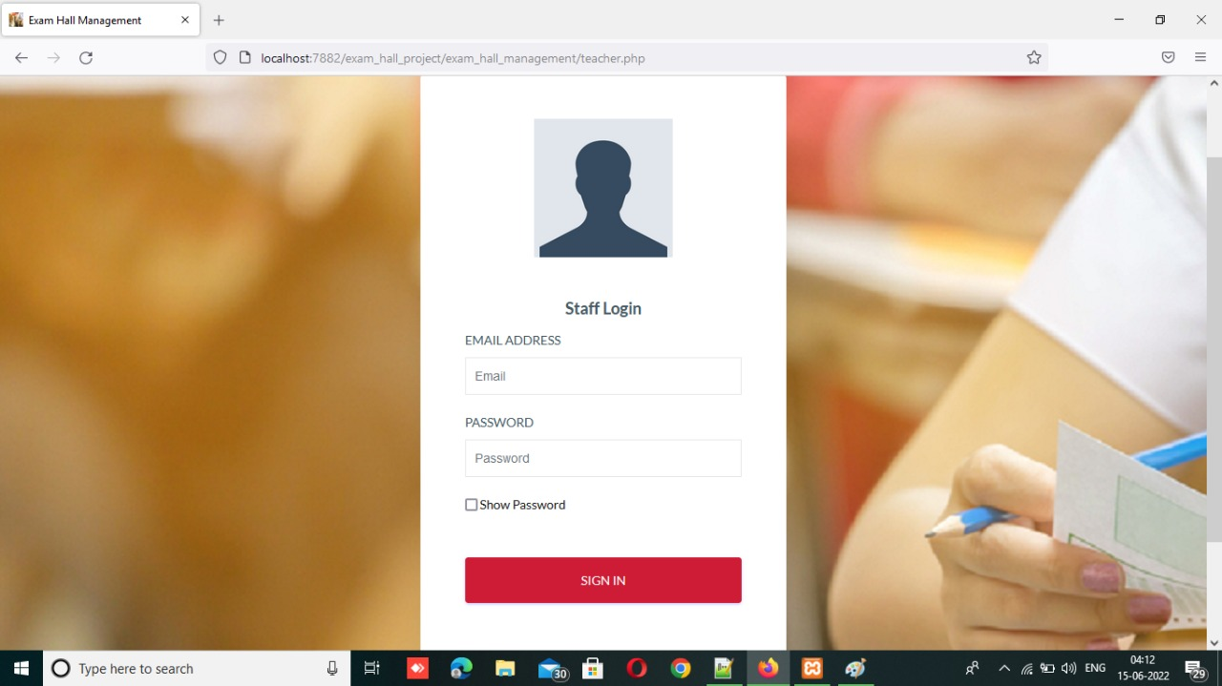
STAFF LOGIN

Slide 17

STUDENT LOGIN

Slide 18
THANK YOU

