Slide 1
Chat connect - A Real Time Chat And Communication App
M. Mohamed Jasim Armaan
NM id : aut8121cs15
Reg.no: 812122104024

Slide 2
Introduction
Chat Connect could refer to a real-time chat and communication application designed to facilitate instant messaging, voice, and video communication between users. Here's an outline of what such an app could offer:
- Real-Time Messaging
-Voice and Video Calls
-Presence and Status Indicators
- End to End Encryption
-Cross-Platform Compatibility
-Customizable Notifications’
-User Profiles and Customization
-File Sharing and Collaboration

Slide 3
Use Cases:
Personal Communication: Connecting with friends and family through texts, calls, and shared media.
Business Collaboration: Teams can use ChatConnect for real-time communication, file sharing, and project management.
Customer Support: Businesses could offer customer service via instant chat, voice, and video calls.
Educational Use: Facilitating study groups, teacher-student communication, and class discussions in a secure platform.
Technologies:
To make an app like ChatConnect, the following technologies could be used:
Backend: Node.js, Python (Django, Flask), or Go for real-time processing.
Frontend: React Native or Flutter for cross-platform development.
WebRTC for real-time video and voice communication.

Slide 4
Main.Activity.kt
package com.project.pradyotprakash.flashchat
import android.os.Bundle
import androidx.activity.ComponentActivity
import androidx.activity.compose.setContent
import com.google.firebase.FirebaseApp
class MainActivity : ComponentActivity() {
override fun onCreate(savedInstanceState: Bundle?) {
super.onCreate(savedInstanceState)
FirebaseApp.initializeApp(this)
setContent {
NavComposeApp()
}
}
}

Slide 5
fun NavComposeApp() {
val navController = rememberNavController()
val actions = remember(navController) { Action(navController) }
FlashChatTheme {
NavHost(
navController = navController,
startDestination =
if (FirebaseAuth.getInstance().currentUser != null)
Home
else
AuthenticationOption
) {
composable(AuthenticationOption) {

Slide 6
AuthenticationView(
register = actions.register,
login = actions.login
)
}
composable(Register) {
RegisterView(
home = actions.home,
back = actions.navigateBack
)
}
composable(Login) {
LoginView(
home = actions.home,
back = actions.navigateBack
)
}

Slide 7
composable(Home) {
HomeView()
}
}
}
}
class LoginViewModel : ViewModel() {
private val auth: FirebaseAuth = Firebase.auth
private val _email = MutableLiveData("")
val email: LiveData<String> = _email
private val _password = MutableLiveData("")
val password: LiveData<String> = _password

Slide 8
private val _loading = MutableLiveData(false)
val loading: LiveData<Boolean> = _loading
// Update email
fun updateEmail(newEmail: String) {
_email.value = newEmail
}
// Update password
fun updatePassword(newPassword: String) {
_password.value = newPassword
}
// Register user
fun loginUser(home: () -> Unit) {
if (_loading.value == false) {

Slide 9
val email: String = _email.value ?: throw IllegalArgumentException("email expected")
val password: String =
_password.value ?: throw IllegalArgumentException("password expected")
_loading.value = true
auth.signInWithEmailAndPassword(email, password)
.addOnCompleteListener {
if (it.isSuccessful) {
home()
}
_loading.value = false
}}}}

Slide 10
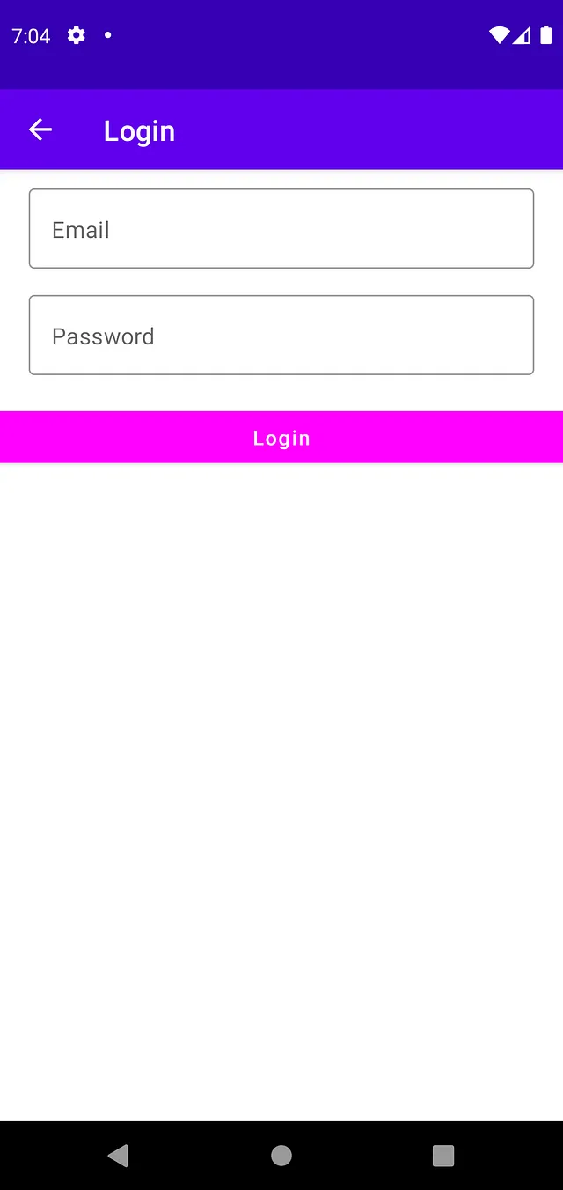

Slide 11
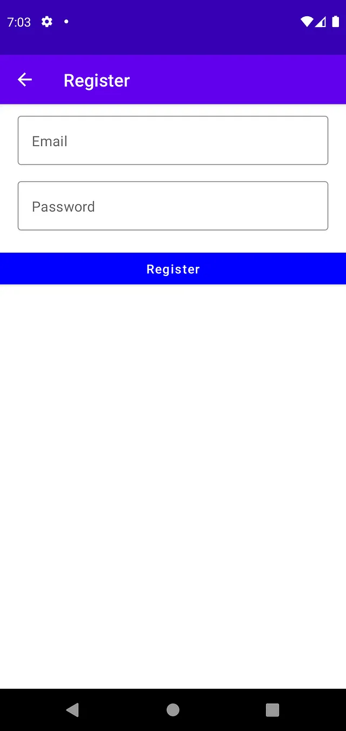

Slide 12
