Slide 1










Point –Of- Sales
HERE IS OUR MAGNIFICENT PRESENTATION.

Slide 2


1)Problems
Problems
1): Creating a Payment Method to easy to pay.
2): Cheapest and has more advantages
3): Available for most of shops

Slide 3
2)Solutions
Solutions:
1): Creating a Payment Method with python .
2): Creating an easy-to-use program for users
3): Simple GUI to show the screen of the program

Slide 4
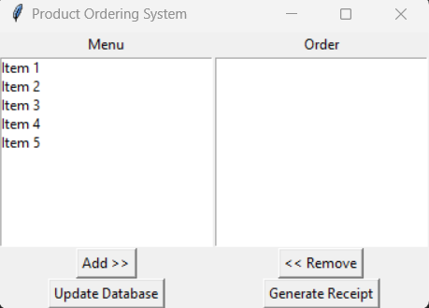
2) Simple Home Page
Home Page
A Clear and Simple interface for everyone

Slide 5

What Can Admin do?
1): Add more &new Products
2): Remove Products
3): Change the price of the products
4): Edit in the recipet information that the user get

Slide 6

What Can User do?
1): Just choose & click on the product name.
2): Add the payment to pay.
3): Get the receipt of process.

Slide 7

Our Recommendations
1): Developing the code to be more advanced.
2): Using different languages behind Python.
3): uploading the project online(For Ex:GitHub)

Slide 8
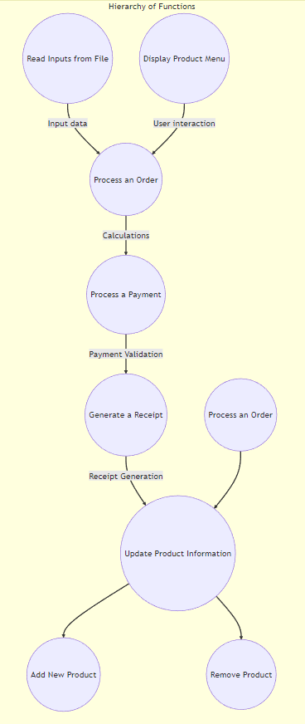
Summary of the Project process

Slide 9



THANKS!
Mohamed Khaled
Amr Khaled

