Slide 1
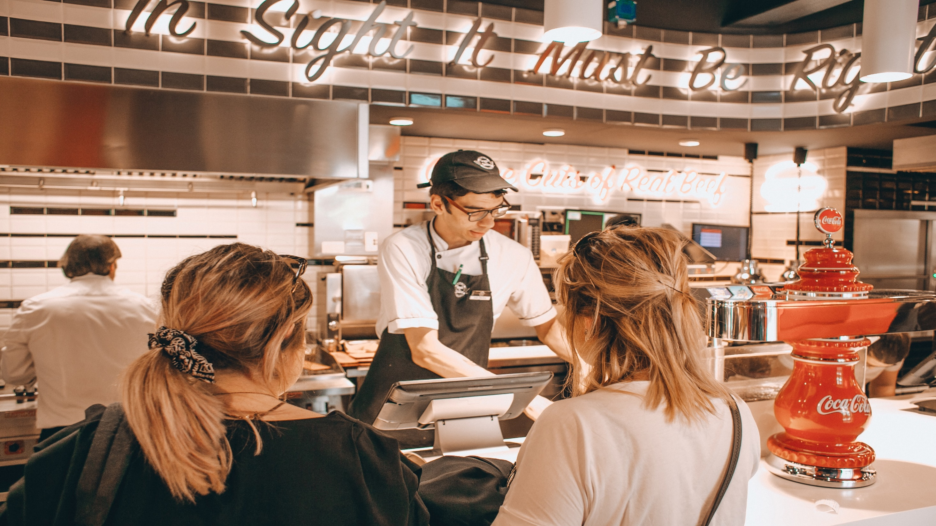
Food corner

Slide 2
hello,
Today we will represent our restaurant wepsite food land.
Our teem name is develober team
Teem member:
Mohamed Abd Elbast
Mohamed khalid
Ahmed Alatar
Mohamed bd

Slide 3
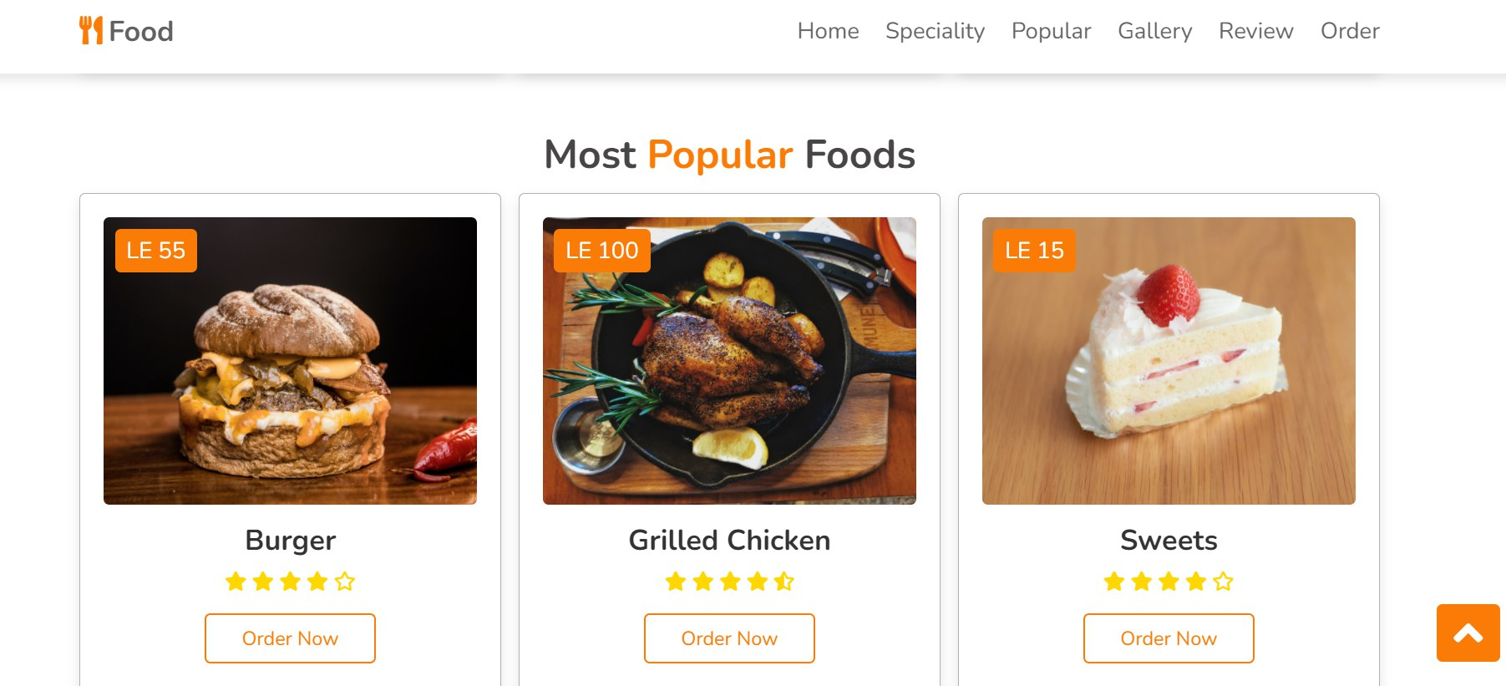
This is the popular category all photo under it order button

Slide 4
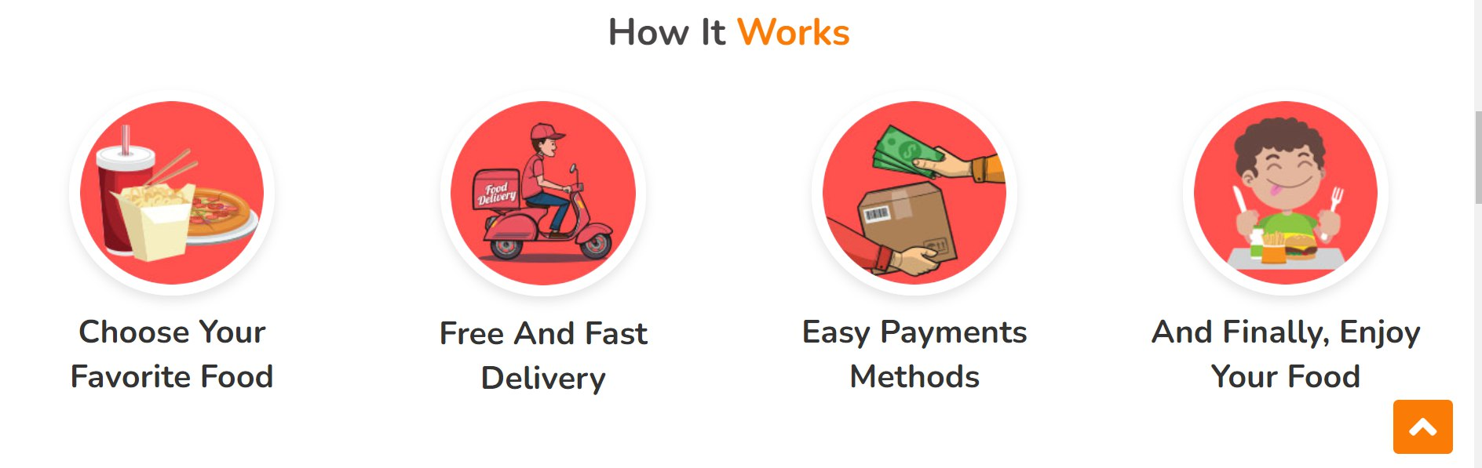
This is the way that our website work

Slide 5
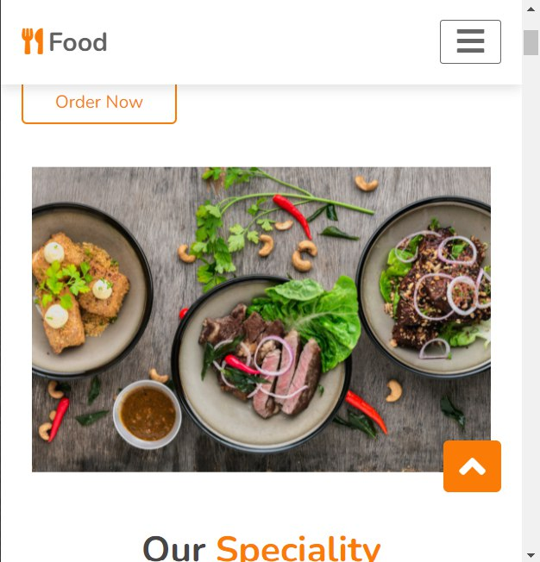
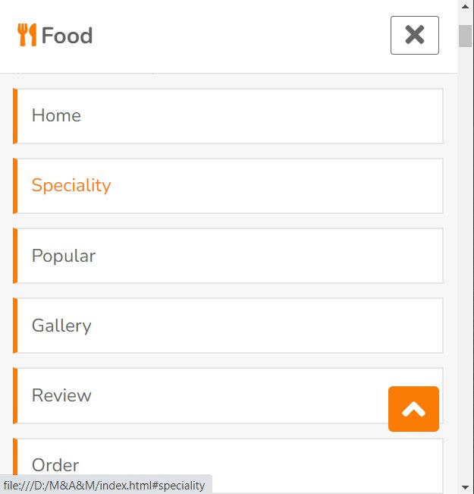
Our website can fits any device. By using css

Slide 6
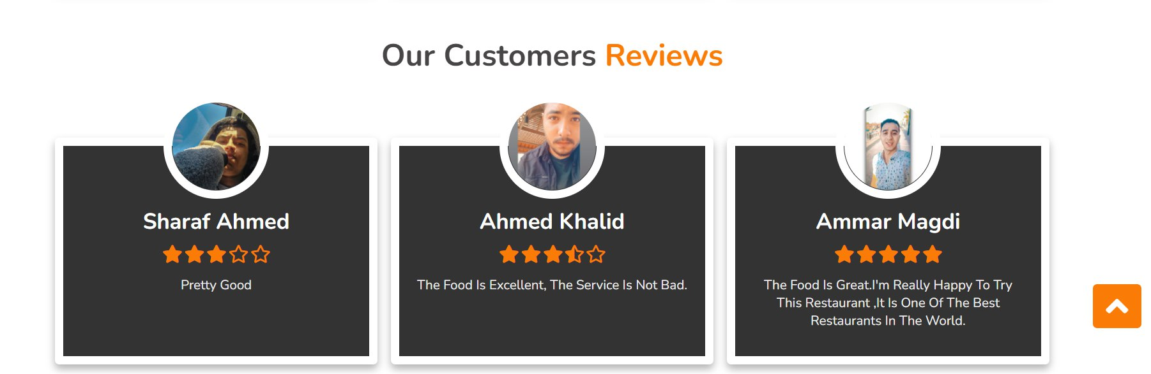
The revewer in our website

Slide 7
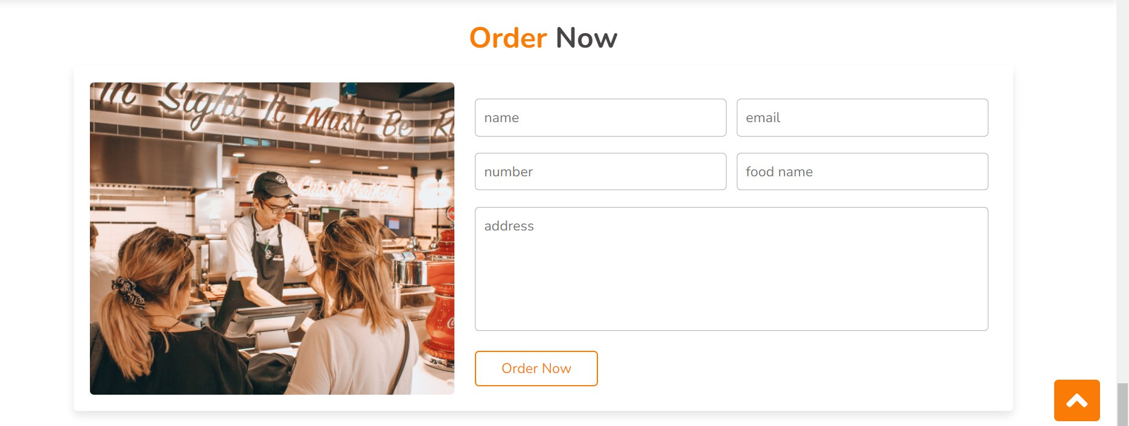
This the part that the user can order from it

Slide 8
our website
Thank you 😊

