Slide 1
MIRAGE
AI deception & honeynet defense for agentic threats
An AI defender that traps attackers in a fake network, studies them, and plants tailored decoys — with a human analyst in control.
Secure Horizon · Track 2: AI for Security & Secure AI

Slide 2
THE PROBLEM
AI agents are a new, unguarded attack surface
• Companies are deploying LLM agents with tools, memory and RAG — a brand-new surface that classic security tools don't see.
• OWASP's Agentic Top-10 (ASI01–ASI06) is largely undefended: prompt injection, tool misuse, identity abuse, tool/data poisoning.
• A hijacked internal assistant can exfiltrate data without a single CVE or malware.
• Meanwhile SOC analysts drown in alerts and must reconstruct the story themselves.
• Honeypots catch intruders — but they're passive and don't adapt to an attacker, let alone an AI one.
MIRAGE · Deception Agent OS
2

Slide 3
THE IDEA
A defender agent that fights deception with deception
• Mirage is an AI defender (AWS Bedrock / Claude) that runs a honeynet of fake hosts, tools and documents.
• When an attacker — human or AI agent — enters, Mirage profiles them, predicts their next move, and plants decoys tailored to that attacker.
• Every trap is an OWASP-Agentic signal: fake credentials (ASI03), decoy MCP tools (ASI02), honey-docs (ASI06), injection detection (ASI01).
• Mirage proposes containment; a human analyst approves — nothing destructive happens autonomously.
• Everything Mirage says about the attacker is re-checked against raw evidence in code, so its analysis can't hallucinate.
MIRAGE · Deception Agent OS
3

Slide 4
ARCHITECTURE
Two networks, one adaptive loop
Attack-net (isolated, no internet) ——— Defense-net
Attacker
Deception env
(SSH · MCP · RAG)
Collector →
Event Store
Mirage brain
(profile · plan)
mirage-control
(human approve)
Exports
(SIEM · reports)
→
→
→
→
→
• Attack-net: the fake company — Cowrie-format SSH hosts, an MCP tool server, a RAG knowledge base, an internal wiki.
• Defense-net: a read-only collector normalises every log into an event + ATT&CK technique; Mirage reasons over batches.
• Feedback loop: Mirage writes new decoys and wiki pages back into the environment to keep the attacker engaged.
MIRAGE · Deception Agent OS
4

Slide 5
THE ADVERSARY
The attackers are AI agents — and they self-plan
• Attackers are LLM-driven agents (Claude Haiku via Bedrock), not fixed scripts — they decide their own moves.
• An auto-planner picks the attack and can mix vectors; it prefers the hard options.
  – Personas: data-thief, injector (tries to manipulate the analyst), and a patient APT that covers its tracks.
  – Agentic scenarios: email-hijack, MCP tool-poisoning, RAG honey-doc theft, and an evasive blend that blinds the audit log.
• Deterministic scripted variants are kept for reproducible demos — well-aligned models often refuse, which is itself a finding.
MIRAGE · Deception Agent OS
5

Slide 6
SCENARIOS USED
Six attack scenarios across every trap source
Scenario | Source | OWASP / ATT&CK | Detection signal
Credential theft → lateral | SSH / Cowrie | T1552 · T1078 · T1083 | canary hits (ASI03)
APT (evasive) | SSH / Cowrie | + T1070 anti-forensics | canary + decoys
Prompt-injection hijack | Email / MCP | ASI01 | injection caught
MCP tool-poisoning | MCP server | ASI06 → ASI02 | trap_hit on decoy tools
RAG honey-doc theft | RAG (Chroma) | ASI06 | doc_retrieval
Evasive blend (blind + exfil) | MCP + RAG | ASI01/02/06 + evasion | trap_hit + egress
MIRAGE · Deception Agent OS
6

Slide 7
THE DEFENDER
Mirage brain — profile, plan, contain
• Runs on Claude Sonnet (Bedrock). Each batch of events: classifies the actor, infers the objective, predicts next ATT&CK moves.
• Plants decoys tailored to the attacker — breadcrumbs with fake credentials, honey-docs, decoy services, wiki pages.
• For a hijacked AI agent it proposes the right containment: revoke the agent token, disable the abused MCP tool, recommend an IOC block.
• mirage-control is the only way Mirage can act — a deterministic MCP tool server enforcing kill-switch, allowlist, schema, evidence and rate caps.
• Human-in-the-loop: risky actions queue for analyst approval; a kill switch freezes the agent instantly.
MIRAGE · Deception Agent OS
7

Slide 8
SECURE AI
The defender can't lie, and can't be injected into trusting the attacker
• Grounded analyst summary: Mirage's every claim is re-verified in code against the raw events — quotes must actually appear.
• Evidence checker (code, not an LLM) reports a grounding rate and a hallucination rate for every incident.
• Measured across 1079 agent runs: grounding 100%, hallucination 0%.
• Injection guard wraps all untrusted input (ASI01); it may flag a session but can never mark it benign — a poisoned note can't disarm Mirage.
• Every mirage-control action carries evidence event-ids and is written to a hash-chained audit log.
MIRAGE · Deception Agent OS
8

Slide 9
REAL STACK — NOT MOCKED
Built on production primitives
• AWS Bedrock — Claude Sonnet (defender), Claude Haiku (attacker/planner), Titan v2 embeddings.
• MCP — the company tools and mirage-control run as real MCP SDK servers over a stdio transport (JSON-RPC).
• RAG — a Chroma vector database with Titan embeddings; retrieving a restricted honey-doc is the ASI06 signal.
• Honeynet — rendered into Cowrie's filesystem format; served locally by an emulated shell (no Docker needed).
• MongoDB is the system of record; a FastAPI console streams the live pipeline. 362 automated tests pass.
MIRAGE · Deception Agent OS
9

Slide 10
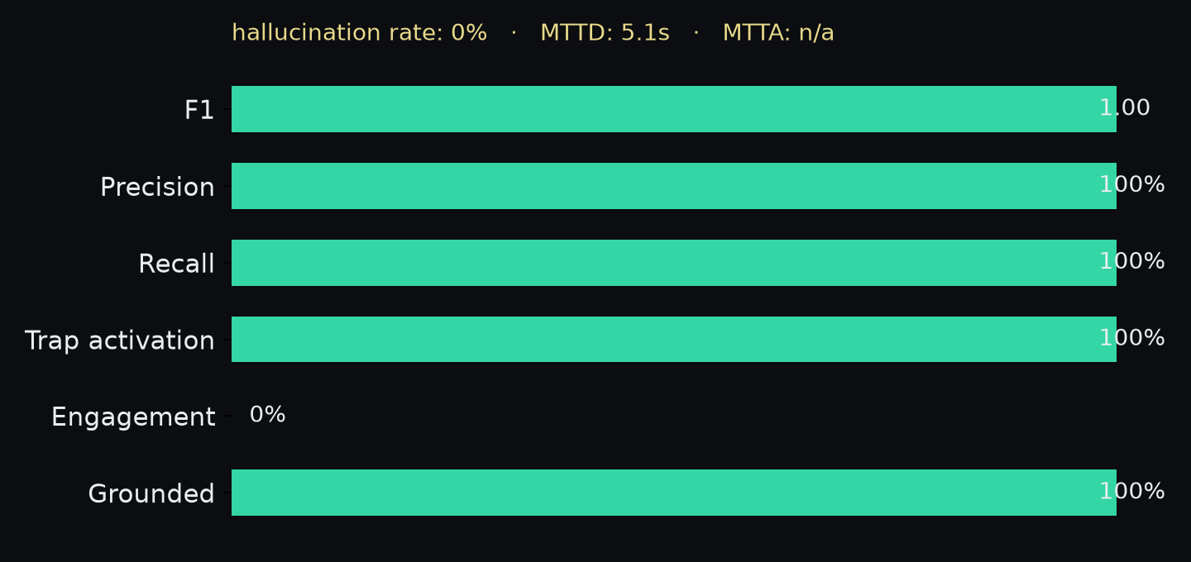
RESULTS
Detection quality
F1 = 1.00
perfect detection coverage
Grounded 100%
Hallucination 0%
MTTD 5.1s
mean time to detect
MIRAGE · Deception Agent OS
10

Slide 11
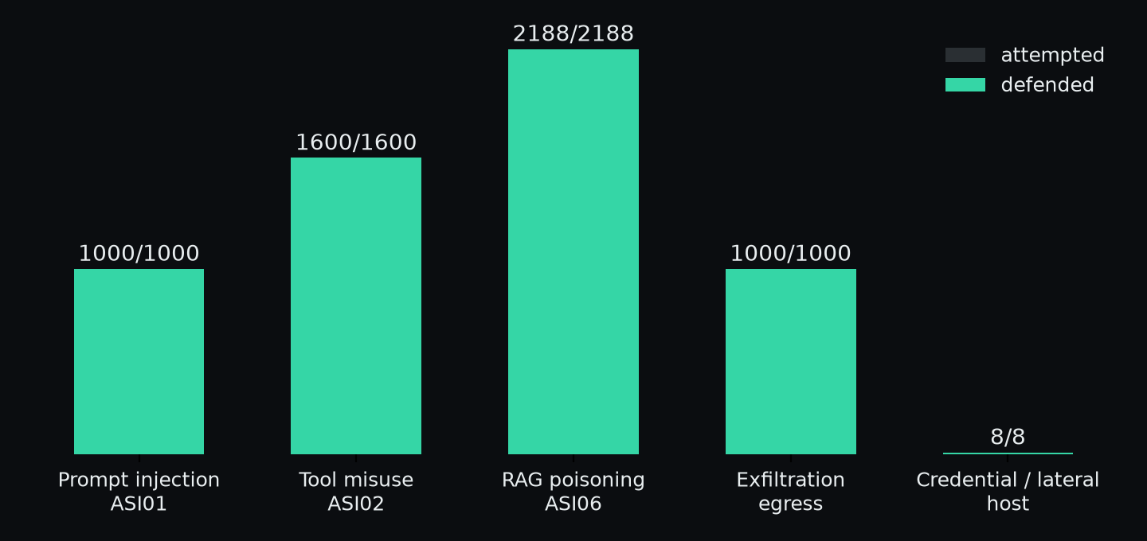
RESULTS
Defense coverage — every attack vector caught
Each bar: attacker actions of that vector; teal = defended. Every action happens inside the deception net and is observed.
MIRAGE · Deception Agent OS
11

Slide 12
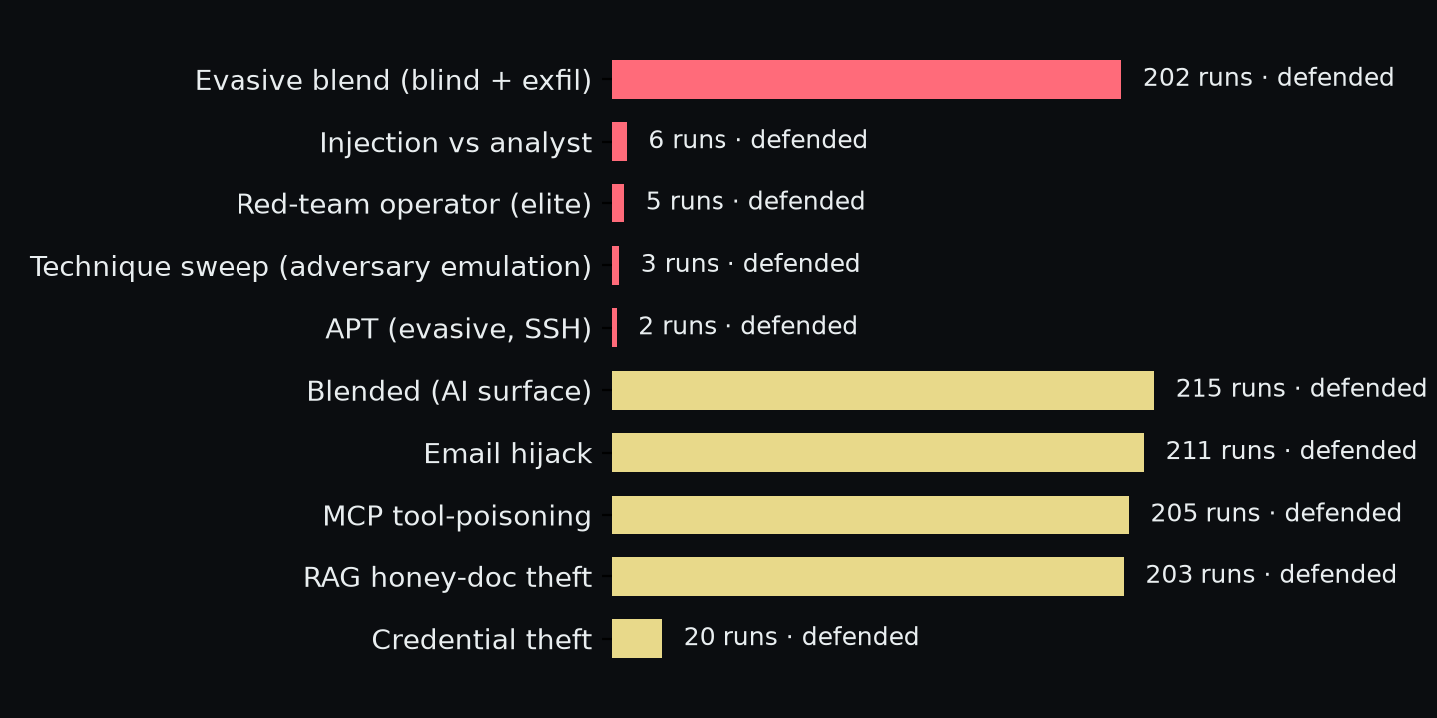
RESULTS
Scenarios defended (hard first)
red = hard · gold = medium. Every scenario across 1079 agent runs was detected and contained.
MIRAGE · Deception Agent OS
12

Slide 13
OPERATIONAL VALUE
Fits a real SOC, and the regulator
• One-click SIEM export: ECS-schema alerts plus ready-to-paste Splunk SPL and Elastic ES|QL per technique and IOC.
• Auto-generated incident report with the grounded summary, ATT&CK mapping, decoys and recommendations.
• NIS2 Article 23 24-hour early-warning draft, pre-filled from the incident.
• Analyst stays in control: approval queue, kill switch, hash-chained audit — AI proposes, human disposes.
• Live console: the attack pipeline as a node graph, plus a scroll-down analytics page (gauges, histograms, ATT&CK coverage).
MIRAGE · Deception Agent OS
13

Slide 14
WHAT'S NEXT
Roadmap & the ask
• Run the real Cowrie daemon and serve MCP over the network for a fully distributed deployment.
• Tamper-evident audit end-to-end; an analyst time-saved study (triage time with Mirage vs raw logs).
• More adversary personas and a single session that blends host + agent compromise.
• Package as a drop-in deception layer in front of any company's real MCP/RAG stack.
Mirage turns every intrusion attempt into labelled, grounded threat intelligence —
and keeps a human in command the whole time.
MIRAGE · Deception Agent OS
14

