Slide 1



DT CrashCourse
Jenkins

Slide 2
Eng. Mohamed Magdy Abu Dief
Email: mohamedmagdyy840@gmail.com
Mobile: +201025088201

Slide 3
Session # OUTLINES
CI-CD
What is it?
Jenkins
What is Jenkins?
Jenkins Architecture.
Why Jenkins?
Installing and Configuring Jenkins.
Jenkins GUI
Jobs types
Plugins
Permissions Management

Slide 4

CI-CD

Slide 5
CI - Definition
“Continuous Integration is a software development practice where members of a team integrate their work frequently, usually each person integrates at least daily - leading to multiple integrations per day. Each integration is verified by an automated build (including test) to detect integration
errors as quickly as possible” – Martin Fowler

Slide 6
CI - CD – What does it really mean?
At a regular frequency (ideally at every commit), the system is:
Integrated
- All changes up until that point are combined into the project
Built
- The code is compiled into an executable or package
Tested
- Automated test suites are run
Archived
- Versioned and stored so it can be distributed as is, if desired
Deployed
- Loaded onto a system where the developers can interact with it

Slide 7
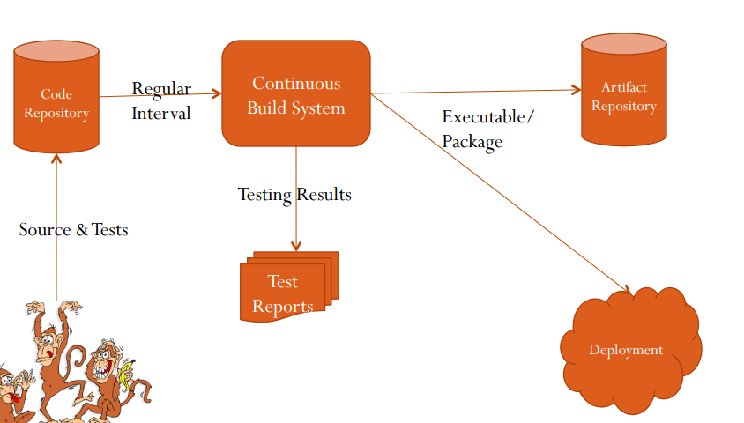
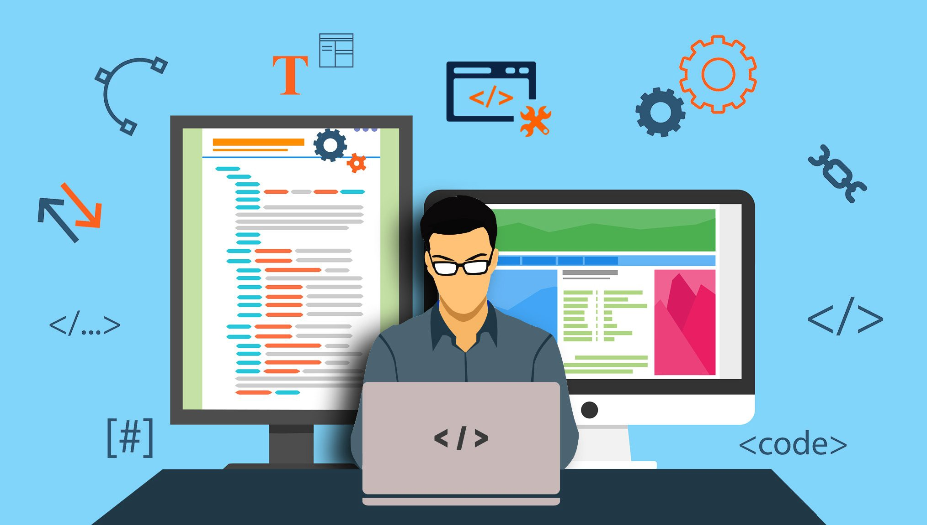
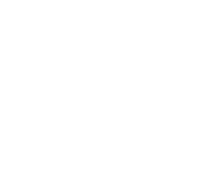
Workflow

Slide 8
Jenkins

Slide 9
What is Jenkins?
Jenkins is an open-source Continuous Integration server written in Java for orchestrating a chain of actions to achieve the Continuous Integration process in an automated fashion.
Jenkins supports the complete development life cycle of software from building, testing, documenting the software, deploying, and other stages of the software development life cycle.
Supported by over 400 plugins
- SCM, Testing, Notifications, Reporting, Artifact Saving, Triggers, External Integration
Under development since 2005
http://jenkins-ci.org/

Slide 10
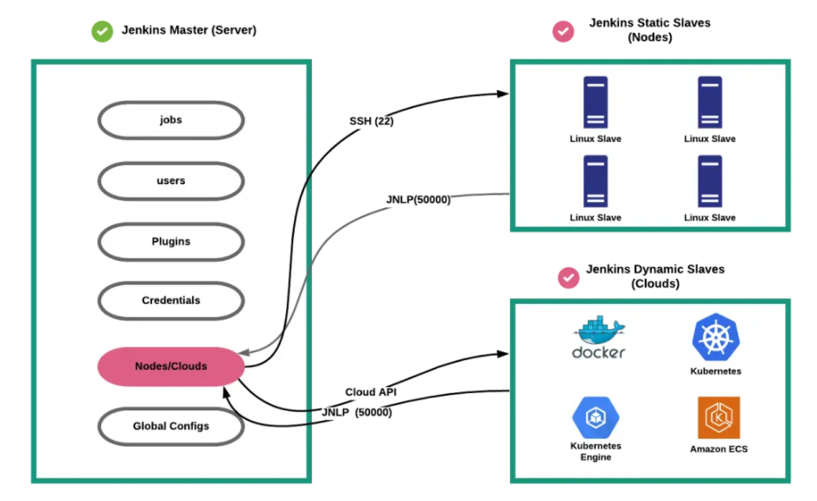
What is Jenkins?
Jenkins Master (Server)
Jenkins’s server or master node holds all key configurations. Jenkins master server is like a control server that orchestrates all the workflow defined in the pipelines. For example, scheduling a job, etc.
Jenkins Agent
Jenkins agents are the worker nodes that actually execute all the steps mentioned in a Job. When you create a Jenkins job, you have to assign an agent to it. Every agent has a label as a unique identifier.

Slide 11

Jenkins GUI

