Slide 1
Name:Mohamed Mahmoud id;205002
Project name:Chatbot
Course name: Natural Language Processing
Teacher:Dr.Esraa Tutor:E.Mostafa Gamal

Slide 2
Abstract:
chatbot implemented using Python and the NLTK library. The chatbot is designed to provide conversational responses, handle greetings, and answer a variety of questions. It utilizes natural language processing techniques such as tokenization, lemmatization, and stop word removal to preprocess user input and improve the accuracy of its responses.

Slide 3
Introduction:
The chatbot is built on allowing it to respond to user inputs based on predefined patterns and a knowledge base. It uses the NLTK library to perform essential natural language processing tasks, including tokenizing user inputs into words, lemmatizing them to their base form, and removing stop words for better understanding.
The chatbot's main features include recognizing and responding to greetings, answering questions based on a predefined knowledge base, and employing synonym recognition techniques to enhance its understanding of user inputs. With this code, you can explore the fundamental concepts of building a rule-based chatbot and customize it to suit your specific requirements.

Slide 4
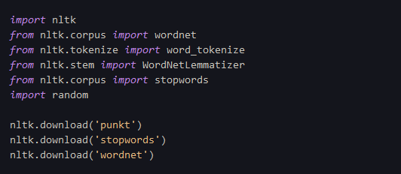
Step 1: Import libraries and download necessary resources
1-nltk :It is a popular library in Python for working with human language data. It provides a wide range of functionalities and resources for natural language processing tasks.
2-wordnet from nltk.corpus: WordNet is a lexical database that provides semantic relationships between words. It contains a large collection of words grouped into synsets (sets of synonyms). The wordnet module from nltk.corpus allows access to WordNet's lexical resources for synonym recognition.
3-word_tokenize from nltk.tokenize: This function is used to split a text into individual words or tokens. It is a common preprocessing step in natural language processing tasks.
4-WordNetLemmatizer from nltk.stem: Lemmatization is the process of reducing words to their base or dictionary form (lemma). The WordNetLemmatizer class provides methods to lemmatize words based on their parts of speech.
5-stopwords from nltk.corpus: Stop words are common words that often do not carry significant meaning and are typically removed in text processing tasks. The stopwords module from nltk.corpus provides a collection of commonly used stop words in various languages.
6-random: This is a Python built-in module that provides functions for generating random numbers and making random choices. In the code, it is used to randomly select a greeting response from a list of predefined responses.

Slide 5
Step 2: Define sample data and responses
list of greeting inputs and responses. The greeting function checks if the user's input contains a greeting and returns a random greeting response if it does.

Slide 6
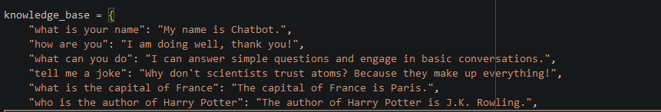
Step 3: Add a simple knowledge base
simple knowledge base as a dictionary, where the keys are questions and the values are the corresponding answers.

Slide 7

Step 4: Initialize the WordNetLemmatizer
WordNetLemmatizer, which will be used to lemmatize words in the user input.

Slide 8
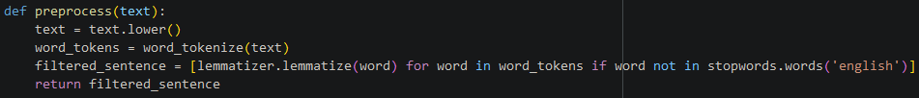
Step 5: Preprocess the user input
preprocess function that takes the user input, converts it to lowercase, tokenizes it into words, lemmatizes the words, and removes stopwords. This will help us match the user input to predefined patterns more effectively.

Slide 9
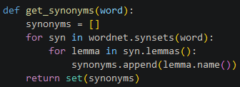
Step 6: Find synonyms using WordNet
get_synonyms function that takes a word and returns a set of its synonyms using WordNet.

Slide 10
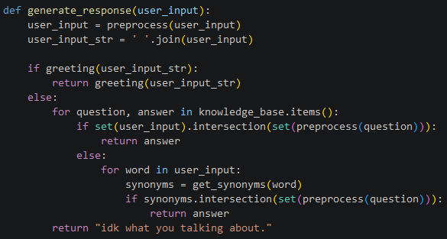
Step 7: Generate the chatbot's response
the generate_response function checks if the user input is a greeting, matches it to the knowledge base, or finds synonyms to match the input to the knowledge base. If no match is found, it returns a default response.

Slide 11
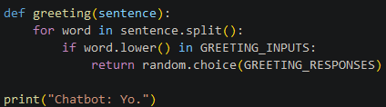
Step 8: Define the greeting function
the greeting function that checks if the user input contains a greeting and returns a random greeting response if it does.

Slide 12
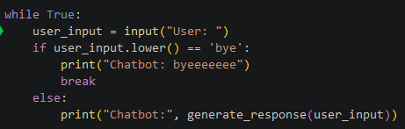
Step 9: Implement the chatbot's main loop
the main loop of the chatbot, which prompts the user for input and generates a response using the generate_response function. The loop continues until the user types 'bye'.

Slide 13
Thank you

