Slide 1
Content
Introduction
Market Research
Functionalities
Choices
Demo
What’s Next
Project Motivation

Slide 2
Introduction

Slide 3
Introduction
Shopify is an e-commerce application that provides a seamless shopping experience for users
The app allows users to browse and purchase electronic products from a wide range of categories.

Slide 4
Project Motivation

Slide 5
Project Motivation
Growing demand for convenient online shopping experiences
E-commerce reduces costs of traditional retail and reaches wider audience

Slide 6
Project Motivation
Provides valuable insights into customer behavior for informed decisions
It is a win-win solution for both customers and businesses

Slide 7
Market Research

Slide 8
Market Research
E-Commerce Trends
Why Not Cross-Platform ?
Target Audience

Slide 9
E-Commerce Trends

Slide 10
Target Audience

Slide 11
Cross-Platform
Amazon has observed that a 100ms increase in response time reduces sales by 1%
Amazon has also observed that 1-second slowdown reduces a customer satisfaction metric by 16%

Slide 12
Functionalities

Slide 13
Functionalities (User)
Sign Up and Log In
Viewing Profile Data
Functional Search Bar
Creating New Order with Unique ID
Selecting Delivery Time and Area
Order Tracking/History Page
Dynamic Cart Page

Slide 14
Functionalities (Admin)
Change Order Status
Add New Products
Check Application Stats
Filter Order By Status

Slide 15
Choices

Slide 16
Choices
Design Pattern
Interface Design
Why Fragments ?
Stack
Security

Slide 17
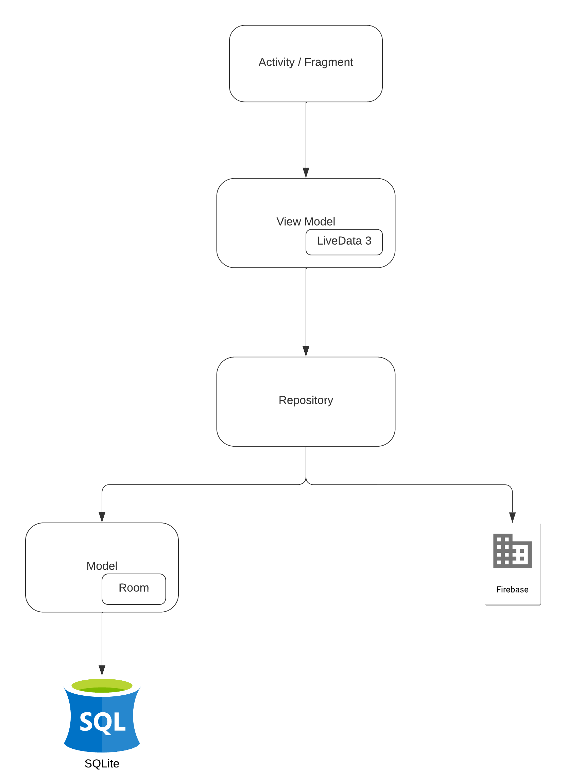
Design Pattern (MVVM)

Slide 18
Stack
Android Studio
Firebase
ROOM Database

Slide 19
Interface Design (User Application)
Sign Up / Log In Activities
Navigation Menu
Fragments

Slide 20
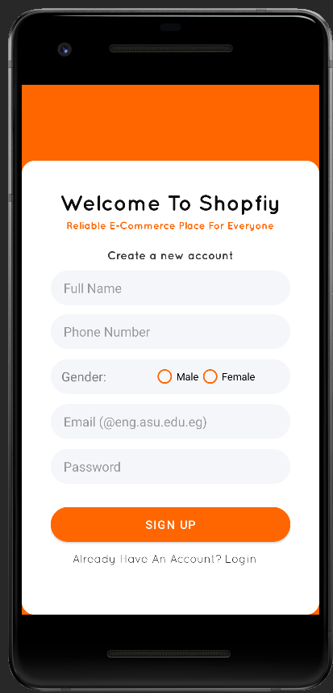
Sign Up Activity

Slide 21
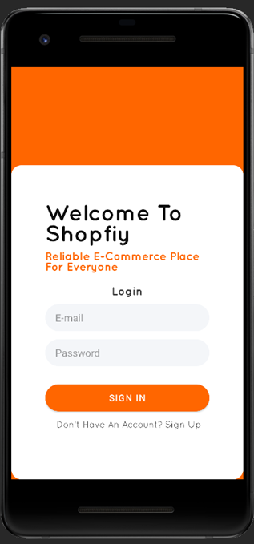
Log In Activity

Slide 22
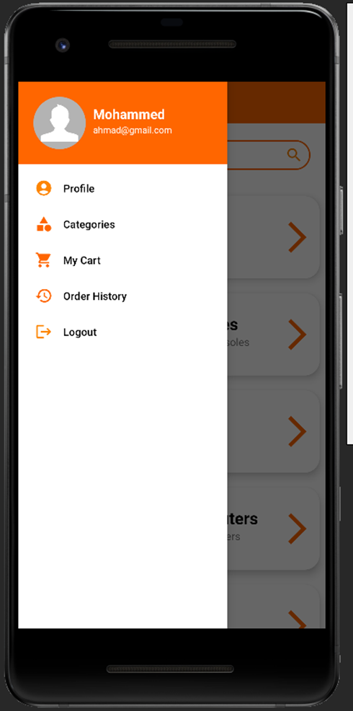
Navigation Menu

Slide 23
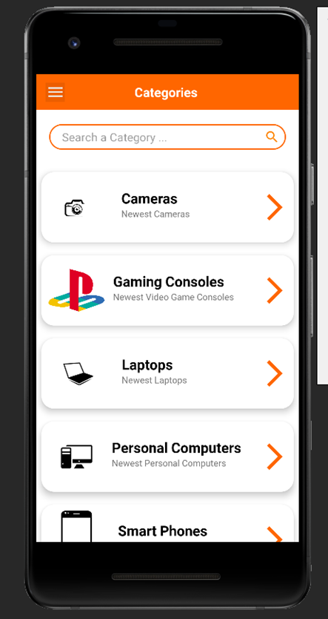
Category List Fragment

Slide 24
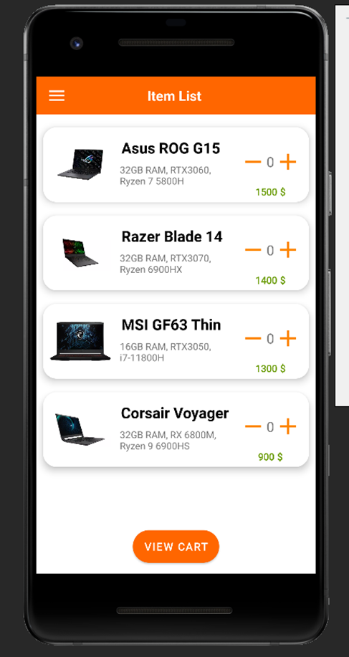
Item List Fragment

Slide 25
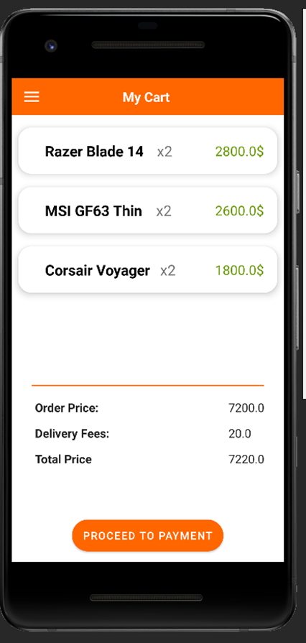
Cart Fragment

Slide 26
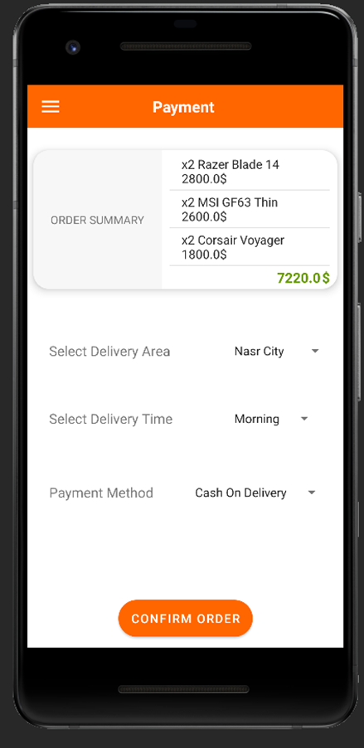
Confirm Order Fragment

Slide 27
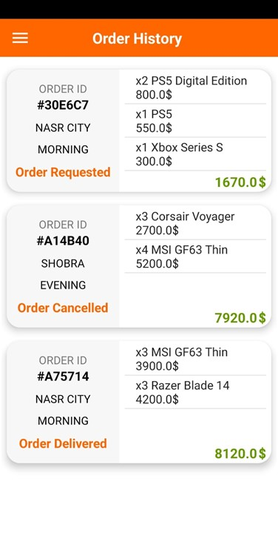
Order History and Tracking Fragment

Slide 28
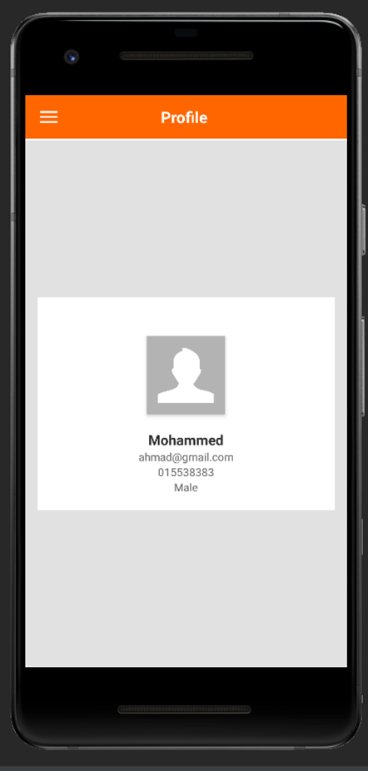
Profile Data Fragment

Slide 29
Interface Design (Admin Application)
Change Order Status Activity
Add Products Activity
Stats Activity

Slide 30
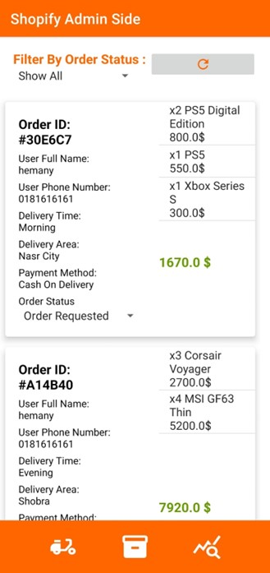
Change Order Status Activity

Slide 31
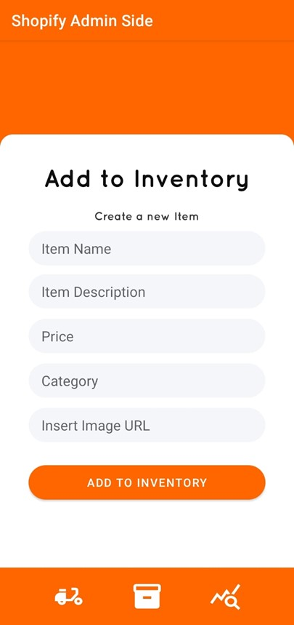
Add Products Activity

Slide 32
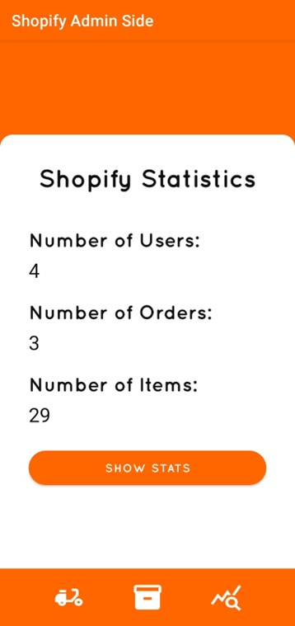
Stats Activity

Slide 33
Why Fragments ?
Modular and Reusable UI Components
Flexibility and Dynamic UI
Code Organization and Maintainability
Testing and Debugging
Enhanced Navigation and UI Flow

Slide 34
Security
Secure By Design
Secure By Default
Secure By Communication
Secure By Implementation

Slide 35
Demo

Slide 36
What’s Next ?

Slide 37
What’s Next
New Features
Kaizen

Slide 38
New Features
Functional Payment System
Transaction Logs
Most Selling Items
Recommendations
Loyalty System

Slide 39
Kaizen Cycle For Continuous Improvement
Plan
Do
Check
Repeat
Act

Slide 40
Thank You

