Slide 1

AWT PJ Video Streaming Mixer Library
Poonam Kumari Roy, Mohamed Mesto, Yuni Quintero | AWT PJ | Workshop 1
Notes:
Introduction: Mohamed
Welcome to the Advanced Web Technologies Project. Our Topic handles the Video Streaming Mixer Library.

Slide 2
Agenda
Problem Statement
Paper and Technology Review
Possible Solutions
Schedule
Next Steps
Poonam Kumari Roy, Mohamed Mesto, Yuni Quintero | AWT PJ | Workshop 1
Notes:
Agenda: Mohamed
We will present to you the following contents about Video Streaming Mixer Library, Problem Statement, Paper and Technology Review, Possible Solutions, Schedule and Next Steps.

Slide 3
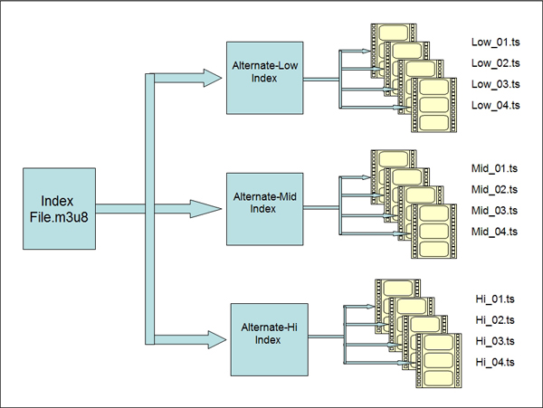
Problem Statement
We are in the Streaming Era
Content is transmitted without downloading
ABS dynamically changes the video source to avoid buffering
HLS splits a video file into little segments
Not all streams share the same representations
We need an algorithm that identifies matching representation from variant video streams in order to output a single playlist
Poonam Kumari Roy, Mohamed Mesto, Yuni Quintero | AWT PJ | Workshop 1
Notes:
We are definitely in the streaming era. Live shows, movies, TV programs, music and any other multimedia content is being delivered and consumed continuously from a source over the internet. The user can start playing the content without having to wait for it to be downloaded or totally transmitted.
Adaptive bitrate streaming standards, like HLS, are being used nowadays to enhance the user experience while consuming video streams over the internet, changing and adapting dynamically the resolution of the video source to avoid buffering and bandwidth bottlenecks. HLS provides different versions or copies of a video stream with lower, medium and higher quality of resolution and bitrate. HLS splits a video source into little segments for each available resolution. Each resolution is a playlist itself containing all those split videos of their respective resolution and bitrate.
A user, for example, might want to enjoy multiple streams as one single playlist to avoid pausing each TV episode. In order to combine these streams into a main one, they have to be compatible with each other in terms of video resolution and bitrate.
A video stream can have multiple resolutions available thanks to HLS, but not all streams share the same representations. Two video streams might not be compatible with each other because they may have different source resolutions and bitrates from the HLS initial formatting.
We seek to resolve this issue by creating a playlist consisting of multiple video streams that already exist, making sure that the different video stream sources are all compatible in regards of resolution and bitrate. We need to identify the multiple representations available from each video stream that is intended to be in the playlist. Then, having this data, an algorithm is needed to handle and filter out the video streams that are not compatible in order to output a single playlist with the final matching representation that includes multiple video stream sources.

Slide 4
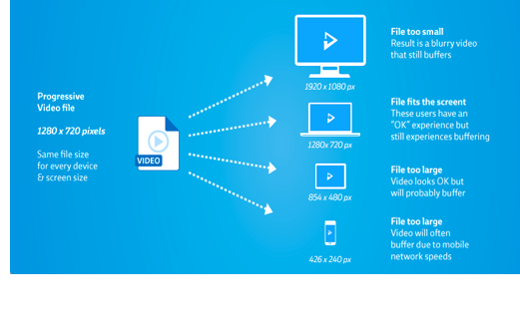
Paper and Technology review
A progressive video stream is one single video file being streamed over the internet.
Two major problems with progressive streaming are:
Quality
Buffering
Poonam Kumari Roy, Mohamed Mesto, Yuni Quintero | AWT PJ | Workshop 1

Slide 5
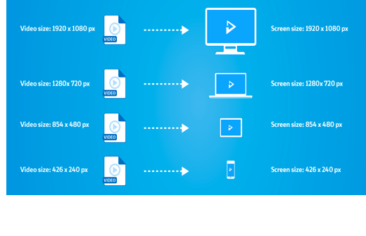
Paper and Technology review
Adaptive bitrate streaming
- Adapting : To speed of the user Internet connection.
- Adaptive streaming allows the video provider to create a different video for each of the screen sizes.
Poonam Kumari Roy, Mohamed Mesto, Yuni Quintero | AWT PJ | Workshop 1

Slide 6
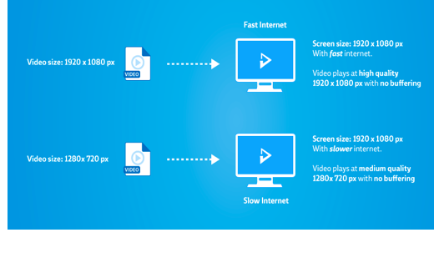
Paper and Technology review
HTTP Live streaming (HLS)
- Most widely used video streaming protocols.
- All Internet connected device support HTTP
- It can increase or decrease video quality depending on network condition without interrupting playback.
Poonam Kumari Roy, Mohamed Mesto, Yuni Quintero | AWT PJ | Workshop 1

Slide 7


Paper and Technology review
HLS Parser JS Library
Node Js
- HLS allows User’s video/song loads quickly.
- The majority of unwatched or un-listened to portions of the song won’t be downloaded.
- We can use the familiar HTTP protocol, which means less server and client configuration.
Poonam Kumari Roy, Mohamed Mesto, Yuni Quintero | AWT PJ | Workshop 1

Slide 8
Paper and Technology review
“Dynamic ad-insertion and content orchestration workflows through manifest manipulation in HLS and MPEG-DASH” is an example of how the hls manifest can be manipulated to output a different video stream
Content manipulation and dynamic ad insertion is realized through non-video-intrusive technologies operating on manifest level
Poonam Kumari Roy, Mohamed Mesto, Yuni Quintero | AWT PJ | Workshop 1
Notes:
From fraunhofer Institute Focus research team in one of paper about Dynamic ad-insertion and content orchestration workflows has proven that HLS manifest can be manipulated to the output a different video stream..
In addition to that content creation and player implementations have been evaluated to further support the integration of those technologies in future solution.

Slide 9
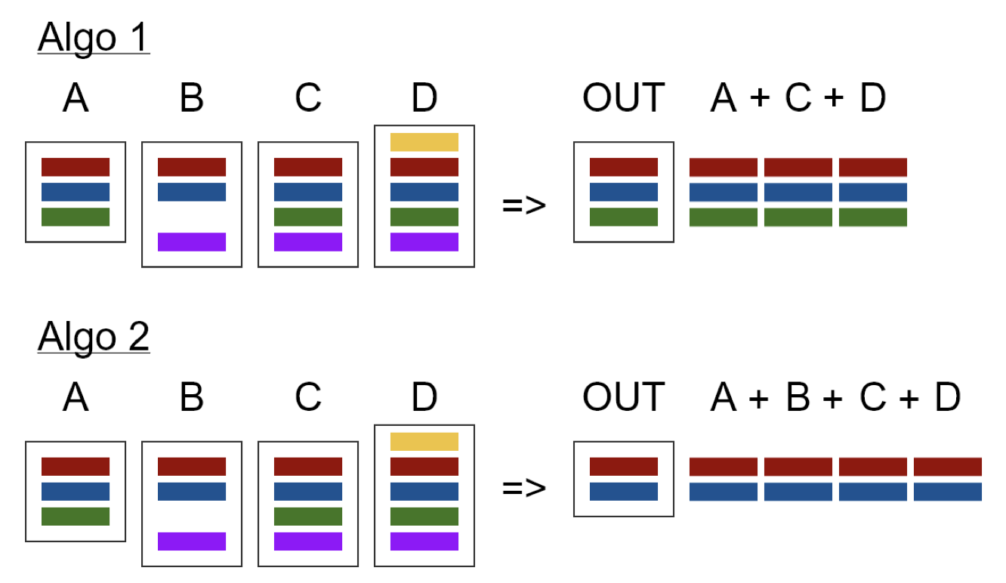
Possible Solutions - Video Streaming Mixer Library
Parse HLS manifest into object representations
Implement algorithm to identify matching video streams
Strategy 1: set Filter against first element’s attributes
Strategy 2: set intersection for matching attributes
The output should be a master HLS manifest of a playlist including all matching video streams
Poonam Kumari Roy, Mohamed Mesto, Yuni Quintero | AWT PJ | Workshop 1
Notes:
We will parse the HLS manifests from the multiple video streams using hls-parse JS library. Having the respective object representations for further manipulation and handling, we will implement two algorithms that will identify the matching representations based on resolution and bitrate.
The first strategy consists on identifying which video streams have matching representations from the first element of the input array. One video stream might have more resolutions than the first input so those would have to be left out.
The second strategy consists of finding an intersection between the variant playlists in regards to their resolution and bitrate. For both strategies, the final output should be the master HLS manifest of a playlist that includes the concatenated segments from all inputs matching the respective representation. Using the hls-parser library we will create and manipulate this final HLS master manifest.

Slide 10
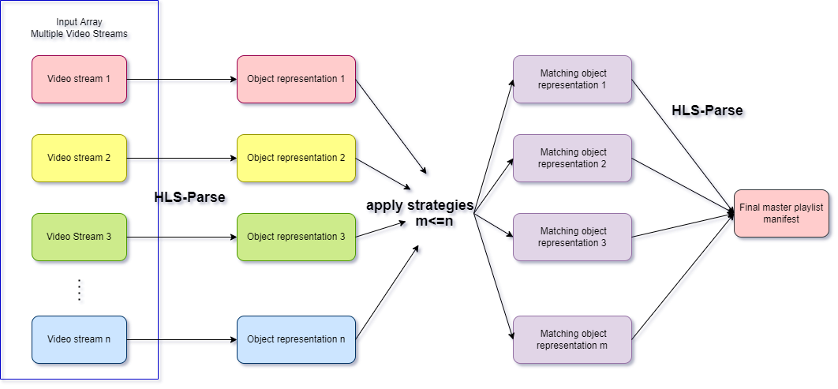
Possible Solutions - Video Streaming Mixer Library
Poonam Kumari Roy, Mohamed Mesto, Yuni Quintero | AWT PJ | Workshop 1
Notes:
Here we can see the diagram flow that shows how the multiple video streams manifest as input are going to be parsed through the hls-parse library to obtain each object representation. Then, the two strategies will be applied to this set of objects to find the matching and compatible representations in orden to output a final master playlist using, again, the hls-parse library to create/write the master manifest.
1:25 seconds

Slide 11
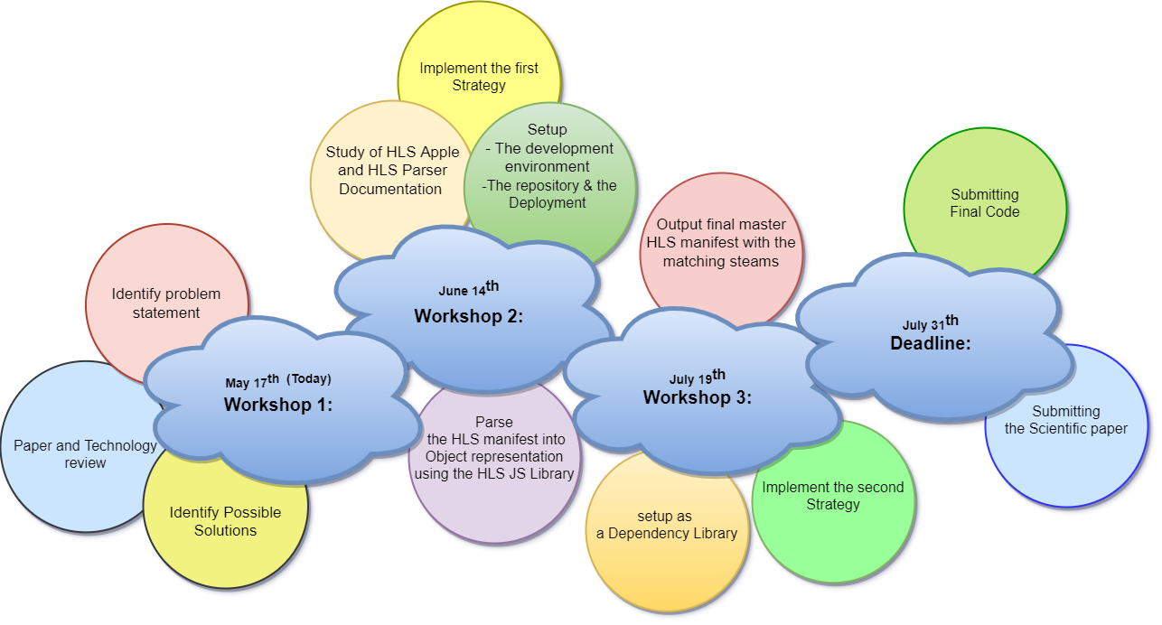
Roadmap
Poonam Kumari Roy, Mohamed Mesto, Yuni Quintero | AWT PJ | Workshop 1
Notes:
In this slide I’d like to highlight our project’s Roadmap:
So by today the 17th of May is the 1st workshop taking place: As my group mates Yuni, Poonam and me clarified the three main points: Identify the problem statement, review the Paper and Technology and Identify Possible Solutions.
Until the 14th of Juni we will achieve the following work elements: Implement the first Strategy, Study of HLS Apple and HLS Parser Documentation ,Setup the development environment, the repository, deployment and Parse the HLS manifest into Object representation using the HLS JS Library. Which referred to as workshop 2.
Moreover, the 3d workshop which will take place on 19th of July include: Output final master HLS manifest with the matching steams, setup as a dependency Library and Implement the second strategy. nevertheless the project will finished on the 31th of July by Submitting the final code and the Scientific paper 1:25 seconds

Slide 12
Next Steps
Implement the first strategy (First Demo. )
Setup the development environment
Setup the repository & the deployment
Study of HLS Apple and HLS Parser Documentation
Review of Use cases and graphical representation.
Poonam Kumari Roy, Mohamed Mesto, Yuni Quintero | AWT PJ | Workshop 1
Notes:
Next steps: Mohamed
The next steps (workshop 2) are represented in: Implement the first strategy (First Demo. ), Setup the development environment, Setup the repository & the deployment, Study of HLS Apple and HLS Parser Documentation and Review of Use cases and graphical representation. 25 seconds

Slide 13
Resources
https://bitmovin.com/adaptive-streaming/
https://www.wowza.com/blog/adaptive-bitrate-streaming
HLS documentation https://datatracker.ietf.org/doc/html/rfc8216
hls-parse js library https://www.npmjs.com/package/hls-playlist-parser
R. Seeliger, D. Silhavy, Dr. S. Arbanowski “Dynamic ad-insertion and content orchestration workflows through manifest manipulation in HLS and MPEG-DASH” https://ieeexplore.ieee.org/document/8228708
https://developer.apple.com/documentation/http_live_streaming/about_apple_s_http_live_streaming_tools
Poonam Kumari Roy, Mohamed Mesto, Yuni Quintero | AWT PJ | Workshop 1

