Slide 1


English for Academic Purposes -- English for Architects B2
MCs: Supervisor:
Mohamed Mesto Ms. Ing Kathryn Nussdorf
Dated: 8th july 2018

Slide 2

Crosswords of Architecture
The intersection of goals and achievements in our lives builds us a bridge of hope over a river of despair

Slide 3
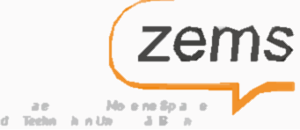
1- Introduction

Slide 4
1-A definition:
A crossword is a word puzzle that usually takes the form of a square or a rectangular grid of white-and black-shaded squares. The game's goal is to fill the white squares with letters, forming words or phrases, by solving clues, which lead to the answers. In languages that are written left-to-right, the answer words and phrases are placed in the grid from left to right and from top to bottom. The shaded squares are used to separate the words or phrases.[1]

Slide 5
1-B Background:
Science Explains Why Crossword Puzzles Are Good For Your Mental Health:
Plenty of researchers have discovered the positive effects that crossword puzzles can have on one’s brain if played regularly. Regularly doesn’t necessarily mean every day — once a week is fine. Among these researchers is Ann Lukits, who wrote “Puzzles Boost Verbal Skills, Cut Dementia Risk” for the Wall Street Journal. She firmly believes that solving crosswords on a regular basis can “improve memory and brain function in older adults.” Such activities can also “improve mental functions in patients with brain damage or early dementia.”[2]

Slide 6
1-C Motivation:
solving interactive Crosswords puzzle are more interesting then writing because it has more features than normal way with pencil and paper.

Slide 7


2- Crosswords Puzzle

Slide 8
2-1 preparing words and Defintions:
Cement | Fiberglass | Force | Bond | Roof | Construction
Mineral | Area | Designer | Terrace | Sample | Structure
Concrete | Chemical | Tensile | Beam | Scale | Architect
Rebar | Weather | Steel | Load | Flat
Brick | Mixture | Waterproof | Plan | Ground
Moisture | Hardness | Inspection | Plot | Measurement
Dam | Schema | Performance | Gap | Feasibility study

Slide 9
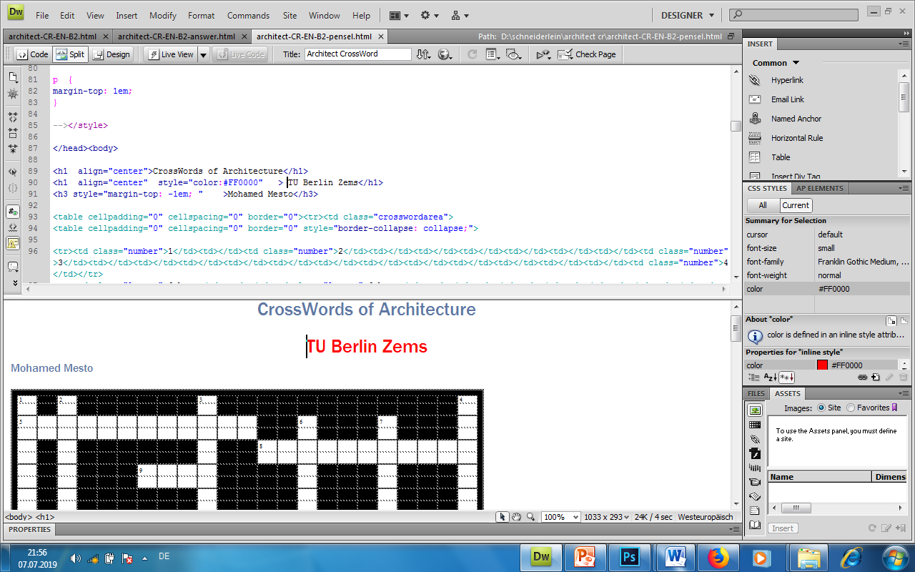
2-2 Creating and development:
using Java script and html and Dreamweaver to build a web interactive applications Fig1, 2
Fig. 1

Slide 10
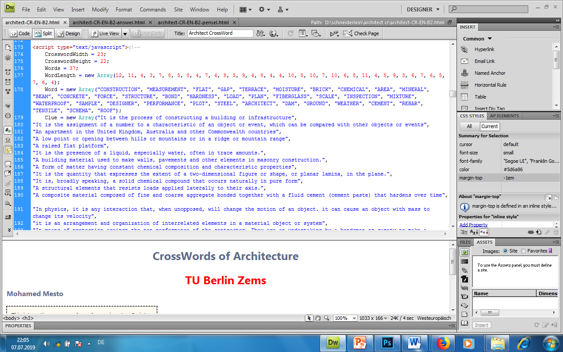
Fig. 2

Slide 11
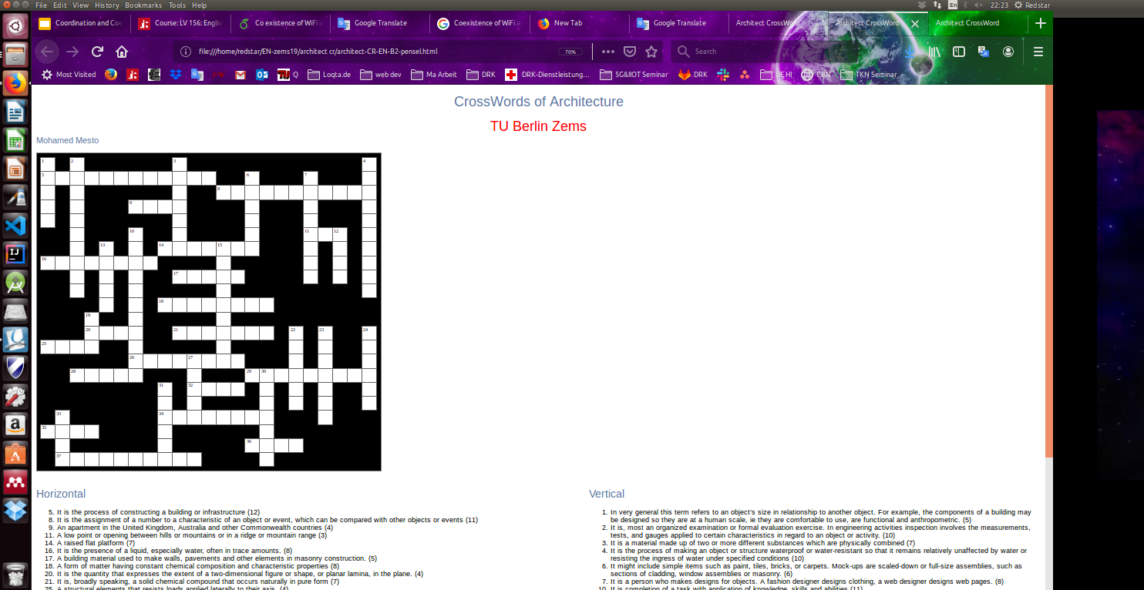
2-3: Stages of the puzzle
2-3-1: normal solving with pencil and a printed copy of the puzzle: Fig.3
Fig. 3

Slide 12
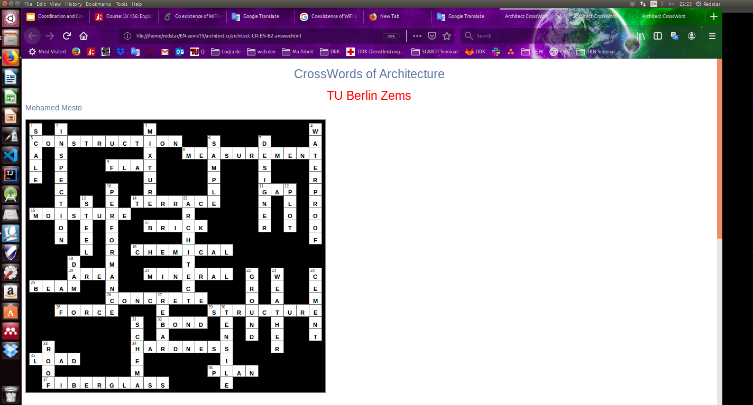
2-3-2:Keywords or answer words: Fig.4
Fig. 4

Slide 13
2-3-3: solving the puzzle through the interactive User interface: Fig.5
Startup the puzzle like a web app in any browser within an interactive environment
by running the file architect-CR-EN-B2.html Fig.5
Fig. 5

Slide 14
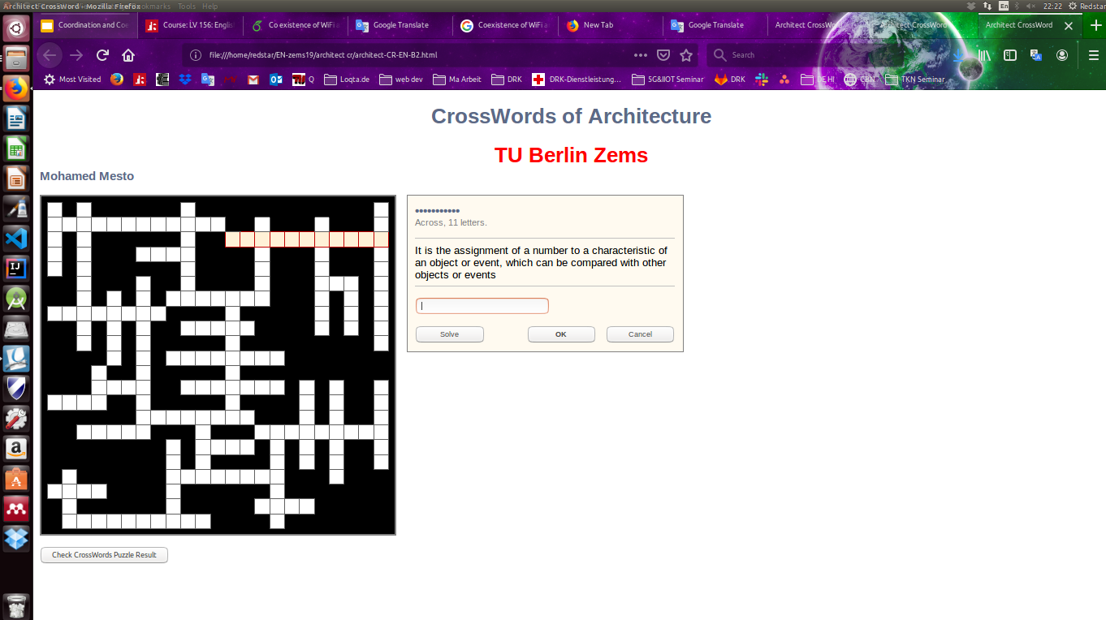
2-3-3 interactive User interface:
After clicking on any word it shows definition window and solving button and checking the puzzle result Fig. 6 , 7
Fig. 6

Slide 15
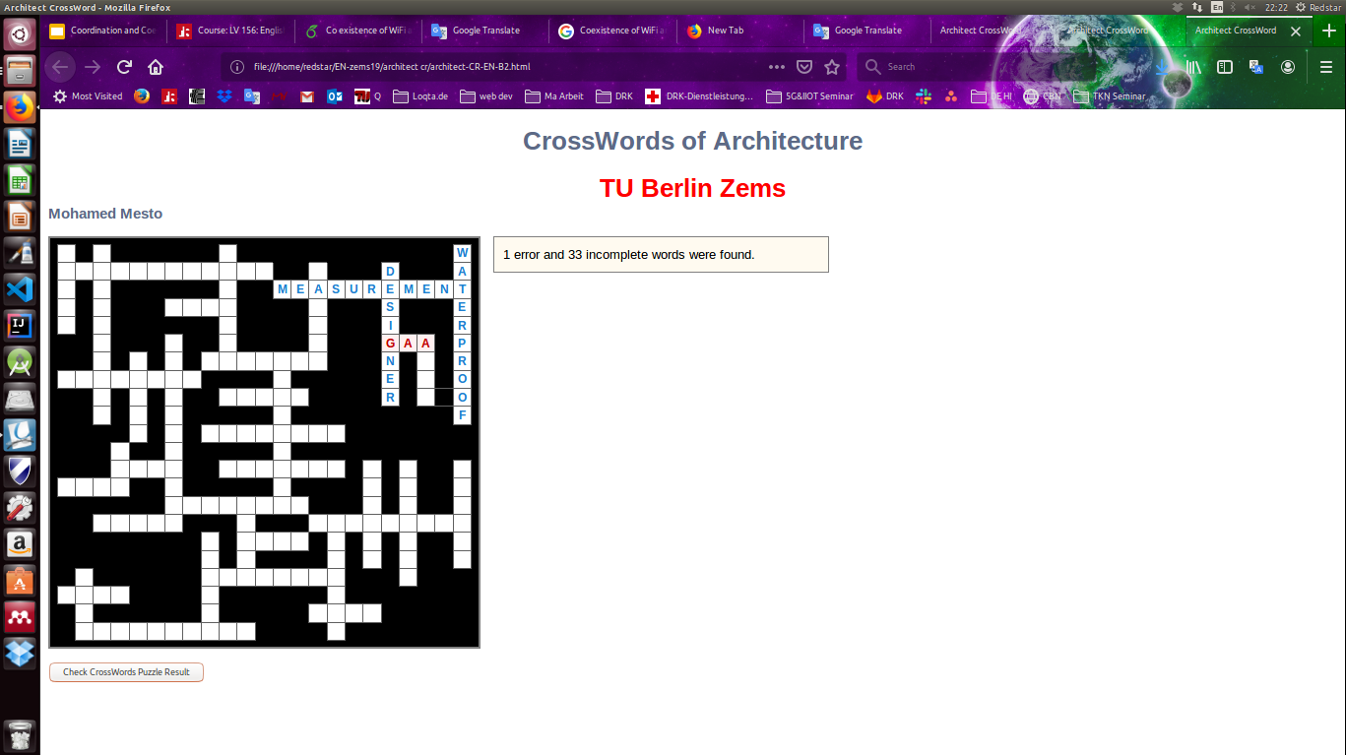
Fig. 7

Slide 16
3- Conclusion:

Slide 17
Crosswords of architecture
Solving crossword puzzles alone is beneficial, but working in a group adds a bigger advantage to one’s brain function.
One important factor of collaborative cruciverbalism is the ability to think creatively in a more strategic fashion.
The other factors are fairly easy to capture. Involving yourself in such a brain-consuming activity helps you vastly by improving your verbal skills, making you solve problems, and causing you to think deeply.

Slide 18
My opinion:
I agree with solving as much as possible crosswords and puzzle which by time improve you knowledge and experience for solving life problems and impact positively your brain to deep thinking

Slide 19
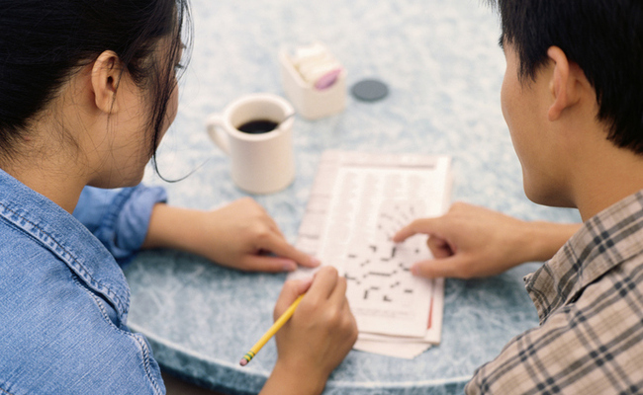
so have a break please with a cup of coffee to enjoy solving Crosswords and Unleash your thoughts

Slide 20

1.https://en.wikipedia.org/wiki/ 2.https://www.lifehack.org/374975/science-explains-why-crossword-puzzles-are-good-for-our-mental-health 3.https://www.designingbuildings.co.uk/wiki/Types_of_beam
References:

Slide 21
Thank Your
Questions?

