Slide 1
Enhancing Edge Computing with Database Replication
Presented By Muhammad Ali Swati Gurbani Haris Pervaiz

Slide 2
Table Of Content
Introduction
Execution Model and Architecture
Advantages Of Edge server with Replication Middleware
Protocol Overview and Details Performance evaluation Conclusion
•
•

Slide 3
Introduction
It is a technique for delivering web content over the internet, which reduces workload over WAN.
There are two types of approaches:
a.) Lazy-replication Approach: It is used to overcome the lack of scalability in ICS.
b.) Primary-Secondary Approach : This approach was introduced to overcome the faults of lazy- replication approach.
Above and other introduced approaches had focus on replication within data centre and not to the edge of the network
Proposed approach in paper is based on middleware architecture, which is useful for both the Fog as well as to support heterogeneous set of database.

Slide 4
Execution Model & Architecture
There are two types of execution model
a.) Transaction : User request that requires database access are always encapsulated in transactions, always operated as read and write operations in sequence.
b.) Non-Transaction : User request that only access static content.
Example: Snapshot Transaction which is used in Oracle and Microsoft SQL servers.

Slide 5
Architecture
There are 5 different types of Architecture, some of them are: 1.) Centralized Approach
2.) Edge Server sharing a centralised DB 3.) Edge Server based on lazy primary
Common criteria in all the approaches is, Clients that are local to main server connect it directly and execution is also always local
The new approach introduced in the paper to avoid faults and improve performance using “Replication Middleware”.

Slide 6
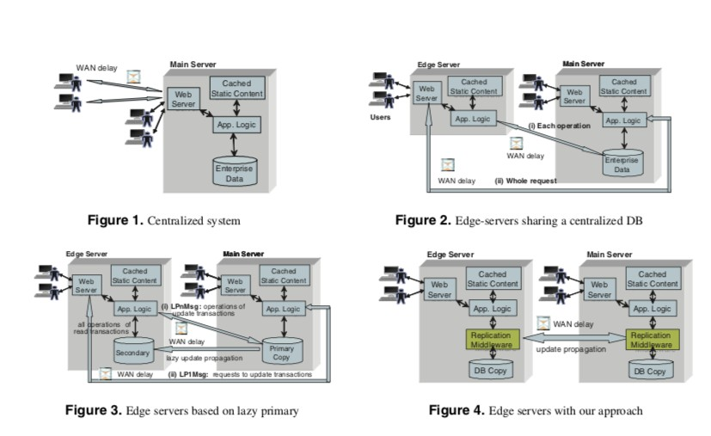
Architecture

Slide 7
Advantages Of Edge server with Replication Middleware
SEQ in it, is replica control for WAN.
If the message overhead is kept as small as possible transaction execution is kept as small as possible.
There is a replication middleware instance for each database copy at each server all the requests are processed locally

Slide 8
Protocol Overview and detail
•
Read only transactions are executed locally and committed immediately without synchronization.
•
Middleware keep track of all modified object.
•
Middleware is referred as Global sequence which upon receiving signals waits for validation.
•
The SEQ has better load balancing than primary replication.

Slide 9
Protocol Overview and detail
The application logic serves user as standard database interface.
At the beginning of each transaction to is assigned a timestamp “start”
All the “read” request and “write” request are simply forwarded to local database replica.
If transaction is “read” it commits, otherwise sends to middleware replica.
After each steps a validation check is performed.
Transaction are committed in validation order.
Hybrid approach is introduced for better fault tolerance and performance.
Its is based on GCS (Group communication System)

Slide 10
Performance Evaluation
Comparison of SEQ with Hybrid against lazy primary copy replication. Example:
Setup of 100,000 items and 100 emulated browsers which leads to 645MB.
The round trip was between 40 to 150 ms “depending on distance”
Clients were evenly distributed among the main server.
Two Scenarios:
1.) Indvidual Edge Server
2.) Clustered Edge Server

Slide 11
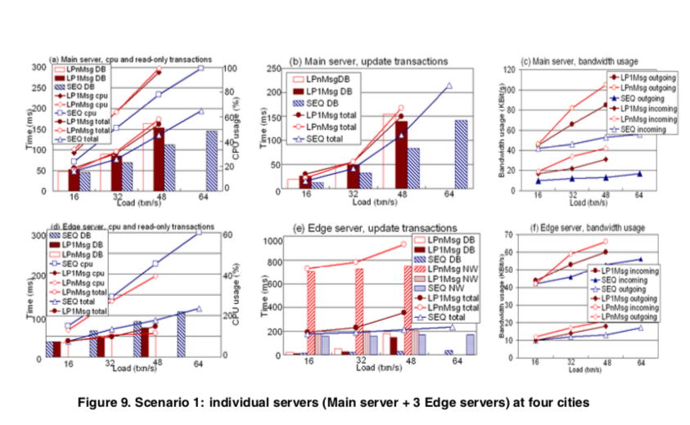
Individual Edge Server

Slide 12
Conclusion
Novel approach to deliver dynamic content in edge computing.
The mentioned approach is transparent to the application
This approach result in higher scalability and lower latency.
It also provides higher degree of fault-tolerance, especially “Hybrid”.

Slide 13
ANSWER: Yes, this approach can be used with Fog computing as it gives better fault tolerance and better performance using Replication Middleware and Hybrid approach, because to this we are able to adjust the network topology of the application.
It comes with an additional cost of implementation, but as it has a higher response time too. However small implementation can be considered keeping other factors into account.

