Slide 1


Accented speech Recognition (ASR)
06.02.2023
First supervisor: Prof. Dr. Sebastian Möller
Second supervisor: Dr. Tim Polzehl
Mohamed Mesto M.Cs degree

Slide 2
Agenda
Introduction to ASR
Acoustic and linguistic models
Cahllenges and Significant metrics in this field
Data → 11 German Accent
Durations
Noise
WER
Suggested solutions
Blot Charts
Planned Implementaions
Q&A

Slide 3
Introduction to ASR
Reliability of the speech recognition system increasing in many fileds:
terms for the concept of speech recognition:
→ It is a sub-domain of the joint work between computer science, computer engineering, and computational linguistics
Notes:
Reliability of the speech recognition system increasing: and has many benifits:
solving many industrial issues
Medical matter
various challenges in different areas of daily life
Most Important terms for the concept of speech recognition:
Automatic Speech Recognition (ASR)
Accented speech Recognition (ASR)
Computer speech recognition
Speech-To-Text (STT)
Text-To-Speech (TTS)
Basically It is a sub-domain of the joint work between computer science, computer engineering, and computational linguistics

Slide 4
Introduction to ASR- Examples
in our homes, Alexa
In our cars like Summalinguae
At workplace ,or PCs (e.g., Cortana)
In our mobile devices (e.g., Siri and Google Assistant).
Notes:
Including IoT and personal identification systems at home, Alexa has a built-in ASR to comprehend our instructions.
In our cars like Summalinguae
At workplace ,or PCs (e.g., to speak with Cortana virtual assistant in Windows PC).
In our mobile devices, there are ASRs that we can use to type texts or communicate with a mobile virtual assistant (e.g., Siri and Google Assistant).

Slide 5
Acoustic and linguistic models - Introduction
Introduction
Acoustic and linguistic models
Non-streaming versus Streaming Models
Notes:
Audio formats performed through the Web fall into two general classifications.
The user must download non-streaming audio files to the user’s hard disk before being able to play after that,
unlike Streaming audio files, which can play almost immediately and continue playing while they are downloading.
However, each category has advantages and disadvantages.
In artificial intelligence algorithms which specialized in dealing with linguistics, stream processing is a programming layout that considers data streams, or series of events in time, as the primary input and output entities of analysis.
Nevertheless: Parallel computing empowers the Stream processing systems for data streams and relies on streaming algorithms for efficient performance.

Slide 6
Acoustic and linguistic models - Examples
Acoustic models
Emformer Model
DeepSpeech Model
Wav2vec2
Transformer-Transducers
Conformer Model
Recurrent Neural Network Transducer (RNN-T)
linguistic models
N-gram
Transformer (BERT etc.)
GPTx

Slide 7
Suggested solutions – DeepSpeech
DeepSpeech, an End-to-End model for ASR
Contents
At runtime, DeepSpeech is made up of two main parts:
the acoustic model and
the language model.
Training
Notes:
On this work, as a study use case, we will focus on, DeepSpeech , an End-to-End model for ASR. We handle tw aspects: Contents and Training
Contents
At runtime, DeepSpeech is made up of two main parts: (1) the acoustic model and (2) the language model.
The acoustic model takes audio as input and converts it to a probability over characters in the alphabet.
The language model helps to turn these probabilities into words of coherent language.
The language model assigns probabilities to words and phrases based on statistics from training data.
Training
The acoustic model is a neural network trained with Tensorflow, and the training data is a corpus of speech and transcripts.
The language model is a n-gram model trained with kenlm, and the training data is a corpus of text.

Slide 8
Suggested solutions -STT De Conformer-Transducer Large
Model Architecture
Training
Datasets
Notes:
Model Architecture:
Conformer-Transducer model is an autoregressive variant of Conformer model [1] for Automatic Speech Recognition which uses Transducer loss/decoding.
Training
The NeMo toolkit [3] was used for training the models.
Datasets
All the models in this collection are trained on a composite dataset (NeMo ASRSET) comprising of over two thousand hours of cleaned German speech:
MCV7.0 567 hours MLS 1524 hours VoxPopuli 214 hours

Slide 9
STT De Conformer-Transducer Large, an End-to-End model for ASR
We use a state-of-the-art end-to-end ASR system,
German-accented German speech
We are going to examine the effects of accent on the internal representation using three main probing techniques:
Gradient-based explanation methods
Information-theoretic measures
Outputs of accent and phone classifiers.
Notes:
In this work, we are going to present a detailed analysis of how accent information is reflected in the internal representation of speech in an end-to-end automatic speech recognition (ASR) system.
We use a state-of-the-art end-to-end ASR system, comprising convolutional and recurrent layers, that is trained on a large amount of German-accented German speech and evaluate the model on speech samples from 11 different german accents.
We are going to examine the effects of accent on the internal representation using three main probing techniques:
Gradient-based explanation methods
Information-theoretic measures
Outputs of accent and phone classifiers.

Slide 10
Cahllenges and Significant metrics in ASR
Durations
Noise
Accent
WER analysis
Notes:
The duration aspect of audio files refers to the length of time that the audio recording lasts. Audio files can vary in duration, ranging from just a few seconds to several hours.
The duration of an audio file is an important consideration when working with speech recognition technology, as the longer the recording, the more challenging it can be to accurately transcribe the speech.

Slide 11
Cahllenges and Significant metrics in ASR
Datasets – 11 German Accent samples
Österreichisches Deutsch
Kanadisches Deutsch
Schweizerdeutsch
Alemannische Färbung,Schweizer Standart Deutsch
Niederländisch Deutsch
Deutschland Deutsch
Französisch Deutsch
Britisches Deutsch
Italienisch Deutsch
Russisch Deutsch
Amerikanisches Deutsch
Notes:
In speech recognition, not only the duration of the audio file can impact the accuracy of the transcription because longer recordings may contain more background noise, variations in speaking style or accent, and other factors that can make it more difficult for the speech recognition system to transcribe the speech accurately

Slide 12
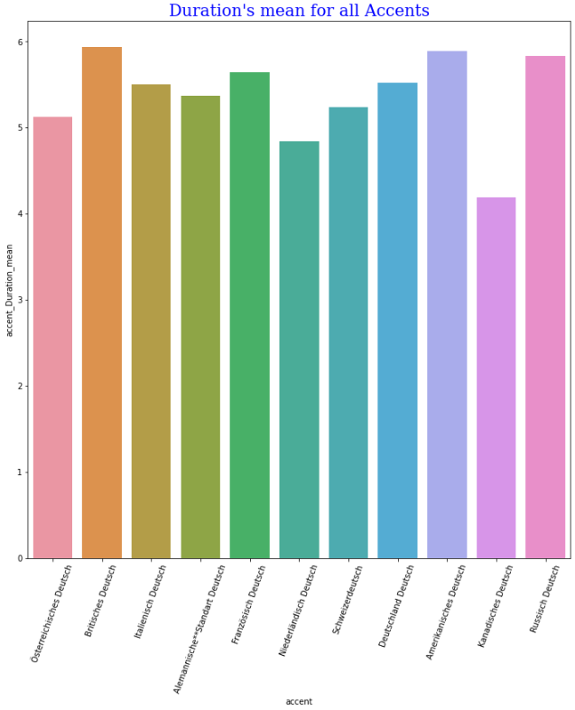
Bar Diagrams of
Duration resp. Accent
Notes:
For the previous mentioned reasons: when working with speech recognition technology, it's important to consider the duration of the audio files and ensure that the system is optimized to handle audio of different lengths and speaking styles.

Slide 13
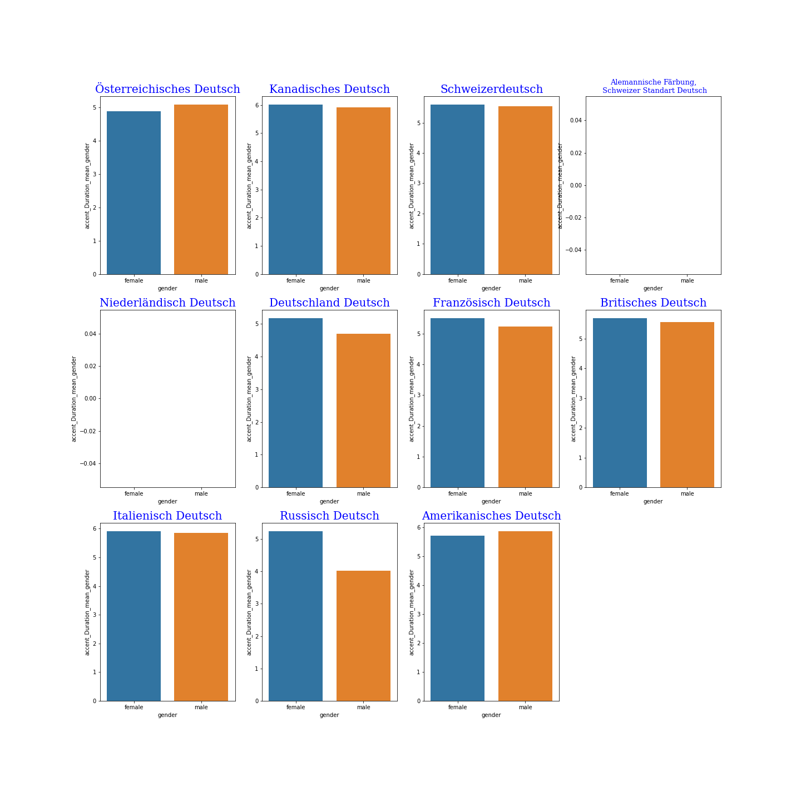
Bar Diagrams of
Accent resp. Gender

Slide 14
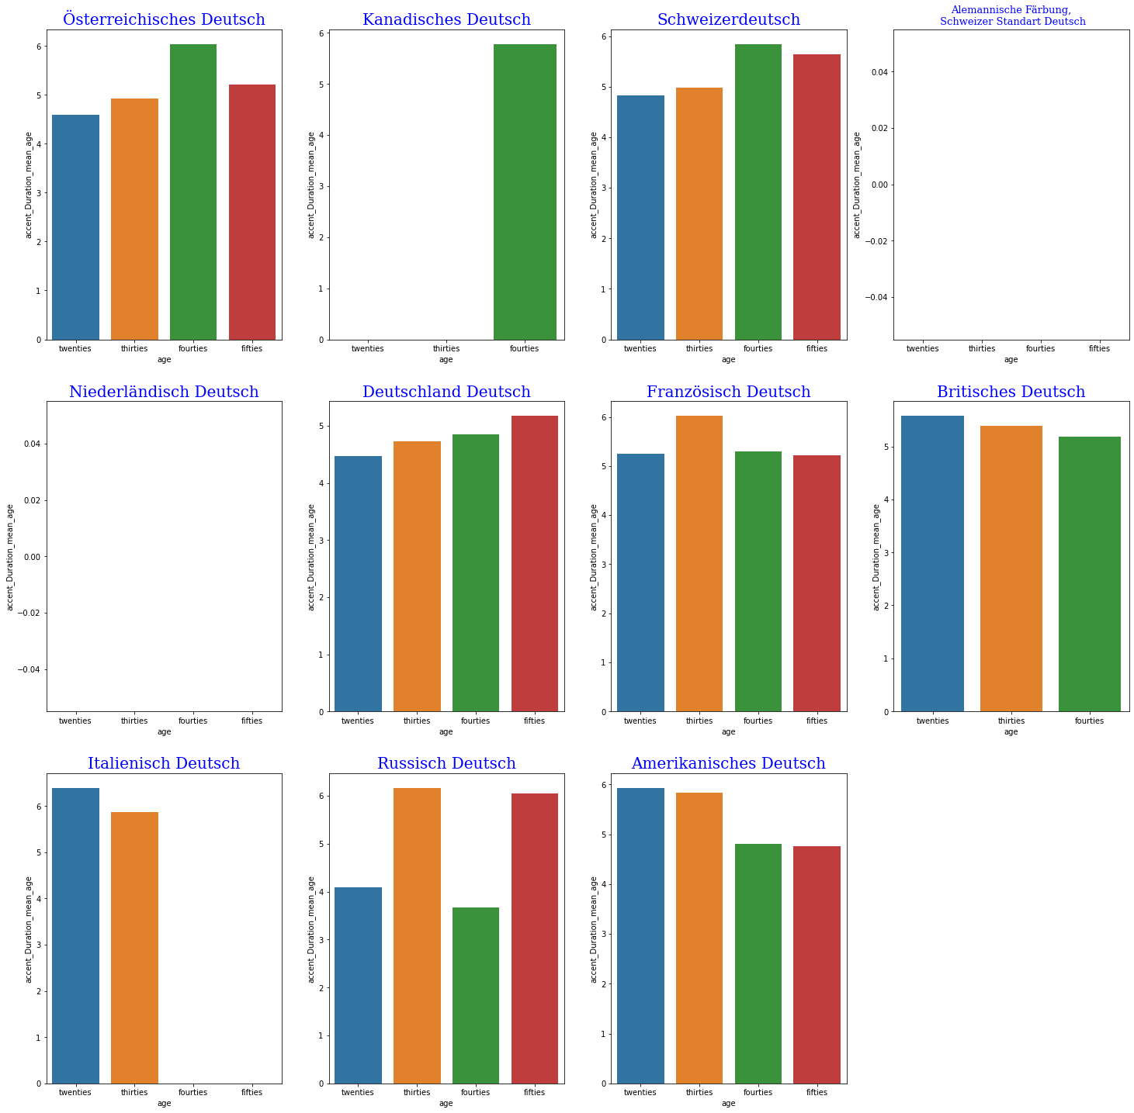
Bar Diagrams of
Accent resp. Age

Slide 15
The Duration and WER analysis
Metric: WER
Word error rate (WER)
WER = (S + D + I) / N = (S + D + I) / (S + D + C)
Where
S is the number of substitutions
D is the number of deletions,
I is the number of insertions
C is the number of correct words
N is the number of words in the reference (N=S+D+C).
Notes:
Word error rate (WER) is a common metric of the performance of an automatic speech recognition system.
This value indicates the average number of errors per reference word. The lower the value, the better the performance of the ASR system with a WER of 0 being a perfect score.

Slide 16
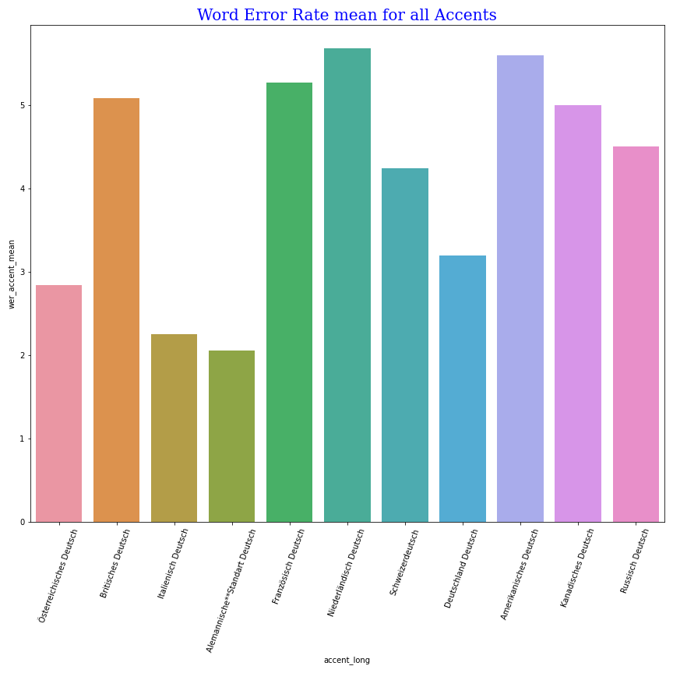
Bar Diagrams of
WER resp. Accents

Slide 17
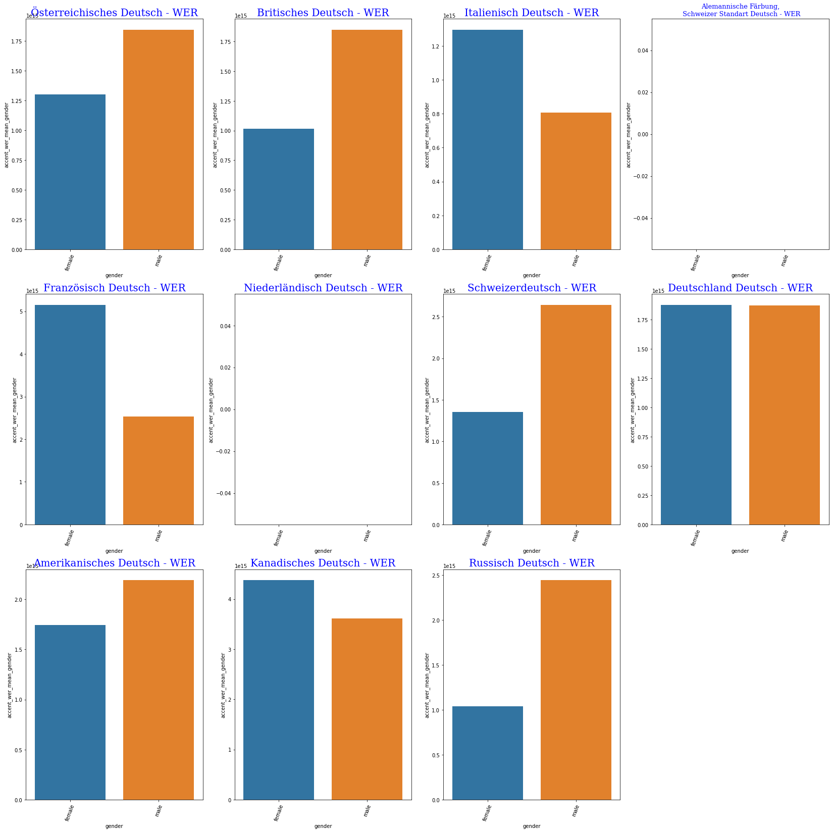
Bar Diagrams of
WER resp. Gender

Slide 18
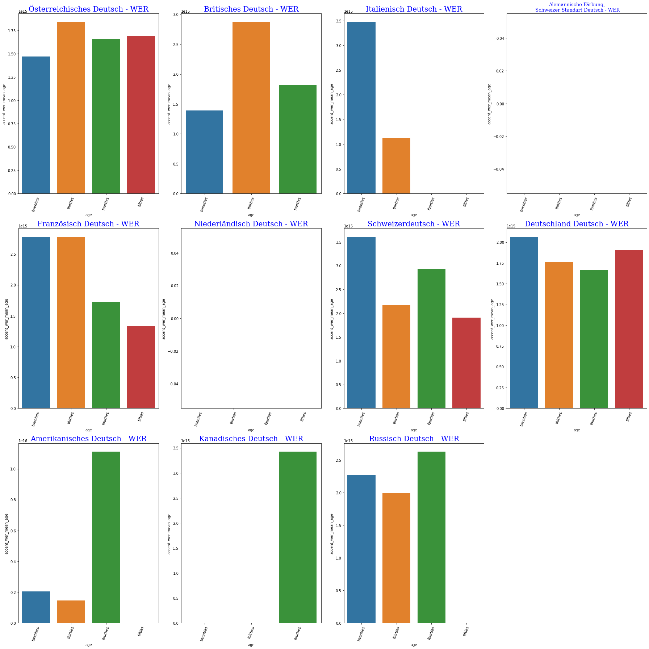
Bar Diagrams of
WER resp. Age groups

Slide 19
How the 11 Accents Confound:
Probing for Accent Information in End-to-End Speech Recognition Systems

Slide 20
Thank you for your attention

