Slide 1

Amoun Langauge Schools
School Management System (LMS)
Supervised by: Dr. Essam Eliwa Supervising Assistant: Eng. Nada Ayman
Karim Ehab, Youssif Assem, Mohamed Moataz & Philip George

Slide 2
Agenda:
Introduction
Problem Statement
System Overview
Use Case Diagram
Functional Requirements
Non-Functional Requirements
Class Diagram
Survey results
Prototype
Paper Submission
Live Demo

Slide 3
Introduction

Slide 4
Introduction:
Millions of videos all over the internet, and more and more are being uploaded every second.
Large collection of videos makes it very hard to find the video you are looking for.
Summarization plays an important role in saving time.
Timestamp helps finding specific part quickly.
Having keywords makes finding process easier

Slide 5
Problem Statement

Slide 6
Problem Statement:
Online and e-learning systems for schools are a bit neglected. So when the pandemic hit our country. The online system was needed more than ever. It was not provided the way that the student needed it to be for him/her to benefit fully from it.

Slide 7
System Overview

Slide 8
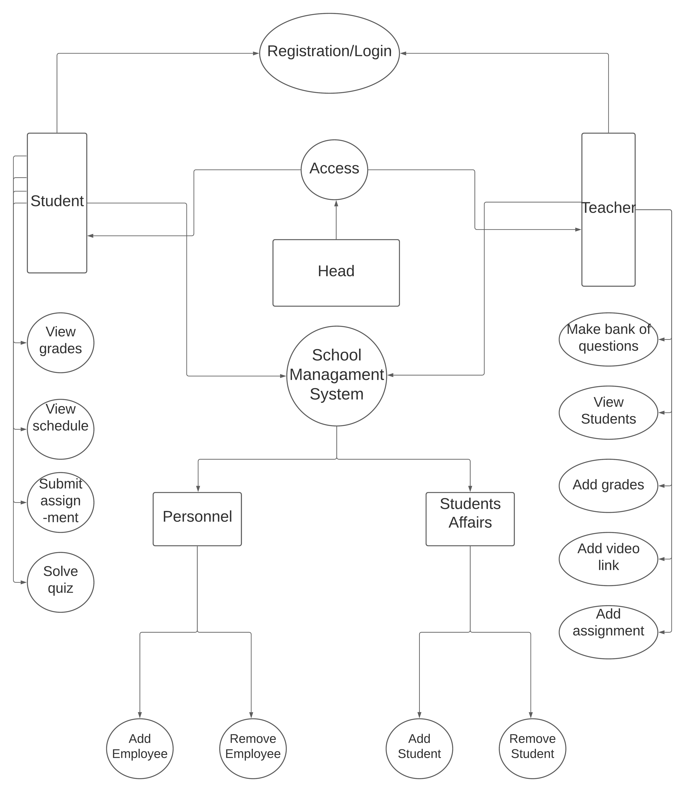

Slide 9
Use Case:

Slide 10
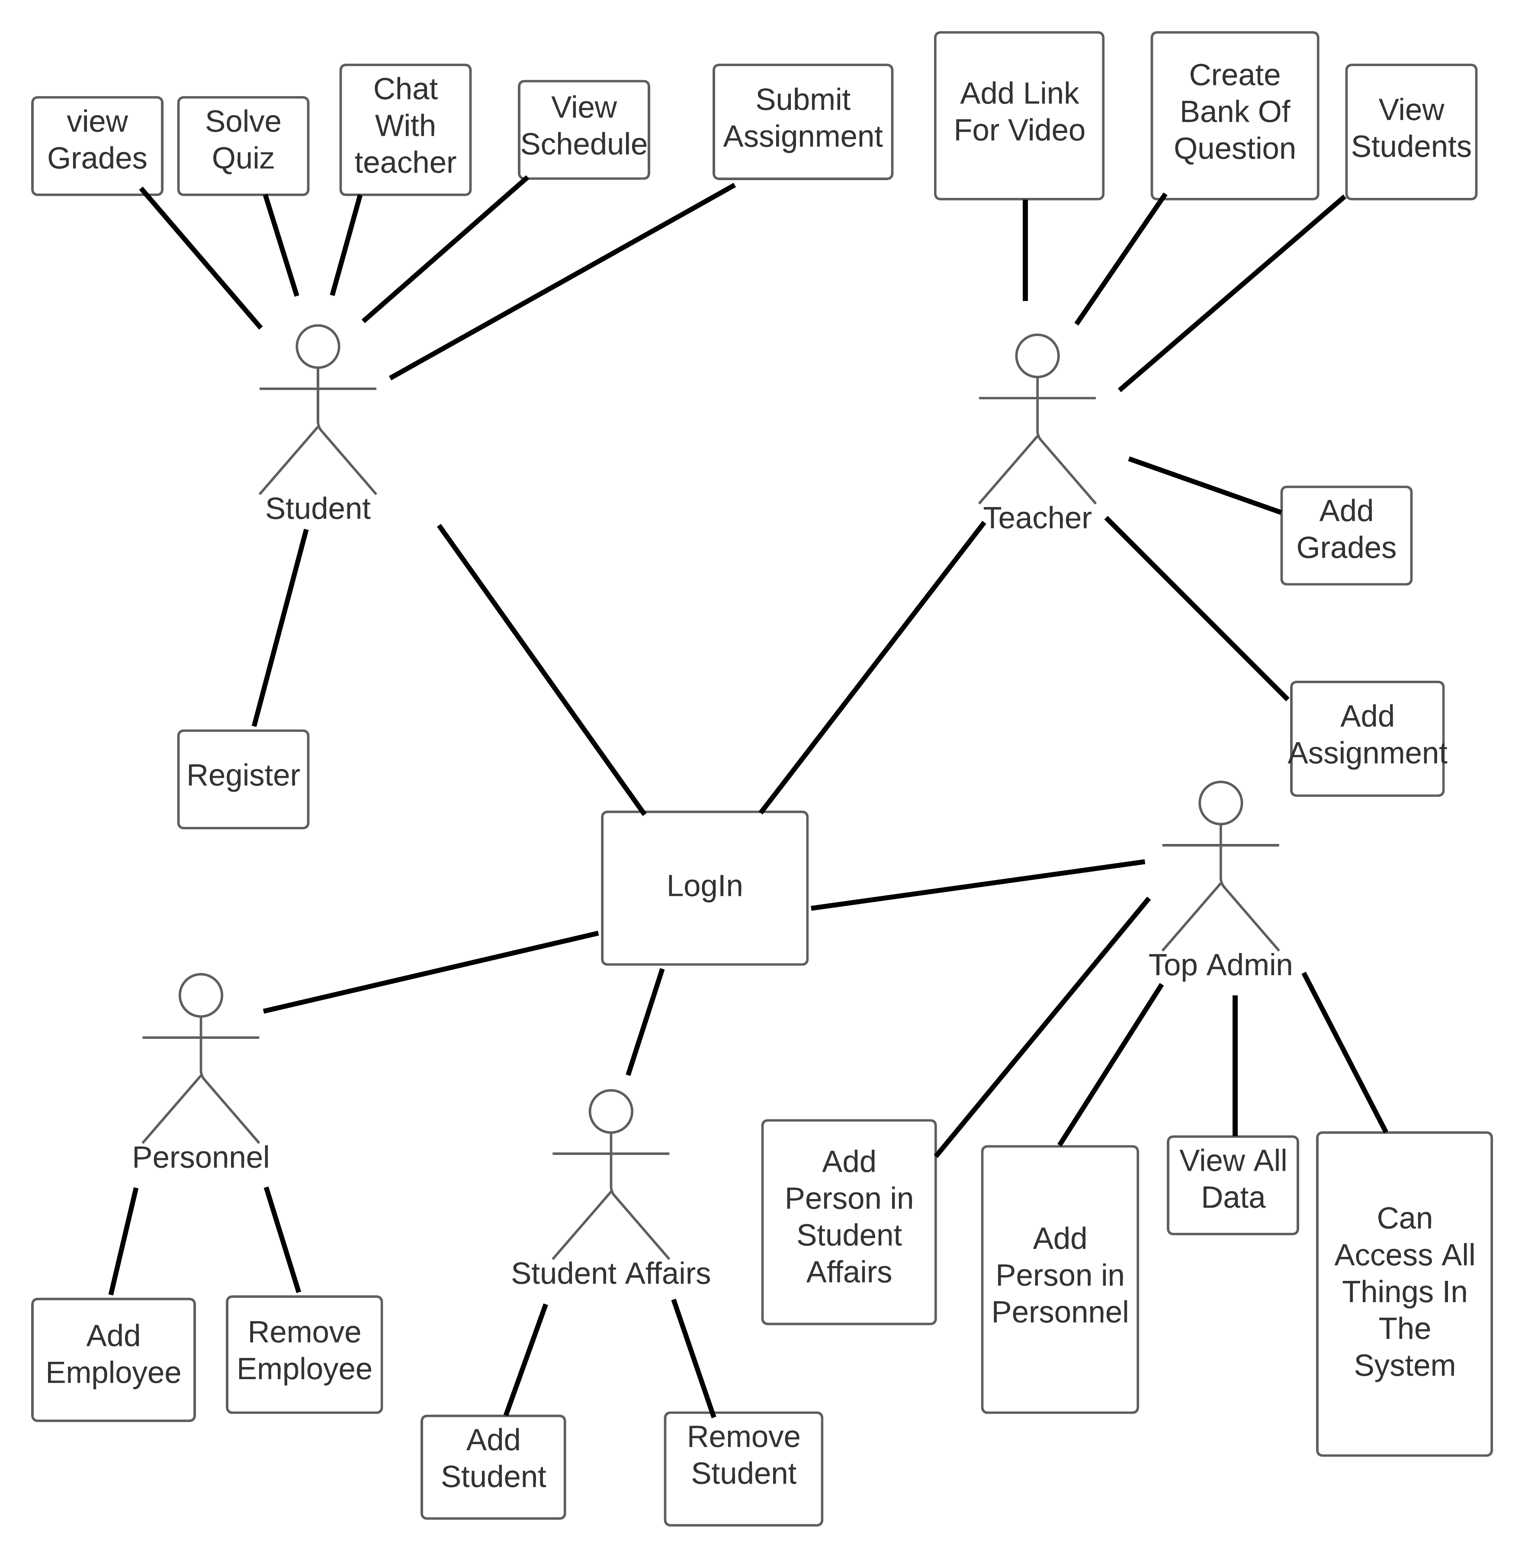
Use Case Diagram:

Slide 11
Functional Requirements

Slide 12
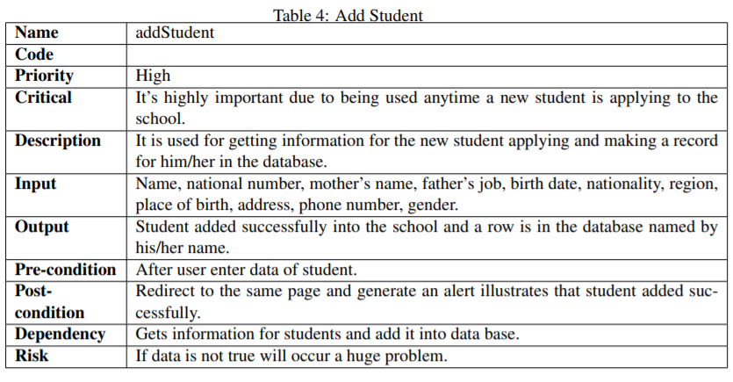
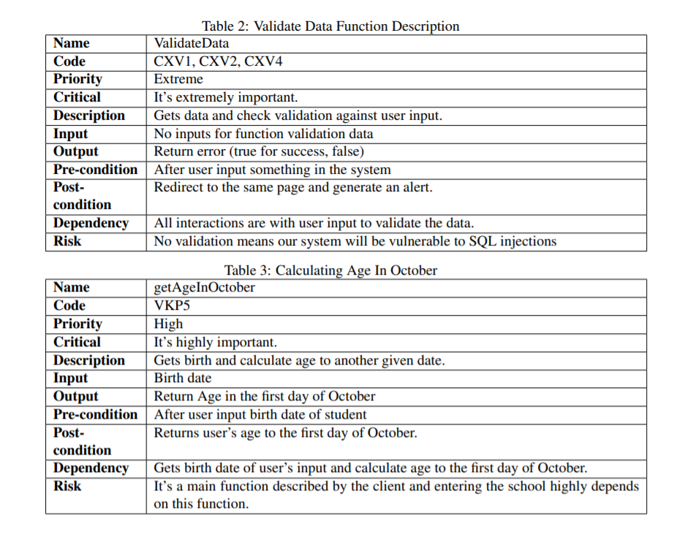
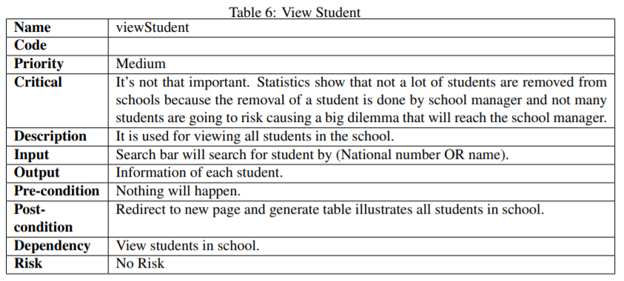
Functional Requirements:

Slide 13
Non- Functional Requirements

Slide 14






Non-Functional Requirements:
Security
Accessibilty
Availability
Performance
Usability
Hashing
Encryption
MVC
Different Platforms
Offer client’s needs
Ease of use and understanding
Efficient as it should be

Slide 15
Database Diagram

Slide 16
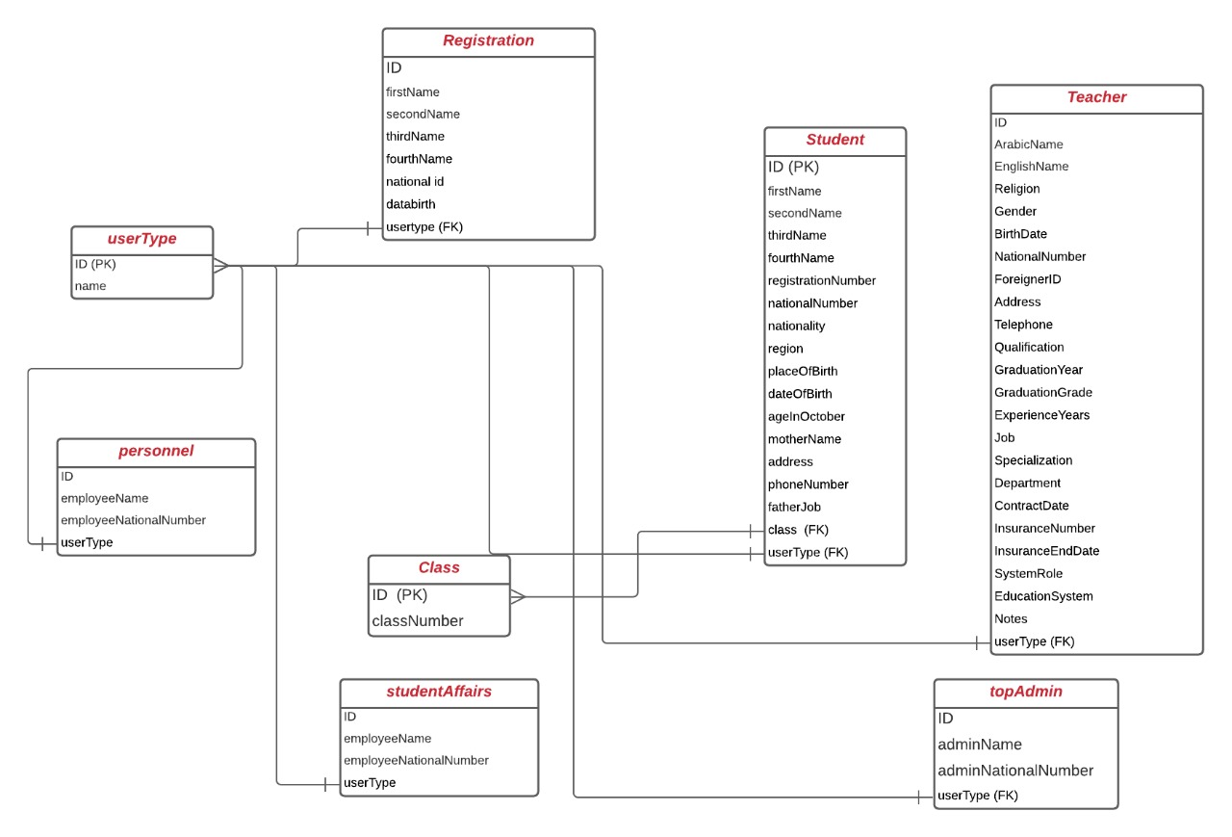
Database Diagram:

Slide 17
Class Diagram

Slide 18
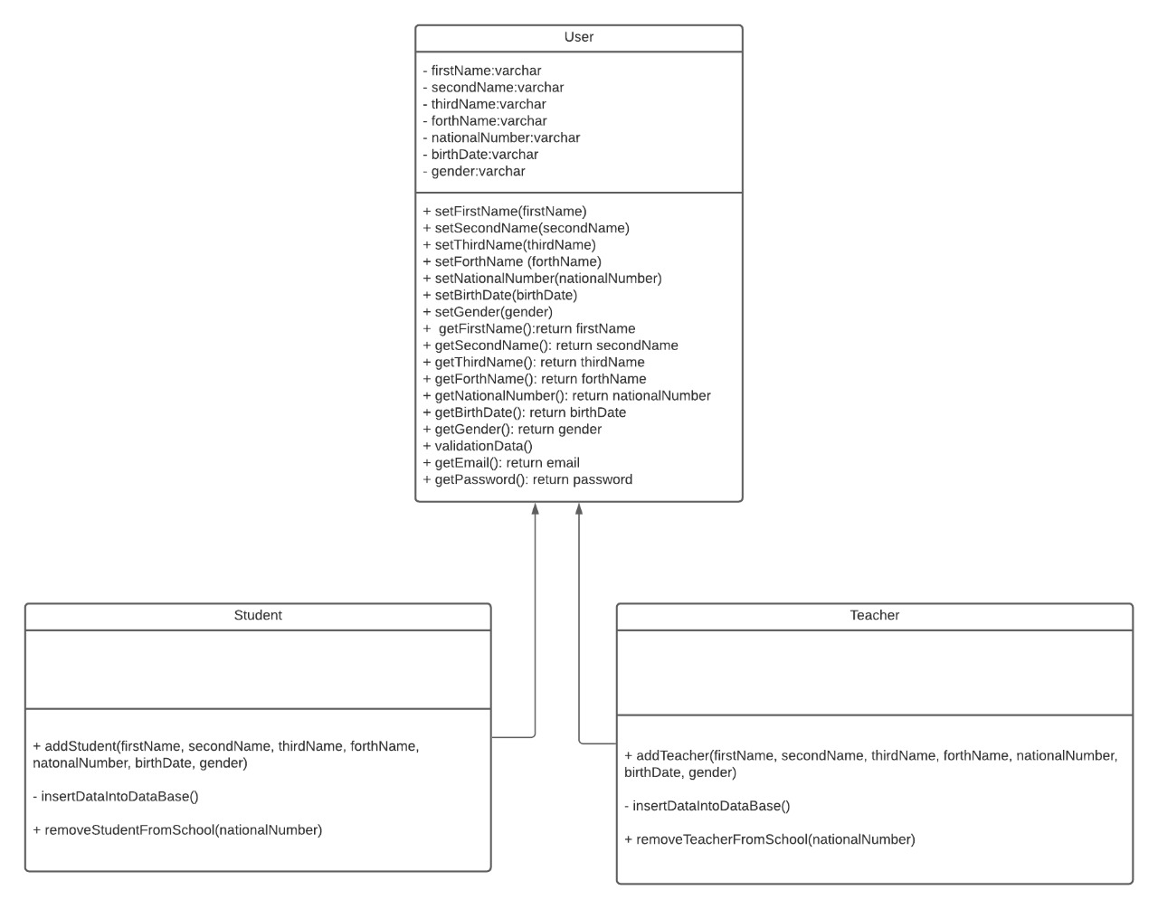
Class Diagram:

Slide 19
Survey Results

Slide 20
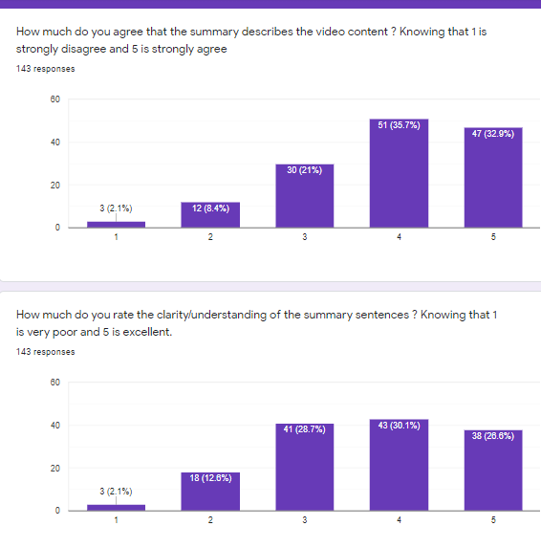
Survey
143 Responses

Slide 21
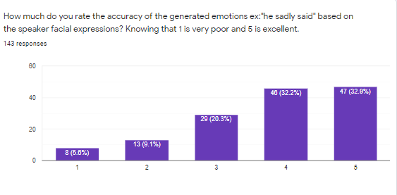

Slide 22
Prototype

Slide 23
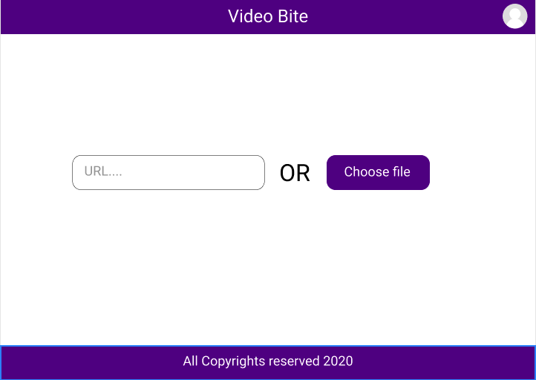
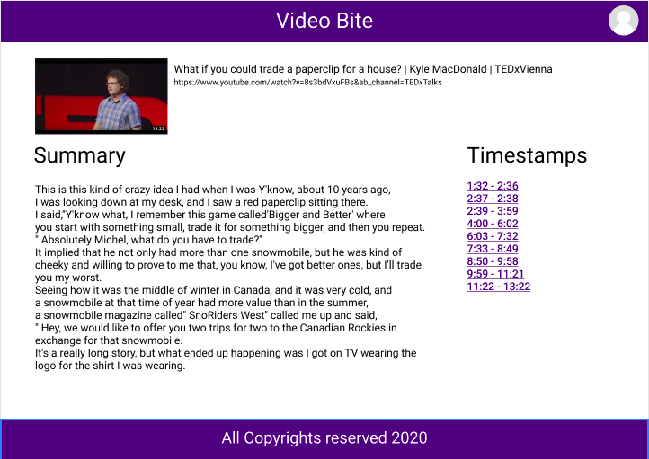
Prototype(1/2):

Slide 24
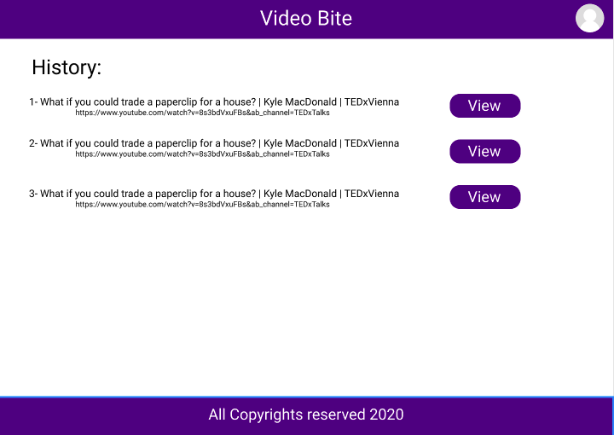
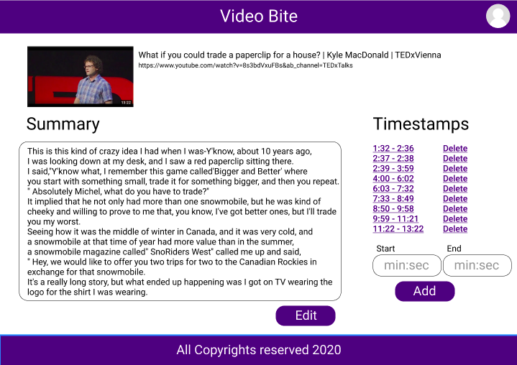
Prototype(2/2):

Slide 25

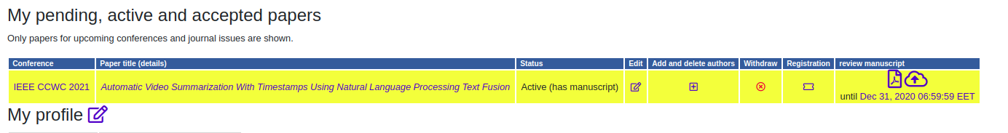
Contribution paper status
Our conference paper is submitted in “The 11th annual computing and communication workshop and conference (CCWC) - IEEE”
Insert screenshot from mail

Slide 26
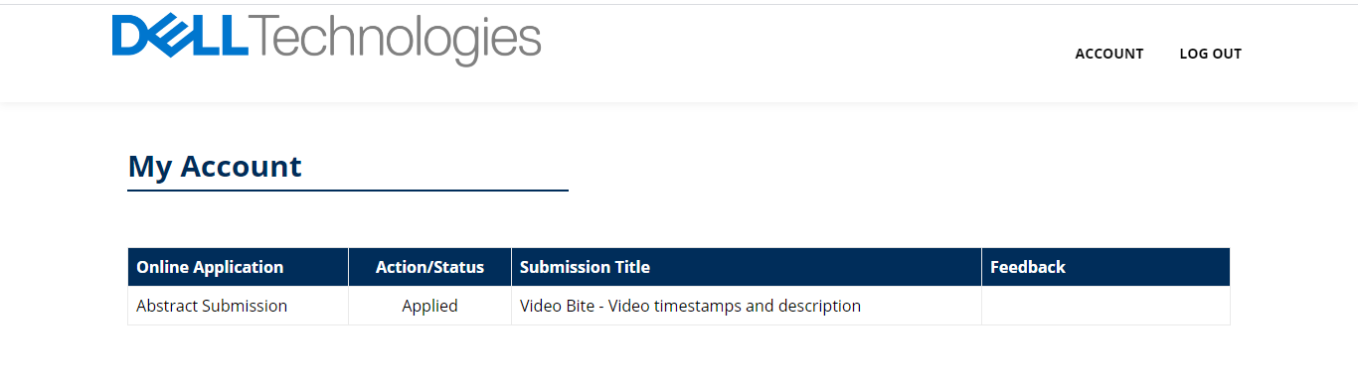
Competition status
We submitted our abstract to Dell Emc technologies competition ”Envision The Future”.
Insert Image Here

Slide 27
Live Demo

Slide 28
Any Questions ?
THANK YOU!

Slide 29
Appendices
Survey Video : https://www.youtube.com/watch?v=rW2r5uStgG0&ab_channel=TEDxTalks
Survey Summary
I think that it's totally crazy that all anyone ever talks about is games TV shows what's ,he sadly said up Instagram Bitmoji I don't even know what that is my brother just told me about it.
Some I like more, but they all took me for such an adventure as my family members I'm a truly unhappy child.
I love reading in places like my bed on the move while walking in the toilet and cues and vehicles.
But ,he sadly said more importantly at home, I hide behind various corners of my house so nobody can find me and make me do anything else.
So for all of you skeptical people out there, let me tell you when you have a good book to keep you company.
You can't meet reading is love in action and the positives are endless.
Like, I usually never have to study for spelling tests and it makes my vocabulary.
Talking about me, I can't imagine my life without a book.
What I'm comparing is the last star of reading writing communicating and persuading the sum of the great societal ills of a text message.
While these wonders of modern technology have their place, we the young generation has to hold on to reading it's the queue to our Kingdom.

Slide 30
Fusion:
Output from video
Output from audio
Output from emotions
- Linking Words (ex. But, and, where, etc.)
- Remove duplicate words.
- Remove duplicate names and replace it with he, she or it.
Final Summarized Text

Slide 31
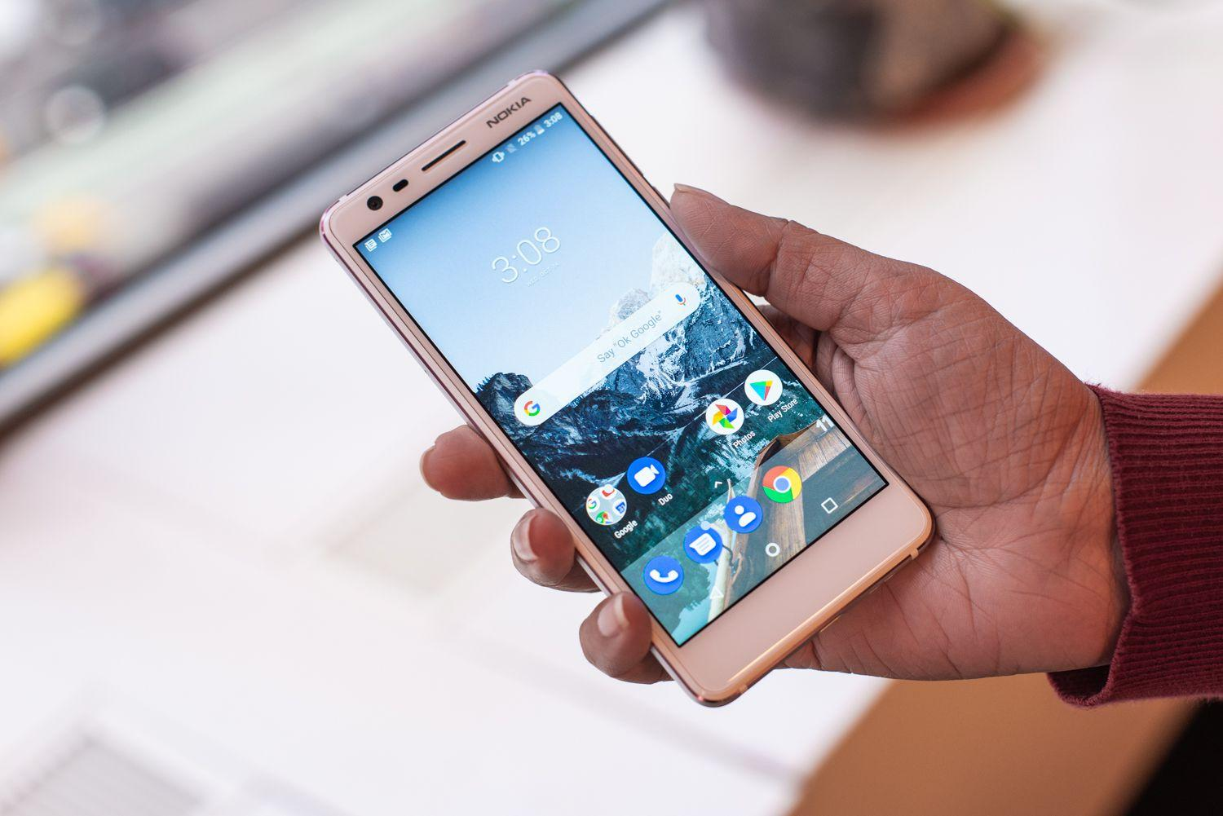

Fusion Example:
“Someone holding phone”
By fusion of the two modalities
“The battery is 4000mah”
He says that the phone battery is 4000mah

Slide 32
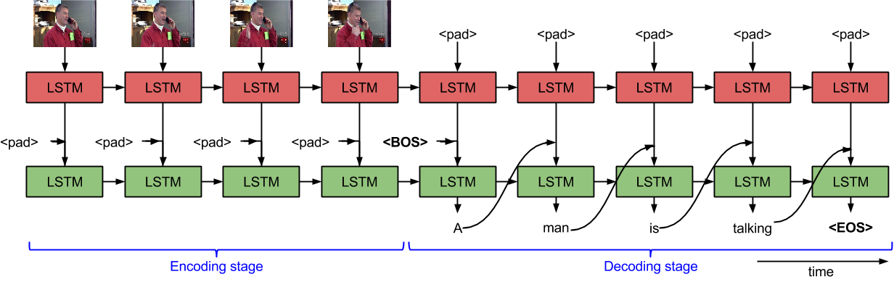
LSTM

