Slide 1
N – Queen problem
the project problem: N – Queen problem by Backtracking algorithm.
Course: Artificial Intelligence.
Date: 03 / 06 / 2022
Team Member: 1- Mohamed Abdelmoniem Mohamed Sayed.
(fourth year in bioinformatics 2018).

Slide 2
Table of Contents :
1 Introduction/Executive Summary …………………3 1.1 What Is N-Queen problem . . . . . . . . . . . . . . . . . . . . . . . . . . . . . . . . . 3 1.2 Algorithm used is Backtracking……………………………………. 4 2 Methodology ………………………………………….5 2.1 Describe the main algorithms. . . . . . . . ……... . . . . . . . . . . . . . . . . . 5
2.2 algorithmic steps. . . . . . . . . . . . . . . ………………………………… 5 2.3 Pseudo Code. . . . . . . . . . . . . . . . ………………………... . . . . . . . . 6 2.4 Flowchart:. . . . . . . . . . . . . . . . . . . . . . . . . . ………………………… 7
2.5 how algorithm can solve the problem . …………………….. . . . . . . . 9
2.6 Complexity for code……………………………………..…………….9
3 Experimental Simulation …………………………….10
3.1 the programming language……………………………………………..10
3.2 the primary function …………………………………………………...10
3.3 the test cases………………………………………………………….…11
3.4 Illustration ……………………………………..………………………13
4 Results ………………………………………………….14
5 Conclusions ……………………………………………..15
6 References ……………………………………………….16
7 Appendix …………………………………………………17

Slide 3
Introduction/Executive Summary:
N-Queen Problem :
The N queen problem is one of the challenging concepts in computer science, the principle of the n-queen problem as follows: N is the number of queens that is placed on the n*n chessboard. The queens cannot be interacting with each other. Each queen has a unique path to travel. a solution requires that no two queens share the same row, column, or diagonal.
8 – queen :
The eight queens puzzle is a special case of the more general n queens problem of placing n non-attacking queens on an n × n chessboard. Solutions exist for all natural numbers n with the exception of n = 2 and n = 3. Although the exact number of solutions is only known for n ≤ 27, the asymptotic growth rate of the number of solutions is (0.143 n) ^ n .

Slide 4
Algorithm used is Backtracking :
Backtracking : is an algorithmic-technique for solving problems recursively by trying to build a solution incrementally, one piece at a time, removing those solutions that fail to satisfy the constraints of the problem at any point of time

Slide 5
Methodology
Describe the main algorithms:
Backtracking : Backtracking is a form of recursion. The usual scenario is that you are faced with a number of options, and you must choose one of these. After you make your choice you will get a new set of options; just what set of options you get depends on what choice you made. This procedure is repeated over and over until you reach a final state. If you made a good sequence of choices, your final state is a goal state; if you didn't, it isn't.

Slide 6
algorithmic steps:
1. Place the queens column wise, start from the left most column
2. If all queens are placed.
1. Return true and print the solution matrix.
3. Else
1. Try all the rows in the current column.
2. Check if queen can be placed here safely if yes mark the current cell in solution matrix as 1 and try to
solve the rest of the problem recursively.
3. If placing the queen in above step leads to the solution return true.
4. If placing the queen in above step does not lead to the solution, BACKTRACK, mark the current cell
in solution matrix as 0 and return false.
4. If all the rows are tried and nothing worked, return false and print NO SOLUTION

Slide 7
Pseudo Code:
Boolean solve (Node n)
{
if n is a leaf node
{
if the leaf is a goal node, return true
else return false
}
else
{
for each child c of n
{
if solve(c) succeeds, return true
}
Return false
}
}

Slide 8
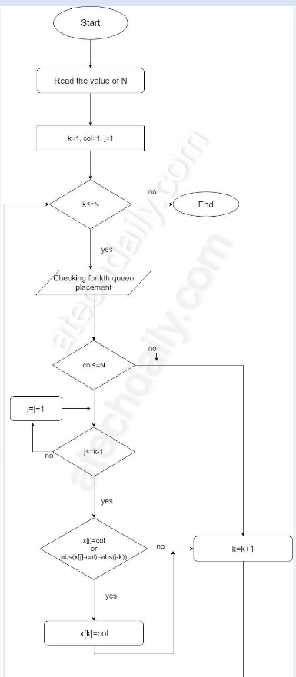
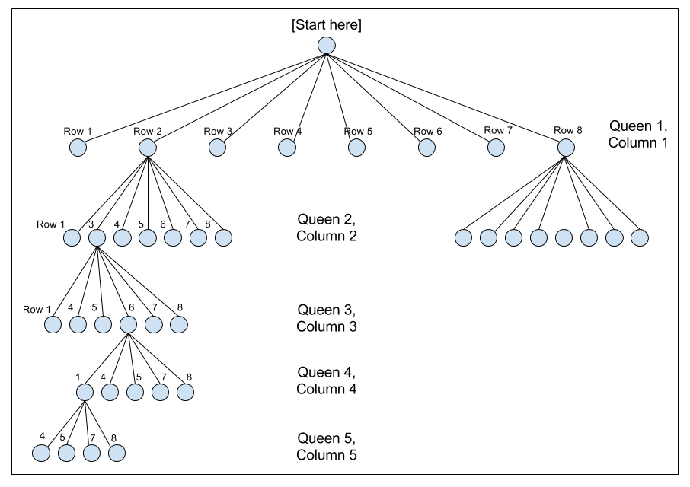
Flowchart

Slide 9
how algorithm can solve the problem:
The idea is to place queens one by one in different columns, starting from the leftmost column. When we place a queen in a column, we check for clashes with already placed queens. In the current column, if we find a row for which there is no clash, we mark this row and column as part of the solution. If we do not find such a row due to clashes, then we backtrack and return false.
Complexity for code:
Time Complexity: O(N!)
Memory Space: O(N)

Slide 10
Experimental Simulation:
the programming language is used in the project is: C++.
C++ language is suitable for solve this problem with Backtracking algorithm.
the primary function used to implement the Backtracking algorithm are:
1- check Function for check this board is true or false.
2- fast Function to fast the code
3- main Function

Slide 11
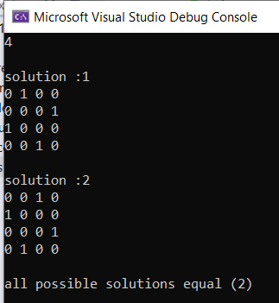
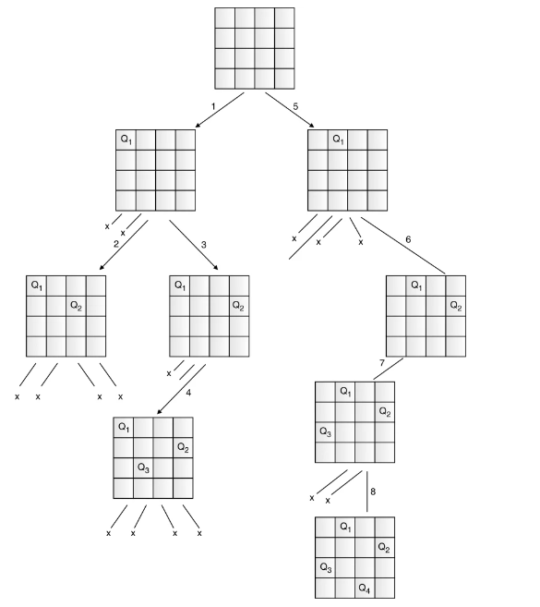
the test cases:
example n = 4
answer = 2

Slide 12
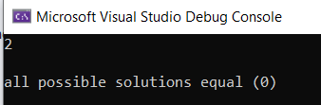
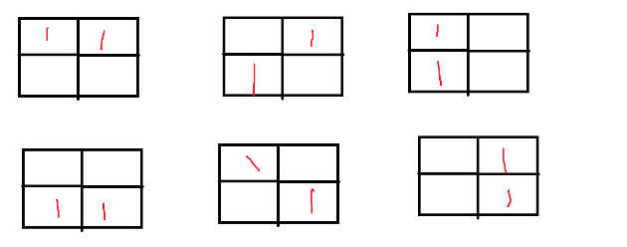
example n = 2
answer = 0
Because all possible solution will be diagonal or at the same row or column

Slide 13
Illustration:
1) Start in the leftmost column
2) If all queens are placed
return true
3) Try all rows in the current column.
Do following for every tried row.
a) If the queen can be placed safely in this row
then mark this [row, column] as part of the
solution and recursively check if placing
queen here leads to a solution.
b) If placing the queen in [row, column] leads to
a solution then return true.
c) If placing queen doesn't lead to a solution then
unmark this [row, column] (Backtrack) and go to
step (a) to try other rows.
4) If all rows have been tried and nothing worked,
return false to trigger backtracking.

Slide 14
Results :
input | output
1 | 1
2 | 0
3 | 0
4 | 2
5 | 10
6 | 4
7 | 40
8 | 92
9 | 352
10 | 724
11 | 2680
12 | 14200
13 | 73713

Slide 15
Conclusions
the efficiency of the traditional backtracking algorithm maybe improved by the use of a hybrid approach taking advantage of sets to reduce the number of trials and error attempts. Time taken to solve the n-queen problem in the backtracking is more than that of the Tuned hybrid technique. Space taken to solve the n-queen problem in the backtracking is more than that of the Tuned hybrid technique. Complexity Analysis can be improved using different algorithms and that approach will be applied on the one of the applications of the N-Queen Problem to obtain the fast and better solution. Complexity Analysis can be based in the time, space, convergence-rate and conflict-minimization.

Slide 16
References:
https://en.wikipedia.org/wiki/Eight_queens_puzzle
https://www.geeksforgeeks.org/backtracking-introduction/
https://www.geeksforgeeks.org/n-queen-problem-backtracking-3/
https://www.dotnetoffice.com/2022/02/solving-n-queens-problem-in-c-print-all.html
https://codecrucks.com/n-queen-problem/
https://atechdaily.com/posts/Flowchart-and-Algorithm-for-N-Queen-Problem
http://www.ijesrt.com/issues%20pdf%20file/Archive-2017/February-217/10.pdf
https://www.researchgate.net/publication/333661204_Survey_on_N-Queen_Problem_with_Genetic_Algorithm

Slide 17
Appendix:
Source code:
https://ideone.com/KNXZY5
another idea:
https://ideone.com/t8IfVd

