Slide 1
Big Data Project:
Sakila Data Warehouse & Analytics Dashboard
Transforming Movie Rental Data into Actionable Insights

Slide 2
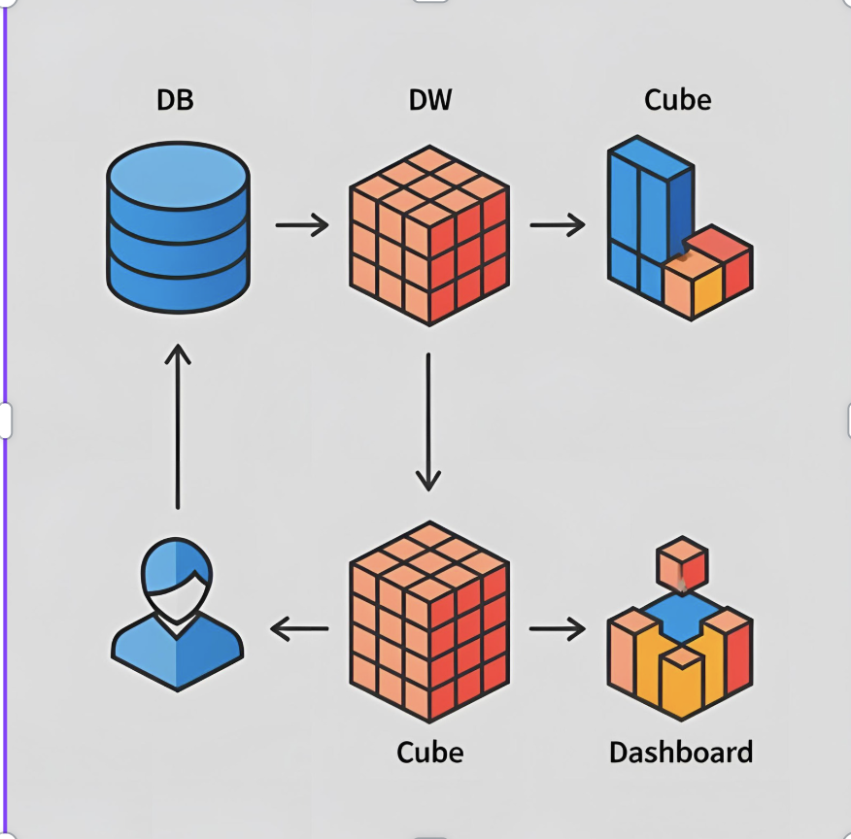
Data Warehouse for DVD Rental Business
Database Source Name: Sakila Database Business Area: Sales and Business Development
Submitted By:
Mohamed Mostafa (22-101203)
Mahmoud El-shikha (22-101193)
Youssef Walid (22-101048)
Mohamed Ibrahim (22-101058)
Instructors: Prof. Hoda & Eng. Maha Sayed
Course: Big Data Engineering Date: 3/12/2025

Slide 3

Project Overview
Transform classic Sakila Movie Rental DB into a Star Schema Data Warehouse.
Build an OLAP cube for multidimensional analysis.
Develop an interactive Power BI Dashboard.

Slide 4
Business Goals
This data warehouse project focuses on sales performance analysis of a DVD rental business:
1. Boost Revenue Through Sales Insights
2. Identify High-Value Customers
3. Uncover Seasonal Trends in Sales

Slide 5

Tools and Technologies
Microsoft SQL Server (DB, DW)
SQL Server Integration Services (SSIS)
SQL Server Analysis Services (SSAS)
Power BI
T-SQL, MDX

Slide 6
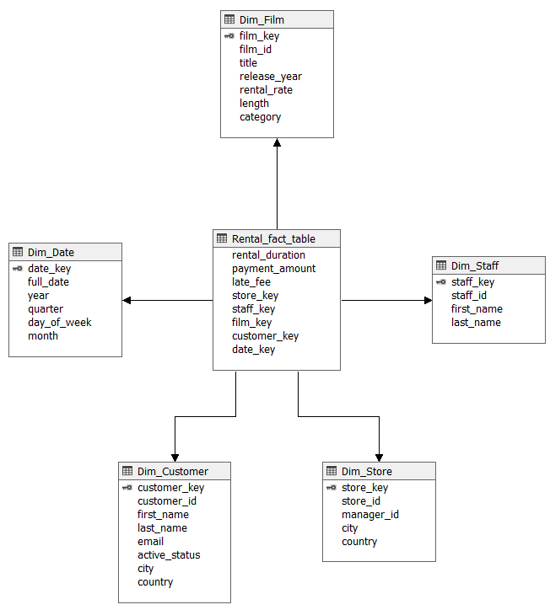
Data Modeling - Star Schema
Fact Table: Fact_Payment
Dimensions:
Dim_Date
Dim_Customer
Dim_Staff
Dim_Store
Dim_Film

Slide 7
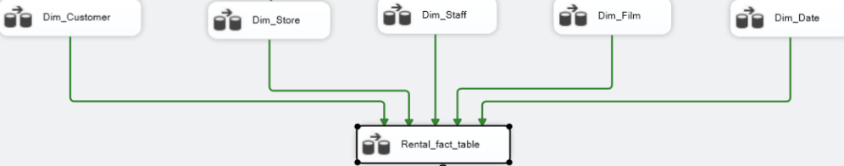
ETL Process
Extracted data from Sakila DB.
Transformed using T-SQL queries inside SSIS packages.
Loaded into Sakila Data Warehouse (DW).

Slide 8
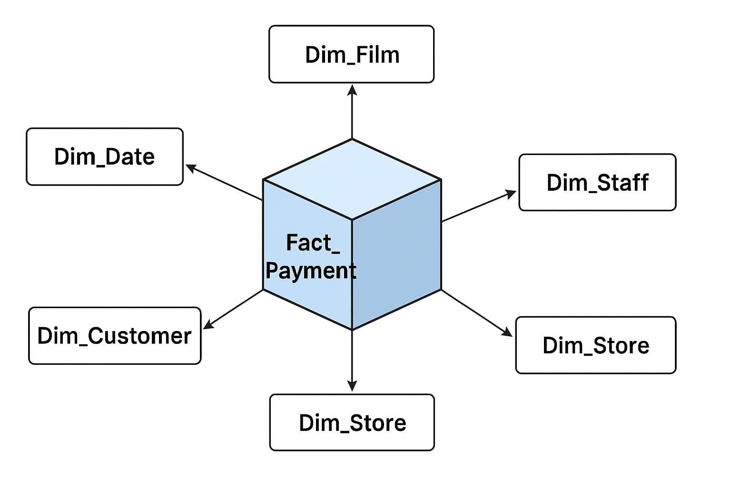
OLAP Cube Design
Built an SSAS Multidimensional Cube.
Defined Measures:
Payment Amount
Late Fee
Rental Duration
Enabled multidimensional querying with MDX.

Slide 9
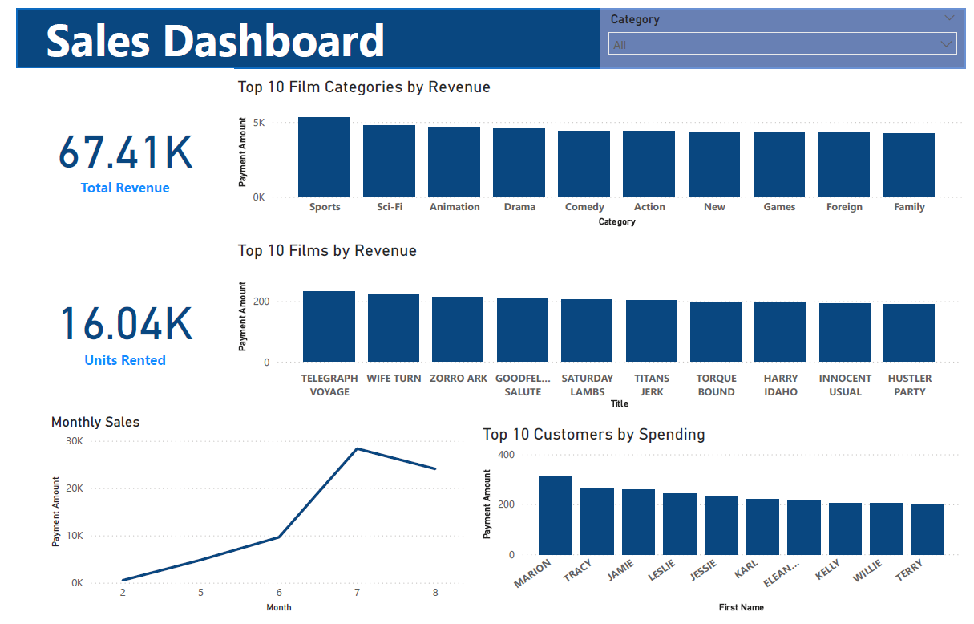
Power BI Dashboard & Key Insights
Connected to OLAP cube.
Created an interactive dashboard for business insights.

Slide 10
Challenges and Solutions
Challenge#1:
Learning and using MDX for cube queries
Solution:
Practiced basic MDX scripts to retrieve and validate cube data.
Challenge#3:
Cube deployment issues
Solution:
Handled hierarchies in the time dimension
Solved SQL server connection issues
Challenge#2:
ETL Process
Solution:
Designed a powerful pipeline using SSIS tools
Challenge#4: Challenge:
Keeping Star Schema simple but effective
Solution:
Selected only the most meaningful dimensions and avoided snowflake complexity.

Slide 11
Questions?
Thank you for listening!

