Slide 1


Stroke Risk Prediction
Leveraging AI to Support Clinical Decisions

Slide 2
Project Overview
Objective: Predict stroke risk using patient health data.
Method: Machine learning model served via a Flask API.
Goal: Support timely interventions and improve healthcare outcomes.

Slide 3






Why This Matters ?!
Stroke is a leading cause of death and long-term disability.
Early risk identification can save lives.
Healthcare professionals need data-driven tools to assist decision-making.

Slide 4
Data columns
id | gender | age | hypertension | heart_disease | ever_married | work_type | Residence_type | avg_glucose_level | bmi | smoking_status | stroke
9046 | Male | 67 | 0 | 1 | Yes | Private | Urban | 228.69 | 36.6 | formerly smoked | 1

Slide 5
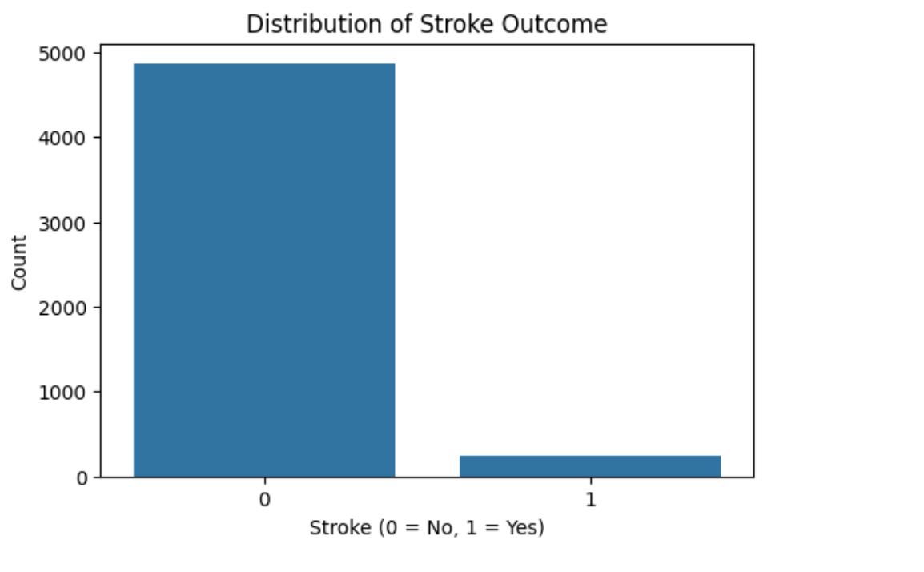
Problem!
We are dealing with implanced data

Slide 6
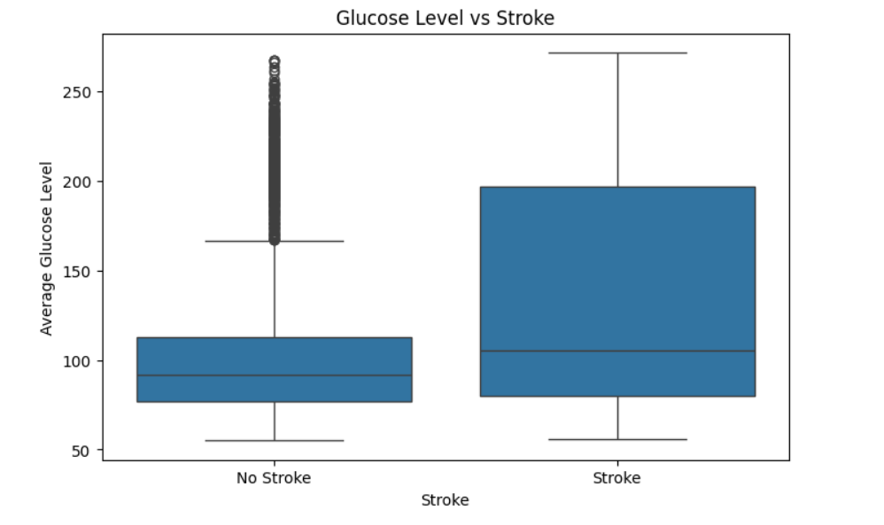
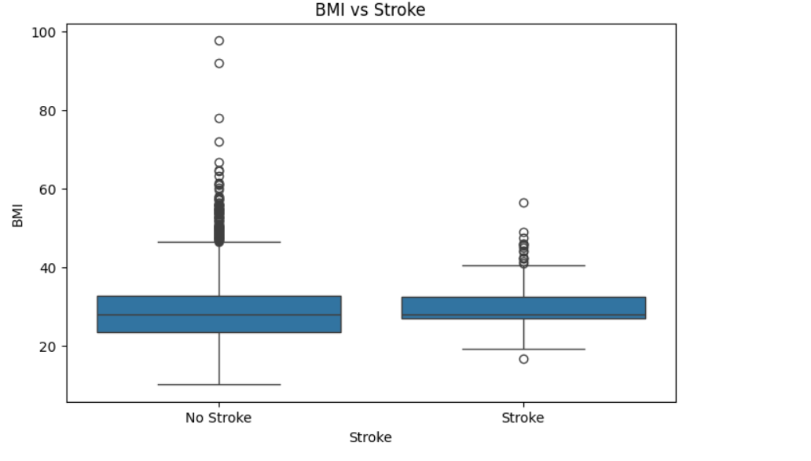
Outliers problem

Slide 7
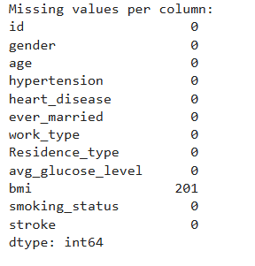
Null Values

Slide 8
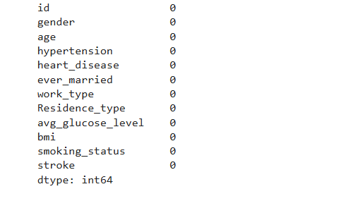
Preprocessing
Was an essential action to handle the outliers and nulls
Both were handled by replacing them with median
Notes:
Mean = (60 + 62 + 61 + 65 + 1000) / 5 = 249.6
Median = 62

Slide 9

Model Functionality
Inputs: Patient attributes (age, BMI, smoking status, etc.)
Output: Probability of stroke risk.
Interface: Flask REST API—simple integration into healthcare platforms.
Real-time predictions enable prompt clinical responses.

Slide 10
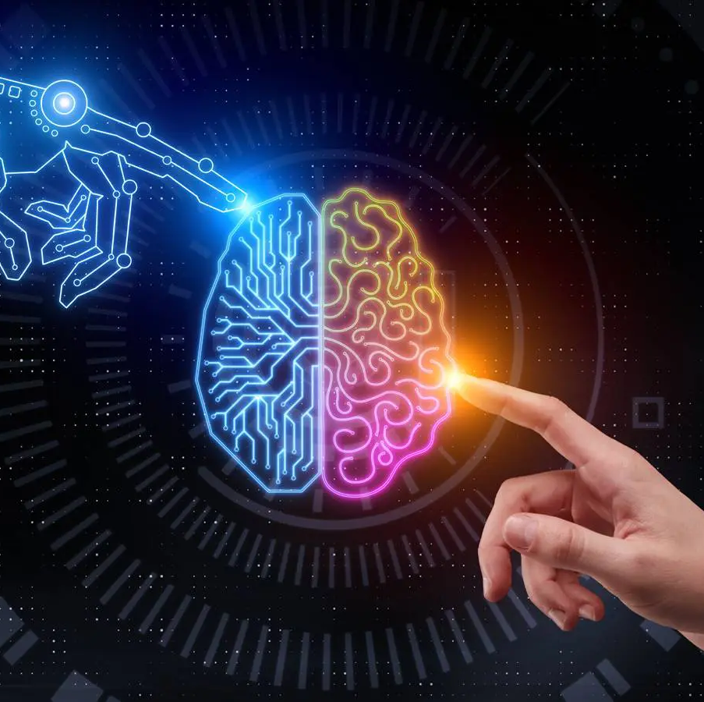
Model Accuracy & Validation
Trained using healthcare datasets
Random forest was the best choice as it gives a higher accuracy
SMOTE Oversampling (Imbalanced Data)
Accuracy: exceeds 90%

Slide 11
Real-World Impact
Early warning for high-risk patients.
01
Trend analysis for hospital-wide stroke risk profiles.
02
Supporting clinical workflows with intelligent triage.
03

Slide 12
Flask API Integration
Lightweight and scalable API.
Returns prediction in real-time

Slide 13

Future Improvements
Train with more diverse patient data.
Incorporate real-time streaming from wearables or hospital IoT systems.
Add explainability tools (e.g., SHAP values) for transparent decision-making.

Slide 14
Scalability & Deployment
Can be deployed on cloud services (AWS, GCP, Azure).
MLOps ready for continuous monitoring and updates.

Slide 15
Conclusion
AI can empower clinicians, not replace them.
This model helps predict stroke risk early, aiding preventive care.
Future-ready and designed for integration into modern healthcare systems.

Slide 16
Thanks

