Slide 1

Student Feedback Analysis And Improvement
Notes:
Entered text
SQL Database Setup and Data Collection for student feedback analysis and improvement

Slide 2
Supervised by:
Team Members:
Magdy Shaaban Mohamed Mourad
Ahmed Sameh
Sherif Atef
Eman Abdelmohsen
Shrouk Mohamed
Mohamed Safi

Slide 3
Agenda
Introduction
Problem Statement
Project Phases
1. Database Design
2. Data warehouse
3. Sentiment Analysis
4. Mlops and deployment

Slide 4

What if the key to unlocking academic excellence lies hidden within the voices of students—can universities decode it?

Slide 5
Introduction
This project explores the process of setting up an SQL database and collecting student feedback to analyze and improve educational experiences.
Also coverring the steps involved in creating and importing data into the database, designing the data collection process, extracting feedback data using SQL queries, analyzing feedback trends and patterns, implementing improvement strategies

Slide 6
Objectives :
To design and set up a SQL database to manage student data, including importing historical student information and writing SQL queries to extract and analyze this data
To implement a data warehouse for aggregating feedback data and process the data using Python for cleaning and sentiment analysis.
Sentiment Analysis
Model deployment and insights

Slide 7
Problem Statement
Universities face significant challenges in effectively managing and analyzing large volumes of student feedback data, which is crucial for maintaining and enhancing educational quality. As emphasized by the National Authority for Quality Assurance and Accreditation of Education such as :
Standard 5: Faculty Members and Supporting Staff
Standard 7: Quality Assurance and Program Evaluation
the systematic collection, analysis, and use of student feedback are essential for continuous improvement and accountability.

Slide 8
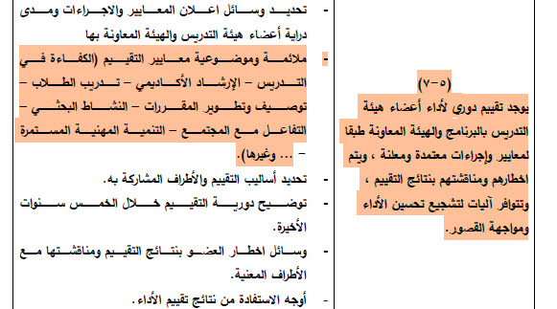
Problem Statement
Standard 5: Faculty Members and Supporting Staff

Slide 9
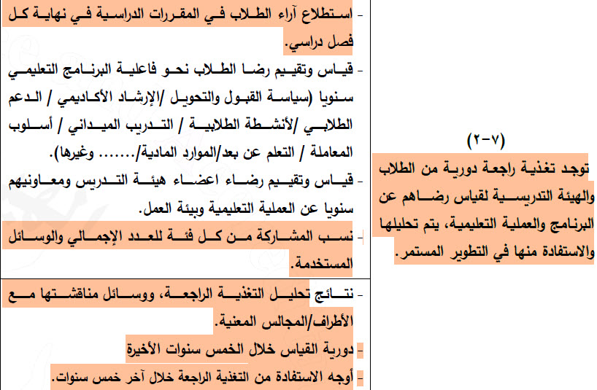
Problem Statement
Standard 7: Quality Assurance and Program Evaluation

Slide 10
Problem Statement
The current systems often lack integration, making it difficult to store, process, and analyze feedback in a structured and meaningful way. This project seeks to address these challenges by building a robust data infrastructure, including a SQL database and data warehouse, to efficiently store and manage student feedback.
Additionally, by leveraging Python for data preprocessing and sentiment analysis, integrating Azure for enhanced scalability and data management, and deploying sentiment models to provide actionable insights, this solution will significantly contribute to improving the quality assurance processes within universities. These improvements will allow institutions to better understand student sentiment, optimize decision-making processes, and ensure that their programs meet the high standards required for accreditation and continuous educational excellence.

Slide 11
Project Phases
Data Collection and SQL Database Setup.
Data Warehouse and Python Data Processing
Sentiment Analysis
MLOps and Deployment

Slide 12
1. Data Collection and SQL Database Setup
Data Collection.
https://www.youtube.com/watch?v=jJQUZn3E31U This video explains how to use the Electronic Guide App for students to evaluate courses and schedule exams. The app allows students to evaluate the courses they have taken and works on all operating systems, whether on a phone or a computer. After logging into the app using their university email, students can access the interface, which enables them to evaluate courses and check the exam schedule. To evaluate courses, students are asked to assess four aspects: faculty member performance, exams and assignments, the course page on the e-platform, and the course's scientific content. The evaluation is done using a star rating system, ranging from one star (completely disagree) to five stars (completely agree). Students can also answer three open-ended questions to provide their comments.

Slide 13
1. Data Collection and SQL Database Setup
SQL Database Design.
involves structuring data into organized tables with defined relationships between them. This helps in efficient data storage, retrieval, and management, ensuring data integrity and reducing redundancy
SQL queries
to interact with a database, such as retrieving data, updating records, or performing analysis. For example, extracting their grades or summarizing their course enrollments.

Slide 14
Database Design
Creating a structured SQL database to manage student-related data efficiently. These tables include :
program table: to store student program
Student table: to store student information
Instructor table: to store instructor information
Department table: to store department information
Subject table: to store courses information
Feedback Questions table: to categorize different questions of feedback.

Slide 15
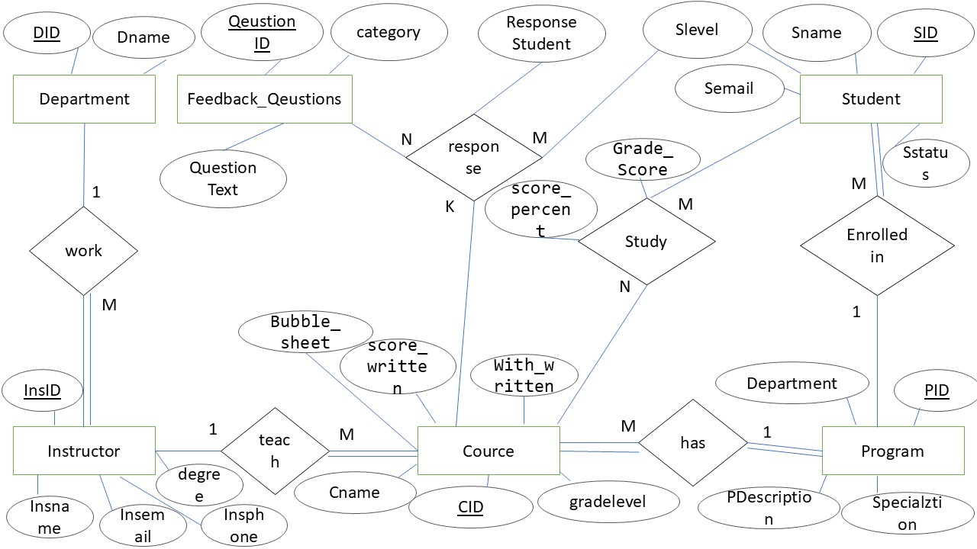
Entity Relationship Diagram (ERD)
Showing relationships between students, instructors, and courses, department.

Slide 16
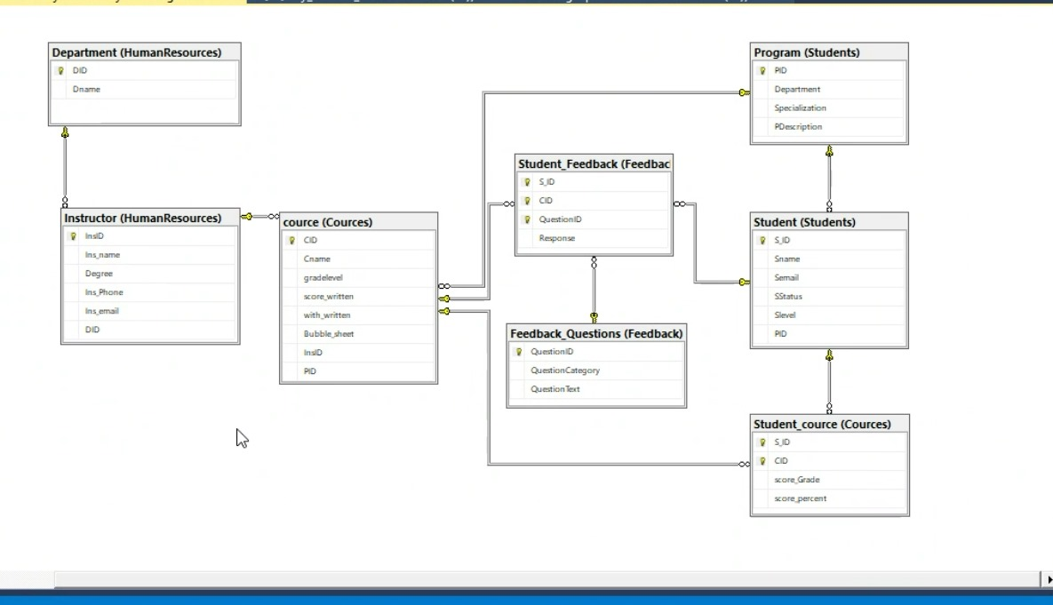
Implement ERD on MS SQL server

Slide 17
Mapping
Student(SID,PID, Sname, Semail, Sstatus, Slevel)
Program(PID, Department, Specialization, Description)
Cource(CID, PID, InsID, CName, gradelevel,Score_written,With_written,bubble_sheet)
Instructor(InsID, DID, InsName, INsEmail, InsPhone, Degree)
Department(DID, DName)
feedback_question(QuestionID, Categotry, QuestionText)
Student_feedback(SID, CID, QuestionID, Response)
Student_cource (SID, CID, score_grade , score_percent)

Slide 18
Schemas
SCHEMA Students
Student
Program
Cources
Cource
Student_cource
3. HumanResources
Instructor
Department
4. Feedback
Student_feedback
Feedback_questions

Slide 19
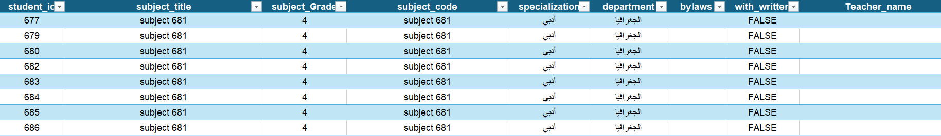
Data Collection
Get real data from Faculty of Education of AinShams University.
Some Columns: Student_id, subject_title, subject_grade
Rows: 96046

Slide 20
Data Collection
Importing historical student data into the database.
Steps
Prepare student data (cleaning, structuring).
Import using SQL Server tools.
Verify data integrity (no duplicate student entries, consistent grade formats)

Slide 21
Examples of SQL queries to extract and analyze student data.
Extract all courses a student is enrolled in:
SELECT Courses.CourseName
FROM students
JOIN Courses ON students.CourseCode = Courses.CourseCode
WHERE StudentID = 1001;

Slide 22
Summarize student grades by course
Find top-performing students:
SELECT S_ID, AVG(Courses.score_Grade) AS AverageGrade
FROM Courses.Student_course
GROUP BY CID;
SELECT S_ID, AVG(Courses.score_Grade) AS AverageGrade
FROM Courses.Student_course
GROUP BY S_ID
ORDER BY AverageGrade DESC;

Slide 23
2. Data Warehouse
Steps
Data Source
Data Warehouse Implementation
Data Integration
Data Storage

Slide 24
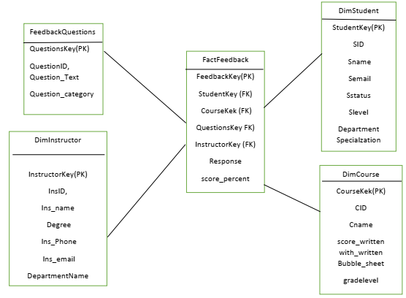
2. Star Schema
Fact table
Feedback
Dimension Tables
Student
Courses
Instructor
Feedback questions

Slide 25
Implement Data Warehouse on MS SQL server

Slide 26
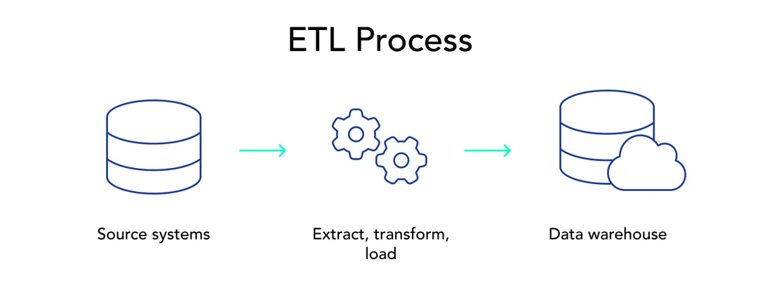
Data Integration
Goal: Load data into the data warehouse.
Steps:
Extract feedback data from source system
Transform the data (formatting, cleaning miss data).
Load the cleaned data into the warehouse.

Slide 27
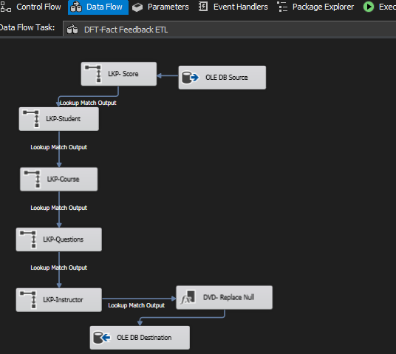
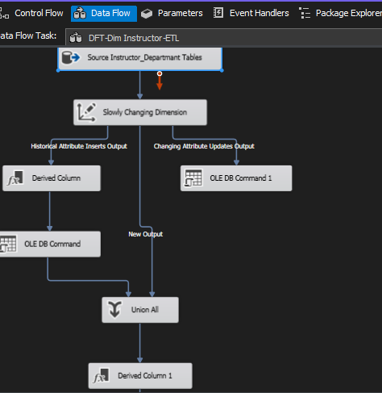
Data Integration Use SQL SERVER INTEGRATION SERVICES

Slide 28
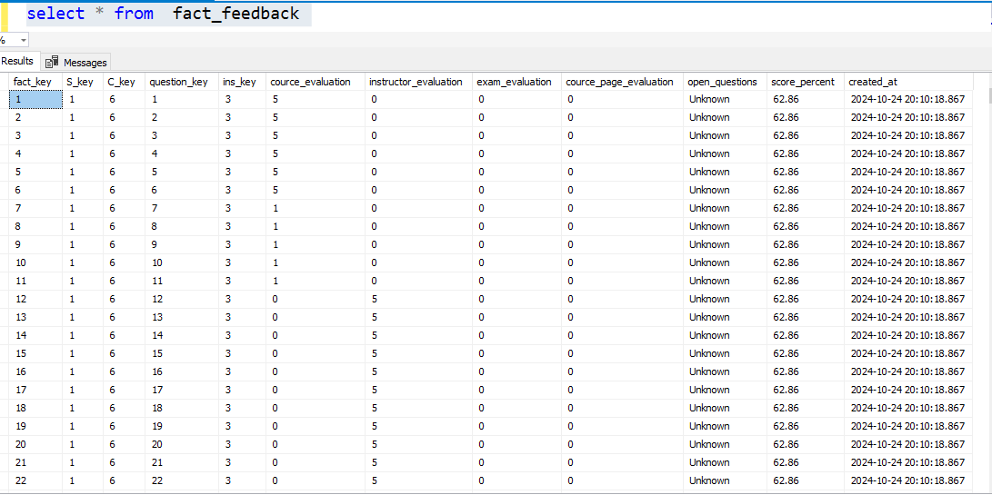
Data Storge Data Warehouse on MS SQL server

Slide 29
Student Feedback Dashboard

Slide 30
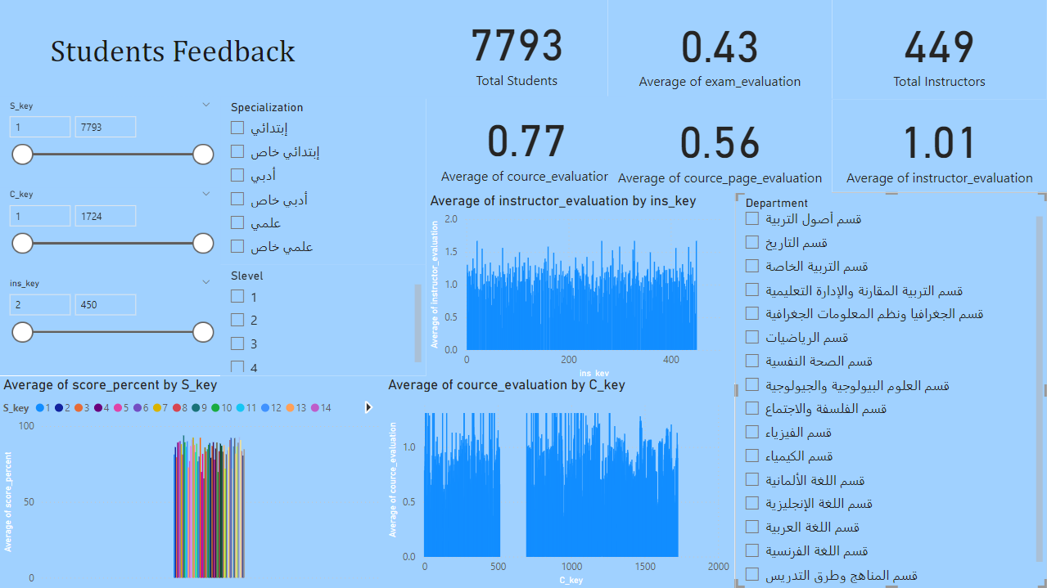
Students feedbacks dashboard using Power bi

Slide 31
3. Summary of key findings
Students are more satisfied with Instructors than with courses and exams.
Courses need to be improved in quality, while exams need to be thoroughly revised.
Final recommendations:
Develop courses and increase student engagement.
Redesign exams to be fairer and more representative of what has been taught.
Motivate Instructors to adopt best teaching practices

Slide 32

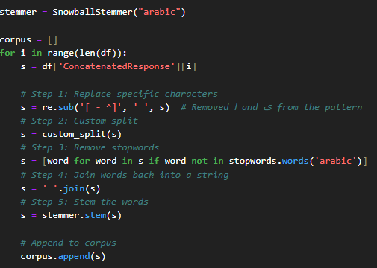
3. Sentiment Analysis .
Naïve based usage 1. Data Input & Preprocessing
Load Data
Load the Excel file containing the responses.
Clean Text
Remove unnecessary characters and apply text preprocessing.
Cleaning Process:
Remove Non-Arabic Characters: Use regex to retain only Arabic characters and spaces.
Remove Stop-words: Filter out common Arabic stop-words that do not add meaningful information.

Slide 33
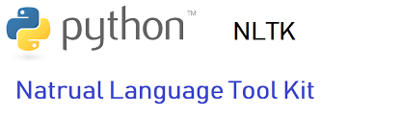
Data preprocessing Using Python
Sentiment Analysis:
Use NLTK's sentiment analysis tools to categorize feedback as positive, negative, or neutral.

Slide 34
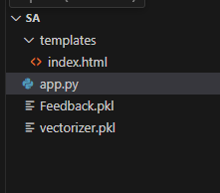
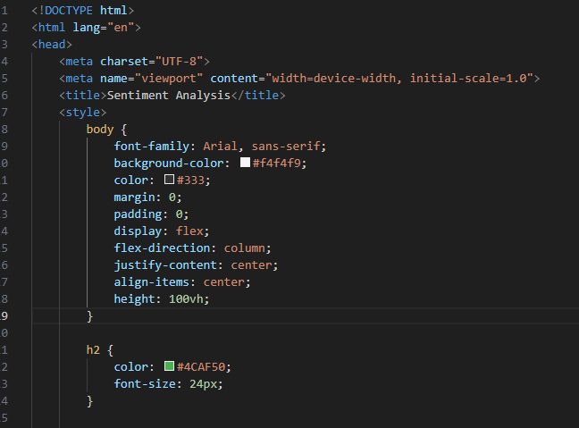
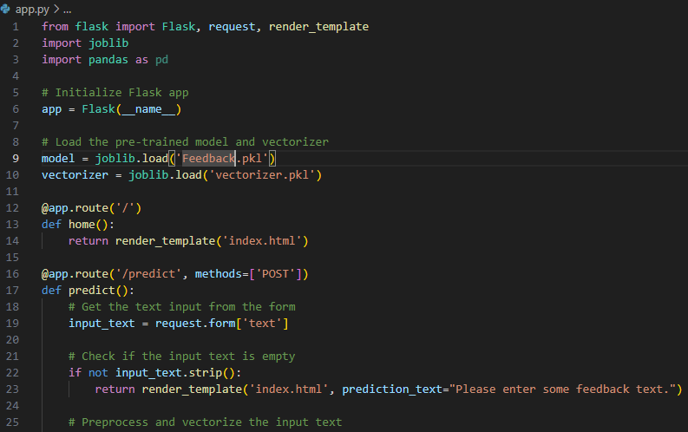
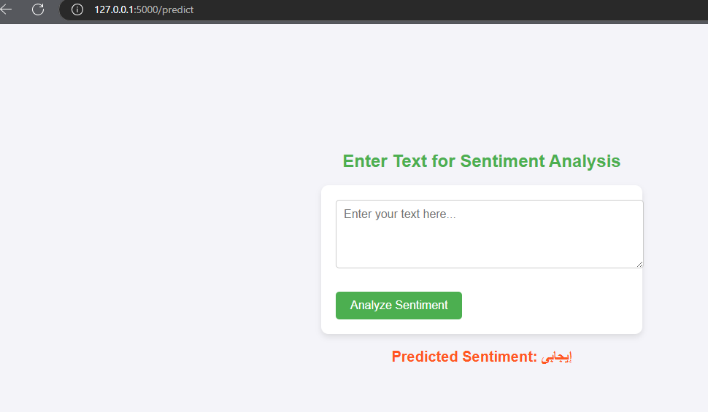
4. MLOps and Deployment
Implement a simple web page that predicts the sentiment of the given text on local host using VS Code and Flask (Python)

