Slide 1
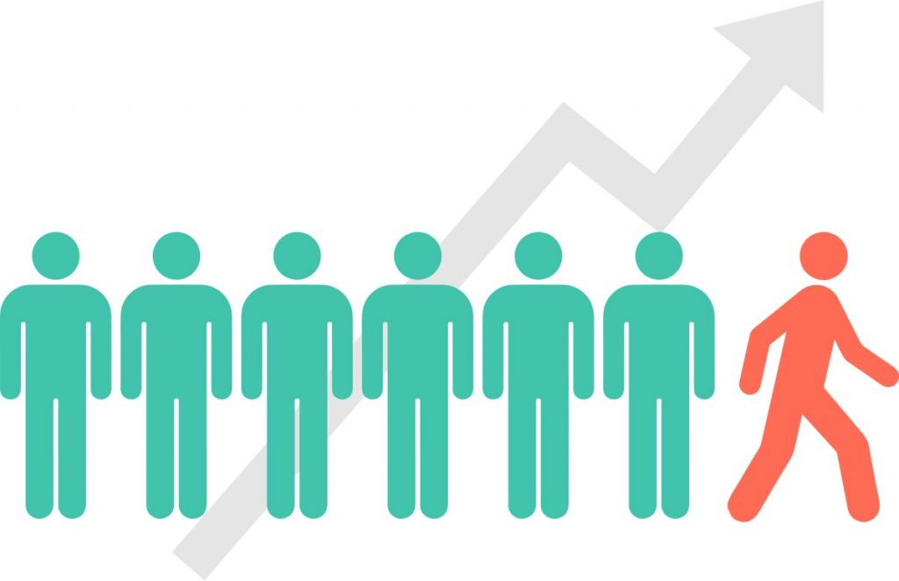
Customer Churn
Prediction

Slide 2
Introduction
Customer churn prediction is the process of identifying customers who are likely to leave/stop using a product or service.

Slide 3
Reasons for customer churn
Poor Customer Service: Slow, unhelpful, or impersonal support drives customers away.
Unmet Expectations: Products or services fail to meet promises or customer needs.
High Prices: Customers perceive better value elsewhere or cannot afford rising costs.
Lack of Engagement: Minimal interaction or communication leaves customers disconnected.
Product Issues: Frequent problems or outdated offerings lead to dissatisfaction.
Competitive Offers: Rivals provide better deals, features, or experiences.
Loss of Need: The customer no longer requires the product or service.
Personal Reasons: Lifestyle, financial changes, or relocations affect usage.
Trust Issues: Breaches, disputes, or unethical practices erode confidence.
No Loyalty Incentives: Lack of rewards or recognition makes customers feel unvalued.

Slide 4
Project Overview
Purpose: Develop a predictive system to identify customer churn risks
Industries Covered:
Telecom
Insurance
Key Objectives:
Machine Learning models for churn prediction
Web application for both branch and single customer analysis
Scalable and adaptable architecture

Slide 5
Synthetic Data Generation
Purpose: Generate a detailed and realistic dataset for telecom and insurance customers.
Tool: Claude AI
Key Objectives:
Simulate diverse customer behaviors
Generate comprehensive 6-month customer profiles
Enable machine learning model training

Slide 6
Synthetic Dataset Generation Methodology
Data Generation Process
Python script for creating realistic telecom and insurance customer datasets
Randomized but controlled data generation
Ensures statistical validity and diversity
Key Generation Parameters
Total Customers: 6,000
Time Span: 6 months
Seed-based randomization for reproducibility

Slide 7
Synthetic Telecom Data Creation Steps
1. Generate Base Customer Characteristics
Random base data usage
Login frequency distribution
Initial billing amount
2. Simulate Monthly Variations
Network performance fluctuations
Login attempt variations
Payment behavior modeling
3. Churn Risk Calculation
Track performance degradation
Implement probabilistic churn prediction
Categorize customers by risk level

Slide 8
Synthetic Insurance Data Creation Steps
1. Generate Base Policy Data
Customer age
Vehicle value
Initial claims history
2. Create Monthly Patterns
Claims occurrence
Processing time variation
Vehicle change events
3. Calculate Churn Risk
Track high claims impact
Monitor processing delays
Assess renewal probability

Slide 9
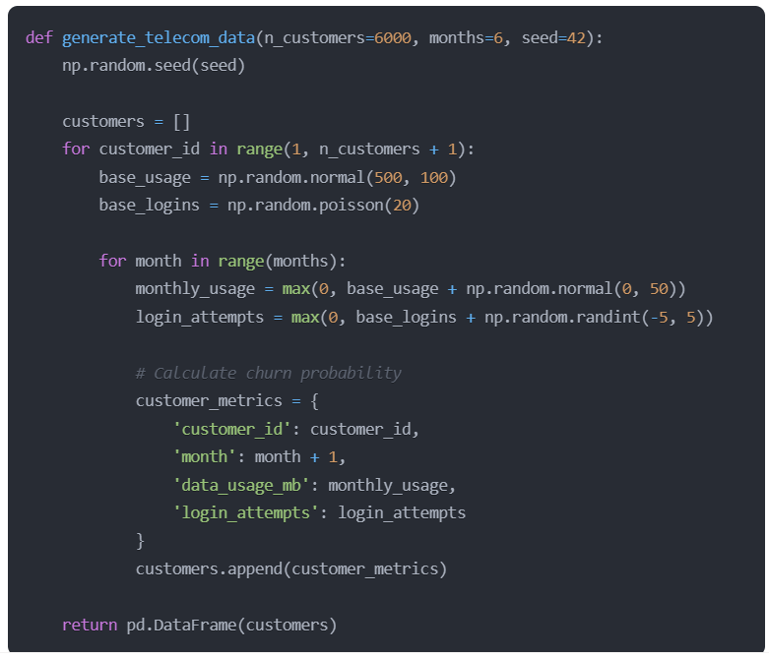
Technical Implementation

Slide 10
Technical Architecture
Frontend Components
Backend (app.py)
Telecom Prediction Interface (CombinedPredictionComponent.js)
Insurance Prediction Interface (InsuranceForm.js)
Framework: Flask
Features:
Machine learning model loading
Data preprocessing
Batch and single prediction endpoints
Risk categorization

Slide 11
Technical Stack
Frontend
Backend
React
State Management with Hooks
CSS for Responsive Design
Libraries:
Papa Parse (CSV Parsing)
Python
Flask Web Framework
Pandas for Data Manipulation
Scikit-learn for Machine Learning
Model Persistence with Joblib
CORS Support

Slide 12
Machine Learning Models
Base models
Ensemble methods
DecisionTreeClassifier
GaussianNB (Naive Bayes)
K-Nearest Neighbor (KNN)
SVC (Support Vector Classifier)
MLP (Multilayer Perceptron)
Logistic Regression
Cat Boost
XGBoost
RandomForestClassifier
AdaBoost
GradientBoosting
ExtraTrees

Slide 13
Industry-Specific Churn Prediction

Slide 14
Telecom Customer
Input Data Requirements
Broadband number
Monthly data over 6 months
Key features:
Data usage
Login attempts
Bill amount
Payment delay
Network latency
Packet loss
Download speed
Preprocessing Steps
Group data by broadband number
Aggregate 6-month customer data
Calculate aggregate and average metrics
Scale features
Predict churn probability
Analysis

Slide 15
Insurance Customer
Input Data Requirements,
Customer ID
6 months of policy data
Key features:
Customer age
Policy age
Vehicle value
Claim history
Vehicle changes
Months to renewal
Preprocessing Steps,
Group data by customer ID
Calculate aggregate metrics
Process policy start dates
Scale features
Predict churn probability
Analysis

Slide 16
Churn Risk Categorization
High Risk : Churn probability > 70%
Medium Risk : Churn probability 40 – 70%
Low Risk : Churn probability < 40%
Visualization Approach
Color-coded risk levels
High Risk: Red gradient
Medium Risk: Orange gradient
Low Risk: Green gradient
Percentage-based probability display

Slide 17
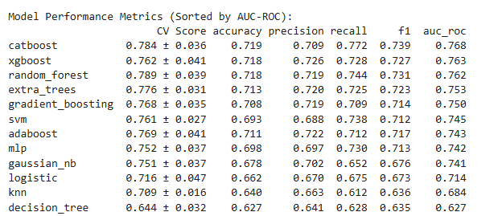
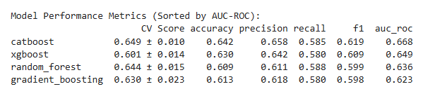
Performance Metrics and Evaluation
Area Under ROC Curve (AUC)
F1-Score
Precision and Recall
Accuracy
Cross-Validation Score

Slide 18
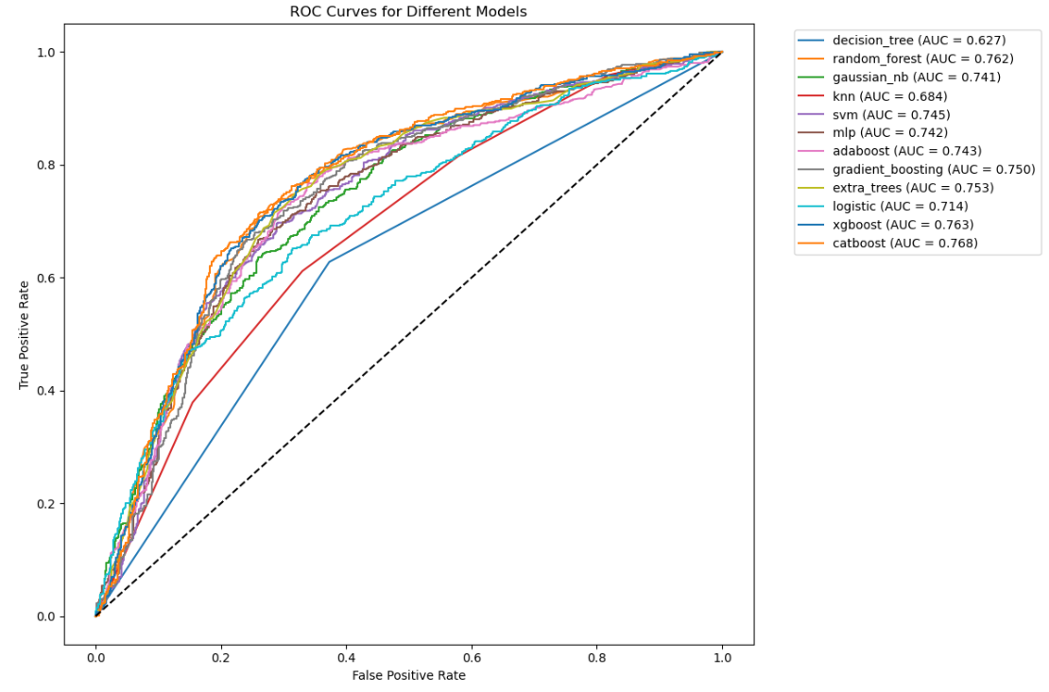
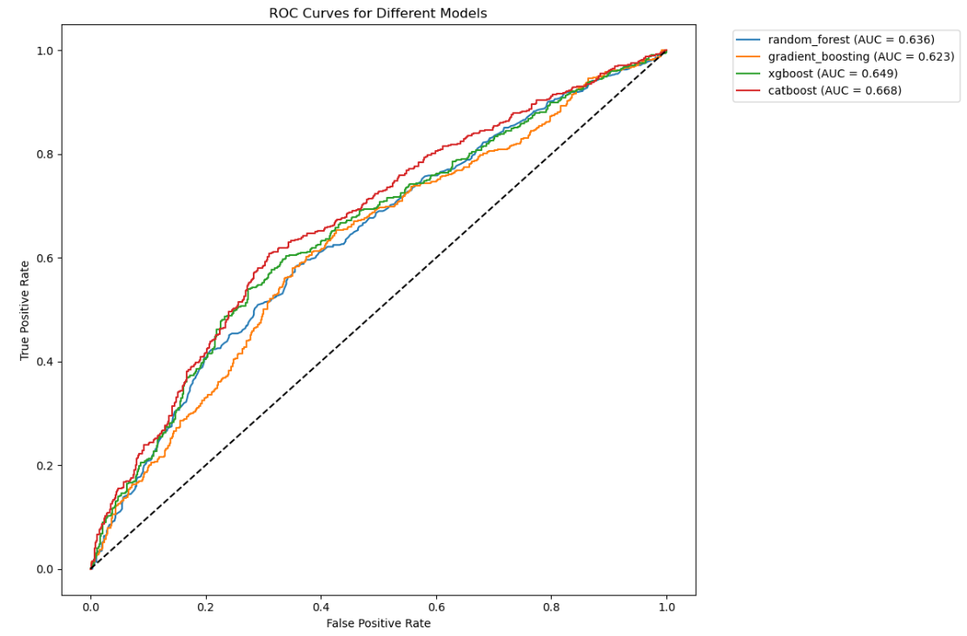
ROC Curves
Telecom
Insurance

Slide 19
Model Performance Comparison and Recommendations
Telecom Sector
1. CatBoost (AUC: 0.768)
Accuracy: 0.719
F1-Score: 0.7392
2. XGBoost (AUC: 0.763)
Accuracy: 0.718
F1-Score: 0.727
Recommendations:
Leverage CatBoost for optimal overall performance
Insurance Sector
1. CatBoost (AUC: 0.668)
Accuracy: 0.642
F1-Score: 0.619
2. XGBoost (AUC: 0.649)
Accuracy: 0.630
F1-Score: 0.609
Recommendations:
Leverage CatBoost for optimal overall performance

Slide 20
Technical Challenges
Data Preprocessing
Handling Varied Data Formats
Feature Scaling
Missing Data Management
User Experience
Responsive Design
Intuitive Interface
Real-time Predictions
Machine Learning
Model Training
Feature Selection
Generalization

Slide 21
User Interface Features
Bulk Upload
CSV file processing
Batch prediction
Risk-level grouping
Single Customer Search
Direct customer ID lookup
Instant churn probability
Risk level visualization

