Slide 1
SRP
Parkinson’s Disease Prediction
By
Mohamed Muzzamil S

Slide 2
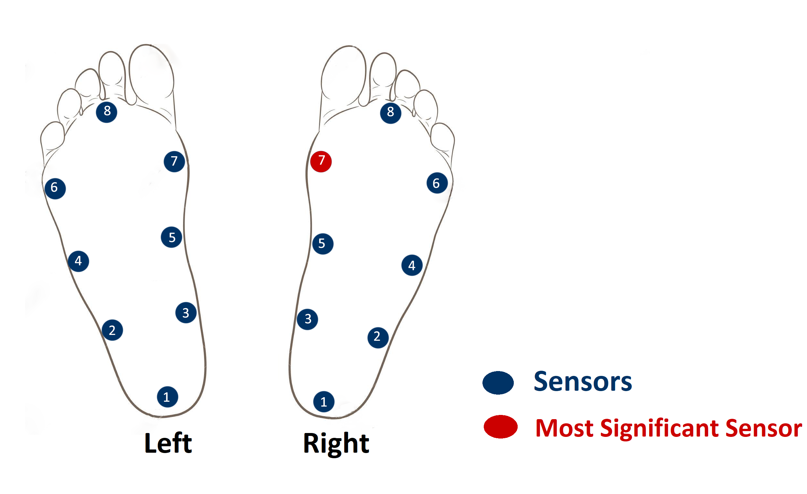
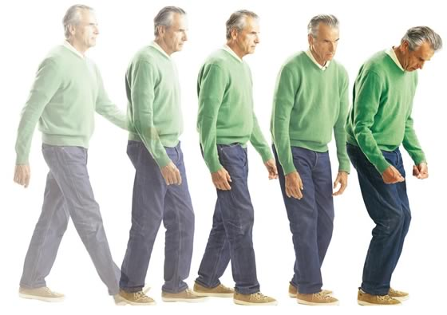

Architecture Diagram
User Input
Parkinson Affected Person
ML Model
Main Module
Feature Extraction and
Transformtion
User Interface
DataSet splitting
PhysioNet Training
DataSet
Trained Model
Prediction
K- Nearest Neighbours Algorithm
PhysioNet Testing DataSet
Healthy Person

