Slide 1
Made by: -
Mohamed Nageh
Mohamed Gamal Hamed
Mohamed Hany Hassan
Abdelrahman Mohamed El-mahdy
Mohamed Fadl Sholkamy
Supervisors:-
Dr\ Nabil Abd rabou
Eng\ Esraa Abdelhady
Smart Parking System

Slide 2
Introduction
There is no doubt that parking problems are ones of the biggest problems nowadays, Parking issues starts from searching for hours just to find free parking slot and sometimes can be as worse as finding out that all parking slots are full.
Our smart parking system offers solutions for these problems by providing clients with the following features: -
Only opens if there are free parking slots
Tells the client which parking spots are free
Alert clients if a car is leaving (when parking is full)
Calculate parking price and show it to clients on their way out

Slide 3
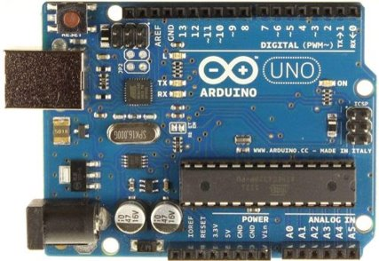
What is Arduino Uno R3 used for?
- It has 20 digital input/output pins (of which 6 can be used as PWM outputs and 6 can be used as analog inputs). Programs can be loaded on to it from the easy-to-use Arduino computer program
Is Arduino Uno R3 a microcontroller?
- The Arduino Uno Rev3 SMD is a microcontroller board based on the ATmega328. It has 14 digital input/output pins (of which 6 can be used as PWM outputs), 6 analog inputs, a 16 MHz ceramic resonator (CSTCE16M0V53-R0), a USB connection, a power jack, an ICSP header, and a reset button
Hardware| Components
Arduino UNO R3

Slide 4
Hardware| Components
Why Arduino Uno R3 is best?
- The Arduino UNO is the best board to get started with electronics and coding. If this is your first experience tinkering with the platform, the UNO is the most robust board you can start playing with. The UNO is the most used and documented board of the whole Arduino family.
Arduino UNO R3

Slide 5
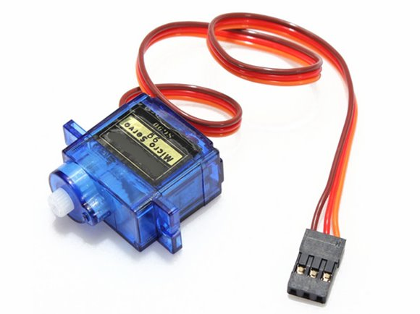
Hardware| Components
How strong is a SG90 servo?
- The TowerPro SG90 servo motor is one of the most popular servo motors at the moment. This servo motor has a torque of up to 1.56 kg * cm, with which all kinds of sensors, cameras or even small robots can easily be moved.
Servo motor (SG90)

Slide 6
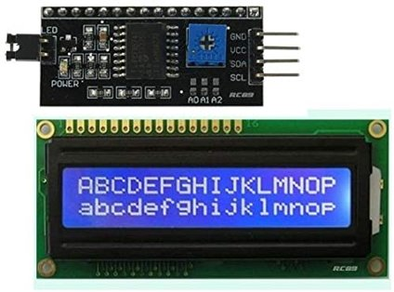
How do you use I2C with LCD 16x2?
Step 1: Components Required. 2 More Images.
Step 2: Connections. Refer the pictures and make the connections.
Step 3: Code. There is an LCD I2C master library included in the Arduino IDE.
Step 4: The Output. Once you have uploaded the code, you are ready to go.
2 People Made This Project!
10 Comments.
Hardware| Components
I2C LCD (16 x 2)

Slide 7
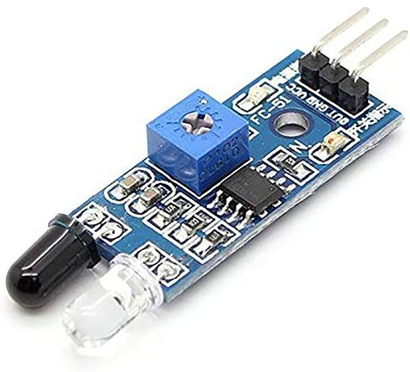
What is IR proximity sensor?
- Proximity Sensor are used to detect objects and obstacles in front of sensor. Sensor keeps transmitting infrared light and when any object comes near, it is detected by the sensor by monitoring the reflected light from the object.
Hardware| Components
Why is proximity sensor used?
- A proximity sensor is a device that can detect or sense the approach or presence of nearby objects and for this it does not need physical contact. There are different kinds of proximity sensors. Some of them are listed [8]: Inductive: This type of sensor is used to detect nearby metallic objects.
IR sensor

Slide 8
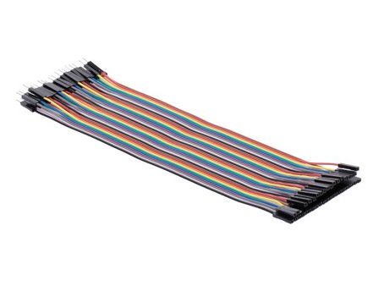
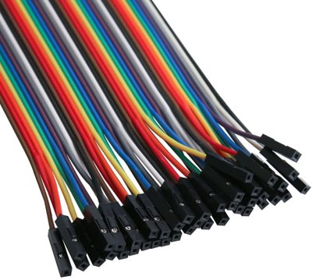
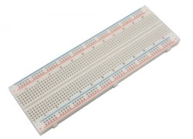
Hardware| Components
38 * jumpers
Other components
2* Bread board

Slide 9
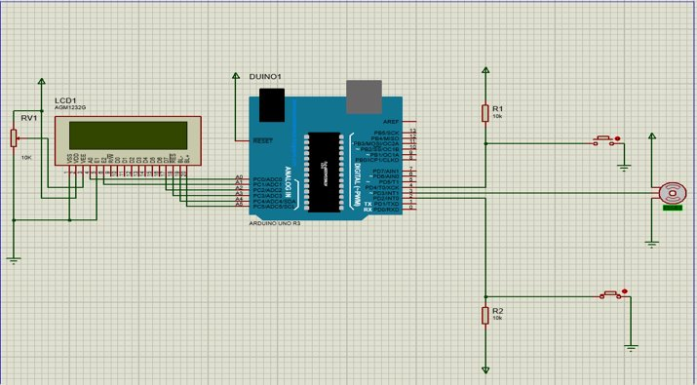
Hardware| Proteus
Circuit design

Slide 10
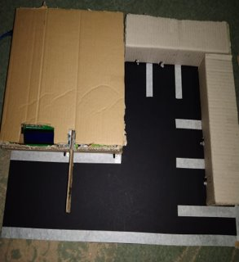
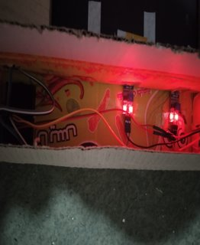
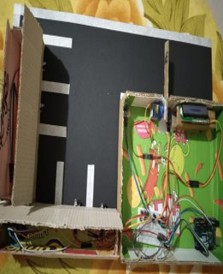
Hardware| Project
Real project

Slide 11
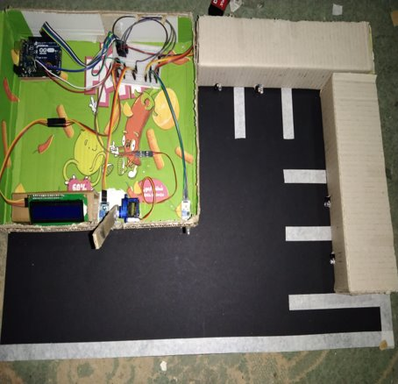
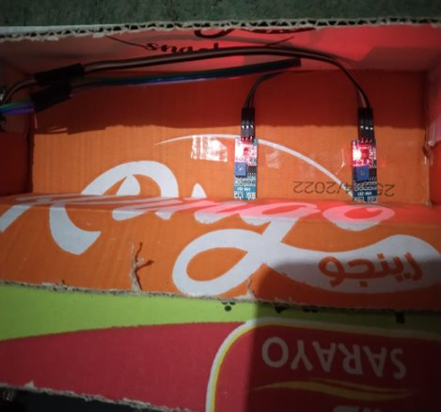
Hardware| Project
Real project

Slide 12
Software

Slide 13
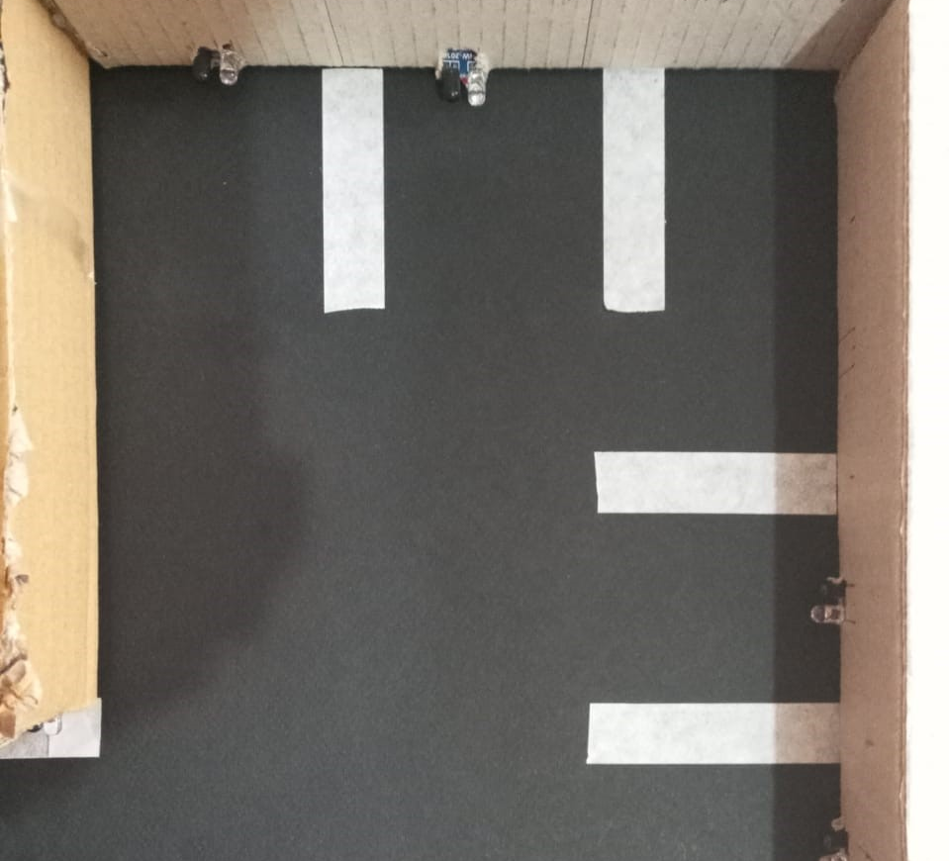
Software| features
Auto detecting number of slots

Slide 14





Software| features
Good user experience

Slide 15
Software| features
Pricing theory
Auto close due to inactivity
Door doesn't open from inside when park is empty
Other features

Slide 16
Challenges
Damaged sensor: -
- Automation
Pricing error: -
- delay in calc

Slide 17

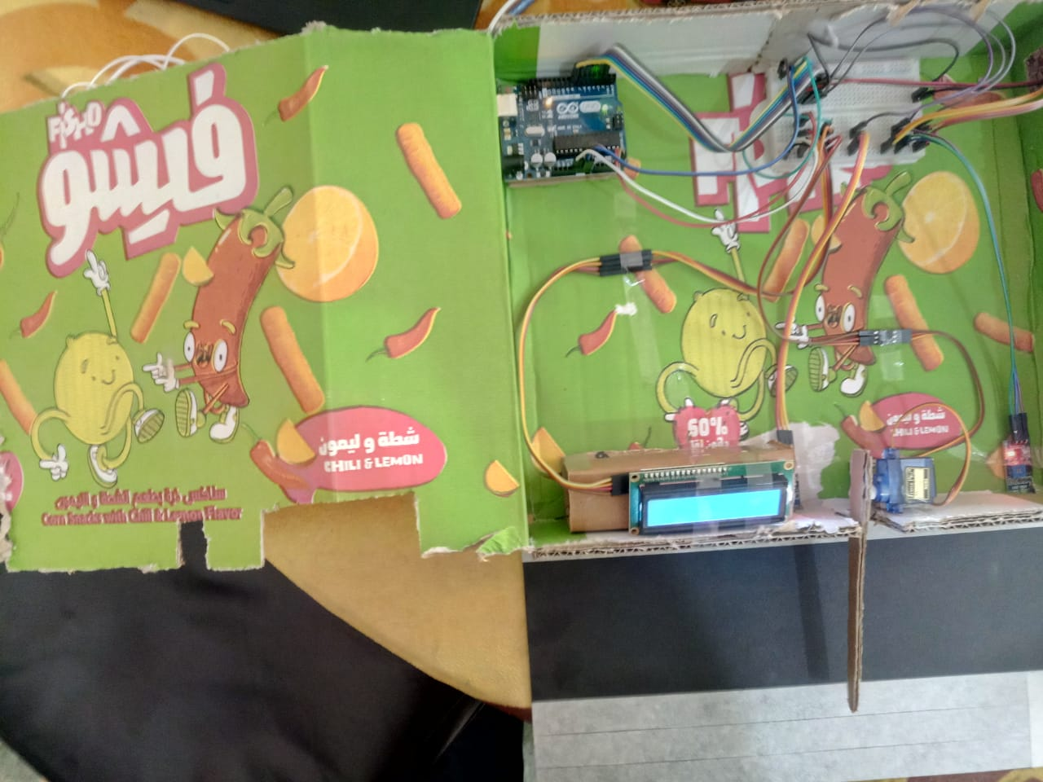

Possible upgrades
More parking slots
Show map on entrance (LCD upgrade)
Ask for help button
Better sponsor

Slide 18
Thank you

