Slide 1

Disease Prediction
Mohamed Nassih

Slide 2
Table of contents
01
Introduction to the project
02
Data Loading and Preparation
03
Exploratory Data Analysis (EDA)
04
Model Selection and Evaluation
05
Feature Importance
06
Model Evaluation by Category
07
Predictions and Final Evaluation
08
Conclusion

Slide 3

01
Introduction
Why This Matters

Slide 4
INTRODUCTION
Why is disease prediction important in healthcare?
Why early prediction is so helpful
Machine learning methods we use
Evaluating how good the models are
Goal of the project: predicting different diseases from medical data

Slide 5

02
Data Loading and Preparation
Getting and Preparing the Data

Slide 6
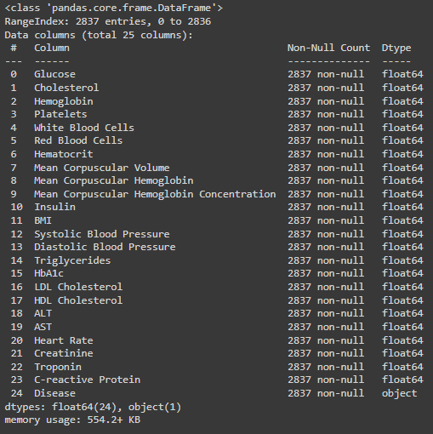
Data Loading and Preparation
Where the data came from: Train_data.csv and test_data.csv
Python tools we used: pandas, numpy, scikit-learn
Putting the data together

Slide 7

03
Exploratory Data Analysis (EDA)
Understanding the Data

Slide 8
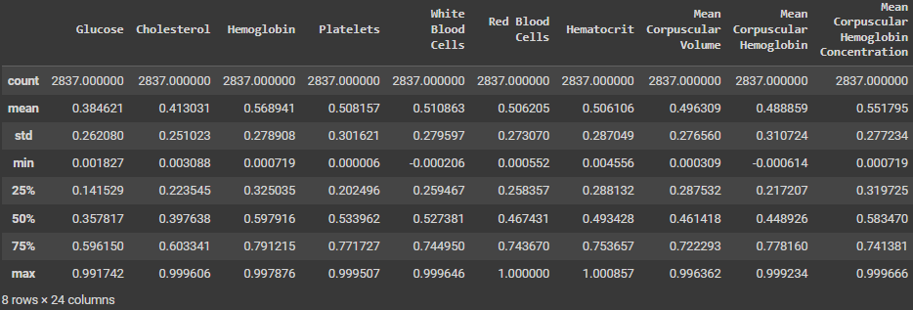
Numbers to describe the data (average, spread, minimum, maximum, etc.)
How often each disease appears in the data
Boxes showing the spread of the medical numbers
A chart showing how things in the data are connected
Exploratory Data Analysis (EDA)

Slide 9
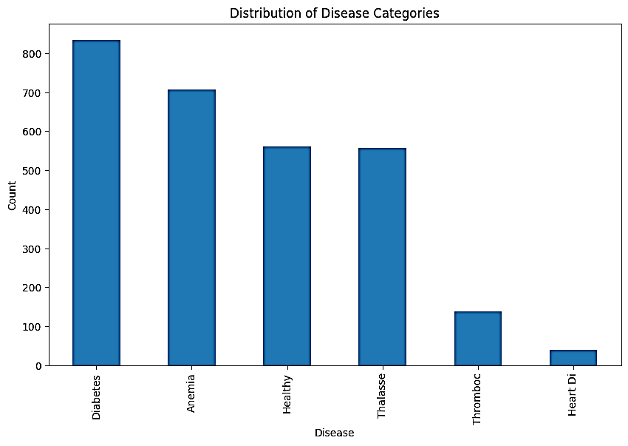
Disease Category Distribution
A bar graph showing how many times each disease appears
Looking at how common each disease is
Which diseases appear most often

Slide 10
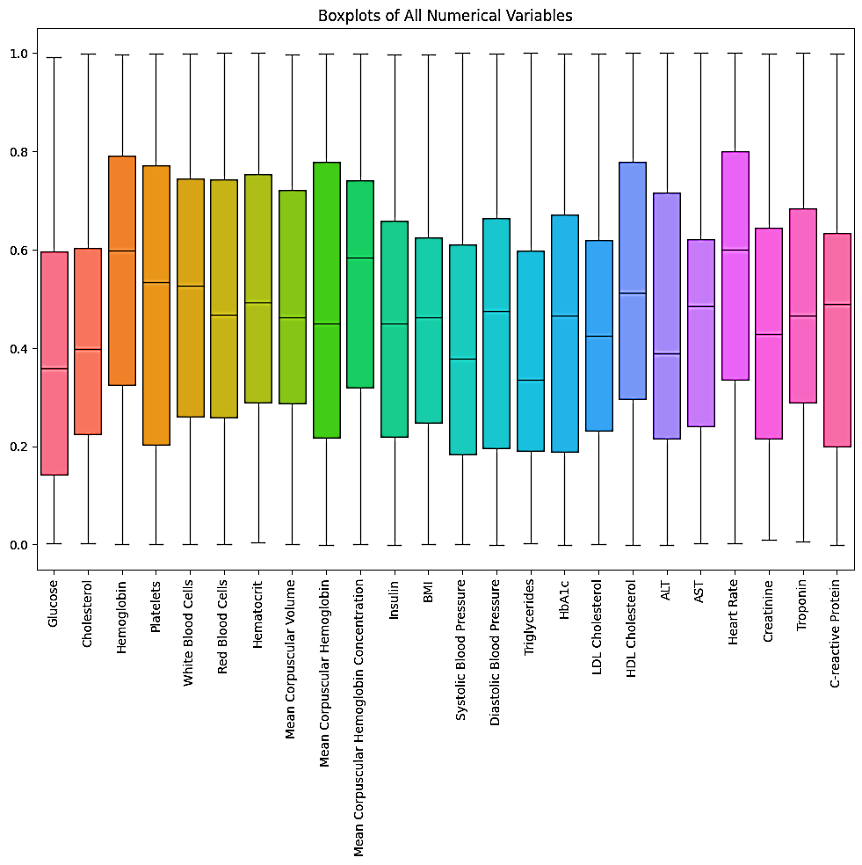
Boxplots for Numerical Variables
A graph showing how the medical numbers are spread out for each variable
Looking at how the medical numbers are spread out
Finding any unusual numbers

Slide 11
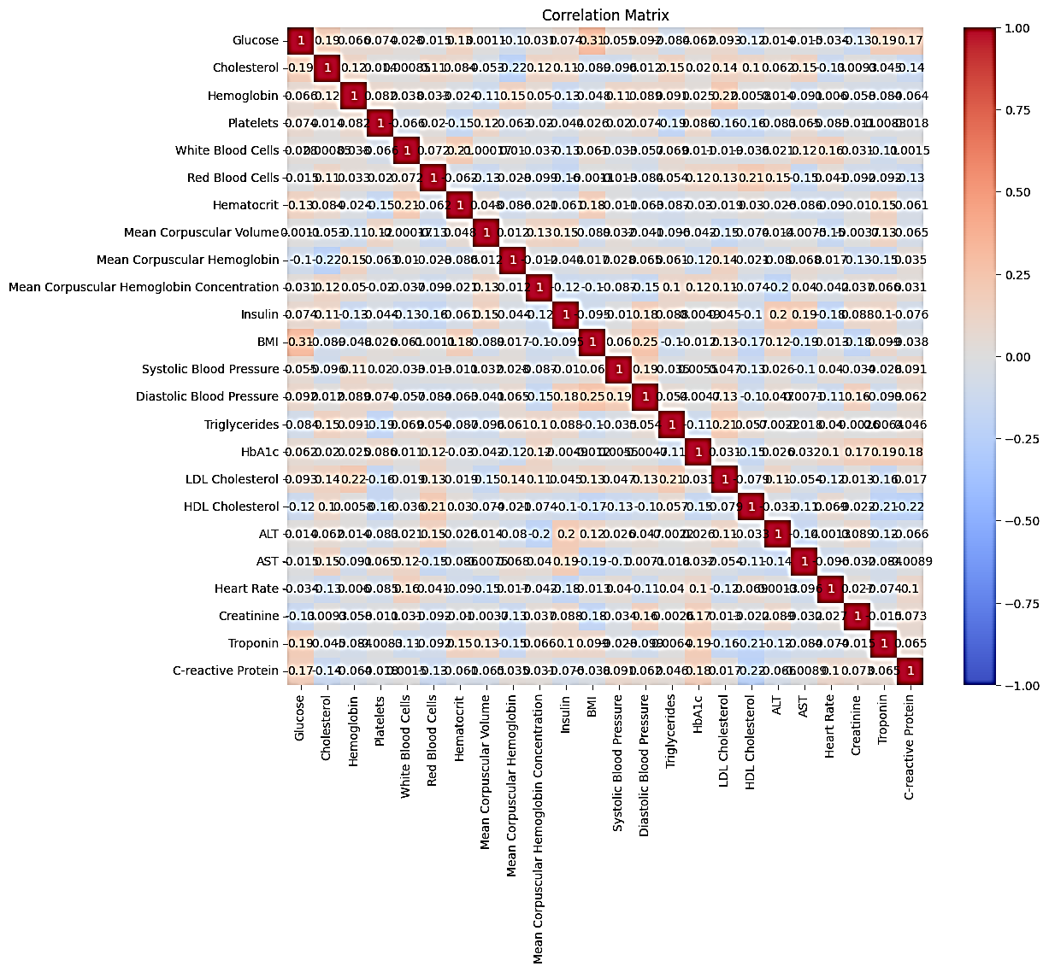
Correlation Matrix
A chart showing how connected different medical variables are
Looking at how medical variables are connected
Finding variables that are strongly connected

Slide 12

04
Model Selection and Evaluation
Choosing the Best Machine Learning Tools

Slide 13
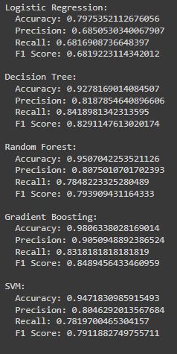
Machine learning methods we use: logistic regression, decision trees, random forests, gradient boosting, support vector machines (SVMs)
How we judge how well the models work: accuracy, precesion, recall, F1-score
Results of each model
Model Selection and Evaluation

Slide 14

05
Feature Importance
What's Most Important for Each Disease?

Slide 15
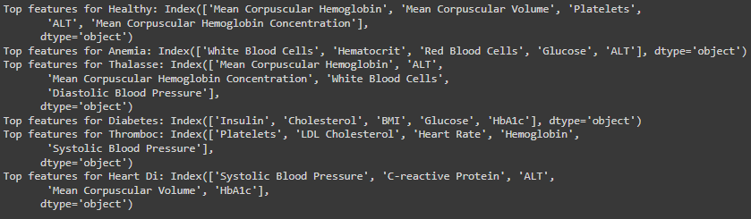
Feature Importance
Finding the most important variables that predict each disease
Using random forests to find important variables
Showing the most important variables for each disease

Slide 16
06
Model Evaluation by Category
Testing the Models for Each Disease

Slide 17
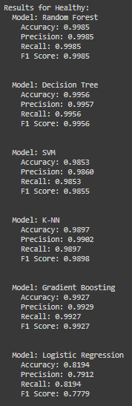
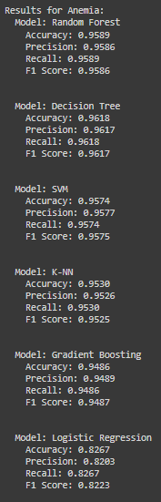
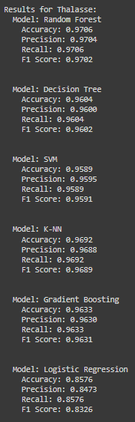
Model Evaluation by Category
Testing the models for each type of disease
Models we used: random forests, decision trees, SVMs, k-NN, gradient boosting, logistic regression
How we judge how well the models work: precision, accuracy, recall, F1-score
Results for each model and each disease

Slide 18
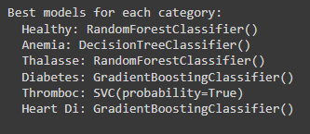
Selecting the Best Models
Choosing the best model for each disease
What we use to choose: F1-score
Showing the best models for each disease

Slide 19

07
Predictions and Final Evaluation
Making Predictions and Checking Them

Slide 20
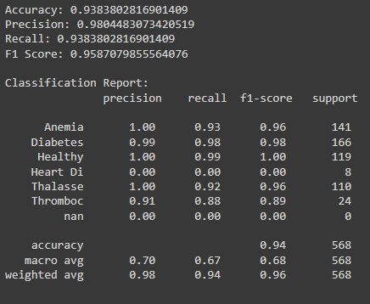
Predictions and Final Evaluation
Making predictions using the best models on the testing data
Checking how well the predictions work
How we judge how well the predictions work: accuracy, recall, F1-score, classification report
Final results

Slide 21

08
Conclusion
What We Learned and What's Next

Slide 22
Conclusion
Summary of the project's results
How important machine learning is for healthcare
Future steps: improving the models, using more data, connecting with healthcare systems

Slide 23

Thank you!

