Slide 1

IBM Data Science

Slide 2
1. What is Data Science ?
2. Open Source tools for Data Science
3. Data Science Methodology
4. Python for Data Science and AI
5. Databases and SQL for Data Science
6. Data Analysis with Python
7. Data visualization with Python
8. Machine Learning with Python
9. Applied Data Science Capstone
There are 9 courses in this certification

Slide 3
Data science is the art of uncovering the insights and trends that are hiding behind data. It's when you translate data into a story. So use storytelling to generate insight. And with these insights, you can make strategic choices for a company or an institution.
1. What is Data Science?

Slide 4
In this course, I have learned about various open source tools for Data Science.
Skill Network Labs
Jupyter Notebooks
Apache Zeppelin Notebooks
Rstudio IDE
IBM Watson studio
2. Open Source tools for Data Science

Slide 5
In this course I have learned about the major steps involved in tackling a data science problem. - The major steps involved in practicing data science, from forming a concrete business or research problem, to collecting and analyzing data, to building a model, and understanding the feedback after model deployment. - How data scientists think!.
3. Data Science Methodology

Slide 6
In this course I have learned about Python Basics like types, expressions, variables, string operations, lists, tuples, sets, dictionaries, Loops, objects and classes, file handling, pandas and numpy.
4. Python for Data Science and AI

Slide 7
In this course, I have learned about relational database concepts that helps to apply foundational knowledge of the SQL language, performing SQL access in a data science environment. The emphasis in this course is on hands-on and practical learning. I have also created some database instances in the cloud. I have done series of hands-on labs, practice building and running SQL queries in this lab. I have also learned how we can access databases from Jupyter notebooks using SQL and Python.
5. Databases and SQL for Data Science

Slide 8
In this course I have learned about Importing Datasets, Cleaning the Data , Data frame manipulation, Summarizing the Data. It includes following parts: Data Analysis libraries, use of Pandas, Numpy and Scipy libraries to work with a sample dataset. I have used this library to load, manipulate, analyze, and visualize cool datasets.
6. Data Analysis with Python

Slide 9
This course was all about several data visualization libraries in Python like Matplotlib, Seaborn, and Folium and how we can tell a compelling story by visualizing the data and findings from the data
7. Data visualization with Python

Slide 10
In this course I have learned about some of machine learning topics like supervised and unsupervised learning, classification, clustering and some Python libraries like Sci-kit learn and Scipy.
8. Machine Learning with Python

Slide 11
Capstone Project

Slide 12
Throughout its history, New York City has been a major point of entry for immigrants; the term "melting pot" was coined to describe densely populated immigrant neighborhoods on the Lower East Side. As many as 800 languages are spoken in New York, making it the most linguistically diverse city in the world. English remains the most widely spoken language, although there are areas in the outer boroughs in which up to 25% of people speak English as an alternate language, and/or have limited or no English language fluency. English is least spoken in neighborhoods such as Flushing, Sunset Park, and Corona.
Background
New York City's demographics show that it is a large and ethnically diverse metropolis. It is the largest city in the United States with a long history of international immigration. New York City was home to nearly 8.5 million people in 2014, accounting for over 40% of the population of New York State and a slightly lower percentage of the New York metropolitan area, home to approximately 23.6 million. Over the last decade the city has been growing faster than the region. The New York region continues to be by far the leading metropolitan gateway for legal immigrants admitted into the United States.

Slide 13
Introduction
With it's diverse culture , comes diverse food items. There are many restaurants in New York City, each belonging each belonging to different categories like Chinese , Indian , French etc. So as part of this project , we will list and visualize all major parts of New York City that has great Indian restaurants.
Queries that can be answered using this project?
What is best location in New York City for Indian Cuisine ?
Which areas have potential Indian Restaurant Market ?
Which all areas lack Indian Restaurants ?
Which is the best place to stay if I prefer Indian Cuisine ?

Slide 14
Data to be used
1. Data source : https://cocl.us/new_york_dataset
Description - his data set contains the required information. And we will use this data set to explore various neighborhoods of new york city. Indian restaurants in each neighborhood of New York city.
2. Data source : Foursquare API
Description : By using this API we will get all the venues in each neighborhood. We can filter these venues to get only Indian Restaurants.
3. Data source : https://data.cityofnewyork.us/City-Government/Borough-Boundaries/tqmj-j8zm
Description : By using this geo space data we will get the New York Borough boundaries that will help us to visualize choropleth map.

Slide 15
Approach
Collect the New York city data from https://cocl.us/new_york_dataset
Using FourSquare API we will find all venues for each neighborhood.
Filter out all venues that are Indian Restaurants.
Find rating , tips and like count for each Indian Restaurants using FourSquare API.
Using rating for each restaurant , we will sort that data.

Slide 16
Libraries to be used
pandas and numpy for handling data.
request module for using FourSquare API.
geopy to get co-ordinates of City of New York.

Slide 17
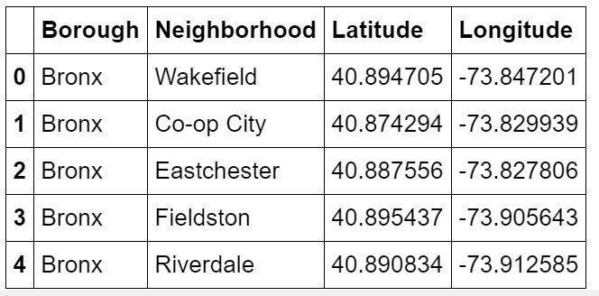
Step 1
Load data from https://cocl.us/new_york_dataset
in pandas Dataframe.
Getting Latitude and Longitude for each address geopy library.
As result –
We have 306 rows like this.

Slide 18
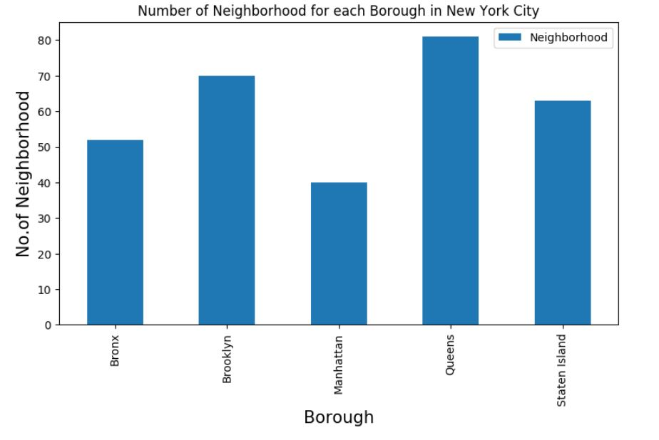
Number of neighborhoods in each Borough

Slide 19
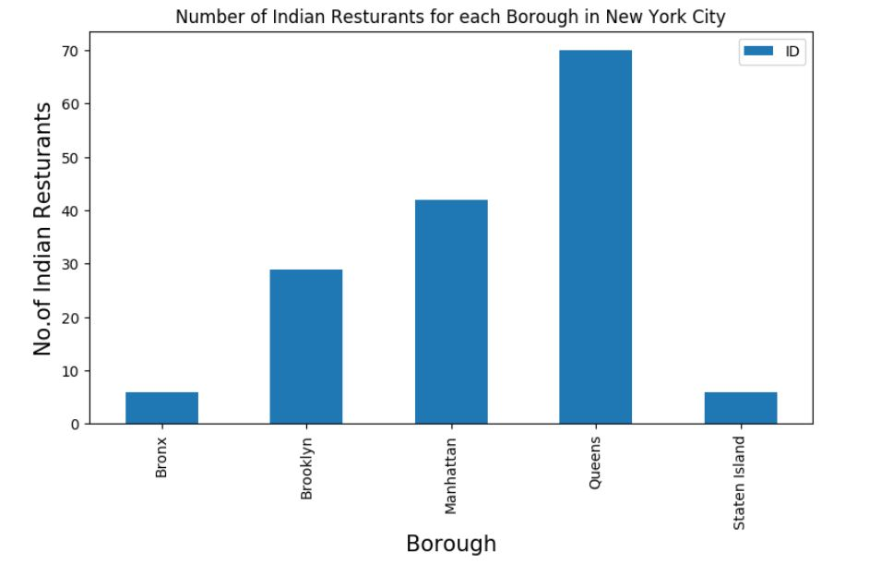
Step 2
Filter out which Borough and Neighborhood have maximum number of Indian Restaurants using FourSquare API.
Result – Queens has maximum number of Restaurants

Slide 20
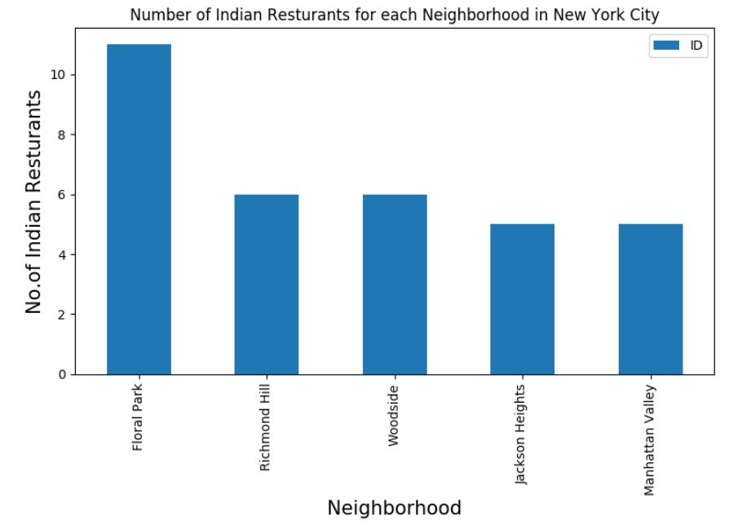
Step 2
Filter out which Borough and Neighborhood have maximum number of Indian Restaurants using FourSquare API.
Result – Floral Park has maximum number of Restaurants

Slide 21
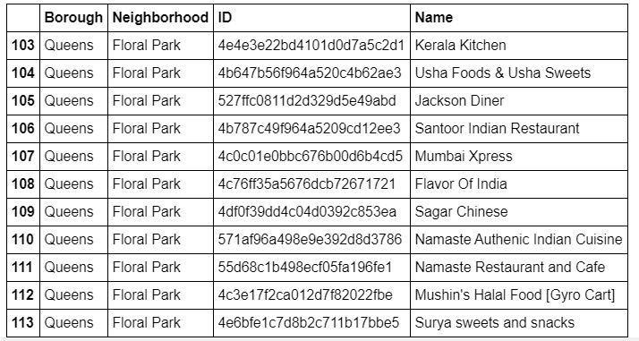
List of Restaurants in Floral Park

Slide 22
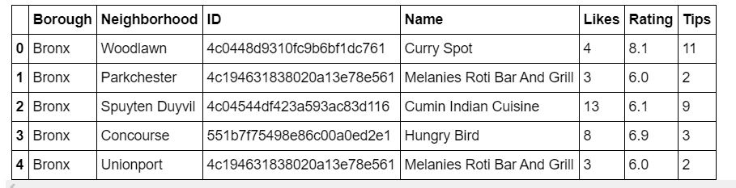
Step 3
Get likes, ratings, tips on each of Indian Restaurant using FourSquare API

Slide 23
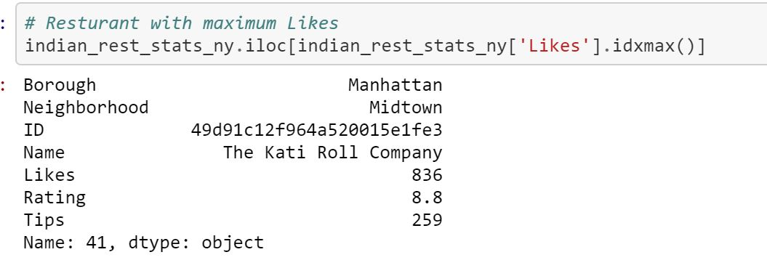
Result
Restaurant with maximum like

Slide 24
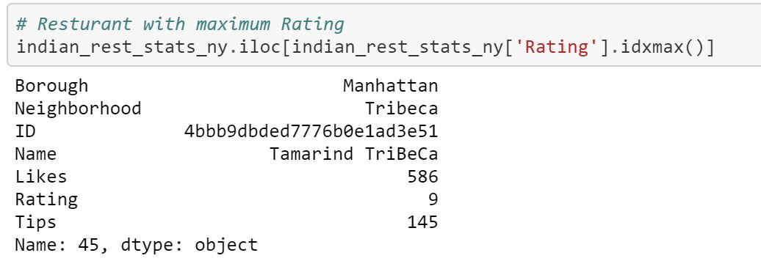
Result
Restaurant having maximum Rating

Slide 25
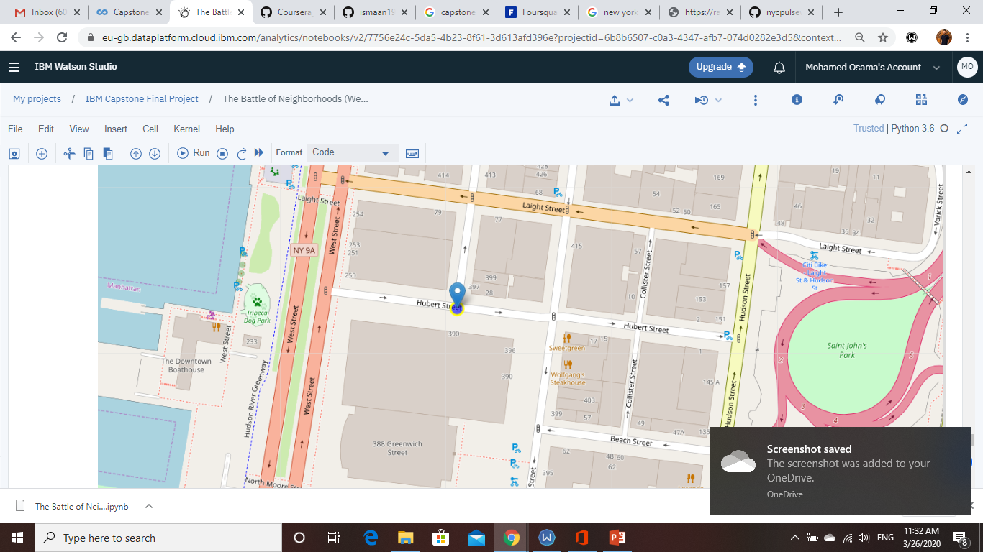
Result
Restaurant having maximum Rating
Location With Folium :

Slide 26
Conclusion
Astoria(Queens), Blissville(Queens), Civic Center(Manhattan) are some of the best neighborhoods for indian cuisine.
Manhattan have potential Indian Resturant Market
Staten Island ranks last in average rating of Indian Restaurants.
Manhattan is the best place to stay if you prefer Indian Cuisine.

Slide 27
The accuracy of data depends purely depends on the data provided by FourSquare
Limitation

Slide 28

Thank you
Any queries ?

