Slide 1

Rabyte
AI Multimedia Suite: Audio, Translation, and Captioning

Slide 2
Context-Aware Transcriptions
Implemented AI that understands the context of the sentence using LLMs to provide more accurate and relevant captions.
01

Slide 3
Voiceover dubbing
Developed an AI tool that can produce voiceovers in various voices and languages for the video content. By using state-of-the-art AI TTS services
02

Slide 4
Multi-lingual Translation
Significantly expands its global reach, allowing content to be accessible to a diverse audience. It enhances user engagement and satisfaction by breaking language barriers, making content inclusive and appealing to non-native speakers.
03

Slide 5
Auto Profanity Filtering
Multi-lingual automated profanity filter to enhance user experience and allow for a family-friendly environment and ensures compliance with content regulations, thereby broadening audience reach and advertiser appeal
04

Slide 6
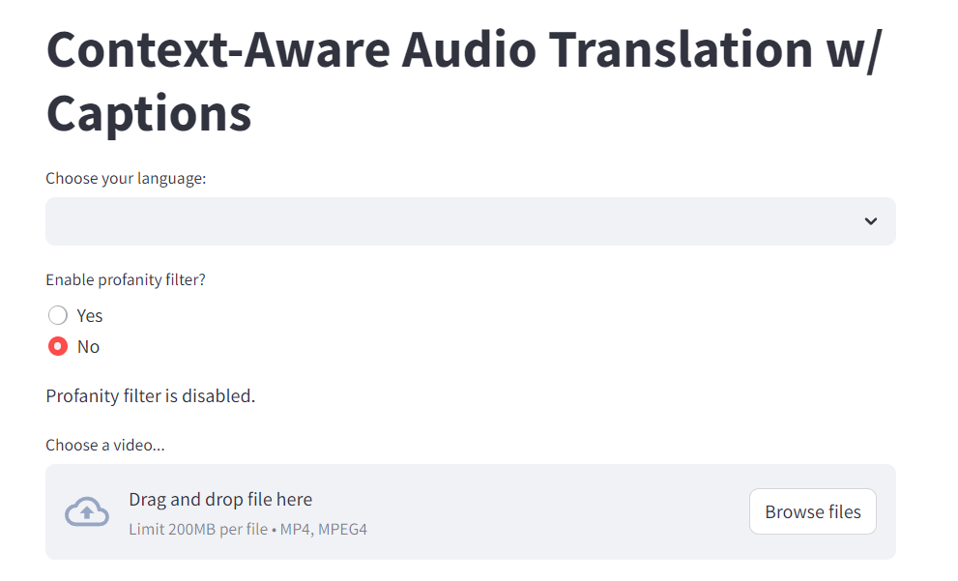
UI/UX
The simplicity of the concept design is enhanced by the clean layout and straightforward options, making it user-friendly and easy to navigate.

Slide 7
All Supported Languages Currently
English
India
Portugal
China
Spain
France
Germany
Japan
Arabic
Russia
South Korea
Indonesia
Italy
Netherlands
Turkey
Poland
Sweden
Philippines
Romania
Ukraine
Greece
Czech Republic
Denmark
Finland
Bulgaria
Croatia
Slovakia
India (Tamil)

Slide 8
Future Works
Al module capable of creating engaging video content based on user inputs
features such as style adaptation, content personalization, and automatic editing
Al-driven audio generation feature that can produce background music, voiceovers, real-time translation to different languages and sound effects tailored to the video content
Interactive captions that provide further information

Slide 9
Live Demo

Slide 10
Thank you!

