Slide 1



FormaFix
AI-Powered Physiotherapy & Rehabilitation System
Graduation Project Presentation • March 2026
Computer Vision
Real-Time Feedback
AI Coaching

Slide 2
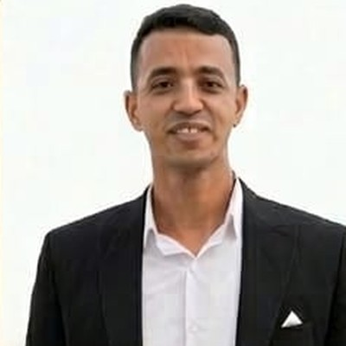
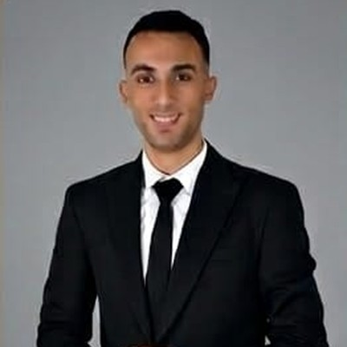
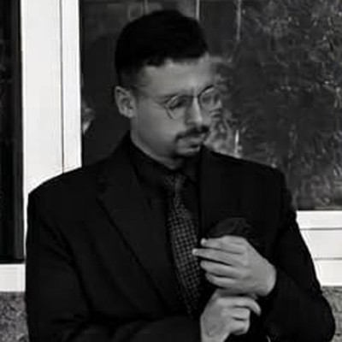
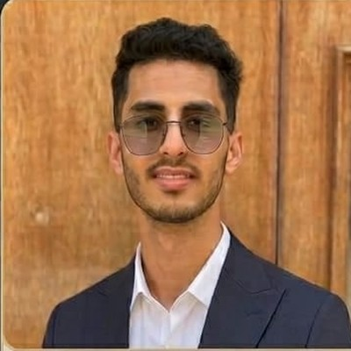
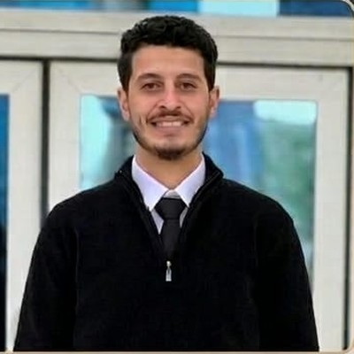
Our Team
The people behind FormaFix
Mohammed Refat
Youssef Al-Amgad
Kerolos Nabil
Ahmed Abdel-Khalek
Ahmed El-Mohamdy

Slide 3




The Problem
Why traditional physiotherapy falls short
Limited Supervision
High Cost
Patients perform exercises at home with no professional feedback or correction
Frequent clinic visits are expensive and logistically challenging for many patients
Re-Injury Risk
Low Adherence
Incorrect form without real-time correction can worsen existing conditions
Patients lose motivation without progress tracking and encouragement

Slide 4

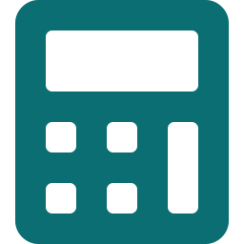




Our Solution
FormaFix — Accessible, intelligent rehabilitation guidance
Real-Time Pose Estimation
Biomechanical Analysis
Webcam or smartphone camera tracks 33 body landmarks using MediaPipe BlazePose
Joint angles calculated with trigonometry and compared against clinical thresholds
Safety-First Feedback
Progress Tracking
Three-tier priority system: Safety Stop → Form Correction → Motivation
Sessions logged and analyzed to surface recovery trends over time
AI Coaching Agent
Adaptive Difficulty
Natural-language feedback generated dynamically using an LLM integration
Exercise parameters auto-adjust based on patient performance history

Slide 5
System Architecture & Workflow
End-to-end AI pipeline: from patient input to adaptive rehabilitation plan
INPUT LAYER
AI PLANNING
COMPUTER VISION
AI FEEDBACK & ADAPTATION
👤 User
Rehab Planning Agent
📷 Camera
Real-Time Coaching Agent
Injury Input
Exercise Plan
Pose Estimation
(MediaPipe BlazePose)
🔊 Audio Feedback
Rep Counter
📊 Session Data
Form Evaluation
Progress Summary Agent
Adaptive Plan Agent
✅ Updated Plan
↻ Adaptive Feedback Loop
FormaFix | AI-Powered Physiotherapy & Rehabilitation

Slide 6
System Architecture
End-to-end pipeline from camera to feedback in under 100ms
Camera
Input
→
Pose
Estimation
→
Angle
Analysis
→
Form
Evaluation
→
Coaching
Agent
→
Feedback
Delivery
⚡ Total Latency: < 100ms on standard hardware
Input Layer
30-60 fps capture, frame buffering, resolution normalization
Processing Layer
MediaPipe BlazePose extracts 33 3D body landmarks per frame
Analysis Layer
Joint angles computed via trigonometry, compared to clinical thresholds
Safety Gate
Critical deviations flagged instantly — e.g., knee valgus > 15°
Feedback Layer
Audio coaching (TTS) + visual skeleton overlay on screen
Data Layer
Session data logged to SQLite/Firebase for trend analysis

Slide 7
Models Used
AI and computer vision models powering the FormaFix pipeline
Computer Vision Models
Language Models (LLM)
MediaPipe BlazePose Heavy
Role: Real-time body landmark detection (33 points)
Output: x, y, z coordinates + visibility score per landmark
Speed: ~25ms on CPU | No GPU or internet required
Claude Sonnet (Primary)
Provider: Anthropic (claude-sonnet-4-20250514)
Role: Rehab agent, session coaching, progress reports
Limit: 2000 tokens/request | Used via Anthropic REST API
OpenCV
Role: Camera capture, frame processing, skeleton overlay
Speed: 30-60 fps | 3-5ms per frame capture
Gemini 2.5 Flash
Google | Cloud LLM fallback option
8000 tokens/request
Ollama / LLaMA3
On-device | Fully offline mode
No API key required
Audio: pyttsx3 (offline TTS, 5-15ms) — no internet required Math: NumPy — joint angle computation via arctan2 (<1ms per frame)

Slide 8
AI Coaching Agent
Intelligent, context-aware feedback generation
How It Works
Three-Tier Feedback Hierarchy
1. Receives form evaluation results each frame
2. Determines priority: Critical → Correction → Motivation
3. Selects appropriate message from exercise-specific library
4. Applies cooldown timer to prevent feedback overload
5. Optionally generates varied phrasing via LLM (GPT-4o-mini)
6. Delivers feedback through audio (TTS) and visual overlay
1 — SAFETY STOP
Joint angle exceeds injury threshold
→ Stop rep immediately, protect patient
2 — FORM CORRECTION
Angle outside optimal range but not dangerous
→ Continue rep, cue verbal correction
3 — MOTIVATION
Form is acceptable, rep is valid
→ Encourage and reinforce good form

Slide 9
Computer Vision — MediaPipe
Real-time body landmark detection with BlazePose
Key Capabilities
Key Rehabilitation Landmarks
33 3D body landmarks detected per frame
Runs at 30+ fps on standard CPU — no GPU needed
On-device processing (no internet required)
Provides x, y, z coordinates + visibility score
Supports both webcam and mobile camera input
Lightweight model: ~5ms on GPU, ~25ms on CPU
Landmark | Used In
Shoulder (11, 12) | Press, Lateral Raise, Rotator Cuff
Elbow (13, 14) | Bicep Curl, Tricep Extension
Hip (23, 24) | Squat, Lunge, Hip Hinge
Knee (25, 26) | Squat, Lunge, Step-Up
Ankle (27, 28) | Squat Depth, Calf Raise

Slide 10
Angle Calculation & Form Evaluation
Trigonometric analysis for precise movement scoring
How Angles Are Calculated
Exercise Threshold Examples
Three landmark points define each joint (A, B, C)
B is the joint vertex (e.g., knee = hip → knee → ankle)
Vectors BA and BC computed, then dot product gives angle
Result in degrees compared to clinical threshold ranges
Exercise | Optimal | Critical
Squat (Knee) | 80°–100° | < 45°
Bicep Curl | 30°–150° | < 10°
Shoulder Press | 80°–160° | > 170°
Lunge (Knee) | 80°–100° | < 50°
Rep State Machine — Tracking Exercise Phases
START
→
DESCENDING
→
BOTTOM
→
ASCENDING
→
COMPLETE
Rep counter increments only on a complete cycle: START → DESCENDING → BOTTOM → ASCENDING → COMPLETE

Slide 11
Processing & Feedback Loop
Complete data flow from camera frame to patient feedback
Pipeline Stage | Latency | Optimization
Frame Capture (OpenCV) | 3–5 ms | Buffer size = 1
BlazePose (CPU) | 20–35 ms | model_complexity=1
Angle Calculation | < 1 ms | Pure NumPy vectors
Form Evaluation | < 1 ms | Rule-based lookups
Coaching Agent | < 1 ms | In-memory dict
Audio (pyttsx3 offline) | 5–15 ms | Pre-rendered .wav files
Visual Overlay | 2–5 ms | OpenCV draw on frame
TOTAL | ~35–65 ms | Well under 100ms target
Key Design Decisions
Offline-first: All core processing runs on-device with zero internet dependency
Pre-rendered audio: All feedback strings converted to .wav at startup for < 5ms playback
Async data logging: Progress agent writes to SQLite/Firebase without blocking the feedback loop

Slide 12
Results & Key Metrics
Performance targets and system capabilities
< 100ms
> 90%
< 5°
Feedback Latency
Pose Accuracy
Angle Error
Camera to audio
On rehab exercises
Joint measurement
Metric | Target | Priority
Session Data Retention | 12 months rolling | Medium
Exercise Library | 30+ rehab exercises (v1) | Medium
Platform Support | iOS, Android, Web (PWA) | High
Temporal Smoothing | 3 consecutive frames for safety stop | High

Slide 13



Mobile Application
Bringing AI-powered rehab to every patient's pocket
App Concept
Key Features
A cross-platform mobile app (React Native + Expo) that puts FormaFix's full AI pipeline in the patient's hands — from camera-based exercise tracking to personalized recovery plans.
Live Tracking
Instant Feedback
Real-time pose estimation
Audio + visual corrections
React Native
Expo Camera
TFLite
Firebase
Progress
Reminders
Deployment Modes
Recovery trends & history
Exercise schedule alerts
Edge (On-Device): Full pipeline locally — lowest latency
Hybrid: Pose on-device + cloud analytics
Web PWA: Browser-based for desktop access
Offline Mode
Privacy First
Works without internet
All video stays on-device

Slide 14





Future Work & Roadmap
Expanding FormaFix beyond the MVP
Expanded Exercise Library
LLM-Powered Coaching
Scale from 3 to 30+ rehabilitation exercises with validated clinical thresholds
Integrate GPT-4o or Mistral for varied, empathetic natural-language guidance
Injury Prediction Model
Therapist Portal
ML model to predict potential injury risks from movement pattern analysis
Web dashboard for clinicians to monitor patient progress and adjust plans remotely
App Store Launch
Wearable Integration
iOS and Android release via Expo with full onboarding flow and demo video
Connect with smartwatches and IMU sensors for enhanced motion tracking accuracy

Slide 15
Our Team
The people behind FormaFix
Mohammed Refat
Youssef Al-Amgad
Kerolos Nabil
Ahmed Abdel-Khalek
Ahmed El-Mohamdy

Slide 16
Thank You
Questions & Discussion
FormaFix • AI-Powered Physiotherapy & Rehabilitation

