Slide 1
TEAM MEMBERS
1- Hanan Saeed Mohamed
-hanasaeedbs12@gmail.com
2- Mohamed Saeed
-Mohamed.sa3ed.faried@gmail.com

Slide 2
Smart Home
A smart home allows homeowners to control appliances, thermostats, lights, and other devices remotely using a smartphone or tablet through an internet connection. Smart homes can be set up through wireless or hardwired systems. Smart home technology provides homeowners with convenience and cost savings.
Smart homes allow you to have greater control of your energy use, all while automating things like adjusting temperature, turning on and off lights, opening and closing window treatments, and adjusting irrigation based on the weather.

Slide 3
H.W Components
01
02
03
04
LCD
Key Pad
To show the data
To Enter The data
LDR
Servo Motor
To Enter The data
To Enter The data
05
Stepper Motor
To control The Fan

Slide 4
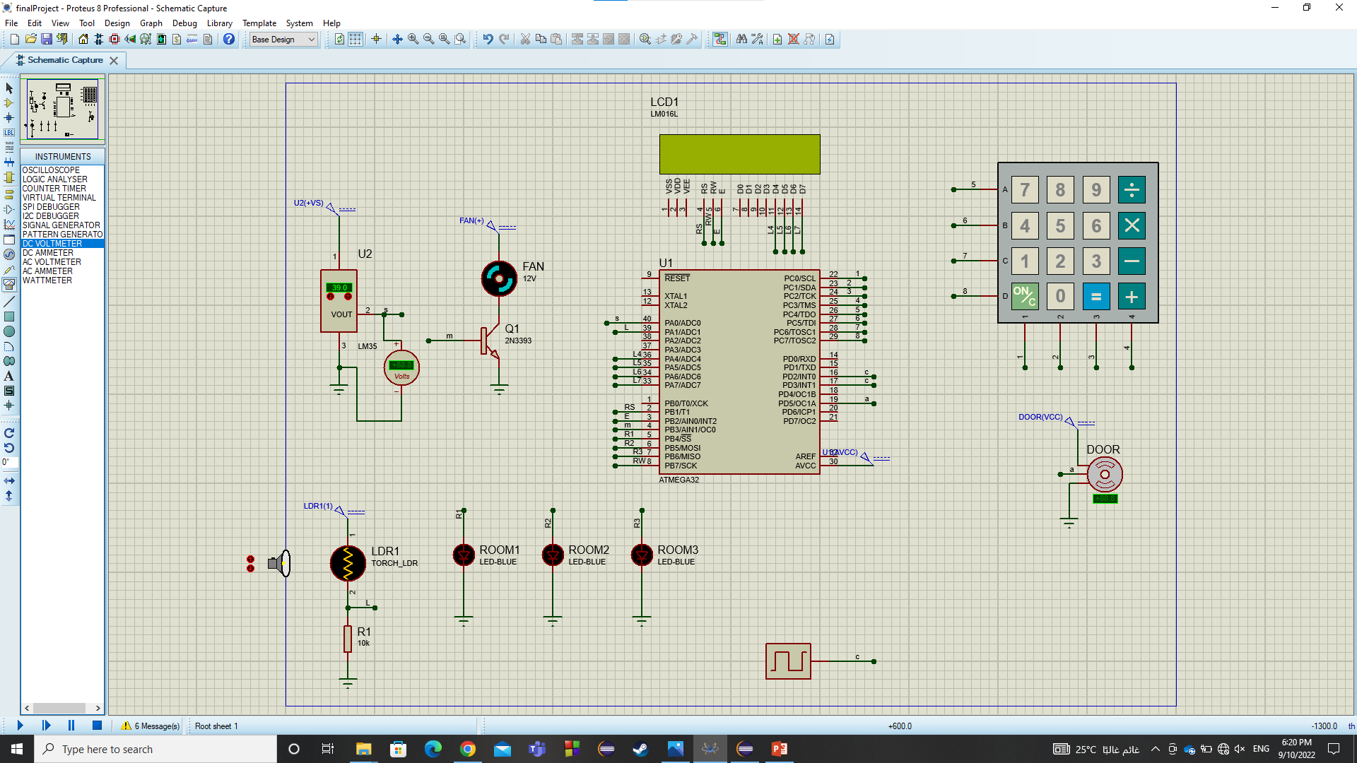

Slide 5
Fuctionalities
Functionalities:
-Controlling the light through LDR.
-Opening/Closing the Door.
-Controlling the Fan through Temperature Sensor.(if temperature is higher than (26 C) the fan will be open automatically using interrupt)
Peripherals used :
DIO
ADC
TIMER0 & TIMER1
EXT-Interrupt
KEYPAD
LCD

Slide 6
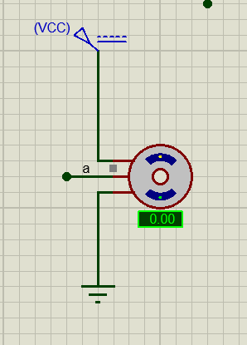
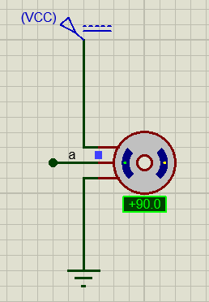
1-DOOR
When servo motor at angle 0 door is closed
When servo motor at angle 90 door is open

Slide 7
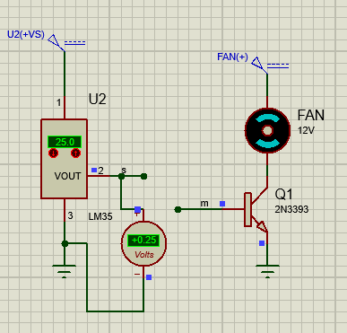
FAN
-Fan speed can be controlled by Sensor

Slide 8
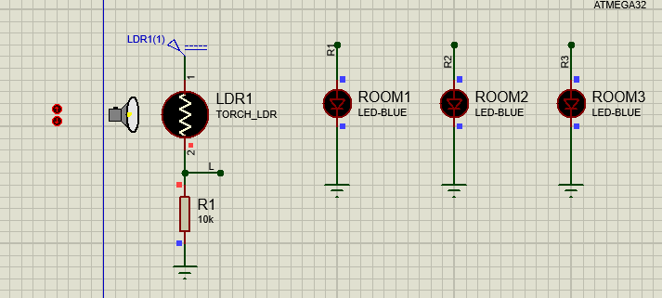
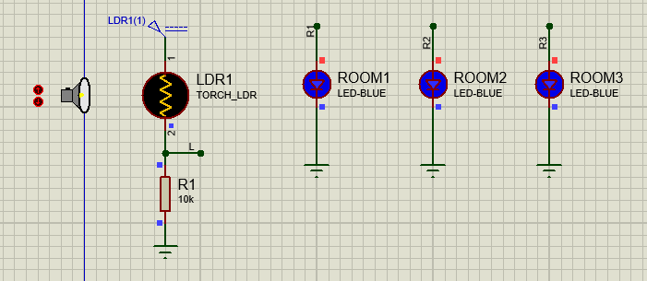
LDR
LDRs (light-dependent resistors) are used to detect light levels.
-when light intensity is high all leds off.
-when light intensity is low all leds on.

Slide 9
END
Any Questions?

