Slide 1




Telecom Egypt Intelligent Assistant
Production-Ready RAG Chatbot
✓
Powered by official website (te.eg) + user uploads
✓
Multilingual support: Arabic, Egyptian dialect, English
✓
Grounded answers with automatic source citations
Presenter: Mohamed Saeed Abu Samaha

Slide 2






Problem & Goals
The Problem
Our Goals
Answer questions grounded on official te.eg website
1000s
Daily customer inquiries about plans, billing, and technical support
Support Arabic, Egyptian dialect, and English seamlessly
Allow file uploads (PDF, DOCX, TXT, HTML, Images)
Provide source citations for all answers
Manual responses a time-consuming and inconsistent
Deliver professional, user-friendly interface
Customers speak Arabic, Egyptian dialect, and English

Slide 3

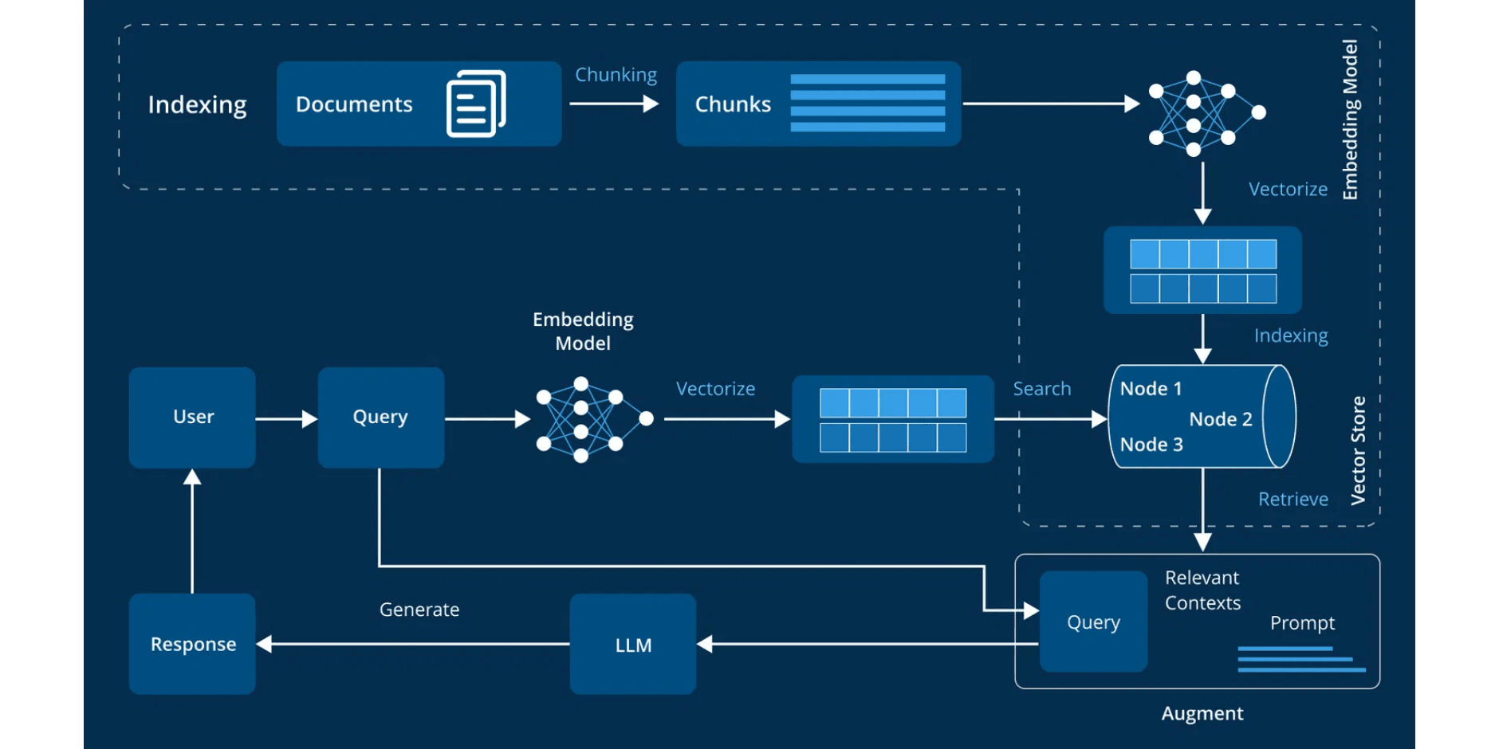
High-Level Architecture

Slide 4
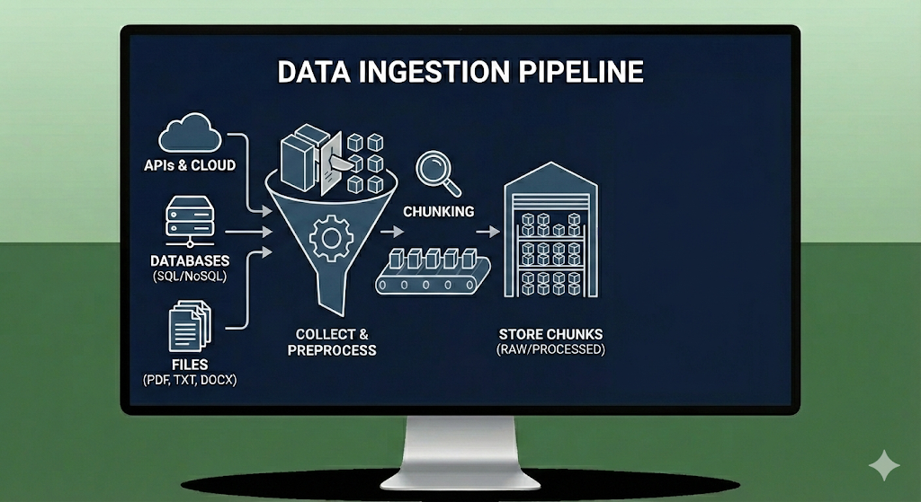
Data Pipeline
Data Ingestion
Web Scraper: Custom Scrapy spider for te.eg.
File Processor: Handles PDF/DOCX/Images.
Chunking
Recursive Chunking: 512-character chunks with overlap.

Slide 5






File Upload & Processing Pipeline
Step 1: Upload via Streamlit
User uploads file through Streamlit interface → stored in object storage or local filesystem
Step 2: Worker Processes File
Background worker picks up file and begins processing pipeline
Step 3: Parse Text Content
Extract text using pdfplumber (PDF), python-docx (DOCX), HTML parser, or Tesseract OCR (images)
Step 4: Normalize Text
Clean whitespace, remove special characters, standardize encoding
Step 5: Language Detection & Chunking
Detect language (Arabic, English, Egyptian dialect) → pass to recursive chunker
Step 6: Embed the chunks and store in the Qdrant database

Slide 6
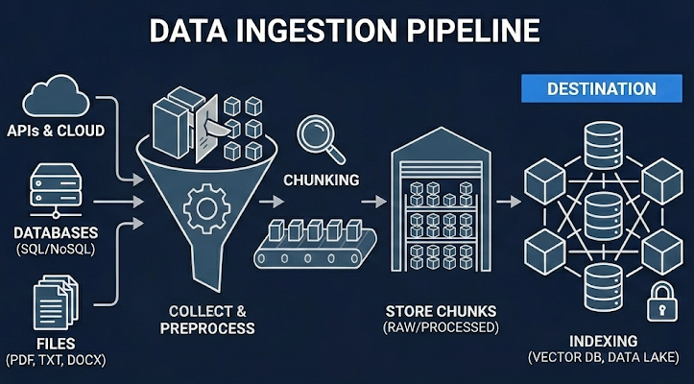
Embedding & Indexing
Chunks embedded with multilingual-e5-large
Indexing with HNSW Graph-based navigation
Stored vectors in Qdrant cloud

Slide 7



Multilingual Embeddings
Embedding Model
Processing Pipeline
intfloat/multilingual-e5-large
Batch Processing
Multilingual embedding model with exceptional support for Arabic and dialectal variations.
1024-dimensional output vectors
Strong Arabic language support
Optimized for semantic search
GPU Acceleration
Vector Normalization
Languages Supported
100+
Persistent Storage

Slide 8
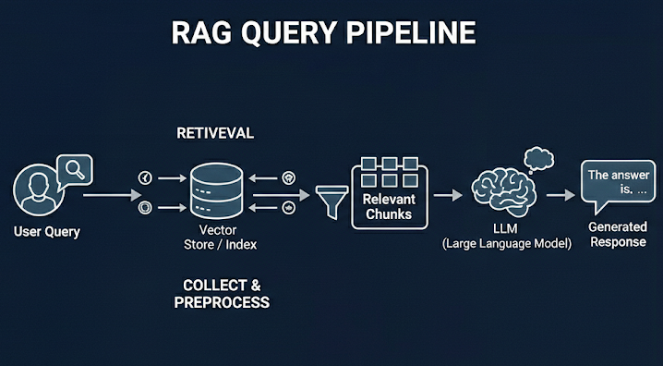
Retrieval Process
User Query ➔ Embed the query
Vector Search: Finds top 6 similar chunks in Qdrant.
Feed Query + Context -> LLM(llama-3.3-70b-versatile)(Groq API key)

Slide 9
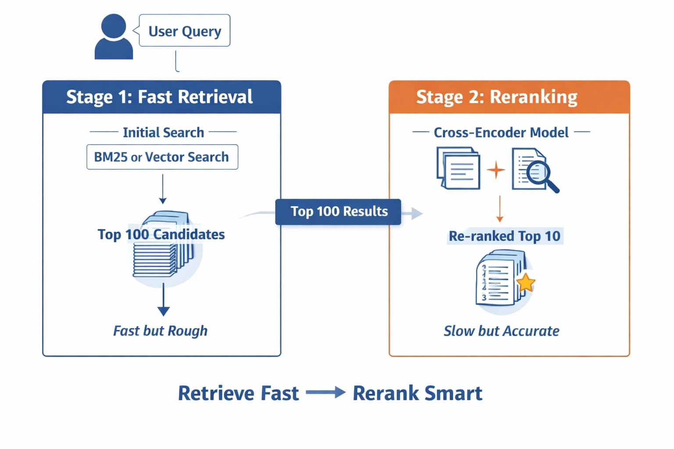
Required Improvement
Hybrid Retrieval ➔ Dense + Sparse(BM25)
Reranking(Cross-Encoder)
Maximal Marginal Relevance (MMR): Balance relevance with diversity (reduce redundancy)
Query Transformation: Multi-Query Generate 3-5 query variations.
Query Routing: Not every query should go to RAG.
RAG Evaluation: Retrieval Metrics, Generation Metrics
Implement semantic caching

Slide 10




Next Steps
Model Fine-Tuning
Multi-Regional Deployment
Autonomous Agents
Train custom Telecom Egypt models for improved accuracy
Enable actions (bill payments, service changes) with authentication
Expand to other operators

Slide 11




Thank You
Questions & Discussion
We welcome your questions, feedback, and ideas for improvement. Let's discuss how this RAG system can transform customer support at Telecom Egypt.
Email
Documentation
Live Demo
mohamedsaidabusamaha@gmail.com
https://github.com/MohamedSaeed130/Telecom-Egypt-mini-chatbot
DEMO
The complete source code, documentation, and deployment guides are available in the project repository. Thank you for considering this solution!

