Slide 1





Football Match Prediction (FMP)
Problem Statement & Dataset
Proposed Analytical | Predictive Model
Result and Discussion
Conclusion
Mohamed Said

Slide 2

Problem
Statement
The Football Match Prediction project focuses on developing a model to forecast football match outcomes and identify key statistical metrics influencing these outcomes. Utilizing historical match data and machine learning, the project aims:
To predict Home Win, Away Win, or Draw and
Highlight the most impactful game factors (Features)
BENEFITS:
Understand / Justify The Outcome
Expected? Anomaly?
Analyze areas of improvements
Defense? Midfield? Attack?

Slide 3
DATASET DESCRIPTION
Data for all English Premier League matches downloaded from Kaggle.com. There are 4,070 matches, from 2010 to 2021, with 113 stats features for each match and team performance throughout the season at the time of each match.
MATCH INFO
DEFENSIVE
MIDFIELD
ATTACK
TARGET VARIABLE
Home Team
Away Team
Match Date & Round
Season
Match Result
Match Score
Tackles
Clearances
Fouls
Yellow & Red cards
Touches
Possession
Passes
Total Shots
Shots on Target
Corners
Offsides
Match Result:
HOME WIN, AWAY WIN, DRAW

Slide 4
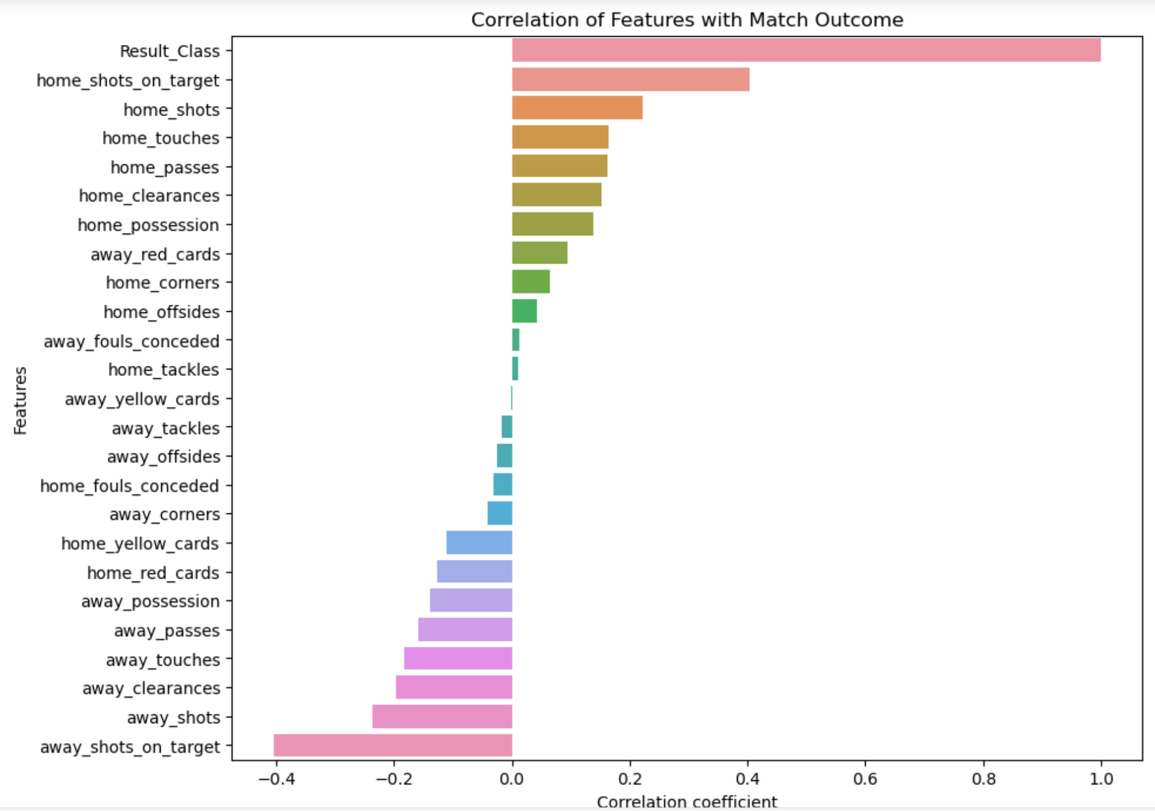
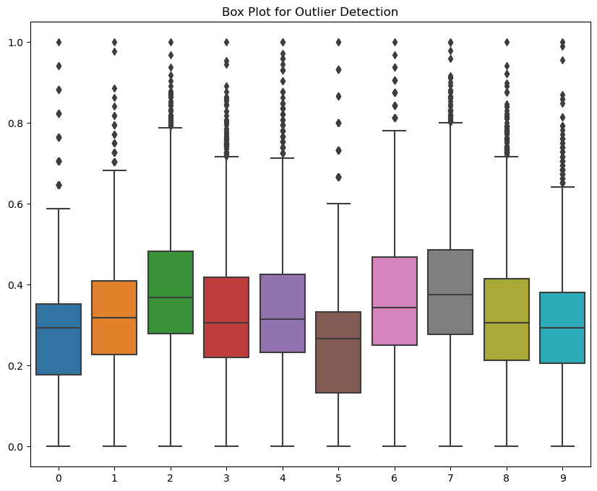
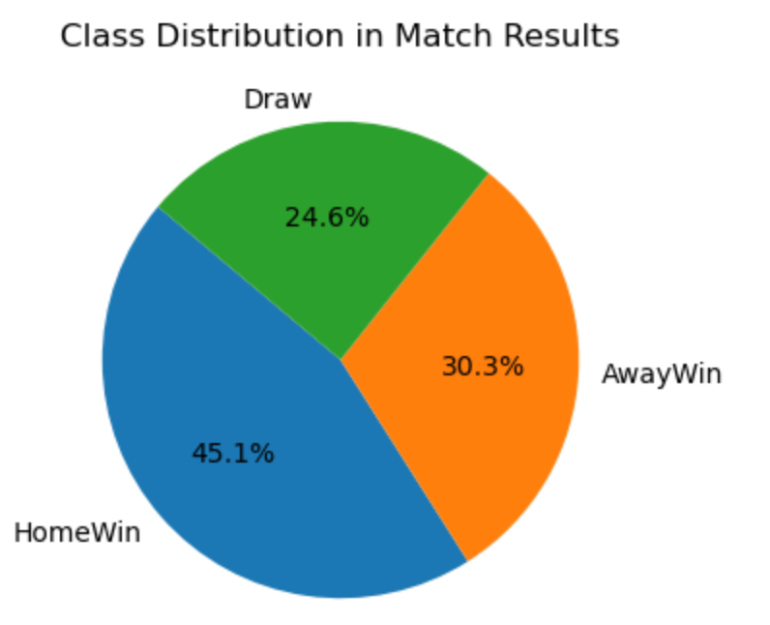
home_shots_on_target: 29
home_shots: 26
home_touches: 17
home_passes: 21
home_clearances: 33
away_shots_on_target: 36
away_shots: 24
away_touches: 19 outliers
away_passes: 32 outliers
Created Class Label: From match result feature.
Feature Reduction: Reduced dataset features from 114 to 25 using field knowledge and looking for repetitive stats (averages, half time, etc.)
Feature Selection: Used Pearson correlation method to select most impactful features. 5

Slide 5
Predictive Model - Logistic Regression
Multiclass Classification
Model
The project used Logistic Regression to solve the prediction problem because of research methodology paper showed that LR scored the highest accuracy for this problem (80%).
Method
Used Multiclass One-versus-Rest

Slide 6
PROPOSED ANALYTICAL
MODEL IMPLEMENTATION
STEPS
MODEL PREDICTION
DATA CLEANSING
MODEL TRAINING
MODEL HPO
Created Label Class
Removed Unnecessary features
Feature Selection
Feature Scaling (MinMaxScalar)
Data split (80-20)
Performed OVR Logistic classification
Both Grid search and Random Search were used for hyperparameter tuning. Random Search scored slightly better.
The initial model is trained on the training set, and predictions are made on the test set.

Slide 7
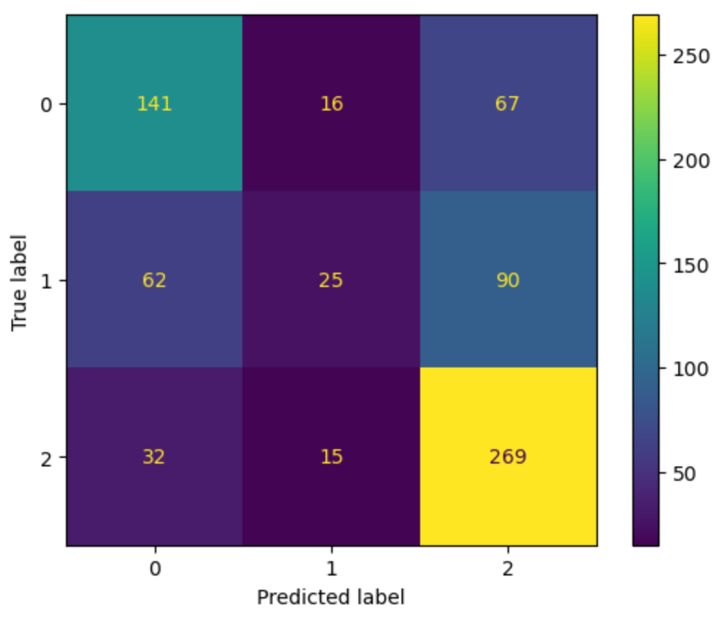
RESULTS AND DISCUSSION
MODEL PERFORMANCE MEASUREMENT
1.8%
HPO
Only a few parameters were tested through Grid Search method due to compute and Time limitation. Random used.
Model delivered the expected results on accuracy and key stats.
Accuracy lower than the researched paper due to it being multiclass.
Add modern-day stats like expected goals (xG) to indicate how serious the created chances were to improve model accuracy.
ACCURACY
F1 SCORE
RECALL
62.83%
72%*
86%*

Slide 8

THE END
ANY
QUESTIONS?

