Slide 1
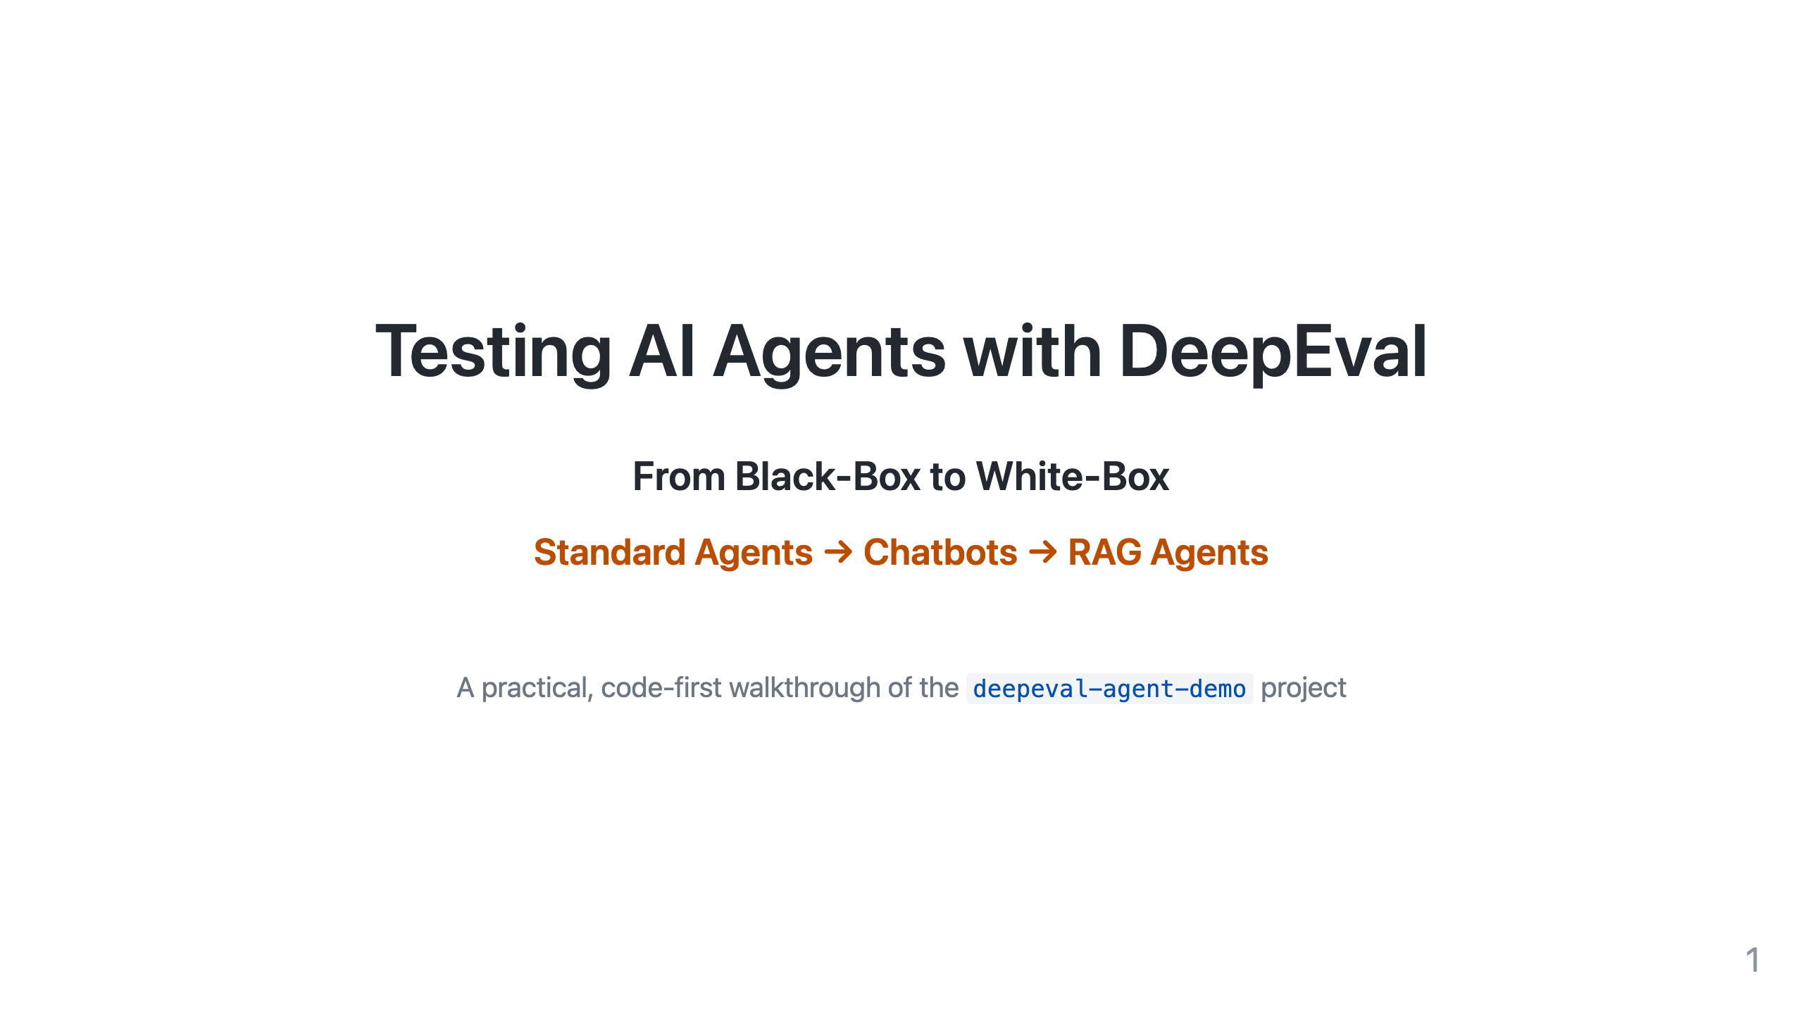
Notes:
Speaker notes:
- Welcome the team. Set expectations: by the end they will know WHEN to use WHICH metric and WHY.
- The whole session is grounded in one small repo we can run live.
- Journey: start treating the agent as a black box (easy, cheap), then open the box (white-box) to inspect how it got the answer.

Slide 2
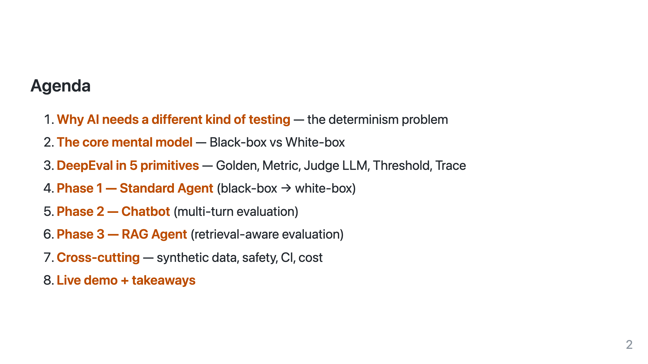
Notes:
Keep this slide up for ~30s. Tell them phases 1-3 mirror the folders in /evals.

Slide 3
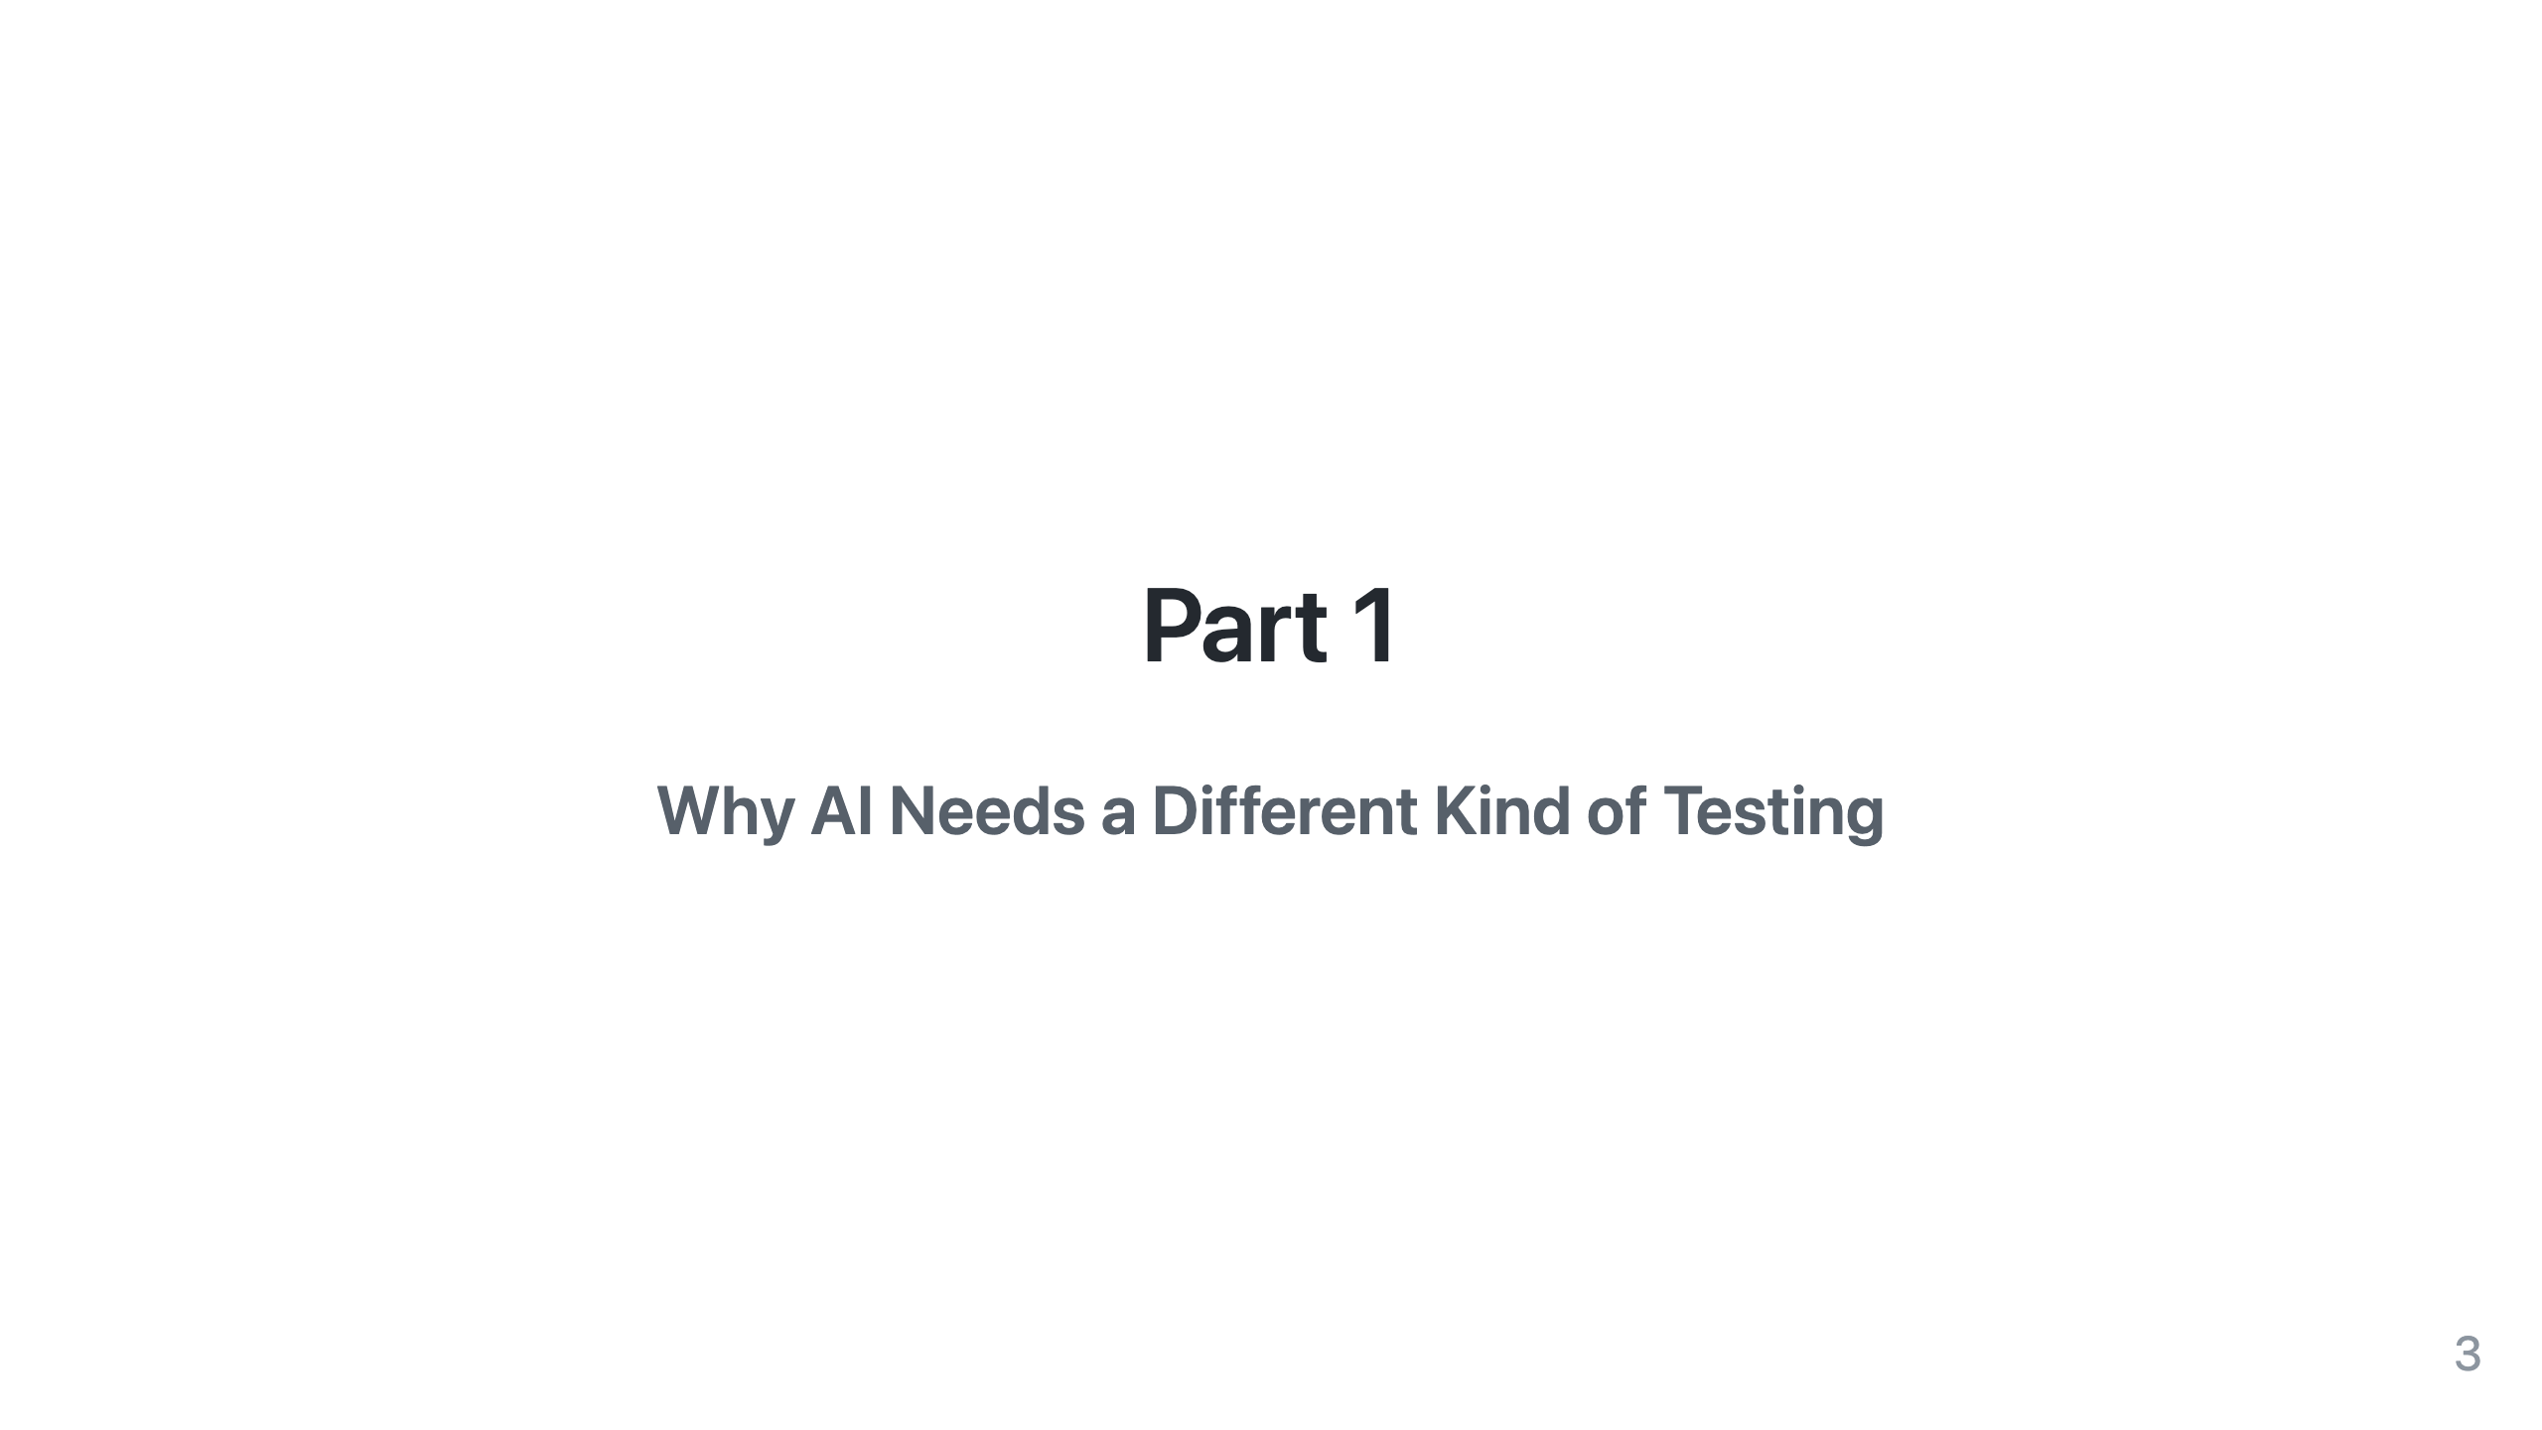

Slide 4
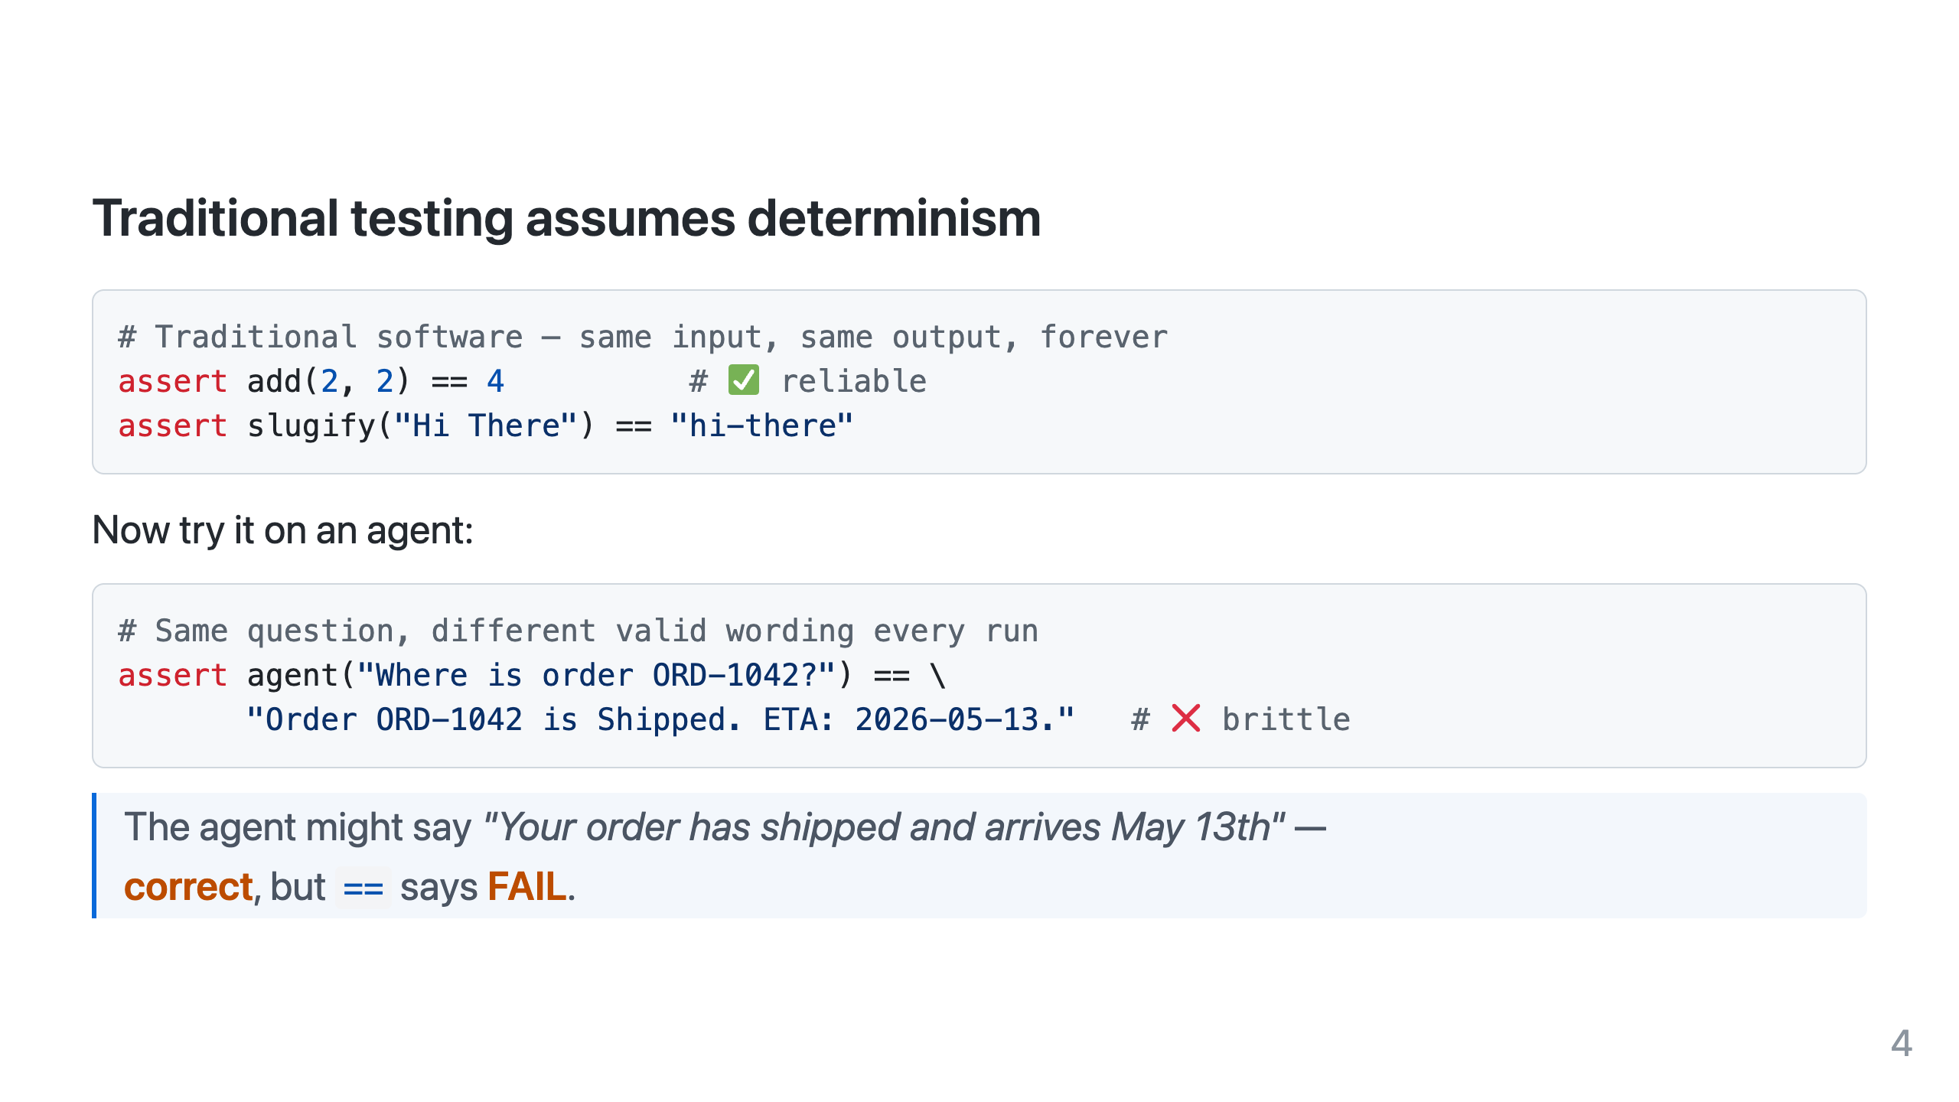
Notes:
This is THE motivating slide. Everyone has felt this pain.
Non-determinism sources: sampling/temperature, model updates, tool ordering, paraphrasing.

Slide 5
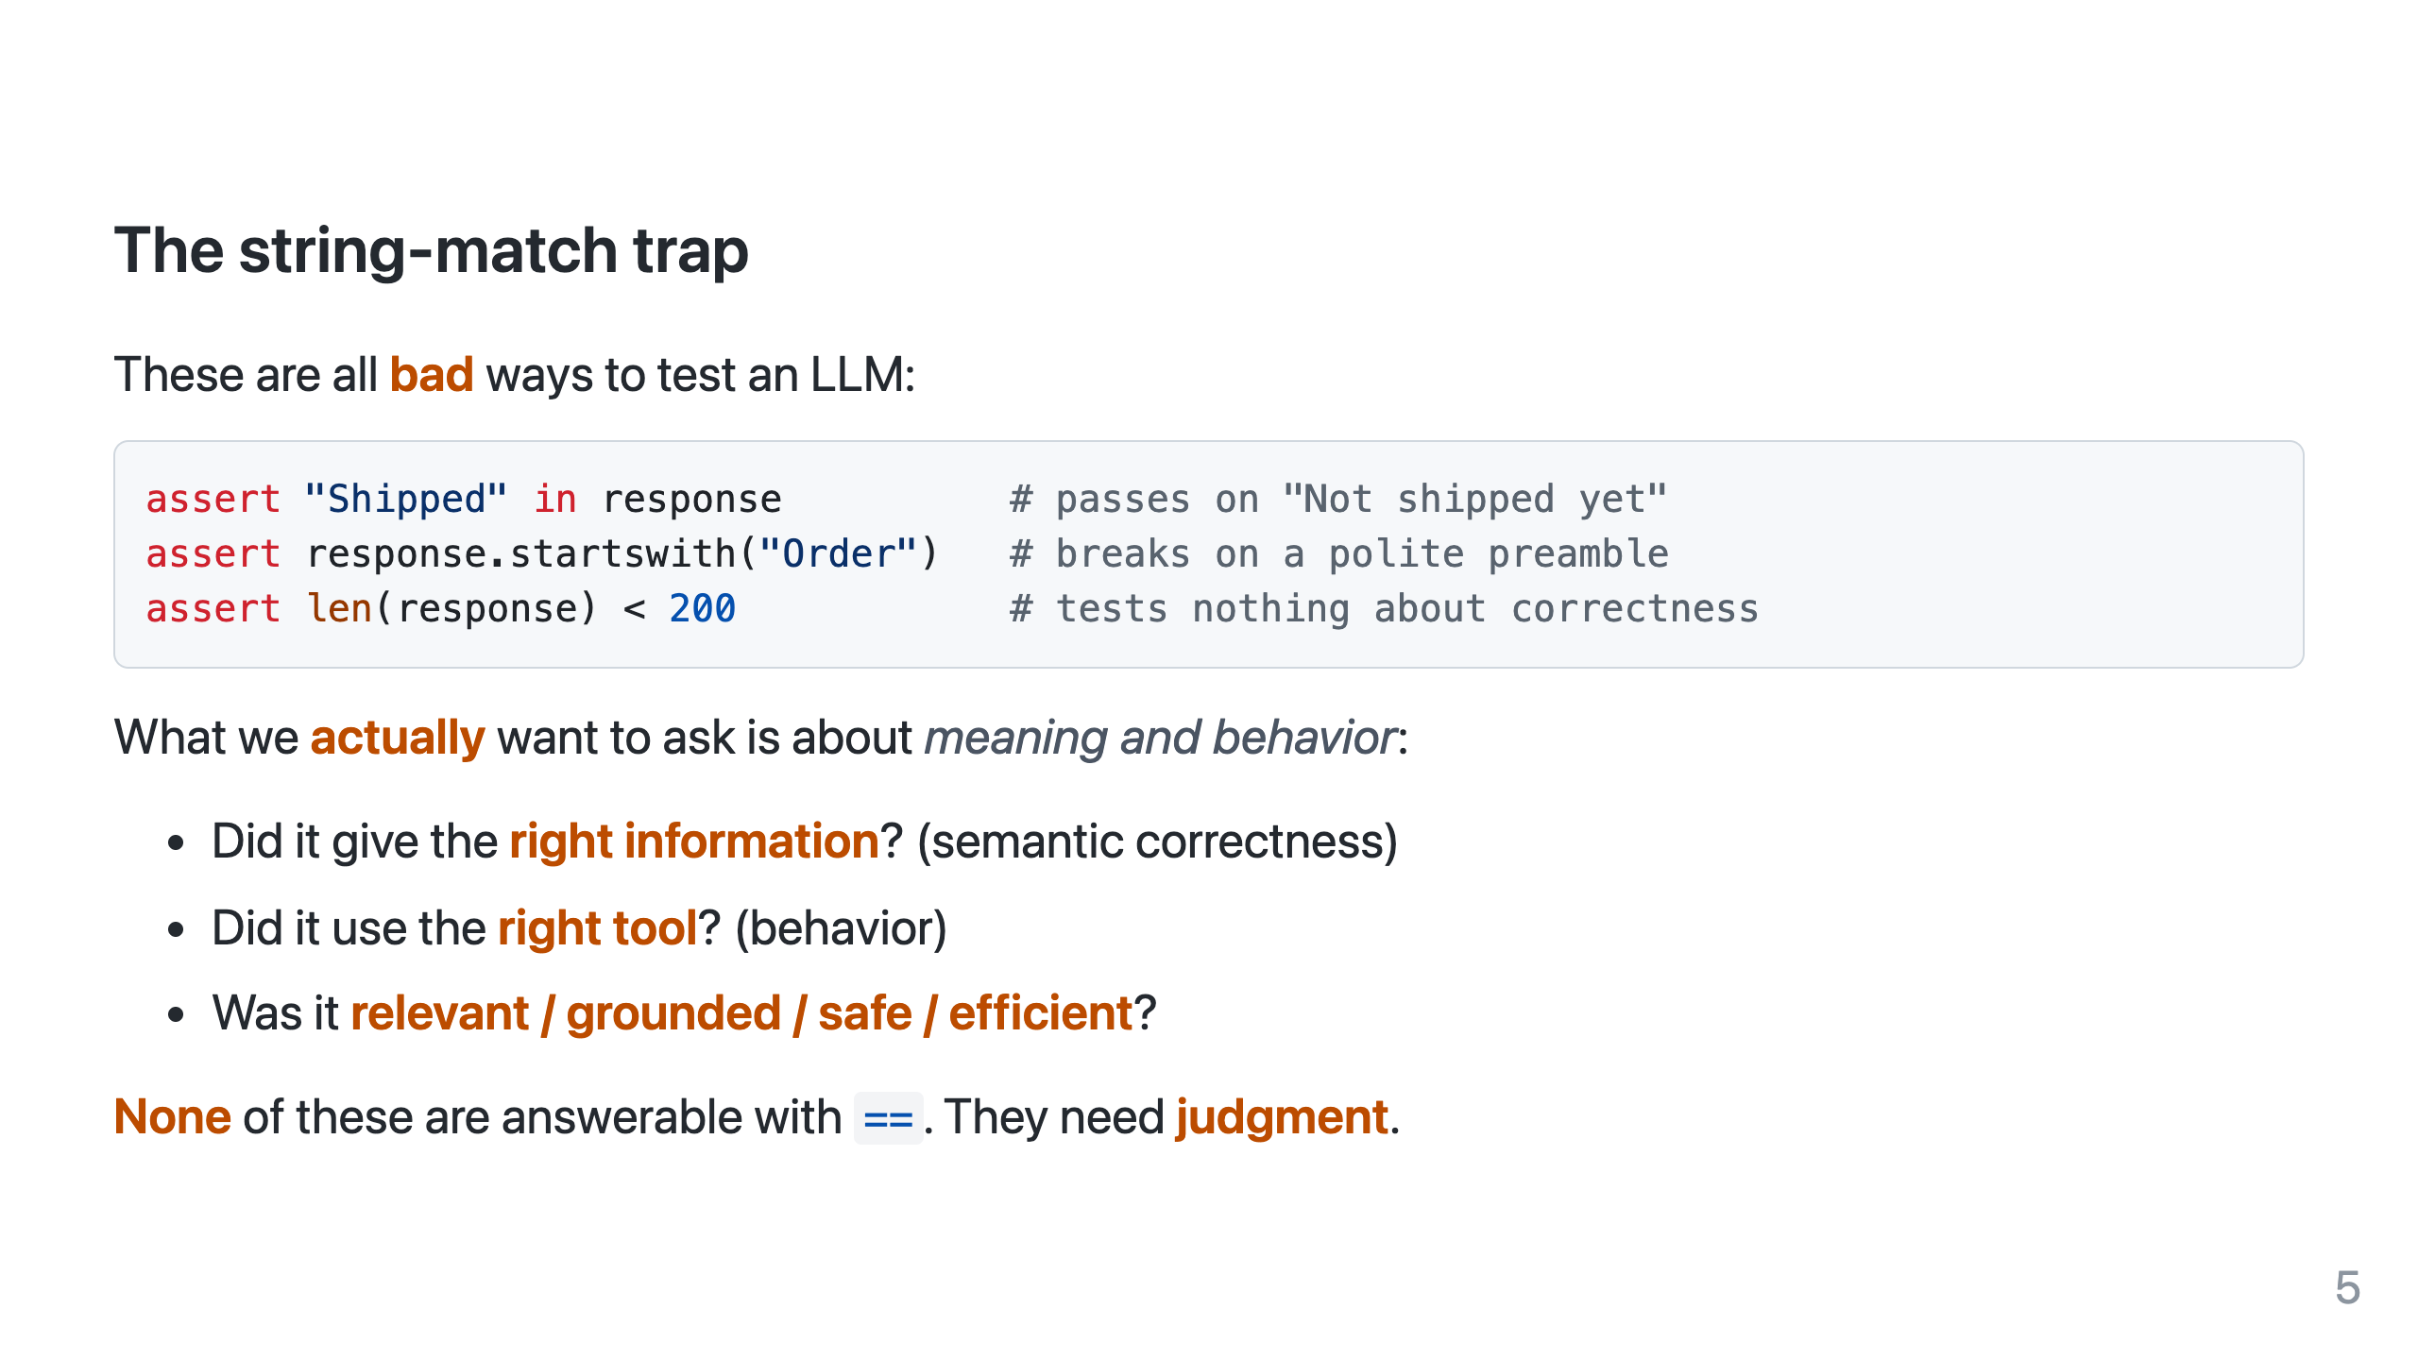

Slide 6
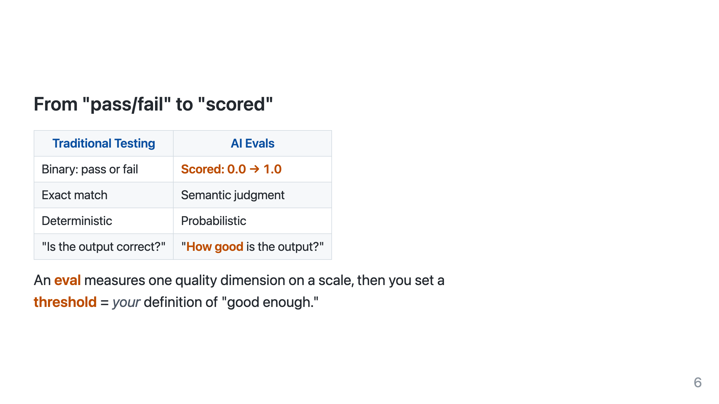
Notes:
Bridge: evals are how we replace assert-equals. DeepEval is the framework that gives us the metrics + judge + runner.

Slide 7
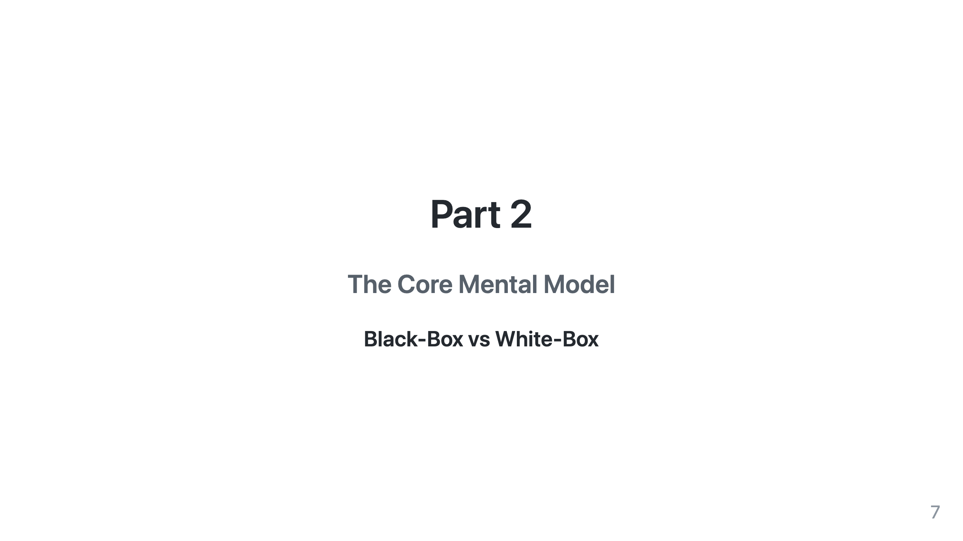

Slide 8
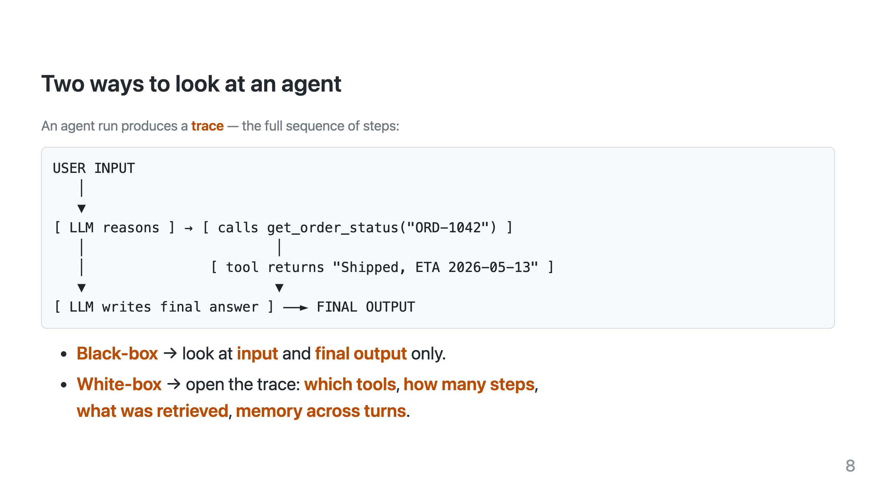

Slide 9
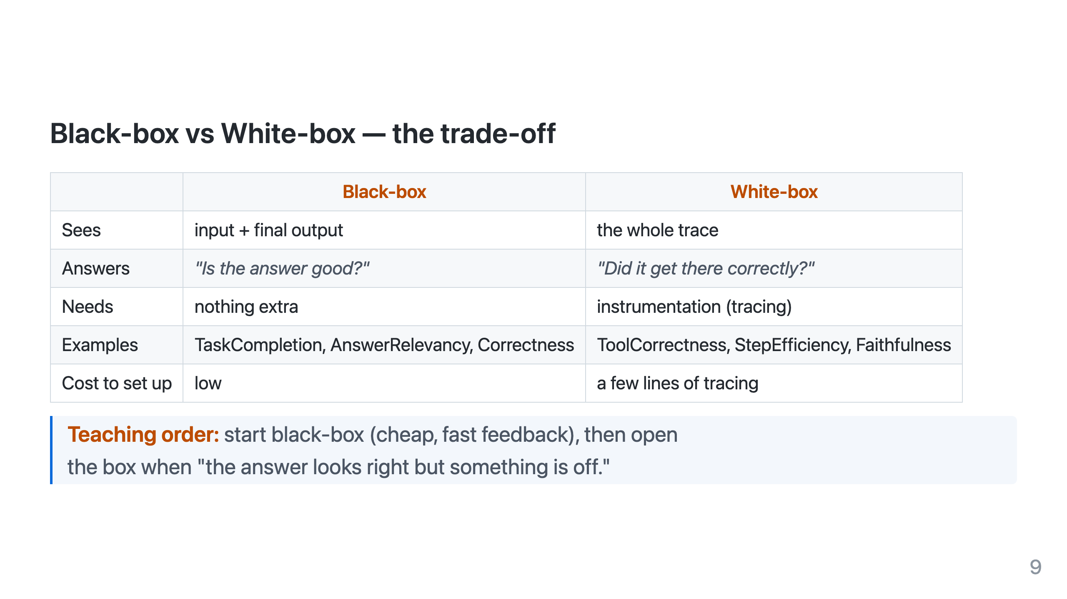
Notes:
The punchline of the whole talk lives here. A passing black-box test can hide a wrong tool call or a hallucinated-but-plausible answer. White-box catches that.

Slide 10
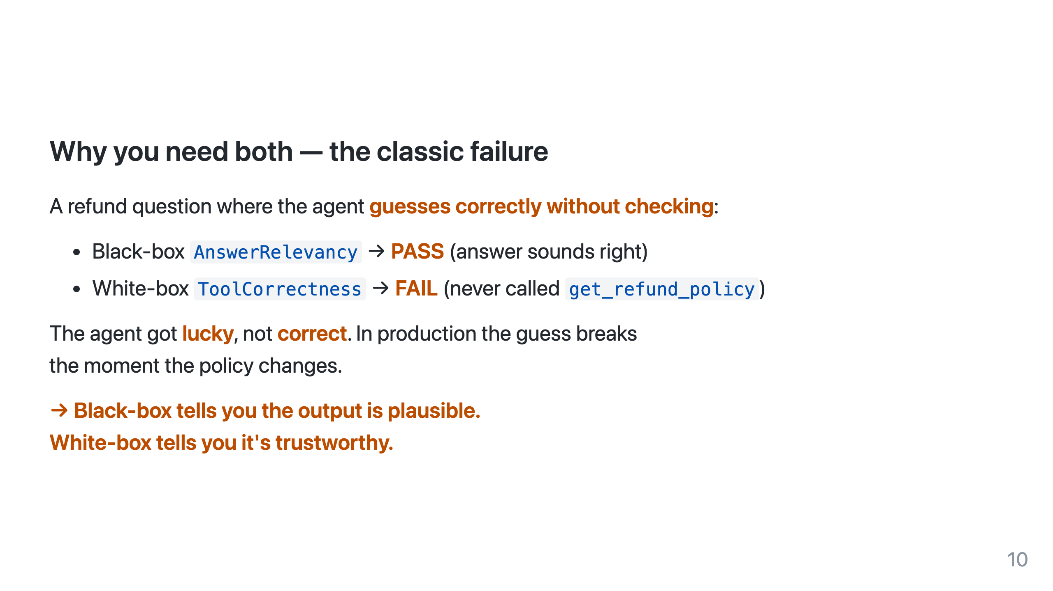

Slide 11
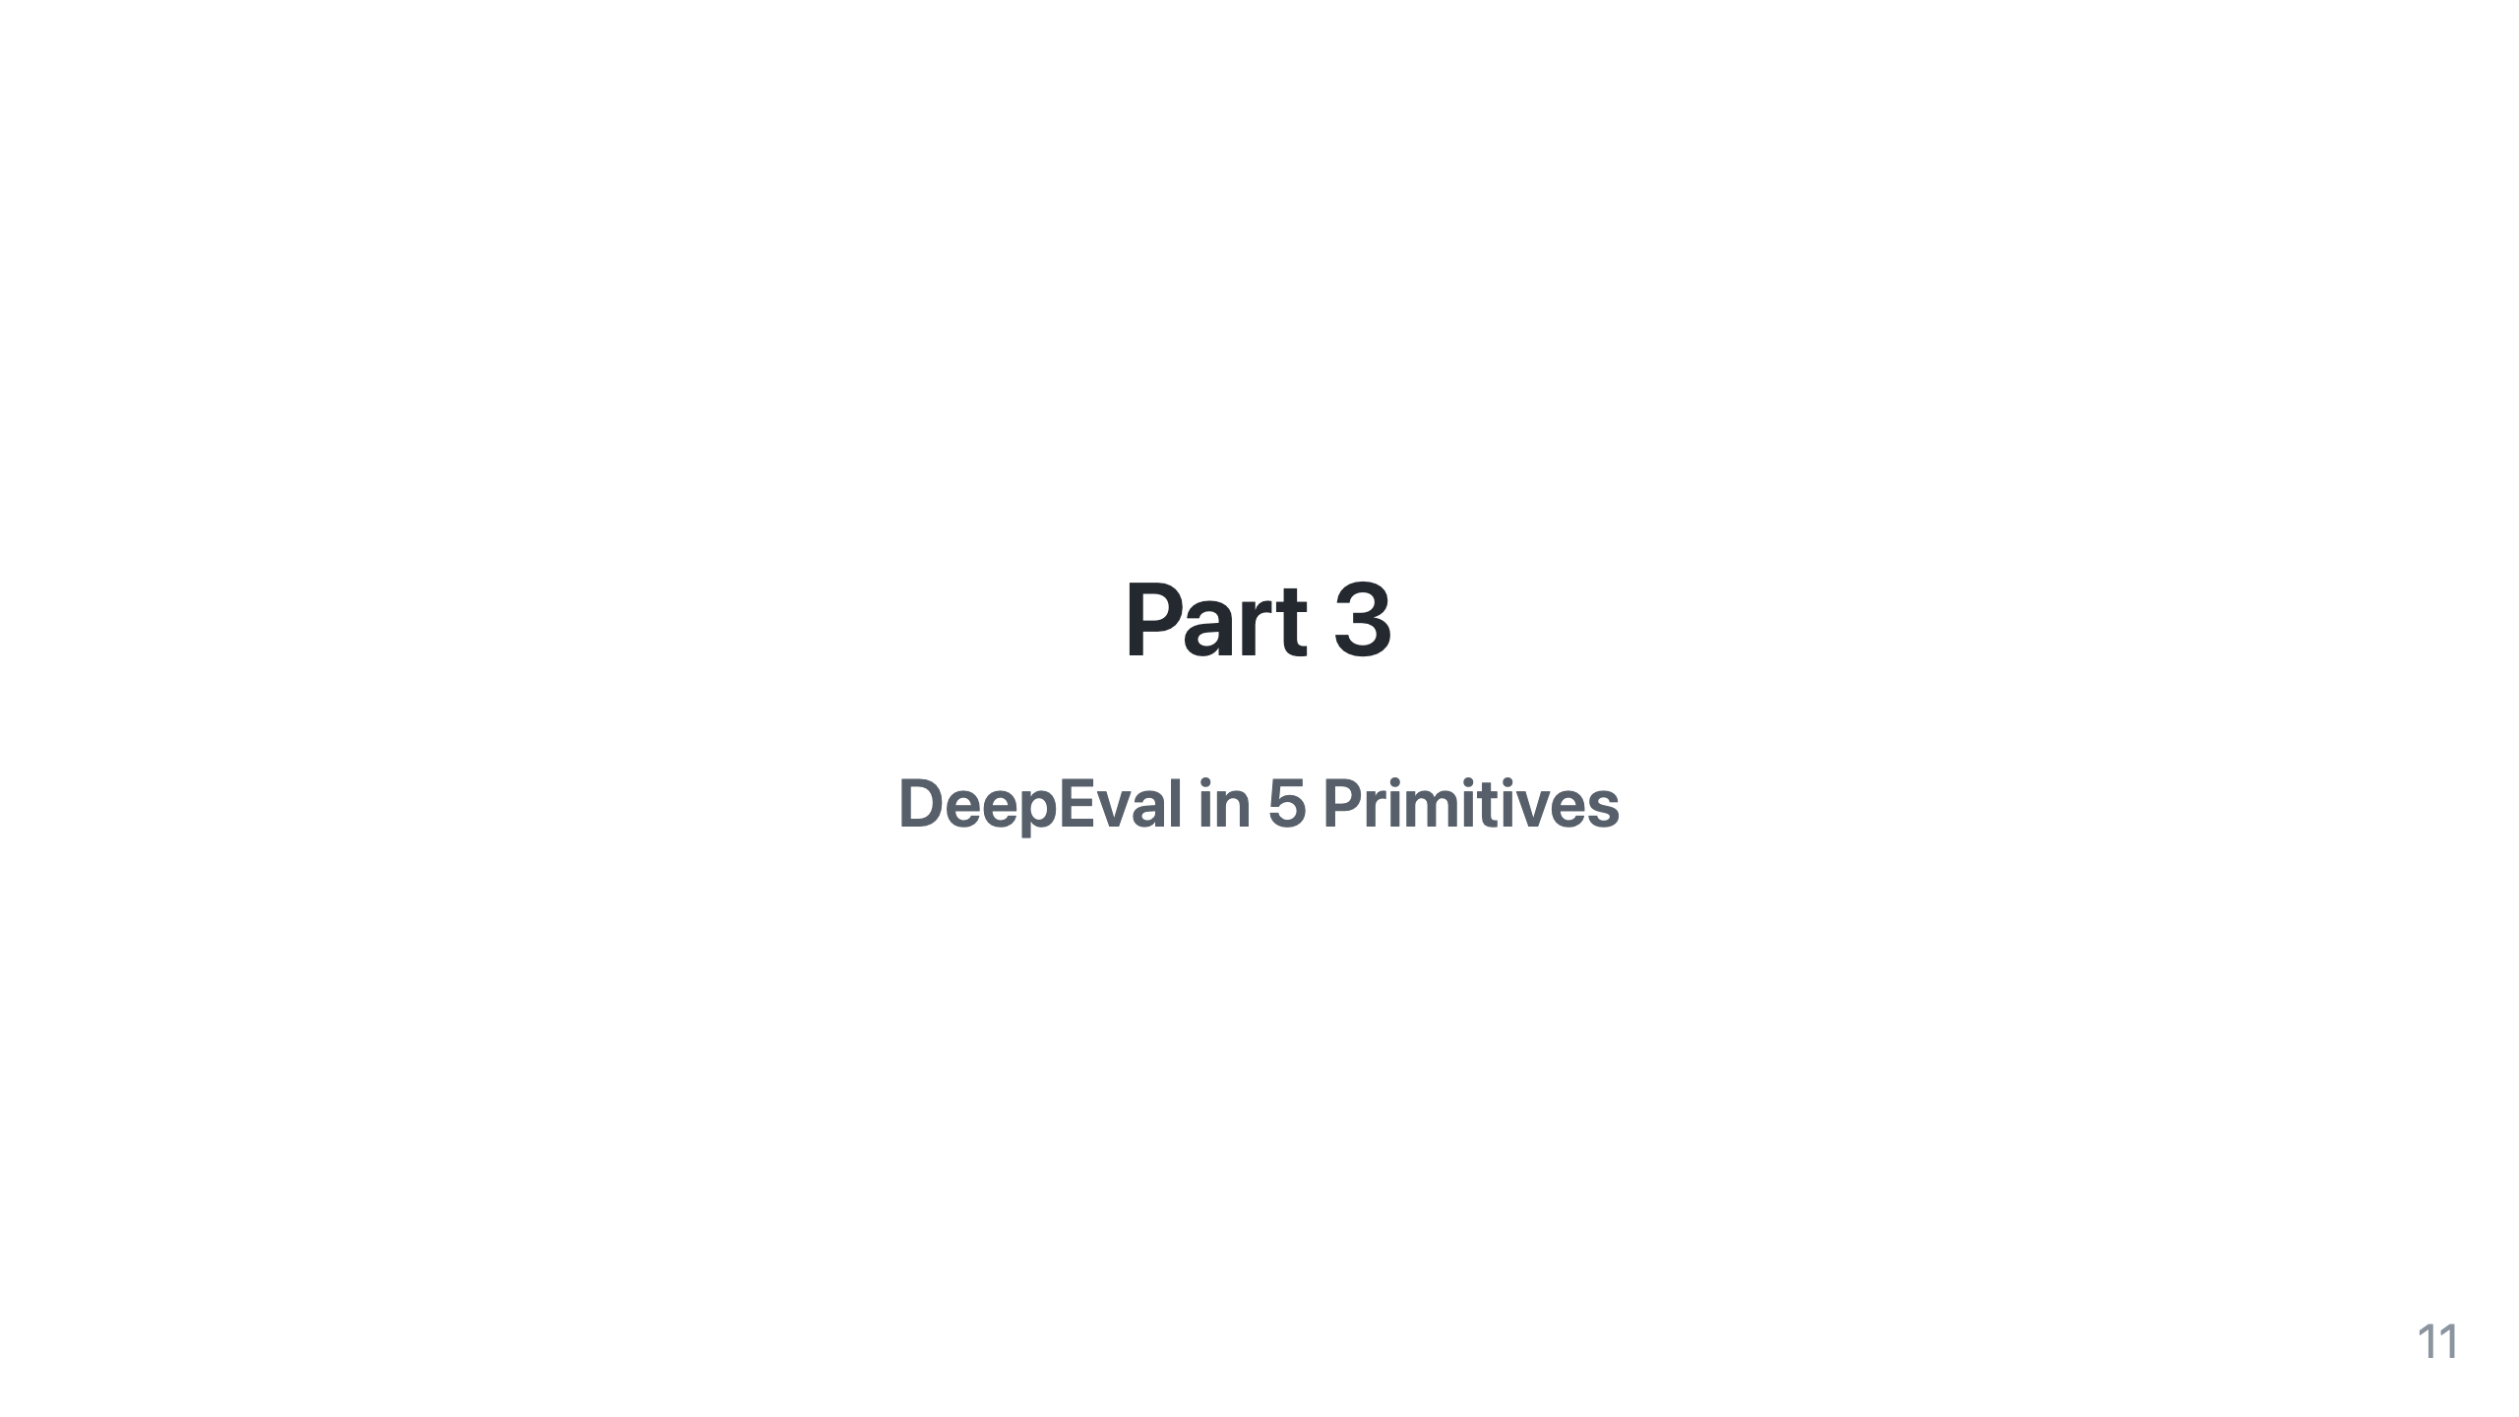

Slide 12
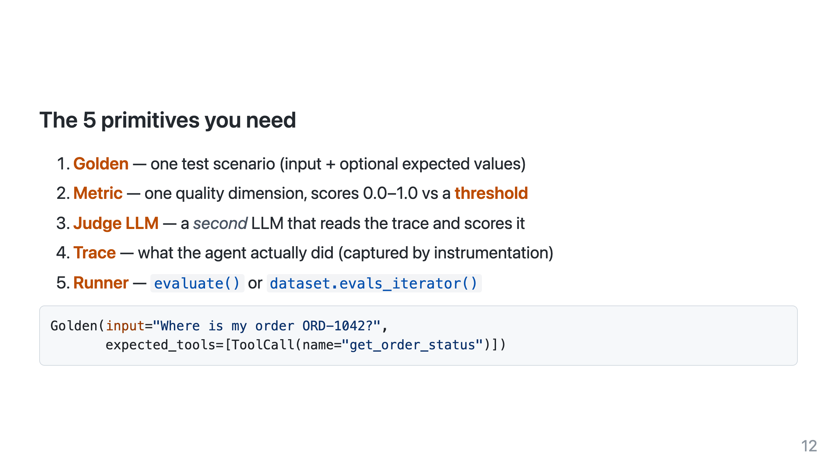
Notes:
Map each primitive to a line of code we'll see repeatedly. Keep it concrete.

Slide 13
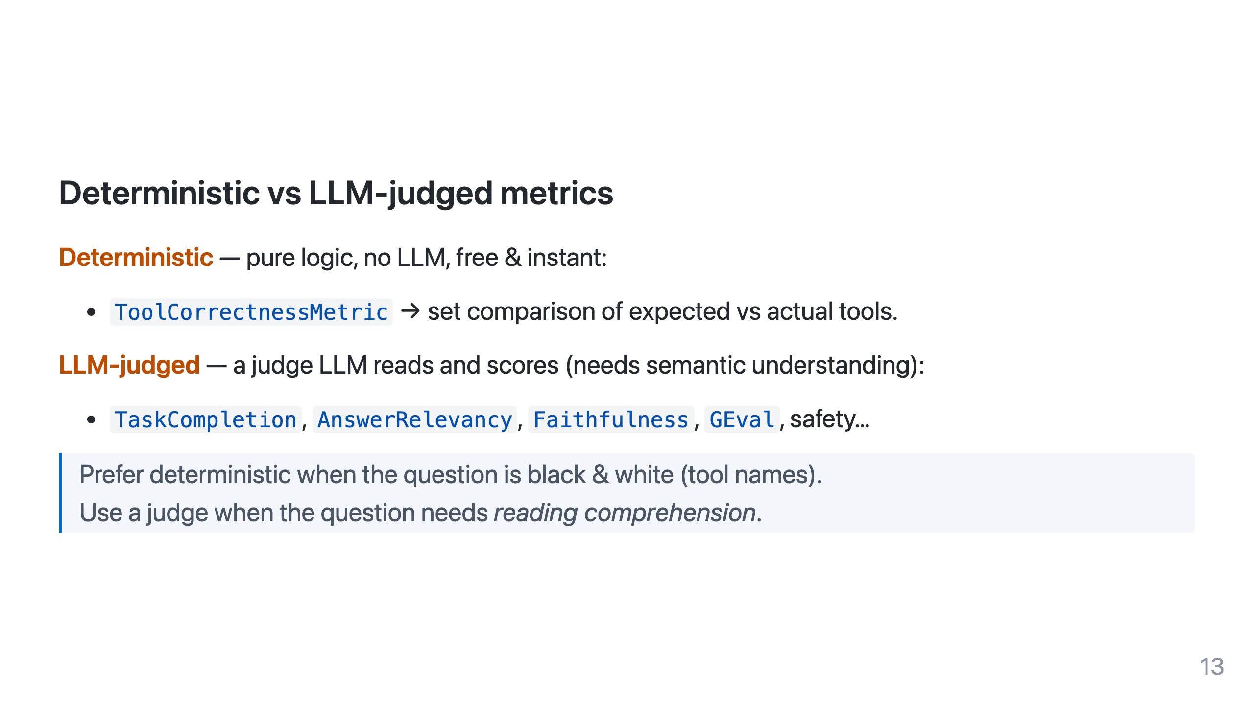

Slide 14
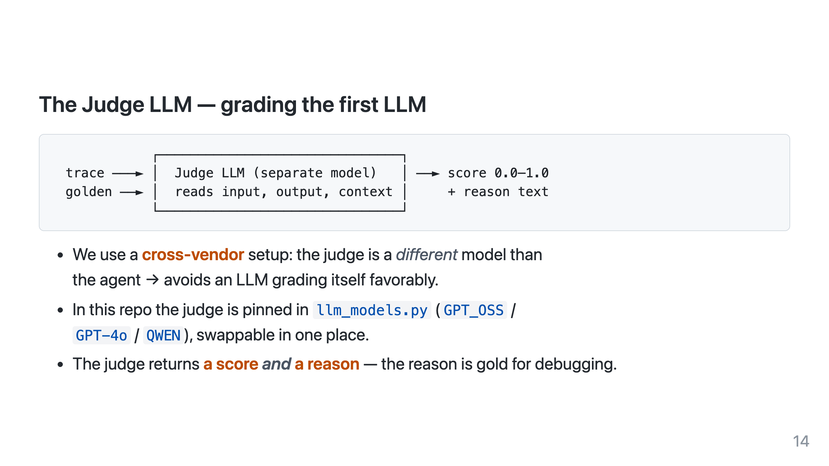
Notes:
Note the judge is imperfect & noisy; that's why thresholds are tuned per metric and why reasons matter more than the raw number early on.

Slide 15
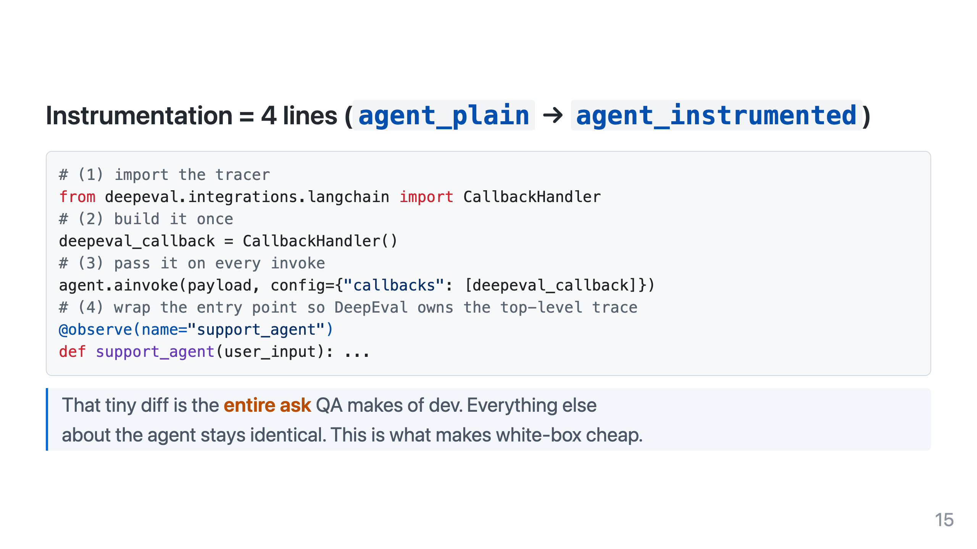
Notes:
Show agent_plain.py and agent_instrumented.py side by side live if time allows.

Slide 16
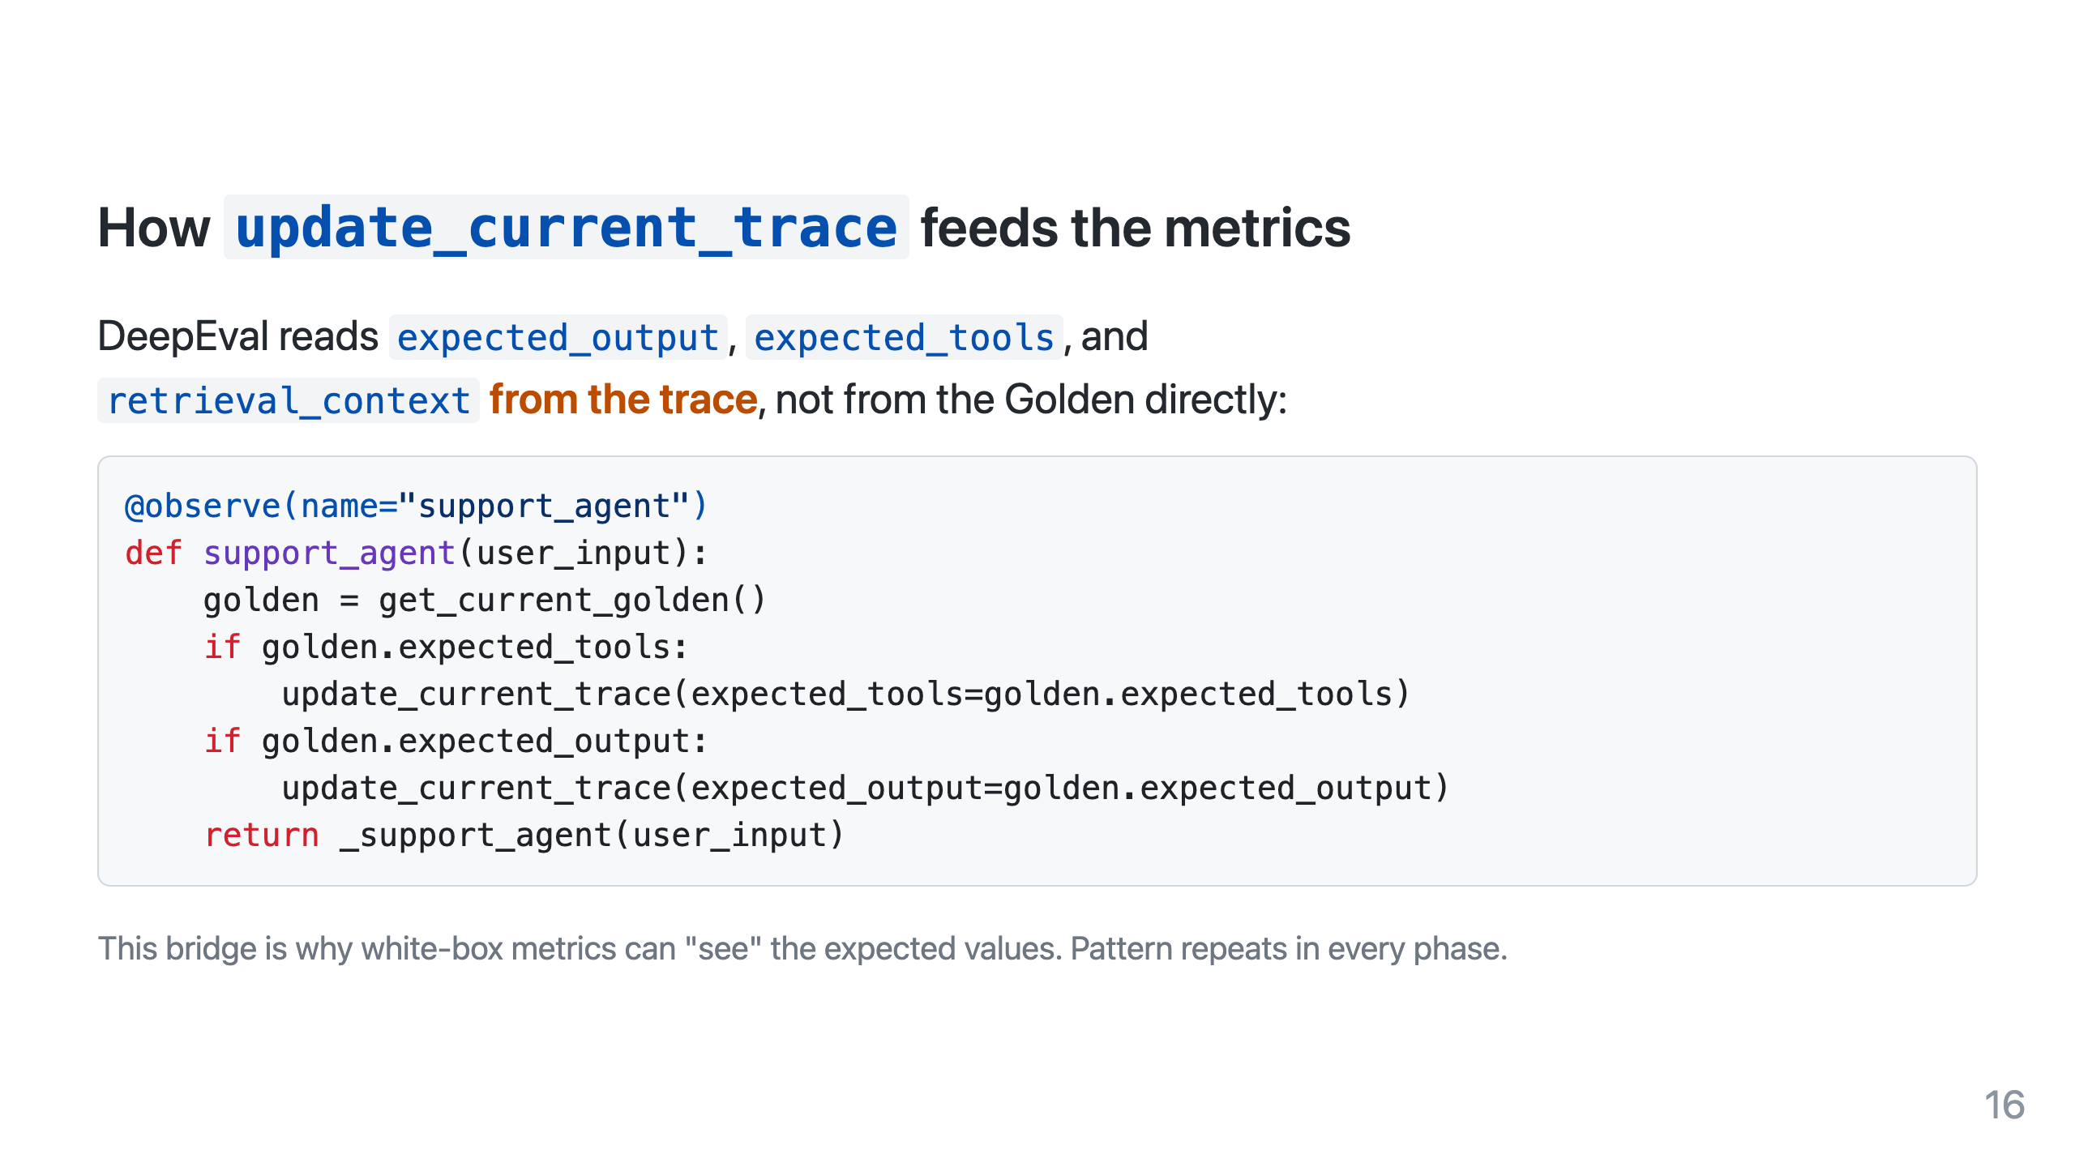

Slide 17
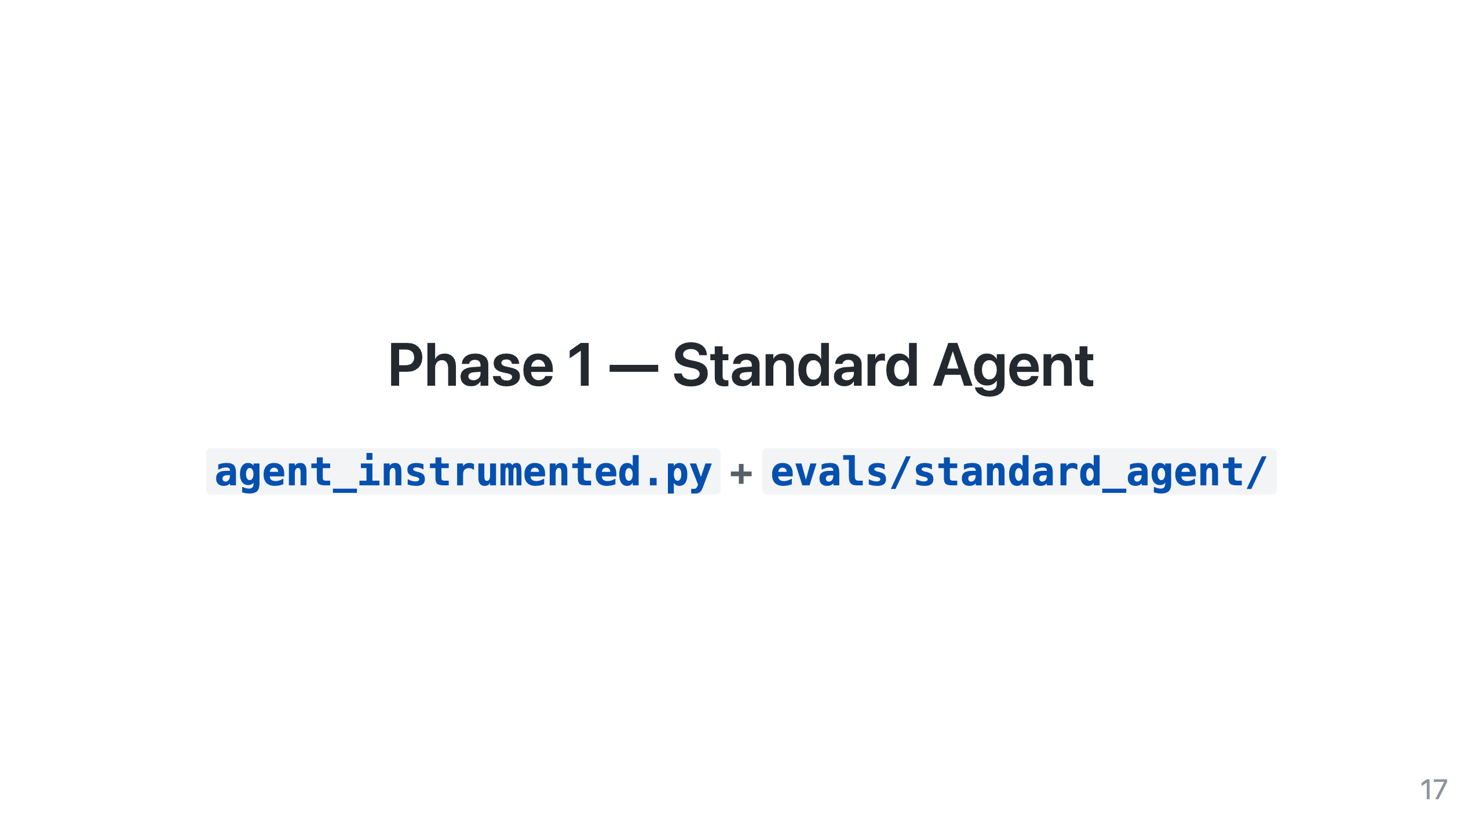

Slide 18
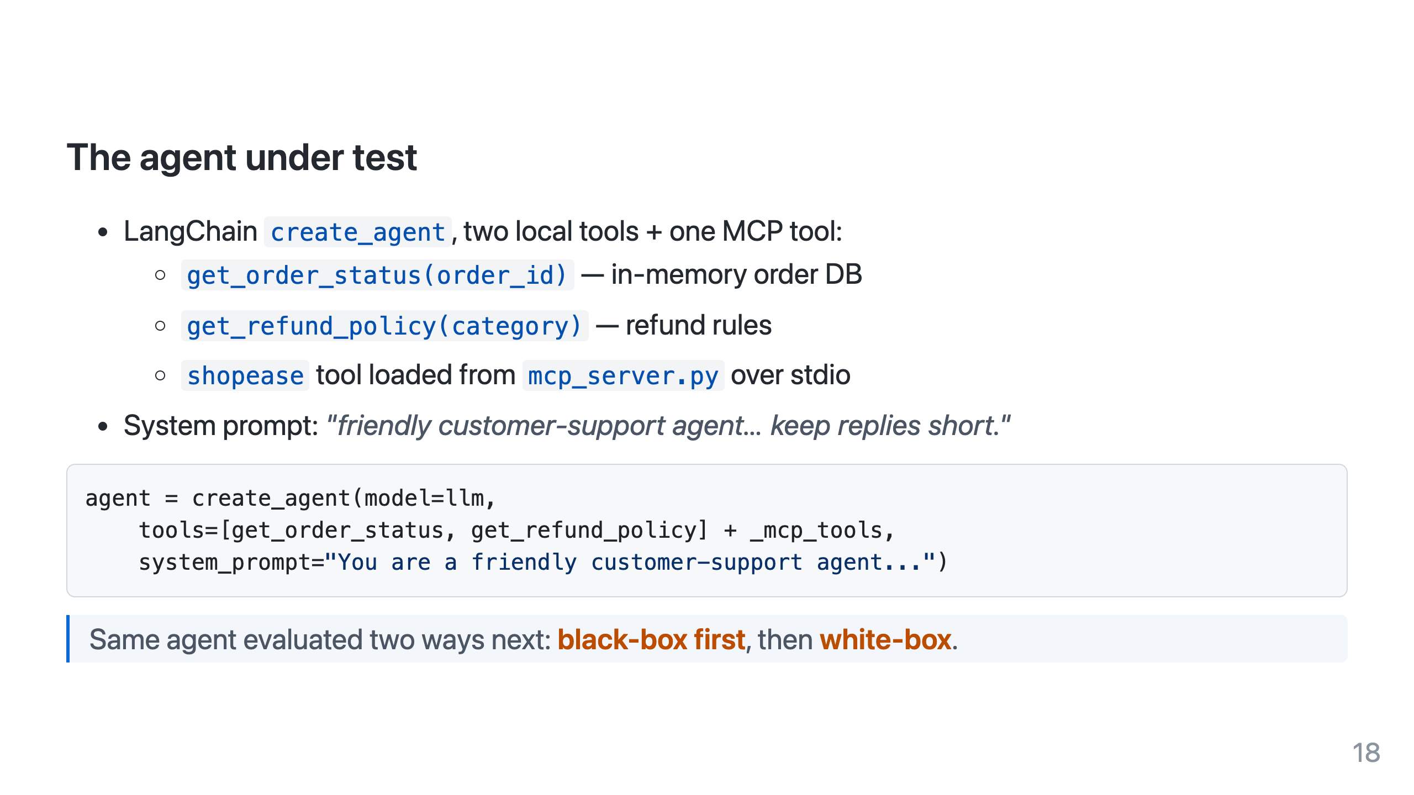

Slide 19
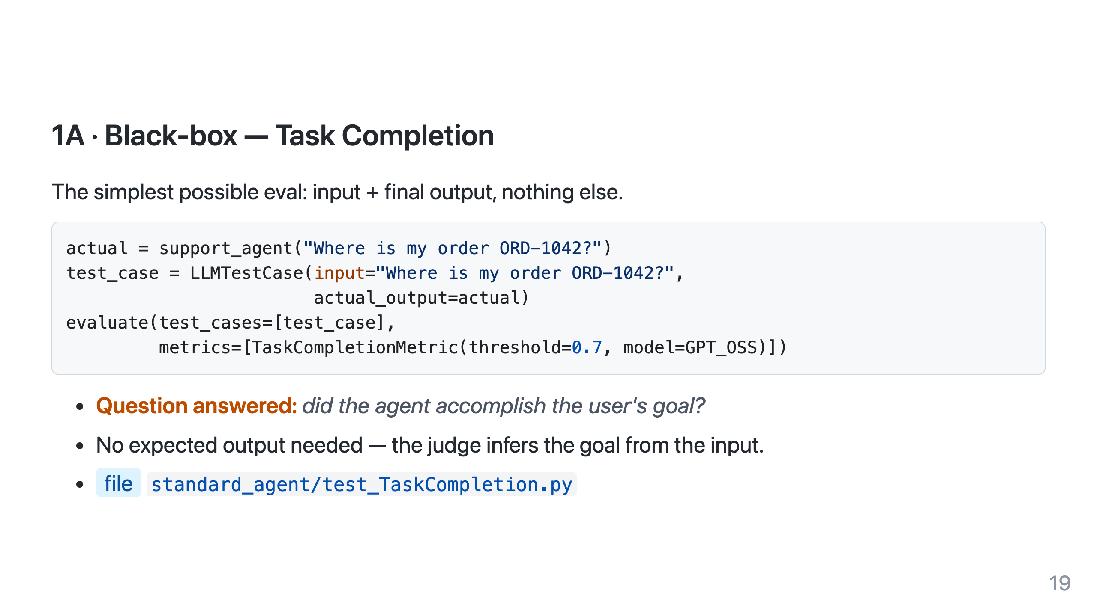
Notes:
Great starter metric: zero ground truth to author, instant signal. Downside: can't tell you HOW it got there.

Slide 20
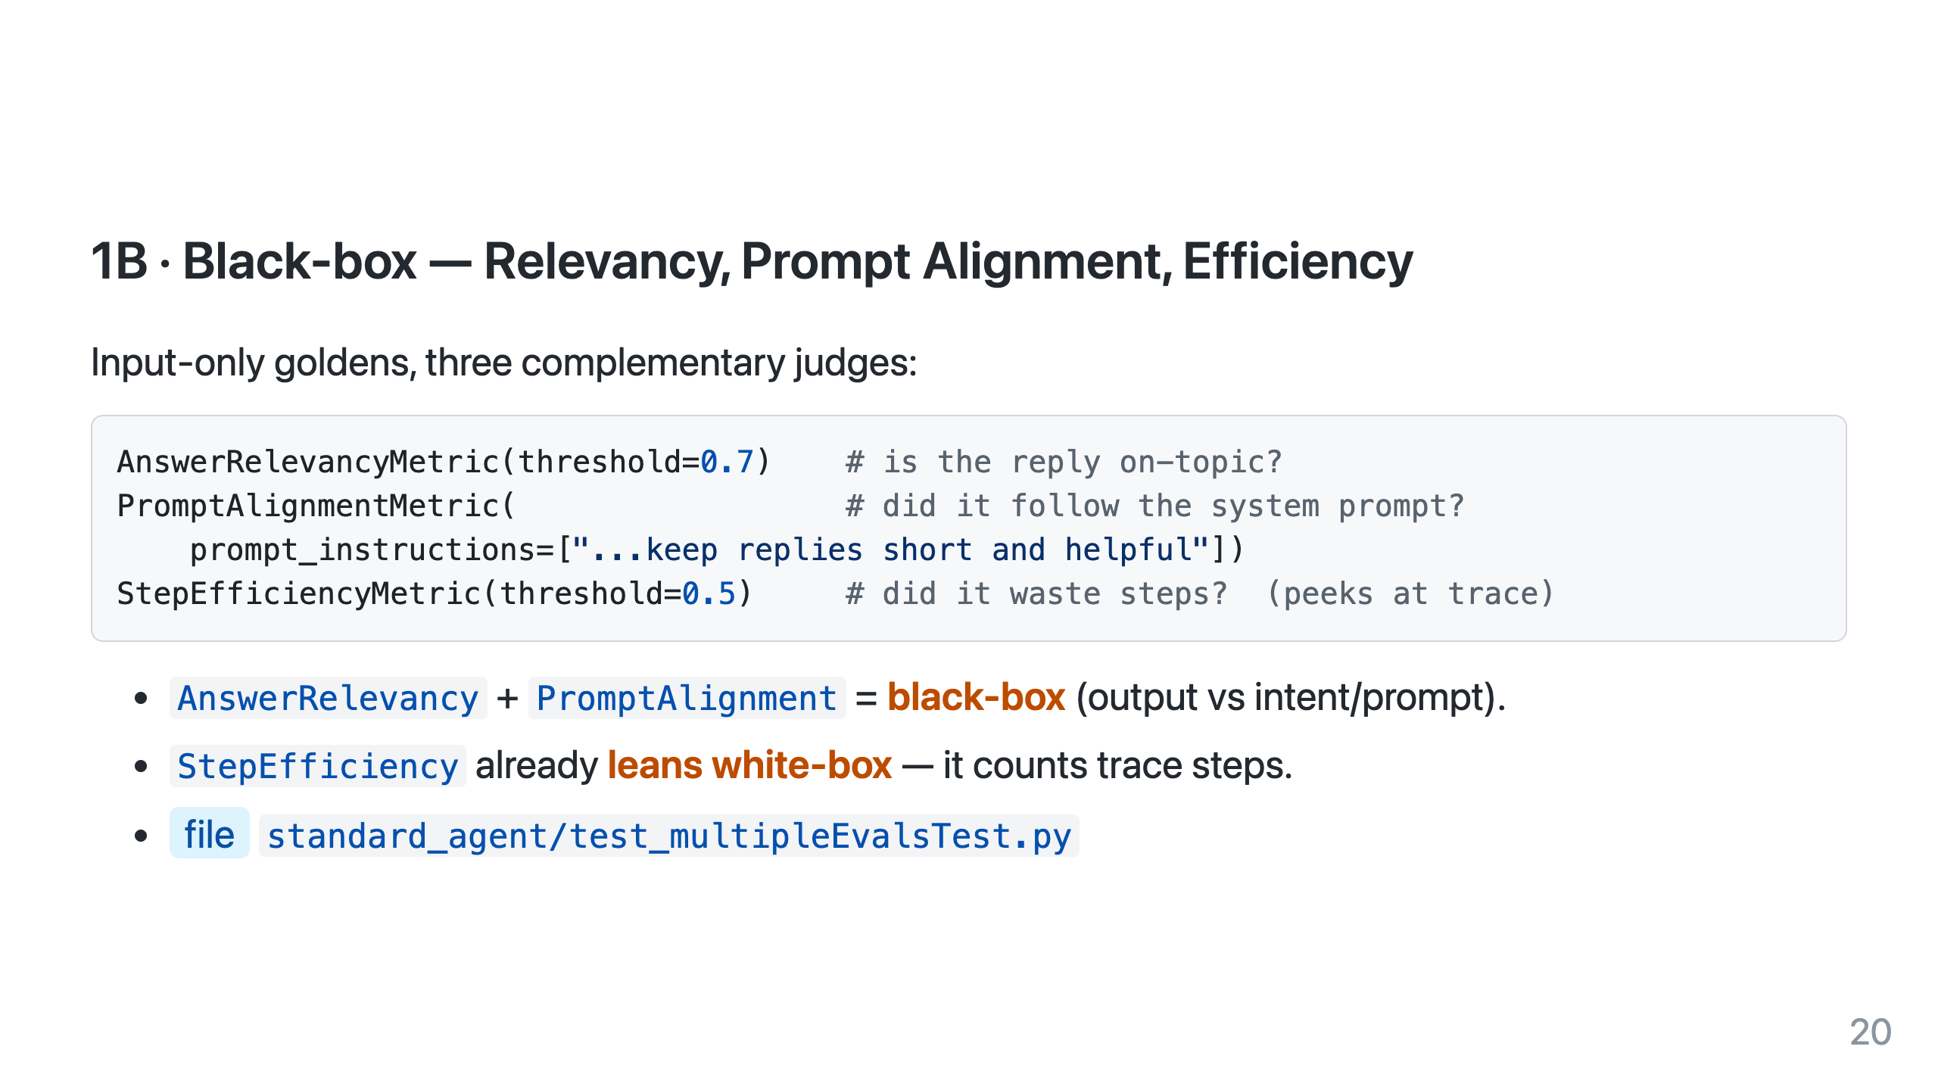

Slide 21
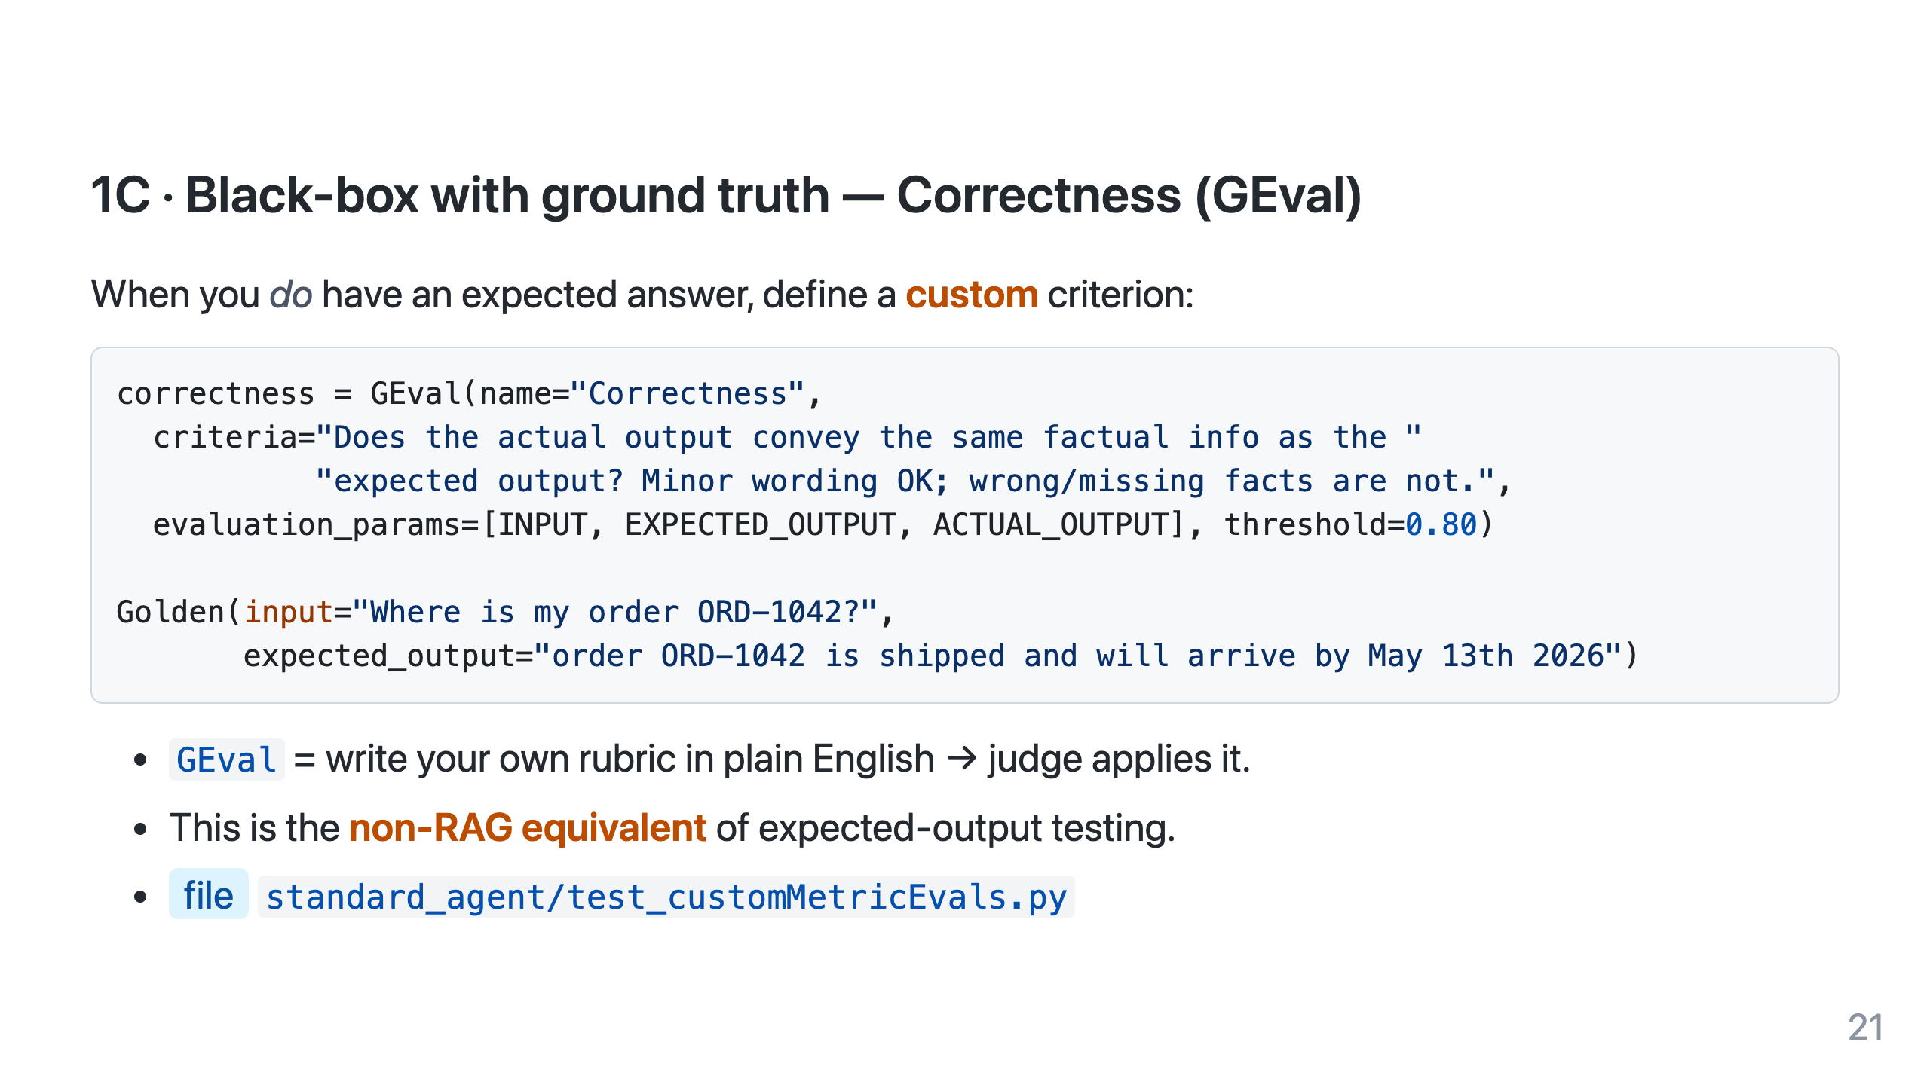

Slide 22
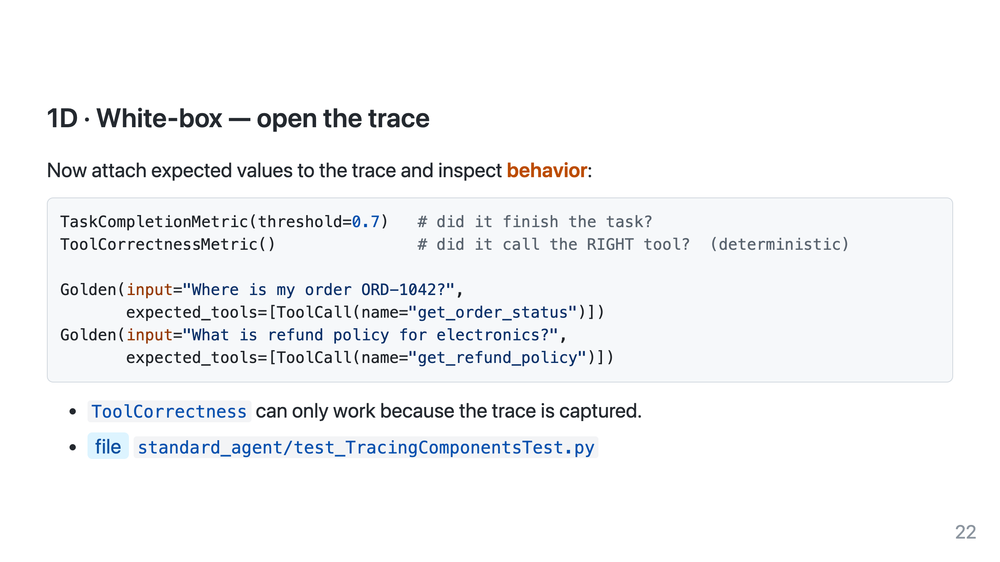
Notes:
This is the "aha": ToolCorrectness is deterministic & free, and it catches the lucky-guess failure black-box misses.

Slide 23
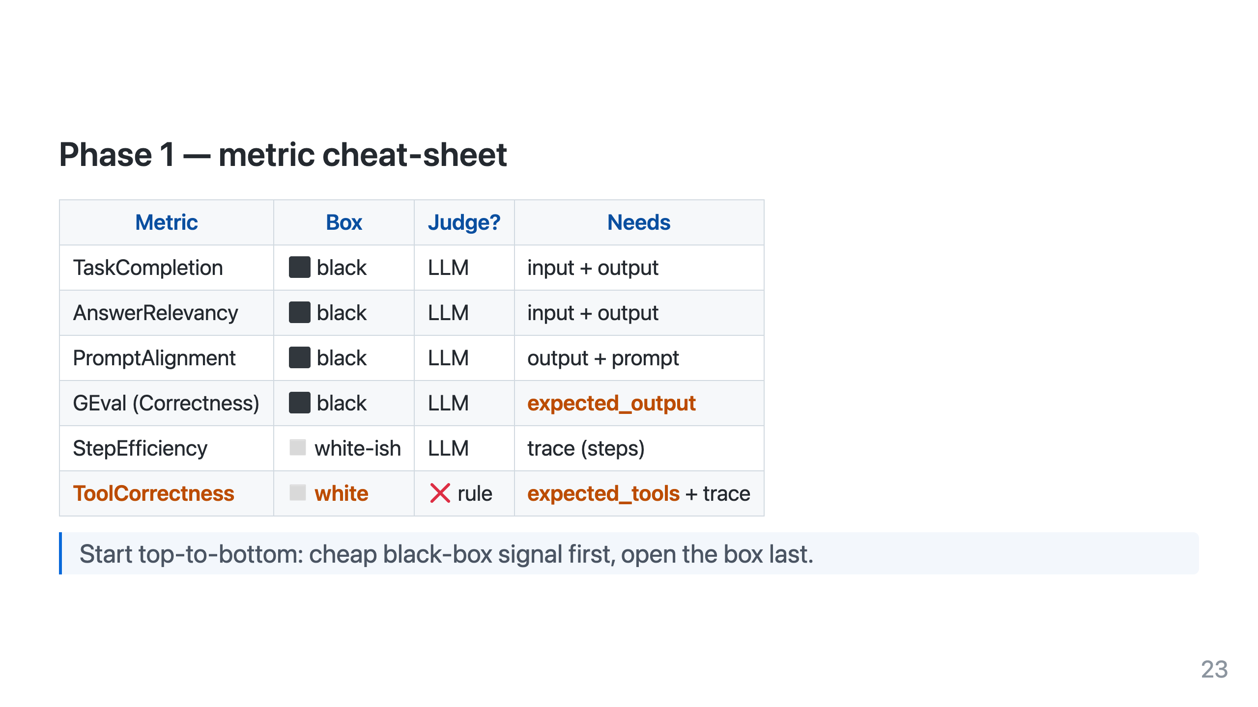

Slide 24
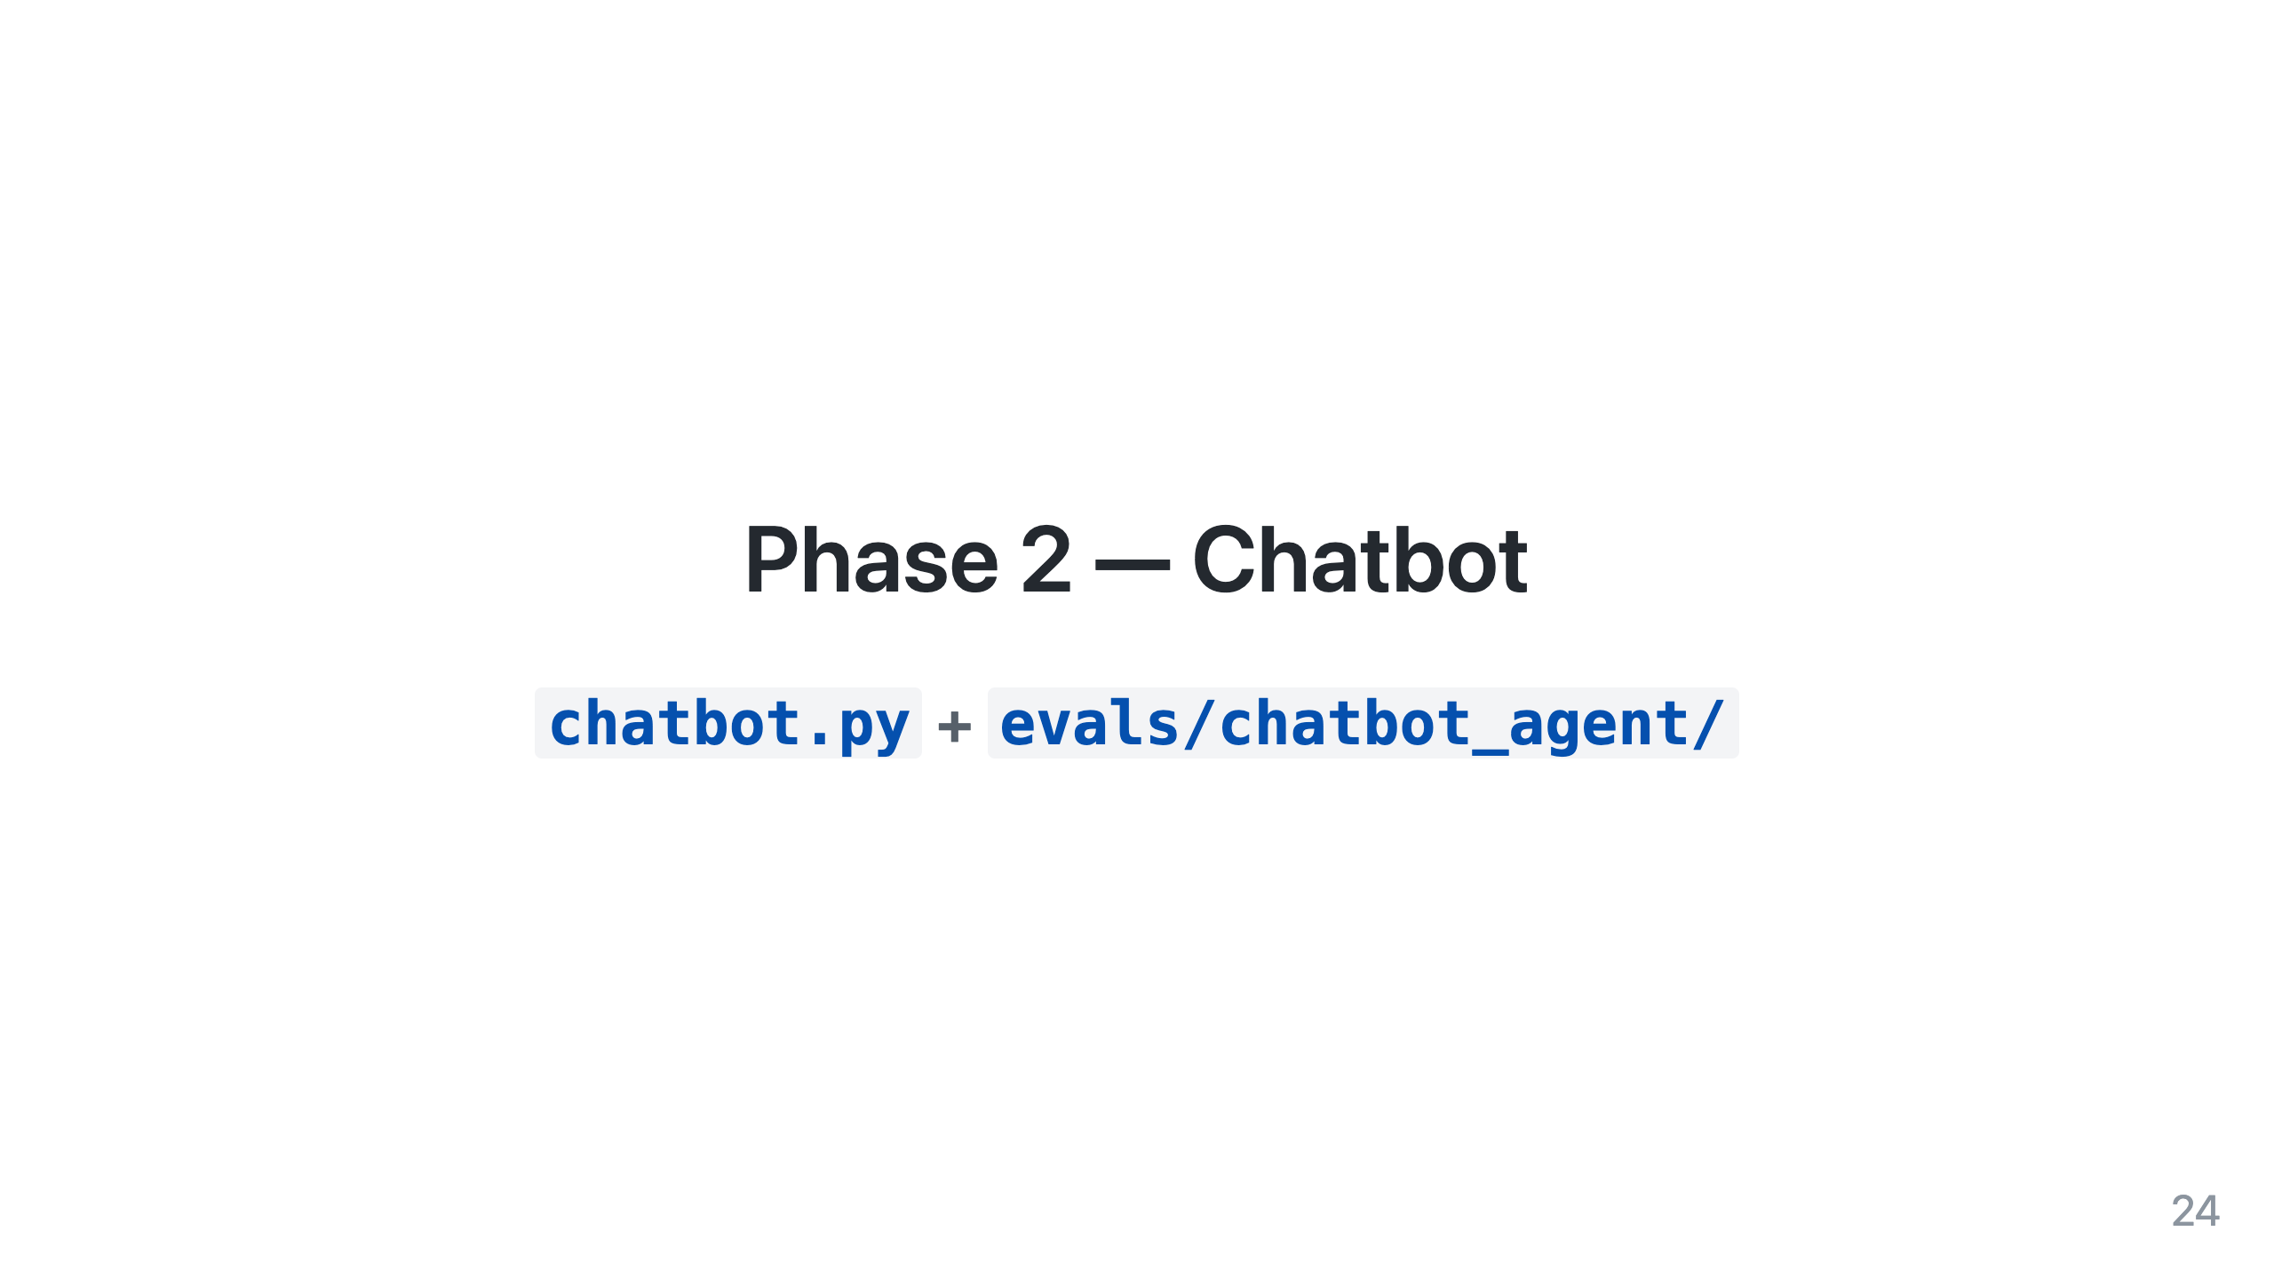

Slide 25
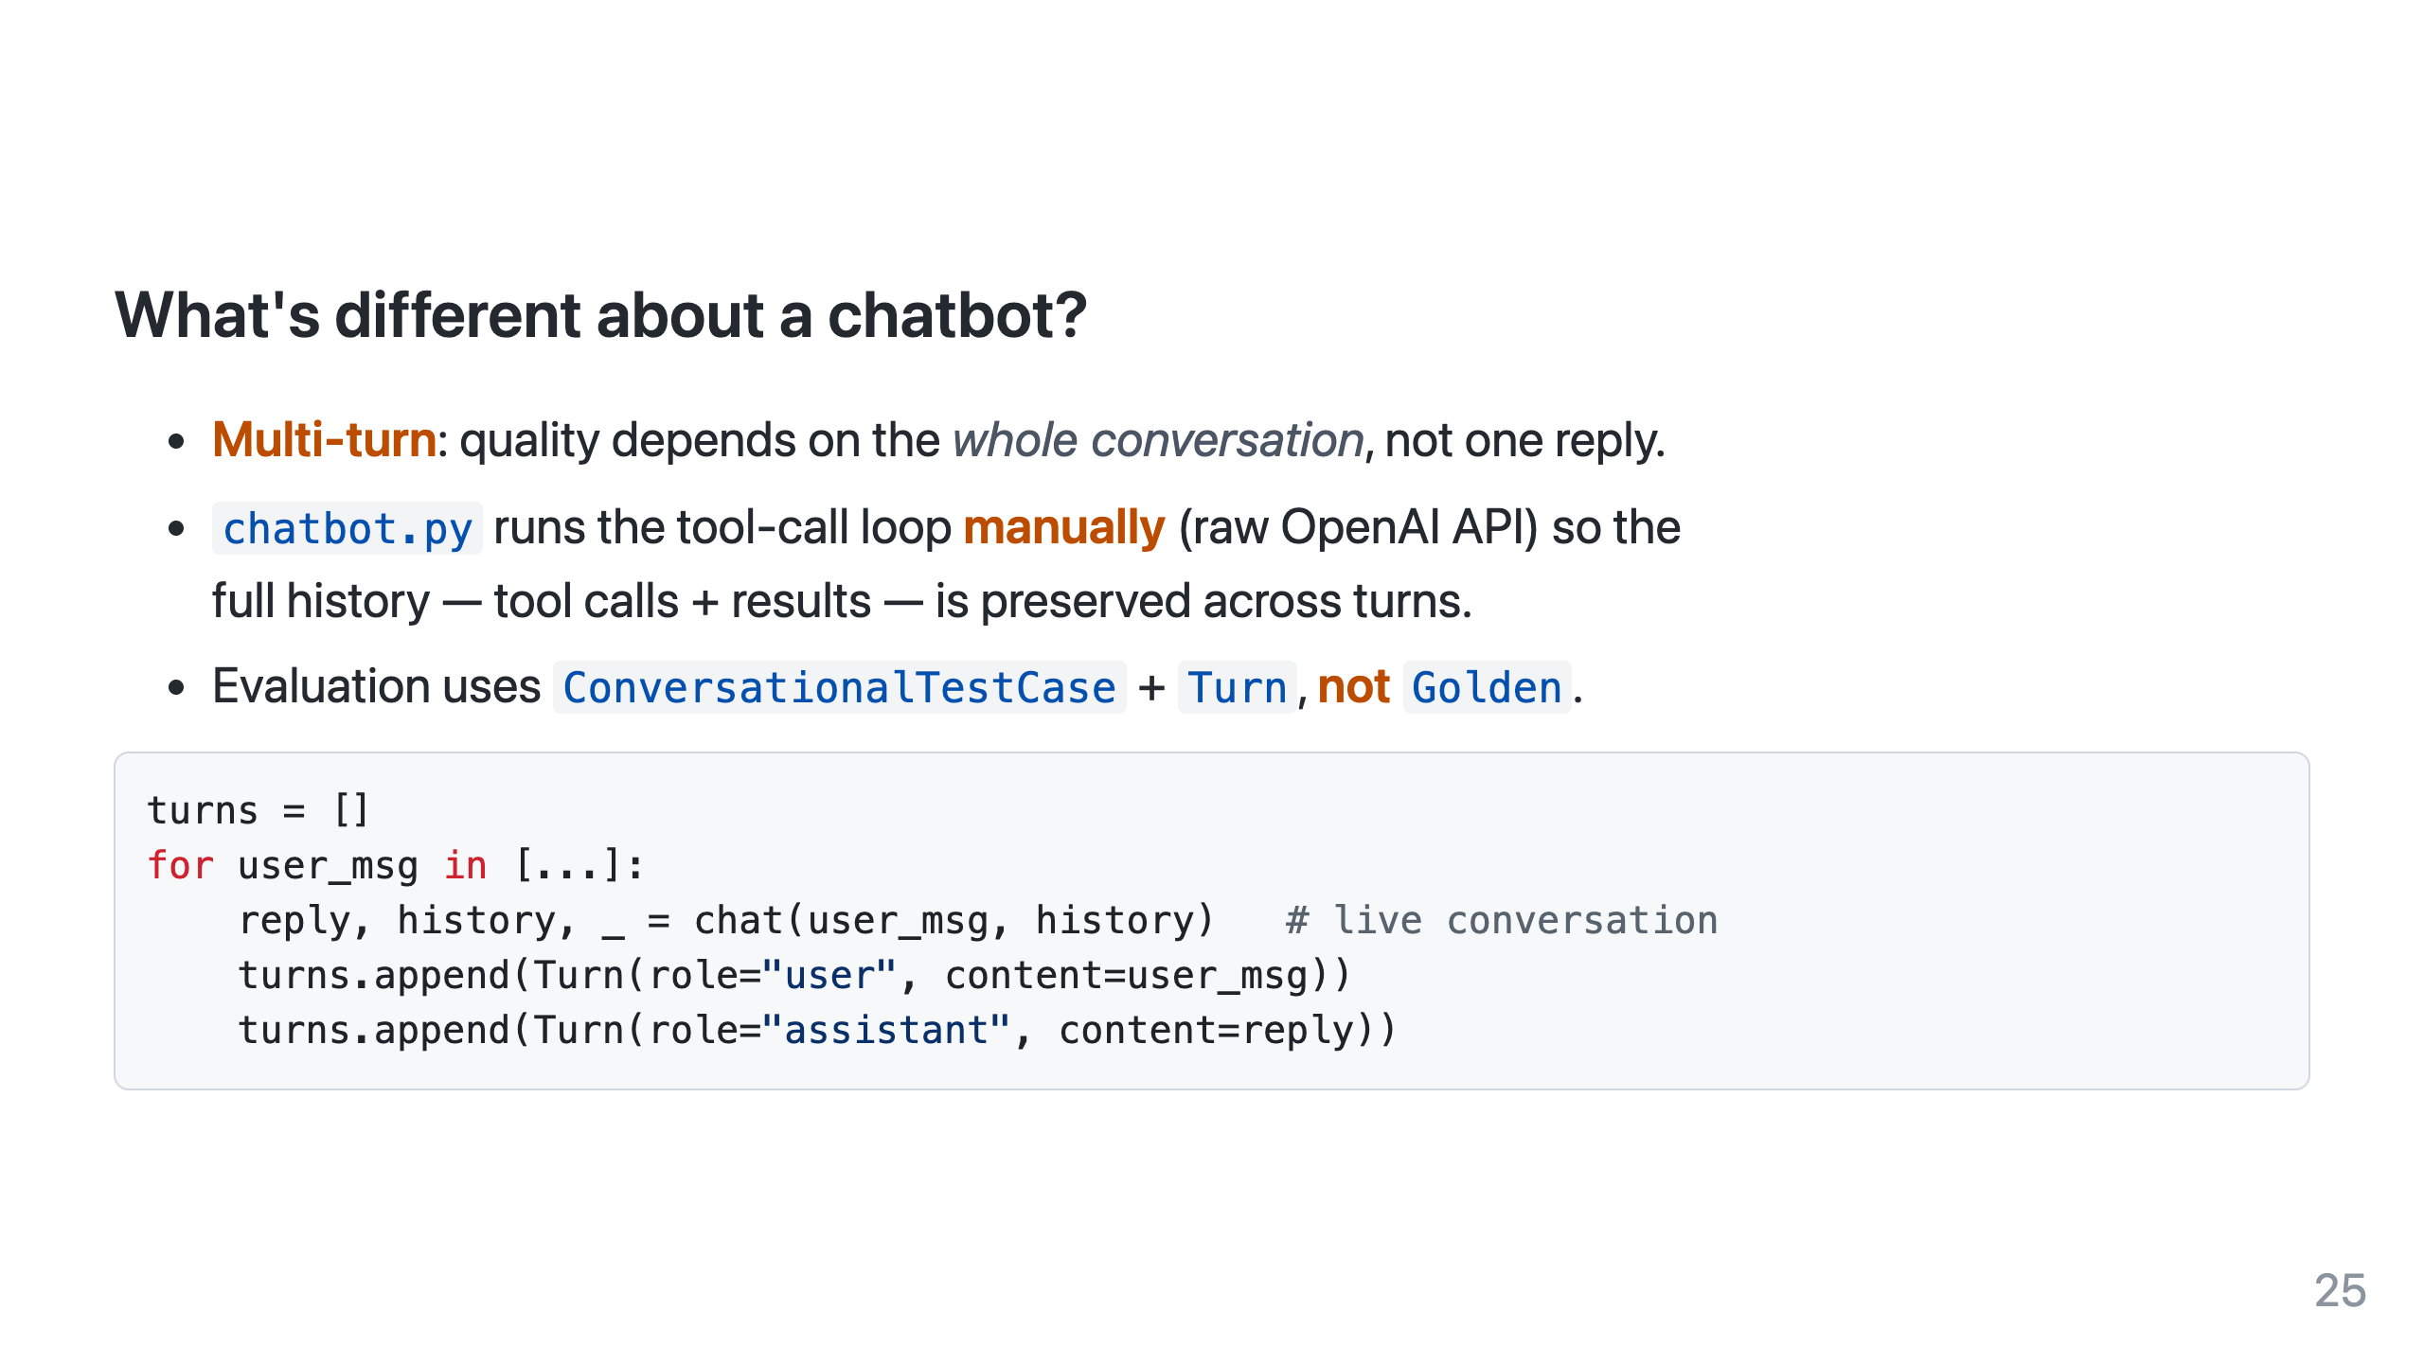
Notes:
Point out: ToolCorrectnessMetric does NOT support ConversationalTestCase — tool quality moves into a ConversationalGEval instead.

Slide 26
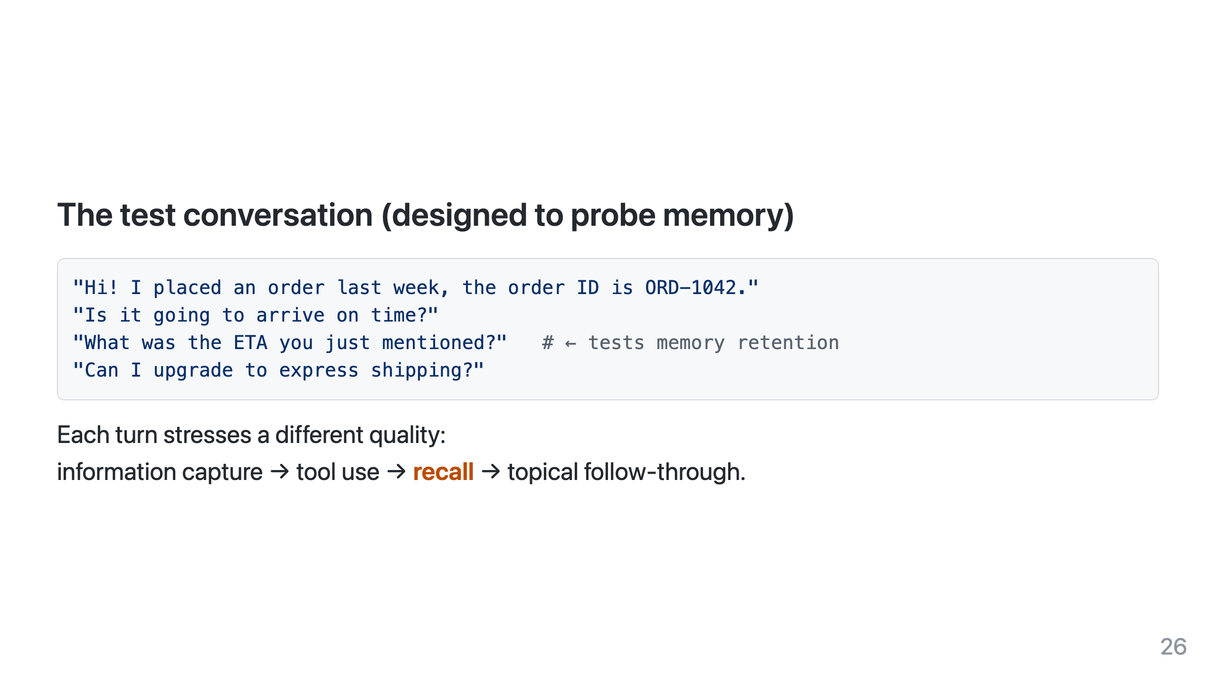

Slide 27
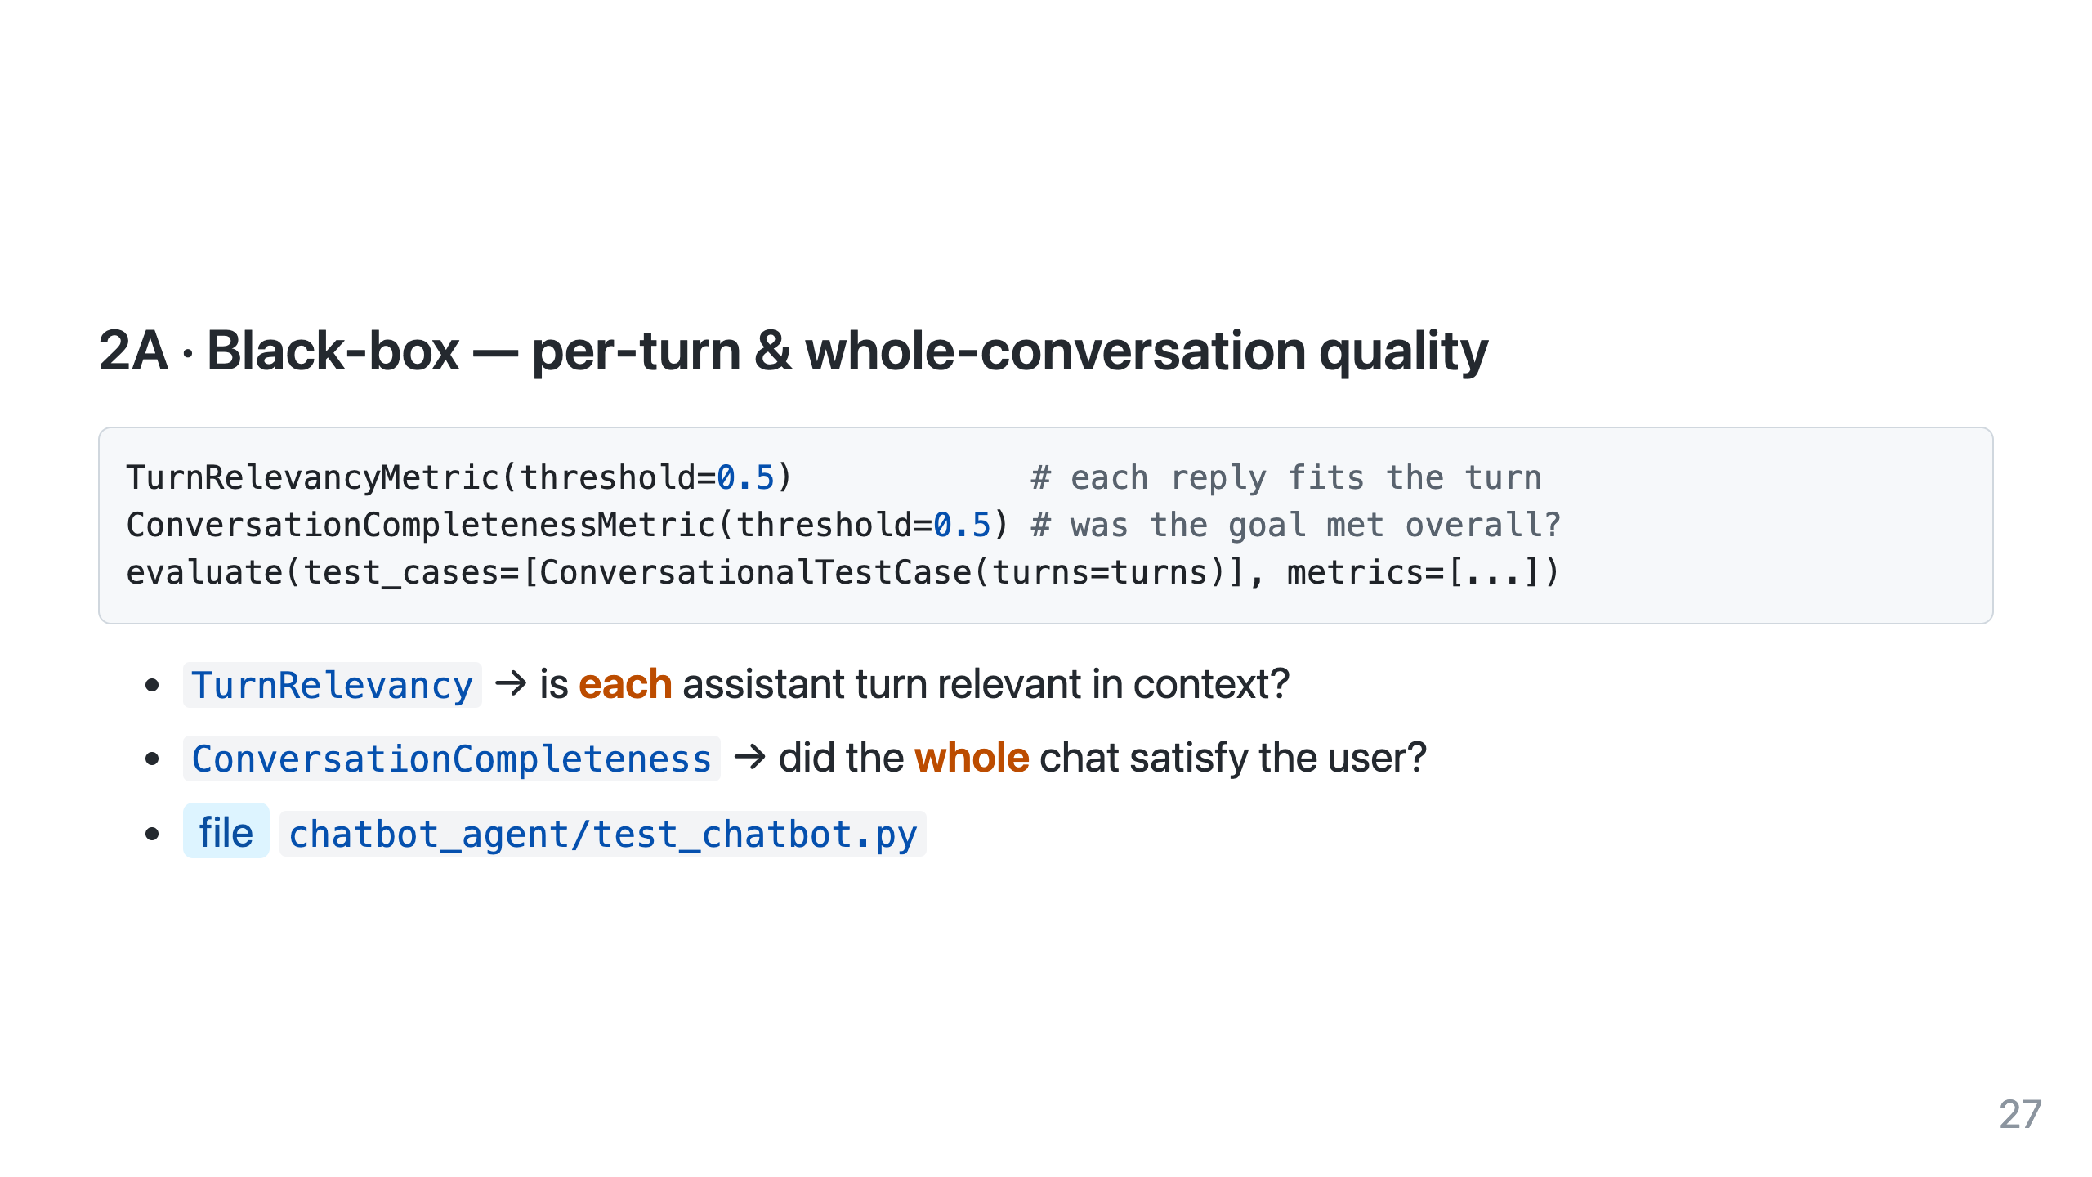

Slide 28
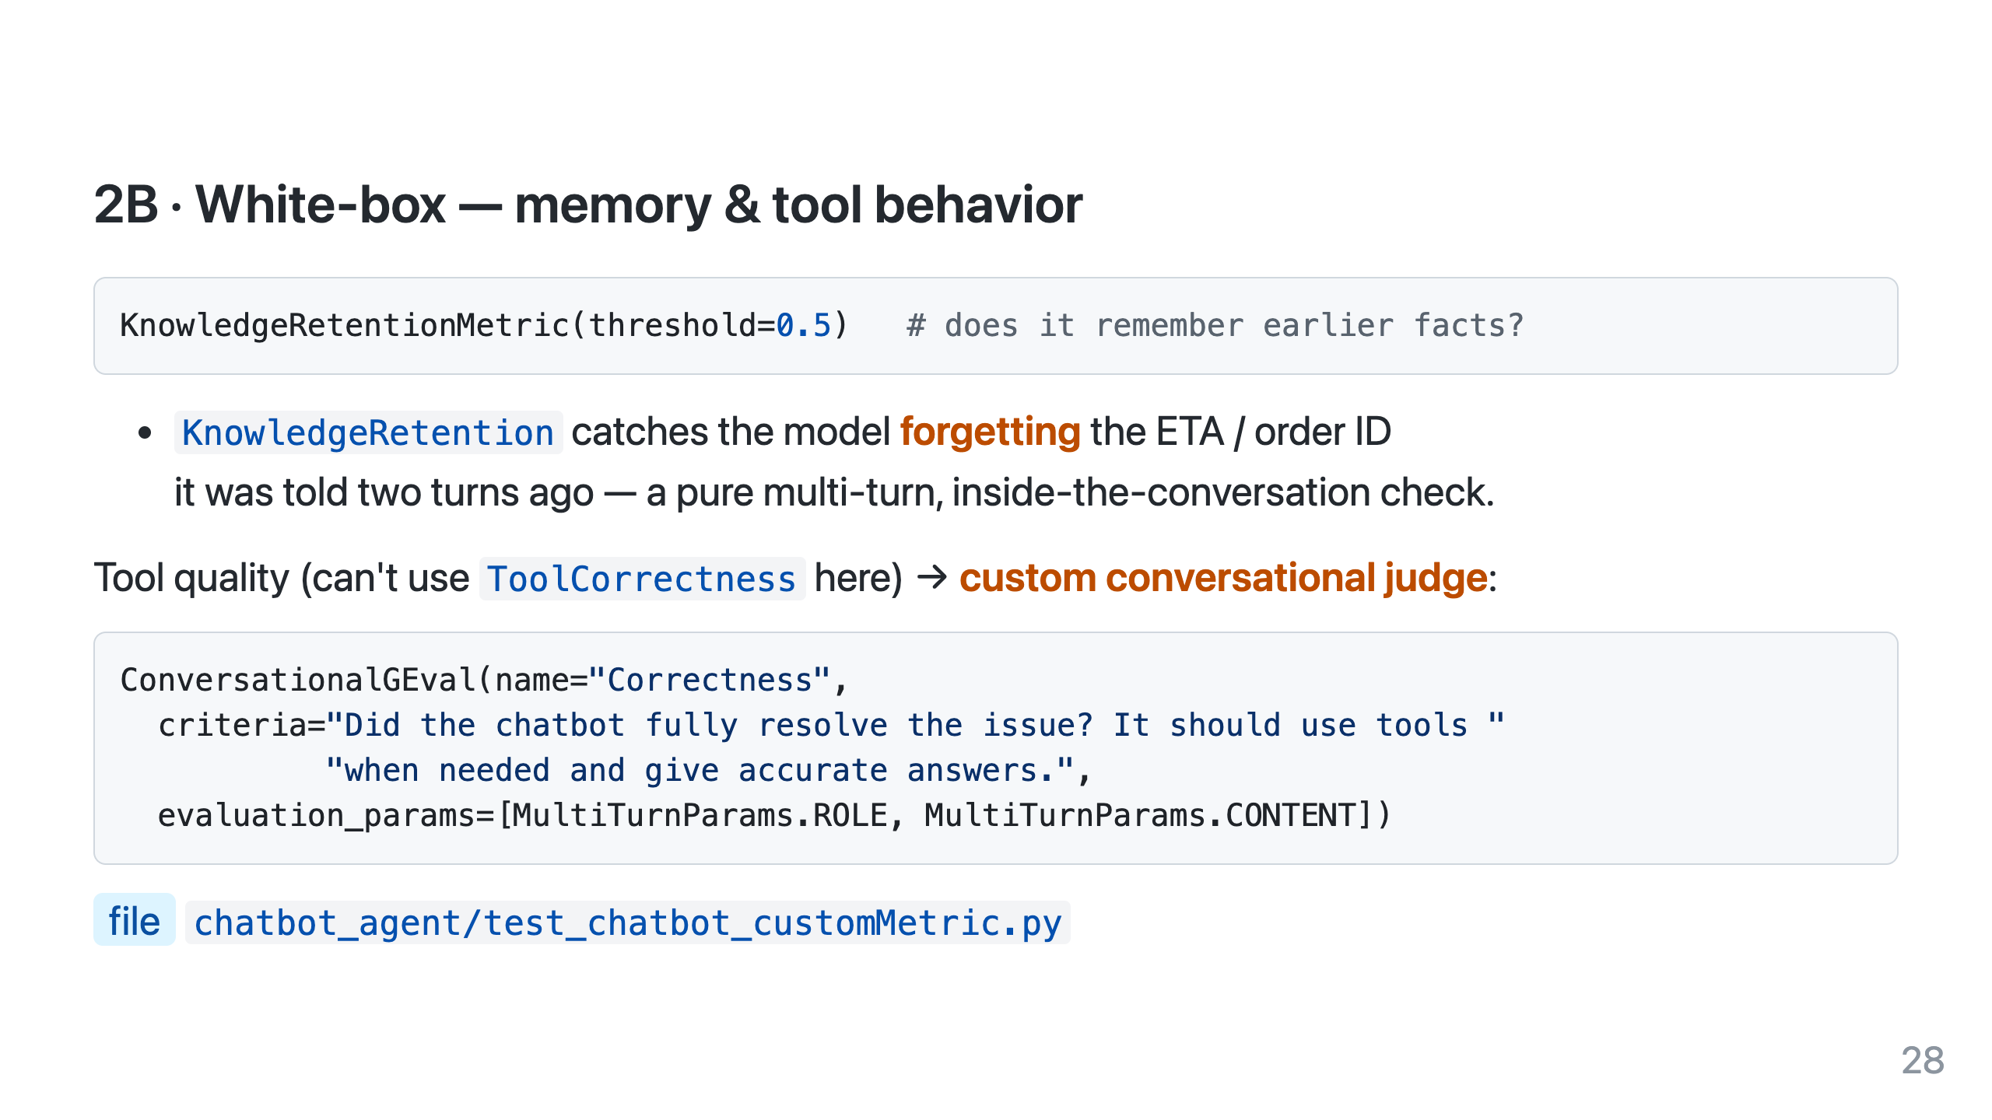

Slide 29
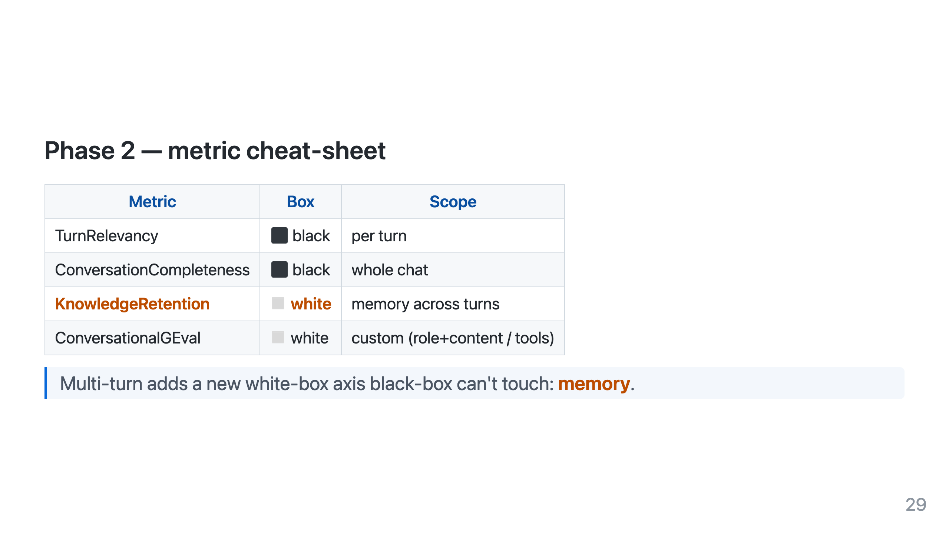

Slide 30
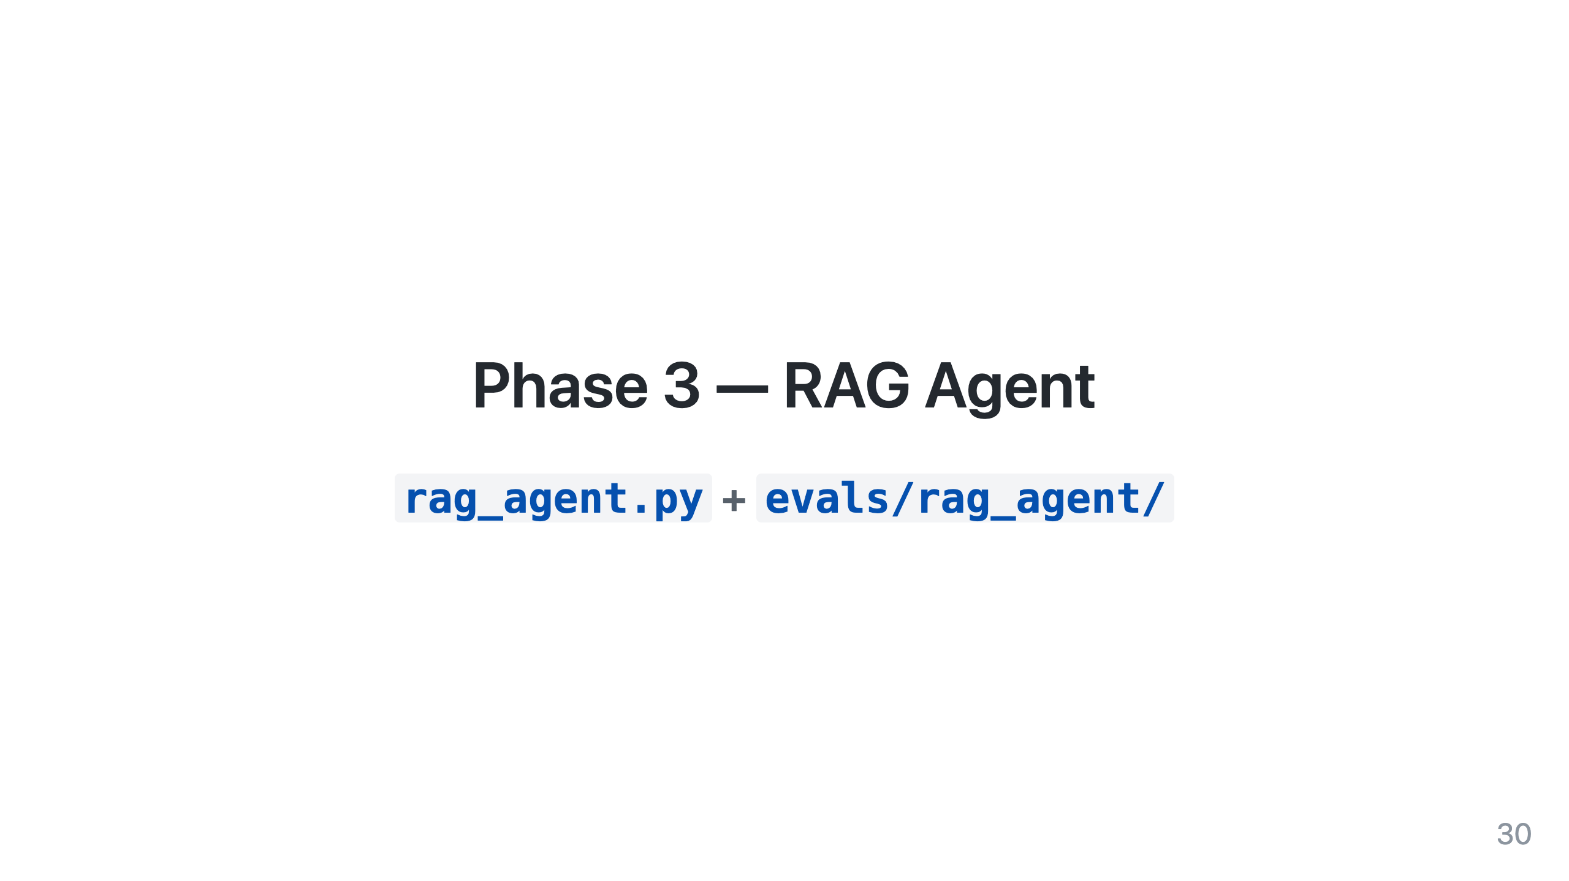

Slide 31
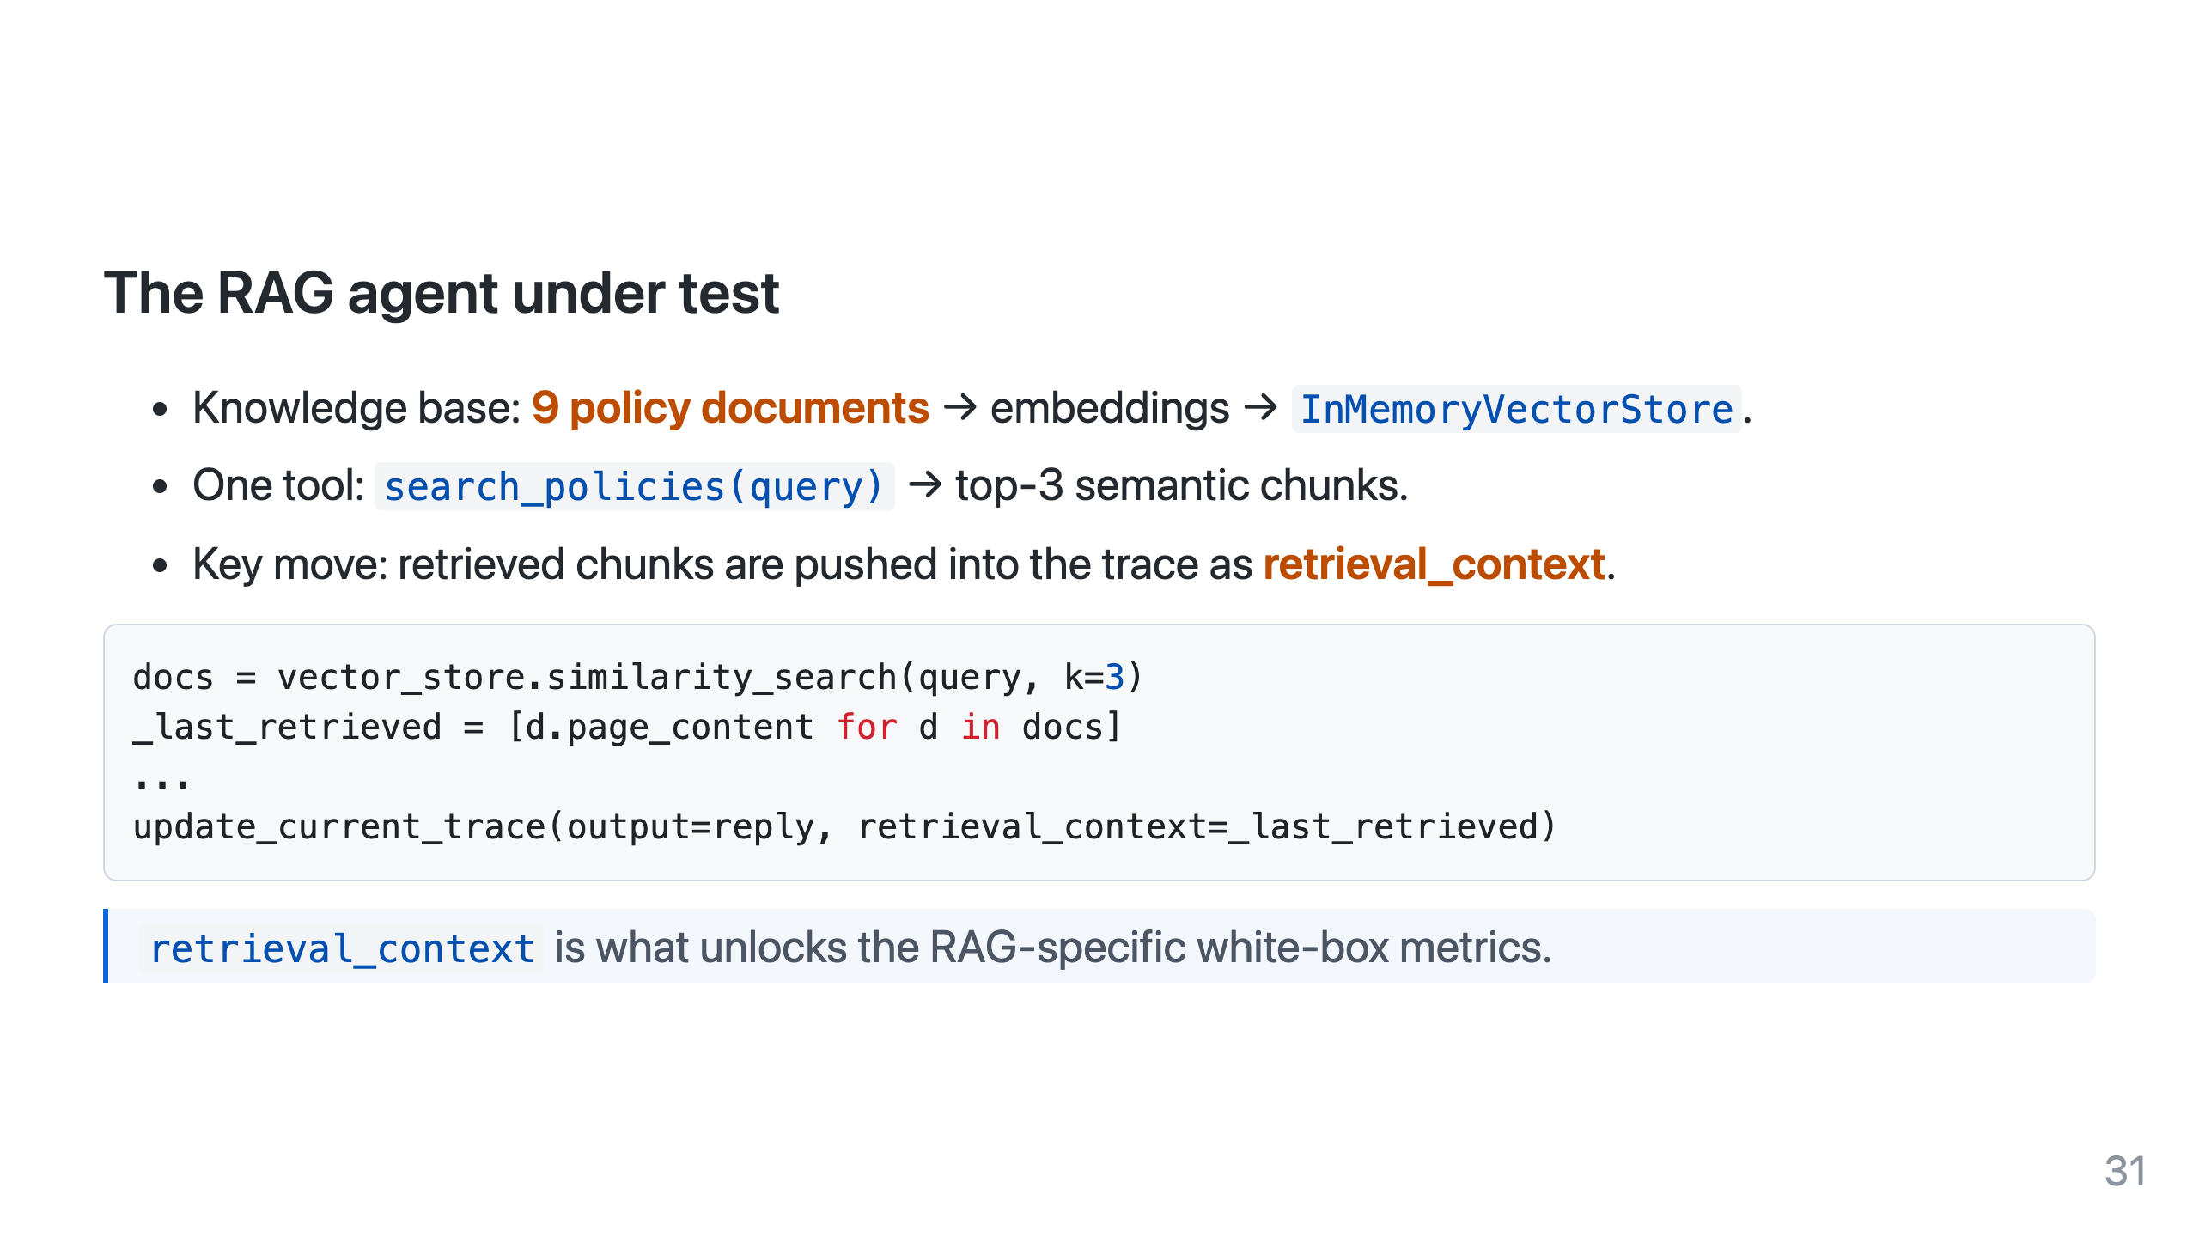
Notes:
Without retrieval_context on the trace, Faithfulness / Contextual metrics literally have nothing to score against.

Slide 32
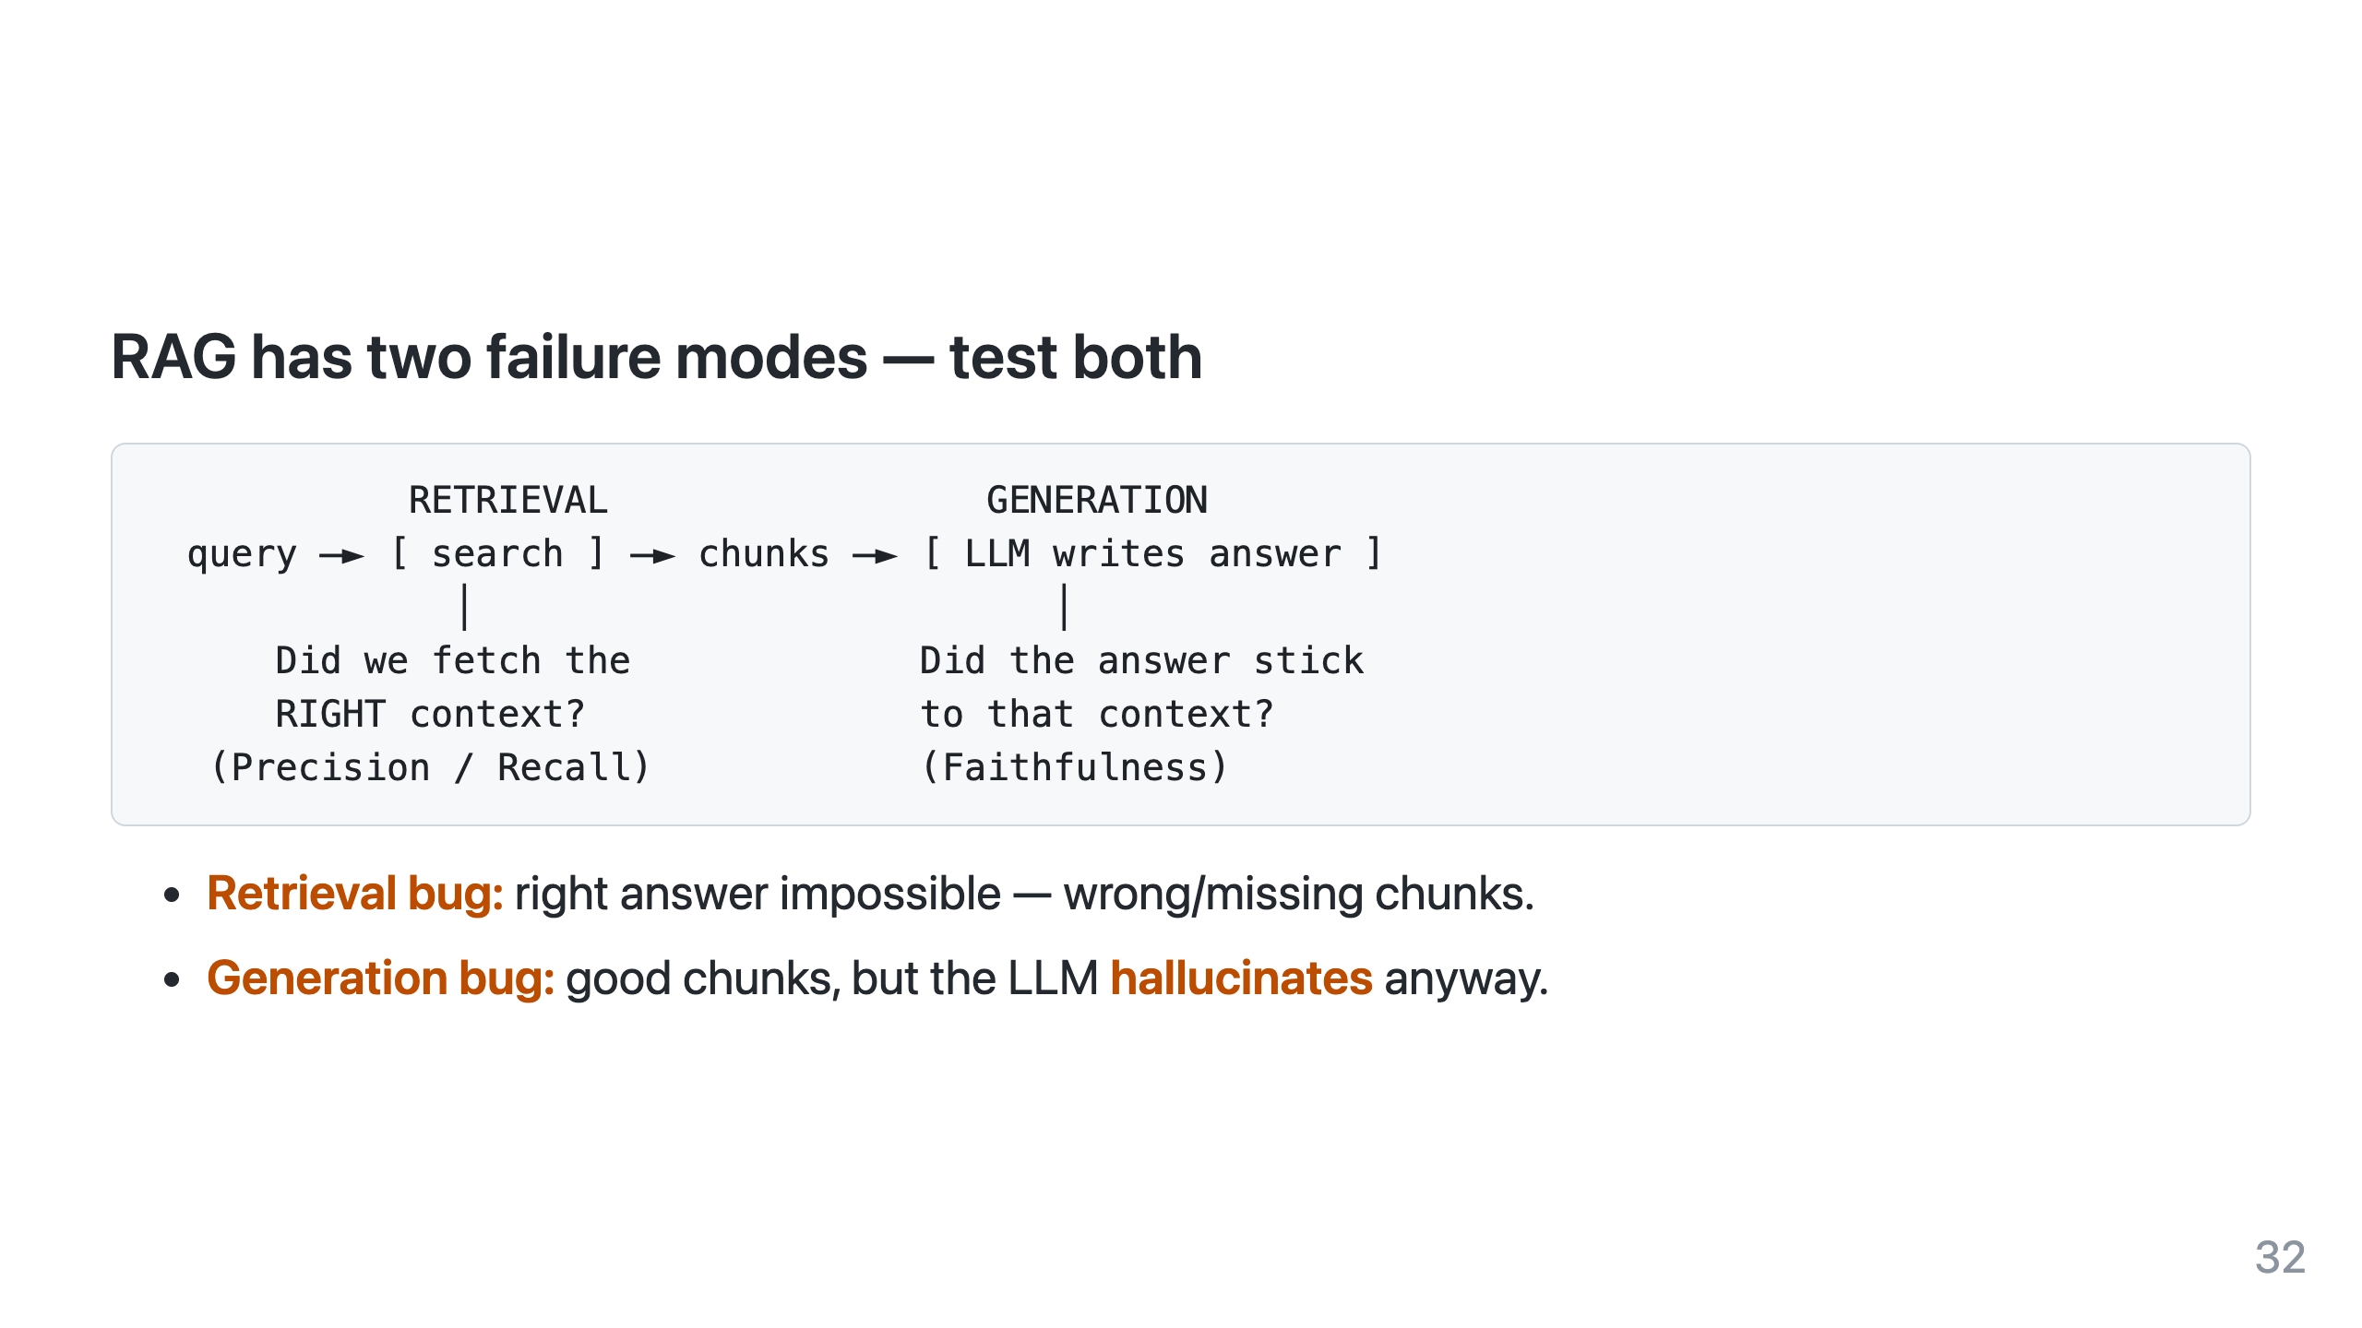

Slide 33
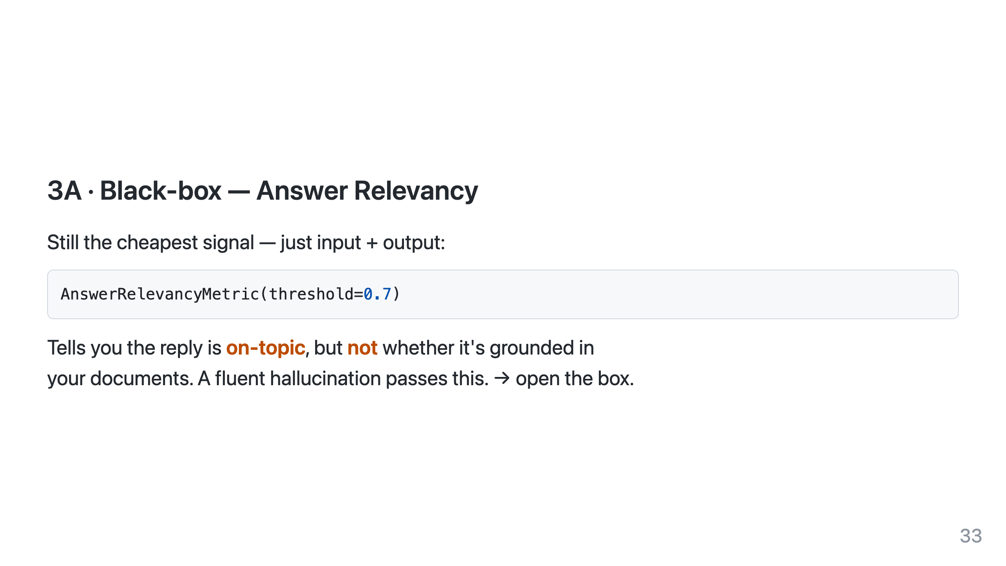

Slide 34
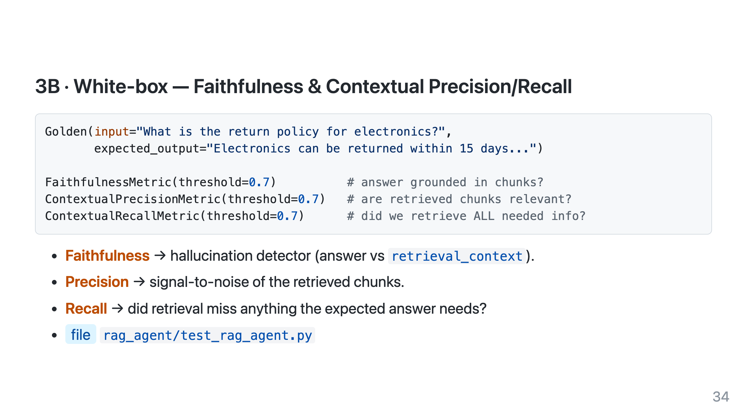

Slide 35
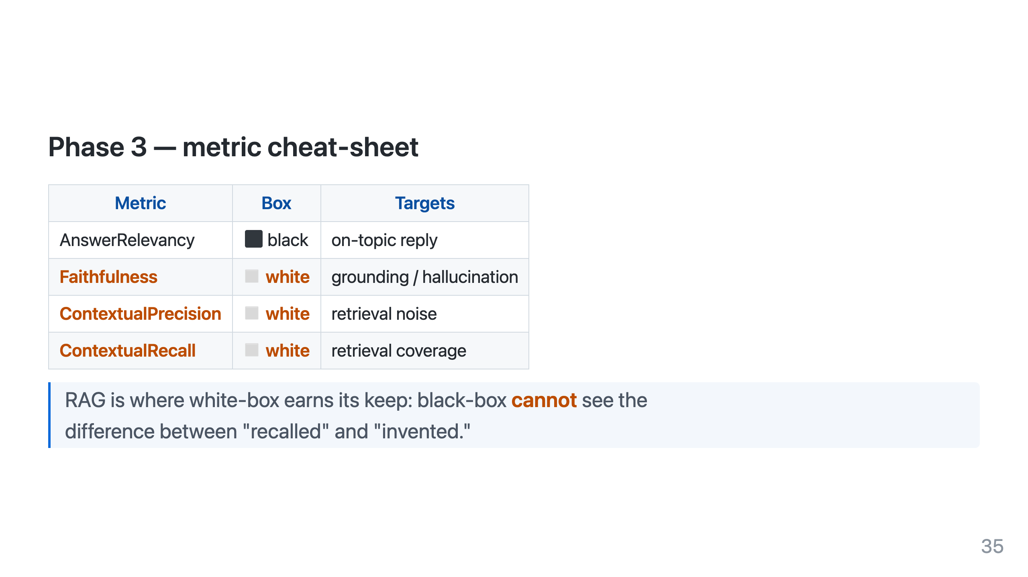

Slide 36


Slide 37
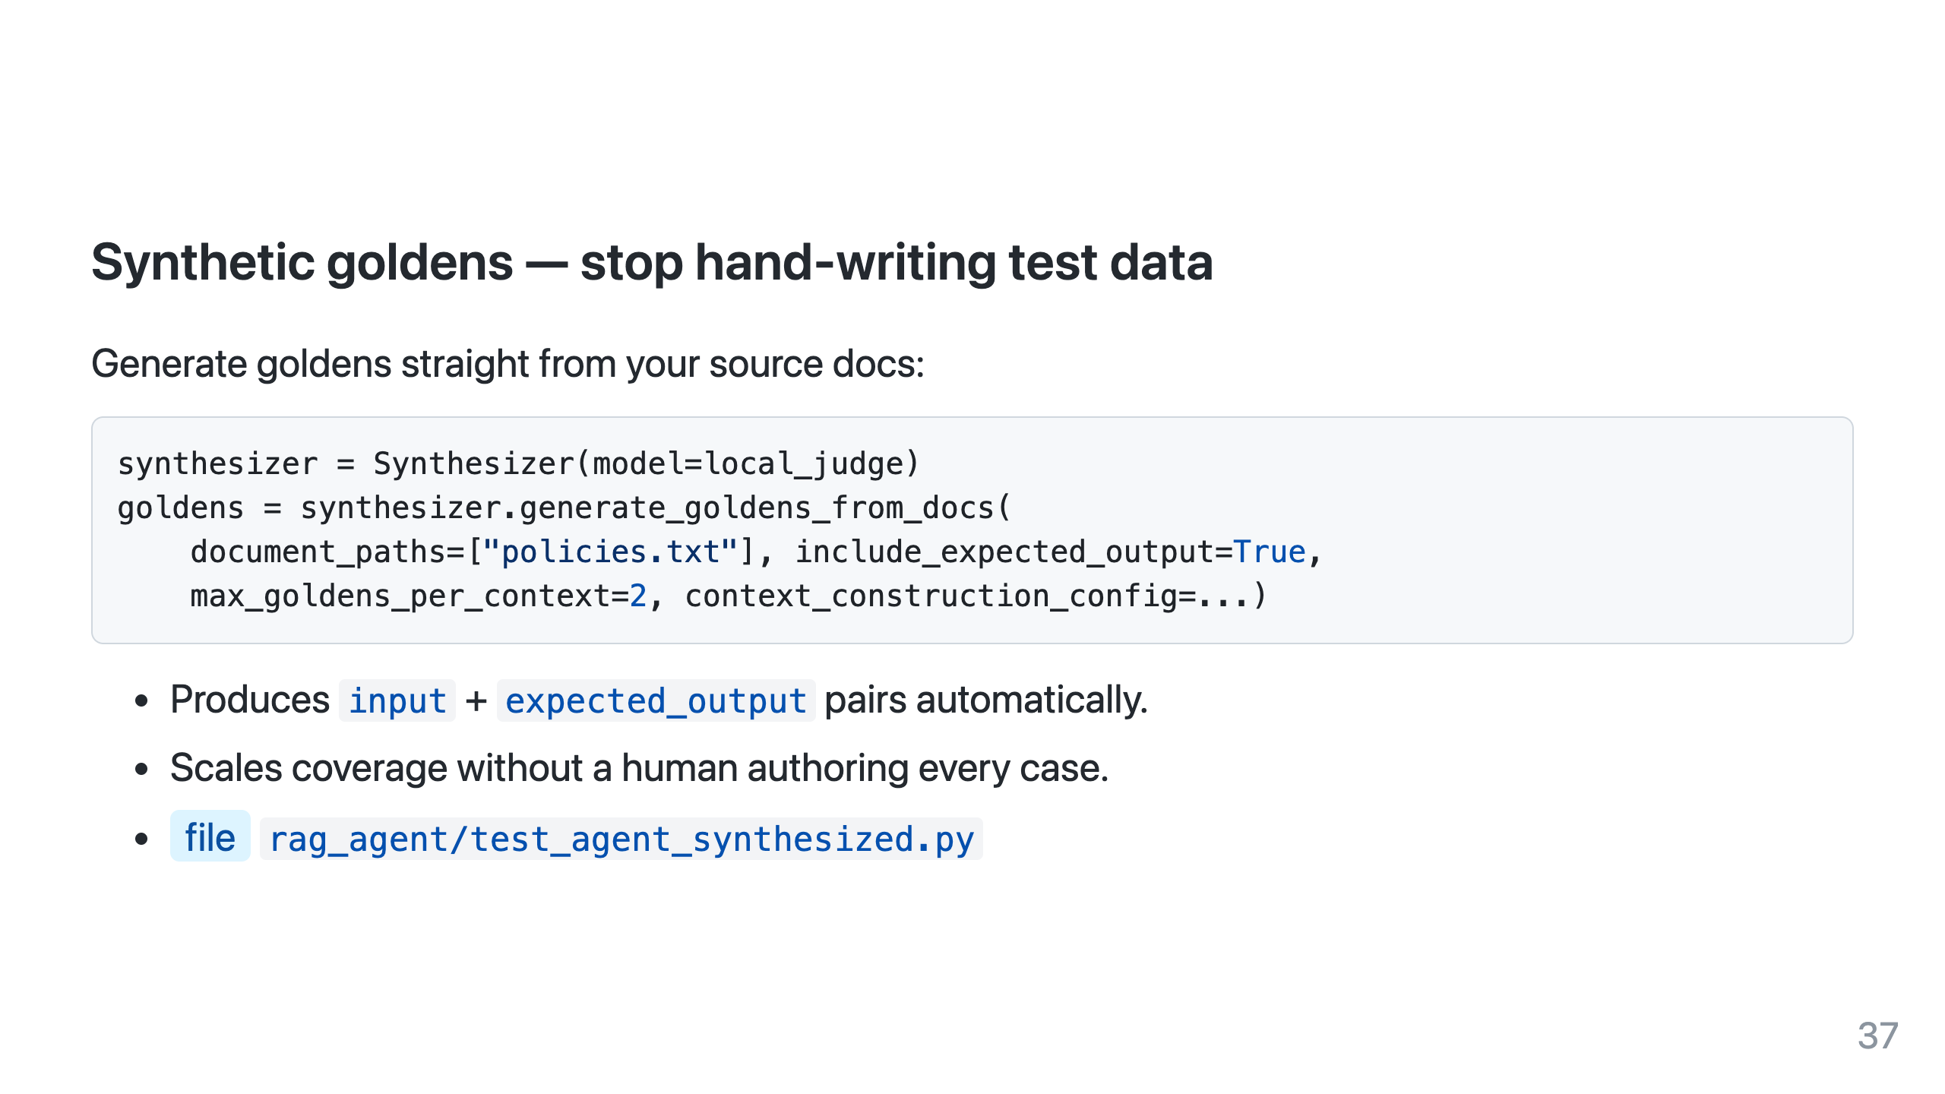

Slide 38
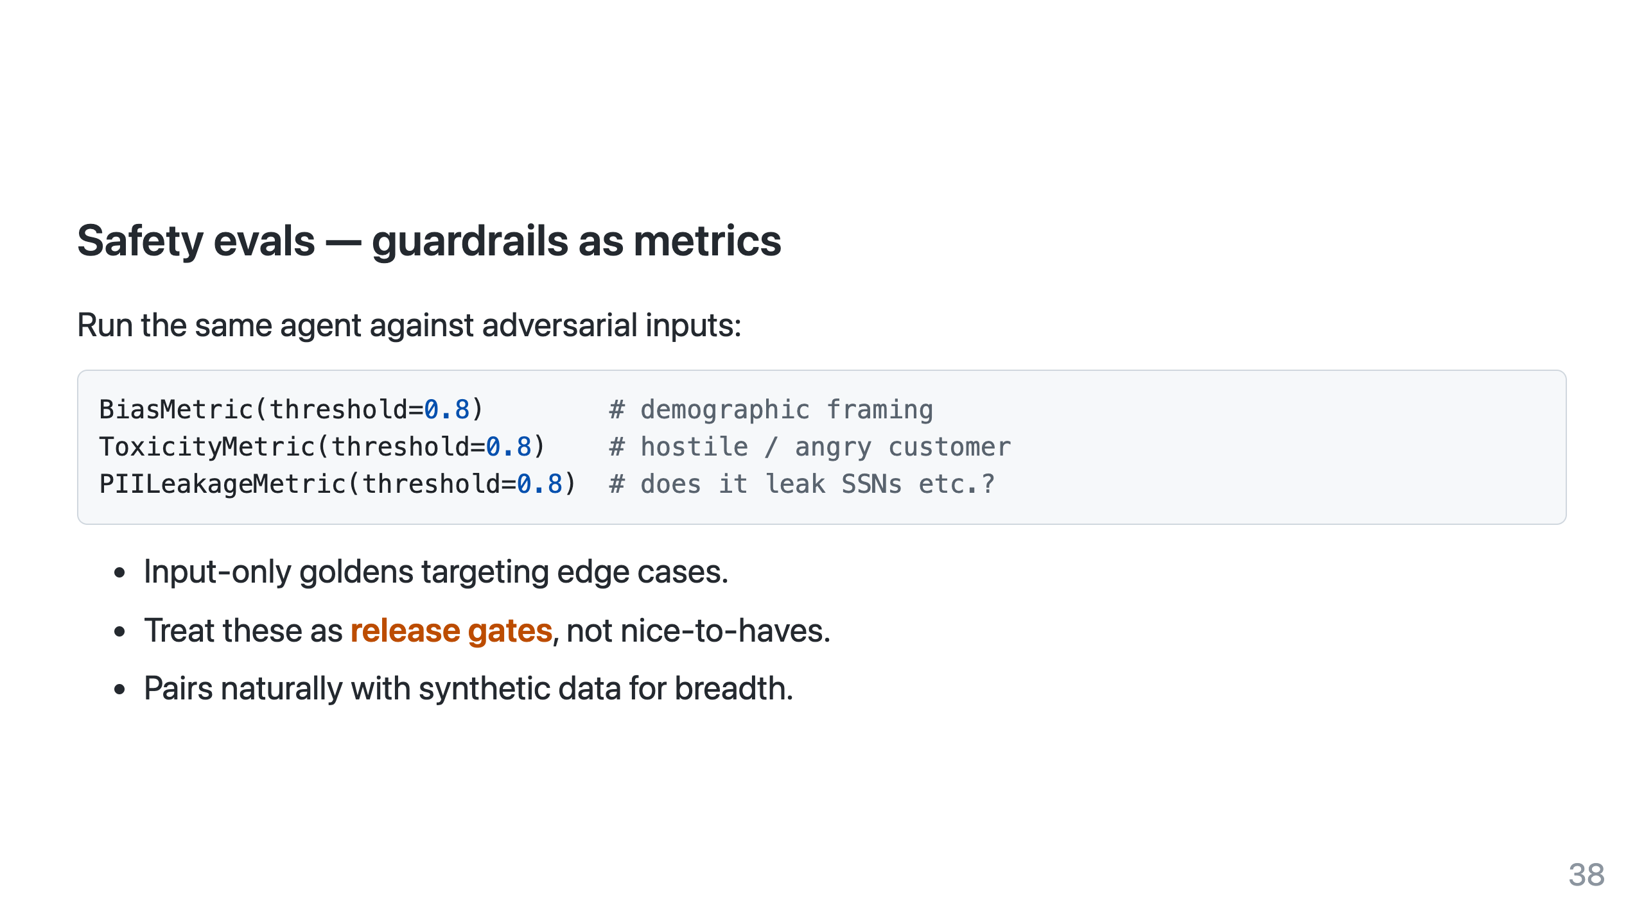

Slide 39
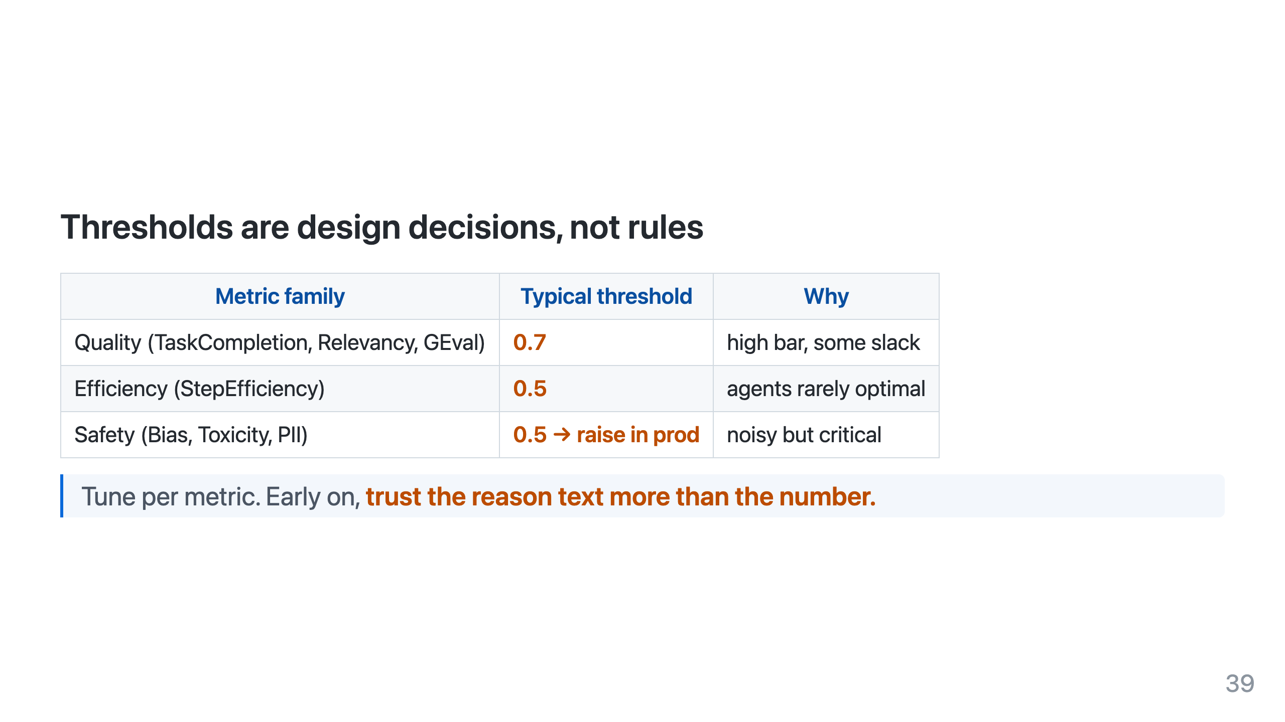

Slide 40
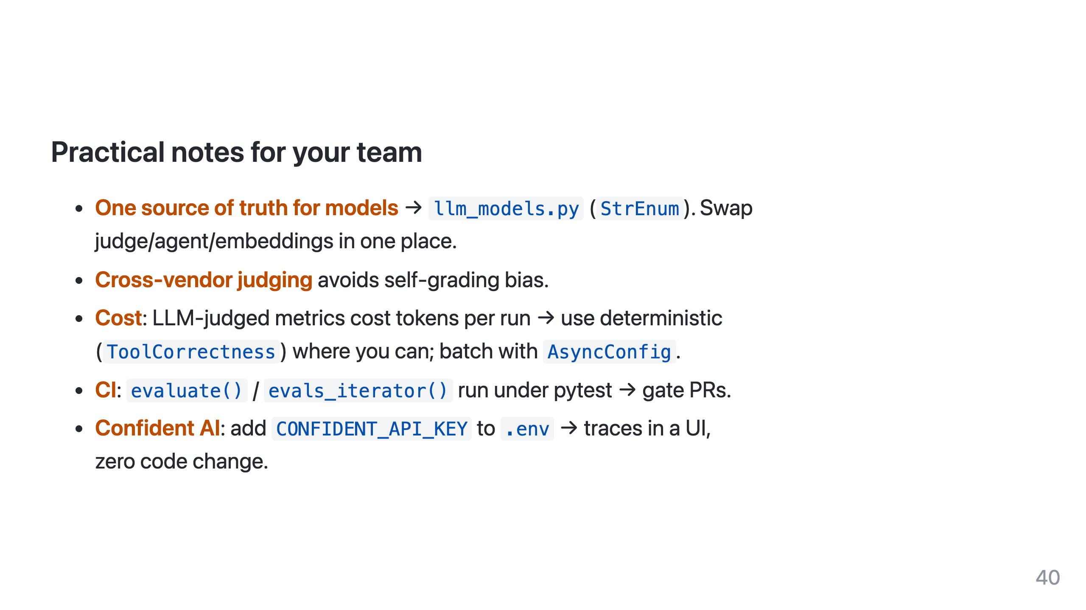

Slide 41
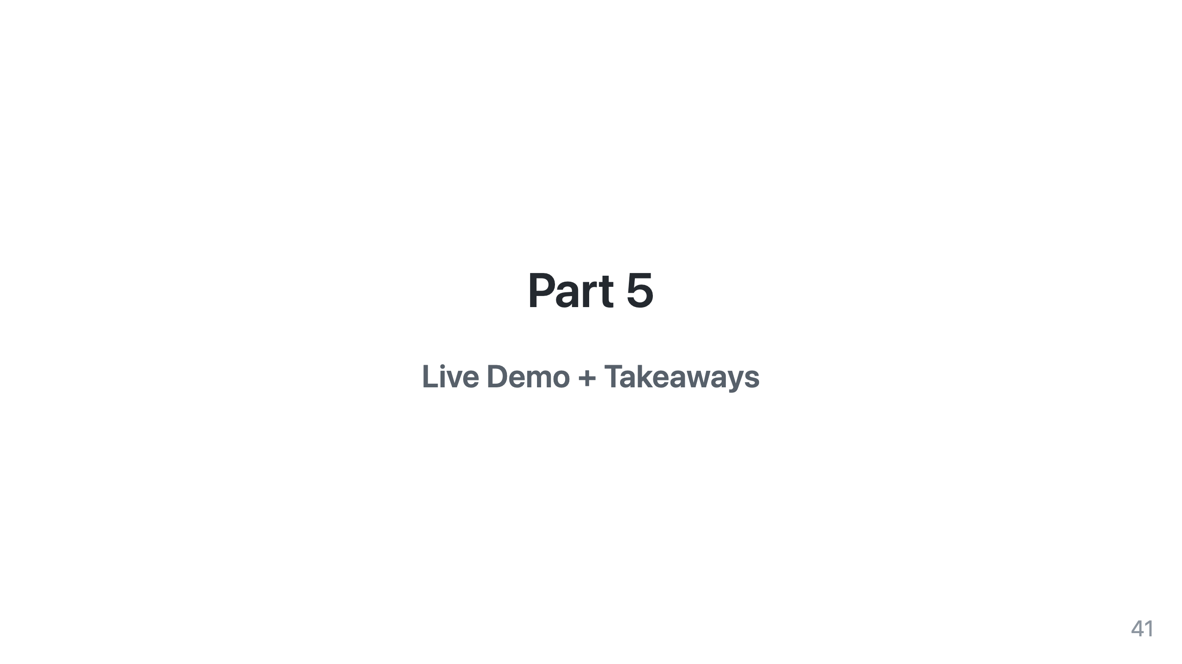

Slide 42
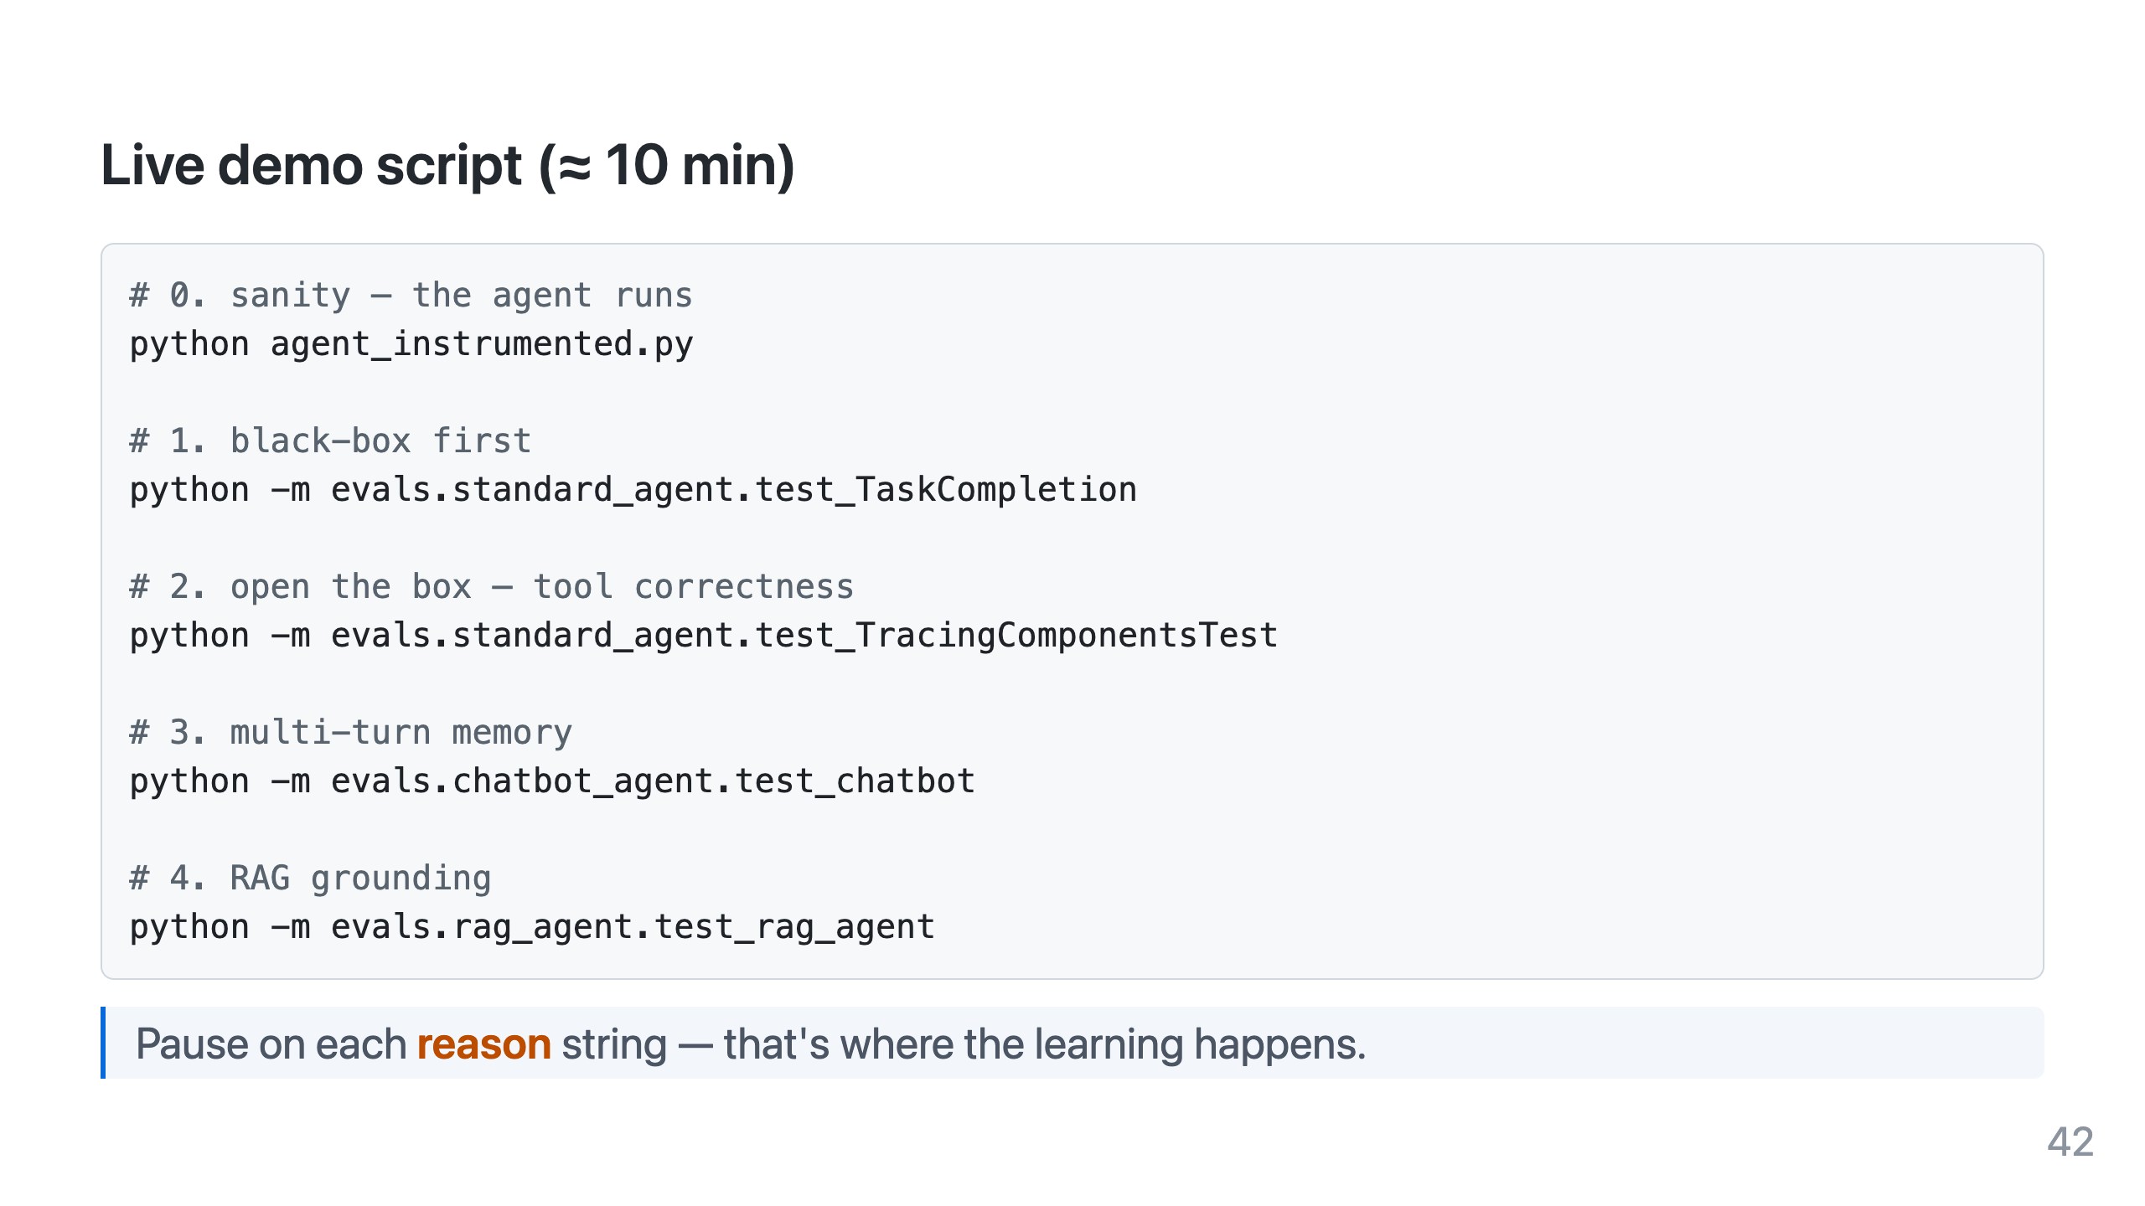
Notes:
Have a terminal ready with .env populated and the local Ollama/judge models pulled. Run #2 and point out ToolCorrectness is deterministic.

Slide 43
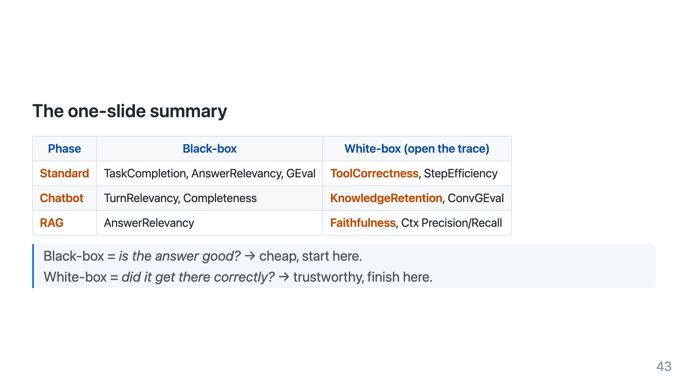

Slide 44
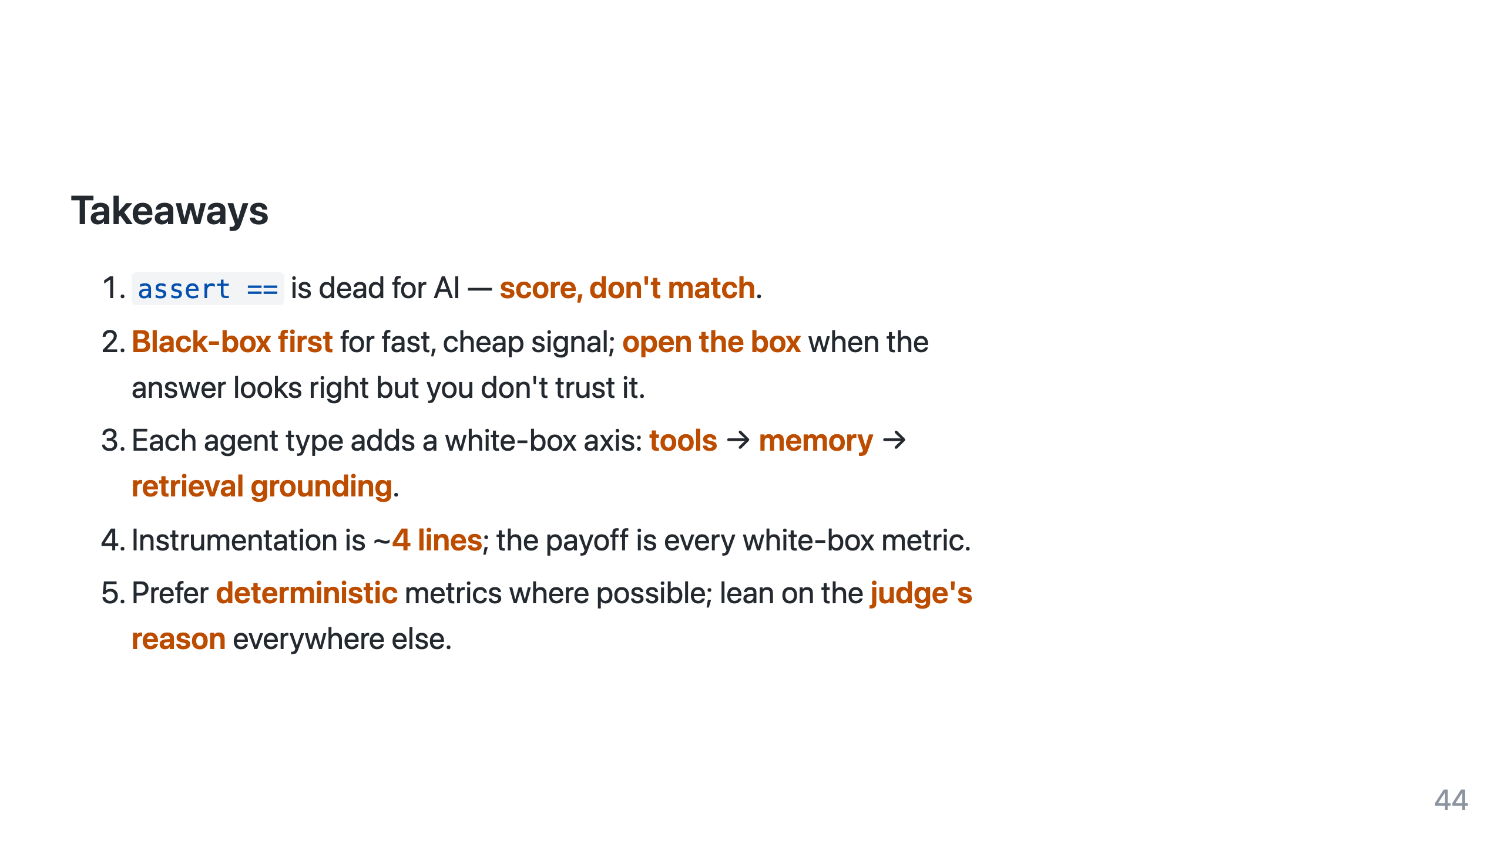

Slide 45
