Slide 1
Lesson 5: Analyzing and Reporting on Data
5.1 Enhancing Reports with Titles, Footnotes, and Labels
5.2 Creating Frequency Reports
5.3 Creating Summary Statistics Reports

Slide 2
Lesson 5: Analyzing and Reporting on Data
5.1 Enhancing Reports with Titles, Footnotes, and Labels
5.2 Creating Frequency Reports
5.3 Creating Summary Statistics Reports

Slide 3

SAS Programming Process
Access data
Explore data
Prepare data
Analyze and report on data
Export results
PRINT
MEANS
TITLE
LABEL
FOOTNOTE
FREQ
Notes:
Now that data access, validation, and manipulation are behind us, we are finally ready to address what I consider to be the peak of the programming process: analyzing and reporting on the data. Analyzing your data can mean a lot of different things. It could be basic summarization to examine what has happened in the past, or it could be complex data mining or machine learning algorithms to predict what will happen in the future. In this lesson, we concentrate on summarizing data. Specifically, you learn more about using the procedures that we touched on for exploration: PRINT, MEANS, and FREQ. You also learn how to use titles, column labels, footnotes, and macro variables to enhance your reports and make them more meaningful.

Slide 4
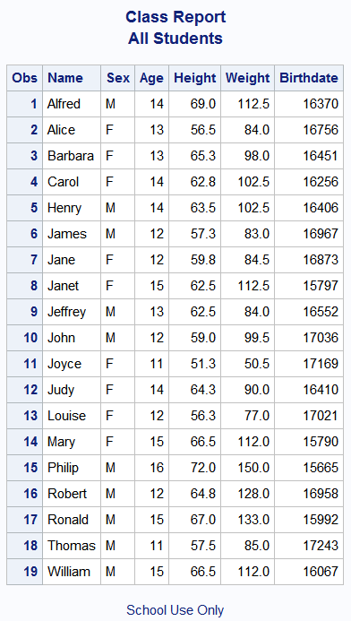
Using Titles and Footnotes
TITLE<n> "title-text";
FOOTNOTE<n> "footnote-text";
title1 "Class Report";
title2 "All Students";
footnote1 "School Use Only";
proc print data=pg1.class_birthdate;
run;
p105d01
Notes:
First let's learn about some additional SAS statements that can be used with any procedure to enhance a report.
TITLE is a global statement that establishes a permanent title for all reports created in your SAS session. The syntax is just the keyword TITLE followed by the title text enclosed in quotation marks. You can have up to 10 titles. You specify a number 1 through 10 after the keyword TITLE to indicate the line number. TITLE and TITLE1 are equivalent.
You can also add footnotes to any report with the FOOTNOTE statement. The same rules for titles apply to footnotes.

Slide 5
5.01 Activity
Open p105a01.sas from the activities folder and perform the following tasks:
In the program, notice that there is a TITLE statement followed by two procedures. Run the program. Where does the title appear in the output?
Add a TITLE2 statement above PROC MEANS to print a second line: Summary Statistics for MaxWind and MinPressure
Add another TITLE2 statement above PROC FREQ with this title: Frequency Report for Basin
Run the program. Which titles appear above each report?
Notes:
Type answer here

Slide 6
5.01 Activity – Correct Answer
title "Storm Analysis";
title2 "Summary Statistics for MaxWind and MinPressure";
proc means data=pg1.storm_final;
var MaxWindMPH MinPressure;
run;
title2 "Frequency Report for Basin";
proc freq data=pg1.storm_final;
tables BasinName;
run;
The first title appears above both reports. The second title is replaced for the PROC FREQ output.
Notes:
Type answer here

Slide 7
5.02 Activity
Open p105a02.sas from the activities folder. Notice that there are no TITLE statements in the code. Run the program. Does the report have the same titles assigned in the previous activity?
 Yes
 No
Notes:
Type answer here

Slide 8
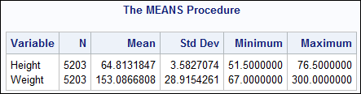
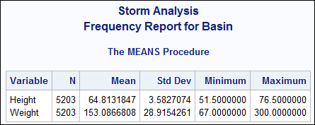
5.02 Activity – Correct Answer
Does the report have titles?
 Yes (SAS Enterprise Guide)
 No (SAS Studio)
Some procedures automatically add a procedure title.
SAS Studio
It depends. SAS Studio automatically clears existing titles before a new program is submitted. Enterprise Guide does not.
Enterprise Guide
Notes:
Both answers are correct

Slide 9
Clearing Titles and Footnotes
TITLE;
FOOTNOTE;
clears titles and footnotes
ODS NOPROCTITLE;
turns off procedure titles
It’s a good practice to clear all titles and footnotes at the beginning or end of a program.
title;footnote;
ods noproctitle;
proc means data=sashelp.heart;
var height weight;
run;
Notes:
Remember that TITLE and FOOTNOTE are global statements, and they remain active as long as your SAS session is active. If you want to clear the titles and footnotes you've specified, you can use the keyword TITLE or FOOTNOTE with no text. That's called a null TITLE statement. The null TITLE statement clears all the titles that you've specified on any line. It's a good idea to do this at the end of your program. Client applications such as SAS Studio submit a null TITLE statement for you at the end of your code, but it's a good idea to get in the habit of submitting the statement yourself.
Some procedures include the name of the procedure in a title above the results. You can turn this off my submitting an ODS statement with the NOPROCTITLE option. You do more with ODS in another lesson.

Slide 10
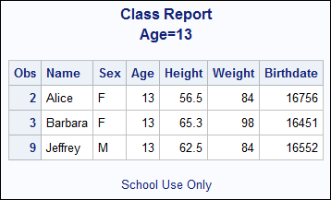
Using Macro Variables in Titles and Footnotes
%let age=13;
title1 "Class Report";
title2 "Age=&age";
footnote1 "School Use Only";
proc print data=pg1.class_birthdate;
where age=&age;
run;
title;
footnote;
Notes:
Macro variables are very helpful in titles. Suppose we have a %LET statement to create a macro variable for age that we're using in a filter in the PRINT procedure. It would be helpful to include the filter criteria in a title so that it is clear what filter has been applied. We can use the macro variable in the title to do just that. Remember that you must enclose the macro variable in double quotation marks so that SAS replaces the macro variable reference with the stored text.

Slide 11

Applying Temporary Labels to Columns
LABEL col-name="label-text";
proc means data=sashelp.cars;
where type="Sedan";
var MSRP MPG_Highway;
label MSRP="Manufacturer Suggested Retail Price"
MPG_Highway="Highway Miles per Gallon";
run;
p105d01
Notes:
Column names must adhere to particular naming conventions, but that means sometimes the names might be a bit difficult to interpret, especially for someone that isn’t familiar with the data. Labels are an easy way to enhance a report with more descriptive column headings. A label can be any text string up to 256 characters, including spaces and special characters.
You can use the LABEL statement in procedures to improve your reports. You start with the keyword LABEL, and then list the column name, equal sign, and the label string enclosed in quotation marks. You can label more than one column in a single LABEL statement.

Slide 12
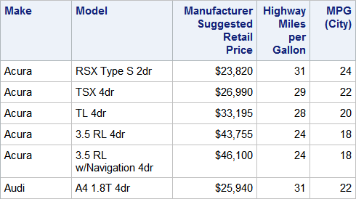
Applying Temporary Labels to Columns
proc print data=sashelp.cars label;
where type="Sedan";
var Make Model MSRP MPG_Highway MPG_City;
label MSRP="Manufacturer Suggested Retail Price"
MPG_Highway="Highway Miles per Gallon";
run;
Notes:
PROC MEANS, PROC FREQ, and most other procedures automatically display the labels in the results. PROC PRINT is an exception. Because the main purpose of PROC PRINT is to examine the data, column names are always displayed by default. To display labels instead, you must add the LABEL option in the PROC PRINT statement.

Slide 13
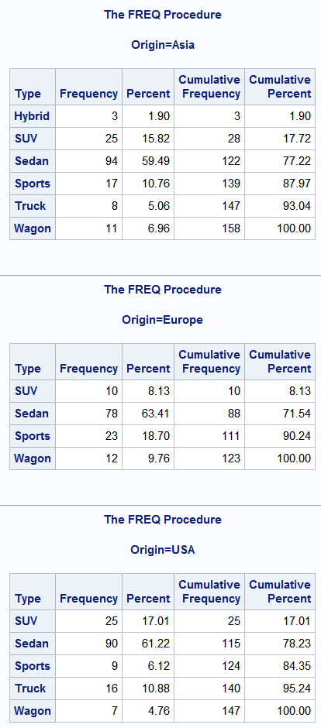
Segmenting Reports
proc sort data=sashelp.cars out=cars_sort;
by Origin;
run;
proc freq data=cars_sort;
by Origin;
tables Type;
run;
The data must be sorted first before you use the BY statement in a reporting procedure.
p105d01
Notes:
We can use the BY statement in a reporting procedure to segment a report based on the unique values of one or more columns. For example, what if I want to generate a separate frequency report for each value of Origin? I must sort the table by Origin first, and then use the BY statement in PROC FREQ. Then SAS treats the rows for each value of Origin as a separate table and runs the frequency report.

Slide 14
Enhancing Reports
This demonstration illustrates using titles, footnotes, labels, and grouping to enhance a report.
p105d01

Slide 15
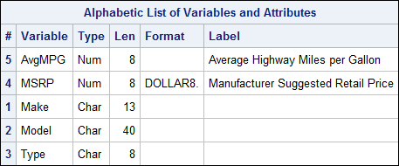
Applying Permanent Labels to Columns
data cars_update;
set sashelp.cars;
keep Make Model Type MSRP AvgMPG;
AvgMPG=mean(MPG_Highway, MPG_City);
label MSRP="Manufacturer Suggested Retail Price"
AvgMPG="Average Miles per Gallon";
run;
proc contents data=cars_update;
run;
If labels are assigned in the DATA step, they become permanent attributes in the table.
Notes:
If we take the same LABEL statement and put it in a DATA step, labels are assigned to the designated columns as permanent attributes in the descriptor portion of the table. When procedures create reports using that data, labels are automatically displayed. However, you still need the LABEL option in PROC PRINT.

Slide 16
5.03 Activity
Open p105a03.sas from the activities folder and perform the following tasks:
Modify the LABEL statement in the DATA step to label the Invoice column as Invoice Price.
Run the program. Why do the labels appear in the PROC MEANS report but not in the PROC PRINT report? Fix the program and run it again.
Notes:
Type answer here

Slide 17
5.03 Activity – Correct Answer
continued...
Modify the LABEL statement in the DATA step to label the Invoice column as Invoice Price.
data cars_update;
set sashelp.cars;
keep Make Model MSRP Invoice AvgMPG;
AvgMPG=mean(MPG_Highway, MPG_City);
label MSRP="Manufacturer Suggested Retail Price"
AvgMPG="Average Miles per Gallon"
Invoice="Invoice Price";
run;
Notes:
Type answer here

Slide 18
5.03 Activity – Correct Answer
Why do the labels appear in the PROC MEANS report but not in the PROC PRINT report? Fix the program and run it again.
proc means data=cars_update min mean max;
var MSRP Invoice;
run;
proc print data=cars_update label;
var Make Model MSRP Invoice AvgMPG;
run;
Most procedures automatically display permanent labels, but PROC PRINT still needs the LABEL option.
Notes:
Type answer here

Slide 19
Lesson 5: Analyzing and Reporting on Data
5.1 Enhancing Reports with Titles, Footnotes, and Labels
5.2 Creating Frequency Reports
5.3 Creating Summary Statistics Reports

Slide 20
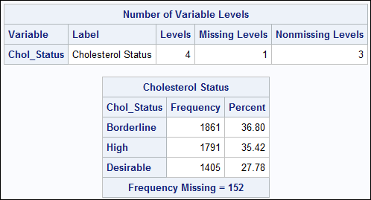
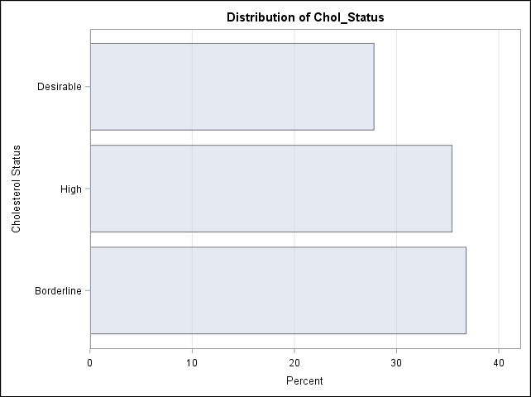
Creating One-Way Frequency Reports and Graphs
number of unique values
change statistics
PROC FREQ can do much more than simple frequency counts!
order of rows
graphs to view distribution
p105d01
Notes:
We used the FREQ procedure for data validation, but there are many more statements and options available in PROC FREQ that we can use to customize the output and include additional statistics.

Slide 21
Creating One-Way Frequency Reports and Graphs
PROC FREQ DATA=input-table < options >;
TABLES col-name(s) < / options >;
RUN;
Don’t forget that you can still use WHERE, FORMAT, LABEL, and BY statements!
Options can be used to request various statistics, reports, and graphs.
Notes:
A basic frequency report is based on individual columns. By default, each column listed in the TABLES statement generates a separate frequency table that includes the number and percentage of rows for each value in the data, as well as a cumulative frequency and percent. The numbers included in this report can be customized using options in the PROC FREQ and TABLES statements.

Slide 22
Creating Frequency Reports and Graphs
This demonstration illustrates using statements and options that are available in PROC FREQ to customize frequency reports and graphs.
p105d02

Slide 23
5.04 Activity
Open p105a04.sas from the activities folder and perform the following tasks:
Create a temporary output table named storm_count by completing the OUT= option in the TABLES statement.
Add the NOPRINT option in the PROC FREQ statement to suppress the printed report.
Run the program. Which statistics are included in the output table? Which month has the highest number of storms?
Notes:
Type answer here

Slide 24
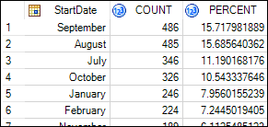
5.04 Activity – Correct Answer
Which statistics are included? Count and Percent
Which month has the highest number of storms? September (With ORDER=FREQ, the highest count is listed first.)
title "Frequency Report for Storm Month";
proc freq data=pg1.storm_final order=freq noprint;
tables StartDate / out=storm_count;
format StartDate monname.;
run;
Notes:
Type answer here

Slide 25
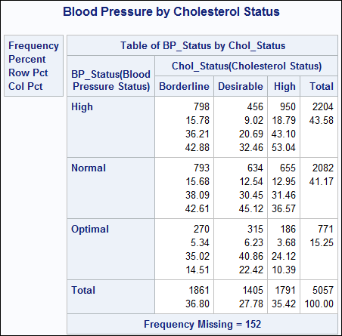
Creating Two-Way Frequency Reports
PROC FREQ DATA=input-table < options >;
TABLES col-name*col-name < / options >;
RUN;
rows
columns
proc freq data=sashelp.heart;
tables BP_Status*Chol_Status;
run;
p105d03
Notes:
One little symbol in the TABLES statement can make a huge difference in the results. When you place an asterisk between two columns in the TABLES statement, PROC FREQ produces a two-way frequency or crosstabulation report. This enables us to look at frequency counts and percentages for a combination of values in the two columns.
A two-way frequency report can use some of the same options we’ve seen with the one-way frequency report, including NLEVELS to create the number of levels table, ORDER= to control the sequence of rows, and OUT= to create an output table. But there are additional options unique to the two-way frequency report that enable you to apply different layouts to the results, or include new statistics or analyses. Let’s check out some of these options in a demo.

Slide 26
Creating Two-Way Frequency Reports
This demonstration illustrates creating a two-way frequency report using PROC FREQ to customize the results with options.
p105d03

Slide 27
Practice
This practice reinforces the concepts discussed previously.

Slide 28
Lesson 5: Analyzing and Reporting on Data
5.1 Enhancing Reports with Titles, Footnotes, and Labels
5.2 Creating Frequency Reports
5.3 Creating Summary Statistics Reports

Slide 29
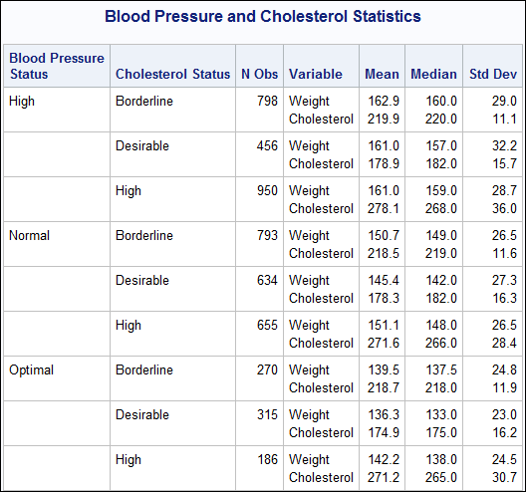
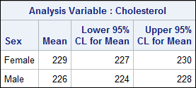
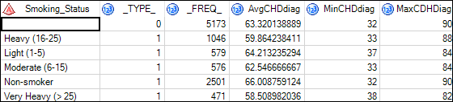
Creating a Summary Statistics Report
specify statistics
group data
PROC MEANS makes it easy to summarize your data in reports or tables!
create output table
Notes:
The MEANS procedure is helpful for calculating basic summary statistics and looking for numeric values that might be outside of an expected range. But now that we’re beyond validation, we can use PROC MEANS to generate complex reports that include various statistics and groupings within the data.

Slide 30
Creating a Summary Statistics Report
PROC MEANS DATA=input-table <stat-list> <options>;
VAR col-name(s);
CLASS col-name(s);
WAYS n;
RUN;
group the statistics based on distinct values of columns in the CLASS statement
specify statistics and options to include in the report
specify ways to combine values of columns in the CLASS statement
Notes:
We’ve used the VAR statement to identify the numeric columns to analyze. Now we can add more to PROC MEANS to customize how data is summarized. In the PROC MEANS statement, you can specify the statistics you want calculated and how they should be displayed. The CLASS statement enables you to name one or more columns to group the data. Statistics are calculated for each unique value of the CLASS columns, and when you have more than one CLASS column, you can use the WAYS statement to control the combination of values of the CLASS columns. Let’s go into a demo to see these new options and statements in action.

Slide 31
Creating Summary Statistics Reports
This demonstration illustrates using statements and options that are available in PROC MEANS to create a custom summary statistics report.
p105d04

Slide 32
5.05 Activity
Open p105a05.sas from the activities folder and perform the following tasks:
Add options to include N (count), MEAN, and MIN statistics. Round each statistic to the nearest integer.
Add a CLASS statement to group the data by Season and Ocean. Run the program.
Modify the program to add the WAYS statement so that separate reports are created for Season and Ocean statistics. Run the program.
Which ocean had the lowest mean for minimum pressure?
Which season had the lowest mean for minimum pressure?
Notes:
Type answer here

Slide 33
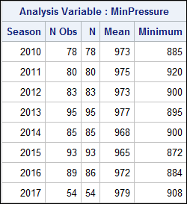
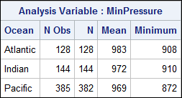
5.05 Activity – Correct Answer
Which ocean had the lowest mean for minimum pressure? Pacific
Which season had the lowest mean for minimum pressure? 2015
proc means data=pg1.storm_final maxdec=0 n mean min;
var MinPressure;
where Season >=2010;
class Season Ocean;
ways 1;
run;
Notes:
Type answer here

Slide 34

Creating an Output Summary Table
OUTPUT OUT=output-table <statistic=col-name>;
proc means data=sashelp.heart noprint;
var Weight;
class Chol_Status;
ways 1;
output out=heart_stats mean=AvgWeight;
run;
Notes:
When you analyze detailed data, you might want to create a SAS table that summarizes the data for further analysis. PROC MEANS is a great way to create summary tables. The OUTPUT statement offers several options to customize the table that is generated. You use the OUT= option to name the output table. The OUTPUT statement also enables you to generate output statistics and name a column to store them in.

Slide 35
5.06 Activity
Open p105a06.sas from the activities folder and perform the following tasks:
Run the PROC MEANS step and compare the report and the wind_stats table. Are the same statistics in the report and table? What do the first five rows in the table represent?
Uncomment the WAYS statement. Delete the statistics listed in the PROC MEANS statement and add the NOPRINT option. Run the program. Notice that a report is not generated and the first five rows from the previous table are excluded.
Add the following options in the OUTPUT statement and run the program again. How many rows are in the output table?
output out=wind_stats mean=AvgWind max=MaxWind;
Notes:
Type answer here

Slide 36
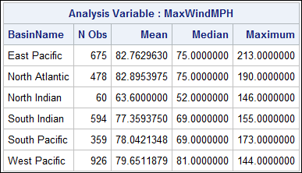
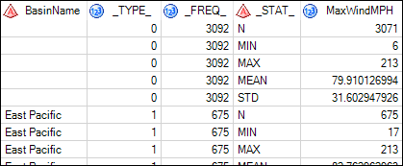
5.06 Activity – Correct Answer
continued...
Run the PROC MEANS step and compare the report and the wind_stats table. Are the same statistics in the report and table? What do the first five rows in the table represent? The statistics are different. The first five rows in the table summarize the entire input table.
Notes:
Type answer here

Slide 37
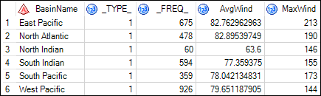
5.06 Activity – Correct Answer
Add the following options in the OUTPUT statement and run the program again. How many rows are in the output table? Six rows, one for each value of BasinName.
proc means data=pg1.storm_final noprint;
var MaxWindMPH;
class BasinName;
ways 1;
output out=wind_stats mean=AvgWind max=MaxWind;
run;
View SAS documentation for more options to customize the output table.
Notes:
Type answer here

Slide 38
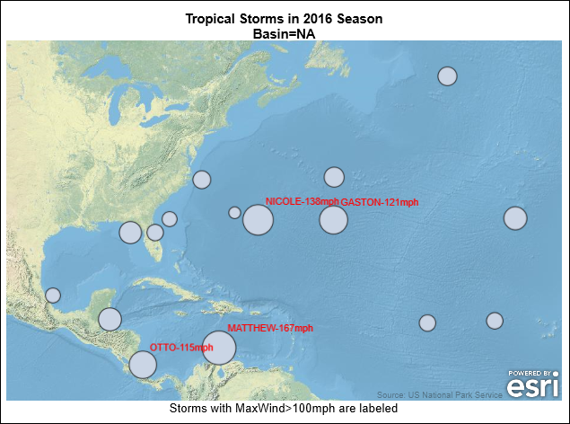
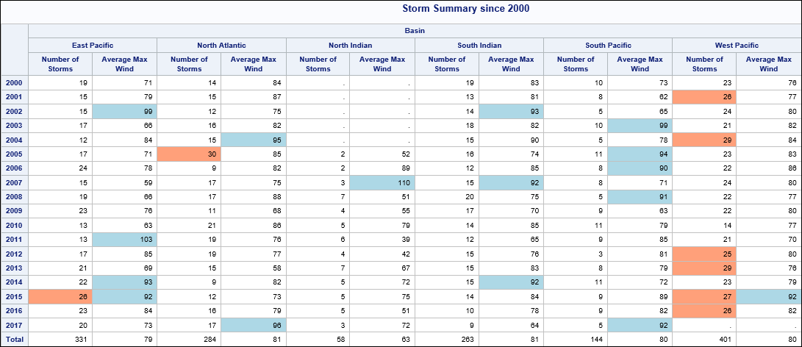
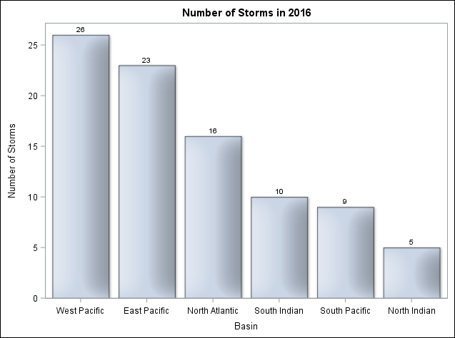
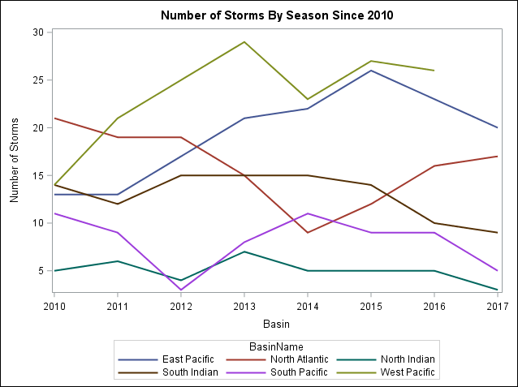
5.07 Activity
Open p105a07.sas from the activities folder. Run the program and examine the results to see examples of other procedures that analyze and report on the data.
Notes:
Type answer here

Slide 39
Beyond SAS Programming 1
What if you want to ...
. . . create high-quality, customized graphs?
. . . learn about basic statistical procedures to analyze your data?
. . . generate detail and summary tabular reports?
Review the SAS 9.4 ODS Graphics documentation.
Take the ODS Graphics: Essentials course.
Use this ODS Graphics tip sheet as a reference.
Take the free e-learning Statistics 1: Introduction to ANOVA, Regression, and Logistic Regression course.
Check out other training options for advanced analytics.
Learn to use PROC REPORT and PROC TABULATE in the SAS Report Writing 1: Essentials course.
Read PROC REPORT by Example: Techniques for Building Professional Reports Using SAS.

Slide 40
Practice
This practice reinforces the concepts discussed previously.

Slide 41
Lesson Quiz

Slide 42
If you run this program, which title or titles appear in the final PROC PRINT results?
The Top Line
The Top Line The Next Line
The Top Line The Second Line
The Top Line The First Line The Next Line
title1 'The First Line';
title2 'The Second Line';
proc print data=sales;
run;
title2 'The Next Line';
proc print data=sales;
run;
title 'The Top Line';
proc print data=sales;
run;
Notes:
Correct answer: a
TITLE is the same as TITLE1. The TITLE statement for the last PROC PRINT step cancels out the higher TITLEn statements.

Slide 43
If you run this program, which title or titles appear in the final PROC PRINT results?
The Top Line
The Top Line The Next Line
The Top Line The Second Line
The Top Line The First Line The Next Line
title1 'The First Line';
title2 'The Second Line';
proc print data=sales;
run;
title2 'The Next Line';
proc print data=sales;
run;
title 'The Top Line';
proc print data=sales;
run;
Notes:
Correct answer: a
TITLE is the same as TITLE1. The TITLE statement for the last PROC PRINT step cancels out the higher TITLEn statements.

Slide 44
Which statement substitutes the value of the macro variable Year in the footnote?
footnote 'year Sales';
footnote '&year Sales';
footnote "%year Sales";
footnote "&year Sales";
%let Year=2018;
Notes:
Correct answer: d
To reference a macro variable, use the & followed by the name of the macro variable, e.g. &YEAR. The macro variable must be in double quotes on the FOOTNOTE statement in order for the value to be substituted. If single quotes are used, the value will not be substituted.

Slide 45
Which statement substitutes the value of the macro variable Year in the footnote?
footnote 'year Sales';
footnote '&year Sales';
footnote "%year Sales";
footnote "&year Sales";
%let Year=2018;
Notes:
Correct answer: d
To reference a macro variable, use the & followed by the name of the macro variable, e.g. &YEAR. The macro variable must be in double quotes on the FOOTNOTE statement in order for the value to be substituted. If single quotes are used, the value will not be substituted.

Slide 46
Which statement is true based on the given program?
The column BatAvg will have a permanent label in the sashelp.baseball table.
The label for BatAvg will appear in the PRINT report.
The label for BatAvg will appear in the MEANS report.
The label for BatAvg will appear in both reports.
data baseball2;
set sashelp.baseball;
BatAvg=CrHits/CrAtBat;
label BatAvg="Batting Average";
run;
proc print data=baseball2;
var Name Team BatAvg;
run;
proc means data=baseball2;
var BatAvg;
class Team;
run;
Notes:
Correct answer: c
The label will appear in the PROC MEANS report. The label will not appear in the PROC PRINT report because the LABEL option is missing on the PROC PRINT statement. The output table WORK.BASEBALL2 (not the input table SASHELP.BASEBALL) contains a permanent label for BatAvg.

Slide 47
Which statement is true based on the given program?
The column BatAvg will have a permanent label in the sashelp.baseball table.
The label for BatAvg will appear in the PRINT report.
The label for BatAvg will appear in the MEANS report.
The label for BatAvg will appear in both reports.
data baseball2;
set sashelp.baseball;
BatAvg=CrHits/CrAtBat;
label BatAvg="Batting Average";
run;
proc print data=baseball2;
var Name Team BatAvg;
run;
proc means data=baseball2;
var BatAvg;
class Team;
run;
Notes:
Correct answer: c
The label will appear in the PROC MEANS report. The label will not appear in the PROC PRINT report because the LABEL option is missing on the PROC PRINT statement. The output table WORK.BASEBALL2 (not the input table SASHELP.BASEBALL) contains a permanent label for BatAvg.

Slide 48
Which statement is true regarding a BY statement in a reporting procedure such as PROC PRINT?
The BY statement is responsible for sorting the table.
Only one column can be specified in the BY statement.
The BY statement groups the report by the specified columns.
The BY statement must be the first statement after the PROC statement.
Notes:
Correct answer: c
The BY statement in a reporting procedure is responsible for grouping the report by the specified columns. One or multiple columns can be on the BY statement. The BY statement can be placed in any order within a PROC step. . The BY statement in PROC SORT is responsible for sorting the table.

Slide 49
Which statement is true regarding a BY statement in a reporting procedure such as PROC PRINT?
The BY statement is responsible for sorting the table.
Only one column can be specified in the BY statement.
The BY statement groups the report by the specified columns.
The BY statement must be the first statement after the PROC statement.
Notes:
Correct answer: c
The BY statement in a reporting procedure is responsible for grouping the report by the specified columns. One or multiple columns can be on the BY statement. The BY statement can be placed in any order within a PROC step. . The BY statement in PROC SORT is responsible for sorting the table.

Slide 50
Which statement is false concerning the FREQ procedure?
The NOPROCTITLE option can be placed in the PROC FREQ statement to remove the procedure title of The FREQ Procedure.
The ORDER=FREQ option can be placed in the PROC FREQ statement to display the column values in descending frequency count order.
The PLOTS= option can be placed in the TABLES statement after the forward slash to create bar charts based on counts or percentages.
The OUT= option can be placed in the TABLES statement after the forward slash to create a table containing counts and percentages.
Notes:
Correct answer: a
The NOPROCTITLE option goes in a global ODS statement to remove the procedure title. ods noproctitle;

Slide 51
Which statement is false concerning the FREQ procedure?
The NOPROCTITLE option can be placed in the PROC FREQ statement to remove the procedure title of The FREQ Procedure.
The ORDER=FREQ option can be placed in the PROC FREQ statement to display the column values in descending frequency count order.
The PLOTS= option can be placed in the TABLES statement after the forward slash to create bar charts based on counts or percentages.
The OUT= option can be placed in the TABLES statement after the forward slash to create a table containing counts and percentages.
Notes:
Correct answer: a
The NOPROCTITLE option goes in a global ODS statement to remove the procedure title. ods noproctitle;

Slide 52
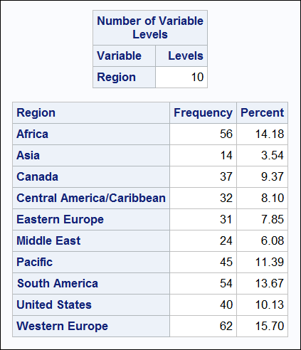
Which PROC FREQ step creates the results shown here?
proc freq data=sashelp.shoes;
tables Region nocum;
run;
a.
b.
c.
d.
proc freq data=sashelp.shoes levels;
tables Region / nocum;
run;
proc freq data=sashelp.shoes nlevels;
tables Region / nocum;
run;
proc freq data=sashelp.shoes / levels;
tables Region nocum;
run;
Notes:
Correct answer: c
The NLEVELS option in the PROC MEANS statement creates a table displaying the number of levels for all TABLES columns. The NOCUM option in the TABLES statement (goes after the forward slash) suppresses the display of cumulative frequencies and cumulative percentages.

Slide 53
Which PROC FREQ step creates the results shown here?
proc freq data=sashelp.shoes;
tables Region nocum;
run;
a.
b.
c.
d.
proc freq data=sashelp.shoes levels;
tables Region / nocum;
run;
proc freq data=sashelp.shoes nlevels;
tables Region / nocum;
run;
proc freq data=sashelp.shoes / levels;
tables Region nocum;
run;
Notes:
Correct answer: c
The NLEVELS option in the PROC MEANS statement creates a table displaying the number of levels for all TABLES columns. The NOCUM option on the TABLES statement (goes after the forward slash) suppresses the display of cumulative frequencies and cumulative percentages.

Slide 54
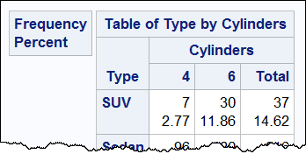
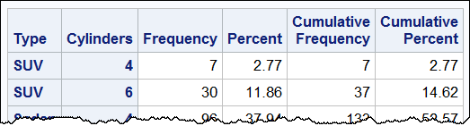
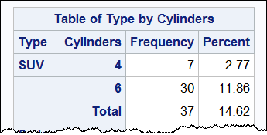
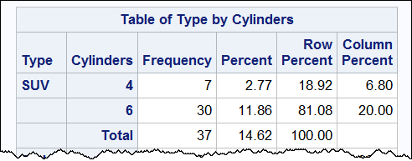
Which report is created from the following PROC FREQ step?
a. b.
c. d.
proc freq data=sashelp.cars;
where Cylinders in (4,6) and Type in ('Sedan','SUV');
tables Type*Cylinders / nocol norow crosslist;
run;
Notes:
Correct answer: c.
NOCOL removes the Column Percent, NOROW removes the Row Percent, and CROSSLIST displays statistic values in columns instead of stacked in a cell.
a. tables Type*Cylinders / nocol norow;
b. tables Type*Cylinders / nocol norow list;
c. tables Type*Cylinders / nocol norow crosslist;
d. tables Type*Cylinders / crosslsit;

Slide 55
Which report is created from the following PROC FREQ step?
a. b.
c. d.
proc freq data=sashelp.cars;
where Cylinders in (4,6) and Type in ('Sedan','SUV');
tables Type*Cylinders / nocol norow crosslist;
run;
Notes:
Correct answer: c.
NOCOL removes the Column Percent, NOROW removes the Row Percent, and CROSSLIST displays statistic values in columns instead of stacked in a cell.
a. tables Type*Cylinders / nocol norow;
b. tables Type*Cylinders / nocol norow list;
c. tables Type*Cylinders / nocol norow crosslist;
d. tables Type*Cylinders / crosslsit;

Slide 56
Which statement is true concerning the MEANS procedure?
The VAR statement is required and identifies the analysis columns.
The WAYS statement specifies the number of ways to make unique combinations of class columns.
The MAXDEC= option is used in the VAR statement to specify the number of decimal places for the statistics.
The _COUNT_ and _FREQ_ columns are automatically included in the output summary table that is produced by the OUT= option of the OUTPUT statement.
Notes:
Correct answer: b
The WAYS statement specifies the number of ways to make unique combinations of class variables. The VAR statement is not required. The MAXDEC= option goes on the PROC MEANS statement. _FREQ_ and _TYPE_ are automatically included in the output summary table.

Slide 57
Which statement is true concerning the MEANS procedure?
The VAR statement is required and identifies the analysis columns.
The WAYS statement specifies the number of ways to make unique combinations of class columns.
The MAXDEC= option is used in the VAR statement to specify the number of decimal places for the statistics.
The _COUNT_ and _FREQ_ columns are automatically included in the output summary table that is produced by the OUT= option of the OUTPUT statement.
Notes:
Correct answer: b
The WAYS statement specifies the number of ways to make unique combinations of class variables. The VAR statement is not required. The MAXDEC= option goes on the PROC MEANS statement. _FREQ_ and _TYPE_ are automatically included in the output summary table.

Slide 58
The input table must be pre-sorted by the columns listed in the CLASS statement of a PROC MEANS step.
True
False
proc means data=sashelp.heart;
var Cholesterol;
class Weight_Status Sex;
run;
Notes:
Correct answer: b
The input table does not have to be pre-sorted by the columns on the CLASS statement of the PROC MEANS step. If a BY statement was used instead, the columns would need to be sorted.

Slide 59
The input table must be pre-sorted by the columns listed in the CLASS statement of a PROC MEANS step.
True
False
proc means data=sashelp.heart;
var Cholesterol;
class Weight_Status Sex;
run;
Notes:
Correct answer: b
The input table does not have to be pre-sorted by the columns on the CLASS statement of the PROC MEANS step. If a BY statement was used instead, the columns would need to be sorted.

Slide 60
Which statement from PROC MEANS contains valid syntax for creating a summary output table?
out=work.summary mean;
out work.summary mean(Weight)=TotW;
output out work.summary Weight=TotW;
output out=work.summary mean(Weight)=TotW;
Notes:
Correct answer: d
The OUTPUT statement writes statistics to an output table. The OUT= option names the output table. statistic(input-variable)=output-variable can be specified on the OUTPUT statement.

Slide 61
Which statement from PROC MEANS contains valid syntax for creating a summary output table?
out=work.summary mean;
out work.summary mean(Weight)=TotW;
output out work.summary Weight=TotW;
output out=work.summary mean(Weight)=TotW;
Notes:
Correct answer: d
The OUTPUT statement writes statistics to an output table. The OUT= option names the output table. statistic(input-variable)=output-variable can be specified on the OUTPUT statement.

