Slide 1

Naive Bayes algorithm

Slide 2
What is the Naive Bayes algorithm
It is a classification technique based on Bayes’ Theorem with an assumption of independence among predictors.

Slide 3
What is the Bayes' theorem
Bayes' theorem describes the probability of an event, based on prior knowledge of conditions that might be related to the event.

Slide 4
What is the Bayes' theorem
For example, if cancer is related to age, then, using Bayes' theorem, a person's age can be used to more accurately assess the probability that they have cancer, compared to the assessment of the probability of cancer made without knowledge of the person's age.

Slide 5
What is the Naive Bayes algorithm
remains a popular method for text categorization, the problem of judging documents as belonging to one category or the other
(such as spam or legitimate sports or politics, etc.)
with word frequencies as the features

Slide 6
What is the Naive Bayes algorithm
it is competitive in this domain with more advanced methods including support vector machines.

Slide 7
What is the Naive Bayes algorithm
Naive Bayes classifiers are highly scalable
requiring a number of parameters linear in the number of variables in a learning problem.

Slide 8
What is the Naive Bayes algorithm
Naive Bayes is a simple technique for constructing classifiers: models that assign class labels to problem instances, represented as vectors of feature values, where the class labels are drawn from some finite set

Slide 9
Naive Bayes algorithm
all naive Bayes classifiers assume that the value of a particular feature is independent of the value of any other feature, given the class variable

Slide 10
Naive Bayes algorithm
Despite their naive design and apparently oversimplified assumptions, naive Bayes classifiers have worked quite well in many complex real-world situations

Slide 11
Naive Bayes algorithm
For some types of probability models, naive Bayes classifiers can be trained very efficiently in a supervised learning setting.

Slide 12
Naive Bayes algorithm
In many practical applications, parameter estimation for naive Bayes models uses the method of maximum likelihood

Slide 13
Naive Bayes algorithm
An advantage of naive Bayes is that it only requires a small number of training data to estimate the parameters necessary for classification

Slide 14
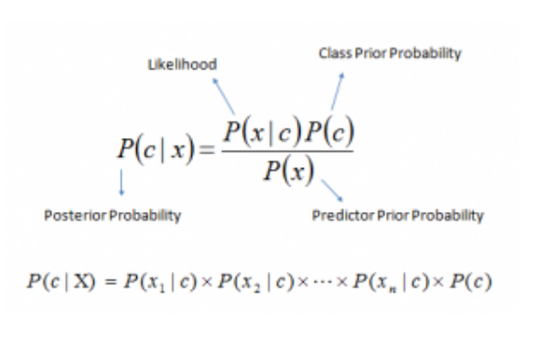
Naive Bayes Low

Slide 15
Naive Bayes Low Example
Problem: Players will play if weather is sunny. Is this statement is correct?
P(Yes | Sunny) = P( Sunny | Yes) * P(Yes) / P (Sunny)
Here we have P (Sunny |Yes) = 3/9 = 0.33,
P(Sunny) = 5/14 = 0.36,
P( Yes)= 9/14 = 0.64
Now, P (Yes | Sunny) = 0.33 * 0.64 / 0.36 = 0.60, which has higher probability.

