Slide 1

TRAPNET
Design and Implementation of a Tamper-Resilient mm Wave-Radar-Based Intrusion Containment System with Mesh-Relayed SOS Alerts
Review Presentation
Guide Name:
Ms.S.Bhuvaneshwari, M.E.,
Assistant Professor, Department of ECE
Batch: 462
Name & Reg No:
Mohamed Sameer F (43130597)
Raahul N (43130640)
Department of Electronics and Communication Engineering
Final Year Project — 2026-2027

Slide 2
Introduction
TRAPNET — Autonomous Intruder Containment System
TRAPNET (Trapping Network) is an Edge-AI driven physical intrusion containment system
designed for small businesses, academic institutions, and residential security. Unlike
conventional CCTV systems that only record, TRAPNET actively responds to intrusion by
physically trapping the intruder and simultaneously triggering a resilient multi-layer SOS
alert.
Core Technology Stack:
mmWave Radar (HLK-LD2410 24GHz)
Detects 5mm chest breathing motion of stationary hidden intruder
YOLOv8 Vision AI (Raspberry Pi Zero 2W)
Camera-based person detection as secondary confirmation layer
Solenoid Door Lock (12V)
Physical containment: door locks in under 3 seconds upon confirmed detection
Multi-Layer SOS Alert
Wi Fi Beacon + BLE Eddystone + GSM SMS + ESP-NOW Mesh; operates with ZERO internet

Slide 3
Objectives
1. To design and implement an autonomous physical intrusion containment system capable of detecting human presence and triggering door locking within 3 seconds of confirmed intrusion.
2. To integrate mmWave radar (HLK-LD2410, 24GHz) for reliable stationary-human detection by sensing 5mm micro-Doppler chest breathing signatures — overcoming the core failure of PIR sensors. To deploy YOLOv8 edge-AI on Raspberry Pi Zero 2W for camera-based person detection as a secondary sensor fusion layer, reducing false-positive rate and confirming intrusion before actuation.
3. To implement a 4-layer internet-independent SOS alert system (WiFi Beacon + BLE Eddystone + GSM SMS via SIM800L + ESP-NOW multi-hop mesh), resilient to WiFi jamming, power cuts, and connectivity loss.
4. To achieve full-system offline resilience using 18650 battery backup (4–6 hrs), MicroSD event logging, and GSM cellular communication — ensuring operation independent of internet infrastructure.

Slide 4
Problem Statement
Why TRAPNET is Needed — The Security Gap
1. CCTV systems only RECORD — they never RESPOND. A thief walks in, steals, and walks out; the camera captures it all but does nothing to stop it.
2. PIR motion sensors MISS stationary intruders. A professional thief who freezes still goes completely undetected — a known and exploited vulnerability.
3. Camera tamper defeats the entire system. Spraying paint or placing a cloth over the camera causes security systems to lose their only detection channel.
4. Single-layer alerts fail under attack. WiFi jamming, internet outage, or power cut disables most IoT-based security systems in a single step.
5. No physical containment exists in affordable systems. High-cost commercial solutions exist, but no sub-₹8,000 system physically traps and alerts simultaneously.

Slide 5
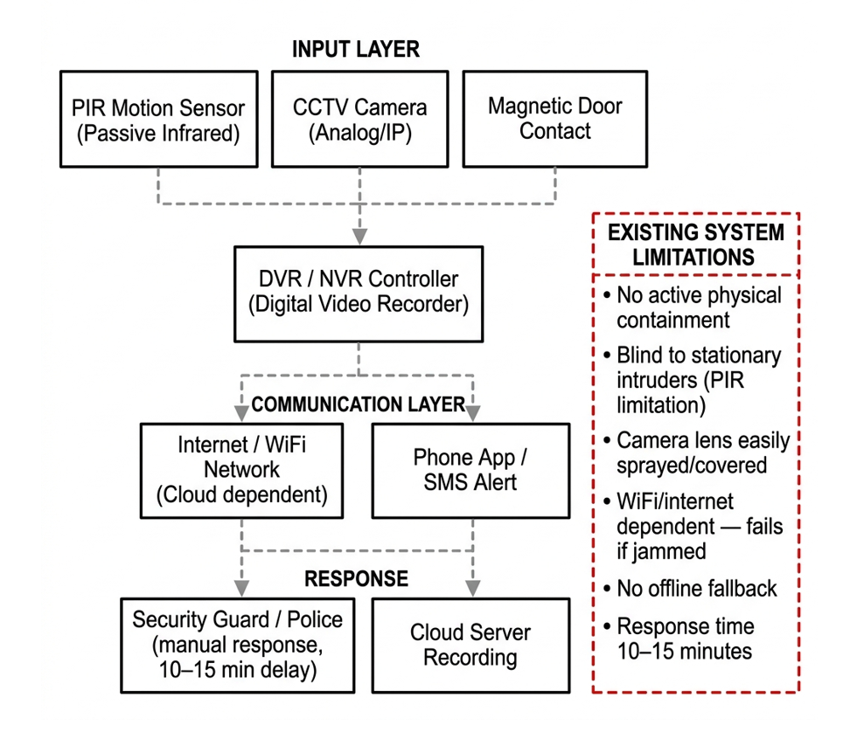
Existing Block Diagram
Existing Conventional Security System Architecture

Slide 6
Scope & Application
Deployment Area | Problem Addressed | TRAPNET Solution
Banks & ATMs | Unauthorized after-hours entry; Restricted zone breach | mm Wave detects frozen intruder + solenoid lock + GSM silent alarm to security
Retail Shops & Warehouses | Night theft after shutter close; camera spray by thieves | Camera tamper = trigger; radar as backup; SMS to owner within 3 sec
Corporate Offices & Server Rooms | Restricted zone breach; insider threat; asset theft | ESP-NOW mesh alerts entire floor; vibration sensor detects locker drilling
Academic Labs & Libraries | Equipment theft; unauthorized equipment removal | GPS on asset sends live coordinates via GSM if moved; OLED live status HUD
Rural & Remote Locations | No internet; no GSM 4G coverage in some areas | GSM 2G SMS works on SIM800L; fully offline with battery backup 4-6 hours
Residential Security | Break-in through back door; no app or subscription | WiFi Beacon visible in nearby phones WiFi list — no app, no pairing needed

Slide 7
Literature Summary
Sl. No | Author & Paper Title | Methodology | Learning / Finding | Future Enhancement
01 | Raimondi et al. (IEEE Sensors Journal, 2024) mmDetect: YOLO-Based mm-Wave Radar for Detecting Moving People | MIMO mmWave radar data cube (Range-Doppler-Angle) fed into YOLO neural network for indoor human detection; replaces conventional CFAR algorithms. | YOLO-based radar processing outperforms CFAR in cluttered indoor environments; effective for moving-person detection using radar-only pipeline. | Extend to stationary human detection via micro-Doppler breathing signal; add physical response layer for security applications.
02 | Sengupta et al. (IEEE Sensors Letters, 2022) Robust Multiobject Tracking Using mmWave Radar-Camera Sensor Fusion | Decision-level fusion of monocular camera + mmWave radar; Hungarian algorithm for measurement association; tri-Kalman filter tracking framework. | Tri-Kalman filter ensures tracking continuity despite single sensor failures; radar depth + camera cross-range fusion improves localization. | Adapt radar-camera fusion tracking to indoor security; maintain detection continuity when camera is tampered or obscured.
03 | Shin et al. (IEEE, 2023) Robust Indoor Human Detection & Tracking via mmWave Radar-Vision Fusion | Deep learning framework fusing mmWave radar point clouds with 3D skeleton annotations from vision sensor; sparse-to-skeleton reconstruction network. | Radar-vision fusion enables reliable and privacy-preserving indoor human detection; deep learning bridges radar point-cloud sparsity. | Apply radar-vision fusion concept to TRAPNET dual-sensor architecture for enhanced dual-confirm detection confidence.
04 | Billah et al. (IEEE ICCIT, 2024) Anomalous Event Detection Based on YOLOv8 for Enhanced Security | Multi-camera YOLOv8 + DCNN system with autonomous surveillance rover; detects weapons, smoking and anomalous activities across multiple locations. | YOLOv8 achieves high precision for threat-object detection; camera spray/tamper causes complete detection failure in vision-only systems. | Add mmWave radar as parallel detection channel independent of optical conditions; integrate physical containment response.
05 | Chatterjee et al. (IEEE, 2024) YOLOv8-Based Intrusion Detection System for Physical Security | YOLOv8 trained on COCO dataset (80 categories) for region-of-interest physical intrusion detection; Python + OpenCV real-time pipeline. | High precision and recall for physical intrusion detection; no offline fallback; system is cloud-dependent for alerts with no physical response. | Add GSM offline fallback + solenoid lock physical containment; integrate mmWave radar for camera-tamper resilience.
06 | Shahbazian & Trubitsyna (IEEE Access, 2023) Human Sensing via RF Signals: Survey on Occupancy & Activity Detection | Comprehensive survey of RF-based human sensing: WiFi, BLE, radar and ML techniques for occupancy detection, activity recognition and vital signs. | Radar-based systems outperform vision in privacy, lighting independence; WiFi CSI and BLE viable for low-cost non-intrusive occupancy sensing. | Combine radar occupancy detection with BLE/WiFi alert propagation as implemented in TRAPNET multi-layer SOS design.

Slide 8
Literature Summary
Sl. No | Author & Paper Title | Methodology | Learning / Finding | Future Enhancement
07 | Shrestha et al. (IEEE Sensors Journal, 2020) Continuous Human Activity Classification from FMCW Radar with Bi-LSTM | FMCW radar micro-Doppler data processed by Bi-LSTM recurrent networks for continuous activity monitoring and multi-class classification. | Bi-LSTM achieves >90% mean accuracy on Doppler-domain data; continuous temporal classification superior to fixed-time discrete approaches. | Apply activity classification to distinguish intruder movements from normal activity in TRAPNET radar signal processing pipeline.
08 | Shen et al. (IEEE, 2023) Human Detection with Weak Ranging Signal for FMCW Radar Systems | Range profile (RP) variation analysis using FMCW mmWave radar; clutter removal + standard deviation per chirp for human presence detection. | Achieves >97% detection accuracy even with weak ranging signals; requires significantly less computational storage than conventional approaches. | Apply weak-signal detection technique to extend TRAPNET radar detection range in challenging cluttered indoor environments.
09 | Wang et al. (IEEE Trans. Ind. Informatics, 2025) Vital Signs Detection via FMCW MIMO Radar | MIMO FMCW radar with maximum ratio combining; singular spectral analysis + correlation-based IMF selection; FastICA for respiration & heartbeat. | Multi-channel combining significantly enhances vital sign SNR; FMCW radar extracts heartbeat signal even when buried in noise/interference. | Use vital sign detection as living-human confirmation layer in TRAPNET radar-based intrusion detection to reduce false alarms.
10 | Vignoli et al. (IEEE Access, 2025) Contactless Vital Signs via Multiple 24GHz FMCW Radars | Multiple SIMO 24GHz FMCW radars; selection combining technique; Bayesian-inspired filtering for real-time heart rate, breathing and apnea detection. | 24GHz commercial radar achieves reliable vital sign monitoring; multi-radar setup improves coverage and robustness over single-sensor approach. | Validates HLK-LD2410 operating band selection; apply 24GHz radar human-presence validation directly to TRAPNET radar module.
11 | Khan et al. (IEEE Sensors Journal, 2025) Contactless Vital Signs on Edge Devices with T-CNN & mmWave Radar | Temporal CNN models for HR and BR estimation from 77GHz FMCW radar time-series; deployed on PYNQ-ZU SoC achieving 12.6ms inference time. | Edge-deployable vital sign monitoring with low MAE (2.37 bpm HR, 1.18 brpm BR); validates real-time radar processing on embedded hardware. | Apply edge inference approach to TRAPNET ESP32/RPi Zero 2W platform for on-device radar signal classification without cloud dependency.
12 | Deng & Zhang (IEEE, 2024) Non-Contact Heartbeat Detection with mmWave Radar Using Impulse Trains | mmWave radar with range FFT + high-resolution angle estimation; respiration-guided target selection; impulse train modeling for heartbeat extraction. | Achieves 3.29% avg heartbeat detection error; confirms mmWave radar sensitivity to sub-cm chest micro-motions even under noise/multi-target. | Apply micro-motion detection capability to confirm living human presence during intrusion; reduces false triggers in TRAPNET security system.

Slide 9
Literature Summary
Sl. No | Author & Paper Title | Methodology | Learning / Finding | Future Enhancement
13 | Balaji et al. (IEEE, 2023) Intruder Alert System in Smart Home Based on IoT | PIR sensor + Raspberry Pi 3 + webcam; motion-triggered image capture; frame comparison for motion detection; call and email alerts to owner. | PIR-based detection misses stationary intruders; CCTV only records without active feedback; IoT alerts improve response time significantly. | Replace PIR with mmWave radar for stationary-intruder detection; add solenoid door lock physical containment beyond alert-only response.
14 | Kumar et al. (IEEE, 2024) IoT-Enabled Smart Door Lock with RFID, OTP & Intrusion Detection | RFID + OTP dual-factor authentication; PIR motion sensor for intrusion detection; cloud IoT notifications; solenoid-actuated lock mechanism. | 97% authentication success; 90% intrusion detection accuracy; 0.8s RFID latency; demonstrates IoT door lock feasibility at low cost. | Replace PIR with mmWave radar; add autonomous lock trigger on radar detection instead of relying solely on manual RFID/OTP unlock.
15 | Suresh K et al. (IEEE, 2024) Real-Time Intrusion Detection for IoT Networks Using Machine Learning | IDS for IoT networks using Random Forest ML; Wireshark-based network traffic capture on local WiFi testbed; real-time anomaly classification. | Random Forest IDS provides scalable intelligent detection; highlights need for multi-layer security beyond network-only monitoring approaches. | Complement network-layer IDS with physical intrusion detection using mmWave radar + camera fusion for comprehensive security coverage.
16 | Karanth et al. (IEEE, 2024) AI & IoT-Based Intrusion Detection System for Smart Home Security | ML-driven network IDS for IoT smart homes; real-time data analysis and anomaly detection to identify and prevent cyber threats in IoT networks. | High accuracy rate with rapid response time; superior to traditional techniques; highlights IoT device security vulnerabilities by design. | Combine network-level IDS with TRAPNET physical intrusion detection using radar-vision fusion for layered smart-home security.
17 | Nair et al. (IEEE Systems Journal, 2025) Emergency Alert System via Compact IoT-Based Safety Device | ESP32-CAM + GPS + GSM wearable; panic button triggers SMS, location sharing, photo capture; Wi-Fi or GSM alert delivery to contacts. | Manual activation only - no autonomous detection or physical containment; validates ESP32 + GPS + GSM hardware combination for alerts. | Apply GPS-GSM telemetry to autonomous stolen asset tracking in TRAPNET V2; remove manual trigger with radar-based auto-detection.
18 | Choi & Bahk (IEEE Comms. Letters, 2023) mmWave FMCW Radar for Detecting Objects Behind Transparent Barriers | 24GHz FMCW radar experiments through acrylic boards; Range FFT + Angle FFT with background subtraction; range-angle map analysis. | mmWave radar detects objects behind transparent obstacles; unintended reflections from beyond barriers must be factored into system design. | Leverage through-barrier sensing for detecting hidden intruders behind glass partitions or transparent doors in TRAPNET deployment.

Slide 10
Literature Summary
Sl. No | Author & Paper Title | Methodology | Learning / Finding | Future Enhancement
19 | Han et al. (IEEE Trans. Mobile Computing, 2024) M2VISION: Recovering Surveillance Video with COTS mmWave Radar | Commercial mmWave radar reconstructs surveillance video when camera is damaged; dual-stage signal denoising; cGAN-based video generation. | Achieves 0.93 SSIM for video reconstruction from radar data; demonstrates mmWave as camera backup when camera is physically tampered. | Use radar-as-backup concept in TRAPNET; continue reliable detection even after camera tamper/spray attack in adversarial scenarios.
20 | Devoti et al. (IEEE INFOCOM, 2023) PASID: Passive Intrusion Detection via Indoor mmWave Deployments | Passive intrusion detection via 28GHz 5G AP beamforming reflections; ML for dynamic environment false-positive reduction; ~99% accuracy. | ~99% detection accuracy; constrained to environments with 5G mmWave infrastructure - unsuitable for standalone embedded deployment. | Embed dedicated LD2410 radar eliminating 5G infrastructure dependency; apply passive-sensing concept locally in TRAPNET nodes.
21 | Shahin & Younis (IEEE LCN, 2015) EMC: Multi-Group Formation & Communication for Wi-Fi Direct | Proxy-member concept for multi-group WiFi Direct mesh; dynamic group formation based on battery specs; cross-group data sharing via bridge nodes. | Proxy-member concept maps directly to TRAPNET ESP-NOW relay design; validates D2D multi-group mesh for alert dissemination in emergencies. | Apply multi-group communication protocol to TRAPNET ESP-NOW mesh for multi-node alert propagation beyond single-room coverage.
22 | Ferrag et al. (IEEE Access, 2022) Edge-IIoTset: IoT/IIoT Cyber Security Dataset for ML/FL | Comprehensive IoT/IIoT testbed dataset with 10+ device types; 14 attack types in 5 threat categories; 61 high-correlation features extracted. | ML/DL models on IoT datasets achieve high detection for DoS, MITM, injection and malware attacks; federated learning preserves privacy. | Use dataset insights to harden TRAPNET IoT communication against network-layer attacks alongside physical intrusion security.
23 | Venkatesha et al. (IEEE INDISCON, 2023) Detection & Simple Tracking for ADAS Using a mmWave Radar | 77GHz FMCW radar with Range-Doppler Map processing; 2D CFAR detection; cumulative Detection & Tracking Map (DTM) for multi-target tracking. | CFAR + DTM reliably detects and tracks multiple targets in real-time; applicable to both moving and stationary objects in field conditions. | Apply DTM-based tracking concept to indoor security in TRAPNET; adapt automotive radar pipeline for room-scale intrusion detection.

Slide 11
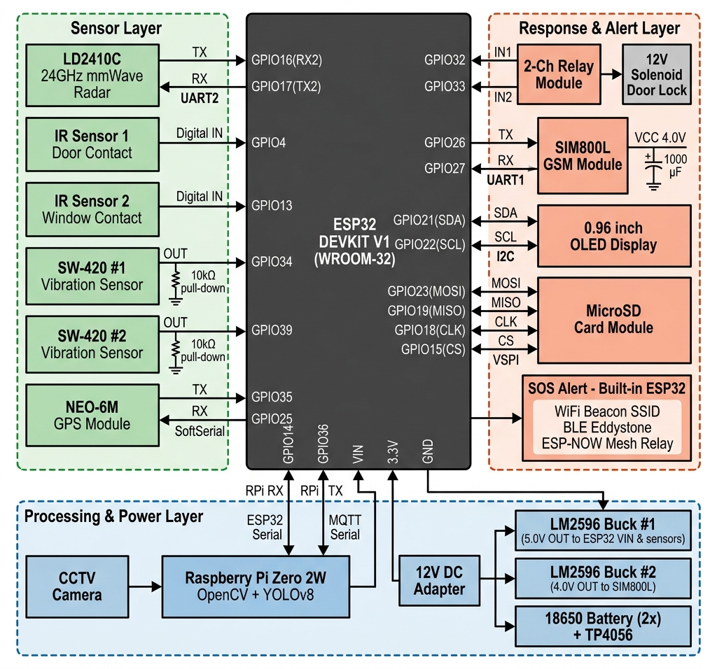
Proposed Block Diagram
Tamper-Resilient mm Wave-Radar-Based Intrusion Containment System with Mesh-Relayed SOS Alerts

Slide 12
Methodology – Four Layer Pipeline Architecture
Pipeline Layer | Hardware & Components | Operational Mechanism & Signal Flow
Layer 1: DETECT (Sensors) | • LD2410C 24GHz mmWave Radar • IR Sensors (Door & Window) • SW-420 Vibration Sensors (x2) • NEO-6M GPS Module • CCTV Camera (RPi CSI) | Fuses radar micro-breathing detection, IR beam-break, vibration triggers, and GPS location tracking. Sends real-time sensor signals to ESP32 coordinator.
Layer 2: PROCESS (Edge-AI Fusion) | • ESP32 DevKit V1 (Main Hub) • Raspberry Pi Zero 2W • Dual LM2596 Bucks (5V / 4V) • 18650 Battery System (TP4056) | ESP32 fuses multi-sensor inputs in <500ms. Raspberry Pi runs OpenCV + YOLOv8 vision AI for secondary confirmation over MQTT Serial bridge to prevent false alarms.
Layer 3: RESPOND (Actuation & Log) | • 2-Ch Relay Module (Active-LOW) • 12V Solenoid Door Lock • MicroSD Card Module (16GB) • 0.96 inch OLED Display (SSD1306) | Relay triggers 12V solenoid lock within 3s upon threat confirmation to trap intruder. System status displayed on OLED HUD; events logged to FAT32 MicroSD.
Layer 4: ALERT (Multi-Layer SOS) | • SIM800L GSM Module (+1000uF cap) • Onboard ESP32 Radios (WiFi Beacon + BLE + ESP-NOW) | Sends GSM SMS alerts to owner & police via SIM800L. Simultaneously broadcasts WiFi Beacon SSID (30m), BLE Eddystone (15m), and ESP-NOW Mesh Relay (200m+). Zero internet required.

Slide 13
Justification of Methodology
Design Choice / Methodology | Why This Method Was Selected | Alternatives Rejected & Why
Four-Layer Pipeline (Detect-Process-Respond-Alert) | Decouples sensing, processing, actuation & alert into modular layers. Multi-sensor fusion (radar+IR+vibration+camera) reduces false alarms to near zero. | Single-layer monolithic architecture (unstable, single point of failure); PIR-only motion sensing (misses stationary intruders).
mmWave Radar (LD2410C 24GHz, ~Rs450) | Detects 5mm chest breathing motion of stationary/hidden humans via micro-Doppler signatures. Works through light obstacles. | PIR sensor (misses frozen intruder); 77GHz COTS radar (Rs22,000+); UWB radar (Rs40,000+ per node - cost prohibitive).
Dual-Controller Fusion (ESP32-S3 + RPi Zero 2W) | ESP32-S3 acts as <500ms hard real-time coordinator. RPi Zero 2W handles heavy YOLOv8 Edge-AI vision confirmation over MQTT Serial bridge. | ESP32-CAM TFLite (low accuracy, poor resolution); Jetson Nano (Rs15,000+ - over budget); Cloud AI (requires internet).
Solenoid Door Lock (12V, <3s Containment) | Physically contains intruder in <3 seconds, directly solving the core 'record-only' limitation of standard CCTV security systems. | Alarm sirens alone (thief ignores and flees); Fog machines (hazard/maintenance issues); CCTV alert only (no physical protection).
Multi-Layer SOS (GSM + WiFi + BLE + ESP-NOW) | 4 redundant channels ensure alert delivery during WiFi jamming or power cuts. GSM SMS reaches phone 99.9%; BLE/WiFi beacon needs no app; ESP-NOW relays 200m+. | Single WiFi/App alert (disabled by Rs200 jammer); Siren-only (no remote notification); LTE-M per node (high monthly SIM cost).
Dual-Rail Power (LM2596 Bucks + 18650s) | Dedicated 4V buck + 1000uF cap absorbs SIM800L 2A transmit spikes without ESP32-S3 brownout. 18650 battery backup provides 4-6 hrs operation. | Single 5V rail (SIM800L current bursts reset ESP32); Lead-acid UPS (heavy, bulky); No battery backup (mains wire cut disables system).
MicroSD Evidence Log (16GB FAT32 SPI) | Provides tamper-proof, timestamped local event logging independent of cloud connectivity or internet uptime. | Cloud-only storage (fails during internet outage or jamming); Internal RAM buffer (event data lost on power reset).

Slide 14

Component List & Hardware Specifications
Status | Component | Model / Specification | Qty | Interface & Purpose
☐ | Main MCU | ESP32 DevKit V1 (WROOM-32) | 1 | V1 Basic Coordinator; Sensor Fusion + SOS; WiFi/BLE
☐ | Human Radar | LD2410C (24GHz mmWave) | 1 | UART2 (256000 baud); 5mm breathing motion detect
☐ | IR Obstacle Sensor | FC-51 / HW-201 | 2 | Digital GPIO (GPIO4, 13); door & window breach
☐ | Vibration Sensor | SW-420 (Adj. sensitivity) | 2 | Digital GPIO (GPIO34, 39 + 10kohm pull-down); forced entry
☐ | GPS Module | NEO-6M (GY-GPS6MV2) | 1 | SoftSerial (9600 baud); location tracking for SOS
☐ | CCTV Camera | RPi Camera Module V2 / USB | 1 | CSI / USB to RPi; visual person detection
☐ | AI Processor | Raspberry Pi Zero 2W | 1 | UART (115200 baud) to ESP32; OpenCV + YOLOv8
☐ | Buck Converter #1 | LM2596 DC-DC Step-Down | 1 | 12V -> 5.0V output rail for ESP32, LD2410, Relay, RPi
☐ | Buck Converter #2 | LM2596 DC-DC Step-Down | 1 | 12V -> 4.0V dedicated output rail for SIM800L GSM
☐ | Battery Backup | 18650 Li-Ion (x2) + TP4056 | 1 set | 7.4V power backup (4-6 hours operation during outage)
☐ | Relay Module | 2-Ch 5V Opto-Isolated | 1 | Digital GPIO (GPIO32/33, Active-LOW); 12V lock switch
☐ | Solenoid Lock | 12V Electromagnetic Lock | 1 | 12V direct via relay; <3s physical intruder containment
☐ | MicroSD Module | SPI Breakout + 16GB Card | 1 | VSPI Bus (GPIO18/19/23/15); local FAT32 evidence log
☐ | OLED Display | 0.96 inch SSD1306 (128x64) | 1 | I2C (GPIO21/22, Addr: 0x3C); real-time HUD status
 | Main MCU | ESP32-S3 DevKit V1 (WROOM-N16R8) | 1 | V2 Advanced Upgrade: Vector AI instruction, Dual Type-C, USB-OTG

