Slide 1
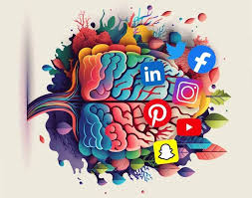
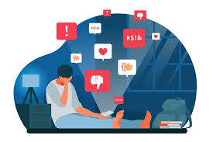
social media and mental health analysis By Python
Mohamed Samy

Slide 2
ABOUT Project
This project explores the impact of social media on mental health by analyzing user behavior and platform usage patterns. With the growing prevalence of social media in daily life, understanding its effects on mental well-being is essential.
Data was collected and analyzed to provide actionable insights into the relationship between social media usage and mental health, aiming to promote healthier digital habits and awareness among users. The findings contribute to ongoing discussions about digital well-being in today's connected world.

Slide 3
Project Content
Data Preparation
The process of gathering and organizing raw data to ensure it is ready for analysis.
Data Cleaning
Refining the dataset by removing inconsistencies, errors, and irrelevant information to enhance accuracy.
Extract Useful insights
Analyzing the data to uncover meaningful patterns, trends, and relationships that inform decision-making.
Conclusion
Contact

Slide 4

Data preparation

Slide 5
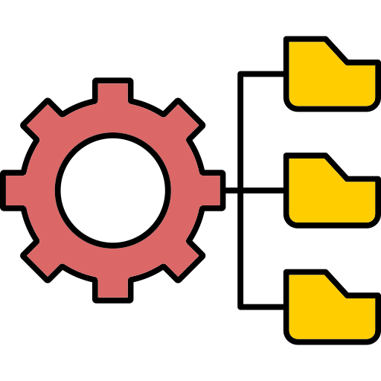
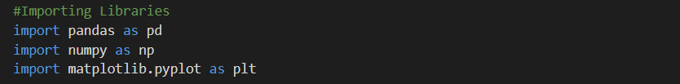

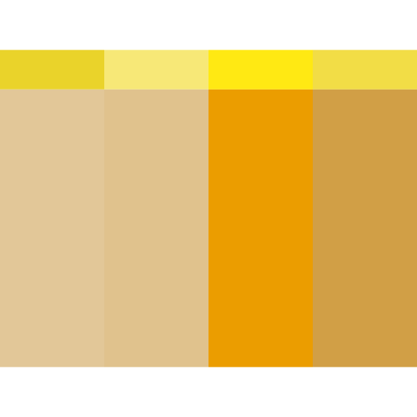
Preparation Steps
Importing the required libraries like Pandas For data manipulation , Numpy for some data calculations and Matplotlib for visualization of data
Reading the Data files
Columns (21)
Timestamp
What is your age?
Gender
Relationship Status
Occupation Status
What type of organizations are you affiliated with?
Do you use social media?
What social media platforms do you commonly use?
What is the average time you spend on social media every day?
How often do you find yourself using Social media without a specific purpose?
How often do you get distracted by Social media when you are busy doing something?
Do you feel restless if you haven't used Social media in a while?
On a scale of 1 to 5, how easily distracted are you?
On a scale of 1 to 5, how much are you bothered by worries?
Do you find it difficult to concentrate on things?
On a scale of 1-5, how often do you compare yourself to other successful people through the use of social media?
Following the previous question, how do you feel about these comparisons, generally speaking?
How often do you look to seek validation from features of social media?
How often do you feel depressed or down?
On a scale of 1 to 5, how frequently does your interest in daily activities fluctuate?
On a scale of 1 to 5, how often do you face issues regarding sleep?

Slide 6

Data cleaning

Slide 7

Data cleaning
Validate columns data type
Checking for missing values
Checking for duplicates
Handling Date Column
Data cleaning is the process of fixing or removing incorrect, corrupted, incorrectly formatted,
duplicate, or incomplete data within a dataset

Slide 8
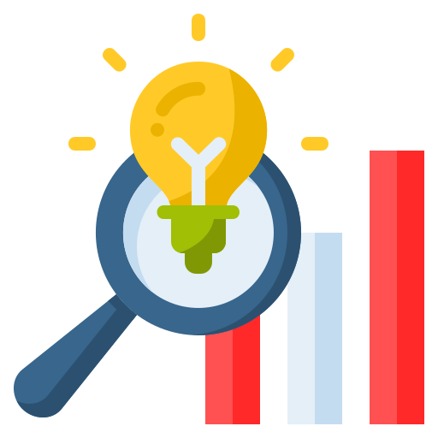
Extract Useful insights

Slide 9
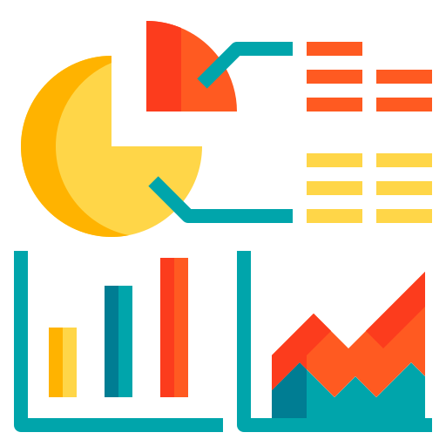
insights
3.55
3.32
3.25
Average Hours finding yourself using Social media without a specific purpose.
How frequently do you allow social media to distract you when you should be concentrating on important tasks?
How often do you find yourself struggling to concentrate on tasks?

Slide 10
insights
2.83
3.26
3.2
How often do you reflect on your journey by comparing it to the success stories you see on social media?
How frequently do you feel sad or depressed because of your experience with social media?
How frequently do social media distractions impact your ability to get a good night's sleep?

Slide 11
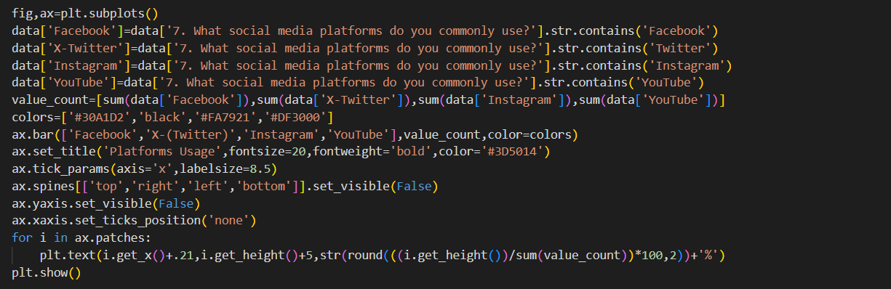
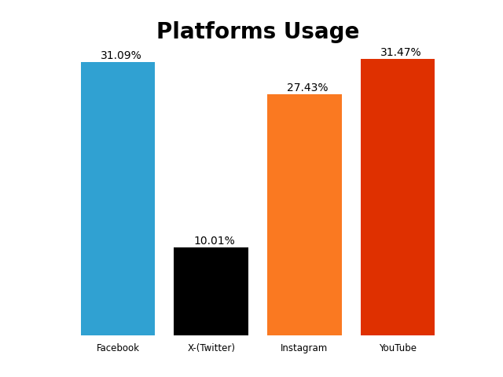
insights
The data showcases the distribution across four popular social media platforms: Facebook and YouTube have the highest usage, demonstrating their dominance among users. Instagram follows closely, maintaining a strong presence. X (formerly Twitter) has the lowest usage, highlighting its relatively smaller user base than the other platforms. The chart provides a clear overview of user preferences and engagement across these platforms.

Slide 12
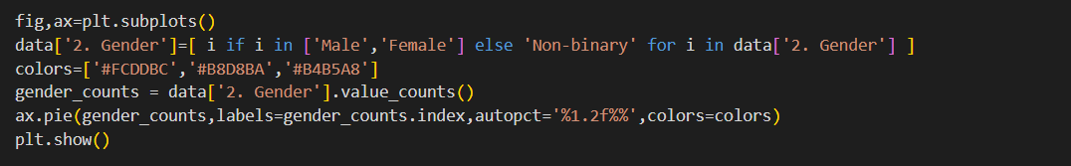
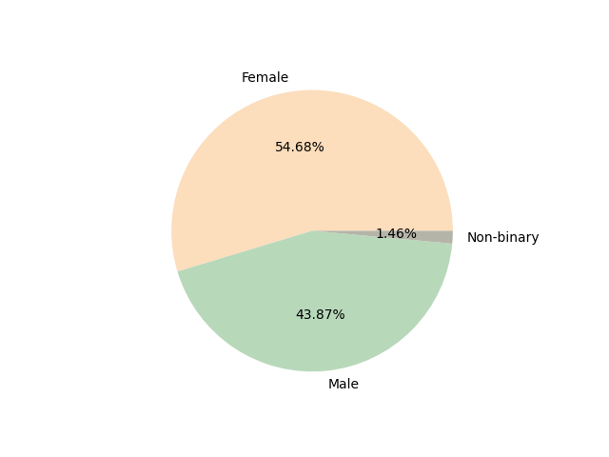
insights
The data indicate that women have the highest level of social media usage, although there has been a significant increase in usage among men.

Slide 13
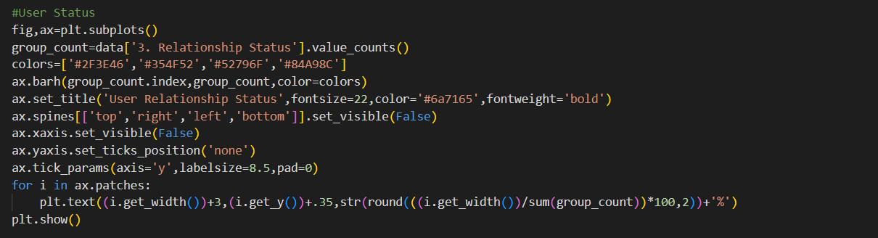
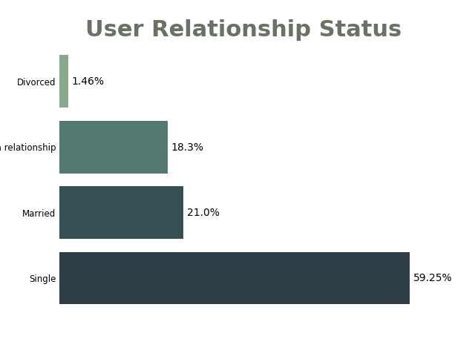
insights
The frequency of social media usage significantly differs based on an individual’s social status. Data shows that singles engage with social media platforms more than any other group, showcasing a vibrant online presence. In contrast, divorced individuals tend to participate the least, reflecting a potential shift in their social connectivity and engagement.

Slide 14
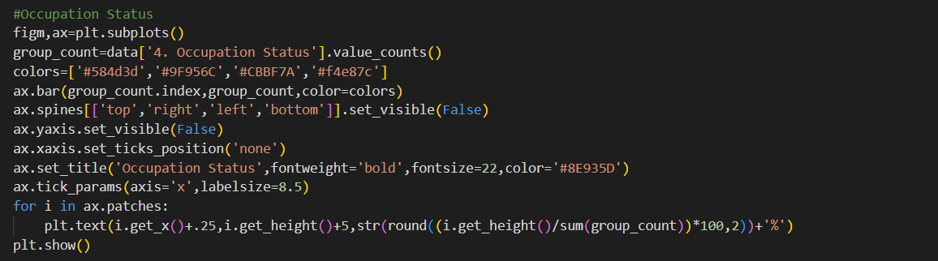
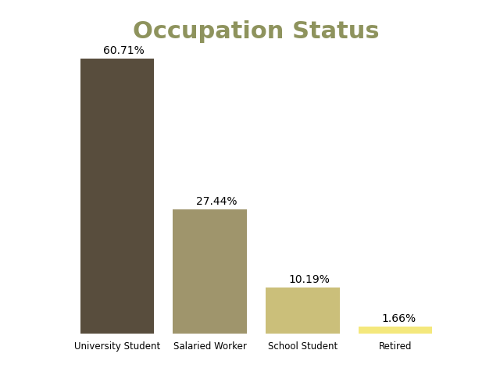
insights
The percentage of social media usage differs significantly across various professions. University students, who often rely on these platforms for communication, networking, and academic collaboration, exhibit the highest levels of engagement. In contrast, retirees tend to use social media the least, often preferring to engage in more traditional forms of communication and leisure activities. This disparity highlights the varying needs and habits of different age groups and professional backgrounds in their interaction with social media.

Slide 15
conclusion
The findings of this project emphasize the significant impact of social media on mental health, both positively and negatively. Platforms such as Facebook, Instagram, YouTube, and X (formerly Twitter) play a crucial role in influencing users' emotional and psychological well-being. While these platforms offer opportunities for connection, self-expression, and information sharing, excessive or unbalanced use can lead to stress, anxiety, and feelings of isolation.
This analysis highlights the importance of being aware of and using social media mindfully. Users should be encouraged to establish healthy boundaries, prioritize offline interactions, and seek professional help when necessary to reduce negative effects. Additionally, social media companies have a responsibility to create platforms that promote well-being and discourage harmful behaviors.
In an increasingly digital world, it is essential to cultivate a balanced relationship with social media. Doing so is vital for maintaining mental health and ensuring that these platforms serve as tools for positive social engagement.

Slide 16



THANK YOU
Mohamed Samy Omar
mohamedsamyomar55@gmail.com
Follow Me On Linked in
For More Details Visit My Github
For More Analysis Visit My Portfolio

