Slide 1
Context Free Grammar (CFG) & Context Free Language (CFL)

Slide 2
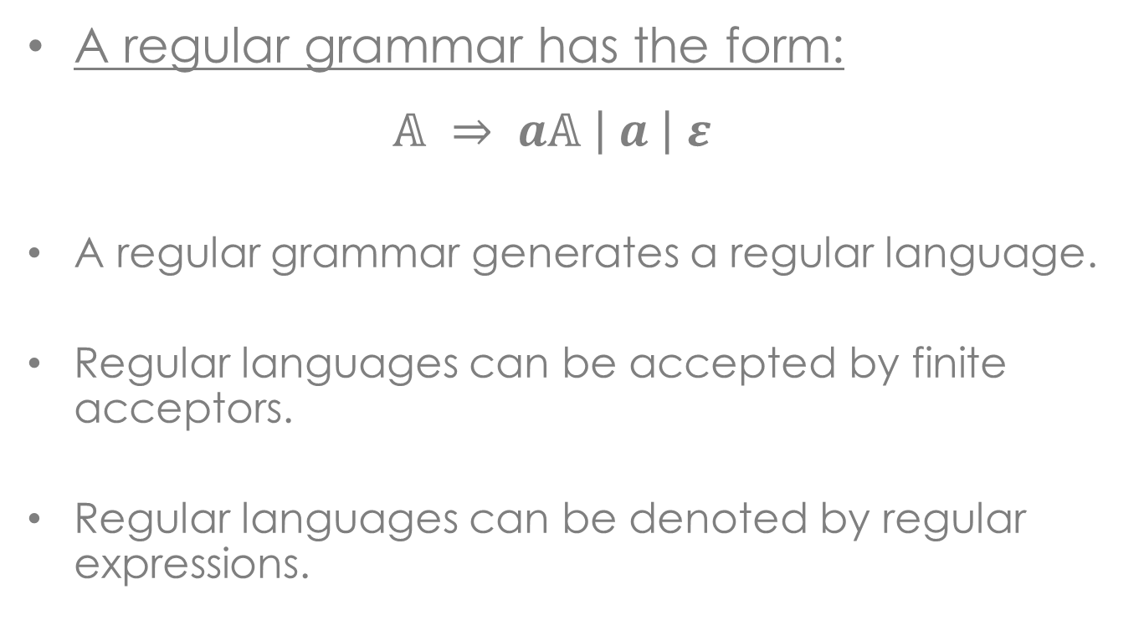
Recall
A regular grammar has the form:
$$𝔸 ⇒ a𝔸 \left| a \right| ε$$
A regular grammar generates a regular language.
Regular languages can be accepted by finite acceptors.
Regular languages can be denoted by regular expressions.

Slide 3
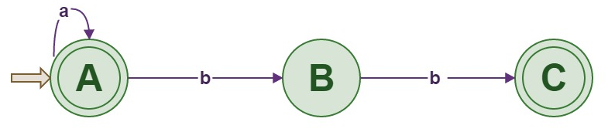
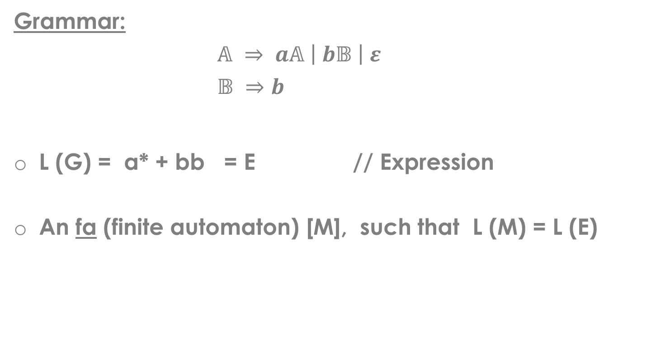
Example
Grammar:
$𝔸 ⇒ a𝔸 \left| b𝔹 \right| ε$
$𝔹 ⇒b$
L (G) = a* + bb = E // Expression
An fa (finite automaton) [M], such that L (M) = L (E)

Slide 4
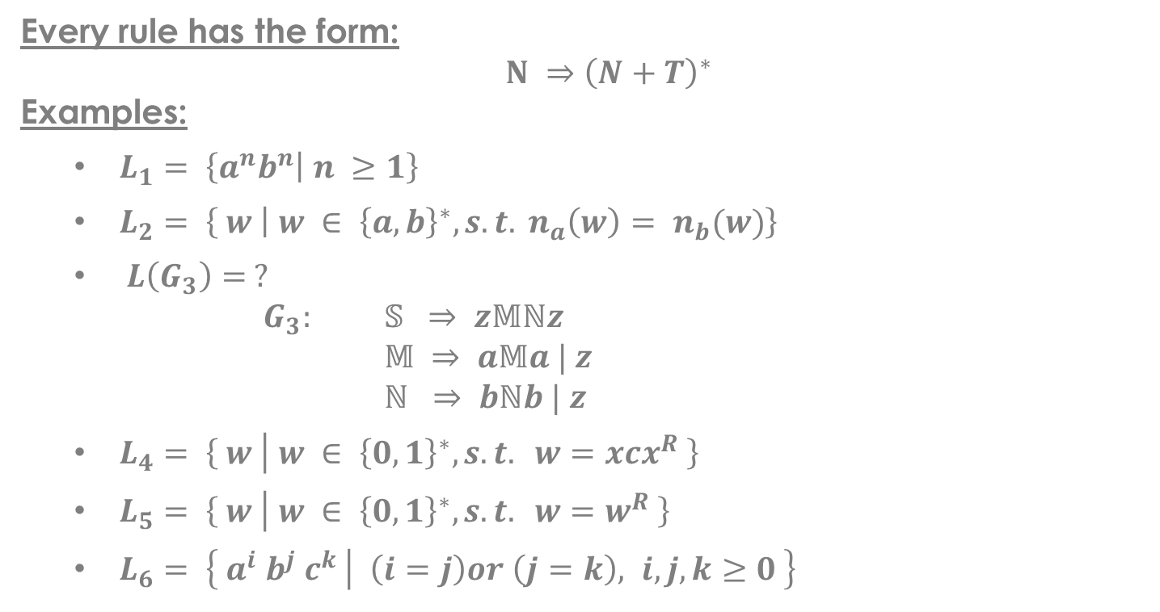
Context Free Grammar
Every rule has the form:
$N ⇒{\left(N+T\right)}^{∗}$
Examples:
$L_{1}= \left\{a^{n}b^{n} | n ≥1\right\}$
$L_{2}= \left\{ w | w ∈ {\left\{a,b\right\}}^{∗}, s.t. n_{a}\left(w\right)= n_{b}(w)\right\}$
$L\left(G_{3}\right)= ?$
$G_{3}:$ $𝕊 ⇒ z𝕄ℕz$
$𝕄 ⇒ a𝕄a | z$
$ℕ ⇒ bℕb | z$
$L_{4}= \left\{ w | w ∈ {\left\{0,1\right\}}^{∗}, s.t. w=xcx^{R} \right\}$
$L_{5}= \left\{ w | w ∈ {\left\{0,1\right\}}^{∗}, s.t. w=w^{R} \right\}$
$L_{6}= \left\{ a^{i}{ b}^{j} c^{k} | \left(i=j\right)or \left(j=k\right), i,j,k≥0 \right\}$

Slide 5
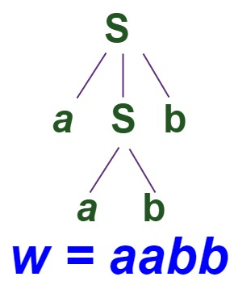
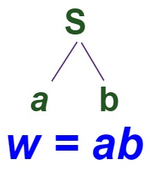
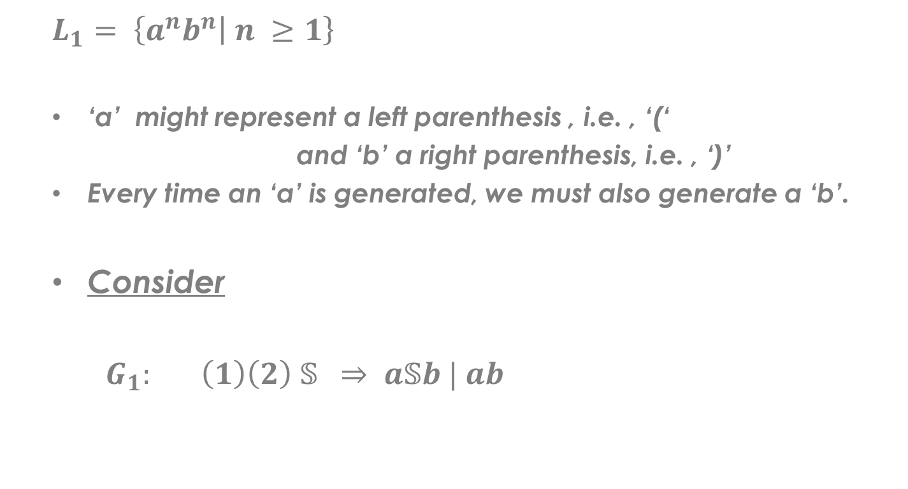
Example (1)
$$L_{1}= \left\{a^{n}b^{n} | n ≥1\right\}$$
‘a’ might represent a left parenthesis , i.e. , ‘(‘
and ‘b’ a right parenthesis, i.e. , ‘)’
Every time an ‘a’ is generated, we must also generate a ‘b’.
Consider
$G_{1}:$ $\left(1\right)\left(2\right) 𝕊 ⇒ a𝕊b | ab$

Slide 6
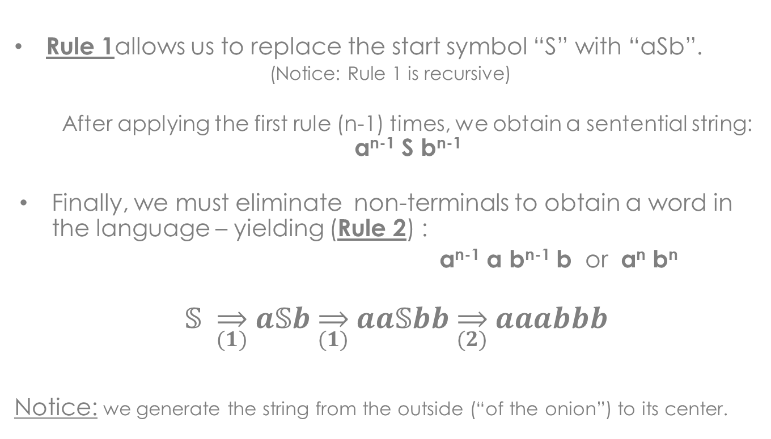
Illustration
Rule 1allows us to replace the start symbol “S” with “aSb”.
(Notice: Rule 1 is recursive)
After applying the first rule (n-1) times, we obtain a sentential string: a^{n-1} S b^{n-1}
Finally, we must eliminate non-terminals to obtain a word in the language – yielding (Rule 2) :
a^{n-1} a b^{n-1} b or a^{n} b^{n}
$𝕊 \overset{⇒}{(1)} a𝕊b \overset{⇒}{(1)} aa𝕊bb \overset{⇒}{(2)} aaabbb$
Notice: we generate the string from the outside (“of the onion”) to its center.

Slide 7
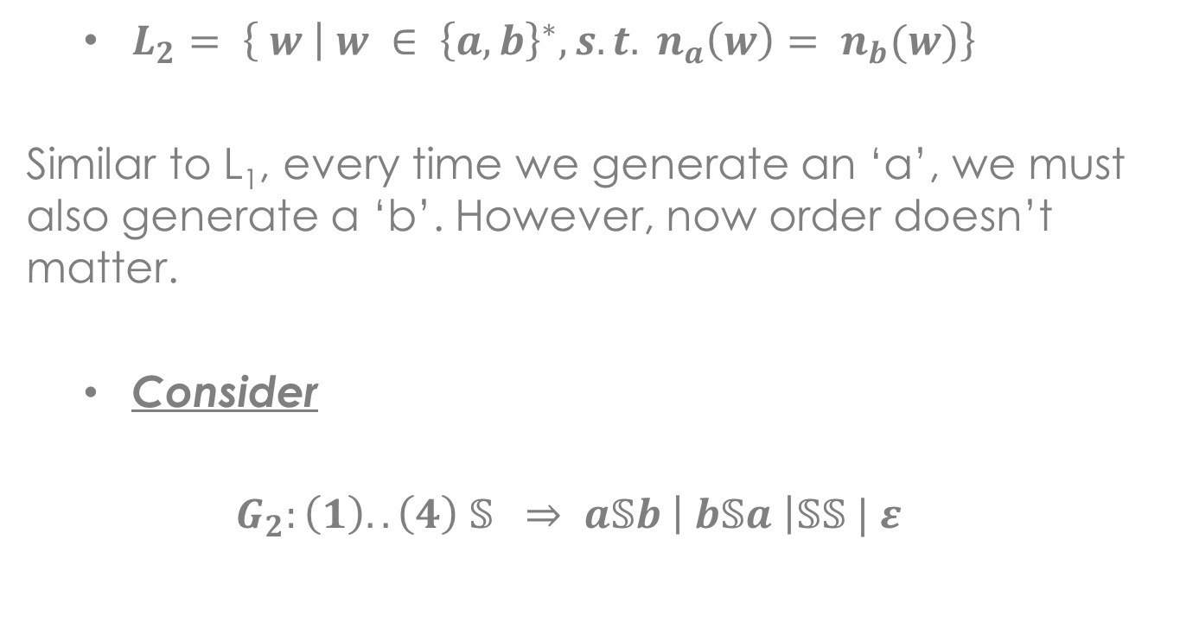
Example (2)
$L_{2}= \left\{ w | w ∈ {\left\{a,b\right\}}^{∗}, s.t. n_{a}\left(w\right)= n_{b}(w)\right\}$
Similar to L₁, every time we generate an ‘a’, we must also generate a ‘b’. However, now order doesn’t matter.
$\text{Consider}$
$$G_{2}: \left(1\right)..\left(4\right) 𝕊 ⇒ a𝕊b \left| b𝕊a \right|𝕊𝕊 | ε$$

Slide 8
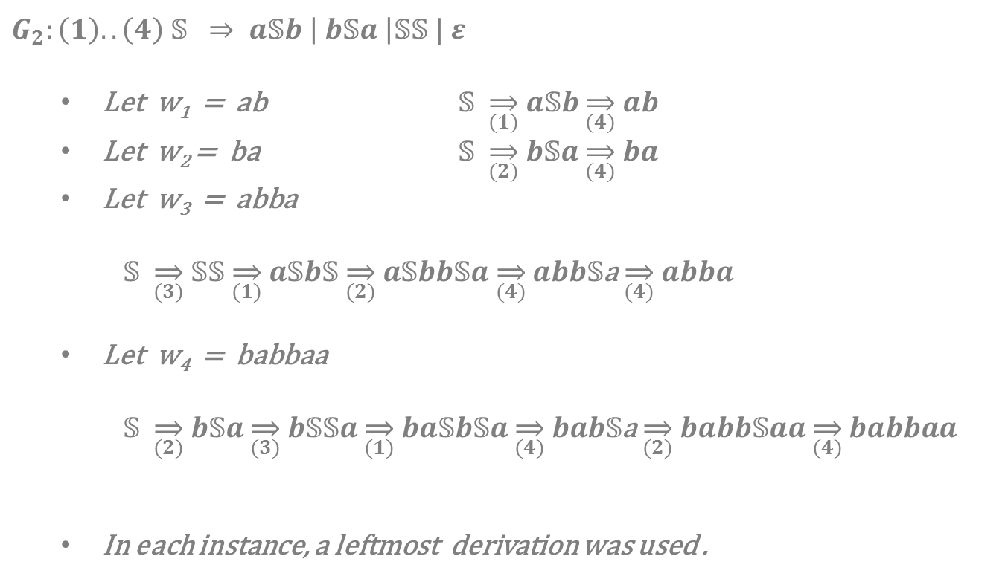
Illustration
$$G_{2}: \left(1\right)..\left(4\right) 𝕊 ⇒ a𝕊b \left| b𝕊a \right|𝕊𝕊 | ε$$
Let w₁ = ab $𝕊 \overset{⇒}{(1)} a𝕊b \overset{⇒}{(4)} ab$
Let w₂ = ba $𝕊 \overset{⇒}{(2)} b𝕊a \overset{⇒}{(4)} ba$
Let w₃ = abba
$𝕊 \overset{⇒}{(3)} 𝕊𝕊 \overset{⇒}{(1)} a𝕊b𝕊 \overset{⇒}{(2)} a𝕊bb𝕊a \overset{⇒}{(4)} abb𝕊$a $\overset{⇒}{(4)} abba$
Let w₄ = babbaa
$𝕊 \overset{⇒}{(2)} b𝕊a \overset{⇒}{(3)} b𝕊𝕊a \overset{⇒}{(1)} ba𝕊b𝕊a \overset{⇒}{(4)} bab𝕊$a $\overset{⇒}{(2)} babb𝕊aa \overset{⇒}{(4)} babbaa$
In each instance, a leftmost derivation was used .

Slide 9
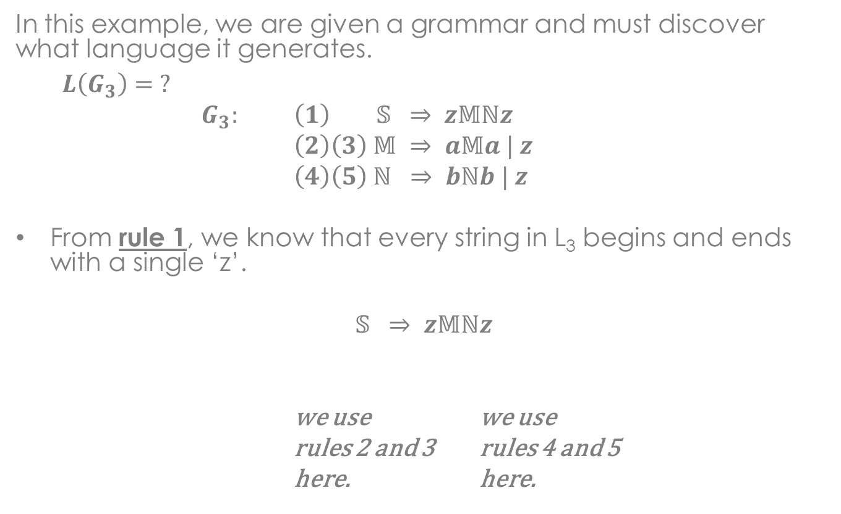
Example (3)
In this example, we are given a grammar and must discover what language it generates.
$$L\left(G_{3}\right)= ?$$
$G_{3}:$ $\left(1\right) 𝕊 ⇒ z𝕄ℕz$
$\left(2\right)\left(3\right) 𝕄 ⇒ a𝕄a | z$
$\left(4\right)\left(5\right) ℕ ⇒ bℕb | z$
From rule 1, we know that every string in L₃ begins and ends with a single ‘z’.
$$𝕊 ⇒ z𝕄ℕz$$
we use we use
rules 2 and 3 rules 4 and 5
here. here.

Slide 10
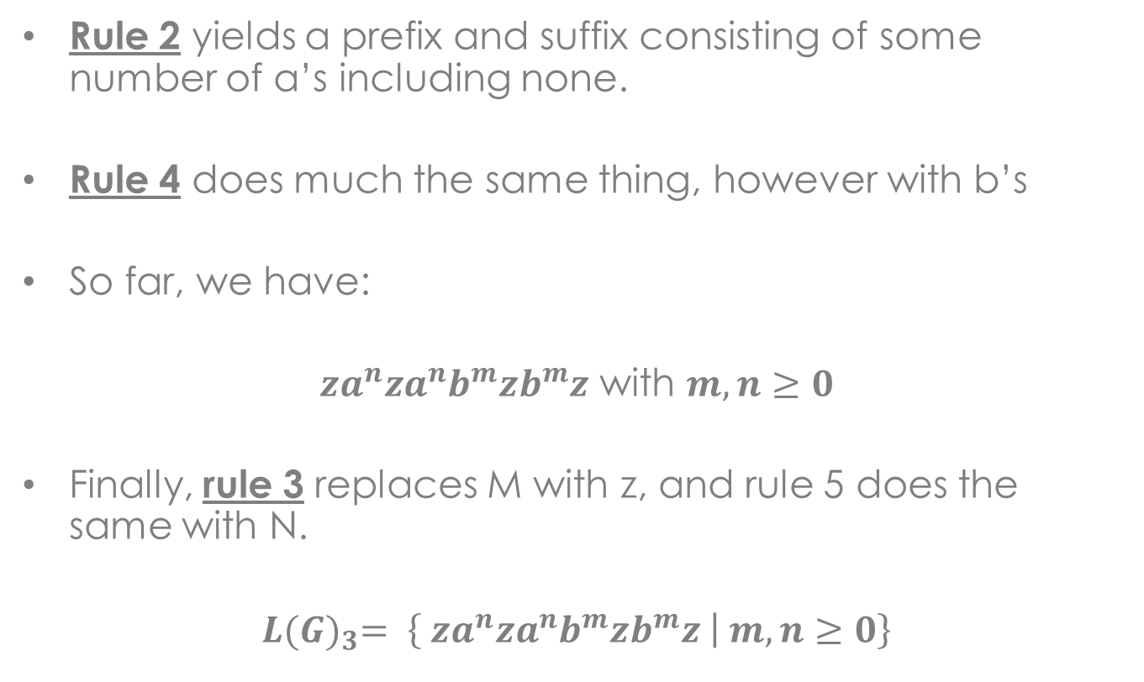
Illustration
Rule 2 yields a prefix and suffix consisting of some number of a’s including none.
Rule 4 does much the same thing, however with b’s
So far, we have:
$za^{n}za^{n}b^{m}zb^{m}z$ with $m,n≥0$
Finally, rule 3 replaces M with z, and rule 5 does the same with N.
$$L{(G)}_{3}= \left\{ za^{n}za^{n}b^{m}zb^{m}z | m,n≥0\right\}$$

Slide 11
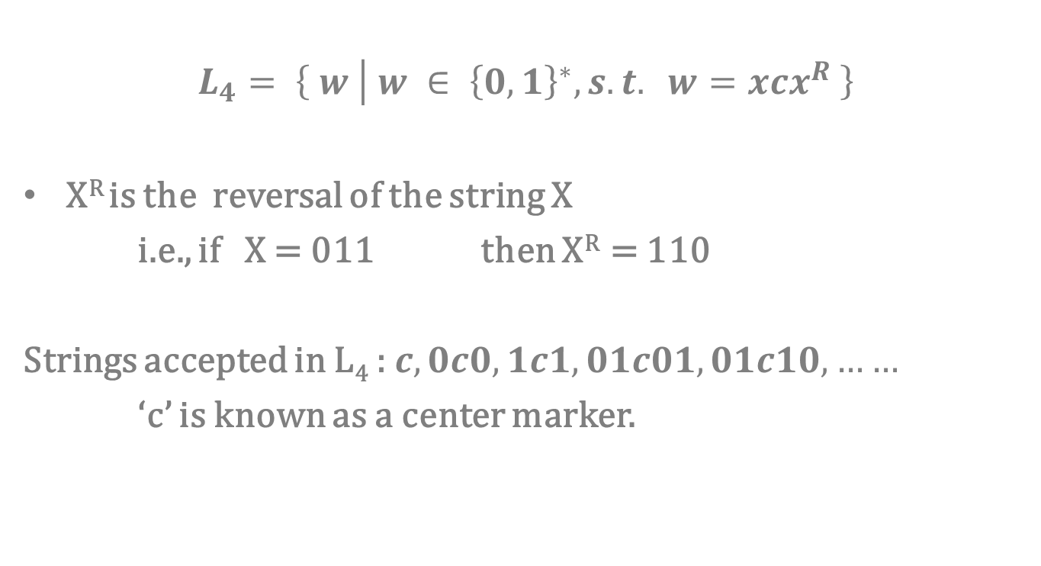
Example (4)
$$L_{4}= \left\{ w | w ∈ {\left\{0,1\right\}}^{∗}, s.t. w=xcx^{R} \right\}$$
X^{R} is the reversal of the string X
i.e., if X = 011 then X^{R} = 110
Strings accepted in L₄ : $c, 0c0, 1c1, 01c01, 01c10, ……$
‘c’ is known as a center marker.

Slide 12

Example (5)
$$L_{5}= \left\{ w | w ∈ {\left\{0,1\right\}}^{∗}, s.t. w=w^{R} \right\}$$
This language generates one string that is the reversal of the input string in each instance (each input string).

Slide 13
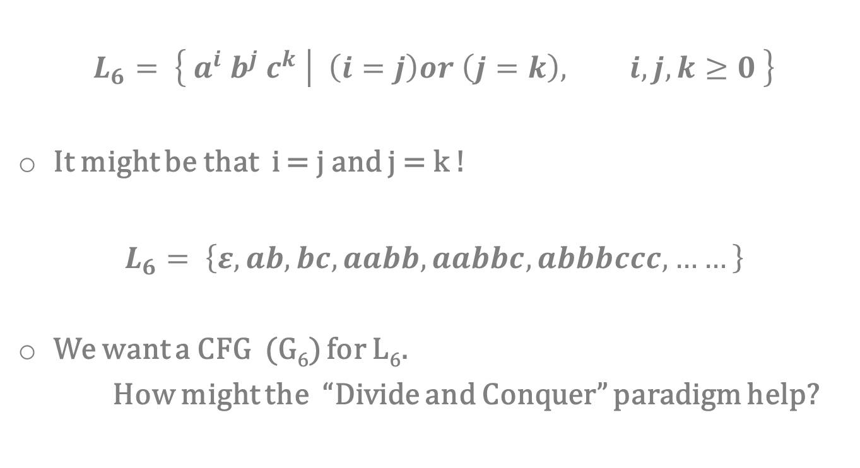
Example (6)
$$L_{6}= \left\{ a^{i}{ b}^{j} c^{k} | \left(i=j\right)or \left(j=k\right), i,j,k≥0 \right\}$$
It might be that i = j and j = k !
$L_{6}= \left\{ε, ab, bc, aabb, aabbc, abbbccc, ……\right\}$
We want a CFG (G₆) for L₆.
How might the “Divide and Conquer” paradigm help?

