Slide 1
Lesson 14 Context Free Grammars (CFG) and Context Free Languages (CFL)

Slide 2
We recall that a regular grammar has the form:
A → aA|a|ϵ
A regular grammar generates a regular language.
Regular languages can be accepted by finite acceptors.
Regular language can be denoted by regular expressions.

Slide 3
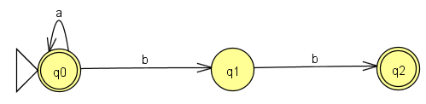
Example
G: A → aA|bB|ϵ
B → b
L(G) = a* + bb = E // expression
A finite automata M s.t. L(M) = L(E)

Slide 4
CFG’s and CFL’s
Context Free Grammar
Every rule has the form :
N → (N + T)*

Slide 5
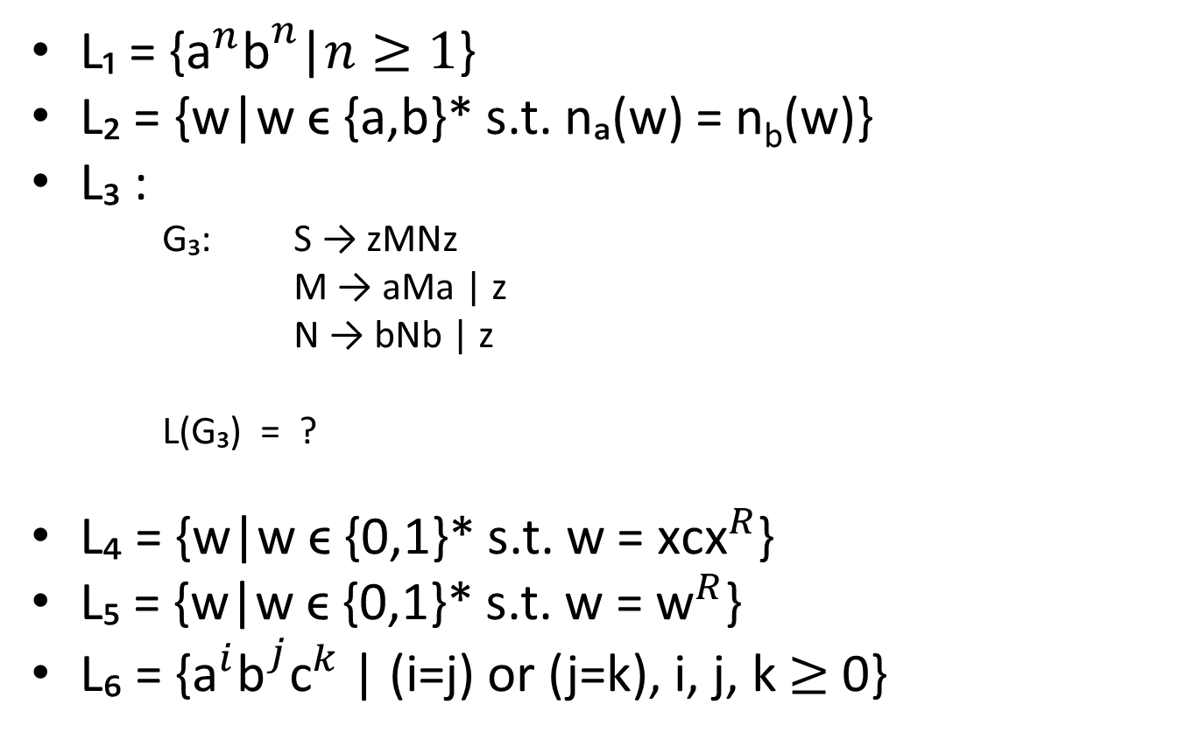
Examples
L₁ = {${\text{a}}^{n}{\text{b}}^{n}$|$n≥1$}
L₂ = {w|w ϵ {a,b}* s.t. nₐ(w) = n_{b}(w)}
L₃ :
G₃: S → zMNz
M → aMa | z
N → bNb | z
L(G₃) = ?
L₄ = {w|w ϵ {0,1}* s.t. w = ${\text{x}\text{c}\text{x}}^{R}$}
L₅ = {w|w ϵ {0,1}* s.t. w = ${\text{w}}^{R}$}
L₆ = {${\text{a}}^{i}{\text{b}}^{j}{\text{c}}^{k}$ | (i=j) or (j=k), i, j, k $≥$ 0}

Slide 6
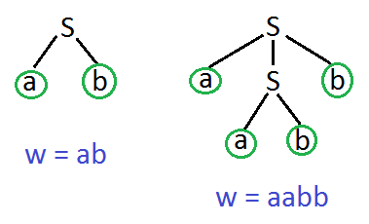
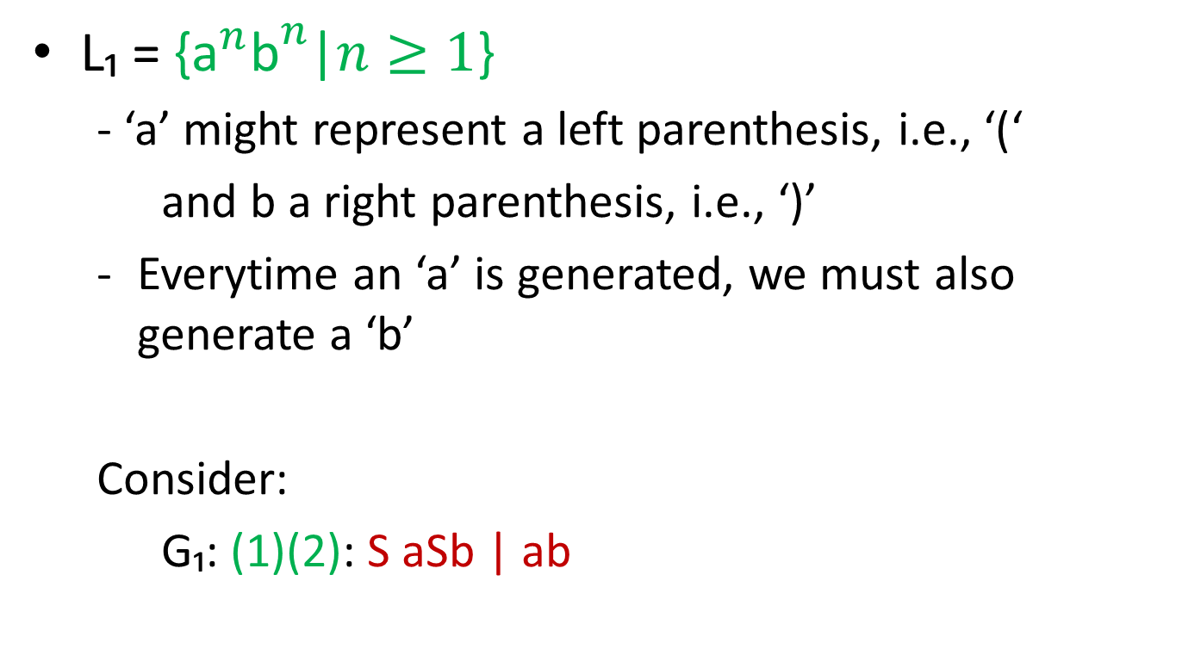
CFG’s and CFL’s
L₁ = {${\text{a}}^{n}{\text{b}}^{n}$|$n≥1$}
- ‘a’ might represent a left parenthesis, i.e., ‘(‘
and b a right parenthesis, i.e., ‘)’
Everytime an ‘a’ is generated, we must also generate a ‘b’
Consider:
G₁: (1)(2): S aSb | ab

Slide 7
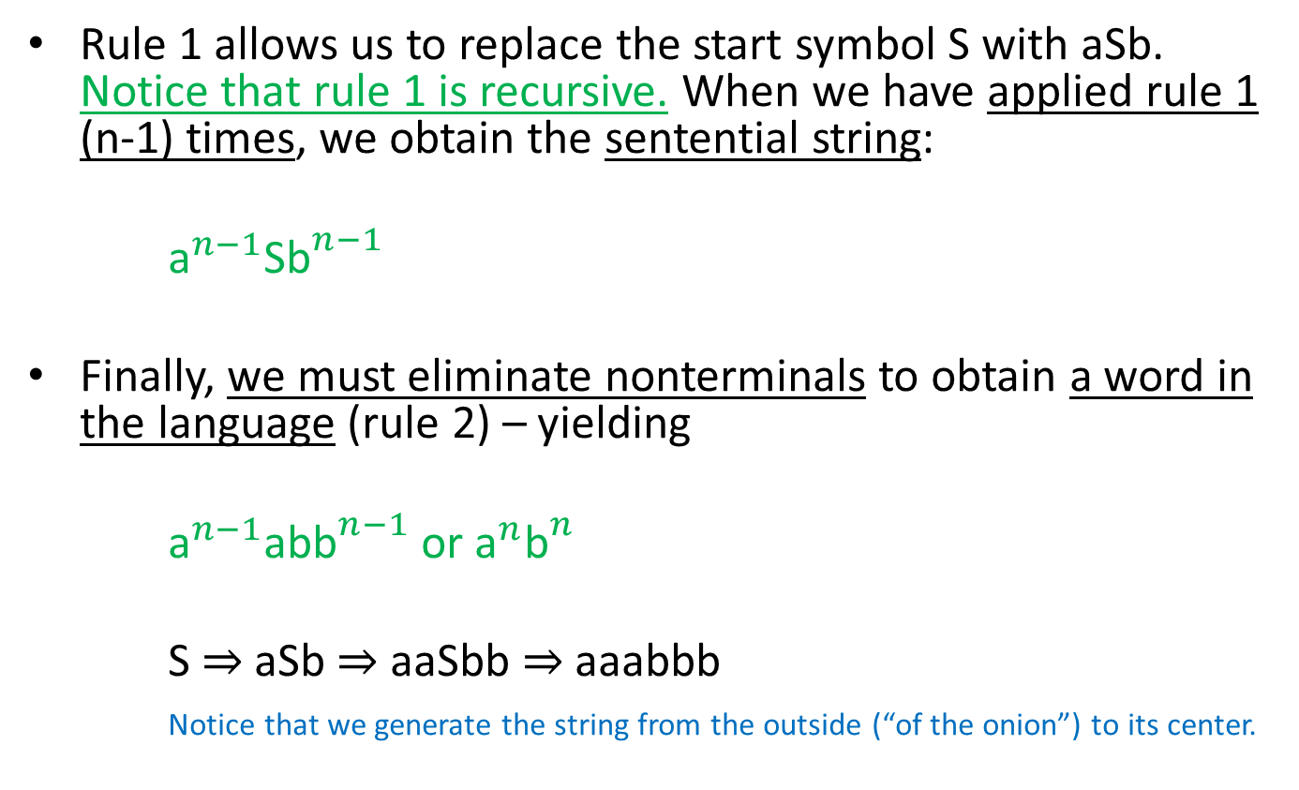
CFG’s and CFL’s
Rule 1 allows us to replace the start symbol S with aSb. Notice that rule 1 is recursive. When we have applied rule 1 (n-1) times, we obtain the sentential string:
${\text{a}}^{n−1}$S${\text{b}}^{n−1}$
Finally, we must eliminate nonterminals to obtain a word in the language (rule 2) – yielding
${\text{a}}^{n−1}$ab${\text{b}}^{n−1}$ or ${\text{a}}^{n}{\text{b}}^{n}$
S ⇒ aSb ⇒ aaSbb ⇒ aaabbb
Notice that we generate the string from the outside (“of the onion”) to its center.

Slide 8
Context Free Languages
L₂ = {w|w ϵ {a,b}* s.t. na(w) = nb(w)}
Similar to L₁, everytime we generate an ‘a’ we must also generate a ‘b’. However, now order does not matter.
We consider:
G₂: (1)…(4) S → aSb | bSa | SS | ϵ
Let w₁ = ab S ⇒ aSb ⇒ ab
w₂ = ba S ⇒ bSa ⇒ ba
w₃ = abba S ⇒ SS ⇒ aSbS ⇒ aSbbSa ⇒ abbSa ⇒ abba
w₄ = babbaa S ⇒ bSa ⇒ bSSa ⇒ baSbSa ⇒ baSbbSaa ⇒ babbSaa ⇒ babbaa
In each instance, a leftmost derivation was used.

Slide 9
Context Free Languages
In our next example, we are given a grammar and must discover what language it generates.
G₃: (1) S → zMNz
(2)(3) M → aMa | z
(4)(5) N → bNb | z
i.e. What is L(G)?
From rule 1 we know that every string in L₃ begins and ends with a single Z.
S ⇒ zMNz
M: we use rules 2 and 3
N: we use rules 4 and 5

Slide 10
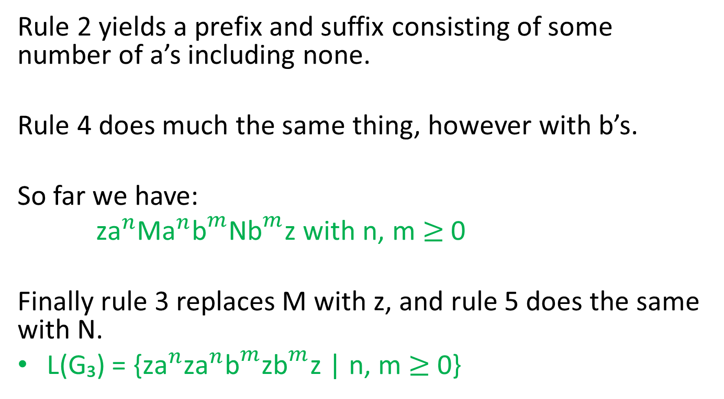
Context Free Languages
Rule 2 yields a prefix and suffix consisting of some number of a’s including none.
Rule 4 does much the same thing, however with b’s.
So far we have:
z${\text{a}}^{n}$M${\text{a}}^{n}{\text{b}}^{m}$N${\text{b}}^{m}$z with n, m $≥$ 0
Finally rule 3 replaces M with z, and rule 5 does the same with N.
L(G₃) = {z${\text{a}}^{n}$z${\text{a}}^{n}{\text{b}}^{m}$z${\text{b}}^{m}$z | n, m $≥$ 0}

Slide 11
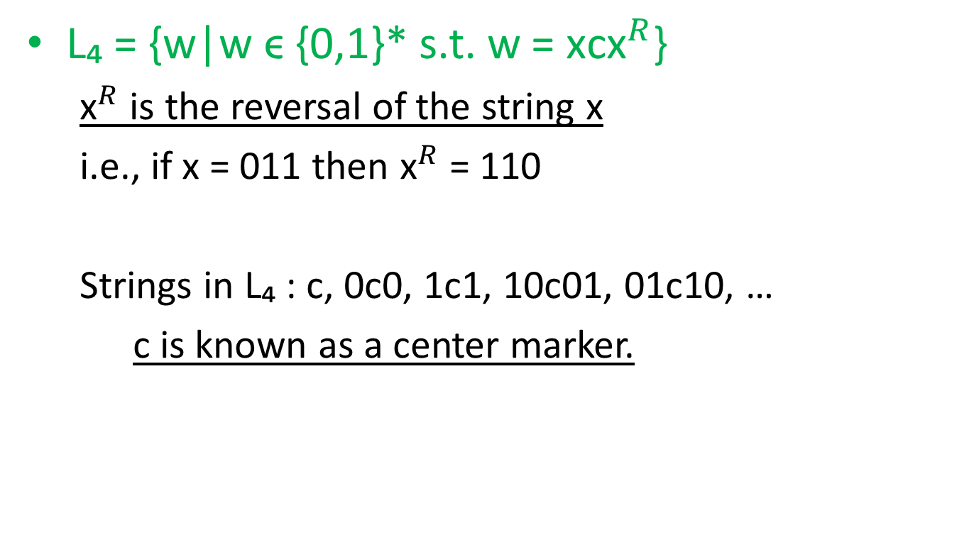
Context Free Languages
L₄ = {w|w ϵ {0,1}* s.t. w = ${\text{x}\text{c}\text{x}}^{R}$}
${\text{x}}^{R}$ is the reversal of the string x
i.e., if x = 011 then ${\text{x}}^{R}$ = 110
Strings in L₄ : c, 0c0, 1c1, 10c01, 01c10, …
c is known as a center marker.

Slide 12

Context Free Languages
L₅ = {w|w ϵ {0,1}* s.t. w = ${\text{w}}^{R}$}

Slide 13
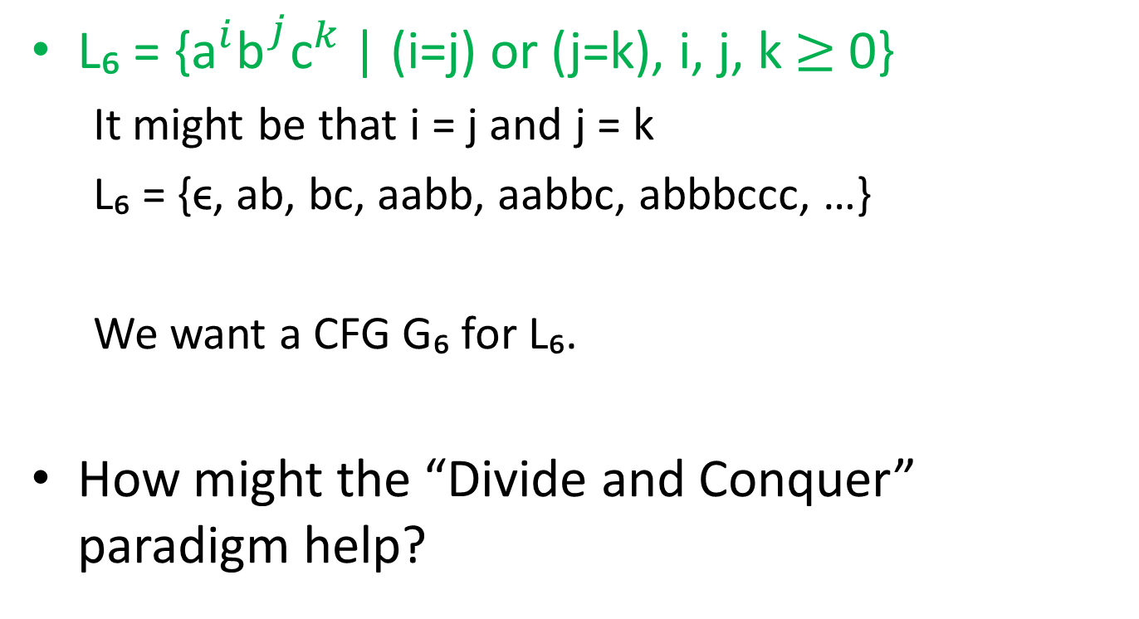
Context Free Languages
L₆ = {${\text{a}}^{i}{\text{b}}^{j}{\text{c}}^{k}$ | (i=j) or (j=k), i, j, k $≥$ 0}
It might be that i = j and j = k
L₆ = {ϵ, ab, bc, aabb, aabbc, abbbccc, …}
We want a CFG G₆ for L₆.
How might the “Divide and Conquer” paradigm help?

