Slide 1
Lesson 7 Turing Acceptors vs Turing deciders
CSc 304
Stephen Lucci

Slide 2
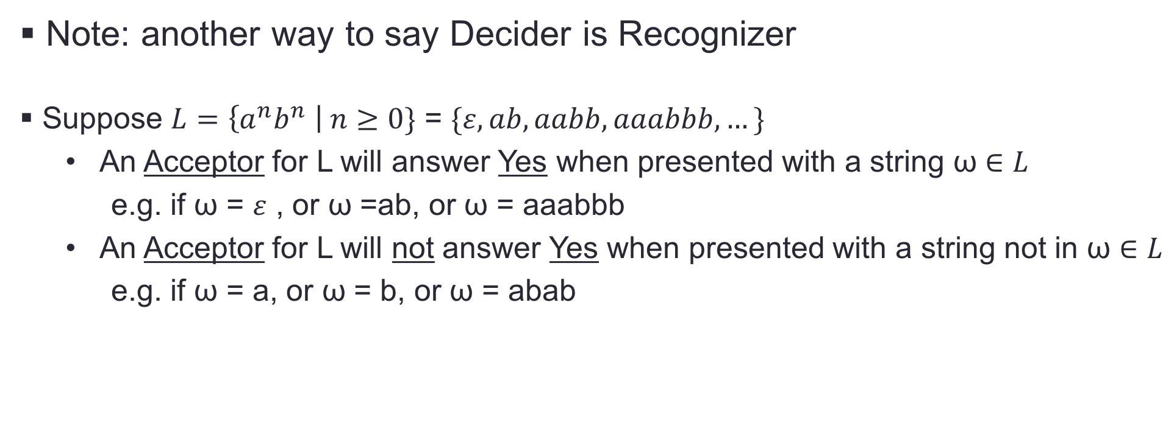
Turing Acceptors vs Turing Deciders
Note: another way to say Decider is Recognizer
Suppose $L=\left\{a^{n}b^{n} \right| n≥0\}$ = $\{ε, ab, aabb, aaabbb, …\}$
An Acceptor for L will answer Yes when presented with a string ω $∈L$
e.g. if ω = $ε$ , or ω =ab, or ω = aaabbb
An Acceptor for L will not answer Yes when presented with a string not in ω $∈L$
e.g. if ω = a, or ω = b, or ω = abab

Slide 3
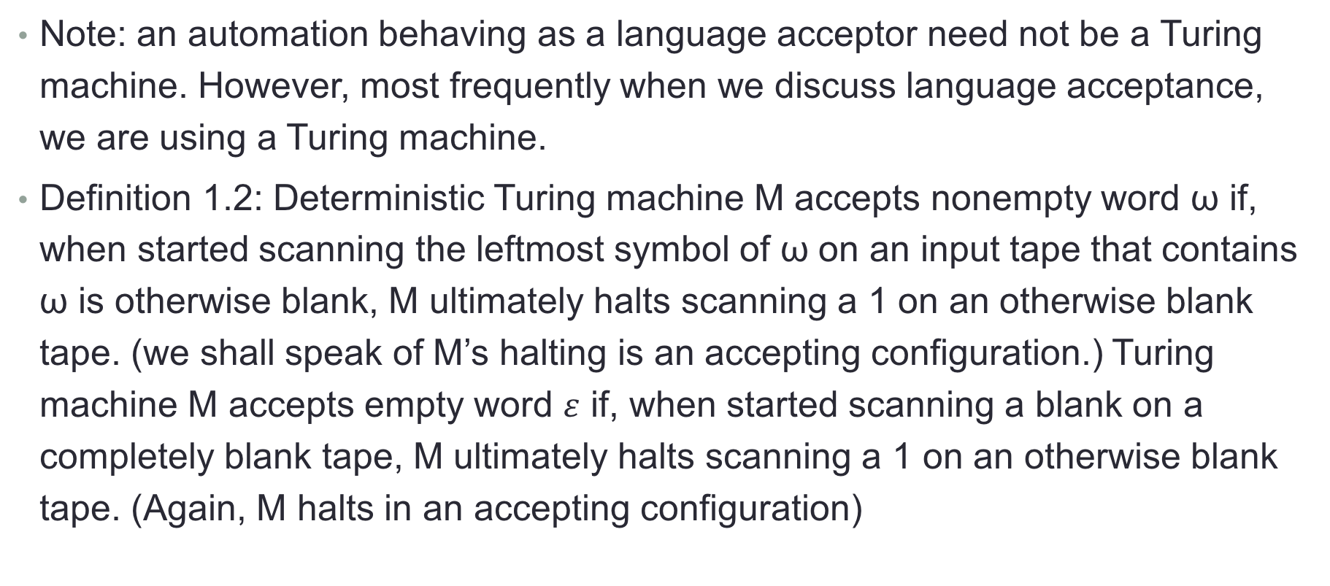
Turing Acceptors vs Turing Deciders
Note: an automation behaving as a language acceptor need not be a Turing machine. However, most frequently when we discuss language acceptance, we are using a Turing machine.
Definition 1.2: Deterministic Turing machine M accepts nonempty word ω if, when started scanning the leftmost symbol of ω on an input tape that contains ω is otherwise blank, M ultimately halts scanning a 1 on an otherwise blank tape. (we shall speak of M’s halting is an accepting configuration.) Turing machine M accepts empty word $ε$ if, when started scanning a blank on a completely blank tape, M ultimately halts scanning a 1 on an otherwise blank tape. (Again, M halts in an accepting configuration)

Slide 4
Turing Acceptors vs Turing Deciders
Definition 1.3: Deterministic Turing machine M accepts language L if M accepts all and only the words ω in L. Furthermore, we shall write L(M) for the language accepted by Turing machine M. So if Turing machine M accepts language L, then L(M) = L. A language L is said to be Turing-acceptable if there exists some deterministic Turing machine M that accepts L.

Slide 5
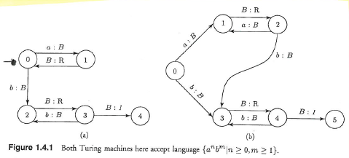
Example using figure 1.4.1
Note: Both machines accept the same Language
Let’s concentrate on Figure 1.4.1(a)
Let ω = b, we have qb |-- q2B |-- Bq3B |-- q41, M has halted with ‘1’ on a o.w. blank tape
M will respond similarly for the strings: b, aab, abb, bbb

Slide 6
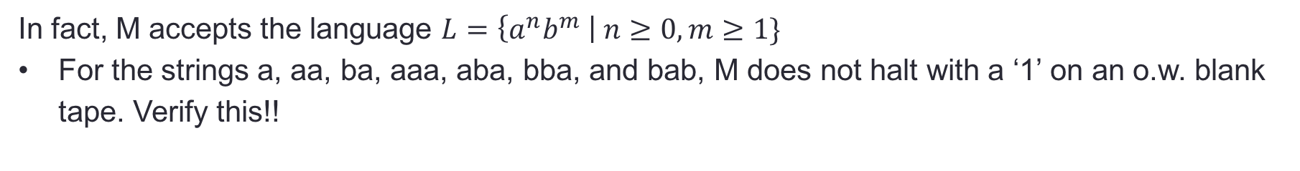
Example using figure 1.4.1 cont’d
In fact, M accepts the language $L=\left\{a^{n}b^{m} \right| n≥0, m≥1\}$
For the strings a, aa, ba, aaa, aba, bba, and bab, M does not halt with a ‘1’ on an o.w. blank tape. Verify this!!

Slide 7
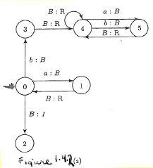
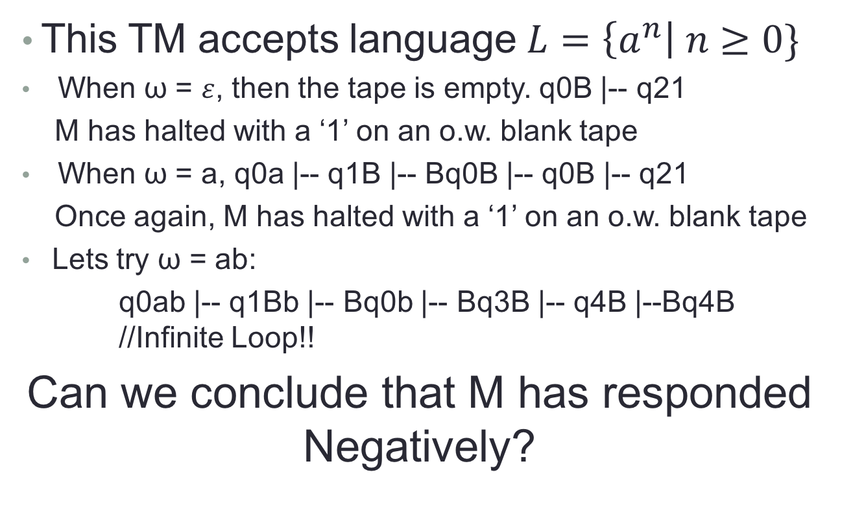
Example using figure 1.4.2 (a)
This TM accepts language $L=\left\{a^{n}\right| n≥0\}$
When ω = $ε$, then the tape is empty. q0B |-- q21
M has halted with a ‘1’ on an o.w. blank tape
When ω = a, q0a |-- q1B |-- Bq0B |-- q0B |-- q21
Once again, M has halted with a ‘1’ on an o.w. blank tape
Lets try ω = ab:
q0ab |-- q1Bb |-- Bq0b |-- Bq3B |-- q4B |--Bq4B //Infinite Loop!!
Can we conclude that M has responded Negatively?

Slide 8
Example using figure 1.4.2 (a) cont’d
Can we conclude that M has responded Negatively?
Generally, we are not privy to the language expression & do not have access to M’s Program
We know the input string ω and we may view M’s R/W head.
How, then do we know that M will not eventually halt with a ‘1’ on an o.w. blank tape? WE DON”T!!

Slide 9
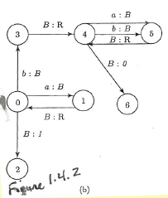
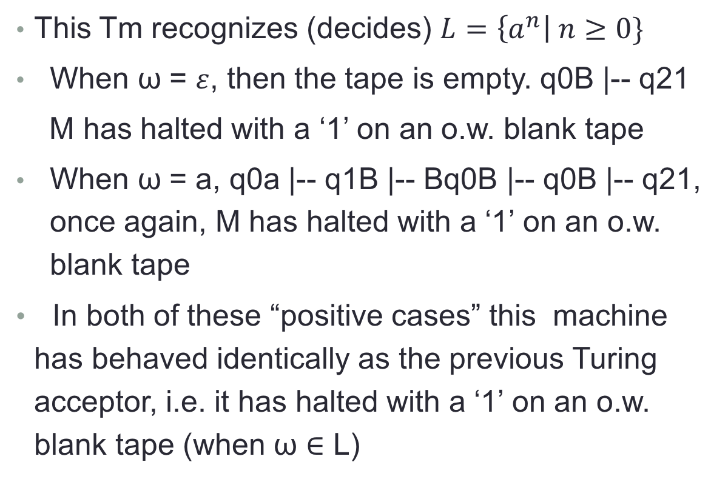
Example using figure 1.4.2 (b)
This Tm recognizes (decides) $L=\left\{a^{n}\right| n≥0\}$
When ω = $ε$, then the tape is empty. q0B |-- q21
M has halted with a ‘1’ on an o.w. blank tape
When ω = a, q0a |-- q1B |-- Bq0B |-- q0B |-- q21, once again, M has halted with a ‘1’ on an o.w. blank tape
In both of these “positive cases” this machine has behaved identically as the previous Turing acceptor, i.e. it has halted with a ‘1’ on an o.w. blank tape (when ω $∈$ L)

Slide 10
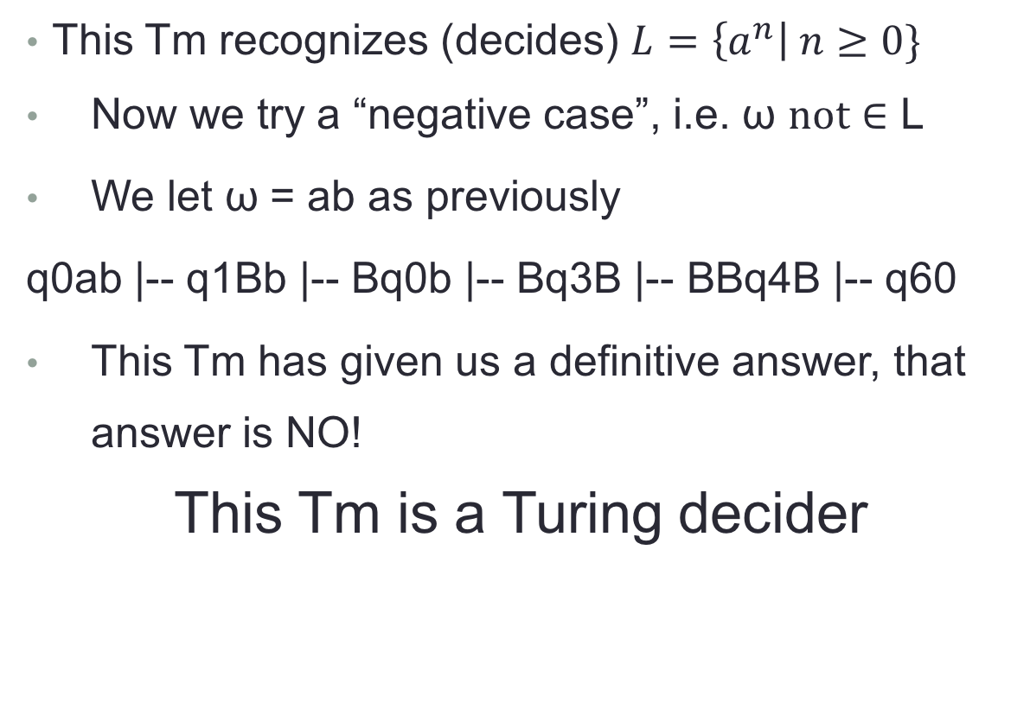
Example using figure 1.4.2 (b) cont’d
This Tm recognizes (decides) $L=\left\{a^{n}\right| n≥0\}$
Now we try a “negative case”, i.e. ω $not∈$ L
We let ω = ab as previously
q0ab |-- q1Bb |-- Bq0b |-- Bq3B |-- BBq4B |-- q60
This Tm has given us a definitive answer, that answer is NO!
This Tm is a Turing decider

Slide 11
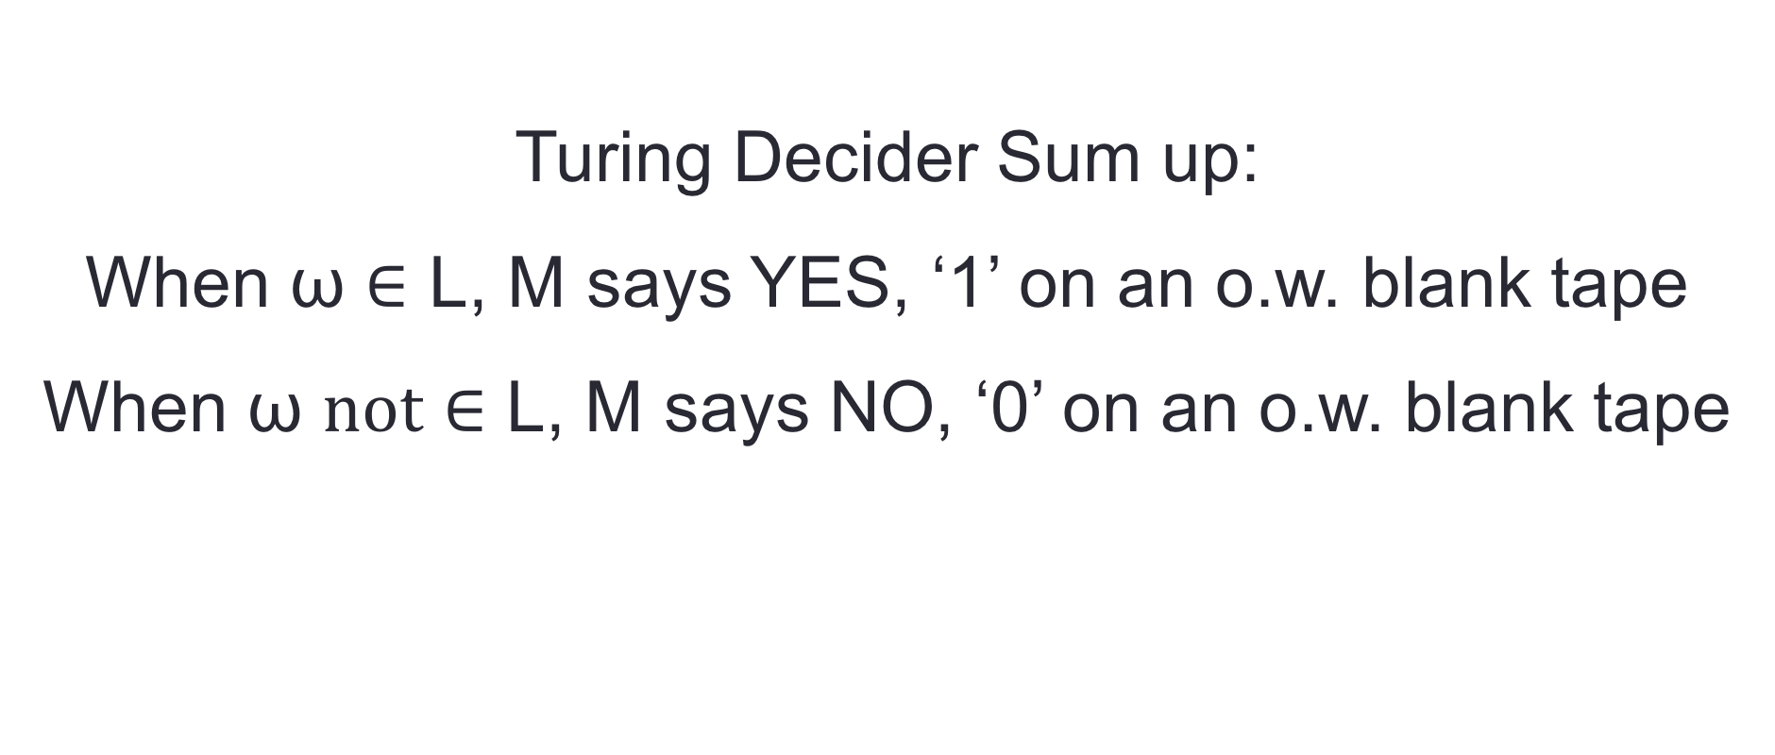
Turing Decider Sum up:
When ω $∈$ L, M says YES, ‘1’ on an o.w. blank tape
When ω $not∈$ L, M says NO, ‘0’ on an o.w. blank tape

Slide 12
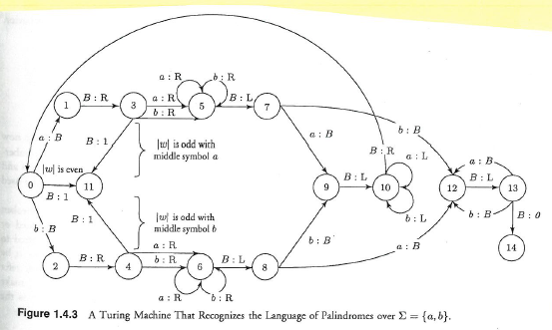
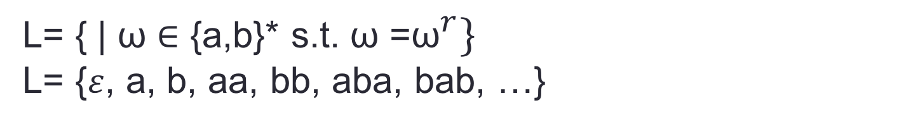
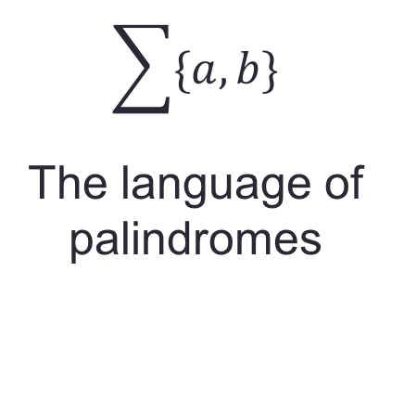
Example using figure 1.4.4
$$\sum{\{a,b\}}$$
The language of palindromes
L= { | ω $∈$ {a,b}* s.t. ω =${\text{ω}}^{r}\}$
L= {$ε$, a, b, aa, bb, aba, bab, …}

Slide 13
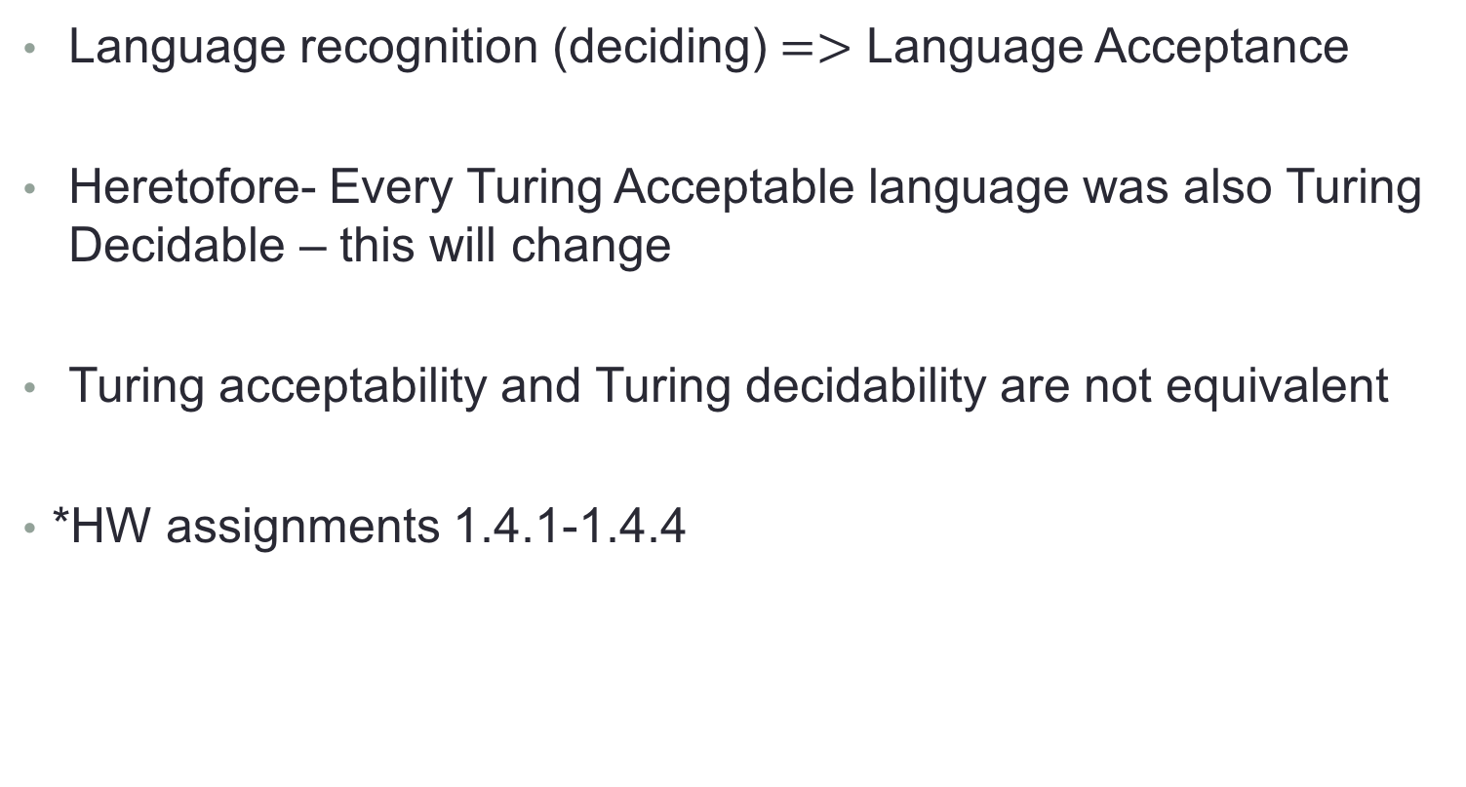
Concluding Remarks
Language recognition (deciding) $=>$ Language Acceptance
Heretofore- Every Turing Acceptable language was also Turing Decidable – this will change
Turing acceptability and Turing decidability are not equivalent
*HW assignments 1.4.1-1.4.4

