Slide 1
Lesson 8: Number-Theoretic Functions
CSC 30400: Introduction to Theoretical Computer Science
Instructor: Professor Stephen Lucci

Slide 2
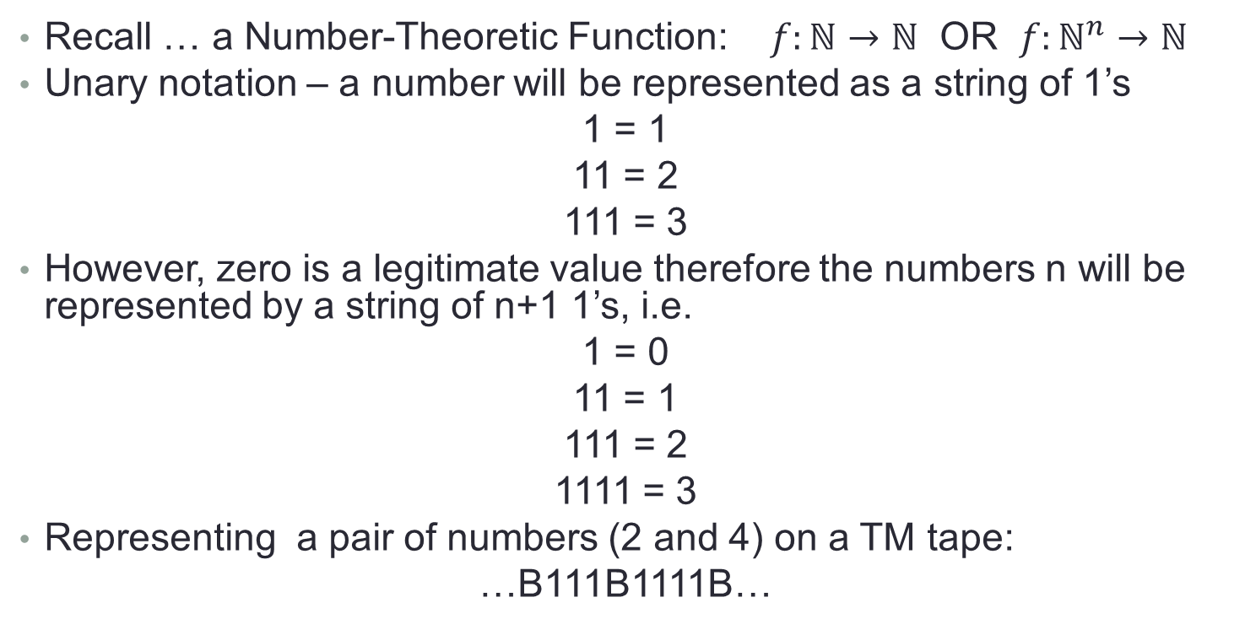
TM’s to compute Number-Theoretic Functions
Recall … a Number-Theoretic Function: $f:ℕ→ℕ$ OR $f:ℕ^{n}→ℕ$
Unary notation – a number will be represented as a string of 1’s
1 = 1
11 = 2
111 = 3
However, zero is a legitimate value therefore the numbers n will be represented by a string of n+1 1’s, i.e.
1 = 0
11 = 1
111 = 2
1111 = 3
Representing a pair of numbers (2 and 4) on a TM tape:
…B111B1111B…
the additional 1 will be referred to as a representational 1. (first or last 1 … does not matter)

Slide 3
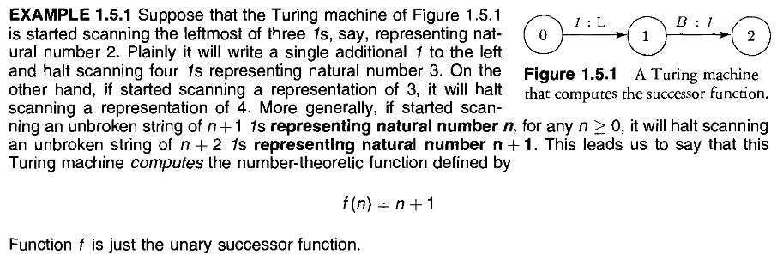
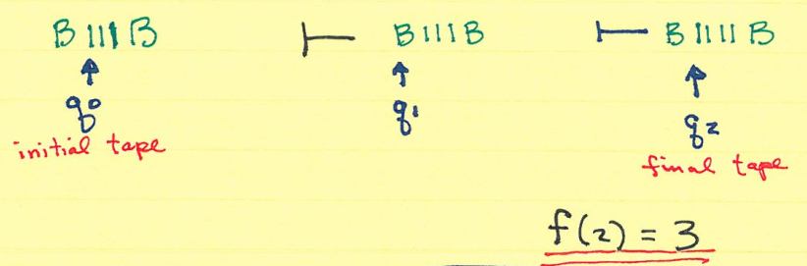
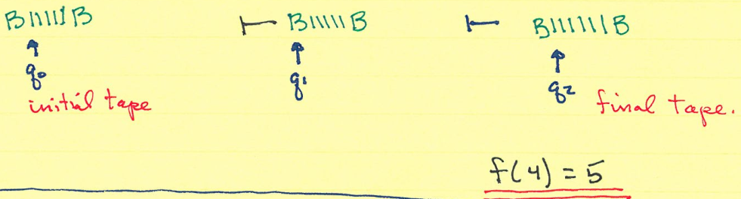
Example 1.5.1
More generally … $f\left(n\right)=n+1$ // unary successor function

Slide 4
How should TM, M behave when f is a partial function?

Slide 5

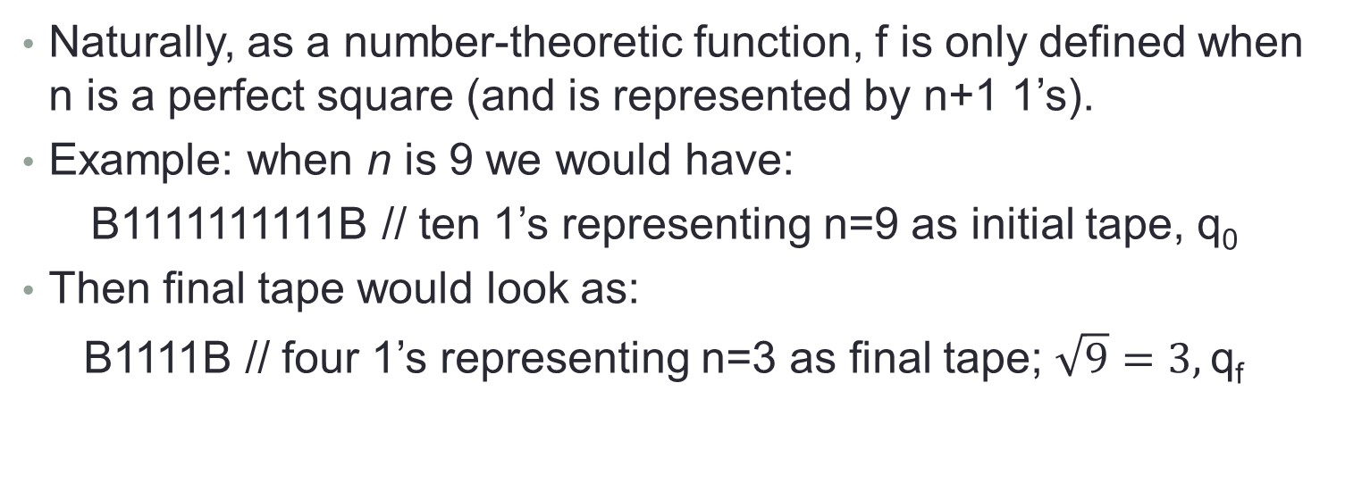
Example 1.5.2
Consider the partial number-theoretic function defined by
$$f:ℕ→ℕ$$
$$f\left(n\right)= \sqrt{n}$$
Naturally, as a number-theoretic function, f is only defined when n is a perfect square (and is represented by n+1 1’s).
Example: when n is 9 we would have:
B1111111111B // ten 1’s representing n=9 as initial tape, q₀
Then final tape would look as:
B1111B // four 1’s representing n=3 as final tape; $\sqrt{9}=3,$q_{f}

Slide 6
Example 1.5.2 cont
What should our TM do when n is not a perfect square?
For example when n = 5
B111111B // initial tape six 1’s
q₀
neither
B111B // n = 2
q_{f}
nor
B1111B // n = 3
q_{f}
Are acceptable

Slide 7
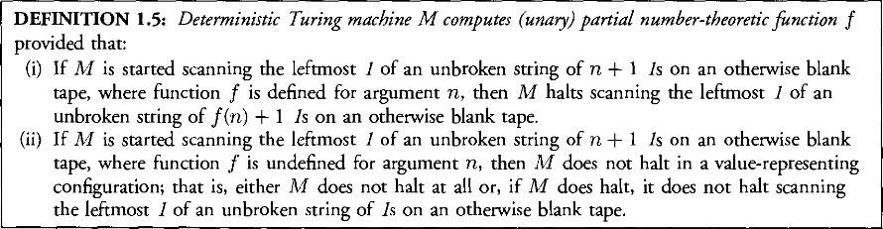
Example 1.5.2 cont
M should not halt in a value–representing configuration. Any of these would do
B11**1B OR B1X1ZB OR BB
q_{f} q_{f} q_{f}
Or M could not halt at all in these situations. More formally:

Slide 8
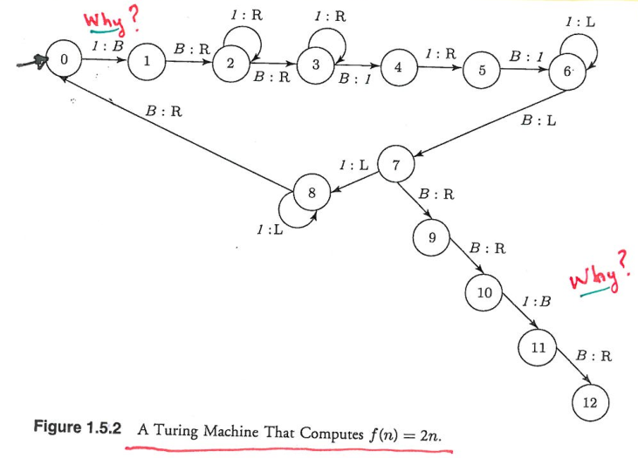
Example 1.5.3
A Turing machine, M, that computes
f(n) = 2n
Let us trace M when n = 2
B111B // initial tape, q₀
B11111B // final tape, q₁₂
BB11B1B //q₅
BB11B1 //q₄
BB11BB //q₃
BB11B //q₂
BB11B //q₂
BB11B //q₂
BB11B //q₁
BB11B11 //q₆
BB11B11 //q₆
BB11B11 //q₆
BB11B11 //q₇
BB11B11 //q₈
…

Slide 9
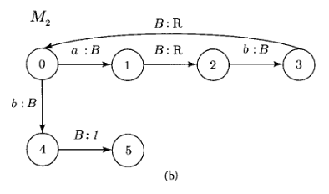

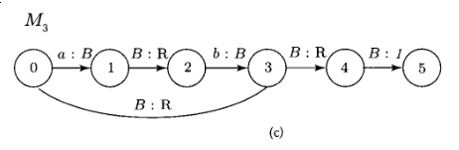
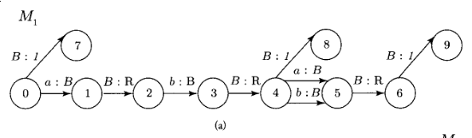
Homework (1.8.1 a-c)

Slide 10
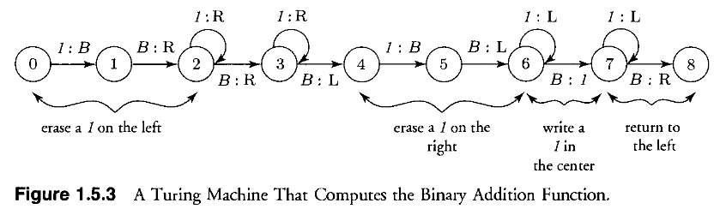
Example 1.5.4
A Turing machine, M, that computes the addition function
f(n, m) = n + m
Let us trace M when n = 2 and m = 3
B111B1111B // initial tape, q₀
BB11B111BB //q₆
BB11B1111B //q₂
BB11B1111B //q₁
BB111111BB //q₇
BB11B1111B //q₄
BB11B1111B //q₂
BB11B111BB //q₅
BB111111BB //q₇
BB11B1111B //q₃
BB111111BB //q_{f}
BB11B1111B //q₃
BB11B111BB //q₆
BB111111BB //q₈

Slide 11
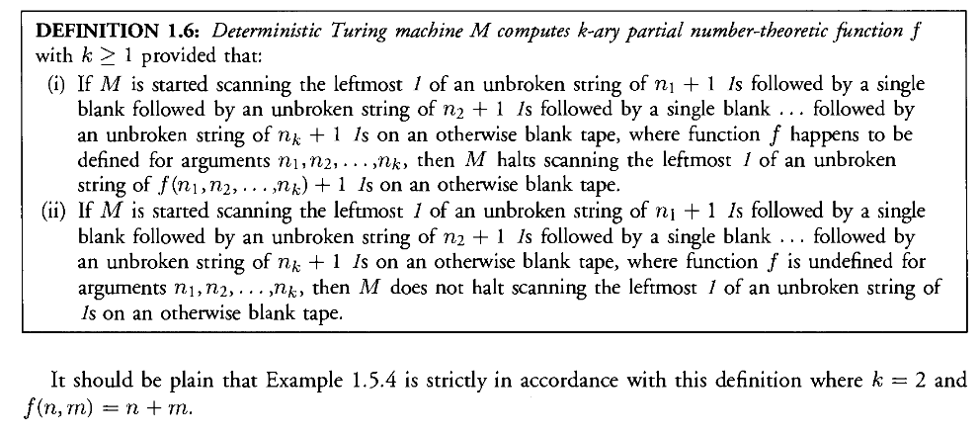
Final Remarks

Slide 12
Final Remarks cont.

Slide 13
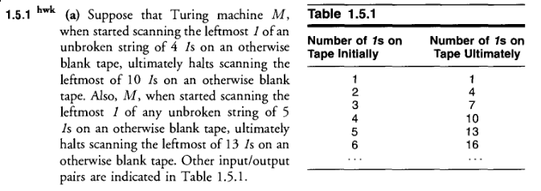

Homework (1.5.1a)

Slide 14
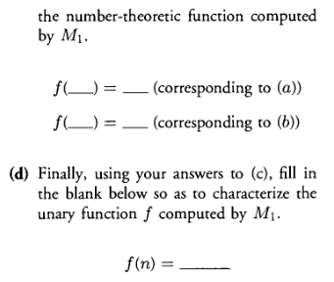
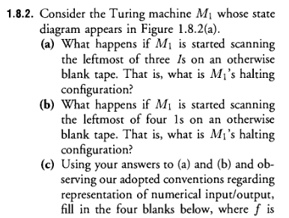
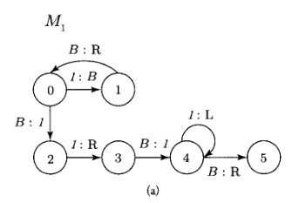

Homework (1.8.2)

Slide 15
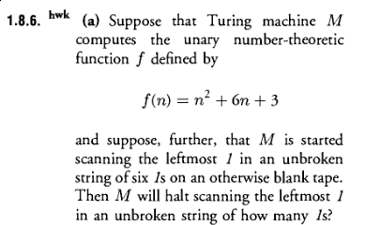


Homework (1.8.6a, 1.8.8, 1.8.9)

