Slide 1
Analyzing data for number of stations Per location and bicycle trips to gain insights on which location has higher traffic

Slide 2
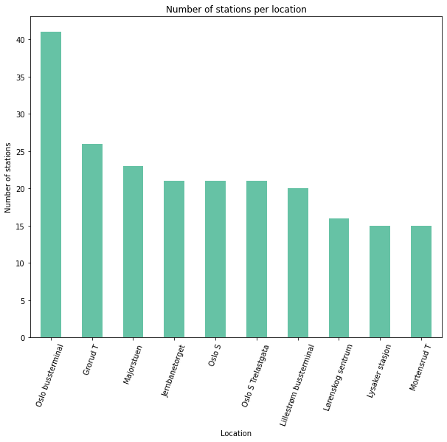
Part 1 investigating station data from the file "Public_transportation_infrastructure.xlsx"
The following questions are of interest
1- which location has the most stations?
Using Univariate Exploration In this section, investigate count of number of stations Per location
As shown by the graph we would conclude that the top 10 locations to be nominated are:
'Oslo bussterminal'
'Grorud T',
Majorstuen'
Jernbanetorget',
'Oslo S'
'Oslo S Trelastgata'
'Lillestrøm bussterminal'
'Lørenskog sentrum'
'Lysaker stasjon'
'Mortensrud T'

Slide 3
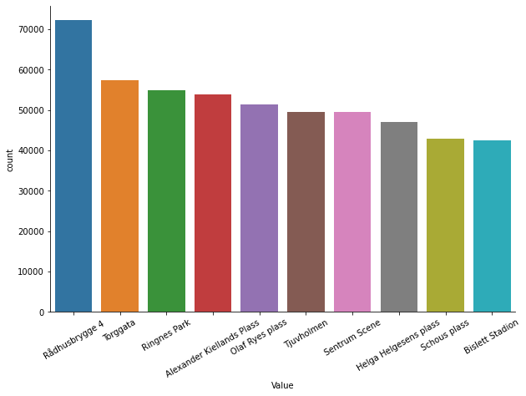
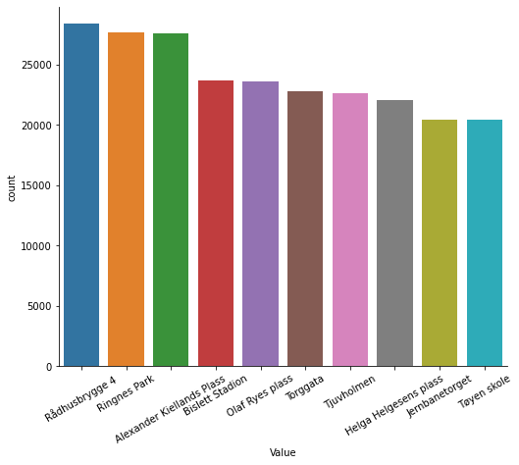
Part 2 invetigating bicycle trip data from the file "Bysykkeloversikt_2019.xlsx"
The following questions are of interest
which location has the most visits for the both start of the trip or the end of the trip
which location has the most visits for Start of trip
which location has the most visits for end of trip
Total stations visits for both start and end
As shown by the graphs we would nominate:
'Rådhusbrygge 4’
'Torggata’
'Ringnes Park’
'Alexander Kiellands Plass’
'Olaf Ryes plass’
'Tjuvholmen’
'Sentrum Scene’
'Helga Helgesens plass’
'Schous plass’
'Bislett Stadion’
In addition two the following for shops that can benefit from needs for the beginning of the trip:
'Jernbanetorget’
'Tøyen skole’
For shops who would benefit from the needs :
'Spikersuppa Vest’
'Bjørvika'
Total stations visits for start Station
Total stations visits for End Station

Slide 4
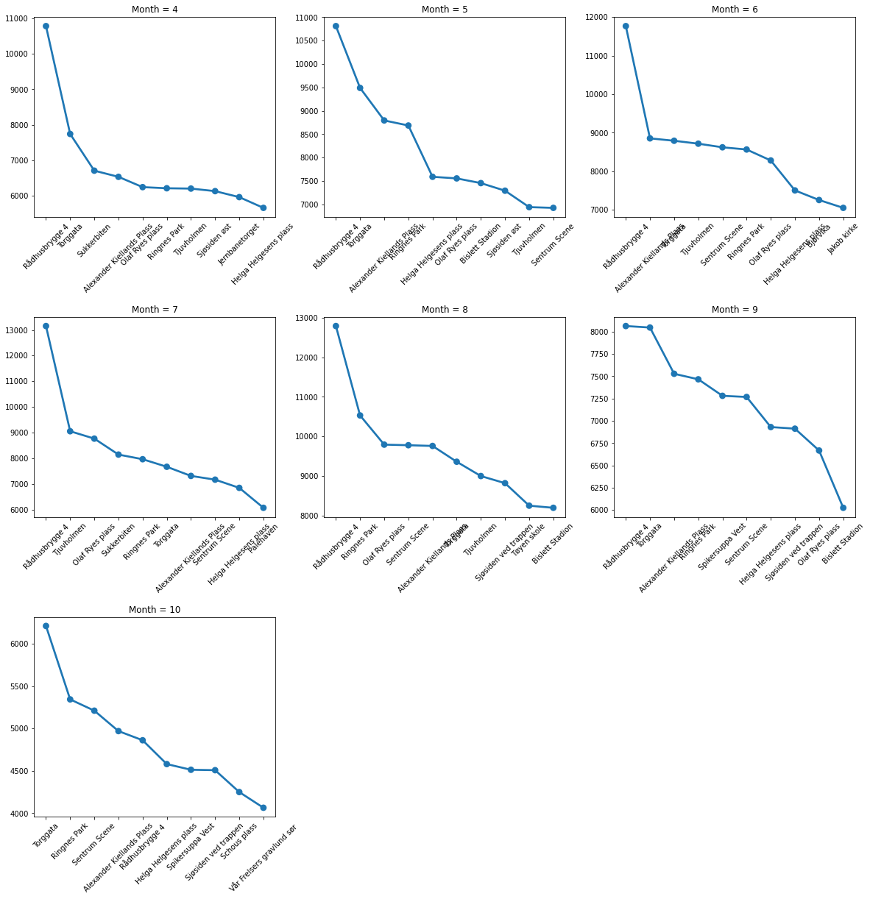
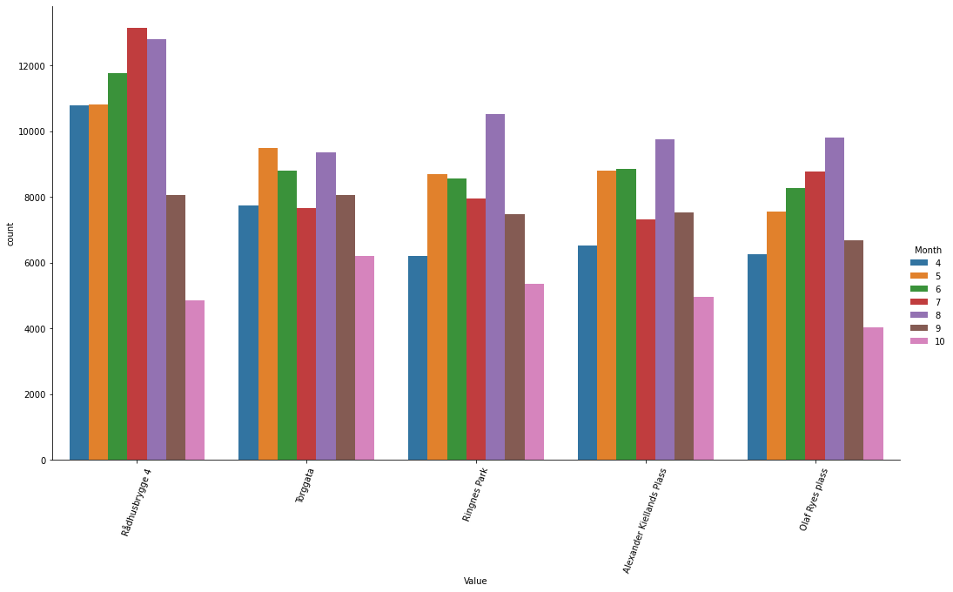
The following questions are of of interest
4- Does change in Month institute change in location Ranking?
.
According to the point plot (Fig1) graph of the top visits counts of location per month we find that they all have the same ranking and with the same trend of differences so there is no major change in ranking
The monthly highest count decreases significantly starting from September which indicate climate change would affect visits and should be investigated more and also using a count plot Fig2 for top 5 visit counts relay the same message
Visit counts Per Month
Fig 2
Fig 1

Slide 5
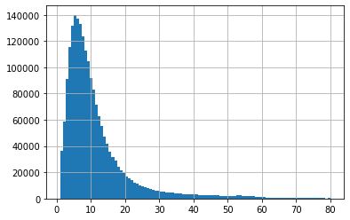
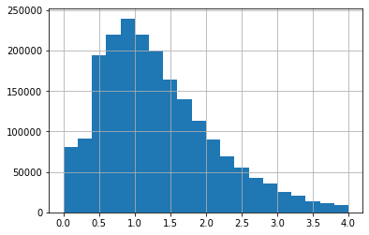
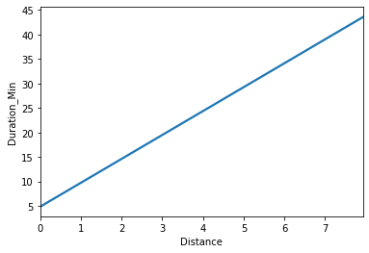
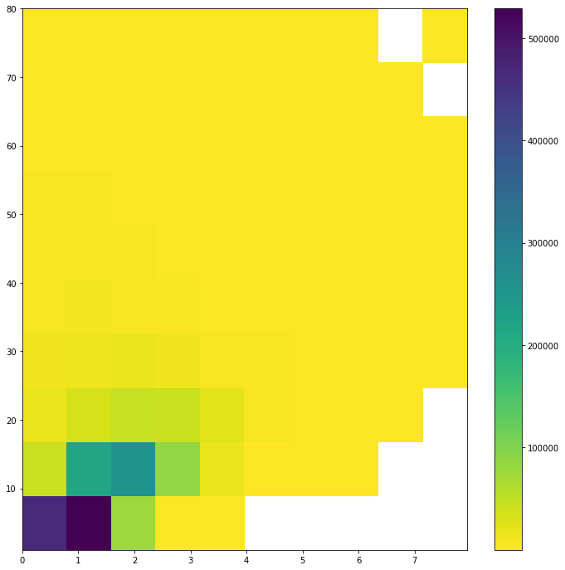
The following questions are of interest
5- Can the study of the durations and distances help in suggesting more things for further analysis and recommendations
Histogram of duration in minutes <=80 min
Histogram of distance in KM<=4KM
Count
Count
From the histogram and relation plot we found :
99.5% of rides are below 80 min
99% of rides are below 4km
And there is a quite similarity between the two distribution which might suggest a +ve relationship and maybe linear
Also their might be a linear relationship between them so we might use only one as an estimator latter
Duration min
Distance KM
"Distance vs Duration"
"Distance vs Duration"
"Distance vs Duration"
From getting the stats for the top 10 locations we found that :
The mean duration time is 12.7 min and the mean Distance is 1.27
The Heat map shows that clustering to be significant around the two means
Stats | Duration min | Distance
count | 10.000000 | 10.000000
mean | 12.716317 | 1.276334
std | 1.797352 | 0.114455
min | 11.081041 | 1.150420
25% | 11.689482 | 1.175598
50% | 12.098294 | 1.253740
75% | 12.468035 | 1.364036
max | 16.066064 | 1.460372
Duration min
Duration min
Distance KM
Distance KM

Slide 6
CONCLUSIONS AND FUTURE SUGGESTIONS
Conclusions:
On the assumption that more stations would lead to higher Traffic visits to a location we would nominate the following locations:'Grorud T',’Majorstuen‘,’Jernbanetorget','Oslo S’,'Oslo S Trelastgata’,'Lillestrøm bussterminal’,'Lørenskog sentrum’,'Lysaker stasjon’,'Mortensrud T’.
The Bike Rides Data would recommend the following locations:'Rådhusbrygge 4’,'Torggata’,'Ringnes Park’,'Alexander Kiellands Plass’,'Olaf Ryes plass’,'Tjuvholmen’,'Sentrum Scene’,'Helga Helgesens plass’,'Schous plass’,'Bislett Stadion’ in addition to 'Jernbanetorget’ , 'Tøyen skole’ the beginning of the trip 'Spikersuppa Vest’, 'Bjørvika’ End trip
Ranking isn’t affected by month i.e climate
Number of visitors are affected according to month hence climate change
Suggestions:
Get more geo location data to link between Public station locations and Bike locations
Try to cluster these locations proximity of distance between them
Analyze low traffic locations to get insights on how to make them a better place e.g Promoting bike rides
Make surveys to see what bike riders /station visitors services seek mostly categorized by when start and end
Get data on services in each location distributed by kind

