Slide 1
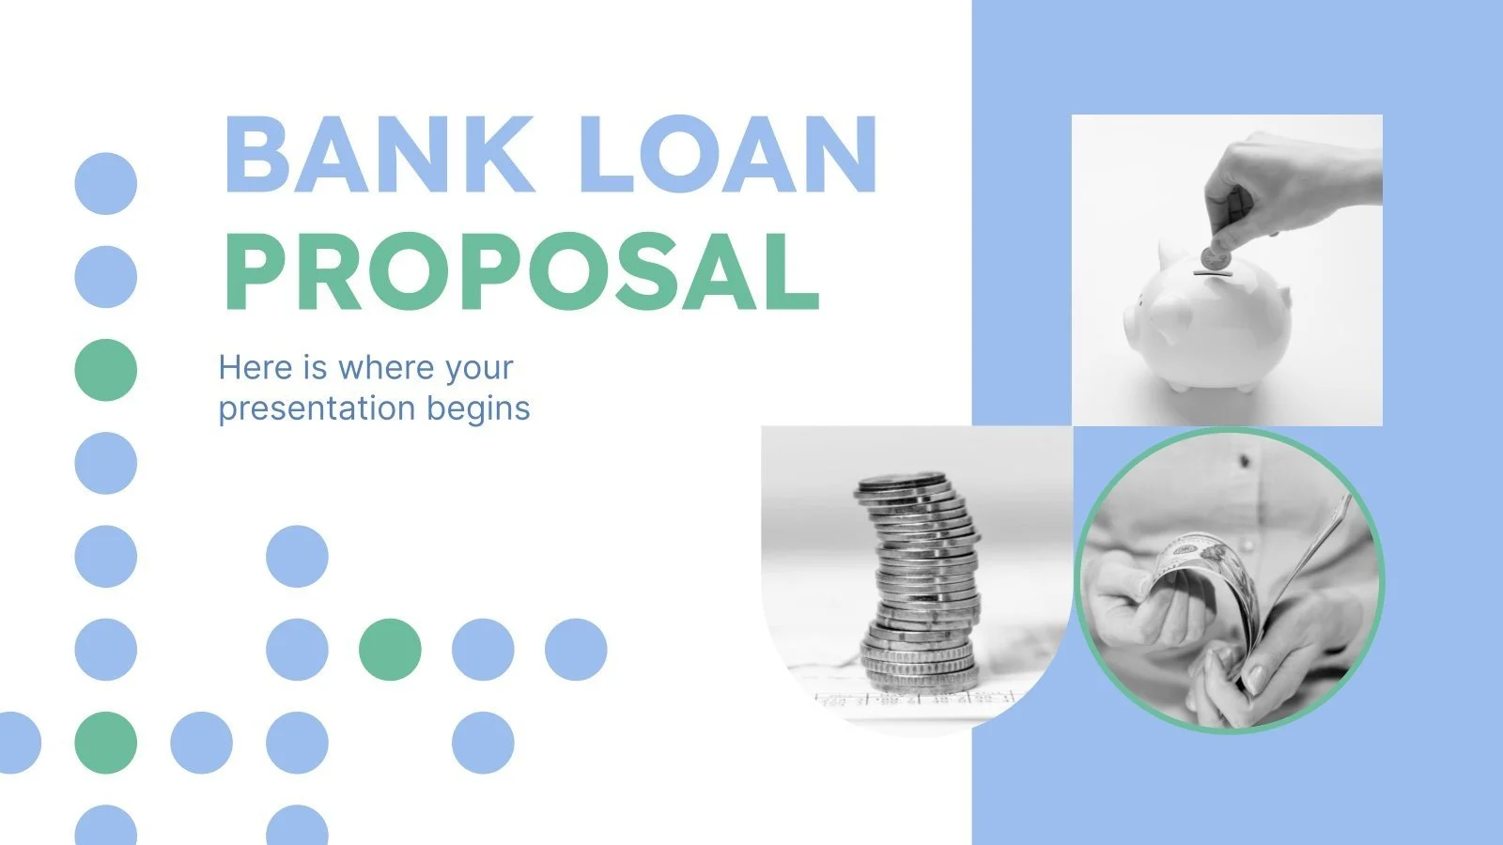
Cutomer Financial Behaviour Analysis

Slide 2
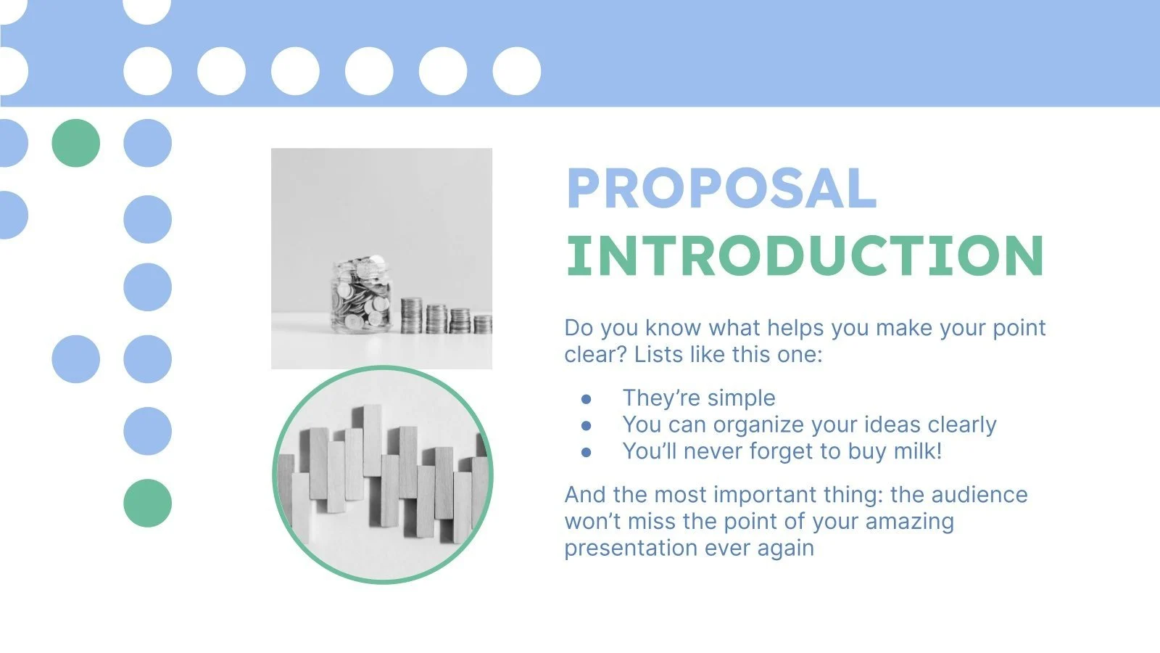
Index:
Problem formulation
Preprocessing of data
Summary statistics overview
Model evaluation and comparison
Improving the model
Impact on business
Future enhancement plan

Slide 3
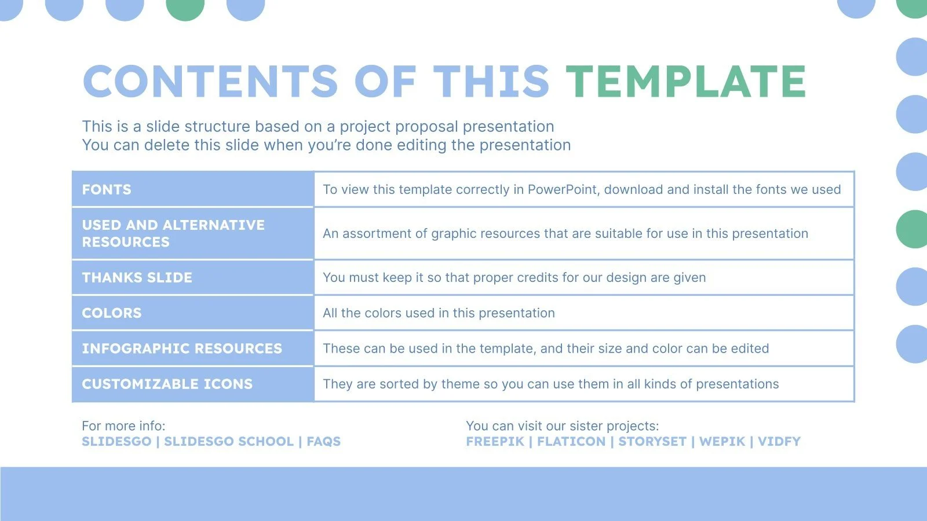
Problem:
Our problem formulation is: "Customer Financial Behaviour Analysis: Analysing customer behaviour by linking their current application data with their previous applications to identify patterns in loan uptake and repayment." This aims to understand customer behaviour in the context of loans by assessing relationships between different features to predict repayment outcomes or detect potential defaulters.

Slide 4
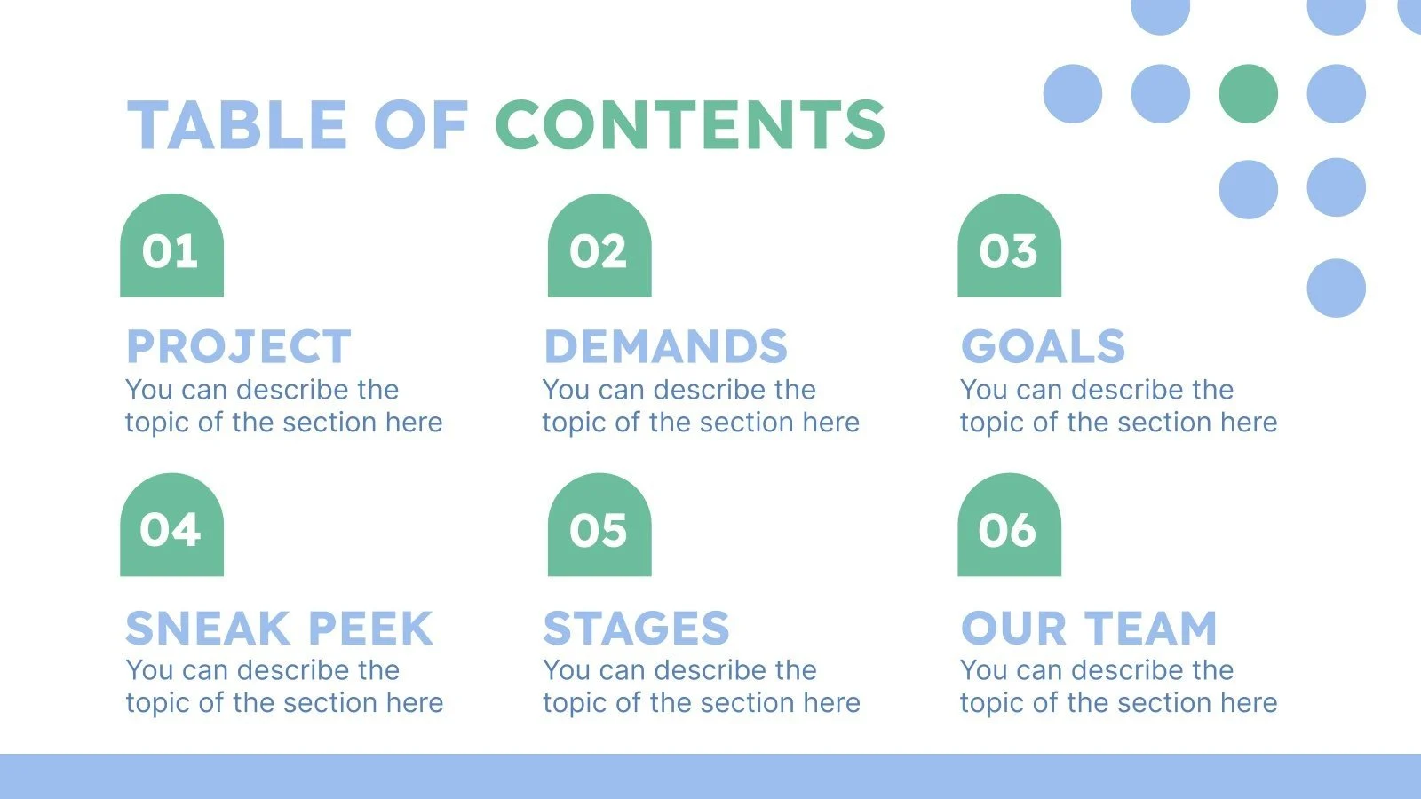
Preprocessing of data:
Missing Values Handling: I worked on analysing and filling the missing values in app_data and pre_app.
Dropped Columns: Removed columns with over 50% missing data.
Imputation: Filled numerical values with median and categorical values with mode.
Duplicates Check: Verified and found no duplicate rows in app_data and pre_app.
Outlier Removal: Used IQR method to remove outliers from AMT_INCOME_TOTAL in app_data.

Slide 5
Preprocessing of data:
Feature Selection and Engineering:
One-Hot Encoding: Converted categorical features into numeric to make them model-compatible.
Correlation Analysis: Identified important features for modelling based on their correlation with the target variable.
Feature Transformation: Applied log transformation to reduce skewness in financial features.
Converted DAYS_BIRTH and DAYS_EMPLOYED into age and employment years for better interpretability.
Created new feature which is Loan to Income Ratio to capture borrowers' debt burden.
Binned age into categories: Young, Middle-aged, Senior, Elderly.

Slide 6
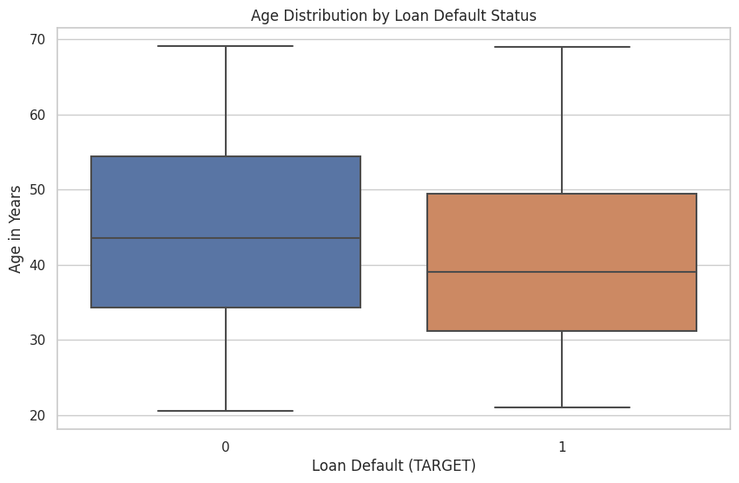
Preprocessing of data:
Age Distribution Visualization:
Created a boxplot to compare the age distribution by loan default status, highlighting that age could be an important factor in loan defaults.
Identifying Non-Linearity: The age distribution graph suggested potential non-linear relationships between age and loan default.
To address this:
Polynomial Features: Introduced polynomial features for AGE_YEARS to capture possible non-linear effects in the data.
Feature Expansion and Standardization: Standardization: Standardized the AGE_YEARS feature for consistency during model training. Handling Missing Values: Removed missing values in AGE_YEARS to maintain data quality.

Slide 7
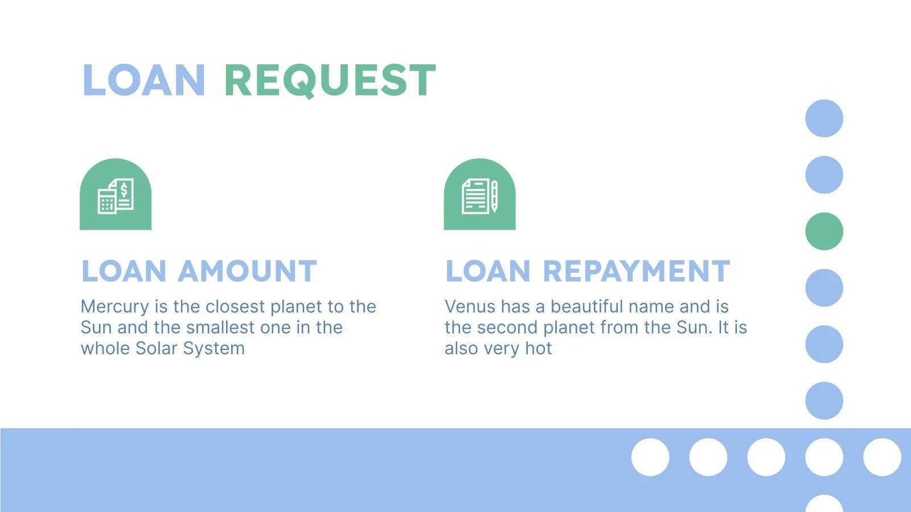
Summary statistics overview:
Application Data (app_data): Variables included income, credit, and demographics.
Key metrics: Avg. income was 154K, avg. credit was 579K.
Previous Applications (pre_app): The data covered credit amounts, down payments, and past decisions.
Key metrics: Avg. credit was 196K, avg. down payment was 4K.

Slide 8
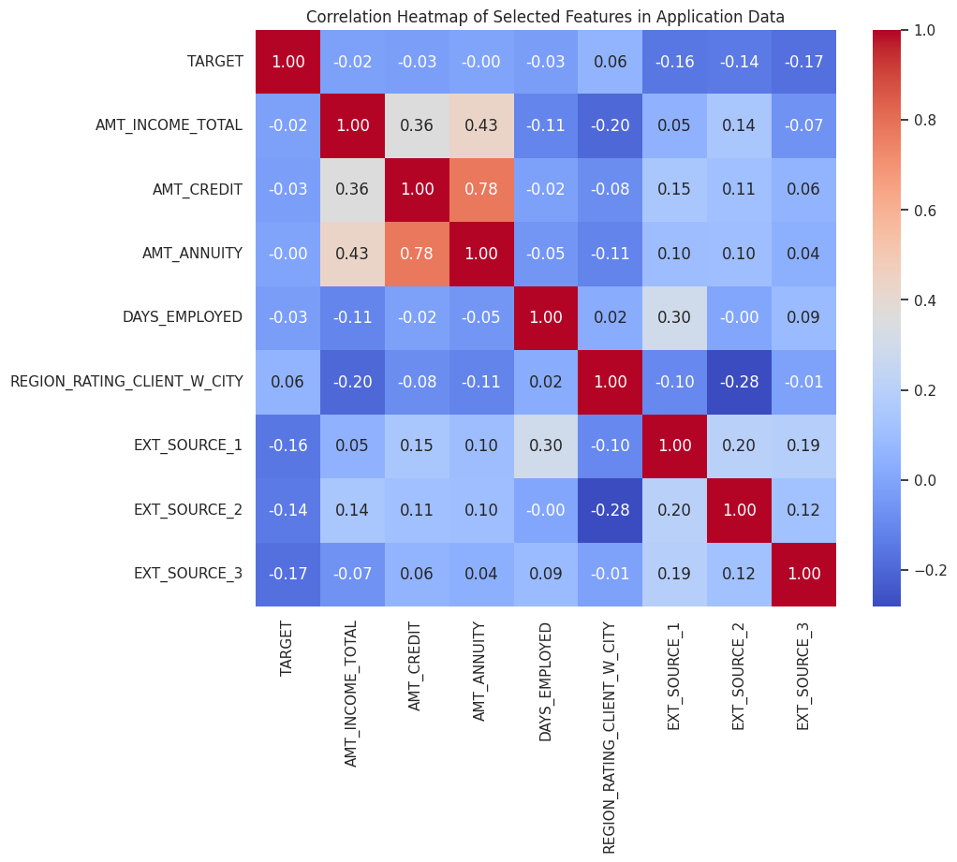
Summary statistics overview:
This heatmap shows the correlations between features in the application data.
Key insights: AMT_CREDIT & AMT_ANNUITY are strongly correlated, meaning that the credit amount and annuity are linked.
EXT_SOURCE_1, EXT_SOURCE_2, EXT_SOURCE_3 have a negative correlation with TARGET which indicating that they may be good predictors for lower loan default risk.
Weak correlations: Most features have weak correlations with the TARGET that means they might not be as useful in predicting loan default. These insights guide us on which features are potentially more predictive for our model.

Slide 9
Model Evaluation and comparison:
Random Forest Classifier Pros: Robust to overfitting due to averaging across multiple decision trees, good handling of categorical and numerical features.
Performance: Achieved high accuracy (92%), but poor recall for defaulters (0%).
Reason for Use: Effective for complex relationships and gives insight into feature importance.
Logistic Regression Pros: Interpretable and easy to implement, handles categorical and continuous variables, provides a probabilistic output.
Performance: Achieved similar accuracy (92%) but struggled with detecting defaulters (recall 2%).
Reason for Use: Provides a baseline model for understanding linear relationships in data and easy interpretability.

Slide 10
Model Evaluation and comparison:
Gradient Boosting Machine (GBM) Pros: Strong performance with boosting, reducing bias, and good handling of nonlinearities.
Performance: Achieved accuracy (92%) with slightly better recall for defaulters (1%) compared to Random Forest.
Reason for Use: Effective for improving prediction accuracy through boosting, suitable for complex relationships.
All models demonstrated poor recall for detecting defaulters and highlighting imbalance issues.

Slide 11
Improving the model:
Improving Model Recall with Upsampling
Upsampling the Minority Class:
Objective: To improve the model's recall for identifying loan defaulters, addressing the initial poor recall performance due to class imbalance. Process: I upsampled the minority class (defaulters) to match the number of instances in the majority class, creating a balanced dataset.
Results: I achieved an equal representation for both defaulters and non- defaulters (257,149 samples each).
Model Performance: Significantly improved recall for the minority class, but the perfect scores (accuracy and recall = 1.00) indicate potential overfitting. Key Takeaway: Upsampling effectively improved recall, ensuring the model better detects defaulters. However, further steps are required to mitigate overfitting.

Slide 12
Improving the model:
Improving Model Recall with Upsampling
Regularizing Upsampled Data:
Objective: Address overfitting after upsampling data.
Approach: Applied regularization to the Random Forest model by limiting tree depth (max_depth=10), increased the minimum samples to split a node (min_samples_split=10) and increased the minimum leaf nodes (min_samples_leaf=5).
Outcome: Reduced accuracy (from 1.00 to 0.72) but achieved a more balanced precision and recall, helping to control overfitting.

Slide 13
Impact on business:
Improving Risk Assessment: Enhance risk evaluation, reduce non-performing loans, and lower default rates.
Optimizing Loan Approvals: Identify high-risk applicants early, leading to more data-driven decisions and improved profitability.
Targeted Marketing: Segment customers effectively to offer tailored products and marketing campaigns, aligning with customer needs.
Customer Retention and Satisfaction: Proactively assist customers based on predictions, leading to higher satisfaction and loyalty.
Compliance and Regulatory Advantage: Ensure better compliance with financial regulations, reducing penalties and legal costs.
Resource Optimization: Allocate resources more efficiently, reducing costs and improving operational effectiveness.

Slide 14
Future enhancement plan:
Further data cleaning and preprocessing
Engineer new features for better predictive accuracy
Utilize visualizations to identify patterns in loan defaults
Explore more advanced models with hyperparameter tuning and cross-validation
Use SMOTE or precision-recall metrics to address class imbalances
Model Deployment and Automation
Develop an automated pipeline and deploy for real-time predictions
Documentation and Reporting
Improve documentation and create an executive summary for stakeholders

