Slide 1

AMIT LEARNING
HEART DISEASE PREDICTION
A machine learning–based heart disease prediction system that analyzes patient clinical data to assess disease risk, helping enable early detection and support informed healthcare decisions through accurate and interpretable models.

Slide 2

1
Introduction
2
Overview
3
Analysis
4
Preprocessing
AGENDA
5
Models
6
Evaluation
7
Deployment
8
Conclusion

Slide 3


INTRODUCTION
  Heart disease is one of the leading causes of death worldwide, making early detection and risk assessment essential for improving patient outcomes. With the increasing availability of healthcare data, machine learning techniques can be used to analyze clinical features and identify patterns associated with heart disease.
  In this project, we develop a machine learning model to predict the presence of heart disease using patient clinical data. The workflow includes data preprocessing, exploratory data analysis, feature engineering, and training multiple classification models. The performance of these models is evaluated using metrics such as accuracy, precision, recall, F1-score, and ROC-AUC to determine the most effective approach.
  This project demonstrates how machine learning and data science techniques can support healthcare decision-making by providing reliable and interpretable predictions.

Slide 4

DATA INSIGHTS
DATA COLUMNS
DATA OVERVIEW
STATISTICAL SUMMARY
INITIAL INSIGHTS

Slide 5

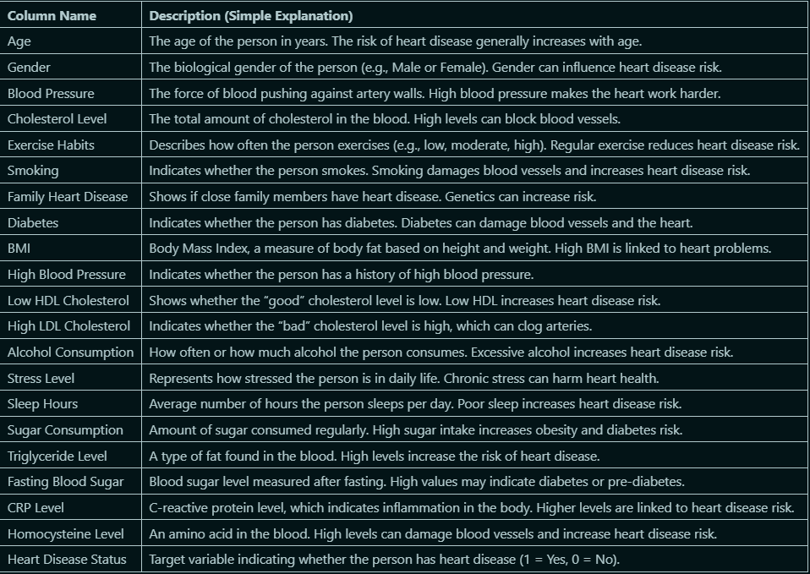
DATA
COLUMNS

Slide 6
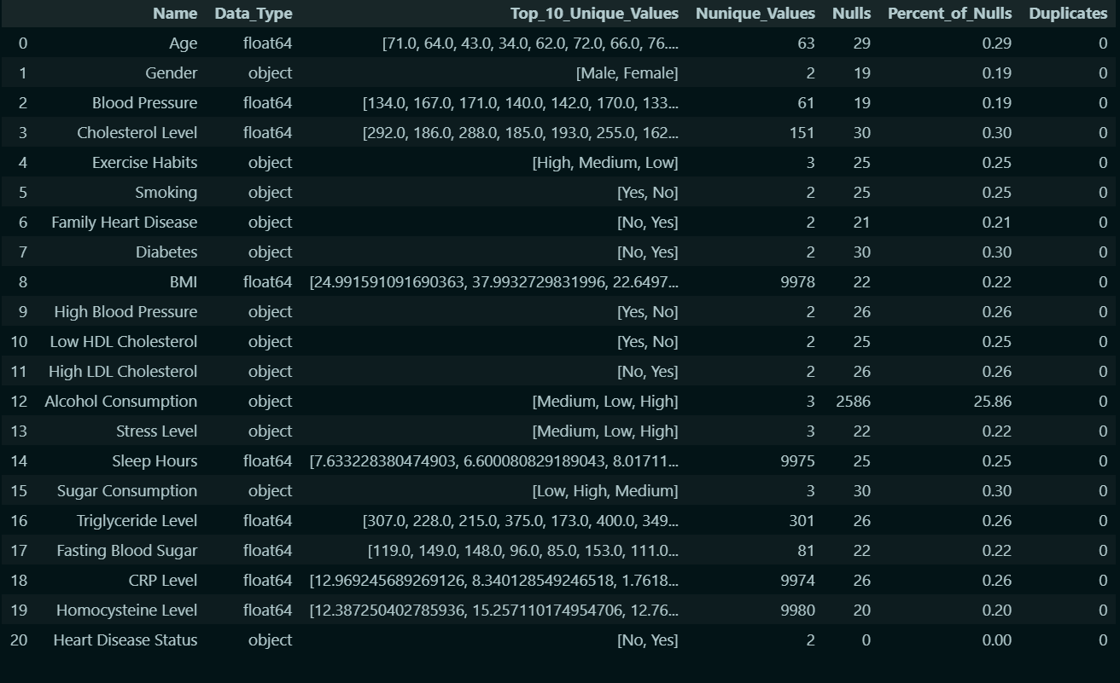
DATA OVERVIEW

Slide 7
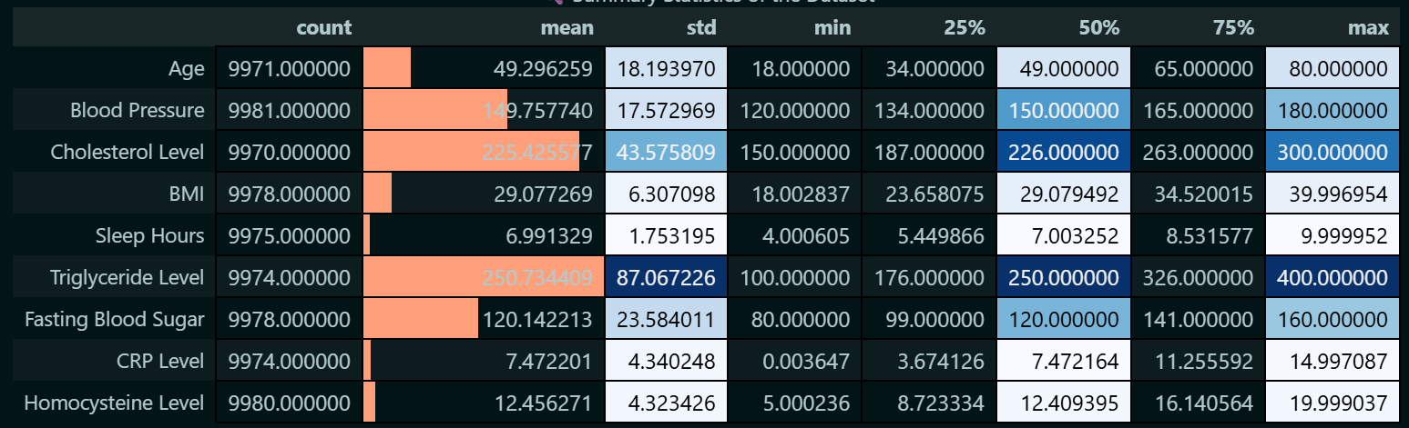
STATISTICAL SUMMARY

Slide 8

INITIAL INSIGHTS
BEFORE PERFORMING DETAILED ANALYSIS AND MODEL TRAINING, AN INITIAL EXPLORATION OF THE DATASET REVEALS SEVERAL IMPORTANT OBSERVATIONS REGARDING DATA QUALITY, FEATURE DIVERSITY, AND POTENTIAL CHALLENGES.
DATASET SIZE AND
FEATURE VARIETY
DATA TYPES AND FEATURE
COMPOSITION
MISSING VALUES DISTRIBUTION
THE DATASET CONTAINS A LARGE NUMBER OF RECORDS (APPROXIMATELY 10,000 SAMPLES) AND A DIVERSE SET OF FEATURES, INCLUDING DEMOGRAPHIC INFORMATION, LIFESTYLE FACTORS, CLINICAL MEASUREMENTS, AND BIOCHEMICAL MARKERS. THIS DIVERSITY ALLOWS THE MODEL TO LEARN COMPLEX RELATIONSHIPS BETWEEN LIFESTYLE HABITS, MEDICAL CONDITIONS, AND HEART DISEASE RISK.
THE DATASET INCLUDES A MIX OF NUMERICAL FEATURES (E.G., AGE, BLOOD PRESSURE, BMI, CHOLESTEROL LEVEL, TRIGLYCERIDE LEVEL) AND CATEGORICAL FEATURES (E.G., GENDER, EXERCISE HABITS, SMOKING, DIABETES). THIS INDICATES THAT APPROPRIATE PREPROCESSING STEPS SUCH AS ENCODING CATEGORICAL VARIABLES AND SCALING NUMERICAL FEATURES WILL BE REQUIRED BEFORE MODEL TRAINING.
SEVERAL COLUMNS CONTAIN MISSING VALUES, THOUGH MOST FEATURES HAVE A RELATIVELY LOW PERCENTAGE OF NULL VALUES (BELOW 1%). HOWEVER, THE ALCOHOL CONSUMPTION FEATURE STANDS OUT WITH A SIGNIFICANTLY HIGHER MISSING RATE (APPROXIMATELY 25%), WHICH MAY IMPACT MODEL PERFORMANCE IF NOT HANDLED CAREFULLY. THIS SUGGESTS THE NEED FOR THOUGHTFUL IMPUTATION STRATEGIES OR FEATURE-SPECIFIC PREPROCESSING DECISIONS.

Slide 9
INITIAL INSIGHTS
CATEGORICAL FEATURE BALANCE
NUMERICAL FEATURE
VARIABILITY
TARGET VARIABLE
QUALITY
MANY CATEGORICAL VARIABLES HAVE A LIMITED NUMBER OF UNIQUE VALUES, SUCH AS GENDER (MALE/FEMALE), SMOKING (YES/NO), AND DIABETES (YES/NO). THIS STRUCTURE SIMPLIFIES ENCODING BUT ALSO HIGHLIGHTS THE IMPORTANCE OF CHECKING CLASS BALANCE WITHIN THESE FEATURES TO AVOID BIASED LEARNING.
NUMERICAL FEATURES SUCH AS CHOLESTEROL LEVEL, TRIGLYCERIDE LEVEL, CRP LEVEL, AND HOMOCYSTEINE LEVEL EXHIBIT A WIDE RANGE OF VALUES. THIS VARIABILITY SUGGESTS THE PRESENCE OF OUTLIERS AND DIFFERING SCALES, MAKING FEATURE SCALING AND OUTLIER ANALYSIS ESSENTIAL STEPS IN THE PREPROCESSING PHASE.
THE TARGET VARIABLE, HEART DISEASE STATUS, CONTAINS NO MISSING VALUES, WHICH IS IDEAL FOR SUPERVISED LEARNING. HOWEVER, ITS CLASS DISTRIBUTION SHOULD BE EXAMINED TO DETERMINE WHETHER THE DATASET IS BALANCED OR REQUIRES IMBALANCE HANDLING TECHNIQUES SUCH AS CLASS WEIGHTING OR RESAMPLING.
DUPLICATE
RECORDS
NO DUPLICATE ROWS WERE DETECTED IN THE DATASET, INDICATING GOOD DATA INTEGRITY AND REDUCING THE NEED FOR DUPLICATE HANDLING DURING PREPROCESSING.

Slide 10
INITIAL INSIGHTS
SUMMARY
OVERALL, THE DATASET IS WELL-STRUCTURED AND SUITABLE FOR A LARGE-SCALE MACHINE LEARNING PROJECT. THE PRESENCE OF BOTH LIFESTYLE AND MEDICAL FEATURES, COMBINED WITH A LARGE SAMPLE SIZE, PROVIDES A STRONG FOUNDATION FOR BUILDING ROBUST PREDICTIVE MODELS. ADDRESSING MISSING VALUES, SCALING NUMERICAL FEATURES, ENCODING CATEGORICAL VARIABLES, AND MANAGING POTENTIAL CLASS IMBALANCE WILL BE CRITICAL STEPS IN THE NEXT STAGES OF THE PROJECT.

Slide 11
DATA ANALYSIS
NUMERICAL COLUMNS
CATEGORICAL COLUMNS
COLUMNS WITH TARGET
INTEGRATED COLUMNS

Slide 12
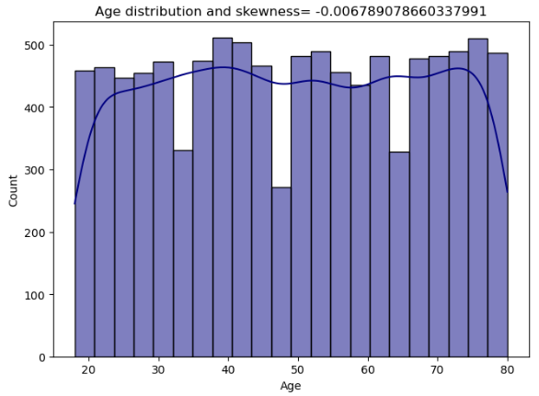
NUMERICAL COLUMNS
Overall, the numerical features exhibit near-normal distributions with very low skewness values. This indicates good data quality, minimal transformation requirements, and suitability for machine learning models. Standard scaling techniques should be sufficient, and no aggressive normalization or logarithmic transformations appear necessary at this stage.

Slide 13
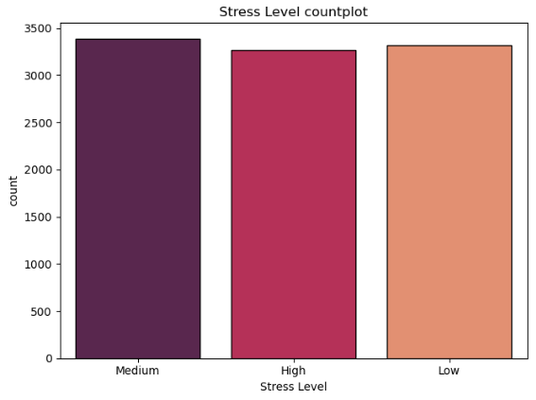
CATEGORICAL COLUMNS
Overall, the categorical features demonstrate well-balanced distributions, indicating high data quality and suitability for machine learning applications. The primary concern lies in the imbalance of the target variable, which must be handled appropriately to ensure robust and unbiased predictive performance.

Slide 14
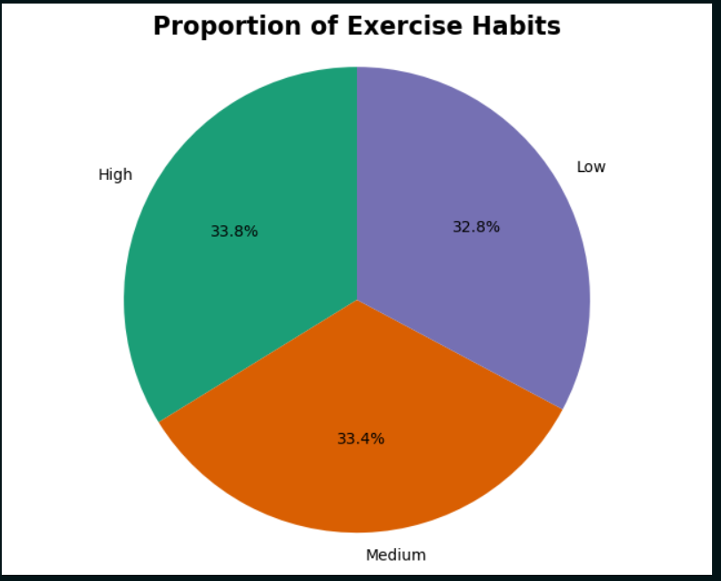
SOME COLUMNS WITH TARGET
Exercise Habits in pie chart

Slide 15

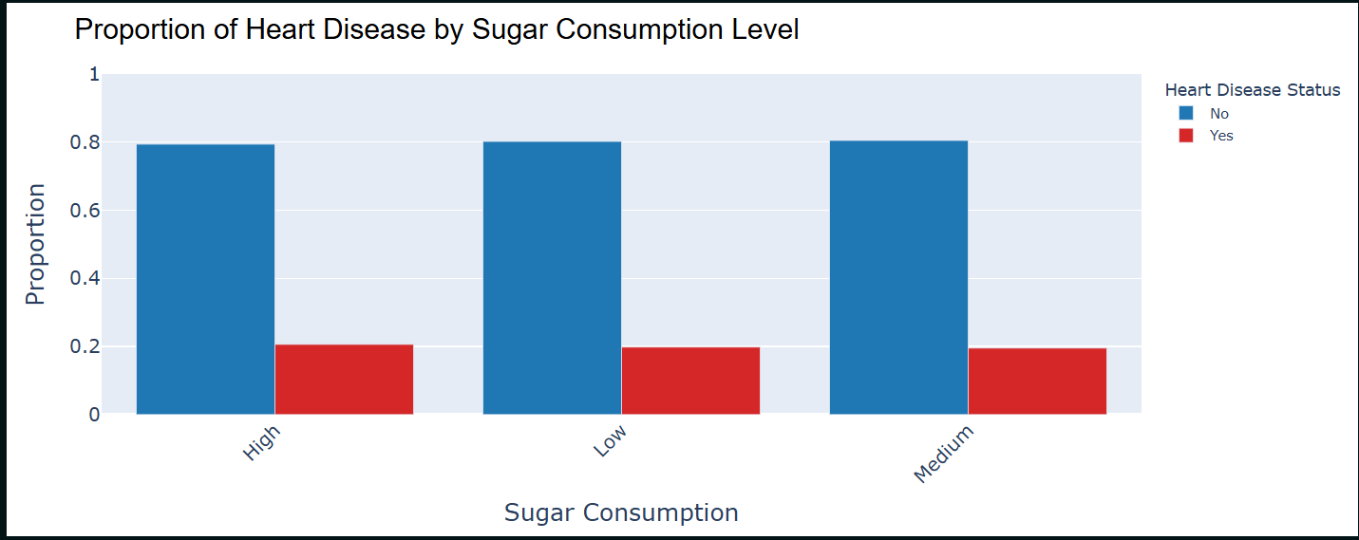
SUGAR CONSUMPTION LEVEL VS TARGET

Slide 16
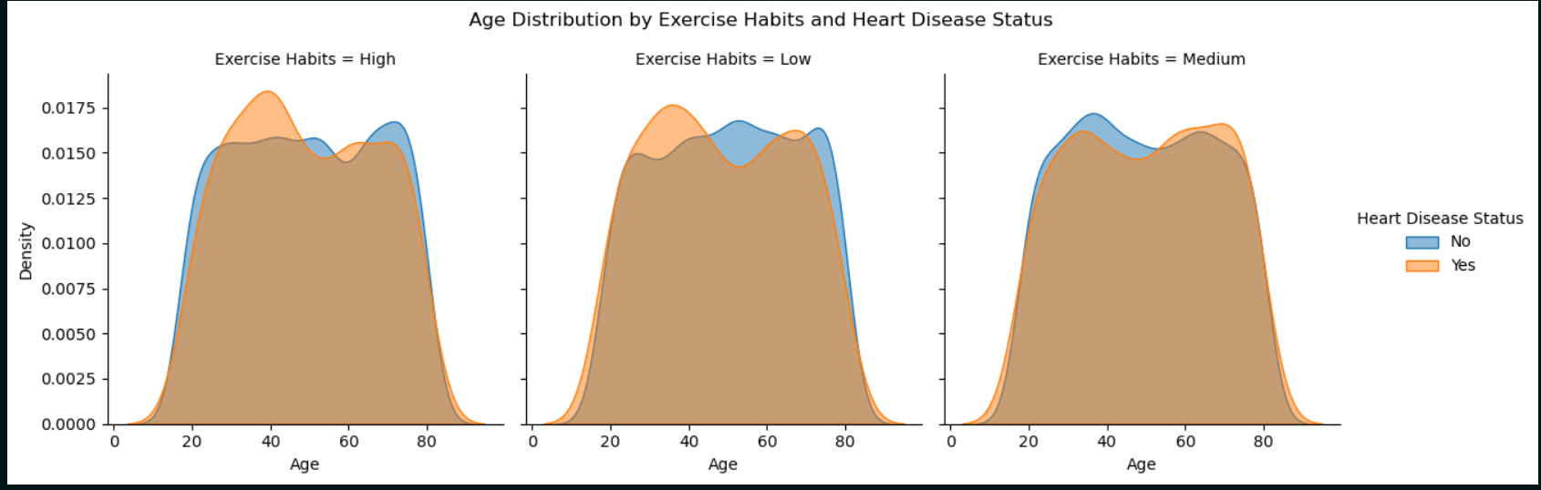
INTEGRATED COLUMNS
Exercise habits with age and target column

Slide 17
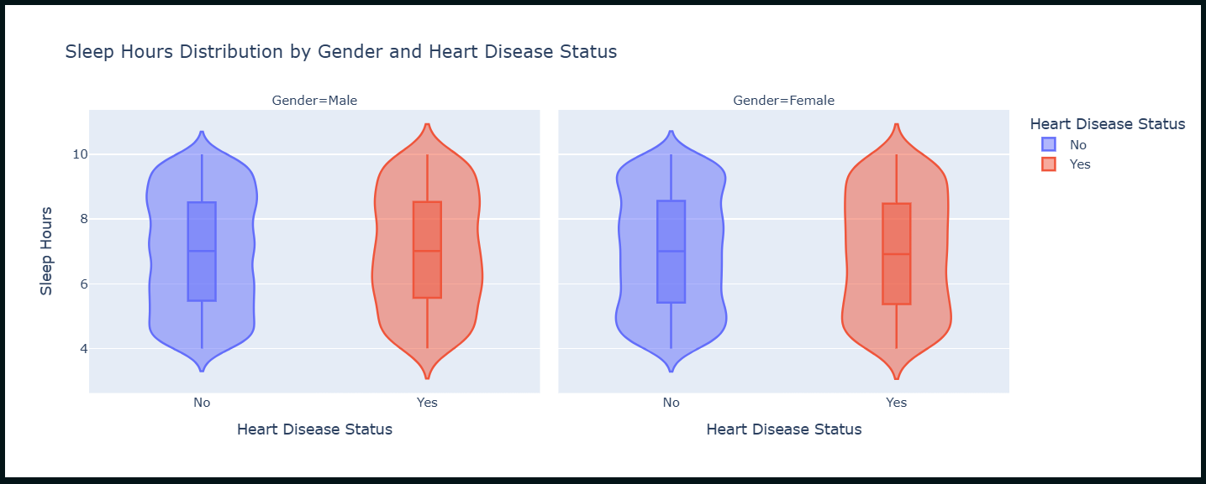
INTEGRATED COLUMNS

Slide 18
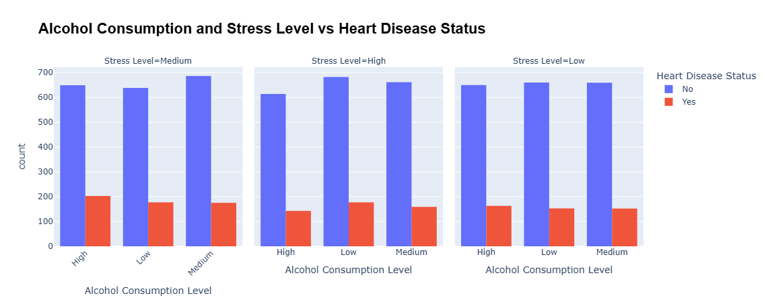
ALCOHOL CONSUMPTION & STRESS LEVEL & TARGET

Slide 19
DATA PREPROCESSING
HANDLING NULLS
DETECTING OUTLIERS
FEATURE ENGINEERING

Slide 20
HANDLING NULLS
for numerical columns : used median to fill nulls
most of the numerical columns contained nulls with less than 1% of the data
1
2
and for categorical used mode

Slide 21
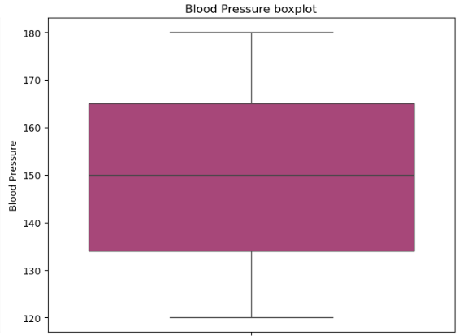
OUTLIERS DETECTION
The analysis showed that the majority of numerical variables follow well-balanced distributions without extreme or abnormal values. No significant outliers were observed that could negatively affect model training or bias the results.
1
Based on this observation, no outlier removal or transformation was applied, and all numerical features were retained in their original form to preserve the natural variability of the data.
2

Slide 22
FEATURE ENGINEERING
Age Group
1
Blood pressure category
2
Cholesterol Level Category
3
BMI Category
4
Life style
5
sleep quality
6

Slide 23
DATA HANDLING
ENCODING
SCALING
BALANCING
CORRELATION

Slide 24
ENCODING
FOR BINARY COLUMNS USED LABEL ENCODER
FOR ORDINAL COLUMNS USED ORDINAL ENCODER
USED LABEL ENCODER FOR TARGET COLUMN
SCALING
TRIED DIFFERENT SCALERS BUT THE BEST SUITABLE ONE IS MINMXAX SCALER
BALANCING DATA
USED MANY TECHNIQUES TO OVERSAMPLE AND UNDERSAMPLE
BUT THE BEST ONE WAS SMOTE AND THE DATA BECAME 6400 FOR BOTH CLASSES
SHAPE WAS
6400 : 1600

Slide 25
CORRELATION
FOR NUMERICAL COLUMNS USED POINTBISERIALR
FOR BINARY COLUMNS USED
CHI2 SCORE
THEN USED MUTUAL INFO
FOR ALL COLUMNS
FOR ORDINAL COLUMNS USED SPEARMANR

Slide 26
MODEL TRAINING
PCA
GRID SEARCH
MODELS TRIED
EVALUATION

Slide 27
PCA
TRIED MANY MODELS WITH PCA WITH MANY # COLUMNS TO GET BEST EVALUATION
AND EVERY ONE WITH GRID SEARCH TO HANDLE HYPERPARAMETERS
GRID SEARCH
USED IT TO HANDLE HYPERPARAMETER TUNING FOR EACH MODEL
MODELS TRIED
  TRIED LOGITSIC REGRESSION, SVM, RANDOMFOREST, XGBOOST, CATBOOST, LIGHTGBM
  TRIED ALSO MLP FOR MORE ROBUSTNESS WITH THIS DATA AND WITH PCA AND CALLBACKS WITH TRAINING

Slide 28
EVALUATION
Evaluated using f1-score , precision, recall and accuracy
1
Then best model with this metrices was catBoost and its the final model we will use
2

Slide 29
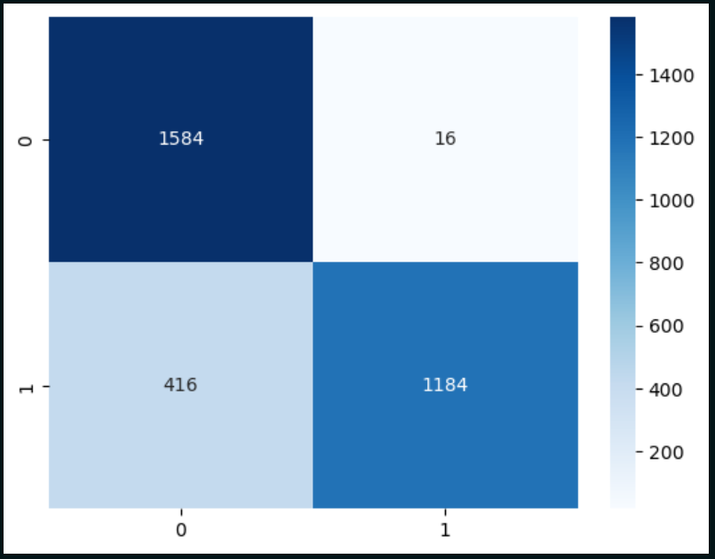
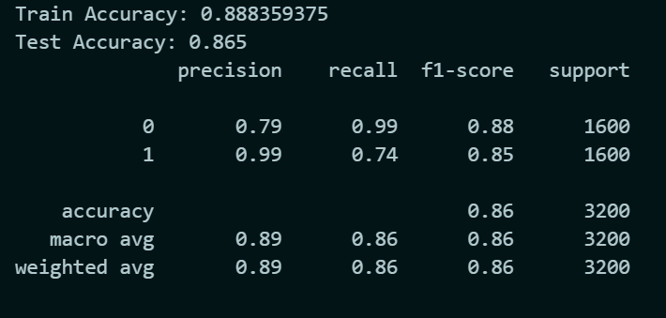
Confusion Matric & Classification Report
(CatBoost)

Slide 30
DEPLOYMENT

Slide 31
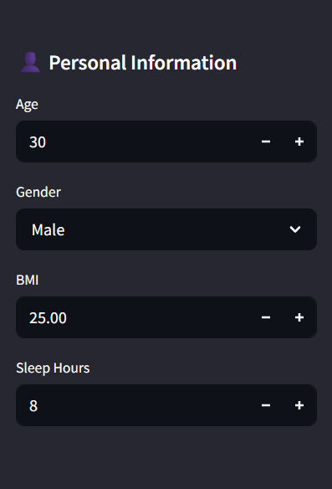
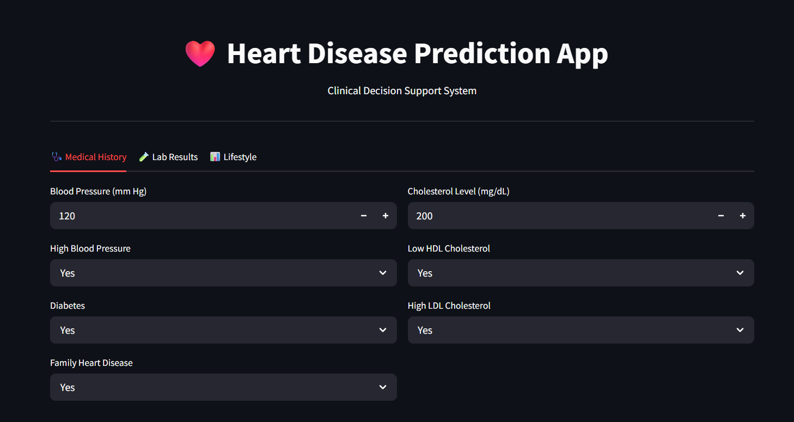

Slide 32
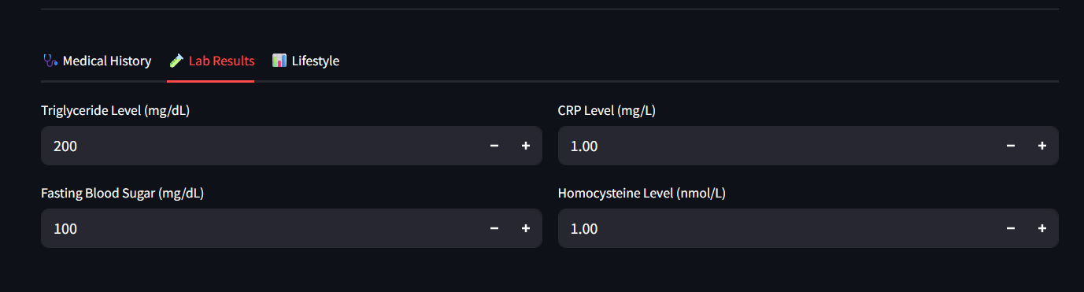
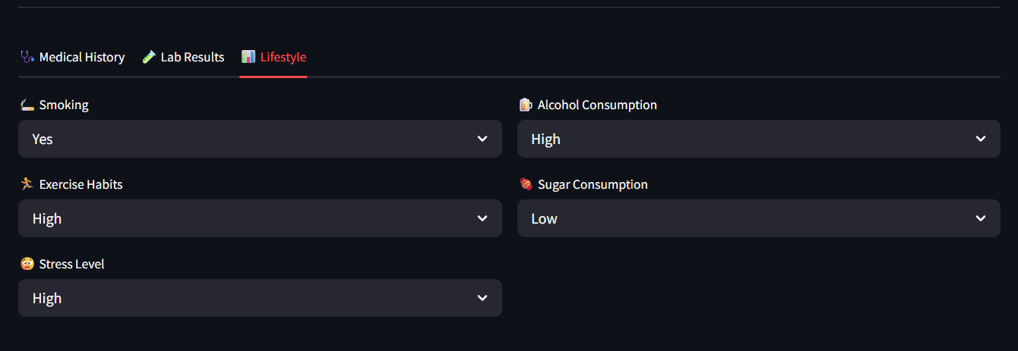

Slide 33
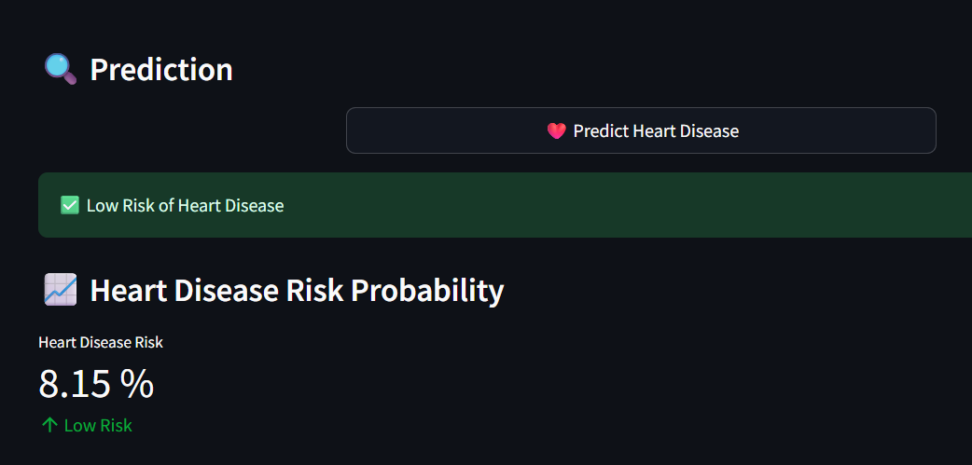

Slide 34
LIBRARIES USED
Pandas
1
Numpy
2
Matplotlib & Seaborn
3
Plotly
4
Sklearn & tensorflow
5
joblib
6

Slide 35


CONCLUSION
  A complete machine learning pipeline was developed to predict heart disease using medical and lifestyle data.
  After extensive analysis, preprocessing, and model comparison, CatBoost achieved the best and most reliable performance.
  The final model was deployed using Streamlit, enabling practical and accessible heart disease risk prediction.

Slide 36

THANK YOU
MOHAMED TAREK EL-ERAKY

