Slide 1
Dashboard
https://group10-acdc-eda-dashboard.streamlit.app/
1
Business understanding
2
Data understanding
Data Mining Project · Deliverable 1
What separates ACDC's coworking members?
3
Data preparation
4
Modelling
Exploratory data analysis, organised along CRISP-DM
5
Evaluation
6
Deployment
Group 10
Gustavo Carvalho · Mohamed Triki · Diogo Gaspar
Filled tiles = covered in this deliverable
Notes:
We follow CRISP-DM. This deliverable covers phases 1 to 3 and gets us ready for phase 4. We build the actual groups in Deliverable 2.

Slide 2
ACDC wants to understand who its members are Notebook section 1
1 Business
understanding
2 Data
understanding
3 Data
preparation
4 Modelling
5 Evaluation
6 Deployment
The business problem
What we want from the data
How we will know it worked
Some members want their own desk and extra services. Others just want a cheap desk for a few days a week
ACDC wants to know these groups, so it can adapt its services and marketing and keep members for longer
Nothing in the data says which group a member belongs to, so we have to find the groups ourselves
We will look at how much each member is worth and how they use the space, then combine both
For ACDC: we can describe each group in one sentence, and ACDC can treat that group differently
For the data: the groups say more than the plan alone, and they stay similar if we clean the data a bit differently
15,465
14,840
1 Jan 2024
6
rows and 31 columns in the raw file
members left after cleaning
the date we treat as "today". The file doesn't give one, so we worked it out from the data
new columns we built from the data
Notes:
Start with the business. ACDC's members want different things, and ACDC wants to adapt what it offers them. The data doesn't tell us who belongs to which group, so we have to find the groups ourselves. We look at two sides: what a member is worth and how they use the space. The success criteria are our own proposal, and Deliverable 2 will test them.

Slide 3
The raw file was messy, so we cleaned it first Notebook sections 2 and 3
1 Business
understanding
2 Data
understanding
3 Data
preparation
4 Modelling
5 Evaluation
6 Deployment
Rows with each problem in the raw file (one row can have several)
71.75%
of rows have no empty cell at all
25.6%
have the end date 1970-01-01. We read this as "no end date yet", so these members count as active
44.3%
of recorded value sits in just 77 rows that look 100x too high: our biggest surprise. We divided them by 100 so they don't distort the groups
15,465
182 duplicates removed
15,283
49 with no way to tell the plan
15,234
394 with dates that don't fit
14,840
rows at the start
without duplicates
with a known plan
clean members
Notes:
This slide describes what we received. The bars count rows, and one row can have several problems, so they don't add up. We only deleted a row when we couldn't recover it: 625 rows in total, about 4%. We fixed or marked everything else, and a flag column records each change so we can undo it. 77 lifetime values looked about 100 times too high, so we divided them by 100. That rests on a guess, a lost decimal point, that only ACDC could confirm.

Slide 4
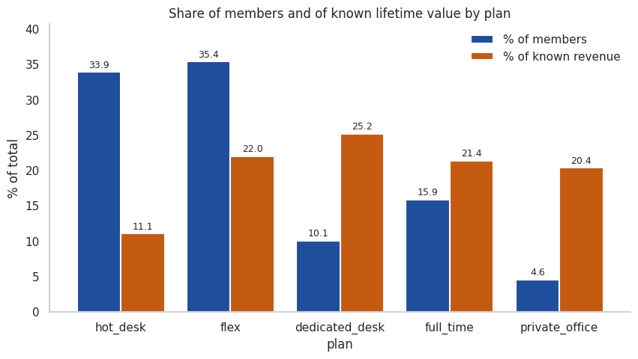
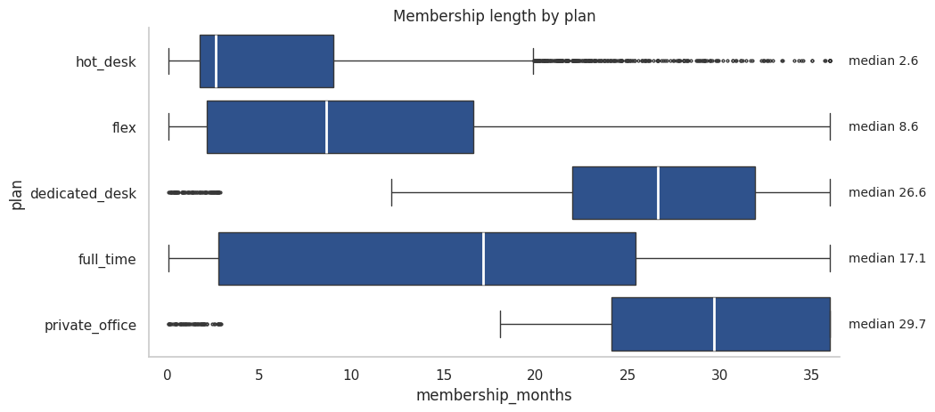
Most members do not bring most of the value Notebook sections 4.3 and 4.4
1 Business
understanding
2 Data
understanding
3 Data
preparation
4 Modelling
5 Evaluation
6 Deployment
What we saw
Hot desk and flex have 69.3% of members but only 33.1% of the known value. A typical dedicated desk or private office member stays 26.6 and 29.7 months.
What it means
These two plans (dedicated desk and private office) bring more per member because they cost more and people stay longer. By our estimate, plans cost from 120 to 650 EUR a month.
Why it matters to ACDC
ACDC could invest more in these plans. We only see revenue, though: private offices may cost more to build and take up more space.
What it means for the groups
We expect members to split into about 3 value groups, based on what they pay: cheaper, middle and top plans.
Notes:
This is our main finding about value. Known value leaves out the 18.2% of members with no usable lifetime value. We estimated prices from members with no extras, who pay almost the same each month within a plan. These prices are our reading of the data, not an official list, and the private office price comes from only 2 members. By price, full time comes before dedicated desk, which is not the order in the guidelines. We can't say investing would pay off, because we have no data on costs or space.

Slide 5
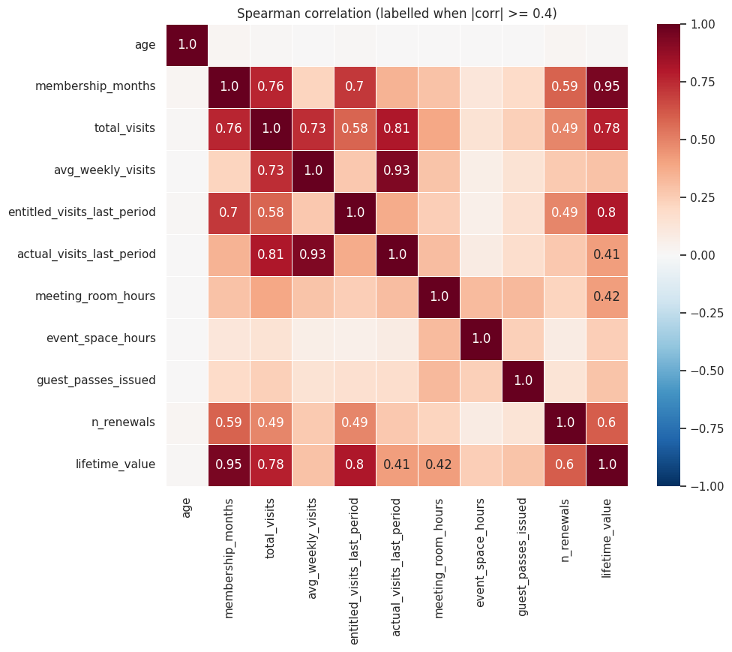
Members who stay longer visit more and bring more value Notebook section 4.9
1 Business
understanding
2 Data
understanding
3 Data
preparation
4 Modelling
5 Evaluation
6 Deployment
0.95
Months as a member and lifetime value
0.78
Total visits and lifetime value
0.76
Months as a member and total visits
How to read this: 1 means two columns rise together. 0 means no link. No pair in this chart is negative, so no column falls while another rises.
What we saw
The longer someone is a member, the more visits they add up and the more they pay in total. Visits and value also rise together. Age has no real link with any of them.
What it means
Long memberships simply have more time to add up visits and money. So part of the link between visits and value is really just time.
Why it matters to ACDC
Value builds up month after month, so keeping members for longer should bring in more money.
What it means for the groups
If we use all these columns, the groups may only show how long people stayed. We will keep just some of them.
Notes:
The heatmap shows how strongly each pair of columns moves together, using Spearman correlation. It only prints values of 0.4 or more. Months as a member and lifetime value almost move as one. Be careful not to say that more visits cause more value: both grow with time. That is why we don't want several columns measuring the same thing when we build the groups, or that one idea would count several times.

Slide 6
We expect about 3 value and 4 or 5 behaviour groups Notebook sections 5 and 6
1 Business
understanding
2 Data
understanding
3 Data
preparation
4 Modelling
5 Evaluation
6 Deployment
Looking at | Groups we expect to find (still to be tested)
Value: about 3 | Based on what members pay: hot desk and flex; full time and dedicated desk; private office
Behaviour: 4 or 5 | New members; people who left early; people who left later; active members who still come; active members who have almost stopped (60.1% on dedicated desks)
Services | Mail handling and storage depend most on the plan (Cramér's V of 0.46 and 0.40), so they add less on their own
New column | What it tells us | Overlaps with
membership_months | How long they've been a member | total_visits (0.76)
plan_usage_rate | Share of allowed visits they used | avg_weekly_visits (0.84)
number_of_addons_used | How many extras they use | lifetime_value (0.53)
monthly_value | Money per month | lifetime_value (0.74)
days_since_last_visit_active | Days since an active member came | plan_usage_rate (−0.79)
plan_tier_ordinal | The plan as a number, 1 to 5 | monthly_value (0.80)
What could go wrong
The groups might just copy the plans, or only split new and old members
Some values are still missing (18.2% of lifetime_value) or wrong, and we must deal with them first
Some columns say almost the same thing
What we will do next
Build the value and behaviour groups separately, then combine them
Treat "uses a service" and "how much" as two different questions
Fix the errors, then put very large values on a similar scale
Start with the columns expected to separate members most: plan_usage_rate, membership_months, monthly_value, number_of_addons_used and recency
Notes:
In simple terms, we expect a few value groups set by what members pay, and a few behaviour groups set by how they use the space and whether they are still members. These are guesses to test in Deliverable 2, because we have not built any groups yet. The 60.1% is the share of active dedicated desk members who use under 10% of the visits they are allowed. The Overlaps column shows how much each new column repeats another one: closer to 1 or -1 means more repetition.

