Slide 1


Slide 2

Introduction to Kotlin for android developers

Slide 3




About me
Mohamed Wael
Senior Android developer @ Vodafone shared services Egypt.
Computer Science 2015, Mansoura University.
MohamedWael
iMohamedWael
MohamedWael

Slide 4

What is Kotlin
Kotlin is a cross-platform, statically typed, general-purpose programming language with type inference.
Developed by JetBrains, the creator of the android studio.
In October 2017, Kotlin is officially supported by Google for Android.

Slide 5
What is Kotlin
Kotlin mainly targets the JVM, but also compiles to JavaScript or native code.
Kotlin is Open Source and it costs nothing to adopt.
Kotlin can be learned easily. It can be learned easily by simply reading the language reference.
The syntax is clean and intuitive(easy to use and understand).
Type inference allows its syntax to be more concise.

Slide 6
Statically typed languages
A language is statically typed if the type of a variable is known at compile time.
The main advantage here is that all kinds of checking can be done by the compiler, and therefore a lot of trivial bugs are caught at a very early stage.
Examples: C, C++, Java, Rust, Go, Scala

Slide 7
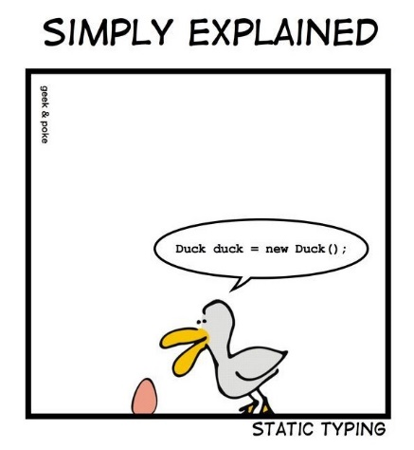

Slide 8
Statically typed languages
/* Java Code */ static int num1, num2; //explicit declaration num1 = 20; //use the variables anywhere num2 = 30;
/* Kotlin Code*/ val a: Int val b: Int a = 5 b = 10

Slide 9
Benefits of Kotlin Language
Kotlin compiles to JVM bytecode or JavaScript:
Like Java, Bytecode is the compiled format for Kotlin programs also.
Bytecode means Programming code that, once compiled, is run through a virtual machine instead of the computer’s processor.

Slide 10
Benefits of Kotlin Language
Kotlin compiles to JVM bytecode or JavaScript:
By using this approach, source code can be run on any platform once it has been compiled and run through the virtual machine.
Once a kotlin program has been converted to bytecode, it can be transferred across a network and executed by JVM(Java Virtual Machine).

Slide 11
Benefits of Kotlin Language
Kotlin programs can use all existing Java Frameworks and Libraries:
Kotlin programs can use all existing java frameworks and libraries, even advanced frameworks that rely on annotation processing.
The main important thing about kotlin language is that it can easily integrate with Maven, Gradle and other build systems.

Slide 12

Benefits of Kotlin Language
Kotlin’s null-safety is great
Now get rid of NullPointerException. This type of system helps us to avoid null pointer exceptions.

Slide 13
Benefits of Kotlin Language
Kotlin’s null-safety is great
In Kotlin the system simply refuses to compile code that tries to assign or return null. Consider the following example:
val name: String = null // tries to assign null, won’t compile.
fun getName(): String = null // tries to return null, won’t compile.

Slide 14
Benefits of Kotlin Language
But, what if we need nullability
In some special cases if we need nullability in our program then we have to ask Kotlin very nicely.
Every Nullable type require some special care and treatment. We can’t treat them the same way as non-nullable types and this is a very good thing.

Slide 15
Benefits of Kotlin Language
But, what if we need nullability
We have to add “?” after the variable type. Kotlin also fails at compile-time whenever a NullPointerException may be thrown at run-time. Consider the following example
val name: String? = null //assigned null and it will compile also. fun getName(): String? = null //returned null and it will compile too.

Slide 16
Benefits of Kotlin Language
But, what if we need nullability
/* correct way */ val name: String? = null val len = name?.length
/* won’t compile */ val name: String? = null val len = name.length

Slide 17
Kotlin file extention
Filename extensions of the Java are .java, .class, .jar but on the other hand filename extensions of the Kotlin are .kt and .kts.

Slide 18
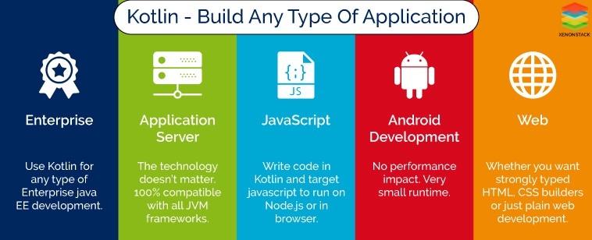

Slide 19
Hello world
Like in Java, C and C++, the entry point to a Kotlin program is a function named “main”. Basically, it passed an array containing any command line arguments.
Consider the following example:
//package level function, which return Unit
//and takes an array of string as parameter fun main(args: Array<String>) { val scope = "world" println("Hello, $scope!") //semicolons are optional
}

Slide 20
Hello world
// Single-line comments start with // /* Multi-line comments look like this. */ // The "package" keyword works in the same way as in Java. package com.example.kotlin

Slide 21
Hello world
Declaring values is done using either "var" or "val".
"val" declarations cannot be reassigned, whereas "vars" can.Consider the following example:
val fooVal = 10 // we cannot later reassign fooVal to something else var fooVar = 10 fooVar = 20 // fooVar can be reassigned

Slide 22
Hello world
In most cases, Kotlin can determine what the type of a variable is, so we don't have to explicitly specify it every time. We can explicitly declare the type of a variable like so:
Strings can be represented in a similar way as in Java. Escaping is done with a backslash.
val foo: Int = 7
val fooString = "My String Is Here!" val barString = "Printing on a new line?\nNo Problem!" val bazString = "Do you want to add a tab?\tNo Problem!" println(fooString) println(barString) println(bazString)

Slide 23
Hello world
Strings can contain template expressions.
A template expression starts with a dollar sign ($).
val fooTemplateString = "$fooString has ${fooString.length} characters" println(fooTemplateString) // => My String Is Here! has 18 characters

Slide 24
Hello world
A raw string is delimited by a triple quote (""").
Raw strings can contain newlines and any other characters.
val fooRawString = """ fun helloWorld(val name : String) { println("Hello, world!") } """ println(fooRawString)

Slide 25
Hello world
For a variable to hold null it must be explicitly specified as nullable.
A variable can be specified as nullable by appending a ? to its type.
We can access a nullable variable by using the ?. operator.
We can use the ?: operator to specify an alternative value to use if a variable is null.

Slide 26
Hello world
var fooNullable: String? = "abc" println(fooNullable?.length) // => 3 println(fooNullable?.length ?: -1) // => 3 fooNullable = null println(fooNullable?.length) // => null println(fooNullable?.length ?: -1) // => -1

Slide 27
Hello world
Functions can be declared using the "fun" keyword.
Function arguments are specified in brackets after the function name.
Function arguments can optionally have a default value.
The function return type, if required, is specified after the arguments.
fun hello(name: String = "world"): String { return "Hello, $name!" } println(hello("foo")) // => Hello, foo! println(hello(name = "bar")) // => Hello, bar! println(hello()) // => Hello, world!

Slide 28
Hello world
Functions can be declared using the "fun" keyword.
Function arguments are specified in brackets after the function name.
Function arguments can optionally have a default value.
The function return type, if required, is specified after the arguments.
fun hello(name: String = "world"): String { return "Hello, $name!" } println(hello("foo")) // => Hello, foo! println(hello(name = "bar")) // => Hello, bar! println(hello()) // => Hello, world!

Slide 29
Hello world
A function parameter may be marked with the "vararg" keyword to allow a variable number of arguments to be passed to the function.
fun varargExample(vararg names: Int) { println("Argument has ${names.size} elements") } varargExample() // => Argument has 0 elements varargExample(1) // => Argument has 1 elements varargExample(1, 2, 3) // => Argument has 3 elements

Slide 30
Hello world
When a function consists of a single expression then the curly brackets can be omitted. The body is specified after a = symbol.
If the return type can be inferred then we don't need to specify it.
fun odd(x: Int): Boolean = x % 2 == 1 println(odd(6)) // => false println(odd(7)) // => true
fun even(x: Int) = x % 2 == 0 println(even(6)) // => true println(even(7)) // => false

Slide 31
Hello world
In Kotlin, functions are first-class citizen.
It means that functions can be assigned to the variables, passed as an arguments or returned from another function.
While Kotlin is statically typed, to make it possible, functions need to have a type. It exists and it is called function type.

Slide 32
Hello world
The function type that returns nothing useful (Unit) and takes no arguments.
The function type that returns Int and takes single argument of type Int.
The function type that returns another function that returns nothing useful (Unit). Both functions take no arguments.
()->Unit
(Int)->Int
()->()->Unit

Slide 33
Hello world
Function type is just a syntactic sugar for an interface, but the interface cannot be used explicitly. Nevertheless we can use function types like interfaces, what includes using them as type arguments or implementing them:
class MyFunction : () -> Unit { override fun invoke() { println("I am called") } } fun main(args: Array<String>) { val function = MyFunction() function() // Prints: I am called }

Slide 34
Hello world
Functions can take functions as arguments and return functions.
Named functions can be specified as arguments using the :: operator.
fun not(f: (Int) -> Boolean): (Int) -> Boolean { return { n -> !f.invoke(n) } }

Slide 35
Resources
https://kotlinlang.org/docs/reference/
https://en.wikipedia.org/wiki/Kotlin_(programming_language)
https://stackoverflow.com/questions/1517582/what-is-the-difference-between-statically-typed-and-dynamically-typed-languages
https://www.xenonstack.com/blog/overview-kotlin-comparison-kotlin-java/
https://blog.kotlin-academy.com/kotlin-programmer-dictionary-function-type-vs-function-literal-vs-lambda-expression-vs-anonymous-edc97e8873e

Slide 36


