Slide 1


Slide 2

Introduction to Kotlin for android developers

Slide 3




About me
Mohamed Wael
Senior Android developer @ Vodafone shared services Egypt.
Computer Science 2015, Mansoura University.
MohamedWael
iMohamedWael
MohamedWael

Slide 4

What is Kotlin
Kotlin is a cross-platform, statically typed, general-purpose programming language with type inference.
type inference allows its syntax to be more concise.
Kotlin mainly targets the JVM, but also compiles to JavaScript or native code.
Developed by JetBrains, the creator of the android studio.
In October 2017, Kotlin is officially supported by Google for Android.

Slide 5
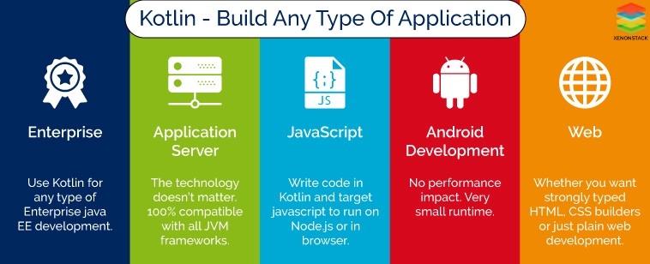

Slide 6
Resources
https://en.wikipedia.org/wiki/Kotlin_(programming_language)

Slide 7


