Slide 1
Selected – 2 Project Presentation
By: Team 30

Slide 2
Dataset Used:
https://www.kaggle.com/datasets/vijaygiitk/multiclass-weather-dataset

Slide 3
Paper’s Implementation

Slide 4
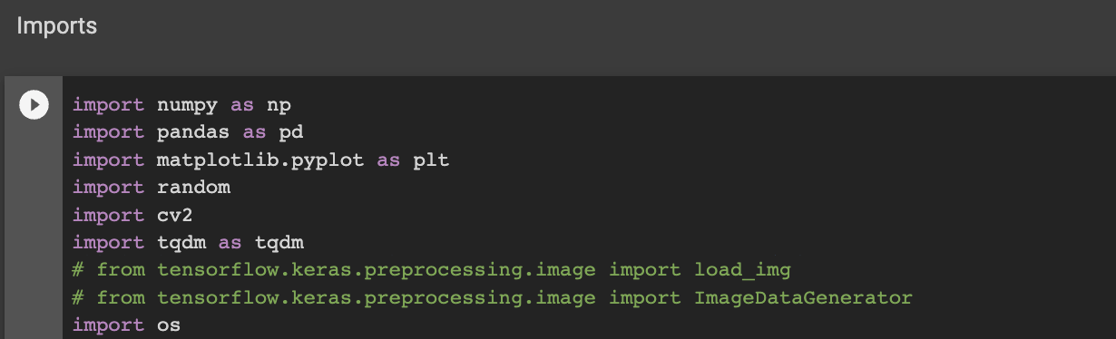
First Step: Imports
Importing libraries needed for the project:

Slide 5
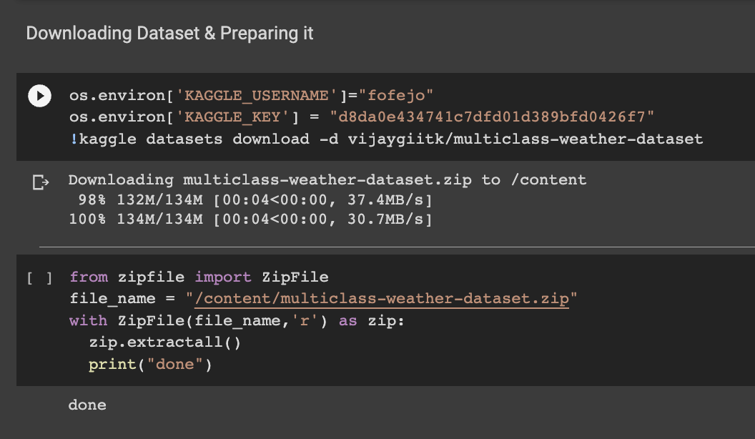
Second Step: Download & Prepare Dataset
Download dataset using Kaggle API

Slide 6
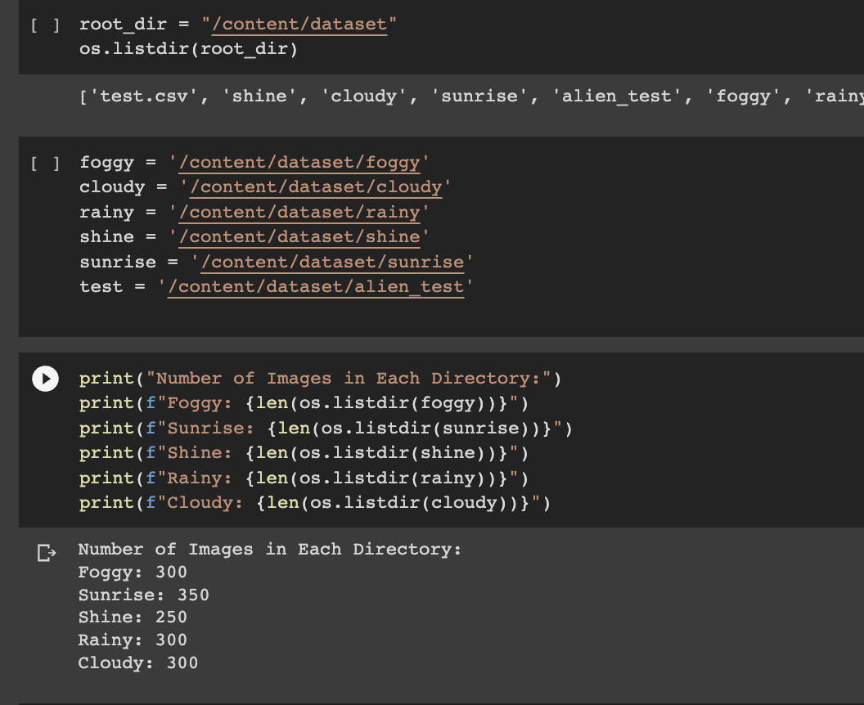
Second Step: Download & Prepare Dataset
Prepare directories

Slide 7
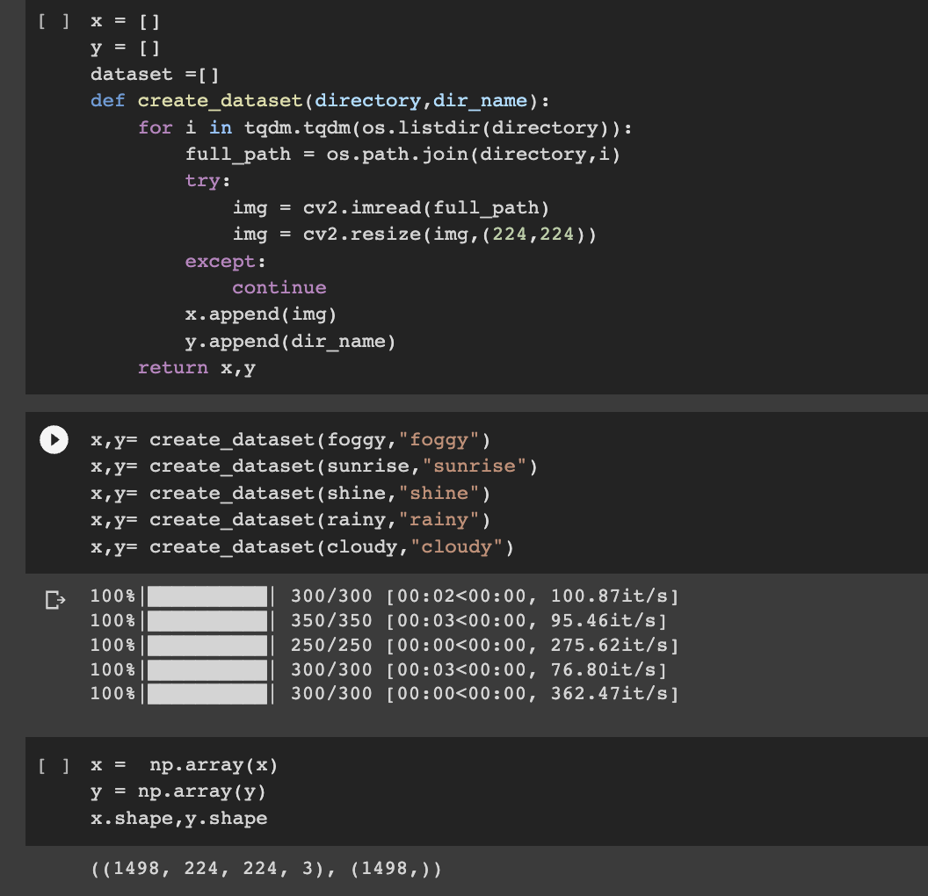
Second Step: Download & Prepare Dataset
Create Numpy arrays (x,y) that contain the dataset and labels

Slide 8
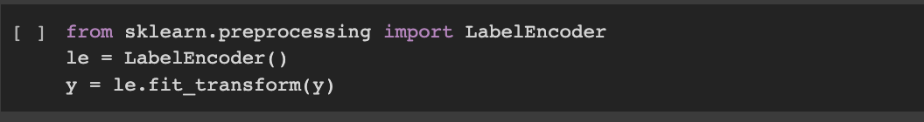
Second Step: Download & Prepare Dataset
Label encode the labels (y) to (0,1,2,3,4) instead of (cloudy,rainy,foggy,shine,sunrise)
LabelEncoder assigns a unique integer for every category

Slide 9
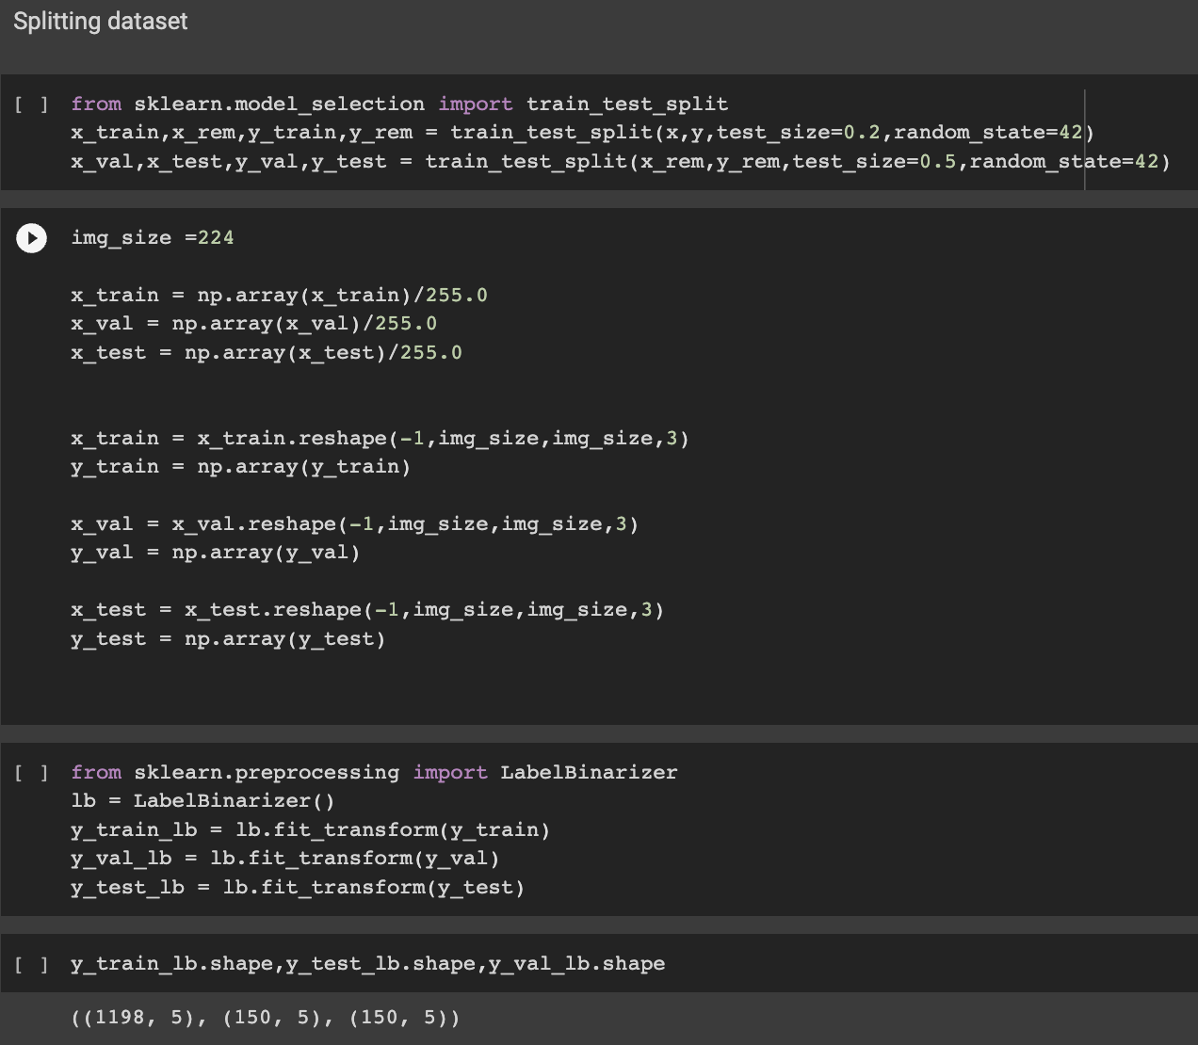
Third Step: Splitting Dataset
Split the dataset using train_test_split() to training, validation, testing
Rescale the image and resize it to (224,224)
Label binarize the labels, it creates a binary indicator for every category

Slide 10
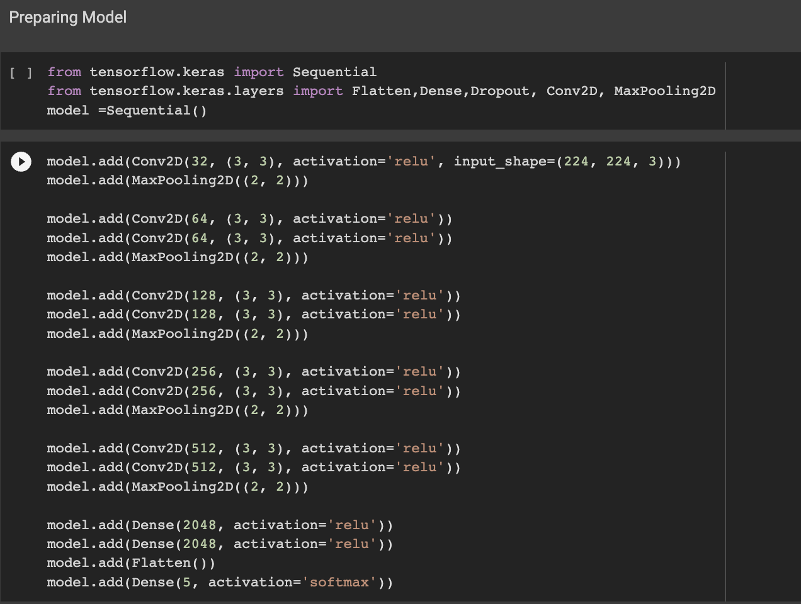
Fourth Step: Preparing Model
Prepare the training model by importing the layers from tf.keras
Add the layers in the way the paper suggests

Slide 11
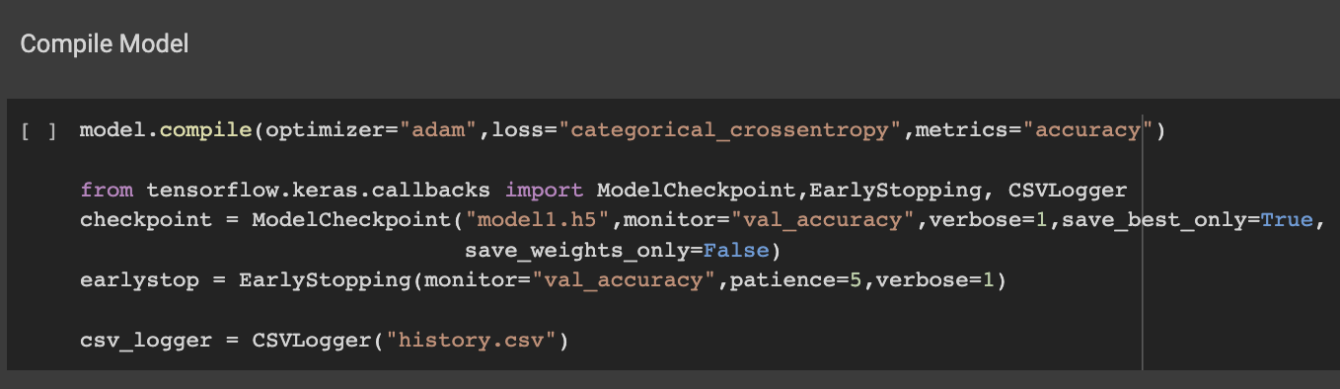
Fifth Step: Compiling Model
Compiling the model and setting the hyperparameters (adam,categorical crossentropy, 32 batch_size, 30 epochs)

Slide 12
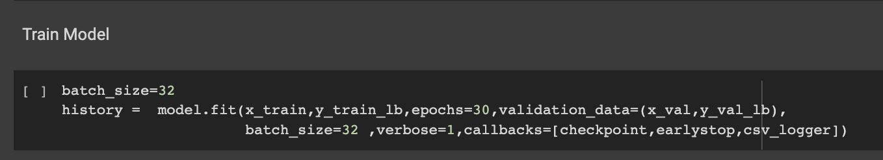
Final Step: Train Model
Start training the model on the training data and validating it with the validation data

Slide 13
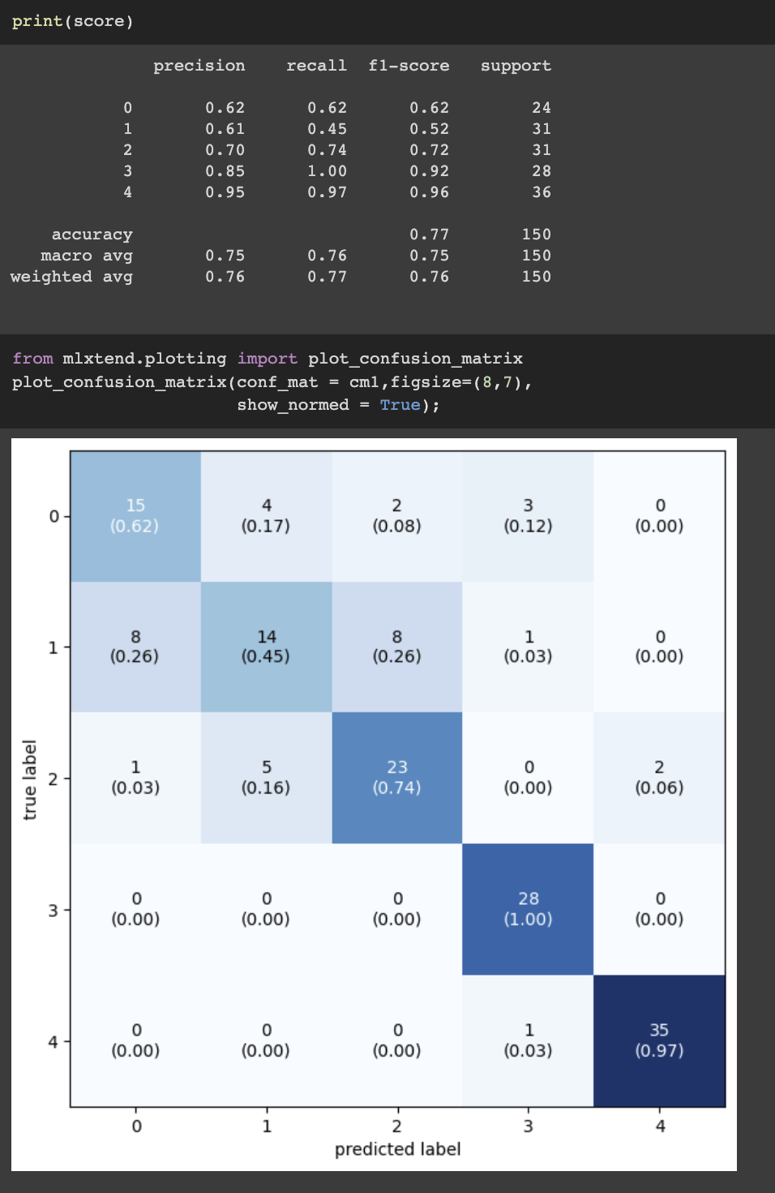
After that, we test the model using the test data and analyze the results and visualize them
Example Results:

Slide 14
Modified Implementation

Slide 15
First Step: Imports
Importing libraries needed for the project:

Slide 16
Second Step: Download & Prepare Dataset
Download dataset using Kaggle AP

Slide 17
Second Step: Download & Prepare Dataset
Prepare directories

Slide 18
Second Step: Download & Prepare Dataset
Create Numpy arrays (x,y) that contain the dataset and labels

Slide 19
Second Step: Download & Prepare Dataset
Label encode the labels (y) to (0,1,2,3,4) instead of (cloudy,rainy,foggy,shine,sunrise)
LabelEncoder assigns a unique integer for every category

Slide 20
Third Step: Splitting Dataset
Split the dataset using train_test_split() to training, validation, testing
Rescale the image and resize it to (224,224)
Label binarize the labels, it creates a binary indicator for every category

Slide 21
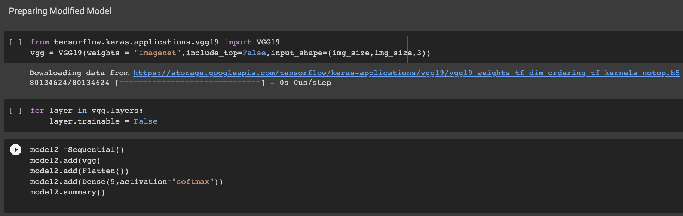
Fourth Step: Preparing Model
Prepare the training model by importing the layers from tf.keras
Preparing the pretrained model by importing it and set it to untrainable
Adding the layers together

Slide 22
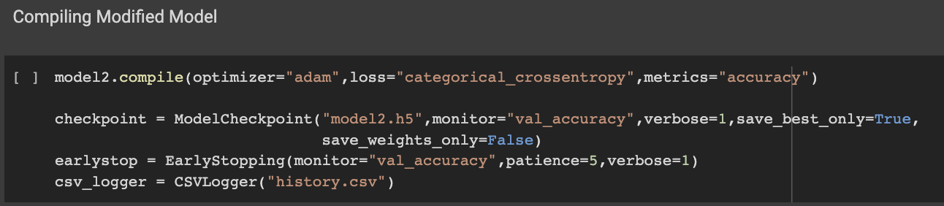
Fifth Step: Compiling Model
Compiling the model and setting the hyperparameters (adam,categorical crossentropy, 32 batch_size, 20 epochs)

Slide 23
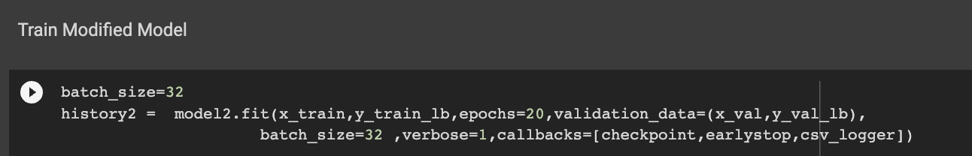
Final Step: Train Model
Start training the model on the training data and validating it with the validation data

Slide 24
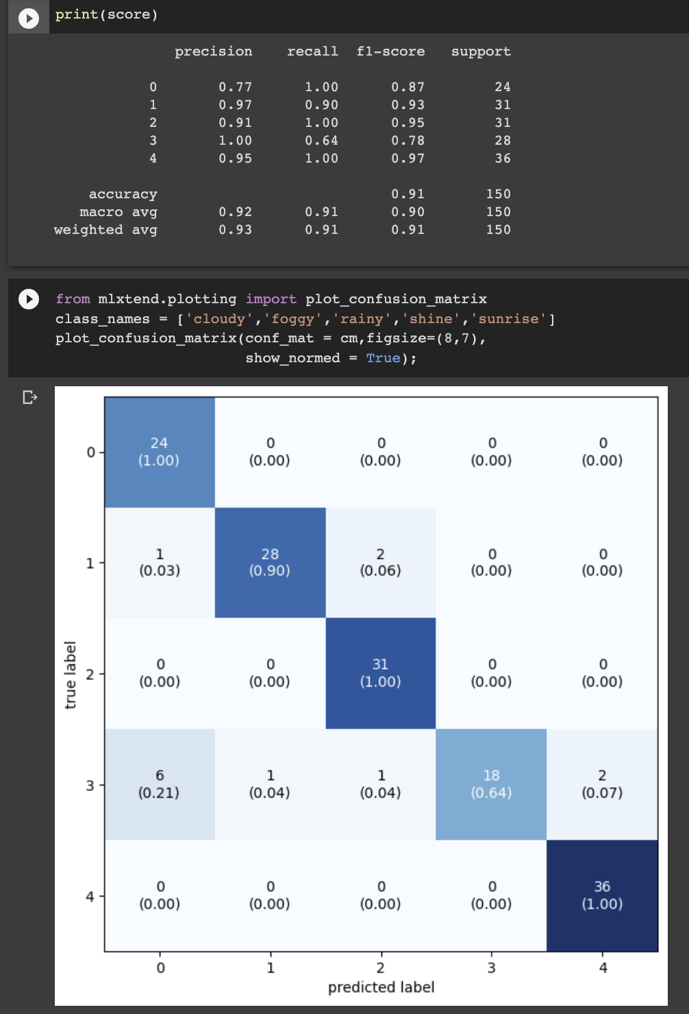
After that, we test the model using the test data and analyze the results and visualize them
Example Results:

Slide 25
Conclusion
As we can see, the modified implementation performed better than the paper’s implementation on the same dataset, mainly because of the usage of Transfer Learning (using pretrained model first), because it makes the training faster and more accurate and does a much better job at feature extraction.

