Slide 1



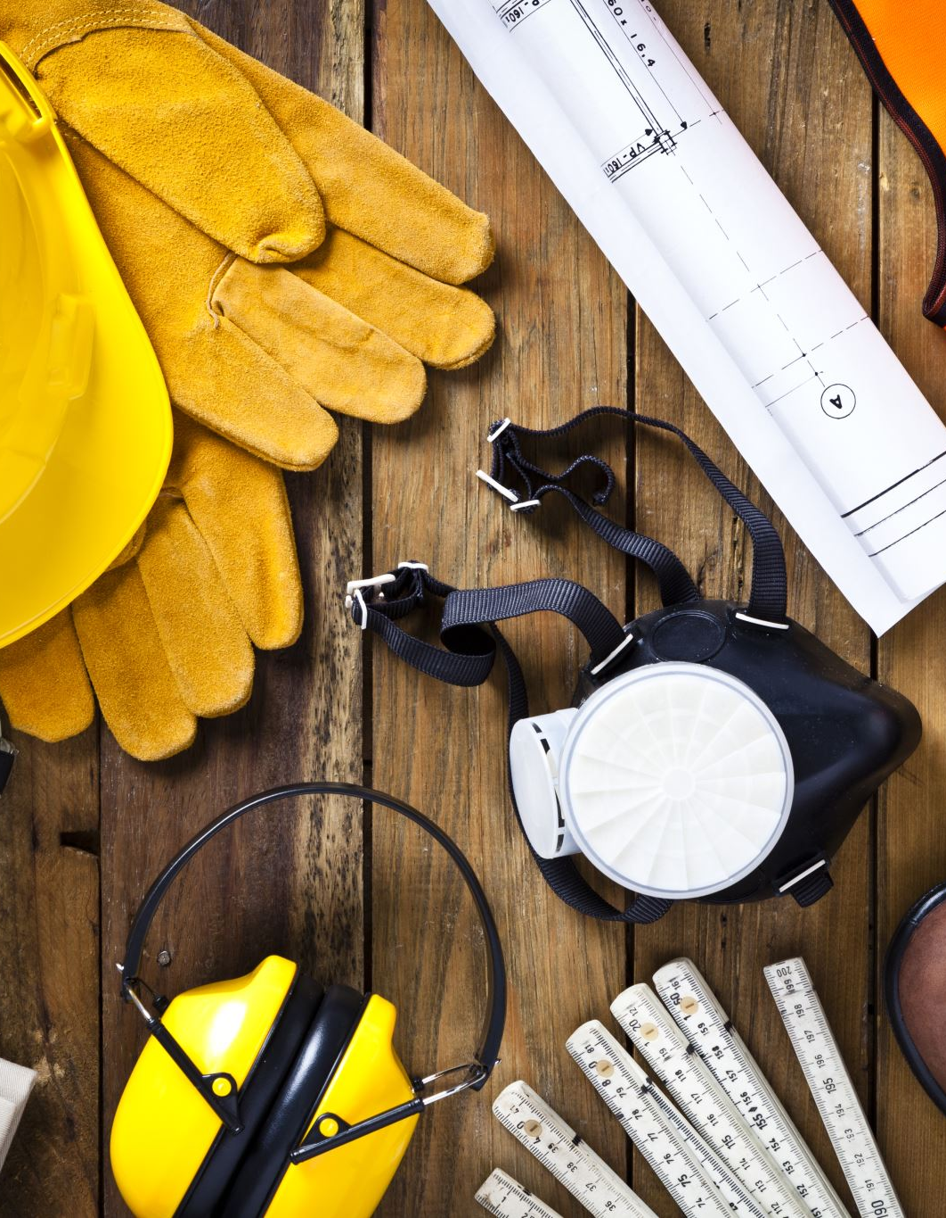
Computer Vision and Deep Learning to Manage Safety in Construction: Matching Images of Unsafe Behavior and Semantic Rules
Mentor :Mrs. P.Swathika , (PhD) (AP(Sr.G))
Team Members: Abishek S (21BAD034)
Mohamed Aslam K (21BAD051)

Slide 2
ABSTRACT
Traditional methods use manual rules to find unsafe behavior in construction images but struggle to detect multiple unsafe acts in one image and apply the correct safety rules.
This work introduces a computer vision and deep learning method to match images of unsafe behavior with safety rules. This method includes:
1. Image feature representation.
2. Safety rule feature representation.
3. Feature fusion similarity to match unsafe behavior with safety rules.

Slide 3
OBJECTIVES
To enhance detection accuracy by integrating cross-attention between image features and safety rule embeddings.
To utilize Faster R-CNN for extracting image features for safety monitoring.
To integrate a GRU network for embedding safety rules effectively.

Slide 4

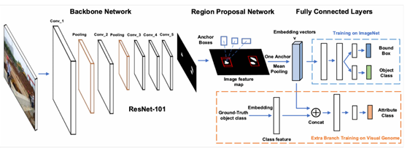
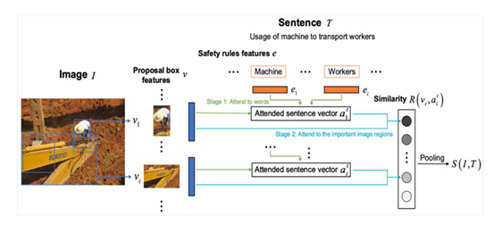
SYSTEM DESIGN

Slide 5
WORKING
Image feature representation:
The input image is first fed into the ResNet-101 network to extract image feature maps.

Slide 6
WORKING
Safety Rules Features Representation

Slide 7
WORKING
Feature Fusion Similarity

Slide 8
BLOCK DIAGRAM

Slide 9
PROJECT OVERVIEW
1. Extract safety rules using GRU for better understanding of safety rules.
2. Employ Faster R-CNN to extract detailed features from construction site images.
3. Fuse safety rule embeddings and image features using cross-attention mechanisms.
4. Enhance detection accuracy of unsafe behaviors on construction sites.

Slide 10
DATASET DESCRIPTION
MSCOCO Dataset
Total Images: 160k Images
Labels : Living and Non-Living objects (Cat , dog, Football etc.)

Slide 11
DATASET DESCRIPTION
Personal Protective Equipment
Total Images: 44002
Labels: Goggles , Safety vest, No mask, No safety vest, Mask, Hardhat, No hard hat, Ladder, Safety cone, No Goggles
People and Ladders
Total Images:974
Labels: Peoples, Ladders

Slide 12
DATASET DESCRIPTION
Safety Vests Computer Vision Project
Total Images:3897
Labels: Safety vest
Excavators Computer Vision Project
Total Images:2655
Labels: Excavators

Slide 13
DATASET DESCRIPTION
MIT Indoor Scene Recognition Computer Vision Project
Total Images : 15571
Labels: Bakery , Closet , Garage , Kitchen , Mall (Includes sub-Categories).
Construction Madness Computer Vision Project
Total Images: 692
Labels: Machinery-Base , Machinery-Whole

Slide 14
DATASET DESCRIPTION
Cloudworker Computer Vision Project
Total Images: 1801
Labels: Worker without helmet, Worker without helmet climbing, worker with helmet worker with helmet climbing, worker with helmet leaning out worker with helmet step on railing, worker with helmet throwing material ,worker without helmet worker with helmet holding.
(Total image dataset 227299)

Slide 15
DATASET DESCRIPTION
Safety risk dataset (Text Data)
Total text: 464 rules
About data: This data consist of ten columns, the first four describing the suggested treatment, and the remaining six characterising the related risk scenario.

Slide 16
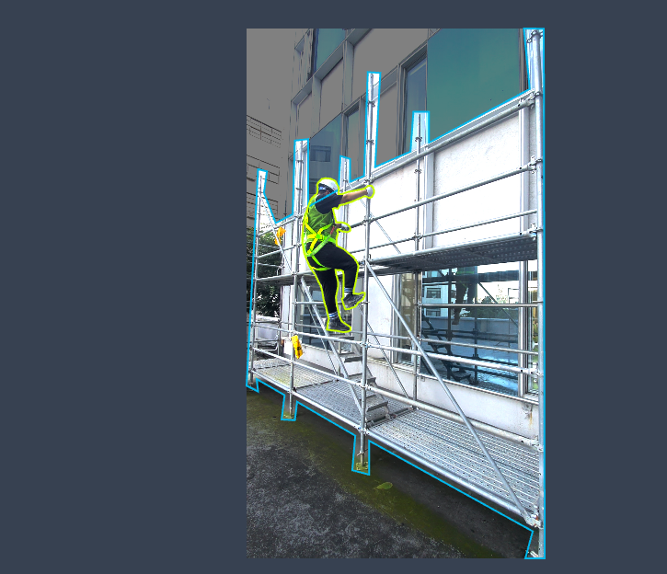
SAMPLE DATA

Slide 17
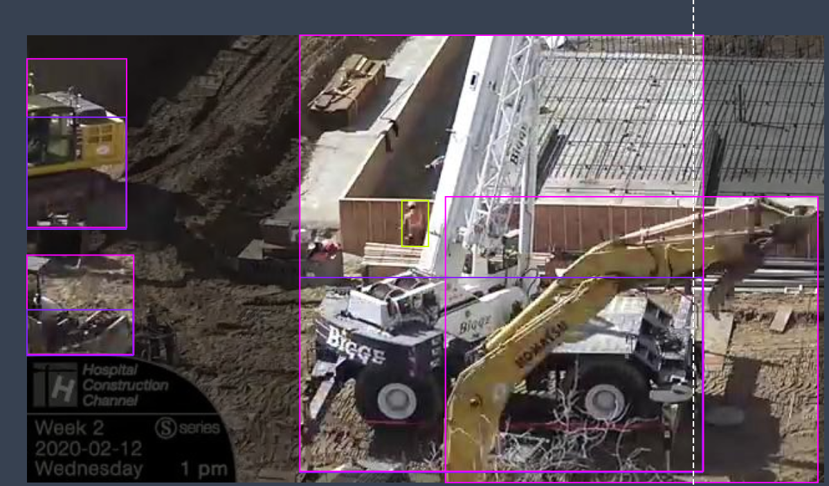
SAMPLE DATA

Slide 18
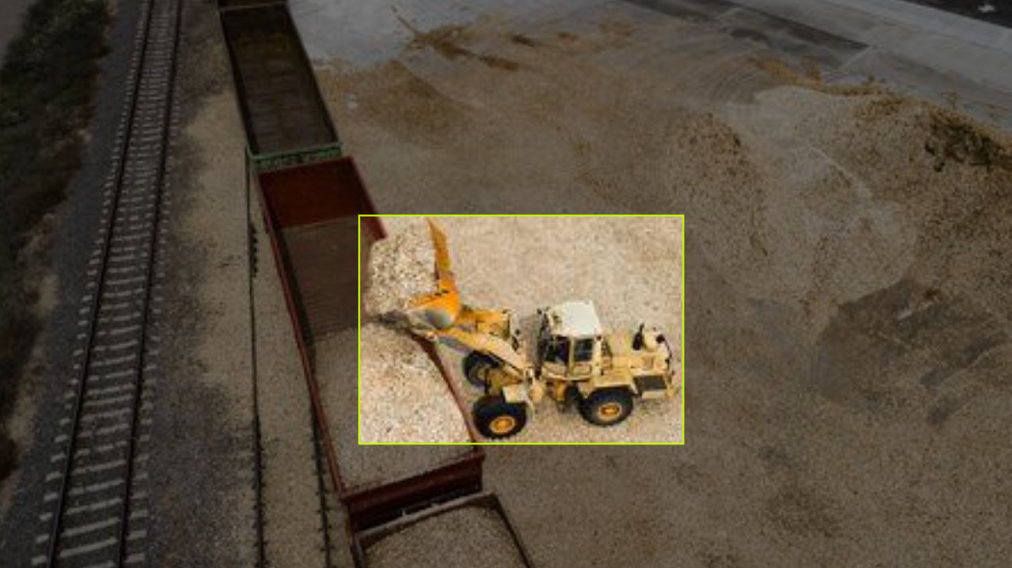
SAMPLE DATA

