Slide 1
1. Introduction There are many different kinds of restaurants and catering services. Whether you are interested in starting a café, a bar, family-style restaurant or event catering business, you will be part of the food services industry. For a restaurant, location is very important. Since location will decide how many potential customers will be and what price they will pay. We will use Foursquare data to find these two things. In Foursquare Places API, we can Get Details of a Venue. Here we try to find the best venue location in Toronto to open a restaurant The result may be useful for people to open their own restaurant, or may lend some thoughts to other business location finding.

Slide 2
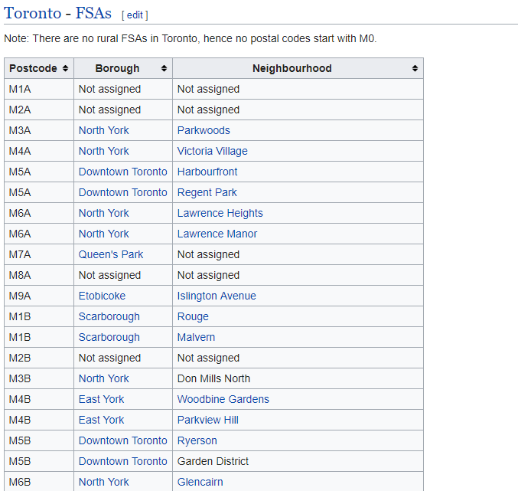
2. DATA
For the Toronto neighborhood data, a Wikipedia page exists that has all the information we need to explore and cluster the neighborhoods in Toronto.

Slide 3
3 . METHODOLOGY
Use the Notebook to build the code to scrape the following Wikipedia page, https://en.wikipedia.org/wiki/List_of_postal_codes_of_Canada:_M, in order to obtain the data that is in the table of postal codes and to transform the data into a pandas dataframe
Get The latitude and the longitude coordinates of each neighborhood.
Explore the neighborhoods in Toronto.
Using a radius of 5km to identify for nearby venues
Identifying the top 10 venue by Borough (i.e. Postcode)

Slide 4
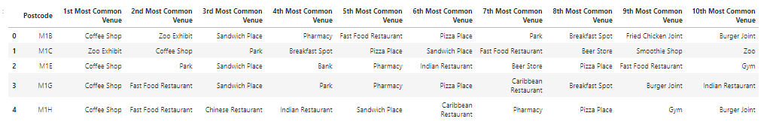
4 . RESULTS
Identifying the top 10 venue by Borough (i.e. Postcode)

Slide 5
5. DiISCUSSION
• Coordinate(latitude/longitude) are very important. Some borough/neighborhood are close, some are far. Map will make more under stand and clear.
• When get request venues from foursquare, alway need to send latitude and longitude to explore venues of destination.
• In case of lack of coordinates, geocoder library can find lat./long. by use only name of destination.
• Completely and correctly of data from Foursquare is effect to quality of project directly.
• This project can help reduce time to find suitable location and make decision base on real
data.
• No only restaurants, we can change business, city, borough and neighborhood by this
concept.

Slide 6
6 . Conclusion
Although, there are a lot of restaurants in Toronto, this project can help to find space and recommend the potential by ranking. It help to reduce process time and cost of business. It make advantage for business competition and can applied to other business.

