Slide 1



JURY
Fraud Detection
President
Mohamed Neji Maatouk
in Banking Transactions
Reviewer
Nizar Kerkeni
Academic Supervisor
Mohsen Maraoui
Professional Supervisor
Chaima Zaier
PREPARED BY
Mohamed Ben Salem
HOSTED AT
Defended on 13 June 2026 at 12:30, Amphi 3
ACADEMIC YEAR
2025 – 2026

Slide 2
Overview
« What’s the plan »
1
Context & Problem
2
Objectives & Proposed Solution
3
Requirements Analysis
4
Methodology & Planning
5
Architecture & Detailed Design
6
ML System
7
Technical Environment
8
Demo

Slide 3
Context
Volume
Growth
Switch
27.9 Billion DT
+10.6% Electronic transactions
+81% Mobile payments
BCT via L'Économiste Maghrébin, 2024
BCT via L'Économiste Maghrébin, 2024
Tunisie Numérique / BCT, 2025

Slide 4
Context
« A cachless generation »
Volume
Growth
Switch
27.9 Billion DT
+10.6% Electronic transactions
+81% Mobile payments
BCT via L'Économiste Maghrébin, 2024
BCT via L'Économiste Maghrébin, 2024
Tunisie Numérique / BCT, 2025

Slide 5


Problematic
Cost
Spike
Expectation
+400 Billion $
+3000% Deepfake Incidents
$40 B
by 2027
Veriff / TechRadar, Fraud Report 2026
VentureBeat / Deloitte, 2024
Deloitte Center for Financial Services

Slide 6




Problematic
« Progress, Followed by Danger »
Fragmentation
No Unified View
Cost
Spike
Expectation
+400 Billion $
+3000% Deepfake Incidents
40 B$
by 2027
******** ?
Veriff / TechRadar, Fraud Report 2026
VentureBeat / Deloitte, 2024
Deloitte Center for Financial Services
????? $

Slide 7
Problematic
« Confused client ➡ Unhappy client »
Fragmentation
No Unified View
******** ?
????? $

Slide 8

How can a single platform protect every transfer with real-time fraud detection while unifying the user's scattered bank operations in one clear view ?

Slide 9
How can a single platform protect every transfer with real-time fraud detection while unifying the user's scattered bank operations in one clear view ?

Slide 10
Existing Solutions

Slide 11





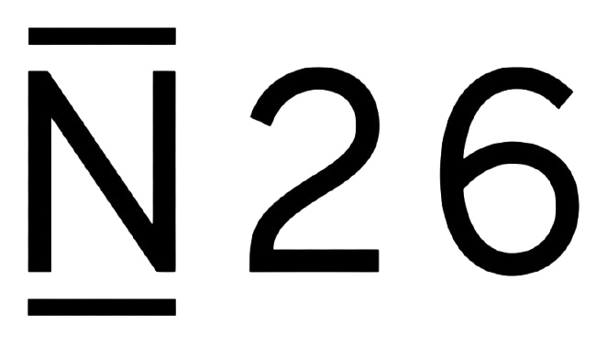
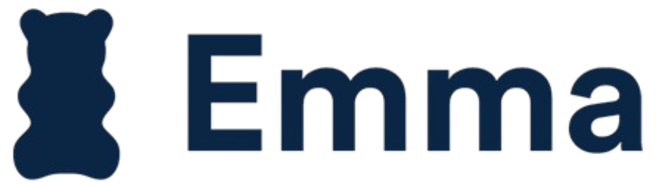


Existing Solutions
« How far the market has come »
Objectives ↓ |  |  |  |  | ?
Client App | ✓ | ✓ | ✗ | ✗ | ✓
Unified View | ✗ | ✓ | ✗ | ◐ | ✓
Open Banking | ✓ | ✓ | ✗ | ✓ | ✓
Fraud Detection | ◐ | ◐ | ✓ | ✓ | ✓
Real-time Alerts | ✓ | ✓ | ✓ | ✗ | ✓
Staff Console | ✗ | ✗ | ◐ | ✓ | ✓
Each solves one piece of the problem. But none puts them together in one system.

Slide 12
Proposed Solution

Slide 13
Proposed Solution
« The answer to the question »
— Easy —
One app, all banks
— Intelligent —
ML scoring engine
— Trusted —
Decided by expert analyst

Slide 14
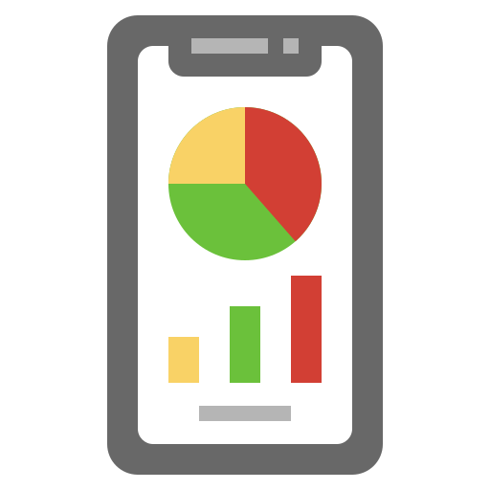
Proposed Solution
« Why PayZo works better »
To face this problem, PayZo follows a 2 layer fix:
ROOT FIX
(closes the structural gap)
Unifies the data
Improves the UX
Connect the banks

Slide 15
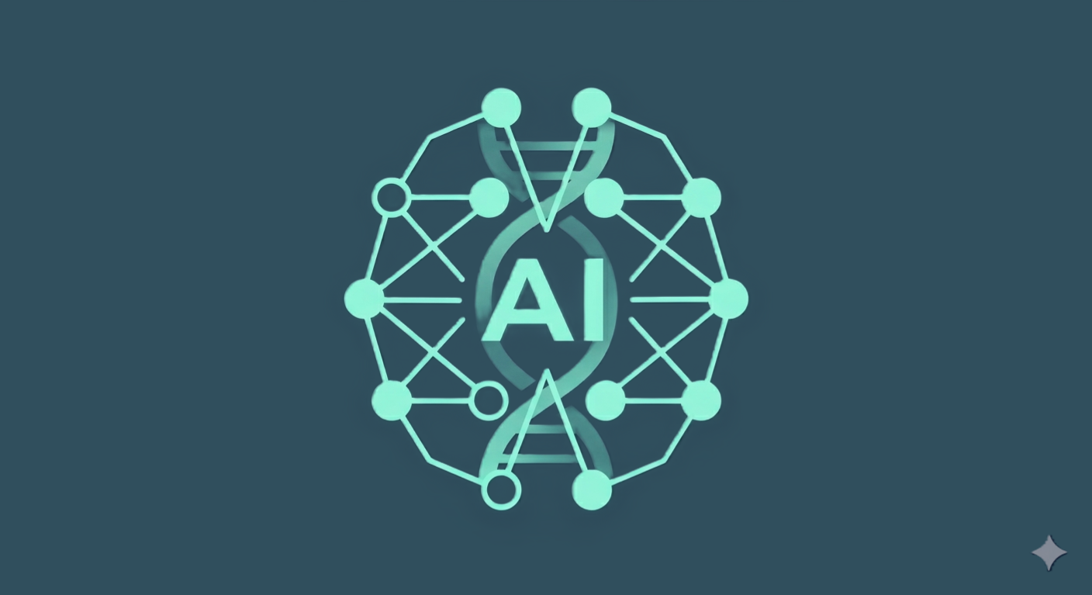
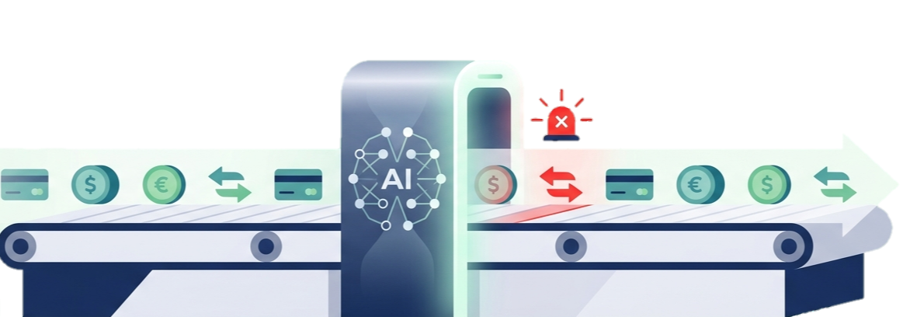
Proposed Solution
« Why PayZo works better »
To face this problem, PayZo follows a 2 layer fix:
ACTIVE FIX
(detects and responds in real time)
ROOT FIX
(closes the structural gap)
Scores transfers
Suspends risky ones
Alert users
Unifies the data
Improves the UX
Connect the banks

Slide 16
Proposed Solution
« Why PayZo works better »
To face this problem, PayZo follows a 2 layer fix:
ROOT FIX
(closes the structural gap)
ACTIVE FIX
(detects and responds in real time)
Scores transfers
Suspends risky ones
Alert users
Unifies the data
Improves the UX
Connect the banks

Slide 17
Actors

Slide 18


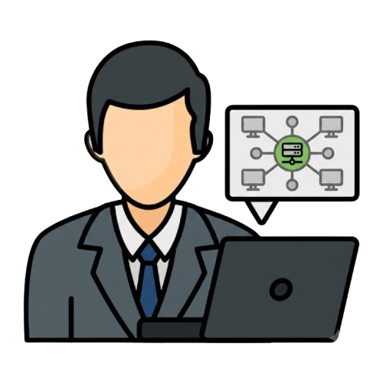

Actors
« Who does what »
End-Users
Back-Office
External System
Admin
Analyst
SuperAdmin
Centralized CBS
Clients
Decide on registrations
Block a client
View client profiles
Review flagged transactions
Approve or reject sus transfers
View client history
Manage staff accounts
Configure ML thresholds
View the audit log
Verify new client identity
Provide accounts and balance data
Synchronize data between banks
Register and login
View all his accounts
Receive fraud alerts
Send money safely to anyone cross-banks
Manage account

Slide 19
Actors
« Who does what »
End-Users
Back-Office
External System
Clients
Register and login
View all his accounts
Receive fraud alerts
Send money safely to anyone cross-banks
Manage account
Admin
Analyst
SuperAdmin
Centralized CBS
Decide on registrations
Block a client
View client profiles
Review flagged transactions
Approve or reject sus transfers
View client history
Manage staff accounts
Configure ML thresholds
View the audit log
Verify new client identity
Provide accounts and balance data
Synchronize data between banks

Slide 20
Actors
« Who does what »
End-Users
Back-Office
External System
Clients
Admin
Register and login
View all his accounts
Receive fraud alerts
Send money safely to anyone cross-banks
Manage account
Decide on registrations
Block a client
View client profiles
Analyst
SuperAdmin
Centralized CBS
Review flagged transactions
Approve or reject sus transfers
View client history
Manage staff accounts
Configure ML thresholds
View the audit log
Verify new client identity
Provide accounts and balance data
Synchronize data between banks

Slide 21
Actors
« Who does what »
End-Users
Back-Office
External System
Clients
Admin
Analyst
Register and login
View all his accounts
Receive fraud alerts
Send money safely to anyone cross-banks
Manage account
Decide on registrations
Block a client
View client profiles
Review flagged transactions
Approve or reject sus transfers
View client history
SuperAdmin
Centralized CBS
Manage staff accounts
Configure ML thresholds
View the audit log
Verify new client identity
Provide accounts and balance data
Synchronize data between banks

Slide 22
Actors
« Who does what »
End-Users
Back-Office
External System
Clients
Admin
Analyst
SuperAdmin
Register and login
View all his accounts
Receive fraud alerts
Send money safely to anyone cross-banks
Manage account
Decide on registrations
Block a client
View client profiles
Review flagged transactions
Approve or reject sus transfers
View client history
Manage staff accounts
Configure ML thresholds
View the audit log
Centralized CBS
Verify new client identity
Provide accounts and balance data
Synchronize data between banks

Slide 23
Actors
« Who does what »
End-Users
Back-Office
External System
Clients
Admin
Analyst
SuperAdmin
Centralized CBS
Register and login
View all his accounts
Receive fraud alerts
Send money safely to anyone cross-banks
Manage account
Decide on registrations
Block a client
View client profiles
Review flagged transactions
Approve or reject sus transfers
View client history
Manage staff accounts
Configure ML thresholds
View the audit log
Verify new client identity
Provide accounts and balance data
Synchronize data between banks

Slide 24
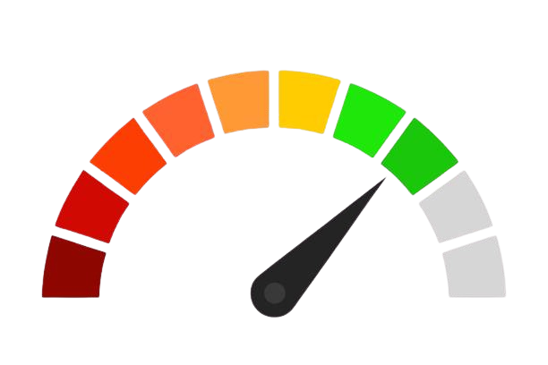



Non-Functional Needs
« What the system must guarantee »
Performance
Security
Reliability
Auditability

Slide 25
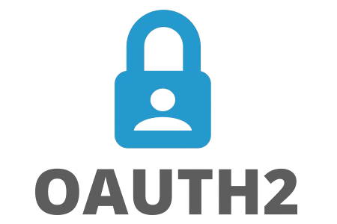




Security
« Security is not an option »
OTP

Slide 26
Methodology & Planning

Slide 27
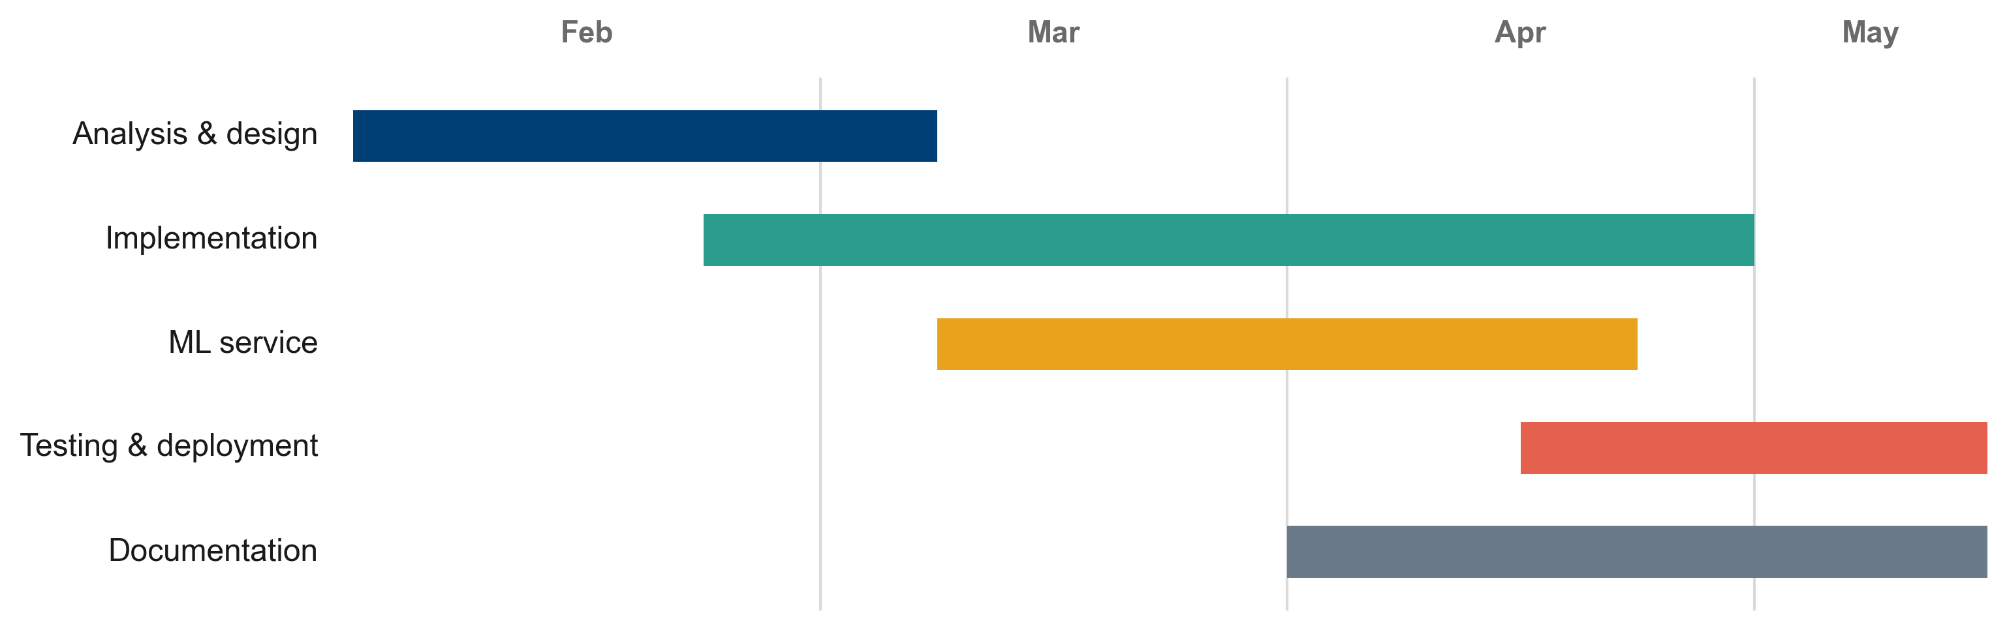
Methodology & Planning
« 2TUP & Gantt »

Slide 28
Architecture

Slide 29
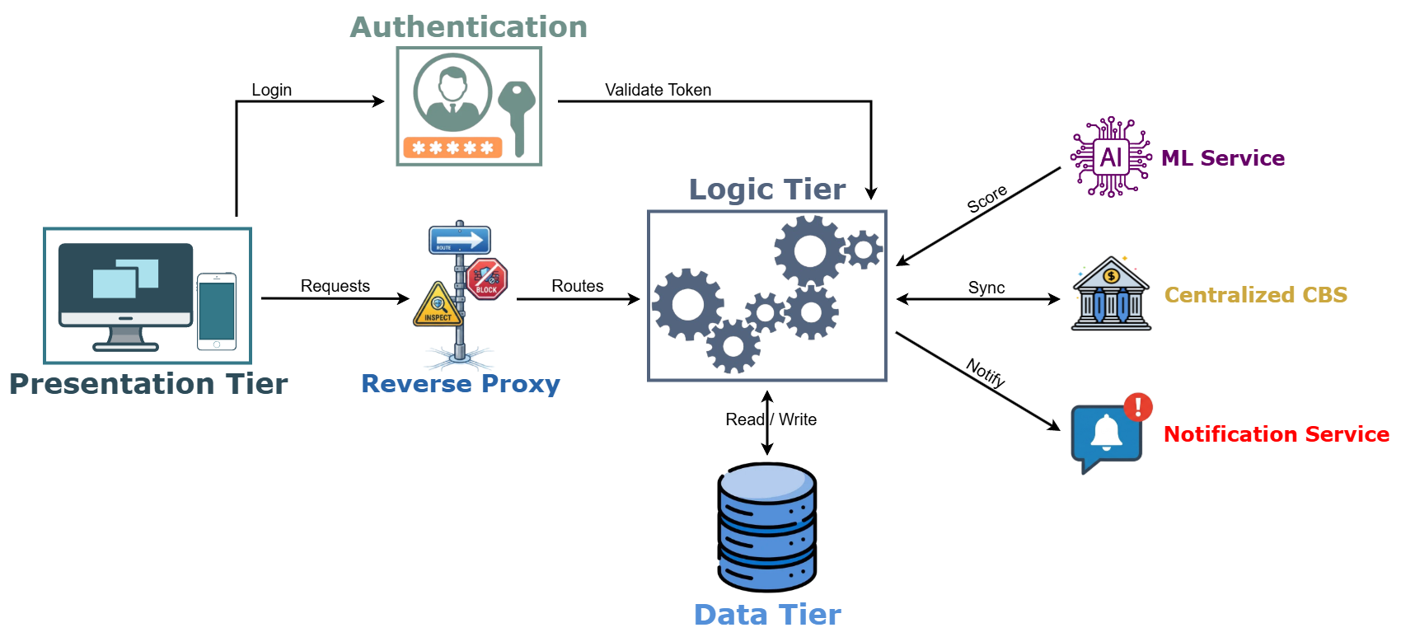
Architecture
« N-Tier structure »

Slide 30
Class Diagram

Slide 31
CBS
Class Diagram
« The core that gathers every bank's data »

Slide 32
PayZo Class Diagram
« How the pieces connect together »

Slide 33
ML System
Notes:
Closer look into the core of this project, the ML system where the magic happens, we tried and tested many opensorce models...

Slide 34
ML System
« Training and Testing »
Data generated:
10,000 User
12,000 Account
500,000 Transaction
1.5% Fraud rate
15 Bank

Slide 35
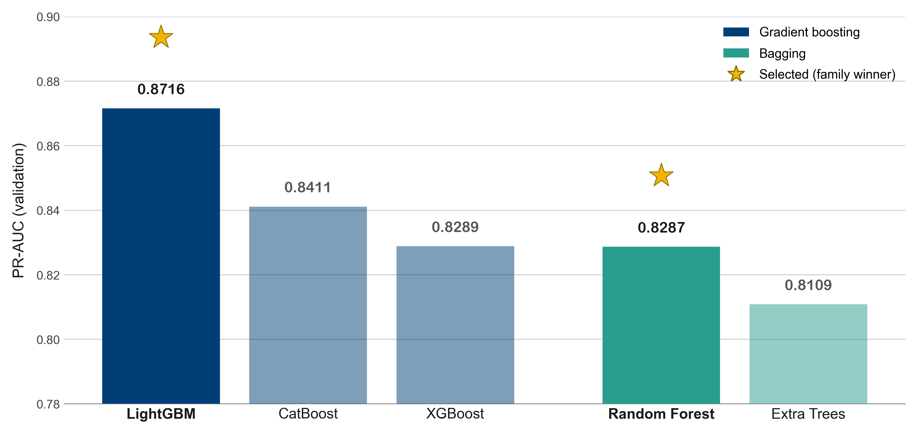
ML System
« Training and Testing »
Data generated:
Algorithms tested:
5 algorithms trained on 24 features
10,000 User
12,000 Account
500,000 Transaction
1.5% Fraud rate
15 Bank

Slide 36
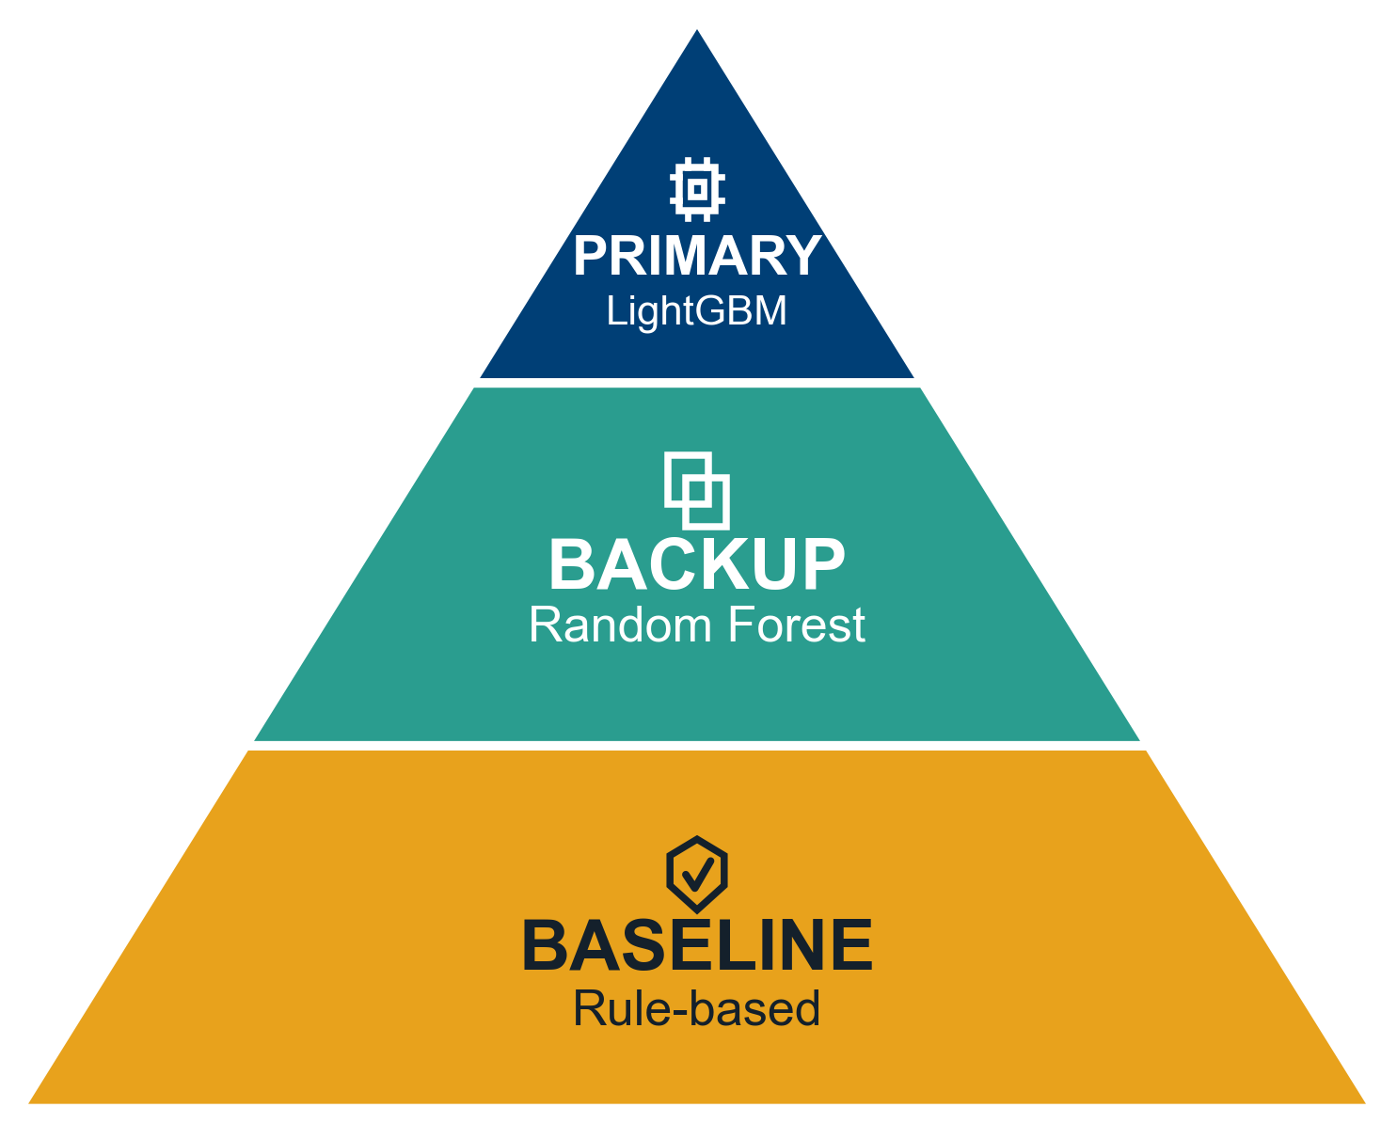
ML System
« The Final Scoring Engine »
PR-AUC
ROC-AUC
Precision
Recall
F1
0.9058
0.99
0.97
0.8
0.88
Silent Fall-Back Mechanism
PR-AUC
ROC-AUC
Precision
Recall
F1
0.8761
0.98
0.86
0.8
0.83
Never fails
Always scores
Optimal Decisions

Slide 37


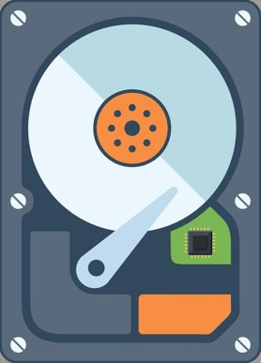










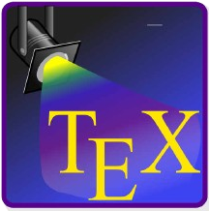











Technical Environment
« What was used »
Hardware:
Ryzen 5
16 GB RAM
512 GB SSD
Windows 11
Software & Tools:
Technologies & Frameworks:
Notes:
This whole project relied on a wide set of hardware, tools, and technologies — to take it from planning…

Slide 38
Demo

Slide 39


Demo
« Each client has his own patterns »
Ahmed Ben Salem
Student
PayZo user since 400 days
Total balance: 8,000 TND
Trust score: 85/100.
Karim Trabelsi
Business Owner
PayZo user since 2.5 years
Total balance: 120,000 TND
Trust score: 82/100.
usually sends 50–150 TND to a few saved friends
sends 200–15 000 TND across many recipients

Slide 40
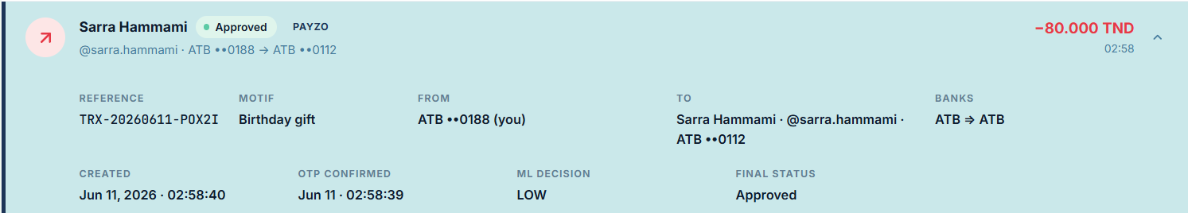
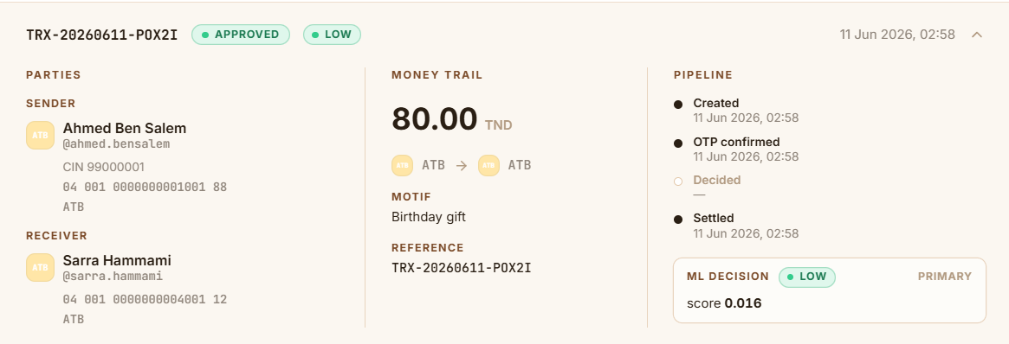
Demo
« Each client has his own patterns »
A 80 TND transfer to a saved recipient:
Analyst View:
Ahmed Ben Salem
Student
PayZo user since 400 days
Total balance: 8,000 TND
Trust score: 85/100.
Karim Trabelsi
Business Owner
PayZo user since 2.5 years
Total balance: 120,000 TND
Trust score: 82.
sends 200–15 000 TND across many recipients

Slide 41
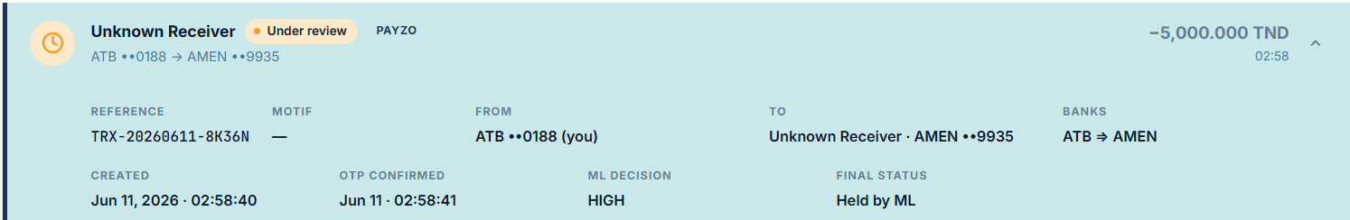
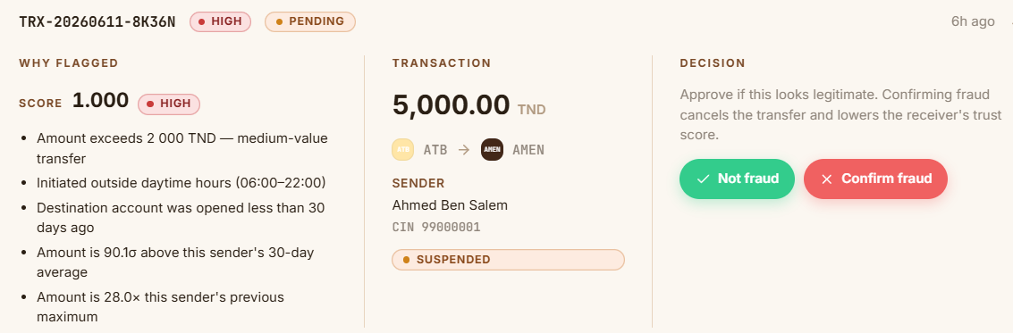
Demo
« Each client has his own patterns »
A 5000 TND transfer to a Unknown recipient:
Analyst View:
Ahmed Ben Salem
Student
PayZo user since 400 days
Total balance: 8,000 TND
Trust score: 85.
Karim Trabelsi
Business Owner
PayZo user since 2.5 years
Total balance: 120,000 TND
Trust score: 82.

Slide 42
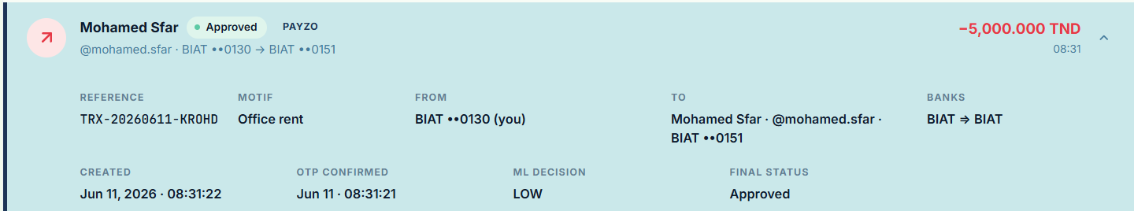
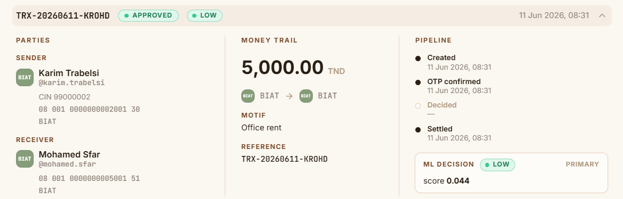
Demo
« Each client has his own patterns »
A 5000 TND transfer:
Analyst View:
Ahmed Ben Salem
Student
PayZo user since 400 days
Total balance: 8,000 TND
Trust score: 85.
Karim Trabelsi
Business Owner
PayZo user since 2.5 years
Total balance: 120,000 TND
Trust score: 82/100.

Slide 43
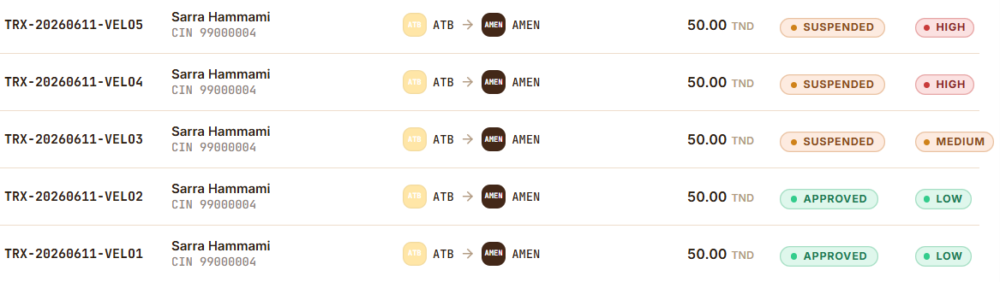
Demo
« Velocity attack »
The ML system doesn’t get tricked by small amounts sent in many tranfers
0.94
0.81
0.51
0.27
0.12
It quickly catches the pattern and suspends them

Slide 44
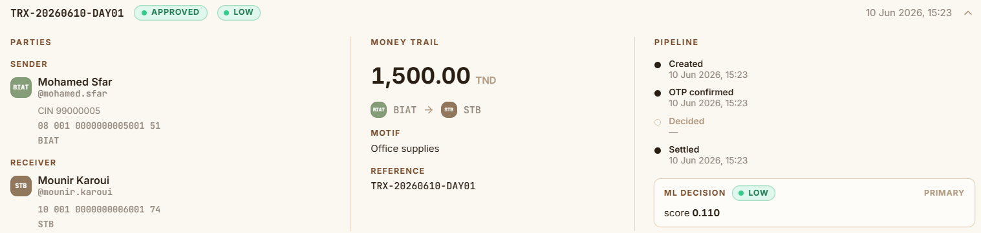
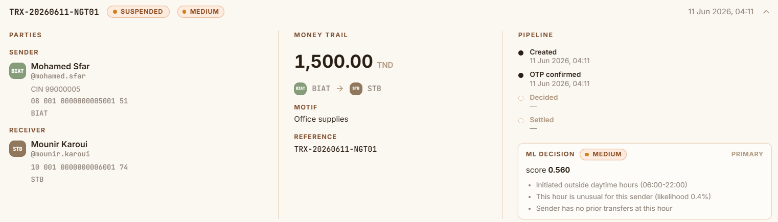
Demo
« The hour as a signal »
The exact same transfer, same amount, same people — only the hour is different
1500 TND 15:23 PM
1500 TND 04:11 AM

Slide 45
Conclusion
« Where we landed »
PayZo unifies cross-bank P2P into one view, and protects every transfer with ML fraud detection
It learns how you normally pay, so it spots what doesn't look like you
The fraud engine is always on thanks to its structure
Delivered: mobile + web apps for clients, desktop + web apps for staff
The hole platform runs end-to-end, packaged with Docker

Slide 46




Perspectives
« What's next »
Biometric login for the mobile app, such as fingerprint and Face ID
New detection features, such as the device and location of each transfer
Automatic retraining for the ML model

Slide 47
Thank you
for your attention

