Slide 1
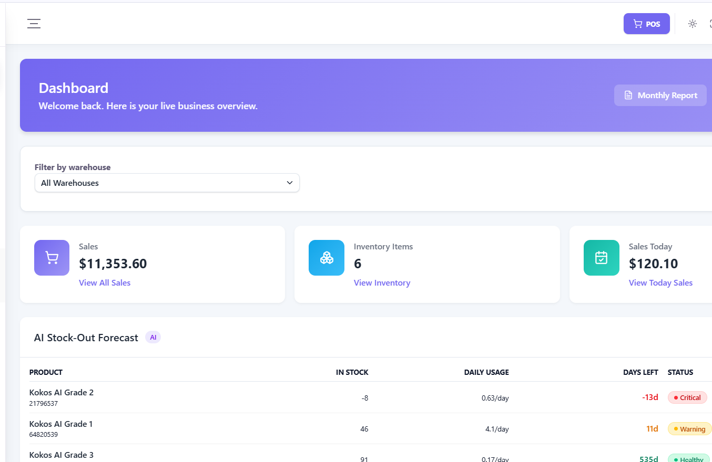
BOOKSHOP SYSTEM
A centralized platform for
BrightMTS operations
Case Study: Bright Multiservices and Tech Solutions
THESIS PRESENTATION
From operational problem to implemented and tested solution
BOOKSHOP SYSTEM • BRIGHT MULTISERVICES AND TECH SOLUTIONS
01
Notes:
Welcome. This presentation summarizes the complete Bookshop System developed for Bright Multiservices and Tech Solutions. It follows the research journey from the problem identified in Chapter One to the implementation and results presented in Chapter Six.

Slide 2
01 / STUDY BACKGROUND
BrightMTS needed one system for a growing operation
The company distributes Magic Pearls and Kokos AI learning series from Waberi District, Mogadishu.
OPERATIONAL CONTEXT
01
More activity
02
More coordination
Bright Multiservices and Tech Solutions serves schools, institutions, organizations, bookstores and individual customers.
Products, customers and daily transactions continued to increase.
Sales, inventory, payments and delivery needed shared information.
Research need
A web-based system that integrates the company’s main business processes and supports accurate decisions.
BOOKSHOP SYSTEM • BRIGHT MULTISERVICES AND TECH SOLUTIONS
02
Notes:
Source: Bookshop system.docx, Chapter One, Background of the Study. BrightMTS distributes educational learning materials to several customer groups. Growth made handwritten records and separate Microsoft Office files increasingly difficult to manage.

Slide 3
02 / PROBLEM STATEMENT
Manual records created errors, delays and limited visibility
Information was distributed across handwritten records and separate Microsoft Office files.
01
Inventory
02
Transactions
Stock levels and movements were difficult to monitor accurately.
Manual recording increased duplication and calculation errors.
03
Customer service
04
Management
Physical and online orders were harder to process and follow.
Reports were delayed, limiting timely decision-making.
BOOKSHOP SYSTEM • BRIGHT MULTISERVICES AND TECH SOLUTIONS
03
Notes:
Source: Chapter One, Section 1.2. The existing process made it difficult to monitor stock, update inventory after sales, manage customer records, process orders, coordinate deliveries and generate timely reports. The fragmented records affected operational efficiency and customer service.

Slide 4
03 / RESEARCH OBJECTIVES
The study linked system development, validation and reporting
The general objective guided three specific objectives that were later evaluated in Chapter Six.
GENERAL OBJECTIVE
Design and develop a web-based Bookshop System that improves inventory management, automates sales operations and supports efficient business decision-making.
01
Implement core modules
02
Validate the system
03
Generate real-time reports
Inventory control, sales processing, online ordering and role-based access control.
Evaluate functionality, usability, security and overall performance.
Report inventory, sales, customers, payments, deliveries and business performance.
BOOKSHOP SYSTEM • BRIGHT MULTISERVICES AND TECH SOLUTIONS
04
Notes:
Source: Chapter One, Section 1.3. The general objective focused on a web-based Bookshop System. The specific objectives covered implementation, validation and real-time reporting. These same objectives appear in Chapter Six as achieved outcomes.

Slide 5
04 / CONTENT SCOPE
The system covers the complete operating cycle
The project combined internal administration, customer ordering and management reporting.
CATALOG
STOCK
COMMERCE
Products, categories, brands and variants
Warehouses, inventory and stock movements
POS, sales, online orders and payments
RELATIONSHIPS
FULFILMENT
CONTROL
Customers and sponsors
Delivery assignments, confirmations and incidents
Users, roles, notifications, settings and reports
BOOKSHOP SYSTEM • BRIGHT MULTISERVICES AND TECH SOLUTIONS
05
Notes:
Source: Chapter One, Section 1.7.1, and Chapter Three, Section 3.5. The scope includes authentication, role-based access, catalog management, warehouses, inventory, stock movements, customers, sponsors, sales, online ordering, payments, delivery, notifications, dashboards and reports.

Slide 6
05 / SIGNIFICANCE
The system creates value for operations, customers and research
Each stakeholder benefits from the same centralized and current information.
1
Company
Less manual work, improved inventory accuracy and reliable operational information.
2
Employees
Simpler daily tasks with fewer repeated entries and fewer avoidable errors.
3
Customers
Clear product availability, online ordering and more organized fulfilment.
4
Management
Current dashboards and reports for monitoring and decisions.
5
Students and researchers
A practical reference for web systems and business process automation.
BOOKSHOP SYSTEM • BRIGHT MULTISERVICES AND TECH SOLUTIONS
06
Notes:
Source: Chapter One, Section 1.6. The system benefits the organization, employees, customers and management. It also provides a practical academic reference for students and researchers studying information systems and automation.

Slide 7
06 / DEVELOPMENT APPROACH
Requirements became an implemented web application
Observation, interviews and document review grounded the design in the company’s real workflow.
1
Analyze
2
Design
3
Develop
4
Test
Identify manual-process problems
Define architecture, database and interfaces
Build frontend, API and data layer
Run unit, integration, system and UAT
TECHNICAL FOUNDATION
Next.js + TypeScript
Node.js + Express
PostgreSQL + Prisma
Tailwind + shadcn/ui
Frontend interface
Backend services
Data management
Responsive UI
BOOKSHOP SYSTEM • BRIGHT MULTISERVICES AND TECH SOLUTIONS
07
Notes:
Source: Chapters Three and Four. Requirements came from observation, interviews and review of company documents. The system used Next.js, TypeScript, Tailwind CSS and shadcn/ui on the frontend, Node.js and Express on the backend, and PostgreSQL with Prisma for data management.

Slide 8
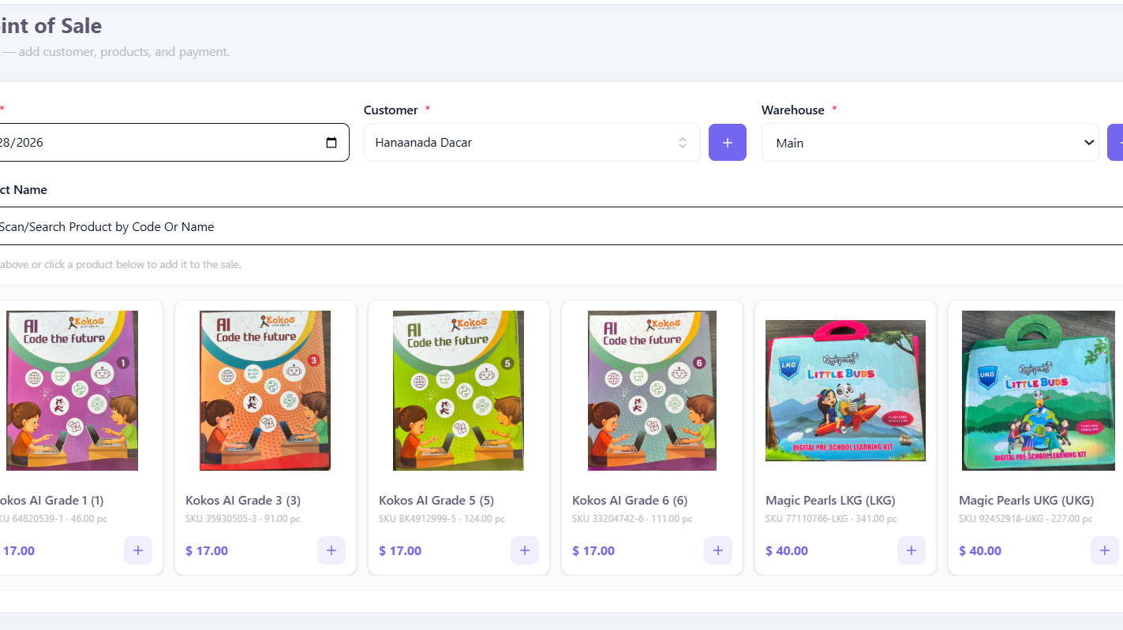
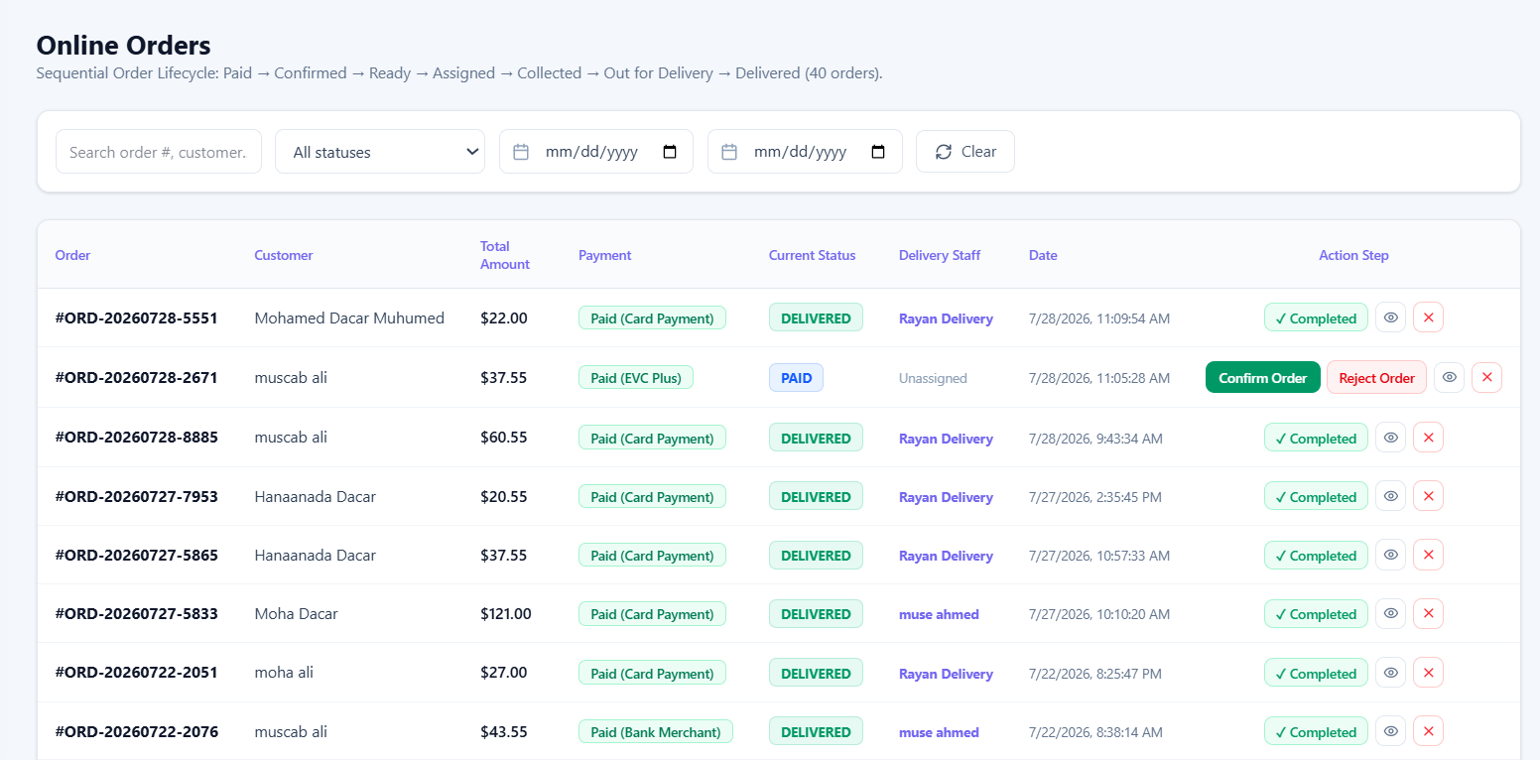
07 / IMPLEMENTED WORKFLOW
One transaction updates every related activity
The system supports both walk-in sales and online orders through a shared database.
01
02
03
04
05
06
Customer selects books
Sale or order is recorded
Payment is registered
Inventory updates
Delivery progresses
Reports refresh
BOOKSHOP SYSTEM • BRIGHT MULTISERVICES AND TECH SOLUTIONS
08
Notes:
Source: Chapter Three system features and Chapter Six results. Walk-in sales use the POS while online customers browse products and place orders. Payment, inventory, delivery status and management reports remain connected through the centralized database.

Slide 9
08 / IMPLEMENTATION RESULTS
All planned modules were completed and integrated
Chapter Six confirms that the major functional modules operated successfully.
Authentication, users and roles
Completed
Integrated with shared operational data
Catalog, warehouses and inventory
Completed
Integrated with shared operational data
Sales, POS, orders and payments
Completed
Integrated with shared operational data
Delivery, notifications and reports
Completed
Integrated with shared operational data
OBJECTIVES ACHIEVED
Core functions, validation and real-time reporting
BOOKSHOP SYSTEM • BRIGHT MULTISERVICES AND TECH SOLUTIONS
09
Notes:
Source: Chapter Six, Tables 6.1 and 6.2. The thesis records every major module as completed. It also states that all three research objectives were achieved: implement core functionality, validate the system and generate accurate real-time reports.

Slide 10
09 / EVALUATION RESULTS
Testing confirmed performance, accuracy and security
The documented Chapter Six metrics met every defined target.
Metric | Target | Result | Status
Login response | ≤ 2 seconds | 1.3 seconds | Achieved
Dashboard loading | ≤ 3 seconds | 2.1 seconds | Achieved
Inventory accuracy | 100% | 100% | Achieved
Sales accuracy | 100% | 100% | Achieved
Report generation | ≤ 5 seconds | 2.8 seconds | Achieved
Role-based security | Implemented | Implemented | Achieved
Testing also confirmed successful online-order processing, functional delivery processing and positive usability feedback.
BOOKSHOP SYSTEM • BRIGHT MULTISERVICES AND TECH SOLUTIONS
10
Notes:
Source: Chapter Six, System Evaluation Metrics. The recorded results were login response 1.3 seconds, dashboard loading 2.1 seconds, inventory and sales accuracy at 100%, report generation 2.8 seconds, and implemented role-based security.

Slide 11
10 / PROBLEMS ADDRESSED
Manual problems and implemented responses
Every major weakness identified in Chapter One received a corresponding system function.
Chapter One problem | Implemented response
Manual product records | Centralized product and catalog database
Manual stock counting | Automatic inventory updates and stock movement history
Paper-based sales | POS and automated transaction recording
No online ordering | Customer-facing web store and order management
Manual delivery follow-up | Delivery assignment, status and confirmation workflow
Delayed manual reports | Current operational dashboards and reports
Limited access control | Authentication and role-based permissions
BOOKSHOP SYSTEM • BRIGHT MULTISERVICES AND TECH SOLUTIONS
11
Notes:
Source: Chapter Six comparison between the existing manual system and the proposed system. The completed system directly addressed manual product records, stock counting, paper sales, lack of online ordering, manual delivery follow-up, delayed reporting and limited security.

Slide 12
11 / CONCLUSION
The project achieved its research purpose
BrightMTS now has a tested foundation for centralized digital operations.
CENTRALIZED
AUTOMATED
Products, stock, customers, sales, orders, payments and delivery
Inventory updates, notifications and operational reporting
VALIDATED
DECISION SUPPORT
Unit, integration, system and user acceptance testing
Current dashboards and reports for authorized users
THANK YOU • QUESTIONS AND DISCUSSION
BOOKSHOP SYSTEM • BRIGHT MULTISERVICES AND TECH SOLUTIONS
12
Notes:
Source: Chapter Six and the thesis conclusion. The system achieved the research objectives by centralizing core processes, automating routine work, protecting access through roles and producing current reports. The project provides BrightMTS with a practical and reliable digital operating foundation. Thank you. We welcome your questions.

