Slide 1
Traffic Light System USING ASSEMBLY LANGUAGE

Slide 2
Abstract
This report is made to cover all the aspects on the program of the traffic light system made. It has explained what kind of signals are there and for what purpose it’s there.
There are different kind of signals for cars, pedestrians and also equestrians.
The apparatus used was emu8086 and the procedure to create the program is evaluated using a flowchart. It covers the whole overview of the process.
This program is made so that it can be implemented in real life scenarios to make sure they are working effectively.

Slide 3
Introduction
The project was carried out to come up with a traffic lights control system using assembly language program.
It was simulated using an emulator.
Assembly language is a low-level programming language for a particular computer architecture in contrast to most high-level programming languages, which are generally portable across multiple systems.
Assembly language is converted into executable machine code by a utility program referred to as an assembler like NASM, MASM.

Slide 4
Introduction
In this project emulators used is known as emu8086.
For assembly language there are advantages and disadvantages, some of the advantages are that it requires less memory during execution and time is likewise less used.
It also allows optimization of systems to user’s preference.
One disadvantage of assembly language is lack of portability. Written assembly language codes are based on specific machines.
Therefore, for the project assembly language of 8086 microprocessor was used to achieve the results.

Slide 5

Types Of traffic Lights
Traffic lights is a set of automatically operated colored lights typically red, amber (yellow), and green, for controlling traffic at road junctions, pedestrian crossings, and roundabouts.
The following are examples of different types of traffic lights:
Signals for Equestrians; These signals consist of Red and Green lights, but with a silhouette of a horse and rider.

Slide 6
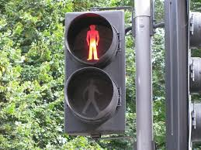

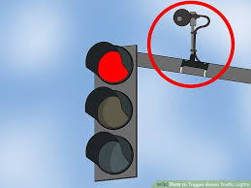
Types Of traffic Lights
Pedestrian Signals; These signals consist of Red and Green lights, but with a silhouette of a man standing for the red, and a walking figure for the green.
Wig-wag signals are traffic signals consisting of a set of three lamps mounted on a rectangular board, with an upper pair of horizontally aligned red lamps which flash alternately ('wig-wag') when in operation.
Installation of the traffic sensor nodes into small holes centered in each lane in the roadbed.
Data collected by the nodes is used to compare the numbers of cars between the lanes and access is granted based on the number of cars in each lane. It has the usual green to red lights.

Slide 7
Objectives
To create a program that controls traffic lights applicable to real life scenarios.
To control traffic lights efficiently and effectively.
To analyze the effect of delay time on performance of traffic lights control system.

Slide 8
Benefits
Creating a program that controls traffic lights which can be implemented in real life scenarios.
It helps reduce traffic around junctions.
Reduce the work for police because they won't have to stand all day to control the traffic.
Ensures orderly movement of traffic in all directions.
Provisions for the progressive flow of traffic in a signal system corridor.
Provision for the side street vehicles to enter the traffic stream.
Providing pedestrians to cross the street safely.
Potential reduction of accidents.
Reduces conflicts hence ensuring safety.
Possible improvements in capacity
Possible reduction in delays.

Slide 9
Apparatus
The project required simulation of the traffic lights and emulator 8086 was used.
The program consisted of assembly language code for 8086 microprocessor to be executed.

Slide 10
Procedure
The first step was to come up with different situations that are possible in traffic signals.
A flow chart was drawn to illustrate the procedures followed by the program.
Based on the flow chart, the program began execution with a delay of 5 seconds before all the red lights in each lane turned red.
After another 5 seconds the north and south lanes get ready before the lights turned green for the cars to move.
At this time the east and west lane were red indicating no movement.

Slide 11
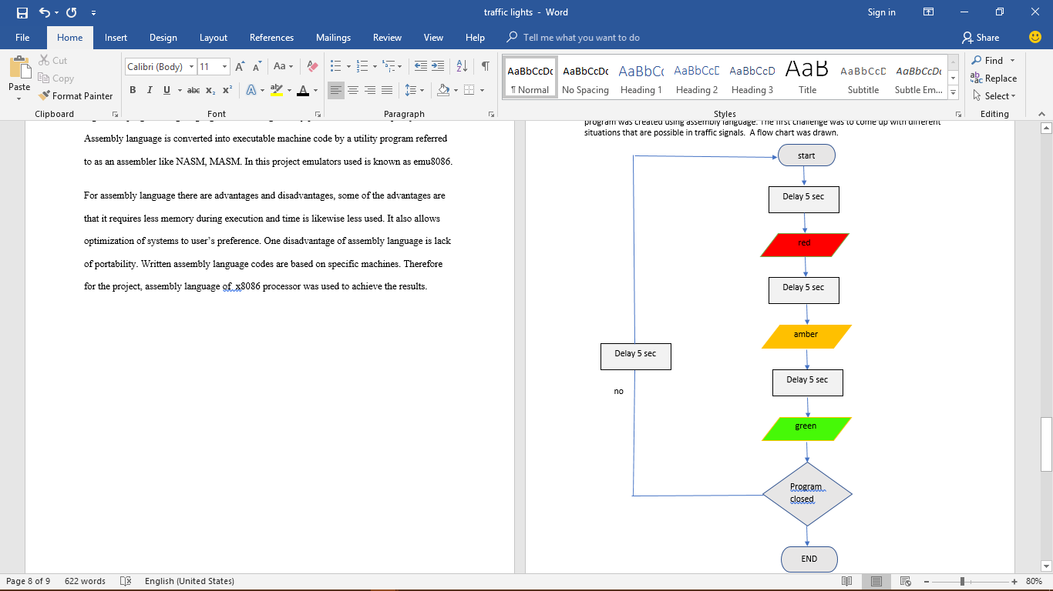
Flow Chart
The process is repeated starting with the east and west lane moving while north and south lanes are red.
The program was in continuous mode until exit was triggered by ending the program.

Slide 12
Procedure
The program was created using assembly language.
In the program variables were declared to define the different types of situations executed by the program;
sit1 equ 0011_0000_1100b
sit2 equ 1000_0110_0001b
sit3 equ 0110_1001_1010b
sit4 equ 0100_1101_0011b
all_red equ 0010_0100_1001b

Slide 13
Procedure
A function to display the led lights was created with the help of the different situations.
A situation was called depending on the lights to be flashed.
Created a 5 seconds wait duration between the lights with the use of hexadecimal digits to represent the time taken.
The program displayed all the lights with cars moving across the lanes effectively.

Slide 14
Register Results
Instruction | AX | BX | CX | DX
mov ax, all_red | 0000 | 0000 | 0045 | 0000
out 4, ax | 0249 | 0000 | 0045 | 0000
mov ax, sit1 | 0249 | 0000 | 0045 | 0000
out 4,ax | 030C | 0000 | 0045 | 0000
mov cx, 4Ch | 030C | 0000 | 0045 | 0000
mov dx, 4B40h | 030C | 0000 | 004C | 0000
mov ah, 86h | 030C | 0000 | 004C | 4B40
int 15h | 860C | 0000 | 004C | 4B40

Slide 15
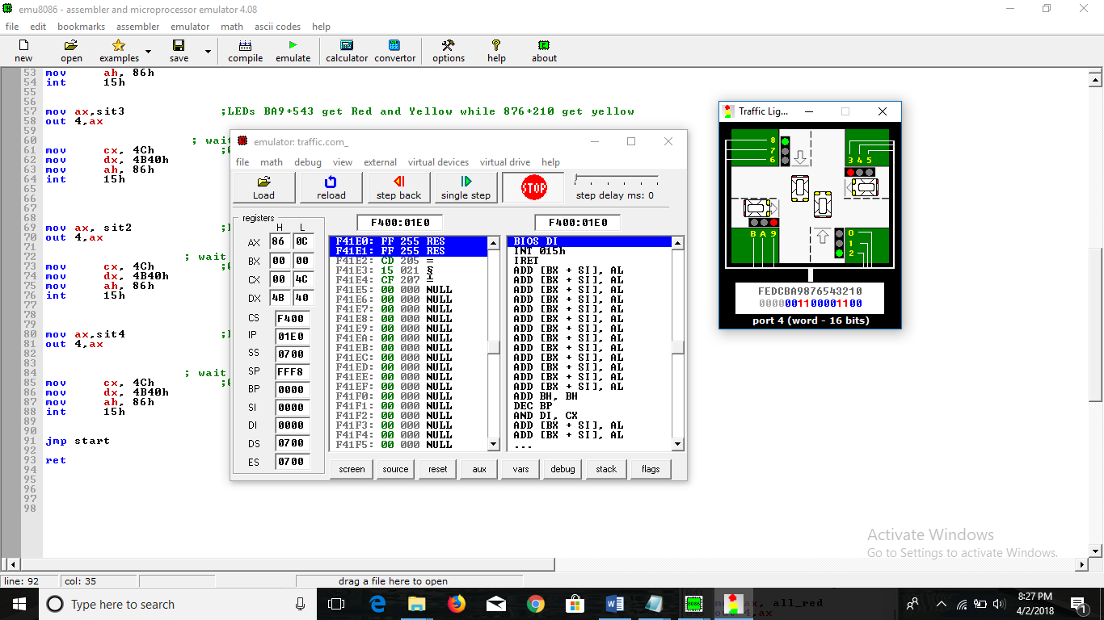


Program Results
The results were accurate and showed how the cars coordinated with the signals- if the lights turned red, the cars stopped, if they turned amber then the car got ready to move and finally when the lights turned green, the cars started moving.
The signal lights kept changing after every 5 seconds.

Slide 16
Delay Tests
For 10 sec;
Value for ax changes from 0000 to 860C
Value of bx changes from 0000 to 0000
Value of cx changes from 0045 to 0098
Value of dx changes from 0000 to 9680
For 20 sec;
Value for ax changes from 0000 to 860C
Value of bx changes from 0000 to 0000
Value of cx changes from 0045 to 0131
Value of dx changes from 0000 to 2D00
We then tested the same program with different delay time. The results are shown below:
For 5 sec;
Value for ax changes from 0000 to 8661
Value of bx changes from 0000 to 0000
Value of cx changes from 0045 to 004C
Value of dx changes from 0000 to 4B40

Slide 17
Improvements
Some improvement can be made in the project whereby it incorporates pedestrian signals in the project and whereby there is a simulation of a figure acting as a pedestrian crossing the road safely with the proper signals being lit up.
Furthermore we can improve on having more cars per lane and looking at the results of the traffic timers then along with different delay times to see the movement when there is traffic.

Slide 18
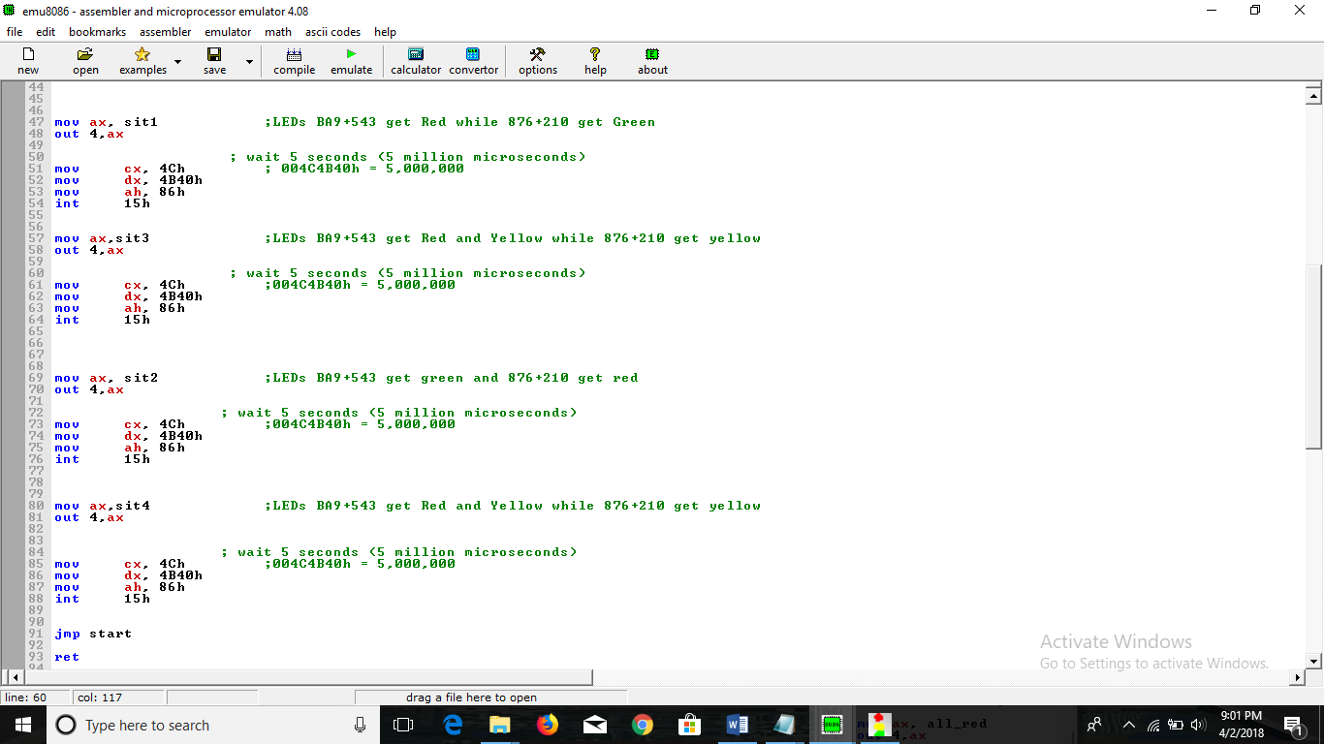
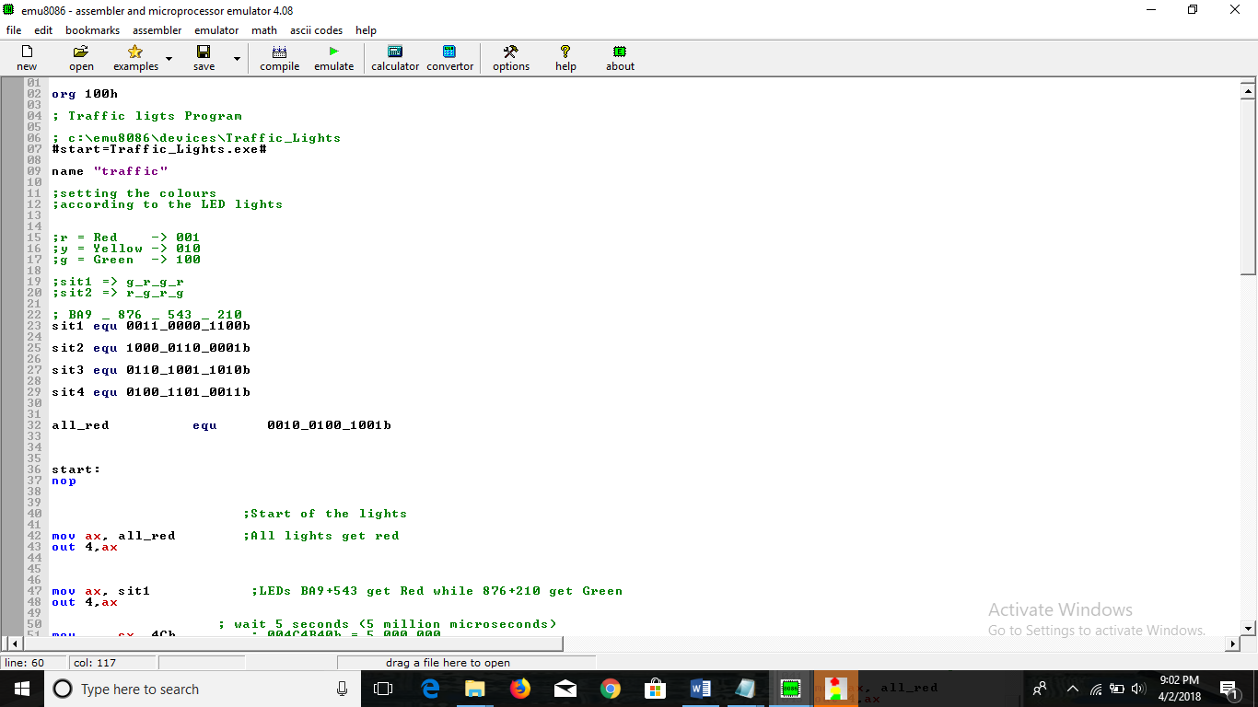
Code Used

Slide 19
Conclusion
The program created for the traffic lights worked well and it was made in order to help improve the traffic system in the real world. Once this method is applied it will reduce the unnecessary traffic everywhere.
The above problem/project operates similarly to the real life situation, i.e. the traffic light colors and their individual operations.
In addition, it also responds to different delay times to show that the program code and smooth operation, however the program can be modified to increase the number of cars passing through as well as for emergency services i.e. special access.

